Slide 1
10/23 製作自我介紹投影片(第一節)
一頁投影片
把上次A-Z的內容拿來用
作業上傳Classroom
製作投影片
上台發表

Slide 2
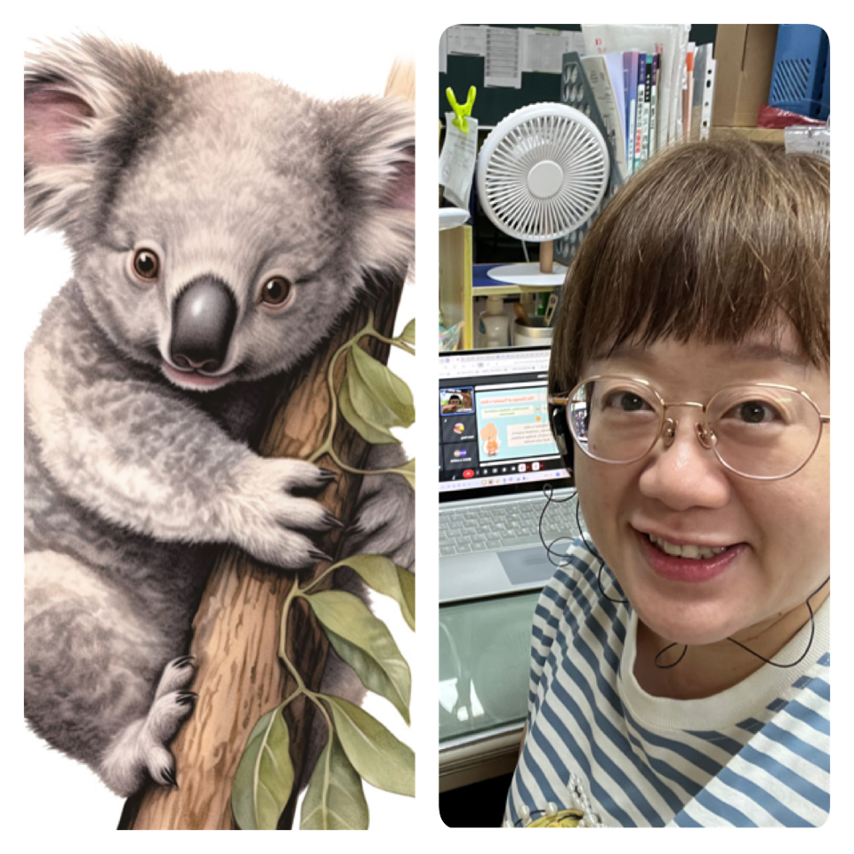
Meet Miffy Lin
Contact:
miffy@gm.yhsh.edu.tw
Hello! My name is Miffy Lin. I have been a teacher for over 10 years and I was born in Taipei, but I love Tainan. I currently live in Tainan to feel the vibe of an energetic city. I love to add little variations to my life, so every day is a special day to me.
Fun Facts:
I am a cat person
MBTI: INTP
make breakfast

Slide 3
10/23 英文課: Dying to be attractive (第二節)
分組討論一段課文
查課文意思
完成共編表單
上台回答問題

