Slide 1
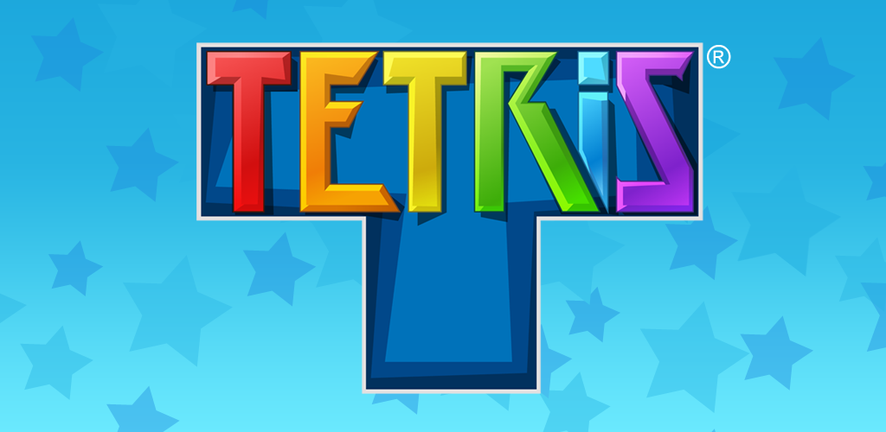
Miffy Chen
CS 232 Final Project

Slide 2
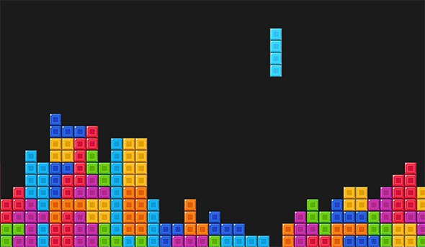
Tetris
Notes:
Game objective
10x22
Different scoring guidelines

Slide 3
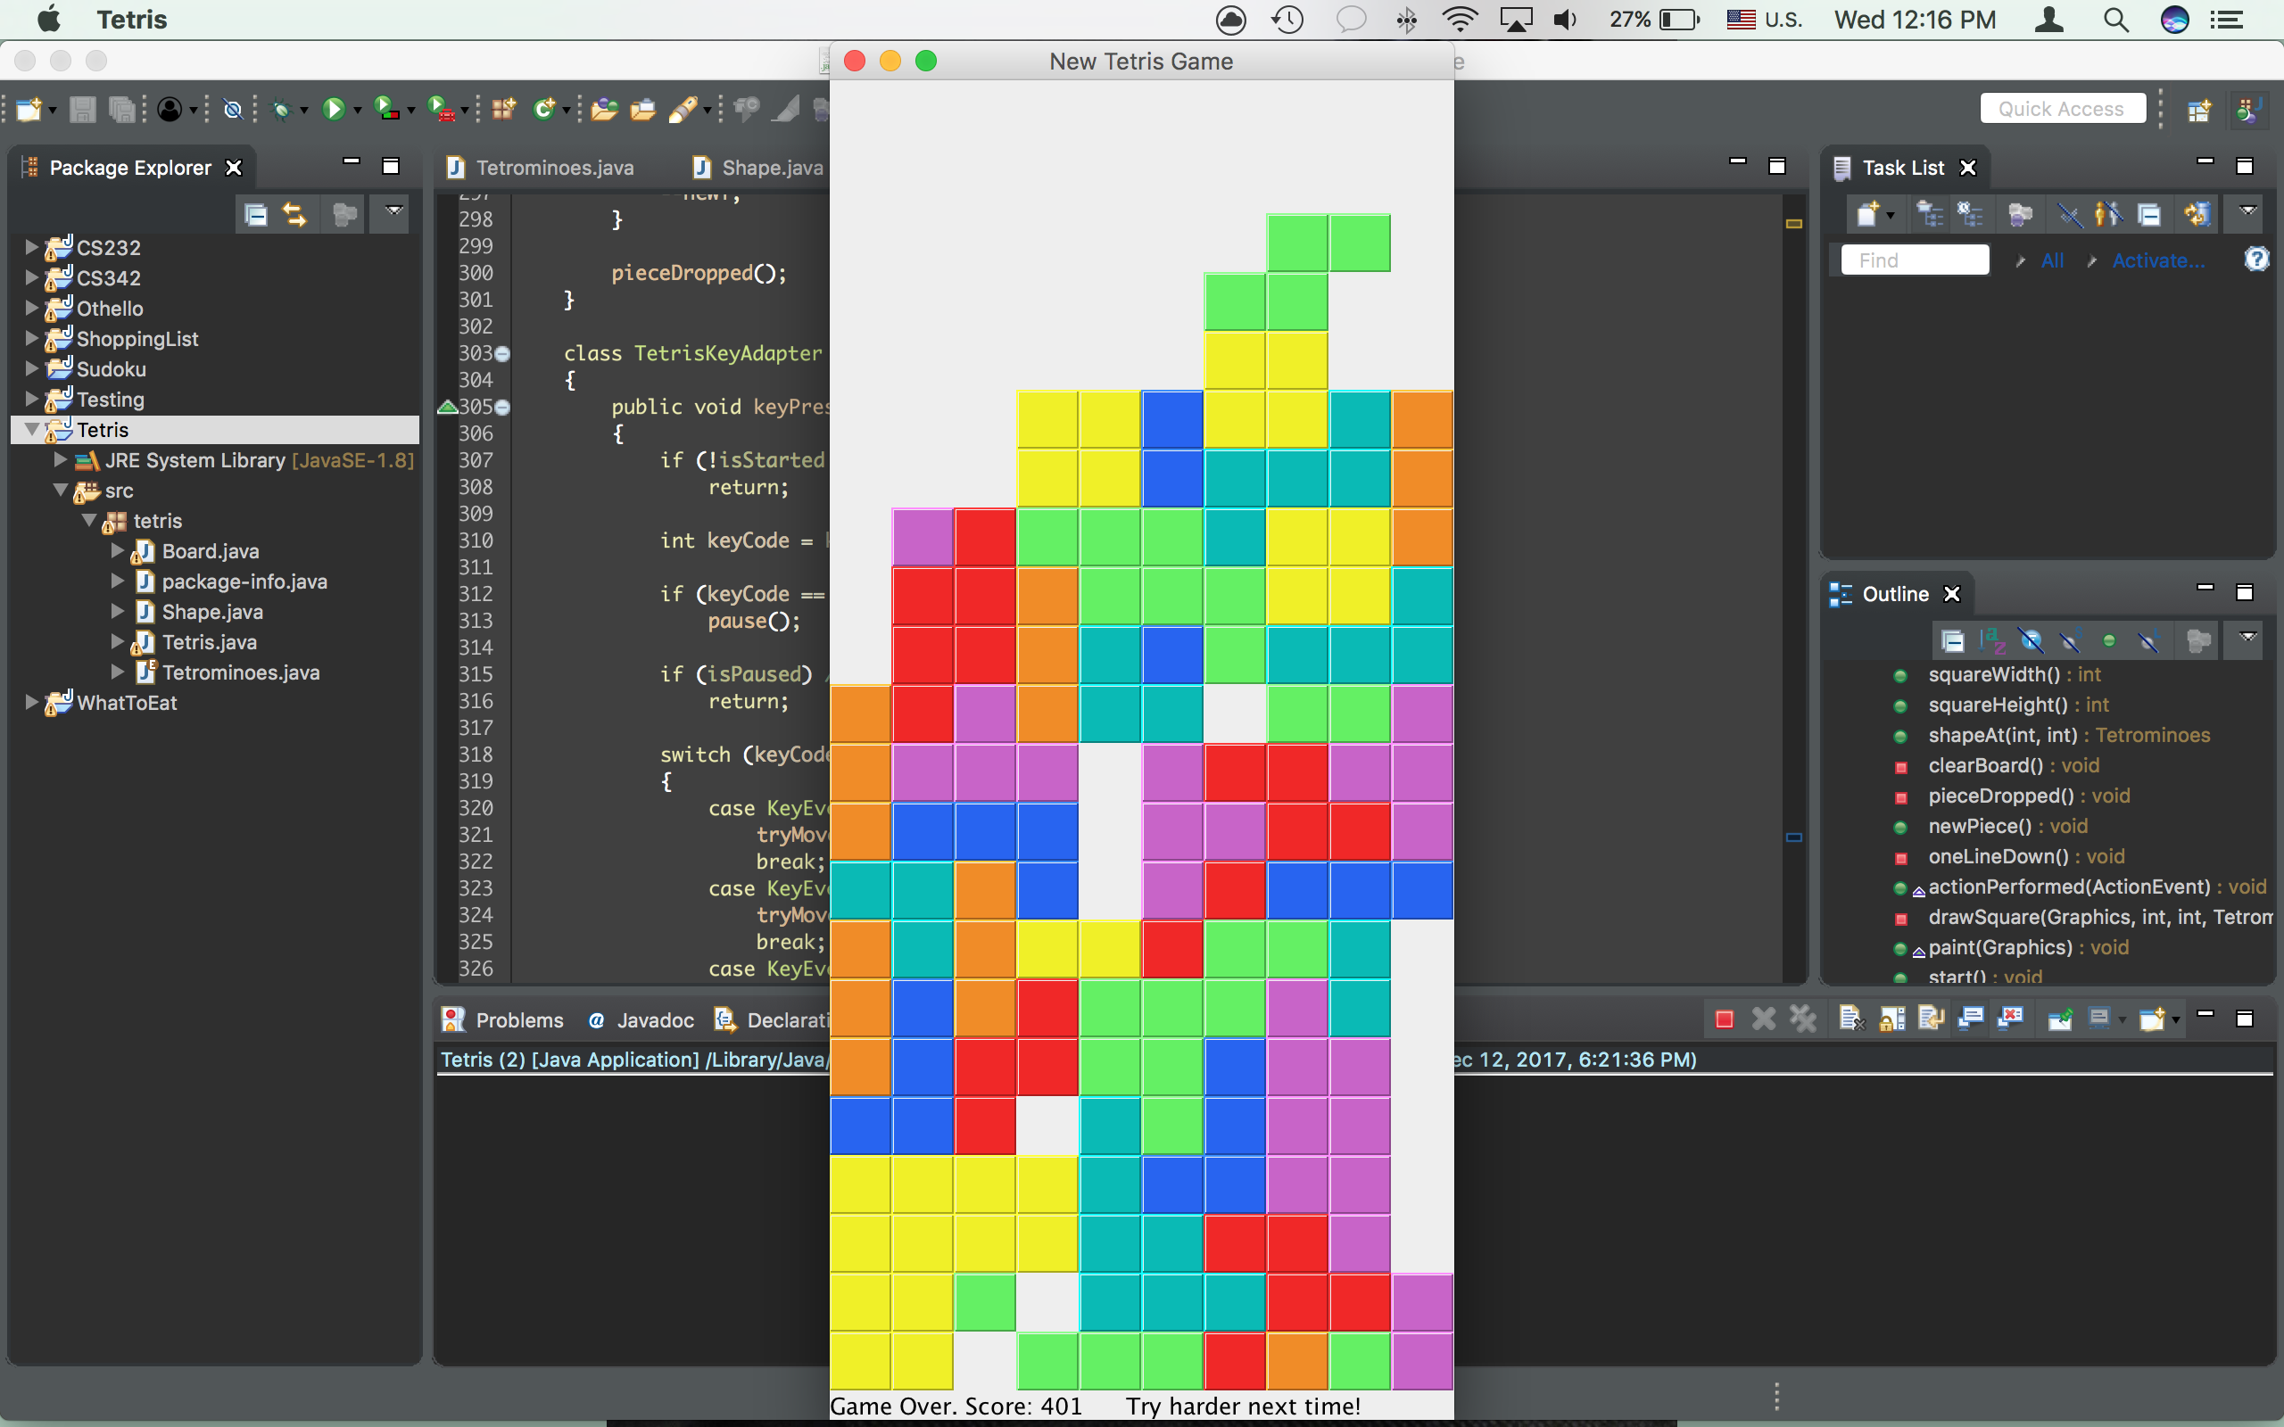

Slide 4
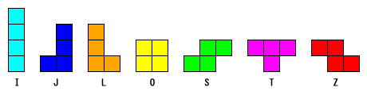
Tetrominoes
Tetrominoes - enum
Notes:
Draw shape [][][][] & Color

Slide 5
Classes
Tetrominoes - enum
Shape
Board - extends JPanel implements ActionListener
Tetris - extends JFrame
Notes:
Shape – pick a shape from Tetrominoes enum; returns shape chosen; rotates shape
Board – draw board, draw shapes by drawing squares; keep statuses of the game: is falling, is cleared, is paused
ActionListener – user keyboard input
Tetris – Calls Board (new object)
Main: Create new game by calling Tetris object

Slide 6
Controls
public class Board JPanel implements ActionListener
{
Class TetrisKeyAdapter extends KeyAdapter
{
“p” || “P” = pause();
“ç” = move piece 1 space to the left
“è” = move piece 1 space to the right
“ê” = move piece 1 space down
“é” = rotate piece in clockwise direction
“(space bar)” = drop piece all the way down to the bottom
}
}
Notes:
Exit: just close, or game over

Slide 8
Problems Encountered
Scoring
Set of 7 shapes

Slide 9
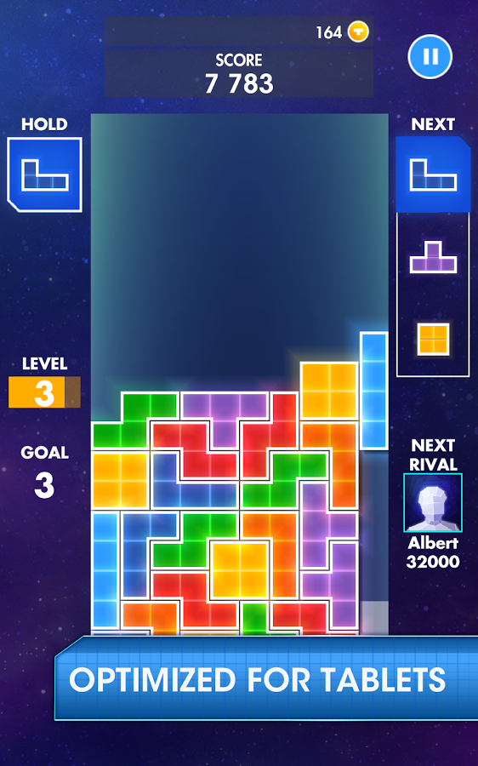
Future Directions
Timer
Keep player name
& high score
Display next piece
(up to 3)
Hold / Swap current piece
Scoring criteria
Speed adjustment
Notes:
Combo: 1 line no points, but put you in combo mode
Not in combo: 1 line = 0; 2 lines = 1 point; 3 lines = 2 points; 4 lines & above = 1 point per line
In combo mode: 1/2 lines += 1 point; 3/4 lines += 2 points; 5/6 lines += 3 points; 7 lines & above += 4 points

