Slide 1
Making Life Multiplanetary
The past, present and future of SpaceX

Slide 2
Introduction
Who are SpaceX?
What did they do so far?
What are their plans?
What problems will they have to solve?

Slide 3
Connection to Astrobiology
space exploration
  more public interest
  more accessible
  more competition
life colonizing other planets

Slide 4
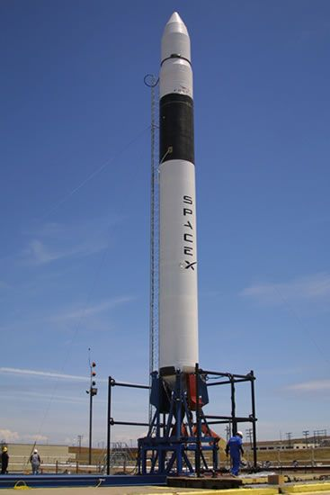
History of SpaceX
started by Elon Musk
originally publicity stunt
failure of acquiring
cheap rockets
founding of a company
to build cheap rockets

Slide 5
Main Goals of SpaceX
To develop a launch system that can be reused when needed
To decrease the cost of travel to space
To make access to space more reliable
To make humans a multiplanetary species

Slide 6
Achievements
First privately funded ...
  … liquid-fueld rocket to reach orbit
  … launch to ISS
  … autonomous docking at ISS

Slide 7
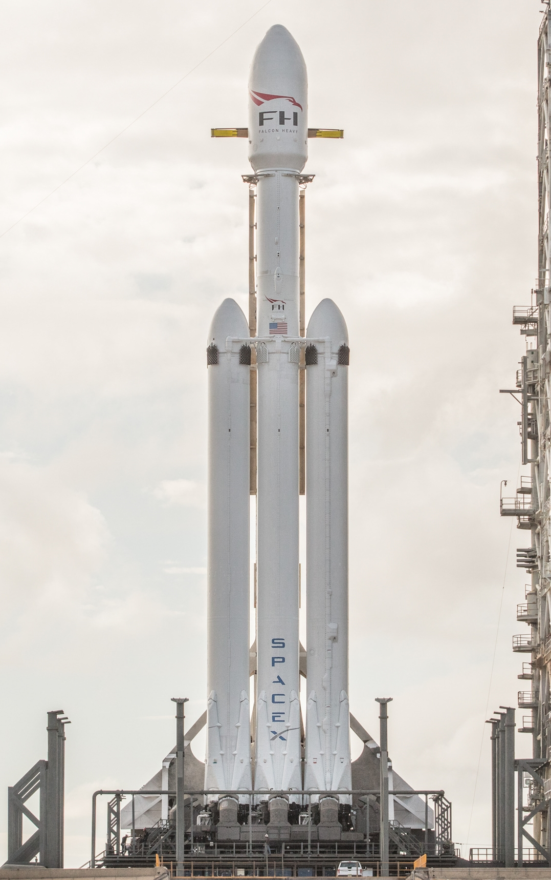
Falcon Heavy
Second most powerful
rocket to reach orbit
Ability to fly beyond Mars
Full recovery of the boosters

Slide 8
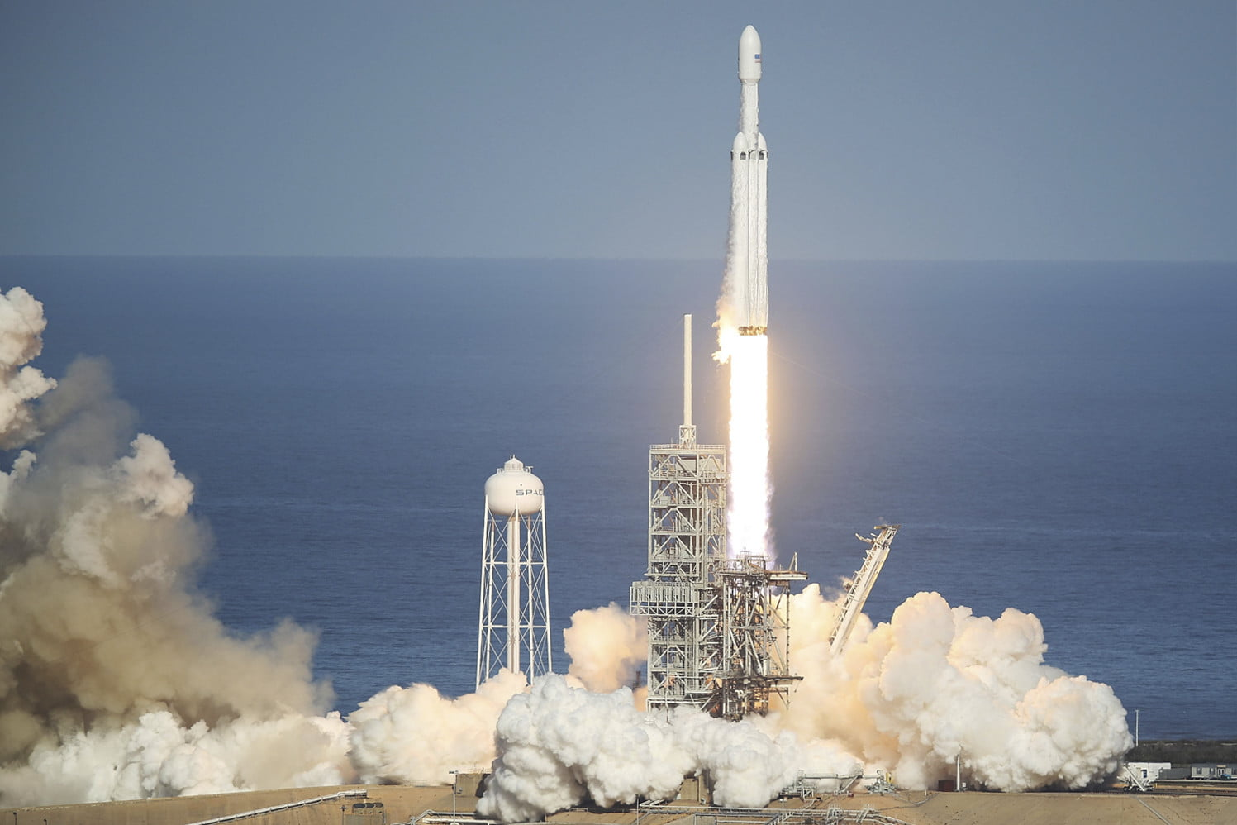

Slide 9
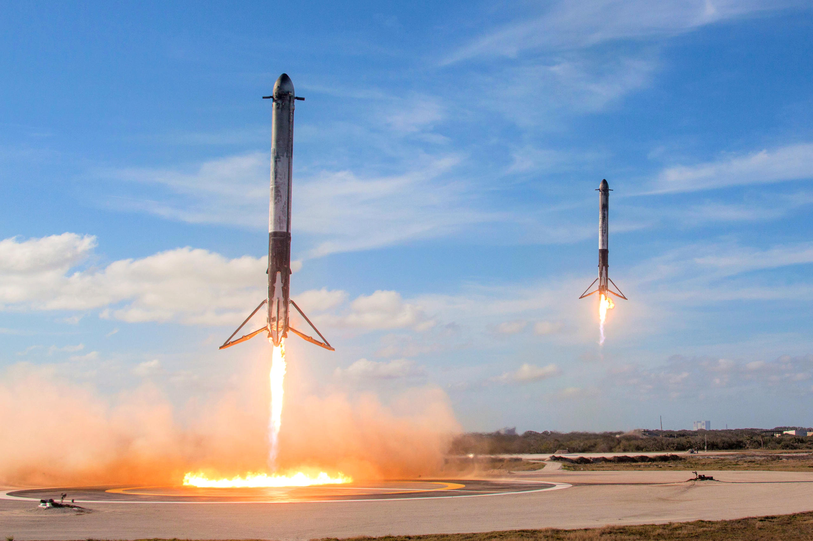

Slide 10
Future Plans of SpaceX
2022:
two cargo ships on Mars
Aims:
  identify hazards
  begin building a propellant plant
  find water source
2024:
four cargo and crew ships to land on Mars
Aims:
  complete propellant plant
  prepare for future landings

Slide 11
Future Plans of SpaceX
Result:
creation of first Mars base
foundations for first Mars city

Slide 12
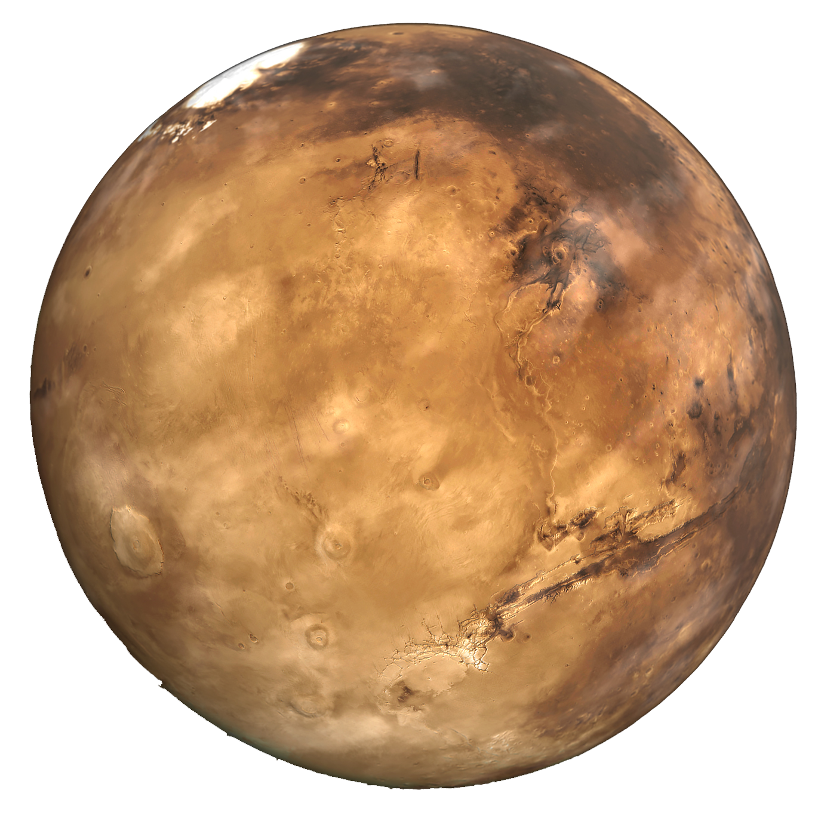
Mars Today
current state very
different to past
liquid water essential
Mars cannot provide this

Slide 13
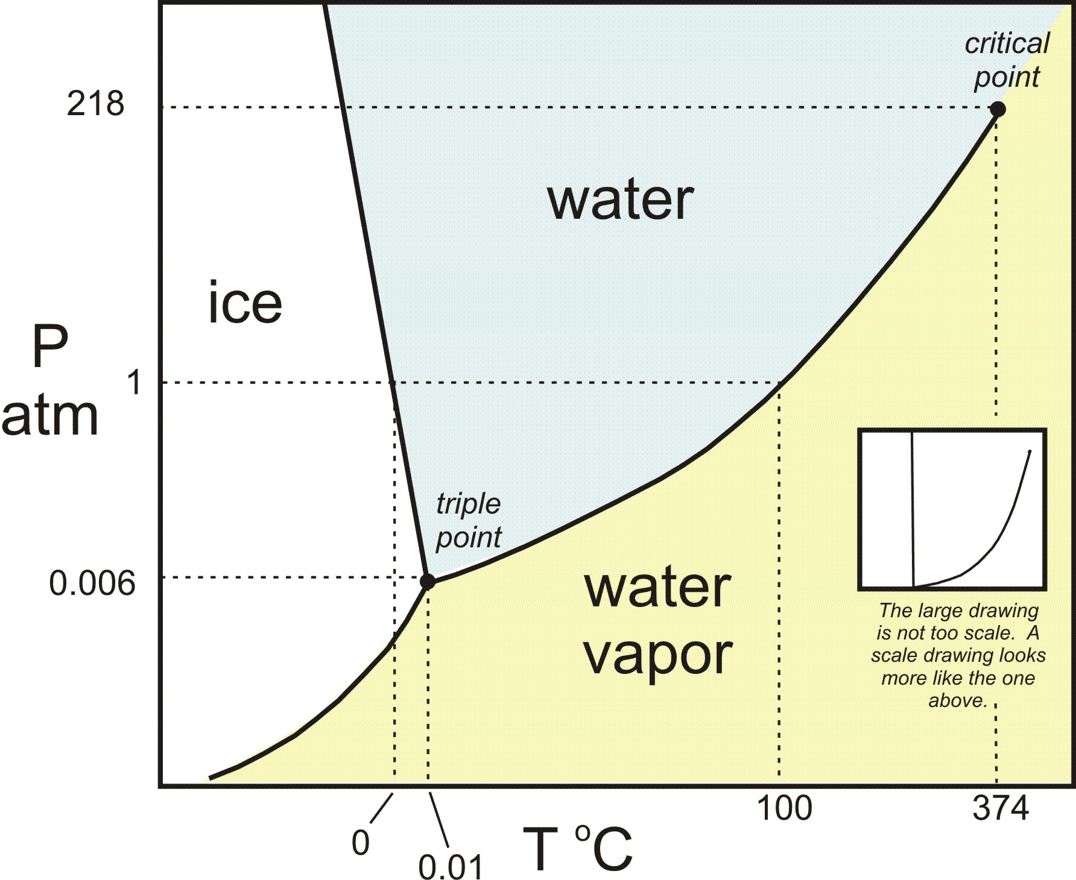
Atmospheric Pressure
very low
higher pressure below
the surface
evidence of flowing water in past
brine can be found to
seep through subsurface
Hellas basin occasionally contains
liquid water

Slide 14
Other Challenges
Gravity: 38% of earths
Radiation:
  thin atmosphere and no magnetosphere
  large amount of solar radiation
Climate and Atmosphere:
  -5 to -87˚C every day
  0.4% oxygen, 95% carbon dioxide

Slide 15
Why colonize Mars?
most like Earth in solar system
still a lot of uncertainty
undiscovered anomalies possible

Slide 16
Sources
Information
  https://en.m.wikipedia.org/wiki/SpaceX
  https://en.m.wikipedia.org/wiki/Elon_Musk
  https://www.spacex.com/mars
  https://www.spacex.com/about
  https://en.wikipedia.org/wiki/Colonization_of_Mars
  Lecture slides

Slide 17
Sources
Images
  http://www.designation-systems.net/dusrm/app3/falcon-1-1.jpg
  https://upload.wikimedia.org/wikipedia/commons/2/2b/Falcon_Heavy_cropped.jpg
  https://s3.amazonaws.com/marquee-test-akiaisur2rgicbmpehea/TFfjONnsRliSQ0tIa0w1_Falcon_Heavy_Side_Boosters_landing_on_LZ1_and_LZ2_-_2018_%2825254688767%29.jpg
  https://pngimg.com/uploads/mars_planet/mars_planet_PNG18.png
  https://serc.carleton.edu/images/research_education/equilibria/h2o_phase_diagram_-_color.v2.jpg

