Slide 1

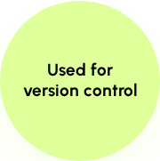

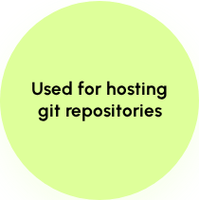
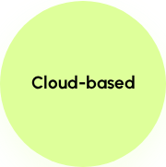



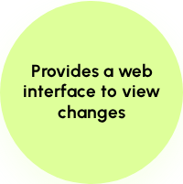


Git vs GitHub : What's the difference ?
GIT
GITHUB

Slide 2
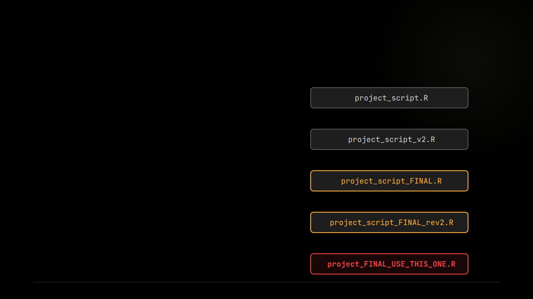
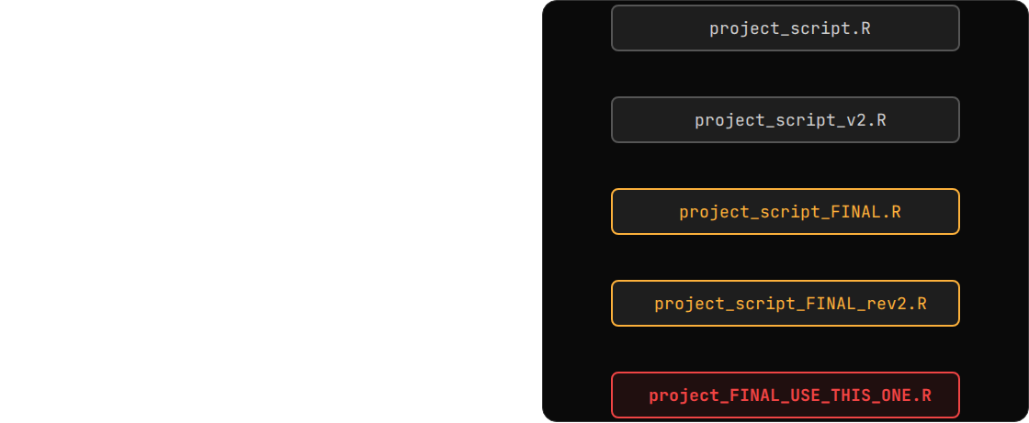
THE PROBLEM: NAMING NIGHTMARE
The "Final" Illusion
Without version control, tracking history turns into file accumulation chaos. Working manually leads to systemic traps:
→
Cluttered Directories: Endless duplication of files just to save a historic snapshot.
→
Loss of Context: Forgetting exactly what lines of code changed between version 3 and version 4 over time.
→
Collaboration Blocking: You cannot easily share a folder of 15 confusing files with a teammate and expect them to know which one works.

Slide 3







THE CORE SOLUTION: TOTAL CONTROL
Granular Snapshots
Flawless Time Travel
Absolute Audit Trails
Instead of copying whole files, Git tracks incremental line changes precisely. Your project folder stays completely clean with just a single file visible.
Faced with broken script executions? Seamlessly roll back your entire workspace to any precise historic commit instantly.
Every dynamic modification maps directly back to an individual author signature, accurate timestamp, and contextual intent description.

Slide 4

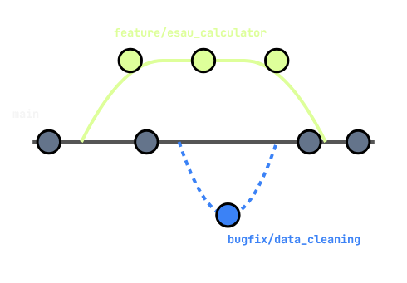
ADVANCED WORKFLOWS: BRANCHING
Parallel Streams of Innovation
Branching structures safely isolate work streams so you can code without breaking the baseline project:
→
The Baseline (main): The pristine, production-ready code. This is the single source of truth.
→
Feature Development (feature/esau_calculator): A safe sandbox where you build and test new models or logic without touching main.
→
Bug Fixing (bugfix/data_cleaning): A quick, parallel branch spun up to fix a specific issue without interrupting the ongoing feature work.

Slide 5
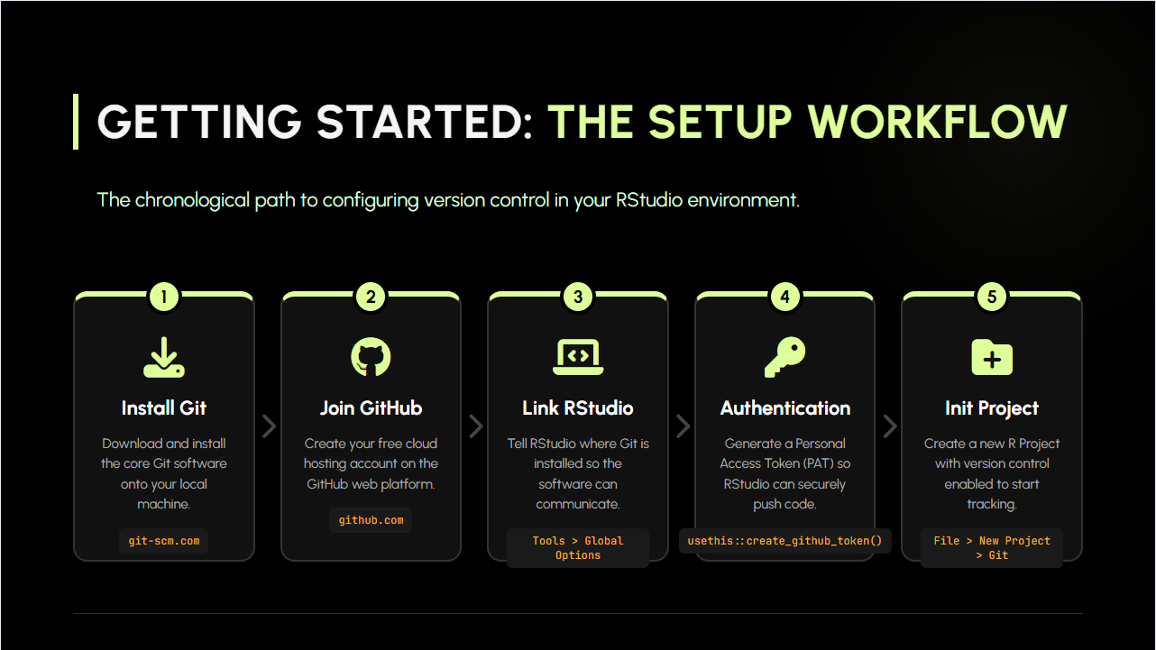

Slide 6

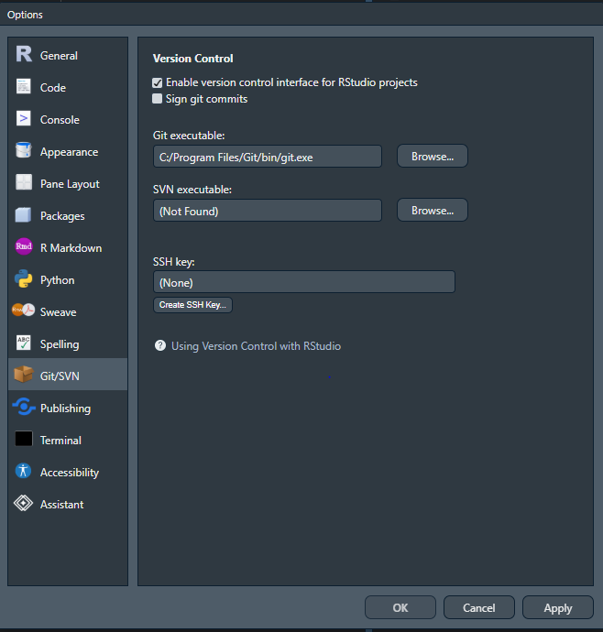
RSTUDIO CONFIGURATION
Navigate to Tools > Global Options
Select the Git/SVN tab
Enable Version Control Interface
Verify path to git.exe

Slide 7

ONE TIME SETUP
Run this in R Console
to link your local commits to profile:
GitHub no longer accepts passwords for Git operations.
We must use a PAT (Personal Access Tokens ) :
Usethis::create_github_token()
Launches GitHub authentication Configuration
Generate Token
Generates a token. Copy this
gitcreds::gitcreds_set()
Paste the token here
usethis::use_git_config( user.name = "Your Name", user.email = "your@email.com" )
* Note: Use the same email address as your GitHub account.

Slide 8


GET STARTED
PROJECT
COMMIT
Create a new R Project
"project.Rproj"
INITIALIZE
Save snapshot
git commit -m "msg"
PUSH
Setup local repo
git init
Publish code
git push origin
GITHUB
TERMINAL
STAGE
LINK
Create a new repository on GitHub.com
Open the Git Bash tab
Prepare files
git add .
Connect GitHub
git remote add

Slide 9
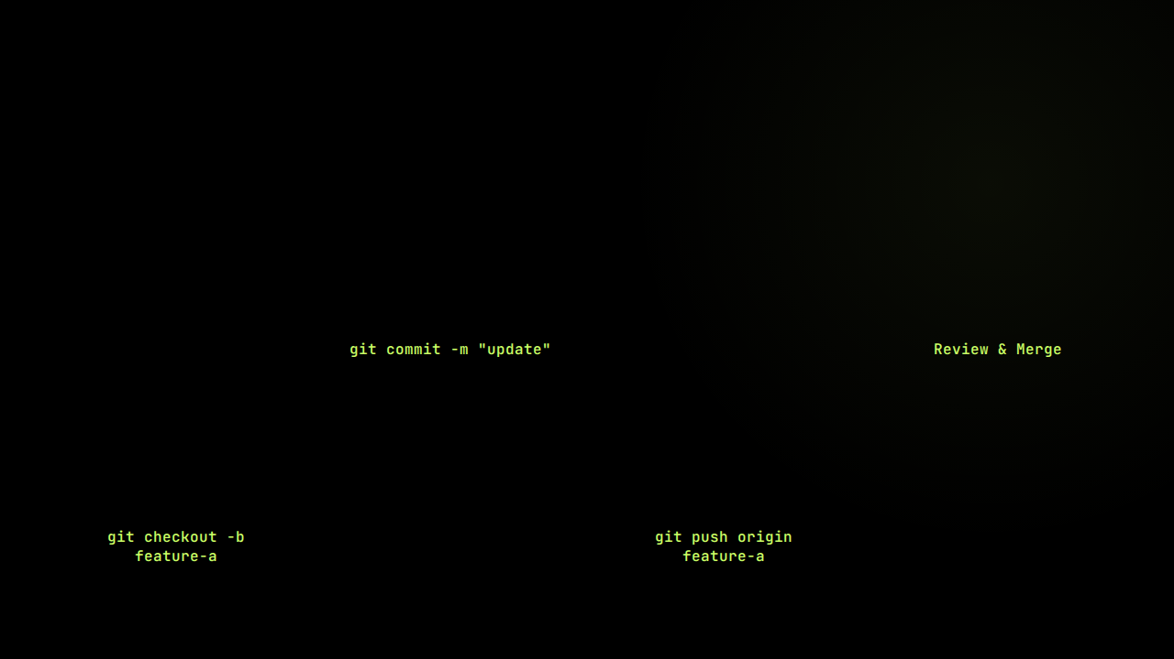
COLLABORATION
DEVELOP
PULL REQUEST
Modify scripts in RStudio. Stage and save snapshots.
On GitHub.com, propose merging code into main.
BRANCH
PUSH
Create a sandbox to isolate your feature code.
Upload your branch and commits to GitHub cloud.

Slide 10



TERMINAL EXAMPLES
FIRST PUSH
FEATURE BRANCH
CONNECT TO GITHUB
COLLABORATE SAFELY
Link your local repository to the cloud and push your "main" branch for the first time.
Create a new work stream, save your modifications, and share them on GitHub.
$git remote add origin https://... $git branch -M main $git push -u origin main
$git checkout -b feature-a # ... edits made in RStudio ... $git commit -am "added feature" $git push origin feature-a

Slide 11
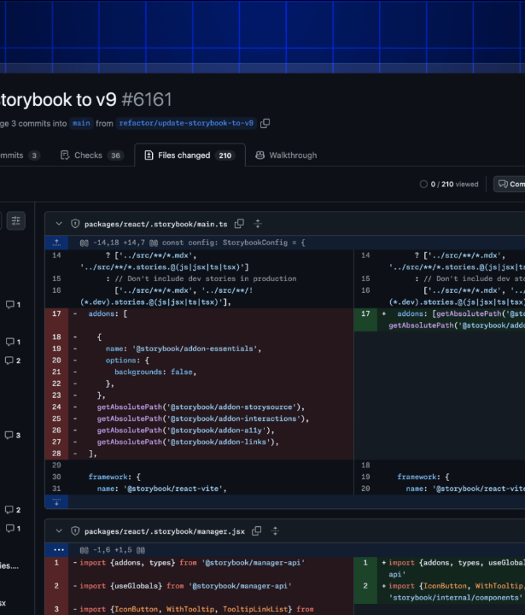
PULL REQUESTS
GITHUB.COM
FINALIZE THE REVIEW
Once your branch is pushed, head to GitHub to propose merging your code into the project.
Compare & PR: GitHub will show a banner to start the merge request.
Assign Reviewers: Tag your teammates to check your code.
Merge: Once approved, hit Merge to update the main project.

Slide 12


HANDLING CONFLICTS
THE 4-STEP RESOLUTION
WHEN CHANGES COLLIDE
Follow this terminal & RStudio sequence to resolve conflicts perfectly:
Conflicts occur when two collaborators edit the exact same line of code. Git stops the merge and inserts markers inside your script.
→
Find: Open the marked file in RStudio and look for conflict headers (<<<<<<<).
cleanup.R RStudio Editor
→
Edit: Decide which code to keep. Manually delete all conflict markers and keep the correct line of code.
data <- data %>% filter(age >= 18)
→
Stage: Save the cleaned file and add it to the index using your Bash console: git add cleanup.R
=======
data <- data %>% filter(age > 17 & active == TRUE)
→
Commit & Push: Save the resolution snapshot and sync to the cloud: git commit -m "Resolve conflict"

Slide 13

KEEPING REPOS CLEAN
.gitignore Workspace Rules
FILTERING UNWANTED FILES
# History files & temp databases .Rhistory .RData .Rproj.user/ # Exclude heavy raw datasets data/raw/ *.csv *.rds # Security Credentials .env config_secret.R
Not every file belongs on GitHub. A .gitignore file tells Git precisely which files, file types, or entire folders to ignore entirely.
→
Avoid Big Uploads: Prevent massive datasets (CSV, RDS) from slowing down your pushes.
→
Secure Passwords: Never push .env or secrets keys to the public cloud.
→
Ignore Local R junk: Leave IDE configuration metadata behind so it doesn't clutter team file history.

Slide 14
CODING CONVENTIONS
Write code your teammates can read, not just code that runs.
📂 project/
source("02_helpers.R")
Helper Functions in a Separate File
Keep reusable functions in a dedicated file. Your main script stays lean and anyone can find logic instantly without hunting through hundreds of lines.
# Recommended project layout project/ ├── 00_libraries.R # all library() ├── 01_globals.R # vars & paths ├── 02_helpers.R # helper fns ├── 03_analysis.R # main logic └── 04_report.R # output # 00_libraries.R library(tidyverse) library(openxlsx) # 01_globals.R report_month <- "2025-05" output_path <- "output/"
library(tidyverse); library(DBI)
All Libraries at the Top
Every dependency declared upfront. A teammate cloning the repo immediately sees what packages are needed before a single line runs.
report_month <- "2025-05"
Global Variables Defined Upfront
Paths, dates, thresholds declared once at the top. Change a month or folder path in one place — not scattered across 12 scripts.
calc_bucket_move() # not fn1()
Descriptive Naming & Comments
Use snake_case, name variables and functions by what they mean. Add a section comment before each logical block so reviewers navigate fast.

Slide 15




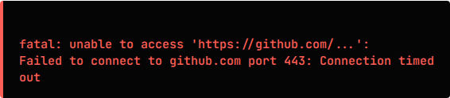
IMPLEMENTATION CHALLENGES
Corporate Firewall Restrictions
Our internal network security policies currently intercept and block outbound git push connections to external GitHub accounts.
Impact: Local commits in RStudio cannot be successfully synced to the cloud, halting the collaborative workflow.
$git push origin main

