Slide 1
Algoritme Pemrograman
Pertemuan XI
Tim TPB Alpro

Slide 2

It is time to go find some Data to mess with!
What
Next?
Software
Input
and Output
Devices
Central
Processing
Unit
Files R Us
Secondary
Memory
if x < 3: print
Main
Memory

Slide 3
File Processing
A text file can be thought of as a sequence of lines
From stephen.marquard@uct.ac.za Sat Jan 5 09:14:16 2008
Return-Path: <postmaster@collab.sakaiproject.org>
Date: Sat, 5 Jan 2008 09:12:18 -0500
To: source@collab.sakaiproject.org
From: stephen.marquard@uct.ac.za
Subject: [sakai] svn commit: r39772 - content/branches/
Details: http://source.sakaiproject.org/viewsvn/?view=rev&rev=39772
http://www.py4e.com/code/mbox-short.txt

Slide 4
Opening a File
Before we can read the contents of the file, we must tell Python which file we are going to work with and what we will be doing with the file
This is done with the open() function
open() returns a “file handle” - a variable used to perform operations on the file
Similar to “File -> Open” in a Word Processor

Slide 5
Using open()
fhand = open('mbox.txt', 'r')
  handle = open(filename, mode)
  returns a handle use to manipulate the file
  filename is a string
  mode is optional and should be 'r' if we are planning to read the file and 'w' if we are going to write to the file

Slide 6
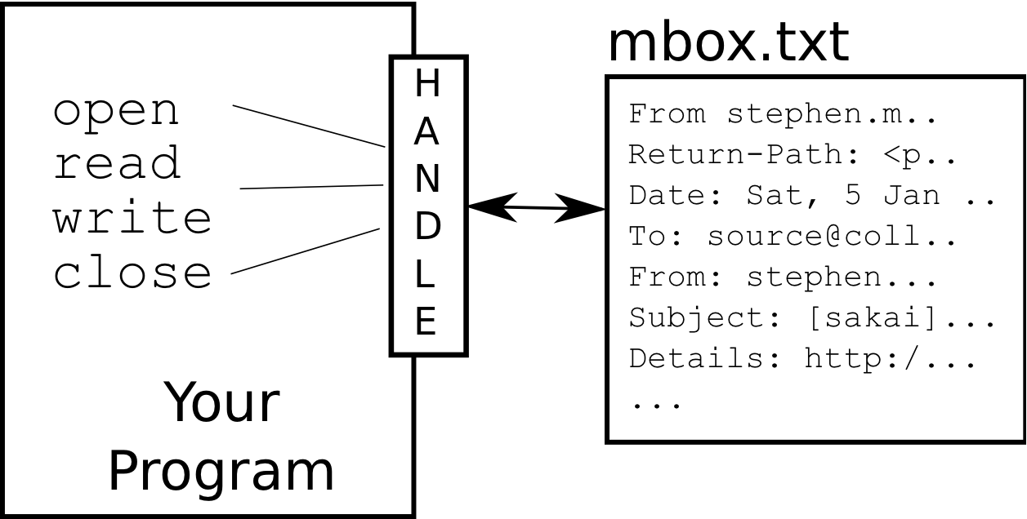
What is a Handle?
>>> fhand = open('mbox.txt')
>>> print(fhand)
<_io.TextIOWrapper name='mbox.txt' mode='r' encoding='UTF-8'>

Slide 7
When Files are Missing
>>> fhand = open('stuff.txt')
Traceback (most recent call last):
File "<stdin>", line 1, in <module>
FileNotFoundError: [Errno 2] No such file or directory: 'stuff.txt'

Slide 8
The newline Character
We use a special character called the “newline” to indicate when a line ends
We represent it as \n in strings
Newline is still one character - not two
>>> stuff = 'Hello\nWorld!'
>>> stuff
'Hello\nWorld!'
>>> print(stuff)
Hello
World!
>>> stuff = 'X\nY'
>>> print(stuff)
X
Y
>>> len(stuff)
3

Slide 9
Reading Files in Python

Slide 10
File Handle as a Sequence
A file handle open for read can be treated as a sequence of strings where each line in the file is a string in the sequence
We can use the for statement to iterate through a sequence
Remember - a sequence is an ordered set
xfile = open('mbox.txt')
for cheese in xfile:
print(cheese)

Slide 11
Counting Lines in a File
Open a file read-only
Use a for loop to read each line
Count the lines and print out the number of lines
fhand = open('mbox.txt')
count = 0
for line in fhand:
count = count + 1
print('Line Count:', count)
$ python open.py
Line Count: 132045

Slide 12
Reading the *Whole* File
We can read the whole file (newlines and all) into a single string
>>> fhand = open('mbox-short.txt')
>>> inp = fhand.read()
>>> print(len(inp))
94626
>>> print(inp[:20])
From stephen.marquar

Slide 13
Searching Through a File
We can put an if statement in our for loop to only print lines that meet some criteria
fhand = open('mbox-short.txt')
for line in fhand:
if line.startswith('From:') :
print(line)

Slide 14
Searching Through a File (fixed)
We can strip the whitespace from the right-hand side of the string using rstrip() from the string library
The newline is considered “white space” and is stripped
fhand = open('mbox-short.txt')
for line in fhand:
line = line.rstrip()
if line.startswith('From:') :
print(line)
From: stephen.marquard@uct.ac.za
From: louis@media.berkeley.edu
From: zqian@umich.edu
From: rjlowe@iupui.edu
....

Slide 15
Skipping with continue
We can conveniently skip a line by using the continue statement
fhand = open('mbox-short.txt')
for line in fhand:
line = line.rstrip()
if not line.startswith('From:') :
continue
print(line)

Slide 16
a in to Select Lines
fhand = open('mbox-short.txt')
for line in fhand:
line = line.rstrip()
if not '@uct.ac.za' in line :
continue
print(line)
We can look for a string anywhere in a line as our selection criteria
From stephen.marquard@uct.ac.za Sat Jan 5 09:14:16 2008
X-Authentication-Warning: set sender to stephen.marquard@uct.ac.za using –f
From: stephen.marquard@uct.ac.za
Author: stephen.marquard@uct.ac.za
From david.horwitz@uct.ac.za Fri Jan 4 07:02:32 2008
X-Authentication-Warning: set sender to david.horwitz@uct.ac.za using -f...

Slide 17
Prompt for File Name
fname = input('Enter the file name: ')
fhand = open(fname)
count = 0
for line in fhand:
if line.startswith('Subject:') :
count = count + 1
print('There were', count, 'subject lines in', fname)
Enter the file name: mbox.txt
There were 1797 subject lines in mbox.txt
Enter the file name: mbox-short.txt
There were 27 subject lines in mbox-short.txt

Slide 18
Bad File Names
fname = input('Enter the file name: ')
try:
fhand = open(fname)
except:
print('File cannot be opened:', fname)
quit()
count = 0
for line in fhand:
if line.startswith('Subject:') :
count = count + 1
print('There were', count, 'subject lines in', fname)
Enter the file name: mbox.txt
There were 1797 subject lines in mbox.txt
Enter the file name: na na boo boo
File cannot be opened: na na boo boo

