Slide 1
Algoritme Pemrograman
Graphical User Inteface (GUI) Tim TPB Alpro

Slide 2
Graphical User Interfaces
Concept:
A graphical user interface allows the user to interact with the operating system and other programs using graphical elements such as icons, buttons, and dialog boxes.

Slide 3
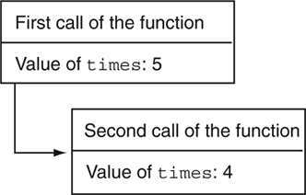
Graphical User Interfaces
A computer’s user interface is the part of the computer that the user interacts with
User interface consists of
Hardware devices
Commands from the user the operating system accepts
Command line interface displays a prompt and the user types a command which is then executed
Figure 12-1 A command line interface

Slide 4
Graphical User Interfaces
The key ideas of graphical user interfaces (on-screen windows, icons, menus, buttons etc, and a pointing device (mouse)) were developed at Xerox PARC during the late 1970s.
These ideas were adopted by Apple, first in the Lisa (1983) and then in the popular Macintosh (1984). In 1985, Microsoft introduced Windows, first as an application and later as an operating system.
Python makes it very easy to implement simple GUIs, so we will look at the main points.

Slide 5
Graphical User Interfaces
A graphical user interface (GUI) allows the user to interact with the operating system and other programs through graphical elements (icons, buttons, slider bars, etc.) on the screen.
GUIs popularized the use of the mouse.
GUIs allow the user to point at graphical elements and click the mouse button to activate them.

Slide 6
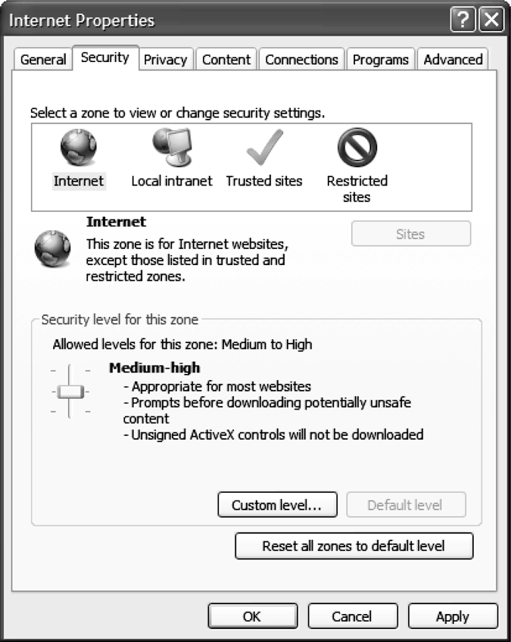
Graphical User Interfaces
Interaction with a GUI is done through dialog boxes – small windows that display information and allow the user to perform actions
Figure 12-2 A dialog box

Slide 7
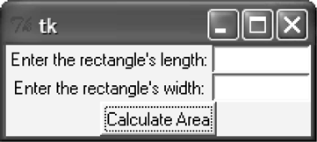
Graphical User Interfaces
GUI Programs Are Event-Driven
User determines the order in which things happen
GUI programs respond to the actions of the user, thus they are event driven.
Figure 12-3 A GUI program

Slide 8
Using the Tkinter Module
Concept:
In Python you can use the Tkinter module to create simple GUI programs.

Slide 9
Using the Tkinter Module
Python does not have GUI programming features built into the language.
The Tkinter module allows the creation of simple GUI programs.
Tkinter does not always run reliably under IDLE
Use IDLE’s editor to write GUI programs, but for best results run the program from the OS command line.

Slide 10
The simplest GUI program in Python
# Use the Tkinter module
import Tkinter
# Create the top-level (or root) window
top = Tkinter.Tk()
# Create a button ...
quitButton = Tkinter.Button(top,text="Quit", command=top.destroy)
# ... and display it in the window
quitButton.grid()
# Start the main loop: responds to the mouse etc
Tkinter.mainloop()
example1

Slide 11
Event-driven programming
GUI applications use a style of programming called event-driven. Events are mouse movements, mouse clicks, key presses, and many higher-level events constructed from these.
(For example, clicking the mouse while the pointer is over a button generates a button press event).
Some events are handled completely within the main loop provided by Tkinter.
(For example, mouse movements are used to update the position of the pointer on the screen; clicking the minimize button of the window has the usual effect.)

Slide 12
Event-driven programming
Other events, usually higher-level events such as
button presses, menu selections, typing in a text field,
are handled in a way that involves the user's code.
This is controlled by defining callbacks.
Example: if we have a button, the event we are interested in is
pressing it. When the button is created, the command parameter
is used to specify which function to call when the button is
pressed.
quitButton = Tkinter.Button(top,text="Quit",
command=top.destroy)

Slide 13
Extending the example
First let's add something to enable us to display a message to
the user. Tkinter provides Label for this purpose.
import Tkinter
top = Tkinter.Tk()
messageLabel = Tkinter.Label(top,text="Hello World!")
messageLabel.grid()
quitButton = Tkinter.Button(top,text="Quit",
command=top.destroy)
quitButton.grid()
Tkinter.mainloop()
example2

Slide 14
Extending the example
Instead of displaying the message immediately, let's add
another button with a callback which will display the message.
import Tkinter
def display():
messageLabel.configure(text="Hello World!")
top = Tkinter.Tk()
messageLabel = Tkinter.Label(top,text="")
messageLabel.grid()
showButton = Tkinter.Button(top,text="Show",command=display)
showButton.grid()
quitButton = Tkinter.Button(top,text="Quit",command=top.destroy)
quitButton.grid()
Tkinter.mainloop()
example3

Slide 15
Points to note
import Tkinter
def display():
messageLabel.configure(text="Hello World!")
top = Tkinter.Tk()
messageLabel = Tkinter.Label(top,text="")
messageLabel.grid()
showButton = Tkinter.Button(top,text="Show",command=display)
showButton.grid()
quitButton = Tkinter.Button(top,text="Quit",command=top.destroy)
quitButton.grid()
Tkinter.mainloop()
definition before use
no brackets

Slide 16
Terminology
The generic term for a GUI element (button, menu, label, …)
is a widget.

Slide 17
Changing the layout
We can use optional arguments with the grid method to control
how widgets are placed.
import Tkinter
def display():
messageLabel.configure(text="Hello World!")
top = Tkinter.Tk()
messageLabel = Tkinter.Label(top,text="",width=12)
messageLabel.grid(row=0,column=0)
showButton = Tkinter.Button(top,text="Show",command=display)
showButton.grid(row=0,column=1)
quitButton = Tkinter.Button(top,text="Quit",command=top.destroy)
quitButton.grid(row=0,column=2)
Tkinter.mainloop()
example4

Slide 18
Getting input from the user
example5
import Tkinter
def display():
name = textVar.get()
messageLabel.configure(text="Hello "+name)
top = Tkinter.Tk()
textVar = Tkinter.StringVar("")
textEntry = Tkinter.Entry(top,textvariable=textVar,width=12)
textEntry.grid(row=0,column=0)
messageLabel = Tkinter.Label(top,text="",width=12)
messageLabel.grid(row=1,column=0)
showButton = Tkinter.Button(top,text="Show",command=display)
showButton.grid(row=1,column=1)
quitButton = Tkinter.Button(top,text="Quit",command=top.destroy)
quitButton.grid(row=1,column=2)
Tkinter.mainloop()

Slide 19
Important idea
The Entry widget allows the user to enter text, but it does not
have storage for the text built in.
We have to create a Tkinter.StringVar object and give it
to the Entry object.
We can then use the get method of the StringVar to obtain
the text.
This style of programming is also needed with several other
Tkinter widgets.
It must be a StringVar, not an ordinary string variable.

Slide 20
Another example: Radiobutton
def display():
name = textVar.get()
ch = choice.get()
if ch == 1:
message = "Hello "+name
elif ch == 2:
message = "Goodbye "+name
else:
message = ""
messageLabel.configure(text=message)
top = Tkinter.Tk()
textVar = Tkinter.StringVar("")
textEntry = Tkinter.Entry(top,textvariable=textVar,width=12)
textEntry.grid(row=0,column=0)
messageLabel = Tkinter.Label(top,text="",width=12)
messageLabel.grid(row=1,column=0)
choice = Tkinter.IntVar(0)
helloButton = Tkinter.Radiobutton(top,text="Hello",
variable=choice,value=1,command=display)
helloButton.grid(row=1,column=1)
goodbyeButton = Tkinter.Radiobutton(top,text="Goodbye",
variable=choice,value=2,command=display)
goodbyeButton.grid(row=1,column=2)
quitButton = Tkinter.Button(top,text="Quit",command=top.destroy)
quitButton.grid(row=1,column=3)
Tkinter.mainloop()
example6

Slide 21
Another example: Radiobutton
def display():
name = textVar.get()
ch = choice.get()
if ch == 1:
message = "Hello "+name
elif ch == 2:
message = "Goodbye "+name
else:
message = ""
messageLabel.configure(text=message)
top = Tkinter.Tk()
textVar = Tkinter.StringVar("")
textEntry = Tkinter.Entry(top,textvariable=textVar,width=12)
textEntry.grid(row=0,column=0)
messageLabel = Tkinter.Label(top,text="",width=12)
messageLabel.grid(row=1,column=0)
choice = Tkinter.IntVar(0)
helloButton = Tkinter.Radiobutton(top,text="Hello",
variable=choice,value=1,command=display)
helloButton.grid(row=1,column=1)
goodbyeButton = Tkinter.Radiobutton(top,text="Goodbye",
variable=choice,value=2,command=display)
goodbyeButton.grid(row=1,column=2)
quitButton = Tkinter.Button(top,text="Quit",command=top.destroy)
quitButton.grid(row=1,column=3)
Tkinter.mainloop()

Slide 22
Another example: Radiobutton
def display():
name = textVar.get()
ch = choice.get()
if ch == 1:
message = "Hello "+name
elif ch == 2:
message = "Goodbye "+name
else:
message = ""
messageLabel.configure(text=message)
top = Tkinter.Tk()
textVar = Tkinter.StringVar("")
textEntry = Tkinter.Entry(top,textvariable=textVar,width=12)
textEntry.grid(row=0,column=0)
messageLabel = Tkinter.Label(top,text="",width=12)
messageLabel.grid(row=1,column=0)
choice = Tkinter.IntVar(0)
helloButton = Tkinter.Radiobutton(top,text="Hello",
variable=choice,value=1,command=display)
helloButton.grid(row=1,column=1)
goodbyeButton = Tkinter.Radiobutton(top,text="Goodbye",
variable=choice,value=2,command=display)
goodbyeButton.grid(row=1,column=2)
quitButton = Tkinter.Button(top,text="Quit",command=top.destroy)
quitButton.grid(row=1,column=3)
Tkinter.mainloop()

Slide 23
Another GUI example
Recall one of the first semester's exercises: working out
whether or not a given text is a palindrome (ignoring spaces
and punctuation).
Let's put a graphical user interface on it.
First we'll reconstruct the original solution.

Slide 24
Checking for Palindromes
def palindrome(s): # s is a string
t = string.lower(s) # lower case version
u = ""
for x in t:
if x in string.letters:
u = u + x
# u is just the letters from t
v = ""
for x in u:
v = x + v
# v is the reverse of u
return u==v

Slide 25
Designing a GUI
Let's go for a layout along the following lines:
text entry area
label for result
Check
Quit

Slide 26
Setting up the window and widgets
import Tkinter
top = Tkinter.Tk()
top.title("Palindrome Checker")
top.geometry("300x50")
entry = Tkinter.Entry(top,width=48)
entry.grid(row=0,column=0,columnspan=3)
# columnspan specifies how many cell columns of the table this cell should span.
resultLabel = Tkinter.Label(top,text="",width=34)
resultLabel.grid(row=1,column=0)
checkButton = Tkinter.Button(top,text="Check")
checkButton.grid(row=1,column=1)
quitButton = Tkinter.Button(top,text="Quit",command=top.destroy)
quitButton.grid(row=1,column=2)
Tkinter.mainloop()
gui1

Slide 27
A variable for the Entry widget
top = Tkinter.Tk()
top.title("Palindrome Checker")
top.geometry("300x50")
entryVar = Tkinter.StringVar("")
entry = Tkinter.Entry(top,width=48,textvariable=entryVar)
entry.grid(row=0,column=0,columnspan=3)
resultLabel = Tkinter.Label(top,text="",width=34)
resultLabel.grid(row=1,column=0)
checkButton = Tkinter.Button(top,text="Check")
checkButton.grid(row=1,column=1)
quitButton = Tkinter.Button(top,text="Quit",command=top.destroy)
quitButton.grid(row=1,column=2)
Tkinter.mainloop()

Slide 28
A callback for the Check button
top = Tkinter.Tk()
top.title("Palindrome Checker")
top.geometry("300x50")
entryVar = Tkinter.StringVar("")
def check():
# definition of the function
entry = Tkinter.Entry(top,width=48,textvariable=entryVar)
entry.grid(row=0,column=0,columnspan=3)
resultLabel = Tkinter.Label(top,text="",width=34)
resultLabel.grid(row=1,column=0)
checkButton = Tkinter.Button(top,text="Check",command=check)
checkButton.grid(row=1,column=1)
quitButton = Tkinter.Button(top,text="Quit",command=top.destroy)
quitButton.grid(row=1,column=2)

Slide 29
Defining the check function
def check():
text = entryVar.get()
result = palindrome(text)
resultLabel.configure(text=result)
gui2

Slide 30
Improving the output
Instead of seeing 1 or 0, we would prefer an informative
message.
def check():
text = entryVar.get()
result = palindrome(text)
if result:
message = "It is a palindrome"
else:
message = "It is not a palindrome"
resultLabel.configure(text=message)
gui3

Slide 31
Stylistic points
In general it is a good idea to define everything before it is
used. It makes the program easier to read, and in any case
many programming languages insist on it.
Python is more flexible than most languages in this respect,
but note that in GUI programs, the definition of a callback
function must appear before creating the widget which calls it.
def check():
# definition of the function
...
checkButton = Tkinter.Button(top,text="Check",command=check)
checkButton.grid(row=1,column=1)

Slide 32
Stylistic points
It is also a good idea in general to put related parts of the
program close to each other: for example, two functions which
do related calculations, or one function which calls another.
In the case of GUI programs, does this mean:
Grouping all of the functions together, and all of the GUI parts together; or
Grouping each widget with its callback function and any related widgets?

Slide 33
Is this the nicest layout? Not sure…
import Tkinter
from palindrome import *
top = Tkinter.Tk()
top.title("Palindrome Checker")
top.geometry("300x50")
entryVar = Tkinter.StringVar("")
entry = Tkinter.Entry(top,width=48,textvariable=entryVar)
entry.grid(row=0,column=0,columnspan=3)
resultLabel = Tkinter.Label(top,text="",width=34)
resultLabel.grid(row=1,column=0)
def check():
text = entryVar.get()
result = palindrome(text)
if result: message = "It is a palindrome"
else: message = "It is not a palindrome"
resultLabel.configure(text=message)
checkButton = Tkinter.Button(top,text="Check",command=check)
checkButton.grid(row=1,column=1)
quitButton = Tkinter.Button(top,text="Quit",command=top.destroy)
quitButton.grid(row=1,column=2)
Tkinter.mainloop()

