Slide 1
Data and Computer Communications
Chapter 14 – Cellular Wireless Networks
Eighth Edition
by William Stallings
Lecture slides by Lawrie Brown
Notes:
Lecture slides prepared by Dr Lawrie Brown (UNSW@ADFA) for “Data and Computer Communications”, 8/e, by William Stallings, Chapter 14 “Cellular Wireless Networks”.

Slide 2
Cellular Wireless Networks
After the fire of 1805, Judge Woodward was the central figure involved in reestablishing the town. Influenced by Major Pierre L’Enfant’s plans for Washington, DC, Judge Woodward envisioned a modern series of hexagons with major diagonal avenues centered on circular parks, or circuses, in the center of the hexagons. Frederick Law Olmstead said, "nearly all of the most serious mistakes of Detroit's past have arisen from a disregard of the spirit of Woodward's plan."
—Endangered Detroit, Friends of the Book-Cadillac Hotel
Notes:
This quote is from the start of Stallings DCC8e 14, is a reflection on issues which occur when a major redesign is done on anything.

Slide 3
Cellular Wireless Networks
key technology for mobiles, wireless nets etc
developed to increase mobile phone capacity
based on multiple low power transmitters
area divided into cells
  in a tiling pattern to provide full coverage
  each with own antenna
  each with own range of frequencies
  served by base station
  adjacent cells use different frequencies to avoid crosstalk
Notes:
Of all the tremendous advances in data communications and telecommunications, perhaps the most revolutionary is the development of cellular networks. Cellular technology is the underlying technology for mobile telephones, personal communications systems, wireless Internet and wireless Web applications, and much more. It is a technique developed to increase the capacity available for mobile radio telephone service. Contrast with the older mobiles using large area, high-power transmitters. The essence of a cellular network is the use of multiple low-power transmitters. The area to be covered is divided into cells in a hexagonal tile pattern that provide full coverage of the area. Because the range of such a transmitter is small, an area can be divided into cells, each one served by its own antenna. Each cell is allocated a band of frequencies and is served by a base station, consisting of transmitter, receiver, and control unit. Adjacent cells are assigned different frequencies to avoid interference or crosstalk. However, cells sufficiently distant from each other can use the same frequency band.

Slide 4
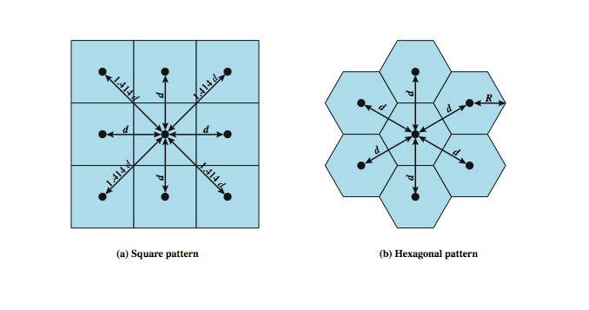
Cellular Geometries
Notes:
The first design decision to make is the shape of cells to cover an area. A matrix of square cells would be the simplest layout to define, as seen here in Stallings DCC8e Figure 14.1a. However, this geometry is not ideal. If the width of a square cell is d, then a cell has four neighbors at a distance d and four neighbors at a distance d. As a mobile user within a cell moves toward the cell's boundaries, it is best if all of the adjacent antennas are equidistant. This simplifies the task of determining when to switch the user to an adjacent antenna and which antenna to choose.
A hexagonal pattern provides for equidistant antennas (Figure 14.1b). The radius of a hexagon is defined to be the radius of the circle that circumscribes it (equivalently, the distance from the center to each vertex; also equal to the length of a side of a hexagon). For a cell radius R, the distance between the cell center and each adjacent cell center is d = R. In practice, a precise hexagonal pattern is not used. Variations from the ideal are due to topographical limitations, local signal propagation conditions, and practical limitation on siting antennas.

Slide 5
Frequency Reuse
must manage reuse of frequencies
power of base transceiver controlled
  allow communications within cell on given frequency
  limit escaping power to adjacent cells
  allow re-use of frequencies in nearby cells
  typically 10 – 50 frequencies per cell
  example for Advanced Mobile Phone Service (AMPS)
    N cells all using same number of frequencies
    K total number of frequencies used in systems
    each cell has K/N frequencies
    K=395, N=7 giving 57 frequencies per cell on average
Notes:
With a wireless cellular system, you are limited in how often you can use the same frequency for different communications because the signals, not being constrained, can interfere with one another even if geographically separated. Systems supporting a large number of communications simultaneously need mechanisms to conserve spectrum. In a cellular system, each cell has a base transceiver. The transmission power is carefully controlled (to the extent that it is possible in the highly variable mobile communication environment) to allow communication within the cell using a given frequency while limiting the power at that frequency that escapes the cell into adjacent ones. The objective is to use the same frequency in other nearby cells, thus allowing the frequency to be used for multiple simultaneous conversations. Generally, 10 to 50 frequencies are assigned to each cell, depending on the traffic expected.
The essential issue is to determine how many cells must intervene between two cells using the same frequency so that the two cells do not interfere with each other. Various patterns of frequency reuse are possible. If the pattern consists of N cells and each cell is assigned the same number of frequencies, each cell can have K/N frequencies, where K is the total number of frequencies allotted to the system. For AMPS (Section 14.2), K = 395, and N = 7 is the smallest pattern that can provide sufficient isolation between two uses of the same frequency. This implies that there can be at most 57 frequencies per cell on average.

Slide 6
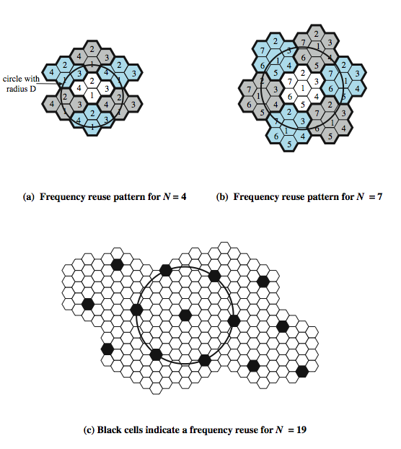
Frequency
Reuse
Patterns
Notes:
Stallings DCC8e Figure 14.2 shows some example reuse patterns. In characterizing frequency reuse, the following parameters are commonly used:
D = minimum distance between centers of cells that use the same band of frequencies (called cochannels)
R = radius of a cell
d = distance between centers of adjacent cells (d = R)
N = number of cells in repetitious pattern (reuse factor), each cell in pattern uses a unique band of frequencies.
With a hexagonal cell pattern, the following values of N possible
N = I² + J² + (I x J), I, J = 0, 1, 2, 3, …
Possible values of N are 1, 3, 4, 7, 9, 12, 13, 16, 19, 21, etc

Slide 7
Increasing Capacity
add new channels
  not all channels used to start with
frequency borrowing
  taken from adjacent cells by congested cells
  or assign frequencies dynamically
cell splitting
  non-uniform topography and traffic distribution
  use smaller cells in high use areas
Notes:
In time, as more customers use the system, traffic may build up so that there are not enough frequencies assigned to a cell to handle its calls. A number of approaches have been used to cope with this situation, including the following:
• Adding new channels: Typically, when a system is set up in a region, not all of the channels are used, and growth and expansion can be managed in an orderly fashion by adding new channels.
• Frequency borrowing: In the simplest case, frequencies are taken from adjacent cells by congested cells. The frequencies can also be assigned to cells dynamically.
Cell splitting: In practice, the distribution of traffic and topographic features is not uniform, and this presents opportunities for capacity increase. Cells in areas of high usage can be split into smaller cells.

Slide 8
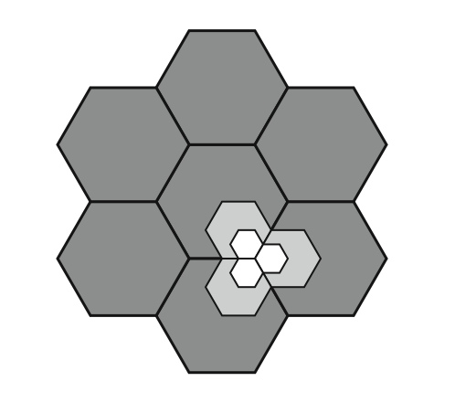
Cell Splitting
Notes:
Cells in areas of high usage can be split into smaller cells. Generally, the original cells are about 6.5 to 13 km in size. The smaller cells can themselves be split; however, 1.5-km cells are close to the practical minimum size as a general solution (but see the subsequent discussion of microcells). To use a smaller cell, the power level used must be reduced to keep the signal within the cell. Also, as the mobile units move, they pass from cell to cell, which requires transferring of the call from one base transceiver to another. This process is called a handoff. As the cells get smaller, these handoffs become much more frequent. Stallings DCC8e Figure 14.3 indicates schematically how cells can be divided to provide more capacity. A radius reduction by a factor of F reduces the coverage area and increases the required number of base stations by a factor of F².

Slide 9
Increasing Capacity
cell sectoring
  cell divided into wedge shaped sectors (3–6 per cell)
  each with own channel set
  directional antennas
microcells
  move antennas from tops of hills and large buildings to tops of small buildings and sides of large buildings
  use reduced power to cover a much smaller area
  good for city streets, roads, inside large buildings
Notes:
Additional approaches to increase capacity include:
• Cell sectoring: With cell sectoring, a cell is divided into a number of wedge-shaped sectors, each with its own set of channels, typically three or six sectors per cell. Each sector is assigned a separate subset of the cell's channels, and directional antennas at the base station are used to focus on each sector.
• Microcells: As cells become smaller, antennas move from the tops of tall buildings or hills, to the tops of small buildings or the sides of large buildings, and finally to lamp posts, where they form microcells. Each decrease in cell size is accompanied by a reduction in the radiated power levels from the base stations and the mobile units. Microcells are useful in city streets in congested areas, along highways, and inside large public buildings.
The use of smaller cells enables the use of lower power and provides superior propagation conditions.

Slide 10
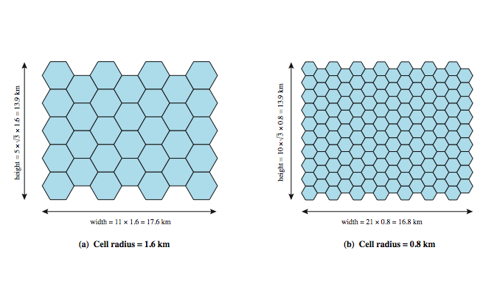
Frequency Reuse Example
Notes:
Stallings DCC8e Example. Assume a system of 32 cells with a cell radius of 1.6 km, a total of 32 cells, a total frequency bandwidth that supports 336 traffic channels, and a reuse factor of N = 7. If there are 32 total cells, what geographic area is covered, how many channels are there per cell, and what is the total number of concurrent calls that can be handled? Repeat for a cell radius of 0.8 km and 128 cells.
Stallings DCC8e Figure 14.4a shows an approximately square pattern. The area of a hexagon of radius R is . A hexagon of radius 1.6 km has an area of 6.65 km², and the total area covered is 6.65 × 32 = 213 km². For N = 7, the number of channels per cell is 336/7 = 48, for a total channel capacity of 48 × 32 = 1536 channels. For the layout of Figure 14.4b, the area covered is 1.66 × 128 = 213 km². The number of channels per cell is 336/7 = 48, for a total channel capacity of 48 × 128 = 6144 channels.

Slide 11
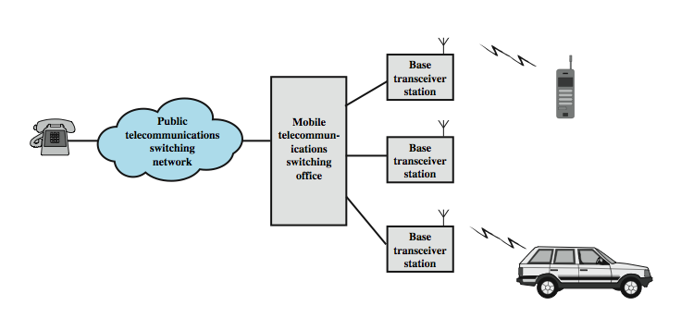
Overview of Cellular System
Notes:
Stallings DCC8e Figure 14.5 shows the principal elements of a cellular system. In the approximate center of each cell is a base station (BS). The BS includes an antenna, a controller, and a number of transceivers, for communicating on the channels assigned to that cell. The controller is used to handle the call process between the mobile unit and the rest of the network. At any time, a number of mobile user units may be active and moving about within a cell, communicating with the BS. Each BS is connected to a mobile telecommunications switching office (MTSO), with one MTSO serving multiple BSs. Typically, the link between an MTSO and a BS is by a wire line, although a wireless link is also possible. The MTSO connects calls between mobile units. The MTSO is also connected to the public telephone or telecommunications network and can make a connection between a fixed subscriber to the public network and a mobile subscriber to the cellular network. The MTSO assigns the voice channel to each call, performs handoffs, and monitors the call for billing information.

Slide 12
Cellular System Channels
system is fully automated
see two types of channels between mobile and base station (BS)
control channels
  set up and maintain calls
  establish relationship between mobile unit and nearest BS
traffic channels
  carry voice and data
Notes:
The use of a cellular system is fully automated and requires no action on the part of the user other than placing or answering a call. Two types of channels are available between the mobile unit and the base station (BS): control channels and traffic channels. Control channels are used to exchange information having to do with setting up and maintaining calls and with establishing a relationship between a mobile unit and the nearest BS. Traffic channels carry a voice or data connection between users.

Slide 13
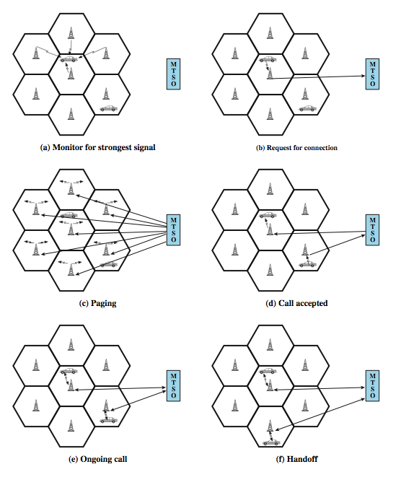
Call Stages
Notes:
Stallings DCC8e Figure 14.6 illustrates the steps in a typical call between two mobile users within an area controlled by a single MTSO:
• Mobile unit initialization: mobile unit scans and selects the strongest setup control channel used for this system (Figure 14.6a). Then a handshake takes place between the mobile unit and the MTSO controlling this cell, through the BS in this cell, to identify the user and register its location.
• Mobile-originated call: A mobile unit originates a call by sending the number of the called unit on the preselected setup channel (Figure 14.6b).
• Paging: The MTSO then attempts to complete the connection to the called unit, sending a paging message to certain BSs depending on the called mobile number (Figure 14.6c).
• Call accepted: The called mobile unit recognizes its number on the setup channel being monitored and responds to that BS, which sends the response to the MTSO. The MTSO sets up a circuit between the calling and called BSs, and also selects an available traffic channel within each BS's cell and notifies each BS, which in turn notifies its mobile unit (Figure 14.6d).
• Ongoing call: While connection is maintained, the mobile units exchange voice or data signals, through respective BSs and MTSO (Figure 14.6e).
• Handoff: If a mobile unit moves out of range of one cell and into the range of another during a connection, the traffic channel has to change to one assigned to the BS in the new cell (Figure 14.6f).

Slide 14
Other Functions
call blocking
  if all traffic channels busy
call termination
  when user hangs up
call drop
  when BS cannot maintain required signal strength
calls to/from fixed and remote mobile subscriber
  MTSO connects mobile user and fixed line via PSTN
  MTSO connects to remote MTSO via PSTN or dedicated lines
Notes:
Other functions performed by the system but not illustrated in Figure 14.6 include:
• Call blocking: During the mobile-initiated call stage, if all the traffic channels assigned to the nearest BS are busy, then the mobile unit makes a preconfigured number of repeated attempts. After a certain number of failed tries, a busy tone is returned to the user.
• Call termination: When one of the two users hangs up, the MTSO is informed and the traffic channels at the two BSs are released.
• Call drop: During a connection, because of interference or weak signal spots in certain areas, if the BS cannot maintain the minimum required signal strength for a certain period of time, the traffic channel to the user is dropped and the MTSO is informed.
• Calls to/from fixed and remote mobile subscriber: The MTSO connects to the public switched telephone network. Thus, the MTSO can set up a connection between a mobile user in its area and a fixed subscriber via the telephone network. Further, the MTSO can connect to a remote MTSO via the telephone network or via dedicated lines and set up a connection between a mobile user in its area and a remote mobile user.

Slide 15
Mobile Radio
Propagation Effects
signal strength
  strength of signal between BS and mobile unit strong enough to maintain signal quality at the receiver
  not too strong to create cochannel interference
  must handle variations in noise
fading
  time variation of received signal
  caused by changes in transmission path(s)
  even if signal strength in effective range, signal propagation effects may disrupt the signal
Notes:
Mobile radio communication introduces complexities not found in wire communication or in fixed wireless communication. Two general areas of concern are signal strength and signal propagation effects.
Signal strength: The strength of the signal between the base station and the mobile unit must be strong enough to maintain signal quality at the receiver but no so strong as to create too much cochannel interference with channels in another cell using the same frequency band. Several complicating factors exist. Human-made noise varies considerably, resulting in a variable noise level. For example, automobile ignition noise in the cellular frequency range is greater in the city than in a suburban area. Other signal sources vary from place to place. The signal strength varies as a function of distance from the BS to a point within its cell. Moreover, the signal strength varies dynamically as the mobile unit moves.
Fading: The term fading refers to the time variation of received signal power caused by changes in the transmission medium or path(s). In a fixed environment, fading is affected by changes in atmospheric conditions, such as rainfall. But in a mobile environment, where one of the two antennas is moving relative to the other, the relative location of various obstacles changes over time, creating complex transmission effects. Even if signal strength is within an effective range, signal propagation effects may disrupt the signal and cause errors.

Slide 16
Design Factors
propagation effects
max transmit power level at BS and mobile units
typical height of mobile unit antenna
available height of the BS antenna
these factors determine size of individual cell
use model based on empirical data
eg. model by Okumura et al & refined by Hata
  detailed analysis of tokyo area
  produced path loss info for an urban environment
  Hata's model is an empirical formulation
Notes:
In designing a cellular layout, the communications engineer must take account of these various propagation effects, the desired maximum transmit power level at the base station and the mobile units, the typical height of the mobile unit antenna, and the available height of the BS antenna. These factors will determine the size of the individual cell. Unfortunately, as just described, the propagation effects are dynamic and difficult to predict. The best that can be done is to come up with a model based on empirical data and to apply that model to a given environment to develop guidelines for cell size. One of the most widely used models was developed by Okumura et al [OKUM68] and subsequently refined by Hata [HATA80]. The original was a detailed analysis of the Tokyo area and produced path loss information for an urban environment. Hata's model is an empirical formulation that takes into account a variety of environments and conditions. See text for more details.

Slide 17
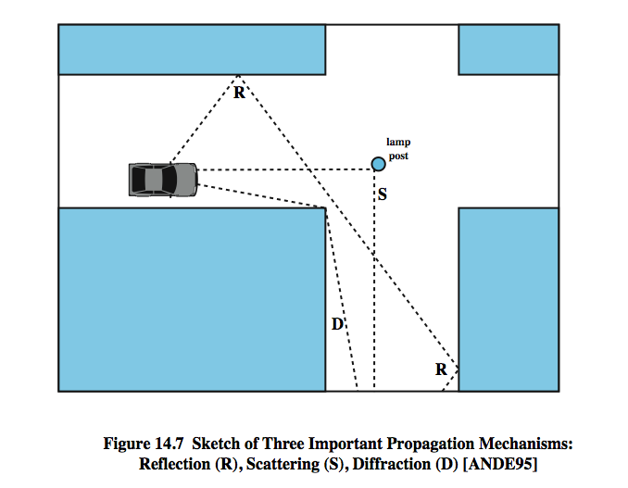
Multipath Propagation
Notes:
Three propagation mechanisms, illustrated in Stallings DCC8e Figure 14.7, play a role. These three propagation effects influence system performance in various ways depending on local conditions and as the mobile unit moves within a cell.
Reflection occurs when an electromagnetic signal encounters a surface that is large relative to the wavelength of the signal. For example, suppose a ground-reflected wave near the mobile unit is received. Because the ground-reflected wave has a 180º phase shift after reflection, the ground wave and the line-of-sight (LOS) wave may tend to cancel, resulting in high signal loss. Further, because the mobile antenna is lower than most human-made structures in the area, multipath interference occurs. These reflected waves may interfere constructively or destructively at the receiver.
Diffraction occurs at the edge of an impenetrable body that is large compared to the wavelength of the radio wave. When a radio wave encounters such an edge, waves propagate in different directions with the edge as the source. Thus, signals can be received even when there is no unobstructed LOS from the transmitter.
If the size of an obstacle is on the order of the wavelength of the signal or less, scattering occurs. An incoming signal is scattered into several weaker outgoing signals. At typical cellular microwave frequencies, there are numerous objects, such as lamp posts and traffic signs, that can cause scattering. Scattering effects are difficult to predict.

Slide 18
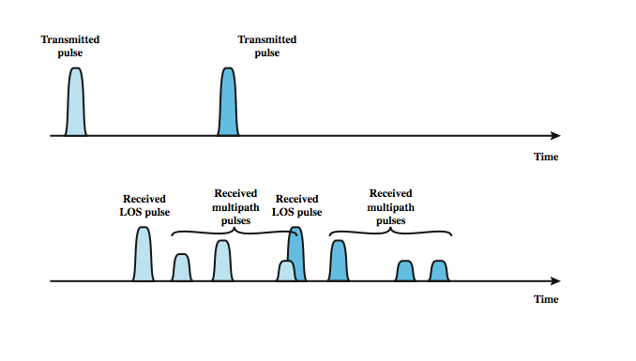
Effects of Multipath Propagation
Notes:
As just noted, one unwanted effect of multipath propagation is that multiple copies of a signal may arrive at different phases. If these phases add destructively, the signal level relative to noise declines, making signal detection at the receiver more difficult. A second phenomenon, of particular importance for digital transmission, is intersymbol interference (ISI). Consider that we are sending a narrow pulse at a given frequency across a link between a fixed antenna and a mobile unit. Stallings DCC8e Figure 14.8 shows what the channel may deliver to the receiver if the impulse is sent at two different times. The upper line shows two pulses at the time of transmission. The lower line shows the resulting pulses at the receiver. In each case the first received pulse is the desired LOS signal. The magnitude of that pulse may change because of changes in atmospheric attenuation. Further, as the mobile unit moves farther away from the fixed antenna, the amount of LOS attenuation increases. But in addition to this primary pulse, there may be multiple secondary pulses due to reflection, diffraction, and scattering. Now suppose that this pulse encodes one or more bits of data. In that case, one or more delayed copies of a pulse may arrive at the same time as the primary pulse for a subsequent bit. These delayed pulses act as a form of noise to the subsequent primary pulse, making recovery of the bit information more difficult. As the mobile antenna moves, the location of various obstacles changes; hence the number, magnitude, and timing of the secondary pulses change. This makes it difficult to design signal processing techniques that will filter out multipath effects so that the intended signal is recovered with fidelity.

Slide 19
Types of Fading
fast fading
  rapid changes in strength over half wavelength distances
    eg. 900MHz wavelength is 0.33m see 20-30dB
slow fading
  slower changes due to user passing different height buildings, gaps in buildings etc.
  over longer distances than fast fading
flat fading
  affects all frequencies in same proportion
selective fading
  different frequency components affected differently
Notes:
Fading effects in a mobile environment can be classified as either fast or slow. Referring to Stallings DCC8e Figure 14.7, as the mobile unit moves down a street in an urban environment, rapid variations in signal strength occur over distances of about one-half a wavelength. At a frequency of 900 MHz, which is typical for mobile cellular applications, a wavelength is 0.33 m. Changes of amplitude can be as much as 20 or 30 dB over a short distance. This type of rapidly changing fading phenomenon, known as fast fading, affects not only mobile phones in automobiles, but even a mobile phone user walking down an urban street. As the mobile user covers distances well in excess of a wavelength, the urban environment changes, as the user passes buildings of different heights, vacant lots, intersections, and so forth. Over these longer distances, there is a change in the average received power level about which the rapid fluctuations occur. This is referred to as slow fading.
Fading effects can also be classified as flat or selective. Flat fading, or nonselective fading, is that type of fading in which all frequency components of the received signal fluctuate in the same proportions simultaneously. Selective fading affects unequally the different spectral components of a radio signal. The term selective fading is usually significant only relative to the bandwidth of the overall communications channel. If attenuation occurs over a portion of the bandwidth of the signal, the fading is considered to be selective; nonselective fading implies that the signal bandwidth of interest is narrower than, and completely covered by, the spectrum affected by the fading.

Slide 20
Error Compensation Mechanisms
forward error correction
  applicable in digital transmission applications
  typically, ratio of total bits to data bits is 2-3
  has a big overhead
adaptive equalization
  applied to transmissions that carry analog or digital information
  used to combat intersymbol interference
  gathering the dispersed symbol energy back together into its original time interval
  techniques include so-called lumped analog circuits and sophisticated digital signal processing algorithms
Notes:
The efforts to compensate for the errors and distortions introduced by multipath fading fall into three general categories: forward error correction, adaptive equalization, and diversity techniques. In the typical mobile wireless environment, techniques from all three categories are combined to combat the error rates encountered.
Forward error correction is applicable in digital transmission applications: those in which the transmitted signal carries digital data or digitized voice or video data. Typically in mobile wireless applications, the ratio of total bits sent to data bits sent is between 2 and 3. This may seem an extravagant amount of overhead, in that the capacity of the system is cut to one-half or one-third of its potential, but the mobile wireless environment is so difficult that such levels of redundancy are necessary. Chapter 6 discusses forward error correction.
Adaptive equalization can be applied to transmissions that carry analog information (e.g., analog voice or video) or digital information (e.g., digital data, digitized voice or video) and is used to combat intersymbol interference. The process of equalization involves some method of gathering the dispersed symbol energy back together into its original time interval. Equalization is a broad topic; techniques include the use of so-called lumped analog circuits as well as sophisticated digital signal processing algorithms.

Slide 21
Error Compensation Mechanisms
diversity
  based on fact that individual channels experience independent fading events
  use multiple logical channels between transmitter and receiver
  send part of signal over each channel
  doesn’t eliminate errors
  reduce error rate
  equalization, forward error correction then cope with reduced error rate
  space diversity involves physical transmission paths
  more commonly refers to frequency or time diversity
Notes:
Diversity is based on the fact that individual channels experience independent fading events. We can therefore compensate for error effects by providing multiple logical channels in some sense between transmitter and receiver and sending part of the signal over each channel. This technique does not eliminate errors but it does reduce the error rate, since we have spread the transmission out to avoid being subjected to the highest error rate that might occur. The other techniques (equalization, forward error correction) can then cope with the reduced error rate.
Some diversity techniques involve the physical transmission path and are referred to as space diversity. For example, multiple nearby antennas may be used to receive the message, with the signals combined in some fashion to reconstruct the most likely transmitted signal. Another example is the use of collocated multiple directional antennas, each oriented to a different reception angle with the incoming signals again combined to reconstitute the transmitted signal. More commonly, the term diversity refers to frequency diversity or time diversity techniques. With frequency diversity, the signal is spread out over a larger frequency bandwidth or carried on multiple frequency carriers.

Slide 22
First Generation Analog
original cellular telephone networks
analog traffic channels
early 1980s in North America
Advanced Mobile Phone Service (AMPS)
also common in South America, Australia, and China
replaced by later generation systems
Notes:
The original cellular telephone networks provided analog traffic channels; these are now referred to as first-generation systems. Since the early 1980s the most common first-generation system in North America has been the Advanced Mobile Phone Service (AMPS) developed by AT&T. This approach is also common in South America, Australia, and China. Although gradually being replaced by second-generation systems, AMPS is still in common use. In this section, we provide an overview of AMPS.

Slide 23
AMPS Spectral Allocation In North America
two 25-MHz bands are allocated to AMPS
  from BS to mobile unit (869–894 MHz)
  from mobile to base station (824–849 MHz)
bands is split in two to encourage competition
operator is allocated only 12.5 MHz in each direction
channels spaced 30 kHz apart (416 channels / operator)
control channels are 10 kbps data channels
voice channels carry analog using frequency modulation
control info also sent on voice channels in bursts as data
number of channels inadequate for most major markets
for AMPS, frequency reuse is exploited
Notes:
In North America, two 25-MHz bands are allocated to AMPS (see Stallings DCC8e Table 14.2), one for transmission from the base station to the mobile unit (869–894 MHz), the other for transmission from the mobile to the base station (824–849 MHz). Each of these bands is split in two to encourage competition (i.e., so that in each market two operators can be accommodated). An operator is allocated only 12.5 MHz in each direction for its system. The channels are spaced 30 kHz apart, which allows a total of 416 channels per operator. Twenty-one channels are allocated for control, leaving 395 to carry calls. The control channels are data channels operating at 10 kbps. The conversation channels carry the conversations in analog using frequency modulation. Control information is also sent on the conversation channels in bursts as data. This number of channels is inadequate for most major markets, so some way must be found either to use less bandwidth per conversation or to reuse frequencies. Both approaches have been taken in the various approaches to mobile telephony. For AMPS, frequency reuse is exploited.

Slide 24
Operation
AMPS-capable phone has numeric assignment module (NAM) in read-only memory
  NAM contains number of phone
  serial number of phone
  when phone turned on, transmits serial number and phone number to MTSO
  MTSO has database of mobile units reported stolen
  MTSO uses phone number for billing
  if phone is used in remote city, service is still billed to user's local service provider
Notes:
Each AMPS-capable cellular telephone includes a numeric assignment module (NAM) in read-only memory. The NAM contains the telephone number of the phone, which is assigned by the service provider, and the serial number of the phone, which is assigned by the manufacturer. When the phone is turned on, it transmits its serial number and phone number to the MTSO (see Stallings DCC8e Figure 14.5); the MTSO maintains a database with information about mobile units that have been reported stolen and uses serial number to lock out stolen units. The MTSO uses the phone number for billing purposes. If the phone is used in a remote city, the service is still billed to the user's local service provider.

Slide 25
AMPS Call Sequence
subscriber initiates call keying in number
MTSO validates telephone number and checks user authorized to place call
MTSO issues message to user's phone indicating traffic channels to use
MTSO sends ringing signal to called party
when called party answers, MTSO establishes circuit and initiates billing information
when one party hangs up MTSO releases circuit, frees radio channels, and completes billing information
Notes:
When a call is placed, the following sequence of events occurs:
1. The subscriber initiates a call by keying in the telephone number of the called party and presses the send key.
2. The MTSO verifies that the telephone number is valid and that the user is authorized to place the call; some service providers require the user to enter a PIN (personal identification number) as well as the called number to counter theft.
3. The MTSO issues a message to the user's cell phone indicating which traffic channels to use for sending and receiving.
4. The MTSO sends out a ringing signal to the called party. All of these operations (steps 2 through 4) occur within 10 s of initiating the call.
5. When the called party answers, the MTSO establishes a circuit between the two parties and initiates billing information.
6. When one party hangs up, the MTSO releases the circuit, frees the radio channels, and completes the billing information.

Slide 26
AMPS Control Channels
21 full-duplex 30-kHz control channels
  transmit digital data using FSK
  data transmitted in frames
control information can be transmitted over voice channel during conversation
  Mmobile unit or the base station inserts burst of data
    turn off voice FM transmission for about 100 ms
    replacing it with an FSK-encoded message
  used to exchange urgent messages
    change power level
    handoff
Notes:
Each AMPS service includes 21 full-duplex 30-kHz control channels, consisting of 21 reverse control channels (RCCs) from subscriber to base station, and 21 forward channels from base station to subscriber. These channels transmit digital data using FSK. In both channels, data are transmitted in frames.
Control information can be transmitted over a voice channel during a conversation. The mobile unit or the base station can insert a burst of data by turning off the voice FM transmission for about 100 ms and replacing it with an FSK-encoded message. These messages are used to exchange urgent messages, such as change power level and handoff.

Slide 27
Second Generation CDMA
provide higher quality signals, higher data rates, support digital services, with overall greater capacity
key differences include
  digital traffic channels
  encryption
  error detection and correction
  channel access
    time division multiple access (TDMA)
    code division multiple access (CDMA)
Notes:
Second-generation systems have been developed to provide higher quality signals, higher data rates for support of digital services, and greater capacity. Some key differences between the two generations are:
• Digital traffic channels: second-generation systems are digital. These readily support digital data; voice traffic is first encoded in digital form before transmitting. Of course, for second-generation systems, the user traffic (data or digitized voice) must be converted to an analog signal for transmission between the mobile unit and the base station
• Encryption: Because all of the user traffic, as well as control traffic, is digitized in second-generation systems, it is a relatively simple matter to encrypt all of the traffic to prevent eavesdropping. All second-generation systems provide this capability.
• Error detection and correction: The digital traffic stream of second-generation systems also lends itself to the use of error detection and correction techniques, giving very clear voice reception.
• Channel access: Second-generation systems also provide multiple channels per cell, but each channel is dynamically shared by a number of users using time division multiple access (TDMA) or code division multiple access (CDMA). We look at CDMA-based systems in this section.

Slide 28
Code Division Multiple Access (CDMA)
have a number of 2nd gen systems
  for example IS-95 using CDMA
each cell allocated frequency bandwidth
is split in two
  half for reverse, half for forward
  uses direct-sequence spread spectrum (DSSS)
Notes:
Beginning around 1990, a number of different second-generation systems have been deployed. A good example is the IS-95 scheme using CDMA. CDMA for cellular systems can be described as follows. As with FDMA, each cell is allocated a frequency bandwidth, which is split into two parts, half for reverse (mobile unit to base station) and half for forward (base station to mobile unit). For full duplex communication, a mobile unit uses both reverse and forward channels. Transmission is in the form of direct-sequence spread spectrum (DS-SS), which uses a chipping code to increase the data rate of the transmission, resulting in an increased signal bandwidth. Multiple access is provided by assigning orthogonal chipping codes (defined in Chapter 9) to multiple users, so that the receiver can recover the transmission of an individual unit from multiple transmissions.

Slide 29
Code Division Multiple Access (CDMA) Advantages
frequency diversity
  noise bursts & fading have less effect
multipath resistance
  chipping codes have low cross & auto correlation
privacy
  inherent in use of spread-spectrum
graceful degradation
  more users means more noise
  leads to slow signal degradation until unacceptable
Notes:
CDMA has a number of advantages for a cellular network:
• Frequency diversity: Because the transmission is spread out over a larger bandwidth, frequency-dependent transmission impairments, such as noise bursts and selective fading, have less effect on the signal.
• Multipath resistance: In addition to the ability of DS-SS to overcome multipath fading by frequency diversity, the chipping codes used for CDMA not only exhibit low cross correlation but also low autocorrelation. Therefore, a version of the signal that is delayed by more than one chip interval does not interfere with the dominant signal as much as in other multipath environments.
• Privacy: Because spread spectrum is obtained by the use of noiselike signals, where each user has a unique code, privacy is inherent.
• Graceful degradation: With FDMA or TDMA, a fixed number of users can access the system simultaneously. However, with CDMA, as more users access the system simultaneously, the noise level and hence the error rate increases; only gradually does the system degrade to the point of an unacceptable error rate.

Slide 30
Code Division Multiple Access (CDMA) Disadvantages
self-jamming
  some cross correlation between users
near-far problem
  signals closer to receiver are received with less attenuation than signals farther away
Notes:
Two drawbacks of CDMA cellular should also be mentioned:
• Self-jamming: Unless all of the mobile users are perfectly synchronized, the arriving transmissions from multiple users will not be perfectly aligned on chip boundaries. Thus the spreading sequences of the different users are not orthogonal and there is some level of cross correlation. This is distinct from either TDMA or FDMA, in which for reasonable time or frequency guardbands, respectively, the received signals are orthogonal or nearly so.
• Near-far problem: Signals closer to the receiver are received with less attenuation than signals farther away. Given the lack of complete orthogonality, the transmissions from the more remote mobile units may be more difficult to recover.

Slide 31
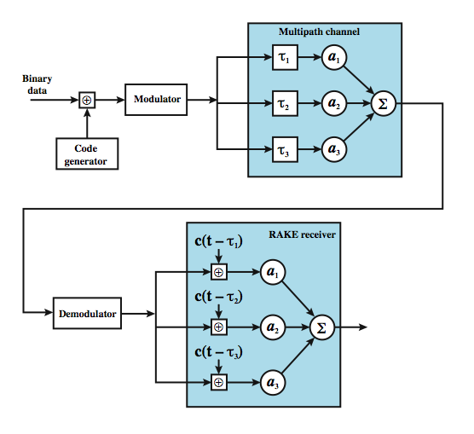
RAKE Receiver
Notes:
In a multipath environment, which is common in cellular systems, if the multiple versions of a signal arrive more than one chip interval apart from each other, the receiver can recover the signal by correlating the chip sequence with the dominant incoming signal. The remaining signals are treated as noise. However, even better performance can be achieved if the receiver attempts to recover the signals from multiple paths and then combine them, with suitable delays. This principle is used in the RAKE receiver.
Stallings DCC8e Figure 14.9 illustrates the principle of the RAKE receiver. The original binary signal to be transmitted is spread by the exclusive-OR (XOR) operation with the transmitter's chipping code. The spread sequence is then modulated for transmission over the wireless channel. Because of multipath effects, the channel generates multiple copies of the signal, each with a different amount of time delay (τ₁, τ₂, etc.), and each with a different attenuation factors (a₁, a₂, etc.). At the receiver, the combined signal is demodulated. The demodulated chip stream is then fed into multiple correlators, each delayed by a different amount. These signals are then combined using weighting factors estimated from the channel.

Slide 32
IS-95
second generation CDMA scheme
primarily deployed in North America
transmission structures different on forward and reverse links
Notes:
The most widely used second-generation CDMA scheme is IS-95, which is primarily deployed in North America. The transmission structures on the forward and reverse links differ and are described separately.

Slide 33
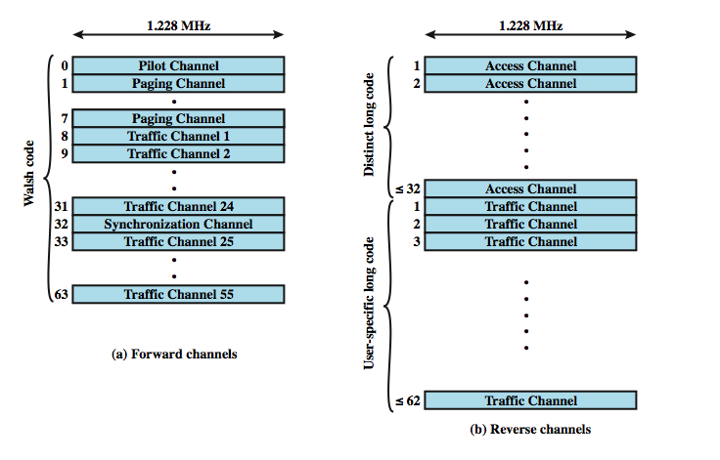
IS-95 Channel Structure
Notes:
The forward link consists of up to 64 logical CDMA channels each occupying the same 1228-kHz bandwidth, as shown in Stallings DCC8e Figure 14.10a.

Slide 34
IS-95 Forward Link
four types of channels
  Pilot (channel 0)
    allows mobile unit to acquire timing information
  Synchronization (channel 32)
    1200-bps channel used by mobile station to obtain identification information about the cellular system
  Paging (channels 1 to 7)
    Contain messages for one or more mobile stations
  Traffic (channels 8 to 31 and 33 to 63)
    55 traffic channels
all channels use same bandwidth
Notes:
The forward link supports four types of channels:
• Pilot (channel 0): A continuous signal on a single channel. This channel allows the mobile unit to acquire timing information, provides phase reference for the demodulation process, and provides a means for signal strength comparison for the purpose of handoff determination. The pilot channel consists of all zeros.
• Synchronization (channel 32): A 1200-bps channel used by the mobile station to obtain identification information about the cellular system (system time, long code state, protocol revision, etc.).
• Paging (channels 1 to 7): Contain messages for one or more mobile stations.
• Traffic (channels 8 to 31 and 33 to 63): The forward channel supports 55 traffic channels. The original specification supported data rates of up to 9600 bps. A subsequent revision added a second set of rates up to 14,400 bps.
Note that all of these channels use the same bandwidth. The chipping code is used to distinguish among the different channels. For the forward channel, the chipping codes are the 64 orthogonal 64-bit codes derived from a 64 × 64 matrix known as the Walsh matrix, as discussed in the text.

Slide 35
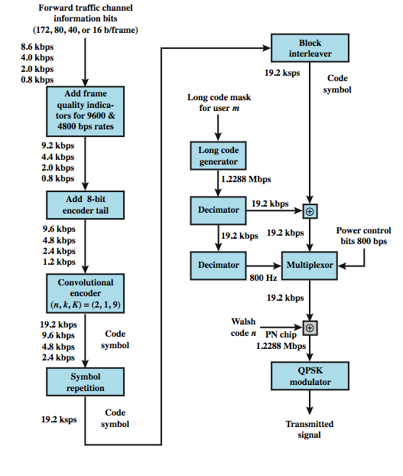
Forward Link Processing
Notes:
Stallings DCC8e Figure 14.11 shows the processing steps for transmission on a forward traffic channel using rate set 1. For voice traffic, the speech is encoded at a data rate of 8550 bps. After additional bits are added for error detection, the rate is 9600 bps. The full channel capacity is not used when the user is not speaking. During quiet periods the data rate is lowered to as low as 1200 bps. The 2400-bps rate is used to transmit transients in the background noise, and the 4800 bps rate is used to mix digitized speech and signaling data.
The data or digitized speech is transmitted in 20-ms blocks with forward error correction provided by a convolutional encoder with rate 1/2, thus doubling the effective data rate to a maximum of 19.2 kbps. For lower data rates, the encoder output bits (called code symbols) are replicated to yield the 19.2-kbps rate. The data are then interleaved in blocks to reduce the effects of errors by spreading them out.

Slide 36
Forward Link - Scrambling
after interleaver, data scrambled
privacy mask
prevent sending of repetitive patterns
  reduces probability of users sending at peak power at same time
scrambling done by long code
  pseudorandom number from 42-bit shift register
  initialized with user's electronic serial number
  output at a rate of 1.2288 Mbps
Notes:
Following the interleaver, the data bits are scrambled. The purpose of this is to serve as a privacy mask and to prevent the sending of repetitive patterns, which in turn reduces the probability of users sending at peak power at the same time. The scrambling is accomplished by means of a long code that is generated as a pseudorandom number from a 42-bit-long shift register. The shift register is initialized with the user's electronic serial number. The output of the long code generator is at a rate of 1.2288 Mbps, which is 64 times the rate of 19.2 kbps, so only one bit in 64 is selected (by the decimator function). The resulting stream is XORed with the output of the block interleaver.

Slide 37
Forward Link - Power Control
inserts power control info in traffic channel
  to control the power output of antenna
  robs traffic channel of bits at rate of 800 bps by stealing code bits
  800-bps channel carries information directing mobile unit to change output level
  power control stream multiplexed to 19.2 kbps
Notes:
The next step in the processing inserts power control information in the traffic channel, to control the power output of the antenna. The power control function of the base station robs the traffic channel of bits at a rate of 800 bps. These are inserted by stealing code bits. The 800-bps channel carries information directing the mobile unit to increment, decrement, or keep stable its current output level. This power control stream is multiplexed into the 19.2 kbps by replacing some of the code bits, using the long code generator to encode the bits.

Slide 38
Forward Link - DSSS
spreads 19.2 kbps to 1.2288 Mbps
using one row of Walsh matrix
  assigned to mobile station during call setup
  if 0 presented to XOR, 64 bits of assigned row sent
  if 1 presented, bitwise XOR of row sent
final bit rate 1.2288 Mbps
bit stream modulated onto carrier using QPSK
  data split into I and Q (in-phase and quadrature) channels
  data in each channel XORed with unique short code
Notes:
The next step in the process is the DS-SS function, which spreads the 19.2 kbps to a rate of 1.2288 Mbps using one row of the 64 × 64 Walsh matrix. One row of the matrix is assigned to a mobile station during call setup. If a 0 bit is presented to the XOR function, then the 64 bits of the assigned row are sent. If a 1 is presented, then the bitwise XOR of the row is sent. Thus, the final bit rate is 1.2288 Mbps. This digital bit stream is then modulated onto the carrier using a QPSK modulation scheme. Recall from Chapter 5 that QPSK involves creating two bit streams that are separately modulated (see Figure 5.11). In the IS-95 scheme, the data are split into I and Q (in-phase and quadrature) channels and the data in each channel are XORed with a unique short code. The short codes are generated as pseudorandom numbers from a 15-bit-long shift register.

Slide 39
IS-95 Reverse Link
up to 94 logical CDMA channels
  each occupying same 1228-kHz bandwidth
  supports up to 32 access and 62 traffic channels
traffic channels are mobile unique
  each station has unique long code mask based on serial number
    42-bit number, 2⁴² – 1 different masks
    access channel used by mobile to initiate call, respond to paging channel message, and for location update
Notes:
The reverse link consists of up to 94 logical CDMA channels each occupying the same 1228-kHz bandwidth, see Stallings DCC8e Figure 14.10b on previous slide. The reverse link supports up to 32 access channels and up to 62 traffic channels. The traffic channels in the reverse link are mobile unique. Each station has a unique long code mask based on its electronic serial number. The long code mask is a 42-bit number, so there are 2⁴² – 1 different masks. The access channel is used by a mobile to initiate a call, to respond to a paging channel message from the base station, and for a location update.

Slide 40
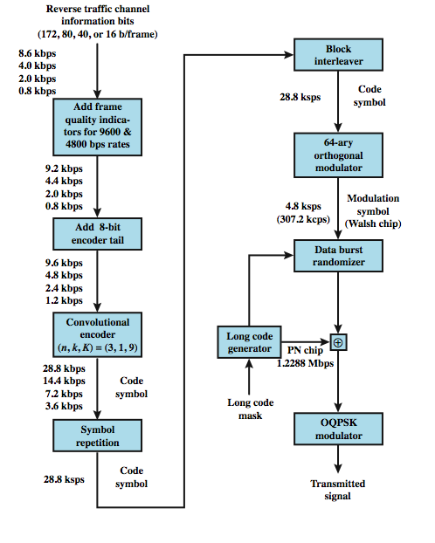
Reverse
Link
Processing
Notes:
Stallings DCC8e Figure 14.12 shows the processing steps for transmission on a reverse traffic channel using rate set 1. The first few steps are the same as for the forward channel. For the reverse channel, the convolutional encoder has a rate of 1/3, thus tripling the effective data rate to a maximum of 28.8 kbps. The data are then block interleaved. The next step is a spreading of the data using the Walsh matrix. The way in which the matrix is used, and its purpose, are different from that of the forward channel. In the reverse channel, the data coming out of the block interleaver are grouped in units of 6 bits. Each 6-bit unit serves as an index to select a row of the 64 × 64 Walsh matrix (2⁶ = 64), and that row is substituted for the input. Thus the data rate is expanded by a factor of 64/6 to 307.2 kbps. The purpose of this encoding is to improve reception at the base station. Because the 64 possible codings are orthogonal, the block coding enhances the decision-making algorithm at the receiver and is also computationally efficient (see [PETE95] for details). We can view this Walsh modulation as a form of block error-correcting code with (n, k) = (64, 6) and d_{min} = 32. In fact, all distances are 32. The data burst randomizer is implemented to help reduce interference from other mobile stations (see [BLAC99b] for a discussion). The operation involves using the long code mask to smooth the data out over each 20-ms frame.

Slide 41
Reverse Link - DSSS
long code unique to mobile XORed with output of randomizer
1.2288-Mbps final data stream
modulated using orthogonal QPSK modulation
differs from forward channel in use of delay element in modulator to produce orthogonality
  forward channel, spreading codes orthogonal
  reverse channel orthogonality of spreading codes not guaranteed
Notes:
The next step in the process is the DS-SS function. In the case of the reverse channel, the long code unique to the mobile is XORed with the output of the randomizer to produce the 1.2288-Mbps final data stream. This digital bit stream is then modulated onto the carrier using an offset QPSK modulation scheme. This differs from the forward channel in the use of a delay element in the modulator (Figure 5.11) to produce orthogonality. The reason the modulators are different is that in the forward channel, the spreading codes are orthogonal, all coming from the Walsh matrix, whereas in the reverse channel, orthogonality of the spreading codes is not guaranteed.

Slide 42
Third Generation Systems
high-speed wireless communications to support multimedia, data, and video in addition to voice
3G capabilities:
    voice quality comparable to PSTN
    144 kbps available to users over large areas
    384 kbps available to pedestrians over small areas
    support for 2.048 Mbps for office use
    symmetrical and asymmetrical data rates
    packet-switched and circuit-switched services
    adaptive interface to Internet
    more efficient use of available spectrum
    support for variety of mobile equipment
    allow introduction of new services and technologies
Notes:
The objective of the third generation (3G) of wireless communication is to provide fairly high-speed wireless communications to support multimedia, data, and video in addition to voice. The ITU’s International Mobile Telecommunications for the year 2000 (IMT-2000) initiative has defined the ITU’s view of third-generation capabilities as:
• Voice quality comparable to the public switched telephone network
• 144 kbps data rate available to users in high-speed motor vehicles over large areas
• 384 kbps available to pedestrians standing or moving slowly over small areas
• Support (to be phased in) for 2.048 Mbps for office use
• Symmetrical and asymmetrical data transmission rates
• Support for both packet-switched and circuit-switched data services
• An adaptive interface to the Internet to reflect efficiently the common asymmetry between inbound and outbound traffic
• More efficient use of the available spectrum in general
• Support for a wide variety of mobile equipment
• Flexibility to allow the introduction of new services and technologies

Slide 43
Driving Forces
trend toward universal personal telecommunications
universal communications access
GSM cellular telephony with subscriber identity module, is step towards goals
personal communications services (PCSs) and personal communication networks (PCNs) also form objectives for third-generation wireless
technology is digital using time division multiple access or code-division multiple access
PCS handsets low power, small and light
Notes:
More generally, one of the driving forces of modern communication technology is the trend toward universal personal telecommunications and universal communications access. The first concept refers to the ability of a person to identify himself or herself easily and use conveniently any communication system in an entire country, over a continent, or even globally, in terms of a single account. The second refers to the capability of using one’s terminal in a wide variety of environments to connect to information services (e.g., to have a portable terminal that will work in the office, on the street, and on airplanes equally well). This revolution in personal computing will obviously involve wireless communication in a fundamental way.
Personal communications services (PCSs) and personal communication networks (PCNs) are names attached to these concepts of global wireless communications, and they also form objectives for third-generation wireless. Generally, the technology planned is digital using time division multiple access or code division multiple access to provide efficient use of the spectrum and high capacity. PCS handsets are designed to be low power and relatively small and light. Efforts are being made internationally to allow the same terminals to be used worldwide.

Slide 44
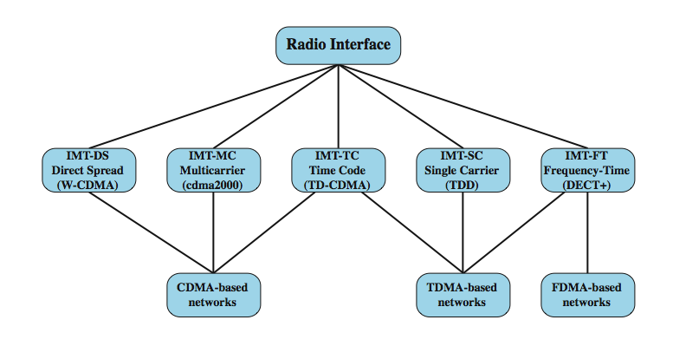
IMT-2000 Terrestrial Radio Alternative Interfaces
Notes:
Stallings DCC8e Figure 14.13 shows the alternative schemes that have been adopted as part of IMT-2000. The specification covers a set of radio interfaces for optimized performance in different radio environments. A major reason for the inclusion of five alternatives was to enable a smooth evolution from existing first- and second-generation systems, and reflect the evolution from the second generation. Two of the specifications grow out of the work at the European Telecommunications Standards Institute (ETSI) to develop a UMTS (universal mobile telecommunications system) as Europe's 3G wireless standard. UMTS includes two standards. One of these is known as wideband CDMA, or W-CDMA. This scheme fully exploits CDMA technology to provide high data rates with efficient use of bandwidth. The other European effort under UMTS is known as IMT-TC, or TD-CDMA. This approach is a combination of W-CDMA and TDMA technology. IMT-TC is intended to provide an upgrade path for the TDMA-based GSM systems. Another CDMA-based system, known as cdma2000, has a North American origin. This scheme is similar to, but incompatible with, W-CDMA, in part because the standards use different chip rates. Also, cdma2000 uses a technique known as multicarrier, not used with W-CDMA. Two other interface specifications are shown in Figure 14.13. IMT-SC is primarily designed for TDMA-only networks. IMT-FT can be used by both TDMA and FDMA carriers to provide some 3G services; it is an outgrowth of the Digital European Cordless Telecommunications (DECT) standard.

Slide 45
CDMA Design Considerations – Bandwidth and Chip Rate
dominant technology for 3G systems is CDMA
  3 CDMA schemes, share some design issues
bandwidth (limit channel to 5 MHz)
  5 MHz reasonable upper limit on what can be allocated for 3G
  5 MHz is enough for data rates of 144 and 384 kHz
chip rate
  given bandwidth, chip rate depends on desired data rate, need for error control, and bandwidth limitations
  chip rate of 3 Mbps or more reasonable
Notes:
The dominant technology for 3G systems is CDMA. Although three different CDMA schemes have been adopted, they share some common design issues, such as:
• Bandwidth: An important design goal for all 3G systems is to limit channel usage to 5 MHz. There are several reasons for this goal. On the one hand, a bandwidth of 5 MHz or more improves the receiver's ability to resolve multipath when compared to narrower bandwidths. On the other hand, available spectrum is limited by competing needs, and 5 MHz is a reasonable upper limit on what can be allocated for 3G. Finally, 5 MHz is adequate for supporting data rates of 144 and 384 kHz, the main targets for 3G services.
• Chip rate: Given the bandwidth, the chip rate depends on desired data rate, the need for error control, and bandwidth limitations. A chip rate of 3 Mbps or more is reasonable given these design parameters.

Slide 46
CDMA Design Considerations – Multirate
provision of multiple fixed-data-rate channels to user
different data rates provided on different logical channels
logical channel traffic can be switched independently through wireless fixed networks to different destinations
flexibly support multiple simultaneous applications
efficiently use available capacity by only providing the capacity required for each service
use TDMA within single CDMA channel
or use multiple CDMA codes
Notes:
The term multirate refers to the provision of multiple fixed-data-rate logical channels to a given user, in which different data rates are provided on different logical channels. Further, the traffic on each logical channel can be switched independently through the wireless and fixed networks to different destinations. The advantage of multirate is that the system can flexibly support multiple simultaneous applications from a given user and can efficiently use available capacity by only providing the capacity required for each service. Multirate can be achieved with a TDMA scheme within a single CDMA channel, in which a different number of slots per frame are assigned to achieve different data rates. All the subchannels at a given data rate would be protected by error correction and interleaving techniques (Stallings DCC8e Figure 14.14a). An alternative is to use multiple CDMA codes, with separate coding and interleaving, and map them to separate CDMA channels (Figure 14.14b).

Slide 47
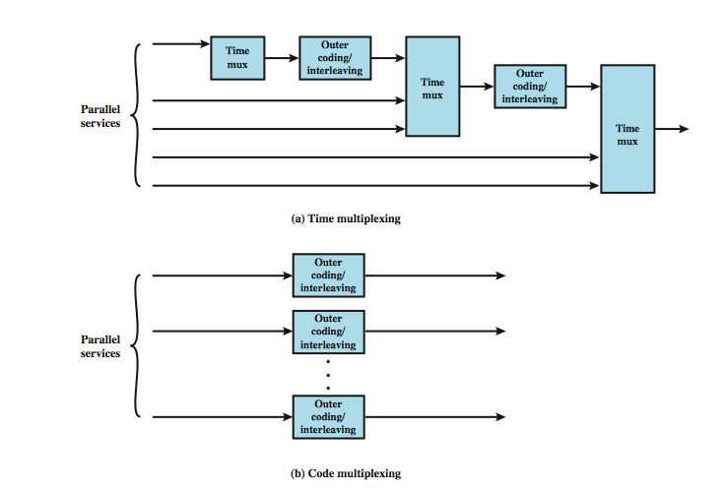
CDMA Multirate
Time and Code Multiplexing
Notes:
All the subchannels at a given data rate would be protected by error correction and interleaving techniques as shown here in Stallings DCC8e Figure 14.14a. An alternative is to use multiple CDMA codes, with separate coding and interleaving, and map them to separate CDMA channels, see Figure 14.14b.

Slide 48
Summary
principles of wireless cellular networks
operation of wireless cellular networks
first-generation analog
second-generation CDMA
third-generation systems
Notes:
Chapter14 summary.

