Slide 1
Data and Computer Communications
Chapter 15 – Local Area Network Overview
Eighth Edition
by William Stallings
Lecture slides by Lawrie Brown
Notes:
Lecture slides prepared by Dr Lawrie Brown (UNSW@ADFA) for “Data and Computer Communications”, 8/e, by William Stallings, Chapter 15 “Local Area Network Overview”.

Slide 2
Local Area Network Overview
The whole of this operation is described in minute detail in the official British Naval History, and should be studied with its excellent charts by those who are interested in its technical aspect. So complicated is the full story that the lay reader cannot see the wood for the trees. I have endeavored to render intelligible the broad effects.
—The World Crisis, Winston Churchill
Notes:
This quote is from the start of Stallings DCC8e 15.

Slide 3
LAN Applications (1)
personal computer LANs
  low cost
  limited data rate
back end networks
  interconnecting large systems (mainframes and large storage devices)
    high data rate
    high speed interface
    distributed access
    limited distance
    limited number of devices
Notes:
We turn now to a discussion of local area networks (LANs). The variety of applications for LANs is wide. To provide some insight into the types of requirements that LANs are intended to meet, this section provides a brief discussion of some of the most important general application areas for these networks.
A common LAN configuration is one that supports personal computers. LANs for the support of personal computers and workstations have become nearly universal in organizations of all sizes. Even those sites that still depend heavily on the mainframe have transferred much of the processing load to networks of personal computers. Perhaps the prime example of the way in which personal computers are being used is to implement client/server applications. For personal computer networks, a key requirement is low cost. In particular, the cost of attachment to the network must be significantly less than the cost of the attached device. Thus, for the ordinary personal computer, an attachment cost in the hundreds of dollars is desirable. For more expensive, high-performance workstations, higher attachment costs can be tolerated.
Backend networks are used to interconnect large systems such as mainframes, supercomputers, and mass storage devices. The key requirement here is for bulk data transfer among a limited number of devices in a small area. High reliability is generally also a requirement. Typical characteristics include: High data rates, High-speed interface, Distributed access, Limited distance, and Limited number of devices.

Slide 4
LAN Applications (2)
storage area networks (SANs)
  separate network handling storage needs
  detaches storage tasks from specific servers
  shared storage facility
    eg. hard disks, tape libraries, CD arrays
  accessed using a high-speed network
    eg. Fibre Channel
  improved client-server storage access
  direct storage to storage communication for backup
Notes:
A concept related to that of the backend network is the storage area network (SAN). A SAN is a separate network to handle storage needs. The SAN detaches storage tasks from specific servers and creates a shared storage facility across a high-speed network. The collection of networked storage devices can include hard disks, tape libraries, and CD arrays. Most SANs use Fibre Channel, which is described in Chapter 16. In a SAN, no server sits between the storage devices and the network; instead, the storage devices and servers are linked directly to the network. The SAN arrangement improves client-to-storage access efficiency, as well as direct storage-to-storage communications for backup and replication functions.

Slide 5
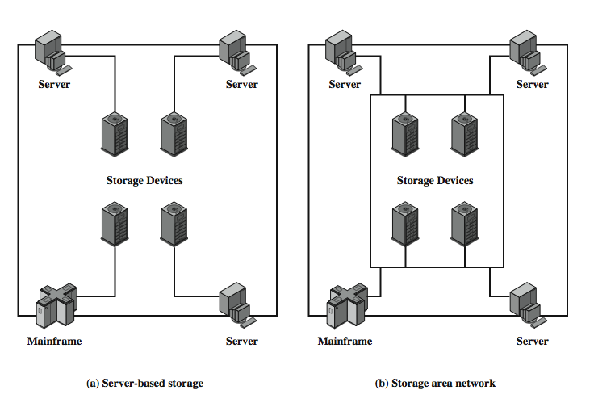
Storage Area Networks
Notes:
Stallings DCC8e Figure 15.1 contrasts the SAN with the traditional server-based means of supporting shared storage. In a typical large LAN installation, a number of servers and perhaps mainframes each has its own dedicated storage devices. If a client needs access to a particular storage device, it must go through the server that controls that device. In a SAN, no server sits between the storage devices and the network; instead, the storage devices and servers are linked directly to the network.

Slide 6
LAN Applications (3)
high speed office networks
  desktop image processing
  high capacity local storage
backbone LANs
  interconnect low speed local LANs
  reliability
  capacity
  cost
Notes:
Traditionally, the office environment has included a variety of devices with low- to medium-speed data transfer requirements. However, applications in today's office environment would overwhelm the limited speeds (up to 10 Mbps) of traditional LAN. Desktop image processors have increased network data flow by an unprecedented amount. Examples of these applications include fax machines, document image processors, and graphics programs on personal computers and workstations. In addition, disk technology and price/performance have evolved so that desktop storage capacities of multiple gigabytes are common. These new demands require LANs with high speed that can support the larger numbers and greater geographic extent of office systems as compared to backend systems.
The increasing use of distributed processing applications and personal computers has led to a need for a flexible strategy for local networking. Support of premises-wide data communications requires a networking service that is capable of spanning the distances involved and that interconnects equipment in a single (perhaps large) building or a cluster of buildings. Although it is possible to develop a single LAN to interconnect all the data processing equipment of a premises, this is probably not a practical alternative in most cases. A more attractive alternative is to employ lower-cost, lower-capacity LANs within buildings or departments and to interconnect these networks with a higher-capacity LAN. This latter network is referred to as a backbone LAN. If confined to a single building or cluster of buildings, a high-capacity LAN can perform the backbone function.

Slide 7
LAN Architecture
topologies
transmission medium
layout
medium access control
Notes:
The key elements of a LAN are listed on the slide. Together, these elements determine not only the cost and capacity of the LAN, but also the type of data that may be transmitted, the speed and efficiency of communications, and even the kinds of applications that can be supported.
This section provides a survey of the major technologies in the first two of these categories. It will be seen that there is an interdependence among the choices in different categories. Accordingly, a discussion of pros and cons relative to specific applications is best done by looking at preferred combinations. This, in turn, is best done in the context of standards, which is

Slide 8
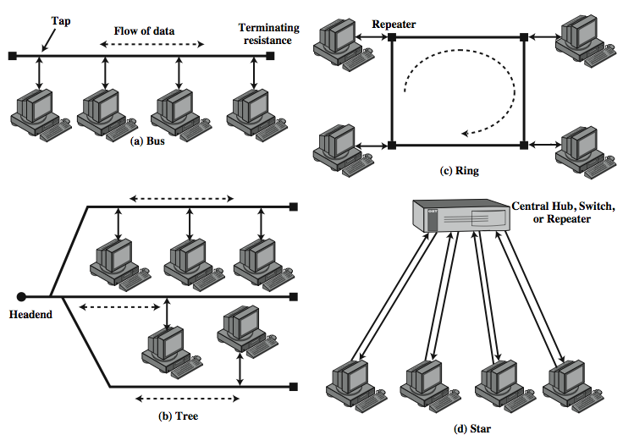
LAN Topologies
Notes:
In the context of a communication network, the term topology refers to the way in which the end points, or stations, attached to the network are interconnected. The common topologies for LANs are shown in Stallings DCC8e Figure 15.2 and include: bus, tree, ring, and star. The bus is a special case of the tree, with only one trunk and no branches.

Slide 9
Bus and Tree
used with multipoint medium
transmission propagates throughout medium
heard by all stations
full duplex connection between station and tap
  allows for transmission and reception
need to regulate transmission
  to avoid collisions and hogging
terminator absorbs frames at end of medium
tree a generalization of bus
headend connected to branching cables
Notes:
Both bus and tree topologies are characterized by the use of a multipoint medium. For the bus, all stations attach, through appropriate hardware interfacing known as a tap, directly to a linear transmission medium, or bus. Full-duplex operation between the station and the tap allows data to be transmitted onto the bus and received from the bus. A transmission from any station propagates the length of the medium in both directions and can be received by all other stations. At each end of the bus is a terminator, which absorbs any signal, removing it from the bus.
The tree topology is a generalization of the bus topology. The transmission medium is a branching cable with no closed loops. The tree layout begins at a point known as the headend. One or more cables start at the headend, and each of these may have branches. The branches in turn may have additional branches to allow quite complex layouts. Again, a transmission from any station propagates throughout the medium and can be received by all other stations.

Slide 10
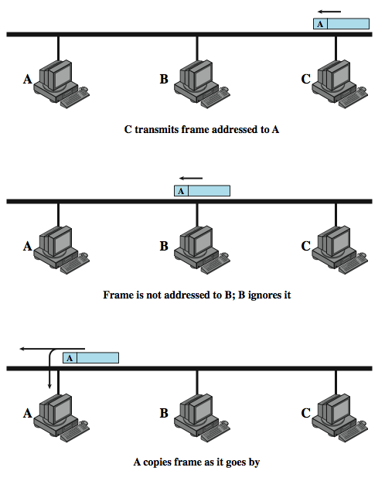
Frame
Transmission on Bus LAN
Notes:
Two problems present themselves in these topologies. First, because a transmission from any one station can be received by all other stations, there needs to be some way of indicating for whom the transmission is intended. Second, a mechanism is needed to regulate transmission. To solve these problems, stations transmit data in small blocks, known as frames. Each frame consists of a portion of the data that a station wishes to transmit, plus a frame header that contains control information. Each station on the bus is assigned a unique address, or identifier, and the destination address for a frame is included in its header.
Stallings DCC8e Figure 15.3 illustrates the scheme. In this example, station C wishes to transmit a frame of data to A. The frame header includes A's address. As the frame propagates along the bus, it passes B. B observes the address and ignores the frame. A, on the other hand, sees that the frame is addressed to itself and therefore copies the data from the frame as it goes by. The use of frames also provides the basic tool for solving the second problem, the regulation of access. In particular, the stations take turns sending frames in some cooperative fashion. This involves putting additional control information into the frame header.

Slide 11
Ring Topology
a closed loop of repeaters joined by point to point links
receive data on one link & retransmit on another
  links unidirectional
  stations attach to repeaters
data in frames
  circulate past all stations
  destination recognizes address and copies frame
  frame circulates back to source where it is removed
media access control determines when a station can insert frame
Notes:
In the ring topology, the network consists of a set of repeaters joined by point-to-point links in a closed loop. The repeater is a comparatively simple device, capable of receiving data on one link and transmitting them, bit by bit, on the other link as fast as they are received. The links are unidirectional; that is, data are transmitted in one direction only, so that data circulate around the ring in one direction (clockwise or counterclockwise). Each station attaches to the network at a repeater and can transmit data onto the network through the repeater. As with the bus and tree, data are transmitted in frames. Because multiple stations share the ring, medium access control is needed to determine at what time each station may insert frames.

Slide 12
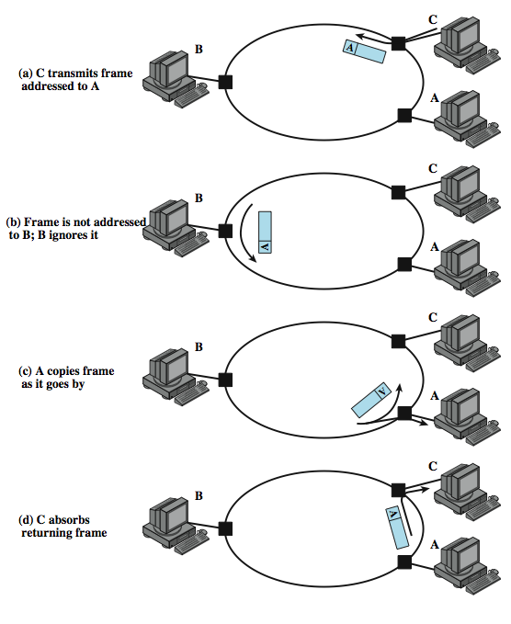
Frame
Transmission
Ring LAN
Notes:
Stallings DCC8e Figure 15.4 illustrates how a frame continues to circulate until it returns to the source station, where it is removed .

Slide 13
Star Topology
each station connects to central node
  usually via two point to point links
either central node can broadcast
  physical star, logical bus
  only one station can transmit at a time
or central node can act as frame switch
Notes:
In the star LAN topology, each station is directly connected to a common central node. Typically, each station attaches to a central node via two point-to-point links, one for transmission and one for reception. In general, there are two alternatives for the operation of the central node. One approach is for the central node to operate in a broadcast fashion. A transmission of a frame from one station to the node is retransmitted on all of the outgoing links. In this case, although the arrangement is physically a star, it is logically a bus: A transmission from any station is received by all other stations, and only one station at a time may successfully transmit. In this case, the central element is referred to as a hub. Another approach is for the central node to act as a frame-switching device. An incoming frame is buffered in the node and then retransmitted on an outgoing link to the destination station.

Slide 14
Choice of Topology
reliability
expandability
performance
needs considering in context of:
  medium
  wiring layout
  access control
Notes:
The choice of topology depends on a variety of factors, including reliability, expandability, and performance. This choice is part of the overall task of designing a LAN and thus cannot be made in isolation, independent of the choice of transmission medium, wiring layout, and access control technique.

Slide 15
Bus LAN
Transmission Media (1)
twisted pair
  early LANs used voice grade cable
  didn’t scale for fast LANs
  not used in bus LANs now
baseband coaxial cable
  uses digital signalling
  original Ethernet
Notes:
There are four alternative media that can be used for a bus LAN:
• Twisted pair: In the early days of LAN development, voice-grade twisted pair was used to provide an inexpensive, easily installed bus LAN. A number of systems operating at 1 Mbps were implemented. Scaling twisted pair up to higher data rates in a shared-medium bus configuration is not practical, so this approach was dropped long ago.
• Baseband coaxial cable: A baseband coaxial cable is one that makes use of digital signaling. The original Ethernet scheme makes use of baseband coaxial cable.

Slide 16
Bus LAN
Transmission Media (2)
broadband coaxial cable
  as in cable TV systems
  analog signals at radio frequencies
  expensive, hard to install and maintain
  no longer used in LANs
optical fiber
  expensive taps
  better alternatives available
  not used in bus LANs
less convenient compared to star topology twisted pair
coaxial baseband still used but not often in new installations
Notes:
The other alternative media that can be used for a bus LAN are:
• Broadband coaxial cable: Broadband coaxial cable is the type of cable used in cable television systems. Analog signaling is used at radio and television frequencies. This type of system is more expensive and more difficult to install and maintain than baseband coaxial cable. This approach never achieved popularity and such LANs are no longer made.
• Optical fiber: There has been considerable research relating to this alternative over the years, but the expense of the optical fiber taps and the availability of better alternatives have resulted in the demise of this option as well.
For a bus topology, only baseband coaxial cable has achieved widespread use, primarily for Ethernet systems. Compared to a star-topology twisted pair or optical fiber installation, the bus topology using baseband coaxial cable is difficult to work with. Even simple changes may require access to the coaxial cable, movement of taps, and rerouting of cable segments. Accordingly, few if any new installations are being attempted. Despite its limitations, there is a considerable installed base of baseband coaxial cable bus LANs.

Slide 17
Ring and Star Usage
ring
  very high speed links over long distances
  single link or repeater failure disables network
star
  uses natural layout of wiring in building
  best for short distances
  high data rates for small number of devices
Notes:
Very-high-speed links over considerable distances can be used for the ring topology. Hence, the ring has the potential of providing the best throughput of any topology. One disadvantage of the ring is that a single link or repeater failure could disable the entire network.
The star topology takes advantage of the natural layout of wiring in a building. It is generally best for short distances and can support a small number of devices at high data rates.

Slide 18
Choice of Medium
constrained by LAN topology
capacity
reliability
types of data supported
environmental scope
Notes:
The choice of transmission medium is determined by a number of factors. It is, we shall see, constrained by the topology of the LAN. Other factors come into play, including
• Capacity: to support the expected network traffic
• Reliability: to meet requirements for availability
• Types of data supported: tailored to the application
• Environmental scope: to provide service over the range of environments required
The choice is part of the overall task of designing a local network, which is addressed in Chapter 16. Here we can make a few general observations.

Slide 19
Media Available
Voice grade unshielded twisted pair (UTP)
  Cat 3 phone, cheap, low data rates
Shielded twisted pair / baseband coaxial
  more expensive, higher data rates
Broadband cable
  even more expensive, higher data rate
High performance UTP
  Cat 5+, very high data rates, switched star topology
Optical fibre
  security, high capacity, small size, high cost
Notes:
Voice-grade unshielded twisted pair (Cat-3 UTP) is an inexpensive, well-understood medium. Typically, office buildings are wired to meet the anticipated telephone system demand plus a healthy margin; thus, there are no cable installation costs. However, the data rate that can be supported is generally quite limited, with the exception of very small LAN. Category 3 UTP is likely to be the most cost-effective for a single-building, low-traffic LAN installation.
Shielded twisted pair and baseband coaxial cable are more expensive than Category 3 UTP but provide greater capacity. Broadband cable is even more expensive but provides even greater capacity. However, in recent years, the trend has been toward the use of high-performance UTP, especially Category 5 UTP. Category 5 UTP supports high data rates for a small number of devices, but larger installations can be supported by the use of the star topology and the interconnection of the switching elements in multiple star-topology configurations.
Optical fiber has a number of attractive features, such as electromagnetic isolation, high capacity, and small size, which have attracted a great deal of interest. As yet the market penetration of fiber LANs is low; this is primarily due to the high cost of fiber components and the lack of skilled personnel to install and maintain fiber systems. This situation is beginning to change rapidly as more products using fiber are introduced.

Slide 20
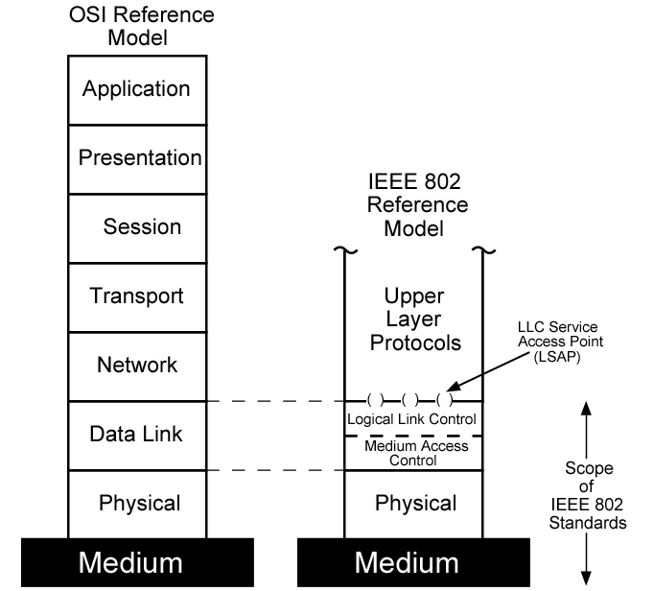
LAN Protocol Architecture
Notes:
The architecture of a LAN is best described in terms of a layering of protocols that organize the basic functions of a LAN. These include physical, medium access control (MAC), and logical link control (LLC) layers. Protocols defined specifically for LAN and MAN transmission address issues relating to the transmission of blocks of data over the network. In OSI terms, a discussion of LAN protocols is concerned principally with lower layers of the OSI model.
Stallings DCC8e Figure 15.5 relates the LAN protocols to the OSI architecture (see Stallings DCC8e Figure 2.6). This architecture was developed by the IEEE 802 LAN standards committee and has been adopted by all organizations working on the specification of LAN standards. It is generally referred to as the IEEE 802 reference model.

Slide 21
IEEE 802 Layers (1)
Physical
  encoding/decoding of signals
  preamble generation/removal
  bit transmission/reception
  transmission medium and topology
Notes:
Working from the bottom up, the lowest layer of the IEEE 802 reference model corresponds to the physical layer of the OSI model and includes such functions as:
• Encoding/decoding of signals
• Preamble generation/removal (for synchronization)
• Bit transmission/reception
In addition, the physical layer of the 802 model includes a specification of the transmission medium and the topology. Generally, this is considered "below" the lowest layer of the OSI model. However, the choice of transmission medium and topology is critical in LAN design, and so a specification of the medium is included.

Slide 22
IEEE 802 Layers (2)
Logical Link Control
  interface to higher levels
  flow and error control
Media Access Control
  on transmit assemble data into frame
  on receive disassemble frame
  govern access to transmission medium
  for same LLC, may have several MAC options
Notes:
Above the physical layer are the functions associated with providing service to LAN users. These include
• On transmission, assemble data into a frame with address and error-detection fields.
• On reception, disassemble frame, and perform address recognition and error detection.
• Govern access to the LAN transmission medium.
• Provide an interface to higher layers and perform flow and error control.
These are functions typically associated with OSI layer 2. The set of functions in the last bullet item are grouped into a logical link control (LLC) layer. The functions in the first three bullet items are treated as a separate layer, called medium access control (MAC). The separation is done for the following reasons:
• The logic required to manage access to a shared-access medium is not found in traditional layer 2 data link control.
For the same LLC, several MAC options may be provided.

Slide 23
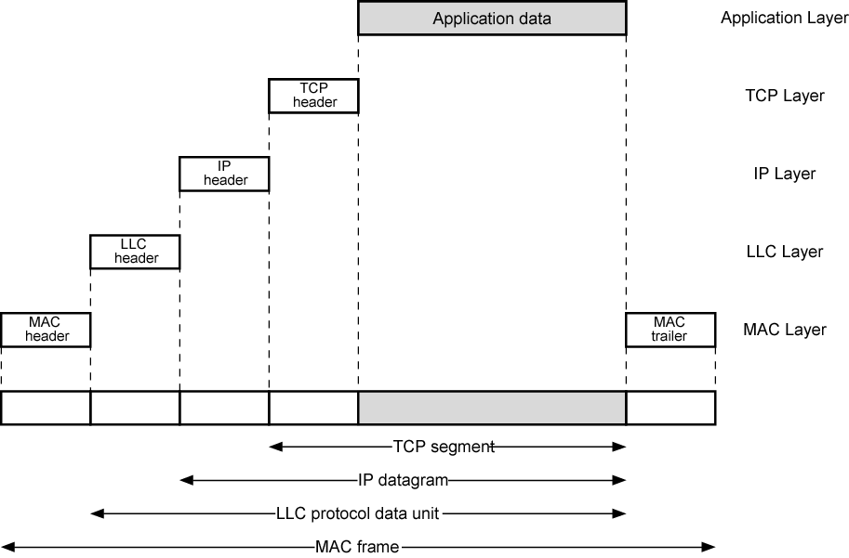
LAN Protocols in Context
Notes:
Stallings DCC8e Figure 15.6 illustrates the relationship between the levels of the architecture (compare Figure 2.2). Higher-level data are passed down to LLC, which appends control information as a header, creating an LLC protocol data unit (PDU). This control information is used in the operation of the LLC protocol. The entire LLC PDU is then passed down to the MAC layer, which appends control information at the front and back of the packet, forming a MAC frame. Again, the control information in the frame is needed for the operation of the MAC protocol. For context, the figure also shows the use of TCP/IP and an application layer above the LAN protocols.

Slide 24
Logical Link Control
transmission of link level PDUs between stations
must support multiaccess, shared medium
but MAC layer handles link access details
addressing involves specifying source and destination LLC users
  referred to as service access points (SAP)
  typically higher level protocol
Notes:
The LLC layer for LANs is similar in many respects to other link layers in common use. Like all link layers, LLC is concerned with the transmission of a link-level PDU between two stations, without the necessity of an intermediate switching node. LLC has two characteristics not shared by most other link control protocols:
1. It must support the multiaccess, shared-medium nature of the link (this differs from a multidrop line in that there is no primary node).
2. It is relieved of some details of link access by the MAC layer.
Addressing in LLC involves specifying the source and destination LLC users. Typically, a user is a higher-layer protocol or a network management function in the station. These LLC user addresses are referred to as service access points (SAPs), in keeping with OSI terminology for the user of a protocol layer.

Slide 25
LLC Services
based on HDLC
unacknowledged connectionless service
connection mode service
acknowledged connectionless service
Notes:
LLC specifies the mechanisms for addressing stations across the medium and for controlling the exchange of data between two users. The operation and format of this standard is based on HDLC. Three services are provided as alternatives for attached devices using LLC:
• Unacknowledged connectionless service: This service is a datagram-style service. It is a very simple service that does not involve any of the flow- and error-control mechanisms. Thus, the delivery of data is not guaranteed. However, in most devices, there will be some higher layer of software that deals with reliability issues.
• Connection-mode service: This service is similar to that offered by HDLC. A logical connection is set up between two users exchanging data, and flow control and error control are provided.
• Acknowledged connectionless service: This is a cross between the previous two services. It provides that datagrams are to be acknowledged, but no prior logical connection is set up.

Slide 26
LLC Protocol
modeled after HDLC
asynchronous balanced mode
  connection mode (type 2) LLC service
unacknowledged connectionless service
  using unnumbered information PDUs (type 1)
acknowledged connectionless service
  using 2 new unnumbered PDUs (type 3)
permits multiplexing using LSAPs
Notes:
The basic LLC protocol is modeled after HDLC and has similar functions and formats. The differences between the two protocols can be summarized as follows:
• LLC makes use of the asynchronous balanced mode of operation of HDLC, to support connection-mode LLC service; this is referred to as type 2 operation. The other HDLC modes are not employed.
• LLC supports an unacknowledged connectionless service using the unnumbered information PDU; this is known as type 1 operation.
• LLC supports an acknowledged connectionless service by using two new unnumbered PDUs; this is known as type 3 operation.
• LLC permits multiplexing by the use of LLC service access points (LSAPs).

Slide 27
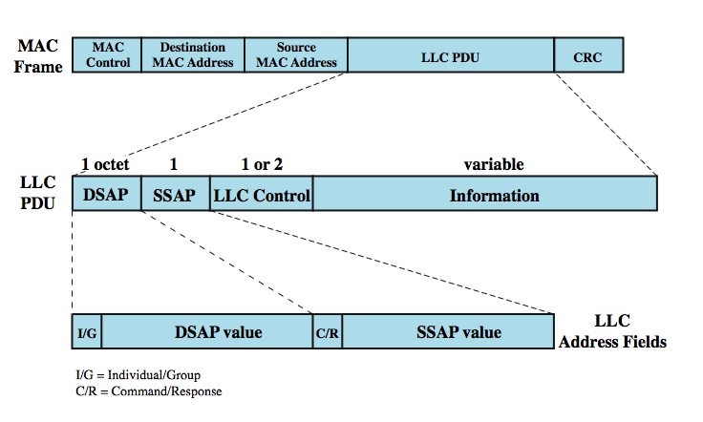
MAC Frame Format
Notes:
All three LLC protocols employ the same PDU format (Stallings DCC8e Figure 15.7), which consists of four fields. The DSAP (Destination Service Access Point) and SSAP (Source Service Access Point) fields each contain a 7-bit address, which specify the destination and source users of LLC. One bit of the DSAP indicates whether the DSAP is an individual or group address. One bit of the SSAP indicates whether the PDU is a command or response PDU. The format of the LLC control field is identical to that of HDLC (Figure 7.7), using extended (7-bit) sequence numbers.
For type 1 operation, which supports the unacknowledged connectionless service, the unnumbered information (UI) PDU is used to transfer user data. There is no acknowledgment, flow control, or error control. With type 2 operation, a data link connection is established between two LLC SAPs prior to data exchange. Connection establishment is attempted by the type 2 protocol in response to a request from a user. Once the connection is established, data are exchanged using information PDUs, as in HDLC. The information PDUs include send and receive sequence numbers, for sequencing and flow control. The supervisory PDUs are used, as in HDLC, for flow control and error control. Either LLC entity can terminate a logical LLC connection by issuing a disconnect (DISC) PDU. With type 3 operation, each transmitted PDU is acknowledged. A new (not found in HDLC) unnumbered PDU, the Acknowledged Connectionless (AC) Information PDU, is defined. User data are sent in AC command PDUs and must be acknowledged using an AC response PDU.

Slide 28
Media Access Control
where
  central
    greater control, single point of failure
  distributed
    more complex, but more redundant
how
  synchronous
    capacity dedicated to connection, not optimal
  asynchronous
    in response to demand
Notes:
All LANs and MANs consist of collections of devices that must share the network's transmission capacity. Some means of controlling access to the transmission medium is needed to provide for an orderly and efficient use of that capacity. This is the function of a medium access control (MAC) protocol. The key parameters are where and how.
Where refers to whether control is exercised in a centralized or distributed fashion. In a centralized scheme, a controller is designated that has the authority to grant access to the network. A station wishing to transmit must wait until it receives permission from the controller. A centralized scheme has certain advantages, including greater control over access, the use of relatively simple access logic at each station, and avoids problems of distributed coordination among peer entities. The principal disadvantages of centralized schemes are that it creates a single point of failure, and it is a bottleneck, reducing performance. In a decentralized network, the stations collectively perform a medium access control function to determine dynamically the order in which stations transmit.
The second parameter, how, is constrained by the topology and is a tradeoff among competing factors, including cost, performance, and complexity. In general, we can categorize access control techniques as being either synchronous or asynchronous. With synchronous techniques, a specific capacity is dedicated to a connection. Such techniques are generally not optimal in LANs and MANs because the needs of the stations are unpredictable.

Slide 29
Asynchronous Systems
round robin
  each station given turn to transmit data
reservation
  divide medium into slots
  good for stream traffic
contention
  all stations contend for time
  good for bursty traffic
  simple to implement
  tends to collapse under heavy load
Notes:
It is preferable to be able to allocate capacity in an asynchronous (dynamic) fashion, more or less in response to immediate demand. The asynchronous approach can be further subdivided into three categories: round robin, reservation, and contention.
With round robin, each station in turn is given the opportunity to transmit. During that opportunity, the station may decline to transmit or may transmit subject to a specified upper bound. When it is finished each station relinquishes its turn, and the right to transmit passes to the next station in logical sequence. Control of sequence may be centralized or distributed.
For stream traffic, reservation techniques are well suited. In general, for these techniques, time on the medium is divided into slots, much as with synchronous TDM. A station wishing to transmit reserves future slots for an extended or even an indefinite period. Again, reservations may be made in a centralized or distributed fashion.
For bursty traffic, contention techniques are usually appropriate. With these techniques, no control is exercised to determine whose turn it is; all stations contend for time in a way that can be, as we shall see, rather rough and tumble. These techniques are of necessity distributed in nature. Their principal advantage is that they are simple to implement and, under light to moderate load, efficient. For some of these techniques, however, performance tends to collapse under heavy load.
Although both centralized and distributed reservation techniques have been implemented in some LAN products, round-robin and contention techniques are the most common.

Slide 30
MAC Frame Handling
MAC layer receives data from LLC layer
fields
  MAC control
  destination MAC address
  source MAC address
  LLC
  CRC
MAC layer detects errors and discards frames
LLC optionally retransmits unsuccessful frames
Notes:
The MAC layer receives a block of data from the LLC layer and is responsible for performing functions related to medium access and for transmitting the data. As with other protocol layers, MAC implements these functions making use of a protocol data unit at its layer. In this case, the PDU is referred to as a MAC frame. The exact format of the MAC frame differs somewhat for the various MAC protocols in use. In general, all of the MAC frames have a format similar to that of Figure 15.7 (see previous slide). The fields of this frame are
• MAC Control: protocol control info needed for MAC protocol functioning
• Destination MAC Address: destination physical attachment point on LAN
• Source MAC Address: source physical attachment point on LAN.
• LLC: LLC data from the next higher layer.
• CRC: The Cyclic Redundancy Check field, an error-detecting code
In the LAN protocol architecture, the functions of detecting errors using the CRC and retransmitting damaged frames are split between the MAC and LLC layers. The MAC layer is responsible for detecting errors and discarding any frames that are in error. The LLC layer optionally keeps track of which frames have been successfully received and retransmits unsuccessful frames.

Slide 31
Bridges
connects similar LANs
identical physical / link layer protocols
minimal processing
can map between MAC formats
reasons for use
  reliability
  performance
  security
  geography
Notes:
In virtually all cases, there is a need to expand beyond the confines of a single LAN, to provide interconnection to other LANs and to wide area networks. Two general approaches are used for this purpose: bridges and routers. The bridge is the simpler of the two devices and provides a means of interconnecting similar LANs. Because the devices all use the same protocols, the amount of processing required at the bridge is minimal. More sophisticated bridges are capable of mapping from one MAC format to another. There are several reasons for the use of multiple LANs connected by bridges:
• Reliability: By using bridges, the network can be partitioned into self-contained units, to provide fault isolation
• Performance: A number of smaller LANs will often give improved performance if devices can be clustered so that intranetwork traffic significantly exceeds internetwork traffic.
• Security: The establishment of multiple LANs may improve security of communications, keeping different types of traffic with different security needs on physically separate media.
• Geography: Clearly, two separate LANs are needed to support devices clustered in two geographically distant locations.

Slide 32
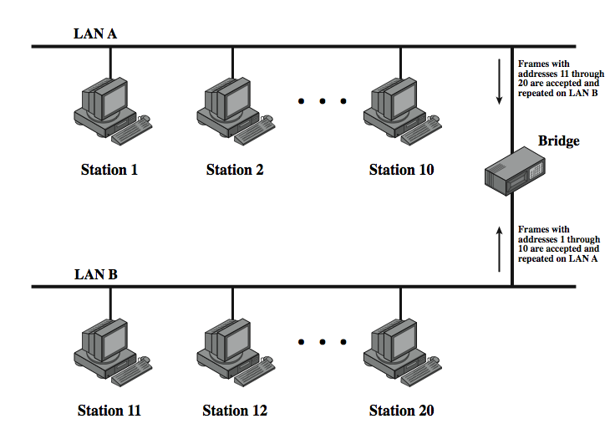
Bridge Function
Notes:
Stallings DCC8e Figure 15.8 illustrates the action of a bridge connecting two LANs, A and B, using the same MAC protocol. In this example, a single bridge attaches to both LANs; frequently, the bridge function is performed by two "half-bridges," one on each LAN. The functions of the bridge are few and simple:
• Read all frames transmitted on A and accept those addressed to any station on B.
• Using the medium access control protocol for B, retransmit each frame on B.
• Do the same for B-to-A traffic.

Slide 33
Bridge Design Aspects
no modification to frame content or format
no encapsulation
exact bitwise copy of frame
minimal buffering to meet peak demand
contains routing and address intelligence
may connect more than two LANs
bridging is transparent to stations
Notes:
Several design aspects of a bridge are worth highlighting:
• The bridge makes no modification to the content or format of the frames it receives, nor does it encapsulate them with an additional header. Each frame to be transferred is simply copied from one LAN and repeated with exactly the same bit pattern on the other LAN. Because the two LANs use the same LAN protocols, it is permissible to do this.
• The bridge should contain enough buffer space to meet peak demands. Over a short period of time, frames may arrive faster than they can be retransmitted.
• The bridge must contain addressing and routing intelligence. At a minimum, the bridge must know which addresses are on each network to know which frames to pass. Further, there may be more than two LANs interconnected by a number of bridges. In that case, a frame may have to be routed through several bridges in its journey from source to destination.
• A bridge may connect more than two LANs.
In summary, the bridge provides an extension to the LAN that requires no modification to the communications software in the stations attached to the LANs.

Slide 34
Bridge Protocol Architecture
IEEE 802.1D
MAC level
bridge does not need LLC layer
can pass frame over external comms system
  capture frame
  encapsulate it
  forward it across link
  remove encapsulation and forward over LAN link
  e.g. WAN link
Notes:
The IEEE 802.1D specification defines the protocol architecture for MAC bridges. Within the 802 architecture, the endpoint or station address is designated at the MAC level. Thus, it is at the MAC level that a bridge can function. Figure 15.9 shows the simplest case, which consists of two LANs connected by a single bridge. The LANs employ the same MAC and LLC protocols. The bridge operates as previously described. A MAC frame whose destination is not on the immediate LAN is captured by the bridge, buffered briefly, and then transmitted on the other LAN. As far as the LLC layer is concerned, there is a dialogue between peer LLC entities in the two endpoint stations. The bridge need not contain an LLC layer because it is merely serving to relay the MAC frames.
The concept of a MAC relay bridge is not limited to the use of a single bridge to connect two nearby LANs. If the LANs are some distance apart, then they can be connected by two bridges that are in turn connected by a communications facility. The intervening communications facility can be a network, such as a wide area packet-switching network, or a point-to-point link. In such cases, when a bridge captures a MAC frame, it must encapsulate the frame in the appropriate packaging and transmit it over the communications facility to a target bridge. The target bridge strips off these extra fields and transmits the original, unmodified MAC frame to the destination station.

Slide 35
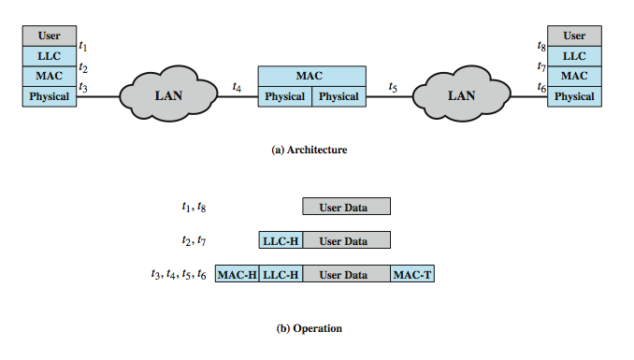
Connection of Two LANs
Notes:
Stallings DCC8e Figure 15.9b indicates the way in which data are encapsulated using a bridge. Data are provided by some user to LLC. The LLC entity appends a header and passes the resulting data unit to the MAC entity, which appends a header and a trailer to form a MAC frame. On the basis of the destination MAC address in the frame, it is captured by the bridge. The bridge does not strip off the MAC fields; its function is to relay the MAC frame intact to the destination LAN. Thus, the frame is deposited on the destination LAN and captured by the destination station.

Slide 36
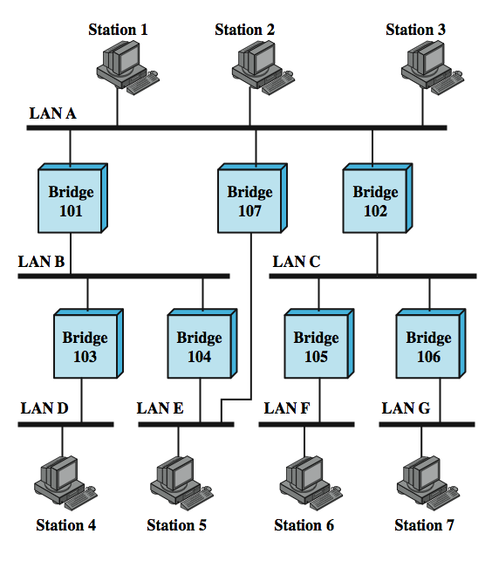
Bridges and
LANs with
Alternative
Routes
Notes:
There is a trend within many organizations to an increasing number of LANs interconnected by bridges. Consider the configuration of Stallings DCC8e Figure 15.10. Suppose that station 1 transmits a frame on LAN A intended for station 6. The frame will be read by bridges 101, 102, and 107. For each bridge, the addressed station is not on a LAN to which the bridge is attached. Therefore, each bridge must make a decision whether or not to retransmit the frame on its other LAN, in order to move it closer to its intended destination. In this case, bridge 102 should repeat the frame on LAN C, whereas bridges 101 and 107 should refrain from retransmitting the frame. Once the frame has been transmitted on LAN C, it will be picked up by both bridges 105 and 106., Each must decide whether or not to forward the frame. In this case, bridge 105 should retransmit the frame on LAN F, where it will be received by station 6.
The routing decision may not always be a simple one. Figure 15.10 also shows that there are two routes between LAN A and LAN E. Such redundancy provides for higher overall Internet availability and creates the possibility for load balancing. In this case, if station 1 transmits a frame on LAN A intended for station 5 on LAN E, then either bridge 101 or bridge 107 could forward the frame. It would appear preferable for bridge 107 to forward the frame, since it will involve only one hop, whereas if the frame travels through bridge 101, it must suffer two hops. Another consideration is that there may be changes in the configuration. For example, bridge 107 may fail, in which case subsequent frames from station 1 to station 5 should go through bridge 101. So the routing capability must take into account the topology of the internet configuration and may need to be dynamically altered.

Slide 37
Fixed Routing
complex large LANs need alternative routes
  for load balancing and fault tolerance
bridge must decide whether to forward frame
bridge must decide LAN to forward frame to
can use fixed routing for each source-destination pair of LANs
  done in configuration
  usually least hop route
  only changed when topology changes
  widely used but limited flexibility
Notes:
As the number of LANs grows, it becomes important to provide alternate paths between LANs via bridges for load balancing and reconfiguration in response to failure. In the general case, the bridge must be equipped with a routing capability. When a bridge receives a frame, it must decide whether or not to forward it. If the bridge is attached to two or more networks, then it must decide whether or not to forward the frame and, if so, on which LAN the frame should be transmitted. The routing decision may not always be a simple one.
A variety of routing strategies have been proposed and implemented in recent years. The simplest and most common strategy is fixed routing. This strategy is suitable for small internets and for internets that are relatively stable. For fixed routing, a route is selected for each source-destination pair of LANs in the configuration. If alternate routes are available between two LANs, then typically the route with the least number of hops is selected. The routes are fixed, or at least only change when there is a change in the topology of the internet. The fixed routing strategy is widely used in commercially available products. It requires that a network manager manually load the data into the routing tables. It has the advantage of simplicity and minimal processing requirements. However, in a complex internet, in which bridges may be dynamically added and in which failures must be allowed for, this strategy is too limited.

Slide 38
Spanning Tree
bridge automatically develops routing table
automatically updates routing table in response to changes
three mechanisms:
  frame forwarding
  address learning
  loop resolution
Notes:
Two groups within the IEEE 802 committee have developed specifications for routing strategies on bridges. The IEEE 802.1 group has issued a standard for routing based on the use of a spanning tree algorithm. The token ring committee, IEEE 802.5, has issued its own specification, referred to as source routing. The spanning tree approach is a mechanism in which bridges automatically develop a routing table and update that table in response to changing topology. The algorithm consists of three mechanisms: frame forwarding, address learning, and loop resolution.

Slide 39
Frame Forwarding
maintain forwarding database for each port
  lists station addresses reached through each port
for a frame arriving on port X:
  search forwarding database to see if MAC address is listed for any port except X
  if address not found, forward to all ports except X
  if address listed for port Y, check port Y for blocking or forwarding state
  if not blocked, transmit frame through port Y
Notes:
In this scheme, a bridge maintains a forwarding database for each port attached to a LAN. The database indicates the station addresses for which frames should be forwarded through that port. When a frame is received on any port, the bridge must decide whether that frame is to be forwarded through the bridge and out through one of the bridge's other ports. Suppose that a bridge receives a MAC frame on port x. The following rules are applied:
1. Search the forwarding database to determine if the MAC address is listed for any port except port x.
2. If the destination MAC address is not found, forward frame out all ports except the one from which is was received. This is part of the learning process described subsequently.
3. If the destination address is in the forwarding database for some port y, then determine whether port y is in a blocking or forwarding state. For reasons explained later, a port may sometimes be blocked, which prevents it from receiving or transmitting frames.
4. If port y is not blocked, transmit the frame through port y onto the LAN to which that port attaches.

Slide 40
Address Learning
can preload forwarding database
when frame arrives at port X, it has come form the LAN attached to port X
use source address to update forwarding database for port X to include that address
have a timer on each entry in database
if timer expires, entry is removed
each time frame arrives, source address checked against forwarding database
  if present timer is reset and direction recorded
  if not present entry is created and timer set
Notes:
The preceding scheme assumes that the bridge is already equipped with a forwarding database that indicates the direction, from the bridge, of each destination station. This information can be preloaded into the bridge, as in fixed routing. However, an effective automatic mechanism for learning the direction of each station is desirable. A simple scheme for acquiring this information is based on the use of the source address field in each MAC frame.
The strategy is this. When a frame arrives on a particular port, it clearly has come from the direction of the incoming LAN. The source address field of the frame indicates the source station. Thus, a bridge can update its forwarding database for that port on the basis of the source address field of each incoming frame. To allow for changes in topology, each element in the database is equipped with a timer. When a new element is added to the database, its timer is set. If the timer expires, then the element is eliminated from the database, since the corresponding direction information may no longer be valid. Each time a frame is received, its source address is checked against the database. If the element is already in the database, the entry is updated (the direction may have changed) and the timer is reset. If the element is not in the database, a new entry is created, with its own timer.

Slide 41
Spanning Tree Algorithm
address learning works for tree layout
in general graph have loops
for any connected graph there is a spanning tree maintaining connectivity with no closed loops
IEEE 802.1 Spanning Tree Algorithm finds this
  each bridge assigned unique identifier
  exchange info between bridges to find spanning tree
  automatically updated whenever topology changes
Notes:
The address learning mechanism described previously is effective if the topology of the internet is a tree; that is, if there are no alternate routes in the network. The existence of alternate routes means that there is a closed loop., which means multiple copies of a frame may be delivered. For example in Figure 15.10, the following is a closed loop: LAN A, bridge 101, LAN B, bridge 104, LAN E, bridge 107, LAN A. To overcome this problem, a simple result from graph theory is used: For any connected graph, consisting of nodes and edges connecting pairs of nodes, there is a spanning tree of edges that maintains the connectivity of the graph but contains no closed loops. In terms of internets, each LAN corresponds to a graph node, and each bridge corresponds to a graph edge. Thus, in Figure 15.10, the removal of one (and only one) of bridges 107, 101, and 104, results in a spanning tree. What is desired is to develop a simple algorithm by which the bridges of the internet can exchange sufficient information to automatically (without user intervention) derive a spanning tree. The algorithm must be dynamic. That is, when a topology change occurs, the bridges must be able to discover this fact and automatically derive a new spanning tree. The spanning tree algorithm developed by IEEE 802.1, as the name suggests, is able to develop such a spanning tree. All that is required is that each bridge be assigned a unique identifier and that costs be assigned to each bridge port. In the absence of any special considerations, all costs could be set equal; this produces a minimum-hop tree. The algorithm involves a brief exchange of messages among all of the bridges to discover the minimum-cost spanning tree. Whenever there is a change in topology, the bridges automatically recalculate the spanning tree.

Slide 42
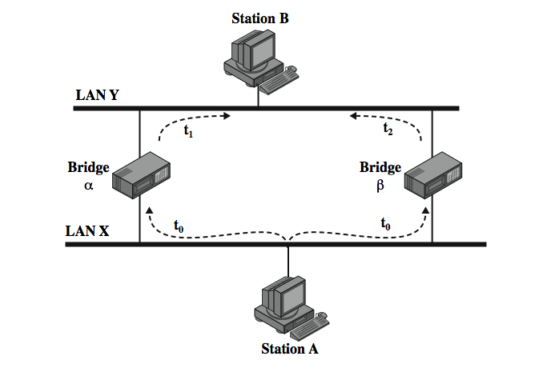
Loop of Bridges
Notes:
To see the problem created by a closed loop, consider Stallings DCC8e Figure 15.11. At time t₀, station A transmits a frame addressed to station B. The frame is captured by both bridges. Each bridge updates its database to indicate that station A is in the direction of LAN X, and retransmits the frame on LAN Y. Say that bridge α retransmits at time t₁ and bridge β a short time later t₂. Thus B will receive two copies of the frame. Furthermore, each bridge will receive the other's transmission on LAN Y. Note that each transmission is a frame with a source address of A and a destination address of B. Thus each bridge will update its database to indicate that station A is in the direction of LAN Y. Neither bridge is now capable of forwarding a frame addressed to station A.

Slide 43
Spanning Tree Algorithm
Address learning mechanism is effective if the topology of the internet is a tree
Terminology
  Root bridge: Lowest value of bridge identifier
  Path cost: Associated with each port
  Root port: Port to the root bridge
  Root path cost: Cost of the path to root bridge
  Designated bridge/port
  Any active port that is not a root port or a designated port is a blocked port

Slide 44
Spanning Tree Algorithm (cont)
Determine the root bridge
  All bridges consider themselves to be the root bridge, Each bridge will broadcast a BPDU on each of its LAN the asserts this fact
  Only the bridge with the lowest-valued identifier will maintain its belief
  Over time, as BPDU propagate, the identity of the lowest-valued bridge identifier will be known to all bridges

Slide 45
Spanning Tree Algorithm (cont)
Determine the root port on all other bridges
  The root bridge will regularly broadcast the fact that it is the root bridge on all of the LANs; It allows the bridges on those LANs to determine their root port and the fact that they are directly connected to the root bridge
  Each of these bridges turn broadcasts a BPDU on the other LANs to which it attached, indicating that it is one hop away from the root bridge
Determine the designated port on each LAN
  On any LAN, the bridge claiming to be the one that is closest (minimum cost path) to the root bridge becomes the designated bridge

Slide 46
Spanning Tree Algorithm (e.g.)
LAN 2
Bridge 3
C = 10
Bridge 4
C = 5
Bridge 1
C = 10
C = 5
C = 10
LAN 5
C = 10
Bridge 5
C = 5
C = 5
LAN 1
Bridge 2
C = 10
C = 5
C = 5
LAN 3
LAN 4

Slide 47
Spanning Tree Algorithm (e.g.)
Bridge 1
Root Path Cost = 0
C = 10
C = 10
D
D
LAN 1
LAN 2
R
R
Bridge 5
RPC = 5
C = 5
Bridge 4
RPC = 5
C = 5
C = 5
R
C = 5
Bridge 3
RPC = 10
R
C = 10
D
Bridge 2
Root Path Cost = 10
C = 10
LAN 5
C = 10
C = 5
C = 5
R = root port
D = designated port
D
D
LAN 3
LAN 4

Slide 48
Interconnecting LANs - Hubs
active central element of star layout
each station connected to hub by two UTP lines
hub acts as a repeater
limited to about 100 m by UTP properties
optical fiber may be used out to 500m
physically star, logically bus
transmission from a station seen by all others
if two stations transmit at the same time have a collision
Notes:
The hub is the active central element of a star-topology LAN. Each station is connected to the hub by two lines (transmit and receive). The hub acts as a repeater: When a single station transmits, the hub repeats the signal on the outgoing line to each station. Ordinarily, the line consists of two unshielded twisted pairs. Because of the high data rate and the poor transmission qualities of unshielded twisted pair, the length of a line is limited to about 100 m. As an alternative, an optical fiber link may be used. In this case, the maximum length is about 500 m. Note that although this scheme is physically a star, it is logically a bus: A transmission from any one station is received by all other stations, and if two stations transmit at the same time there will be a collision.

Slide 49
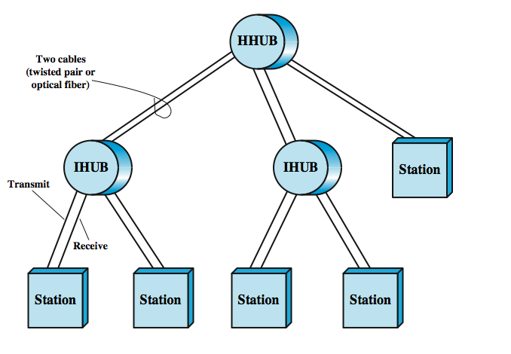
Two Level Hub Topology
Notes:
Multiple levels of hubs can be cascaded in a hierarchical configuration. Stallings DCC8e Figure 15.12 illustrates a two-level configuration. There is one header hub (HHUB) and one or more intermediate hubs (IHUB). Each hub may have a mixture of stations and other hubs attached to it from below. This layout fits well with building wiring practices. Typically, there is a wiring closet on each floor of an office building, and a hub can be placed in each one. Each hub could service the stations on its floor.

Slide 50
Buses, Hubs and Switches
bus configuration
  all stations share capacity of bus (e.g. 10Mbps)
  only one station transmitting at a time
hub uses star wiring to attach stations
  transmission from any station received by hub and retransmitted on all outgoing lines
  only one station can transmit at a time
  total capacity of LAN is 10 Mbps
can improve performance using a layer 2 switch
  can switch multiple frames between separate ports
  multiplying capacity of LAN
Notes:
A hub, often in a building wiring closet, uses a star wiring arrangement to attach stations to the hub. In this arrangement, a transmission from any one station is received by the hub and retransmitted on all of the outgoing lines. Therefore, to avoid collision, only one station can transmit at a time. Again, the total capacity of the LAN is 10 Mbps. The hub has several advantages over the simple bus arrangement. It exploits standard building wiring practices in the layout of cable. In addition, the hub can be configured to recognize a malfunctioning station that is jamming the network and to cut that station out of the network. In recent years, a new device, the layer 2 switch, has replaced the hub in popularity, particularly for high-speed LANs. The layer 2 switch is also sometimes referred to as a switching hub. With a layer 2 switch, an incoming frame from a particular station is switched to the appropriate output line to be delivered to the intended destination. At the same time, other unused lines can be used for switching other traffic.

Slide 51
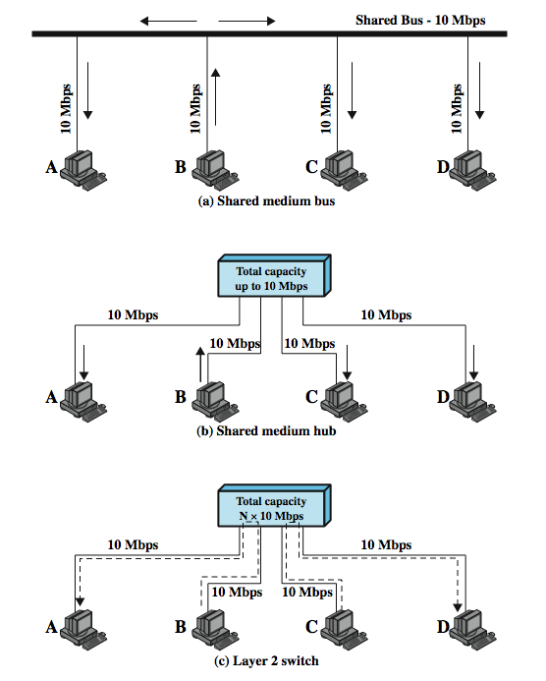
Shared Medium Bus and Hub
Notes:
To clarify the distinction between hubs and switches, Stallings DCC8e Figure 15.13a shows a typical bus layout of a traditional 10-Mbps LAN. A bus is installed that is laid out so that all the devices to be attached are in reasonable proximity to a point on the bus. In the figure, station B is transmitting. This transmission goes from B, across the lead from B to the bus, along the bus in both directions, and along the access lines of each of the other attached stations. In this configuration, all the stations must share the total capacity of the bus, which is 10 Mbps.
Stallings DCC8e Figure 15.13b illustrates the operation of a hub. Here again, station B is transmitting. This transmission goes from B, across the transmit line from B to the hub, and from the hub along the receive lines of each of the other attached stations.
Stallings DCC8e Figure 15.13c shows an example in which B is transmitting a frame to A and at the same time C is transmitting a frame to D. So, in this example, the current throughput on the LAN is 20 Mbps, although each individual device is limited to 10 Mbps.

Slide 52
Layer 2 Switch Benefits
no change to attached devices to convert bus LAN or hub LAN to switched LAN
  e.g. Ethernet LANs use Ethernet MAC protocol
have dedicated capacity equal to original LAN
  assuming switch has sufficient capacity to keep up with all devices
scales easily
  additional devices attached to switch by increasing capacity of layer 2
Notes:
The layer 2 switch has several attractive features:
1. No change is required to the software or hardware of the attached devices to convert a bus LAN or a hub LAN to a switched LAN. In the case of an Ethernet LAN, each attached device continues to use the Ethernet medium access control protocol to access the LAN. From the point of view of the attached devices, nothing has changed in the access logic.
2. Each attached device has a dedicated capacity equal to that of the entire original LAN, assuming that the layer 2 switch has sufficient capacity to keep up with all attached devices. For example, in Figure 15.13c, if the layer 2 switch can sustain a throughput of 20 Mbps, each attached device appears to have a dedicated capacity for either input or output of 10 Mbps.
3. The layer 2 switch scales easily. Additional devices can be attached to the layer 2 switch by increasing the capacity of the layer 2 switch correspondingly.

Slide 53
Types of Layer 2 Switch
store-and-forward switch
  accepts frame on input line, buffers briefly, routes to destination port
  see delay between sender and receiver
  better integrity
cut-through switch
  use destination address at beginning of frame
  switch begins repeating frame onto output line as soon as destination address recognized
  highest possible throughput
  risk of propagating bad frames
Notes:
Two types of layer 2 switches are available as commercial products:
• Store-and-forward switch: The layer 2 switch accepts a frame on an input line, buffers it briefly, and then routes it to the appropriate output line.
• Cut-through switch: The layer 2 switch takes advantage of the fact that the destination address appears at the beginning of the MAC (medium access control) frame. The layer 2 switch begins repeating the incoming frame onto the appropriate output line as soon as the layer 2 switch recognizes the destination address.
The cut-through switch yields the highest possible throughput but at some risk of propagating bad frames, because the switch is not able to check the CRC prior to retransmission. The store-and-forward switch involves a delay between sender and receiver but boosts the overall integrity of the network.

Slide 54
Layer 2 Switch vs Bridge
Layer 2 switch can be viewed as full-duplex hub
incorporates logic to function as multiport bridge
differences between switches & bridges:
  bridge frame handling done in software
  switch performs frame forwarding in hardware
  bridge analyzes and forwards one frame at a time
  switch can handle multiple frames at a time
  bridge uses store-and-forward operation
  switch can have cut-through operation
hence bridge have suffered commercially
Notes:
A layer 2 switch can be viewed as a full-duplex version of the hub. It can also incorporate logic that allows it to function as a multiport bridge. Some differences between layer 2 switches and bridges are:
• Bridge frame handling is done in software. A layer 2 switch performs the address recognition and frame forwarding functions in hardware.
• A bridge can typically only analyze and forward one frame at a time, whereas a layer 2 switch has multiple parallel data paths and can handle multiple frames at a time.
• A bridge uses store-and-forward operation. With a layer 2 switch, it is possible to have cut-through instead of store-and-forward operation.
Because a layer 2 switch has higher performance and can incorporate the functions of a bridge, the bridge has suffered commercially. New installations typically include layer 2 switches with bridge functionality rather than bridges.

Slide 55
Layer 2 Switch Problems
broadcast overload
  users share common MAC broadcast address
  broadcast frames are delivered to all devices connected by layer 2 switches and/or bridges
  broadcast frames can create big overhead
  broadcast storm from malfunctioning devices
lack of multiple links
  limits performance & reliability
Notes:
As the number of devices in a building or complex of buildings grows, layer 2 switches reveal some inadequacies. Two problems in particular present themselves: broadcast overload and the lack of multiple links.
A set of devices and LANs connected by layer 2 switches is considered to have a flat address space. The term flat means that all users share a common MAC broadcast address. Thus, if any device issues a MAC frame with a broadcast address, that frame is to be delivered to all devices attached to the overall network connected by layer 2 switches and/or bridges. In a large network, frequent transmission of broadcast frames can create tremendous overhead. Worse, a malfunctioning device can create a broadcast storm, in which numerous broadcast frames clog the network and crowd out legitimate traffic.
A second performance-related problem with the use of bridges and/or layer 2 switches is that the current standards for bridge protocols dictate that there be no closed loops in the network. That is, there can only be one path between any two devices. Thus, it is impossible, in a standards-based implementation, to provide multiple paths through multiple switches between devices. This restriction limits both performance and reliability.

Slide 56
Router Problems
typically use subnetworks connected by routers
  limits broadcasts to single subnet
  supports multiple paths between subnet
routers do all IP-level processing in software
  high-speed LANs and high-performance layer 2 switches pump millions of packets per second
  software-based router only able to handle well under a million packets per second
Notes:
To overcome these problems, it seems logical to break up a large local network into a number of subnetworks connected by routers. A MAC broadcast frame is then limited to only the devices and switches contained in a single subnetwork. Furthermore, IP-based routers employ sophisticated routing algorithms that allow the use of multiple paths between subnetworks going through different routers.
However, the problem with using routers to overcome some of the inadequacies of bridges and layer 2 switches is that routers typically do all of the IP-level processing involved in the forwarding of IP traffic in software. High-speed LANs and high-performance layer 2 switches may pump millions of packets per second, whereas a software-based router may only be able to handle well under a million packets per second.

Slide 57
Layer 3 Switches
Solution: layer 3 switches
  implement packet-forwarding logic of router in hardware
two categories
  packet by packet
  flow based
Notes:
To accommodate high loads, a number of vendors have developed layer 3 switches, which implement the packet-forwarding logic of the router in hardware. There are a number of different layer 3 schemes on the market, but fundamentally they fall into two categories: packet by packet and flow based.

Slide 58
Packet by Packet or
Flow Based
packet by packet
  operates like a traditional router
  order of magnitude increase in performance compared to software-based router
flow-based switch
  enhances performance by identifying flows of IP packets with same source and destination
  by observing ongoing traffic or using a special flow label in packet header (IPv6)
  a predefined route is used for identified flows
Notes:
The packet-by-packet switch operates in the identical fashion as a traditional router. Because the forwarding logic is in hardware, the packet-by-packet switch can achieve an order of magnitude increase in performance compared to the software-based router. A flow-based switch tries to enhance performance by identifying flows of IP packets that have the same source and destination. This can be done by observing ongoing traffic or by using a special flow label in the packet header (allowed in IPv6 but not IPv4). Once a flow is identified, a predefined route can be established through the network to speed up the forwarding process. Again, huge performance increases over a pure software-based router are achieved.

Slide 59
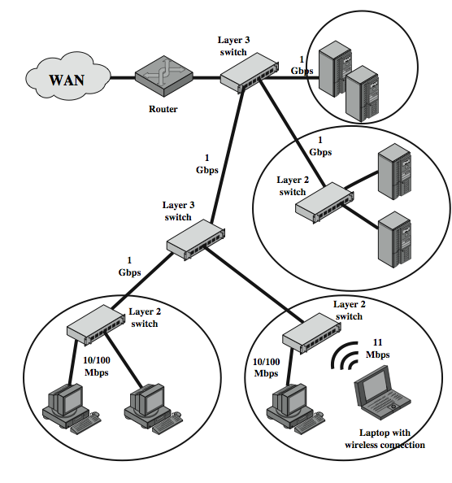
Typical
Large
LAN
Organization
Diagram
Notes:
Stallings DCC8e Figure 15.14 is a typical example of the approach taken to local networking in an organization with a large number of PCs and workstations (thousands to tens of thousands). Desktop systems have links of 10 Mbps to 100 Mbps into a LAN controlled by a layer 2 switch. Wireless LAN connectivity is also likely to be available for mobile users. Layer 3 switches are at the local network's core, forming a local backbone. Typically, these switches are interconnected at 1 Gbps and connect to layer 2 switches at from 100 Mbps to 1 Gbps. Servers connect directly to layer 2 or layer 3 switches at 1 Gbps or possible 100 Mbps. A lower-cost software-based router provides WAN connection. The circles in the figure identify separate LAN subnetworks; a MAC broadcast frame is limited to its own subnetwork.

Slide 60
Summary
LAN topologies and media
LAN protocol architecture
bridges, hubs, layer 2 & 3 switches
Notes:
Chapter15 summary.

