Slide 1
Data and Computer Communications
Chapter 16 – High Speed LANs
Eighth Edition
by William Stallings
Lecture slides by Lawrie Brown
Notes:
Lecture slides prepared by Dr Lawrie Brown (UNSW@ADFA) for “Data and Computer Communications”, 8/e, by William Stallings, Chapter 16 “High Speed LANs”.

Slide 2
High Speed LANs
Congratulations. I knew the record would stand until it was broken.
Yogi Berra
Notes:
This quote is from the start of Stallings DCC8e 16. Recent years have seen rapid changes in the technology, design, and commercial applications for local area networks (LANs). A major feature of this evolution is the introduction of a variety of new schemes for high-speed local networking. To keep pace with the changing local networking needs of business, a number of approaches to high speed LAN design have become commercial products

Slide 3
Introduction
range of technologies
  Fast and Gigabit Ethernet
  Fibre Channel
  High Speed Wireless LANs
Notes:
The most important of these are
• Fast Ethernet and Gigabit Ethernet: The extension of 10-Mbps CSMA/CD (carrier sense multiple access with collision detection) to higher speeds is a logical strategy, because it tends to preserve the investment in existing systems.
• Fibre Channel: This standard provides a low-cost, easily scalable approach to achieving very high data rates in local areas.
• High-speed wireless LANs: Wireless LAN technology and standards have at last come of age, and high-speed standards and products are being introduced (see next chapter)

Slide 4
Why High Speed LANs?
speed and power of PCs has risen
  graphics-intensive applications and GUIs
see LANs as essential to organizations
  for client/server computing
now have requirements for
  centralized server farms
  power workgroups
  high-speed local backbone
Notes:
In recent years, two significant trends have altered the role of the personal computer, increased the volume of data to be handled over LANs, and therefore the requirements on the LAN:
• The speed and computing power of personal computers has continued to enjoy explosive growth
• MIS organizations have recognized the LAN as a viable and indeed essential computing platform, resulting in the focus on network computing.
The following are examples of requirements that call for higher-speed LANs:
• Centralized server farms: In many applications, there is a need for user, or client, systems to be able to draw huge amounts of data from multiple centralized servers, called server farms.. As the performance of the servers themselves has increased, the bottleneck has shifted to the network.
• Power workgroups: These groups typically consist of a small number of cooperating users who need to draw massive data files across the network. In such cases, large amounts of data are distributed to several workstations, processed, and updated at very high speed for multiple iterations.
• High-speed local backbone: As processing demand grows, LANs proliferate at a site, and high-speed interconnection is necessary.

Slide 5
Ethernet (CSMA/CD)
most widely used LAN standard
developed by
  Xerox - original Ethernet
  IEEE 802.3
Carrier Sense Multiple Access with Collision Detection (CSMA/CD)
  random / contention access to media
Notes:
The most widely used high-speed LANs today are based on Ethernet and were developed by the IEEE 802.3 standards committee. As with other LAN standards, there is both a medium access control layer and a physical layer. The media access uses CSMA/CD. This and its precursors can be termed random access, or contention, techniques. They are random access in the sense that there is no predictable or scheduled time for any station to transmit; station transmissions are ordered randomly. They exhibit contention in the sense that stations contend for time on the shared medium.

Slide 6
ALOHA
developed for packet radio nets
when station has frame, it sends
then listens for a bit over max round trip time
  if receive ACK then fine
  if not, retransmit
  if no ACK after repeated transmissions, give up
uses a frame check sequence (as in HDLC)
frame may be damaged by noise or by another station transmitting at the same time (collision)
any overlap of frames causes collision
max utilization 18%
Notes:
The earliest of these techniques, known as ALOHA, was developed for packet radio networks. However, it is applicable to any shared transmission medium. ALOHA, or pure ALOHA as it is sometimes called, specifies that a station may transmit a frame at any time. The station then listens for an amount of time equal to the maximum possible round-trip propagation delay on the network (twice the time it takes to send a frame between the two most widely separated stations) plus a small fixed time increment. If the station hears an acknowledgment during that time, fine; otherwise, it resends the frame. If the station fails to receive an acknowledgment after repeated transmissions, it gives up. A receiving station determines the correctness of an incoming frame by examining a frame check sequence field, as in HDLC. If the frame is valid and if the destination address in the frame header matches the receiver's address, the station immediately sends an acknowledgment. The frame may be invalid due to noise on the channel or because another station transmitted a frame at about the same time. In the latter case, the two frames may interfere with each other at the receiver so that neither gets through; this is known as a collision. If a received frame is determined to be invalid, the receiving station simply ignores the frame. ALOHA is as simple as can be, and pays a penalty for it. Because the number of collisions rises rapidly with increased load, the maximum utilization of the channel is only about 18%.

Slide 7
Slotted ALOHA
time on channel based on uniform slots equal to frame transmission time
  need central clock (or other sync mechanism)
transmission begins at slot boundary
frames either miss or overlap totally
max utilization 37%
both have poor utilization
fail to use fact that propagation time is much less than frame transmission time
Notes:
To improve efficiency, a modification of ALOHA, known as slotted ALOHA, was developed. In this scheme, time on the channel is organized into uniform slots whose size equals the frame transmission time. Some central clock or other technique is needed to synchronize all stations. Transmission is permitted to begin only at a slot boundary. Thus, frames that do overlap will do so totally. This increases the maximum utilization of the system to about 37%. Both ALOHA and slotted ALOHA exhibit poor utilization. Both fail to take advantage of one of the key properties of both packet radio networks and LANs, which is that propagation delay between stations may be very small compared to frame transmission time.

Slide 8
CSMA
stations soon know transmission has started
so first listen for clear medium (carrier sense)
if medium idle, transmit
if two stations start at the same instant, collision
  wait reasonable time
  if no ACK then retransmit
  collisions occur at leading edge of frame
max utilization depends on propagation time (medium length) and frame length
Notes:
The foregoing observations led to the development of carrier sense multiple access (CSMA). With CSMA, a station wishing to transmit first listens to the medium to determine if another transmission is in progress (carrier sense). If the medium is in use, the station must wait. If the medium is idle, the station may transmit. It may happen that two or more stations attempt to transmit at about the same time. If this happens, there will be a collision; the data from both transmissions will be garbled and not received successfully. To account for this, a station waits a reasonable amount of time after transmitting for an acknowledgment, taking into account the maximum round-trip propagation delay and the fact that the acknowledging station must also contend for the channel to respond. If there is no acknowledgment, the station assumes that a collision has occurred and retransmits. This strategy is effective for networks in which the average frame transmission time is much longer than the propagation time. Collisions can occur only when more than one user begins transmitting within a short time interval (the period of the propagation delay). If a station begins to transmit a frame, and there are no collisions during the time it takes for the leading edge of the packet to propagate to the farthest station, then there will be no collision for this frame because all other stations are now aware of the transmission. The maximum utilization achievable using CSMA can far exceed that of ALOHA or slotted ALOHA. The maximum utilization depends on the length of the frame and on the propagation time; the longer the frames or the shorter the propagation time, the higher the utilization.

Slide 9
Nonpersistent CSMA
Nonpersistent CSMA rules:
  if medium idle, transmit
  if medium busy, wait amount of time drawn from probability distribution (retransmission delay) & retry
random delays reduces probability of collisions
capacity is wasted because medium will remain idle following end of transmission
nonpersistent stations are deferential
Notes:
With CSMA, an algorithm is needed to specify what a station should do if the medium is found busy. One algorithm is nonpersistent CSMA. A station wishing to transmit listens to the medium and obeys the following rules:
1. If the medium is idle, transmit; otherwise, go to step 2.
2. If the medium is busy, wait an amount of time drawn from a probability distribution (the retransmission delay) and repeat step 1.
The use of random delays reduces the probability of collisions. To see this, consider that two stations become ready to transmit at about the same time while another transmission is in progress; if both stations delay the same amount of time before trying again, they will both attempt to transmit at about the same time. A problem with nonpersistent CSMA is that capacity is wasted because the medium will generally remain idle following the end of a transmission even if there are one or more stations waiting to transmit.

Slide 10
1-persistent CSMA
1-persistent CSMA avoids idle channel time
1-persistent CSMA rules:
  if medium idle, transmit;
  if medium busy, listen until idle; then transmit immediately
1-persistent stations are selfish
if two or more stations waiting, a collision is guaranteed
Notes:
To avoid idle channel time, the 1-persistent protocol can be used. A station wishing to transmit listens to the medium and obeys the following rules:
1. If the medium is idle, transmit; otherwise, go to step 2.
2. If the medium is busy, continue to listen until the channel is sensed idle; then transmit immediately.
Whereas nonpersistent stations are deferential, 1-persistent stations are selfish. If two or more stations are waiting to transmit, a collision is guaranteed. Things get sorted out only after the collision.

Slide 11
P-persistent CSMA
a compromise to try and reduce collisions and idle time
p-persistent CSMA rules:
  if medium idle, transmit with probability p, and delay one time unit with probability (1–p)
  if medium busy, listen until idle and repeat step 1
  if transmission is delayed one time unit, repeat step 1
issue of choosing effective value of p to avoid instability under heavy load
Notes:
A compromise that attempts to reduce collisions, like nonpersistent, and reduce idle time, like 1-persistent, is p-persistent. The rules are:
1. If the medium is idle, transmit with probability p, and delay one time unit with probability (1 – p). The time unit is typically equal to the maximum propagation delay.
2. If the medium is busy, continue to listen until the channel is idle and repeat step 1.
3. If transmission is delayed one time unit, repeat step 1.
The question arises as to what is an effective value of p. The main problem to avoid is one of instability under heavy load.

Slide 12
Value of p?
have n stations waiting to send
at end of tx, expected no of stations is np
  if np>1 on average there will be a collision
repeated tx attempts mean collisions likely
eventually when all stations trying to send have continuous collisions hence zero throughput
thus want np<1 for expected peaks of n
  if heavy load expected, p small
  but smaller p means stations wait longer
Notes:
Consider the case in which n stations have frames to send while a transmission is taking place. At the end of the transmission, the expected number of stations that will attempt to transmit is equal to the number of stations ready to transmit times the probability of transmitting, or np. If np is greater than 1, on average multiple stations will attempt to transmit and there will be a collision. What is more, as soon as all these stations realize that their transmission suffered a collision, they will be back again, almost guaranteeing more collisions. Worse yet, these retries will compete with new transmissions from other stations, further increasing the probability of collision. Eventually, all stations will be trying to send, causing continuous collisions, with throughput dropping to zero. To avoid this catastrophe, np must be less than one for the expected peaks of n; therefore, if a heavy load is expected to occur with some regularity, p must be small. However, as p is made smaller, stations must wait longer to attempt transmission. At low loads, this can result in very long delays. For example, if only a single station desires to transmit, the expected number of iterations of step 1 is 1/p. Thus, if p = 0.1, at low load, a station will wait an average of 9 time units before transmitting on an idle line.

Slide 13
CSMA/CD Description
with CSMA, collision occupies medium for duration of transmission
better if stations listen whilst transmitting
CSMA/CD rules:
  if medium idle, transmit
  if busy, listen for idle, then transmit
  if collision detected, jam and then cease transmission
  after jam, wait random time then retry
Notes:
CSMA, although more efficient than ALOHA or slotted ALOHA, still has one glaring inefficiency. When two frames collide, the medium remains unusable for the duration of transmission of both damaged frames. For long frames, compared to propagation time, the amount of wasted capacity can be considerable. This waste can be reduced if a station continues to listen to the medium while transmitting. This leads to the following rules for CSMA/CD:
1. If the medium is idle, transmit; otherwise, go to step 2.
2. If the medium is busy, continue to listen until the channel is idle, then transmit immediately.
3. If a collision is detected during transmission, transmit a brief jamming signal to assure that all stations know that there has been a collision and then cease transmission.
4. After transmitting the jamming signal, wait a random amount of time, referred to as the backoff, then attempt to transmit again (repeat from step 1).

Slide 14
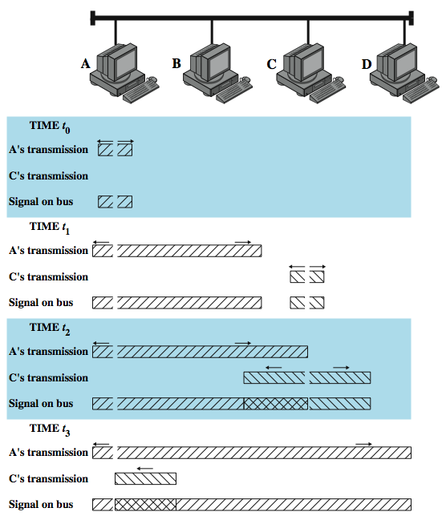
CSMA/CD
Operation
Notes:
Stallings DCC8e Figure 16.2 illustrates the technique for a baseband bus. The upper part of the figure shows a bus LAN layout. At time t₀, station A begins transmitting a packet addressed to D. At t ₁, both B and C are ready to transmit. B senses a transmission and so defers. C, however, is still unaware of A's transmission (because the leading edge of A's transmission has not yet arrived at C) and begins its own transmission. When A's transmission reaches C, at t ₂, C detects the collision and ceases transmission. The effect of the collision propagates back to A, where it is detected some time later, t ₃, at which time A ceases transmission. With CSMA/CD, the amount of wasted capacity is reduced to the time it takes to detect a collision. Question: How long does that take? Let us consider the case of a baseband bus and consider two stations as far apart as possible. For example, in Figure 16.2, suppose that station A begins a transmission and that just before that transmission reaches D, D is ready to transmit. Because D is not yet aware of A's transmission, it begins to transmit. A collision occurs almost immediately and is recognized by D. However, the collision must propagate all the way back to A before A is aware of the collision. By this line of reasoning, we conclude that the amount of time that it takes to detect a collision is no greater than twice the end-to-end propagation delay.

Slide 15
Which Persistence Algorithm?
IEEE 802.3 uses 1-persistent
both nonpersistent and p-persistent have performance problems
1-persistent seems more unstable than p-persistent
  because of greed of the stations
  but wasted time due to collisions is short
  with random backoff unlikely to collide on next attempt to send
Notes:
An important rule followed in most CSMA/CD systems, including the IEEE standard, is that frames should be long enough to allow collision detection prior to the end of transmission. If shorter frames are used, then collision detection does not occur, and CSMA/CD exhibits the same performance as the less efficient CSMA protocol. For a CSMA/CD LAN, the question arises as to which persistence algorithm to use. You may be surprised to learn that the algorithm used in the IEEE 802.3 standard is 1-persistent. Recall that both nonpersistent and p-persistent have performance problems. In the nonpersistent case, capacity is wasted because the medium will generally remain idle following the end of a transmission even if there are stations waiting to send. In the p-persistent case, p must be set low enough to avoid instability, with the result of sometimes atrocious delays under light load. The 1-persistent algorithm, which means, after all, that p = 1, would seem to be even more unstable than p-persistent due to the greed of the stations. What saves the day is that the wasted time due to collisions is mercifully short (if the frames are long relative to propagation delay), and with random backoff, the two stations involved in a collision are unlikely to collide on their next tries.

Slide 16
Binary Exponential Backoff
for backoff stability, IEEE 802.3 and Ethernet both use binary exponential backoff
stations repeatedly resend when collide
  on first 10 attempts, mean random delay doubled
  value then remains same for 6 further attempts
  after 16 unsuccessful attempts, station gives up and reports error
1-persistent algorithm with binary exponential backoff efficient over wide range of loads
but backoff algorithm has last-in, first-out effect
Notes:
To ensure that backoff maintains stability, IEEE 802.3 and Ethernet use a technique known as binary exponential backoff. A station will attempt to transmit repeatedly in the face of repeated collisions. For the first 10 retransmission attempts, the mean value of the random delay is doubled. This mean value then remains the same for 6 additional attempts. After 16 unsuccessful attempts, the station gives up and reports an error. Thus, as congestion increases, stations back off by larger and larger amounts to reduce the probability of collision. The beauty of the 1-persistent algorithm with binary exponential backoff is that it is efficient over a wide range of loads. At low loads, 1-persistence guarantees that a station can seize the channel as soon as it goes idle, in contrast to the non- and p-persistent schemes. At high loads, it is at least as stable as the other techniques. However, one unfortunate effect of the backoff algorithm is that it has a last-in first-out effect; stations with no or few collisions will have a chance to transmit before stations that have waited longer.

Slide 17
Collision Detection
on baseband bus
  collision produces higher signal voltage
  collision detected if cable signal greater than single station signal
  signal is attenuated over distance
  limit to 500m (10Base5) or 200m (10Base2)
on twisted pair (star-topology)
  activity on more than one port is collision
  use special collision presence signal
Notes:
For baseband bus, a collision should produce substantially higher voltage swings than those produced by a single transmitter. Accordingly, the IEEE standard dictates that the transmitter will detect a collision if the signal on the cable at the transmitter tap point exceeds the maximum that could be produced by the transmitter alone. Because a transmitted signal attenuates as it propagates, there is a potential problem: If two stations far apart are transmitting, each station will receive a greatly attenuated signal from the other. The signal strength could be so small that when it is added to the transmitted signal at the transmitter tap point, the combined signal does not exceed the CD threshold. For this reason, among others, the IEEE standard restricts the maximum length of coaxial cable to 500 m for 10BASE5 and 200 m for 10BASE2.
A much simpler collision detection scheme is possible with the twisted-pair star-topology approach. In this case, collision detection is based on logic rather than sensing voltage magnitudes. For any hub, if there is activity (signal) on more than one input, a collision is assumed. A special signal called the collision presence signal is generated. This signal is generated and sent out as long as activity is sensed on any of the input lines. This signal is interpreted by every node as an occurrence of a collision.

Slide 18
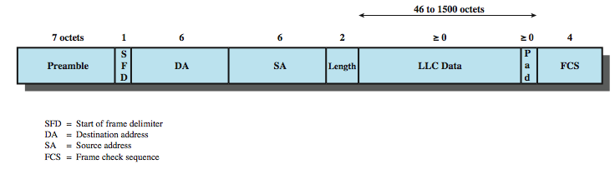
IEEE 802.3 Frame Format
Notes:
Stallings DCC8e Figure 16.3 depicts the frame format for the 802.3 protocol. It consists of the following fields:
• Preamble: A 7-octet pattern of alternating 0s and 1s used by the receiver to establish bit synchronization.
• Start Frame Delimiter (SFD): The sequence 10101011, which indicates the actual start of the frame and enables the receiver to locate the first bit of the rest of the frame.
• Destination Address (DA): Specifies the station(s) for which the frame is intended. It may be a unique physical address, a group address, or a global address.
• Source Address (SA): Specifies the station that sent the frame.
• Length/Type: Length of LLC data field in octets, or Ethernet Type field, depending on whether the frame conforms to the IEEE 802.3 standard or the earlier Ethernet specification. In either case, the maximum frame size, excluding the Preamble and SFD, is 1518 octets.
• LLC Data: Data unit supplied by LLC.
• Pad: Octets added to ensure that the frame is long enough for proper CD operation.
• Frame Check Sequence (FCS): A 32-bit cyclic redundancy check, based on all fields except preamble, SFD, and FCS.

Slide 19
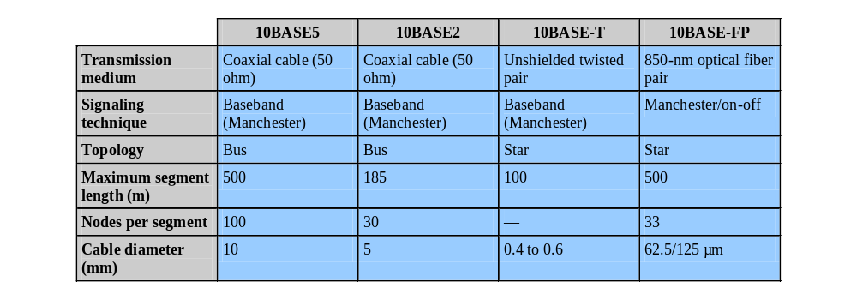
10Mbps Specification (Ethernet)
Notes:
The IEEE 802.3 committee has defined a number of alternative physical configurations. This is both good and bad. On the good side, the standard has been responsive to evolving technology. On the bad side, the customer, not to mention the potential vendor, is faced with a bewildering array of options. However, the committee has been at pains to ensure that the various options can be easily integrated into a configuration that satisfies a variety of needs. Thus, the user that has a complex set of requirements may find the flexibility and variety of the 802.3 standard to be an asset. To distinguish the various implementations that are available, the committee has developed a concise notation: <data rate in Mbps> <signaling method><max segment length in hundreds of meters>
The defined alternatives for 10-Mbps are:
• 10BASE5: Specifies the use of 50-ohm coaxial cable and Manchester digital signaling. The maximum length of a cable segment is set at 500 meters. Can extend using up to 4 repeaters.
• 10BASE2: lower-cost alternative to 10BASE5 using a thinner cable, with fewer taps over a shorter distance than the 10BASE5 cable.
• 10BASE-T: Uses unshielded twisted pair in a star-shaped topology, with length of a link is limited to 100 meters. As an alternative, an optical fiber link may be used out to 500 m.
• 10BASE-F: Contains three specifications using optical fibre

Slide 20
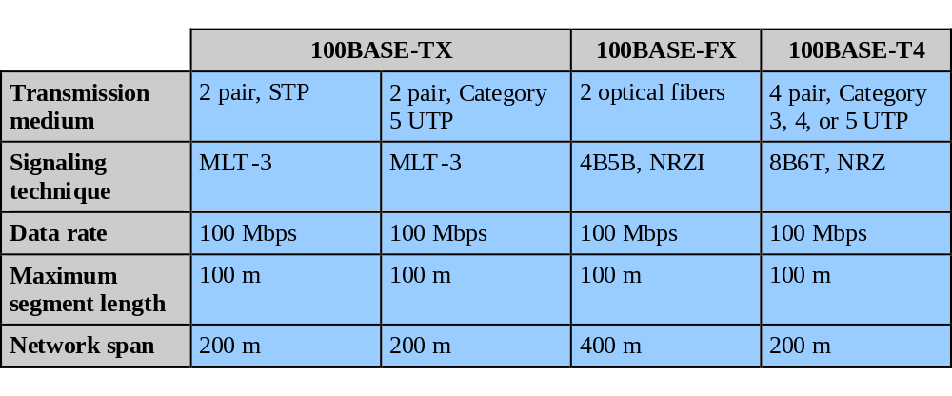
100Mbps Fast Ethernet
Notes:
Fast Ethernet refers to a set of specifications developed by the IEEE 802.3 committee to provide a low-cost, Ethernet-compatible LAN operating at 100 Mbps. The blanket designation for these standards is 100BASE-T. The committee defined a number of alternatives to be used with different transmission media. Stallings DCC8e Table 16.3 summarizes key characteristics of the 100BASE-T options. All of the 100BASE-T options use the IEEE 802.3 MAC protocol and frame format. 100BASE-X refers to a set of options that use two physical links between nodes; one for transmission and one for reception. 100BASE-TX makes use of shielded twisted pair (STP) or high-quality (Category 5) unshielded twisted pair (UTP). 100BASE-FX uses optical fiber. For all of the 100BASE-T options, the topology is similar to that of 10BASE-T, namely a star-wire topology.
In many buildings, any of the 100BASE-X options requires the installation of new cable. For such cases, 100BASE-T4 defines a lower-cost alternative that can use Category 3, voice-grade UTP in addition to the higher-quality Category 5 UTP. To achieve the 100-Mbps data rate over lower-quality cable, 100BASE-T4 dictates the use of four twisted-pair lines between nodes, with the data transmission making use of three pairs in one direction at a time.

Slide 21
100BASE-X
uses a unidirectional data rate 100 Mbps over single twisted pair or optical fiber link
encoding scheme same as FDDI
  4B/5B-NRZI
two physical medium specifications
  100BASE-TX
    uses two pairs of twisted-pair cable for tx & rx
    STP and Category 5 UTP allowed
    MTL-3 signaling scheme is used
  100BASE-FX
    uses two optical fiber cables for tx & rx
    convert 4B/5B-NRZI code group into optical signals
Notes:
For all of the transmission media specified under 100BASE-X, a unidirectional data rate of 100 Mbps is achieved transmitting over a single link (single twisted pair, single optical fiber). For all of these media, an efficient and effective signal encoding scheme is required. The one chosen is referred to as 4B/5B-NRZI. This scheme is further modified for each option. The 100BASE-X designation includes two physical medium specifications, one for twisted pair, known as 100BASE-TX, and one for optical fiber, known as 100-BASE-FX.
100BASE-TX makes use of two pairs of twisted-pair cable, one pair used for transmission and one for reception. Both STP and Category 5 UTP are allowed. The MTL-3 signaling scheme is used.
100BASE-FX makes use of two optical fiber cables, one for transmission and one for reception. With 100BASE-FX, a means is needed to convert the 4B/5B-NRZI code group stream into optical signals. The technique used is known as intensity modulation. A binary 1 is represented by a burst or pulse of light; a binary 0 is represented by either the absence of a light pulse or a light pulse at very low intensity.

Slide 22
100BASE-T4
100-Mbps over lower-quality Cat 3 UTP
  takes advantage of large installed base
  does not transmit continuous signal between packets
  useful in battery-powered applications
can not get 100 Mbps on single twisted pair
  so data stream split into three separate streams
  four twisted pairs used
  data transmitted and received using three pairs
  two pairs configured for bidirectional transmission
use ternary signaling scheme (8B6T)
Notes:
100BASE-T4 is designed to produce a 100-Mbps data rate over lower-quality Category 3 cable, thus taking advantage of the large installed base of Category 3 cable in office buildings. The specification also indicates that the use of Category 5 cable is optional. 100BASE-T4 does not transmit a continuous signal between packets, which makes it useful in battery-powered applications. For 100BASE-T4 using voice-grade Category 3 cable, it is not reasonable to expect to achieve 100 Mbps on a single twisted pair. Instead, 100BASE-T4 specifies that the data stream to be transmitted is split up into three separate data streams, each with an effective data rate of Mbps. Four twisted pairs are used. Data are transmitted using three pairs and received using three pairs. Thus, two of the pairs must be configured for bidirectional transmission. As with 100BASE-X, a simple NRZ encoding scheme is not used for 100BASE-T4. This would require a signaling rate of 33 Mbps on each twisted pair and does not provide synchronization. Instead, a ternary signaling scheme known as 8B6T is used

Slide 23
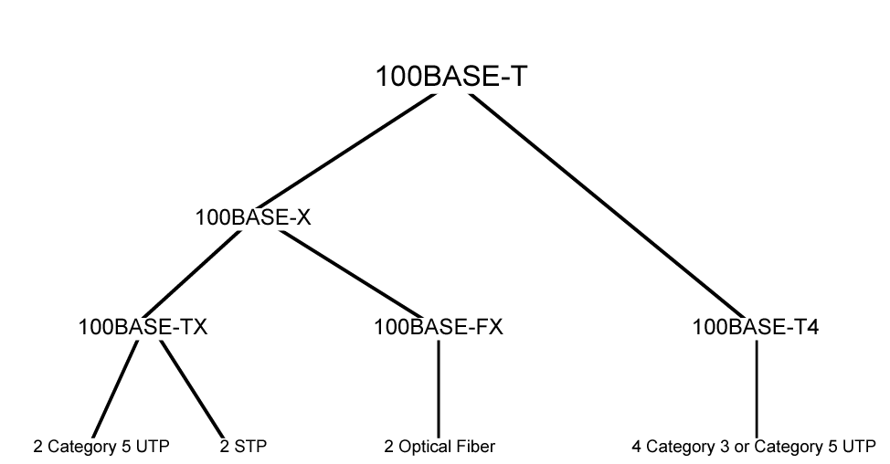
100BASE-T Options
Notes:
Can summarize 100Base-T options as shown.

Slide 24
Full Duplex Operation
traditional Ethernet half duplex
using full-duplex, station can transmit and receive simultaneously
100-Mbps Ethernet in full-duplex mode, giving a theoretical transfer rate of 200 Mbps
stations must have full-duplex adapter cards
and must use switching hub
  each station constitutes separate collision domain
  CSMA/CD algorithm no longer needed
  802.3 MAC frame format used
Notes:
A traditional Ethernet is half duplex: a station can either transmit or receive a frame, but it cannot do both simultaneously. With full-duplex operation, a station can transmit and receive simultaneously. If a 100-Mbps Ethernet ran in full-duplex mode, the theoretical transfer rate becomes 200 Mbps. Several changes are needed to operate in full-duplex mode. The attached stations must have full-duplex rather than half-duplex adapter cards. The central point in the star wire cannot be a simple multiport repeater but rather must be a switching hub. In this case each station constitutes a separate collision domain. In fact, there are no collisions and the CSMA/CD algorithm is no longer needed. However, the same 802.3 MAC frame format is used and the attached stations can continue to execute the CSMA/CD algorithm, even though no collisions can ever be detected.

Slide 25
Mixed Configurations
Fast Ethernet supports mixture of existing 10-Mbps LANs and newer 100-Mbps LANs
supporting older and newer technologies
  e.g. 100-Mbps backbone LAN supports 10-Mbps hubs
    stations attach to 10-Mbps hubs using 10BASE-T
    hubs connected to switching hubs using 100BASE-T
    high-capacity workstations and servers attach directly to 10/100 switches
    switches connected to 100-Mbps hubs use 100-Mbps links
    100-Mbps hubs provide building backbone
    connected to router providing connection to WAN
Notes:
One of the strengths of the Fast Ethernet approach is that it readily supports a mixture of existing 10-Mbps LANs and newer 100-Mbps LANs. For example, the 100-Mbps technology can be used as a backbone LAN to support a number of 10-Mbps hubs. Many of the stations attach to 10-Mbps hubs using the 10BASE-T standard. These hubs are in turn connected to switching hubs that conform to 100BASE-T and that can support both 10-Mbps and 100-Mbps links. Additional high-capacity workstations and servers attach directly to these 10/100 switches. These mixed-capacity switches are in turn connected to 100-Mbps hubs using 100-Mbps links. The 100-Mbps hubs provide a building backbone and are also connected to a router that provides connection to an outside WAN.

Slide 26
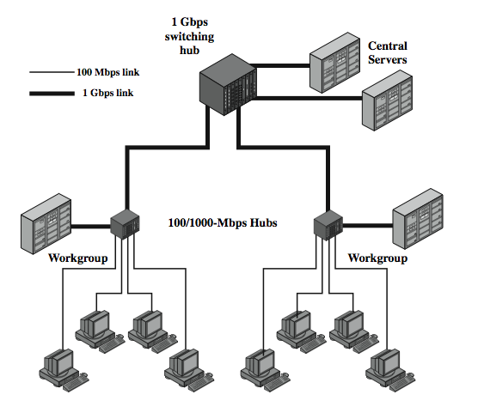
Gigabit Ethernet Configuration
Notes:
In late 1995, the IEEE 802.3 committee formed a High-Speed Study Group to investigate means for conveying packets in Ethernet format at speeds in the gigabits per second range. The strategy for Gigabit Ethernet is the same as that for Fast Ethernet. While defining a new medium and transmission specification, Gigabit Ethernet retains the CSMA/CD protocol and Ethernet format of its 10-Mbps and 100-Mbps predecessors. It is compatible with 100BASE-T and 10BASE-T, preserving a smooth migration path. As more organizations move to 100BASE-T, putting huge traffic loads on backbone networks, demand for Gigabit Ethernet has intensified.
Stallings DCC8e Figure 16.4 shows a typical application of Gigabit Ethernet. A 1-Gbps switching hub provides backbone connectivity for central servers and high-speed workgroup hubs. Each workgroup LAN switch supports both 1-Gbps links, to connect to the backbone LAN switch and to support high-performance workgroup servers, and 100-Mbps links, to support high-performance workstations, servers, and 100-Mbps LAN switches.

Slide 27
Gigabit Ethernet - Differences
carrier extension
  at least 4096 bit-times long (512 for 10/100)
frame bursting
not needed if using a switched hub to provide dedicated media access
Notes:
The 1000-Mbps specification calls for the same CSMA/CD frame format and MAC protocol as used in the 10-Mbps and 100-Mbps version of IEEE 802.3. For shared-medium hub operation, there are two enhancements to the basic CSMA/CD scheme:
• Carrier extension: Carrier extension appends a set of special symbols to the end of short MAC frames so that the resulting block is at least 4096 bit-times in duration, up from the minimum 512 bit-times imposed at 10 and 100 Mbps. This is so that the frame length of a transmission is longer than the propagation time at 1 Gbps.
• Frame bursting: This feature allows for multiple short frames to be transmitted consecutively, up to a limit, without relinquishing control for CSMA/CD between frames. Frame bursting avoids the overhead of carrier extension when a single station has a number of small frames ready to send.
With a switching hub which provides dedicated access to the medium, the carrier extension and frame bursting features are not needed. This is because data transmission and reception at a station can occur simultaneously without interference and with no contention for a shared medium.

Slide 28
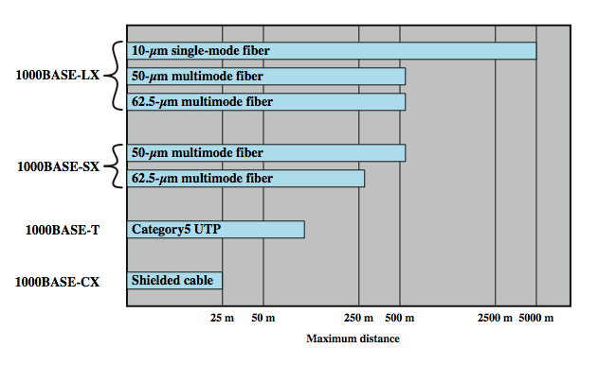
Gigabit Ethernet – Physical
Notes:
The current 1-Gbps specification for IEEE 802.3 includes the following physical layer alternatives, shown above in Stallings DCC8e Figure 16.5:
• 1000BASE-SX: This short-wavelength option supports duplex links of up to 275 m using 62.5-µm multimode or up to 550 m using 50-µm multimode fiber. Wavelengths are in the range of 770 to 860 nm.
• 1000BASE-LX: This long-wavelength option supports duplex links of up to 550 m of 62.5-µm or 50-µm multimode fiber or 5 km of 10-µm single-mode fiber. Wavelengths are in the range of 1270 to 1355 nm.
• 1000BASE-CX: This option supports 1-Gbps links among devices located within a single room or equipment rack, using copper jumpers (specialized shielded twisted-pair cable that spans no more than 25 m). Each link is composed of a separate shielded twisted pair running in each direction.
• 1000BASE-T: This option makes use of four pairs of Category 5 unshielded twisted pair to support devices over a range of up to 100 m.
The signal encoding scheme used for the first three Gigabit Ethernet options just listed is 8B/10B. The signal-encoding scheme used for 1000BASE-T is 4D-PAM5, a complex scheme whose description is beyond our scope.

Slide 29
10Gbps Ethernet
growing interest in 10Gbps Ethernet
  for high-speed backbone use
  with future wider deployment
alternative to ATM and other WAN technologies
uniform technology for LAN, MAN, or WAN
advantages of 10Gbps Ethernet
  no expensive, bandwidth-consuming conversion between Ethernet packets and ATM cells
  IP and Ethernet together offers QoS and traffic policing approach ATM
  have a variety of standard optical interfaces
Notes:
With gigabit products still fairly new, attention has turned in the past several years to a 10-Gbps Ethernet capability. The principle driving requirement for 10 Gigabit Ethernet is the increase in Internet and intranet traffic. Initially network managers will use 10-Gbps Ethernet to provide high-speed, local backbone interconnection between large-capacity switches. As the demand for bandwidth increases, 10-Gbps Ethernet will be deployed throughout the entire network and will include server farm, backbone, and campuswide connectivity. Ethernet can compete with ATM and other wide area transmission and networking technologies. In most cases where the customer requirement is data and TCP/IP transport, 10-Gbps Ethernet provides substantial value over ATM transport for both network end users and service providers:
• No expensive, bandwidth-consuming conversion between Ethernet packets and ATM cells is required; the network is Ethernet, end to end.
• The combination of IP and Ethernet offers quality of service and traffic policing capabilities that approach those provided by ATM, so that advanced traffic engineering technologies are available to users and providers.
• A wide variety of standard optical interfaces (wavelengths and link distances) have been specified for 10-Gbps Ethernet, optimizing its operation and cost for LAN, MAN, or WAN applications.

Slide 30
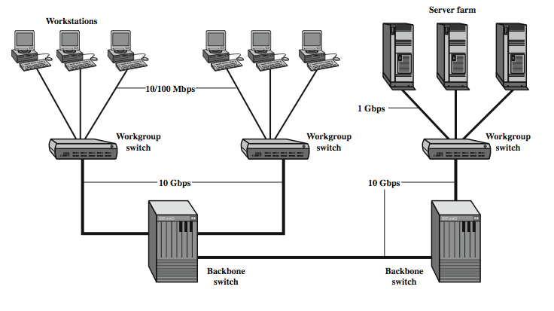
10Gbps Ethernet Configurations
Notes:
Stallings DCC8e Figure 16.6 illustrates potential uses of 10-Gbps Ethernet. Higher-capacity backbone pipes will help relieve congestion for workgroup switches, where Gigabit Ethernet uplinks can easily become overloaded, and for server farms, where 1-Gbps network interface cards are already in widespread use. The goal for maximum link distances cover a range of applications: from 300 m to 40 km. The links operate in full-duplex mode only, using a variety of optical fiber physical media.
The success of Fast Ethernet, Gigabit Ethernet, and 10-Gbps Ethernet highlights the importance of network management concerns in choosing a network technology. Both ATM and Fiber Channel, explored later, may be technically superior choices for a high-speed backbone, because of their flexibility and scalability. However, the Ethernet alternatives offer compatibility with existing installed LANs, network management software, and applications. This compatibility has accounted for the survival of a nearly 30-year-old technology (CSMA/CD) in today's fast-evolving network environment.

Slide 31
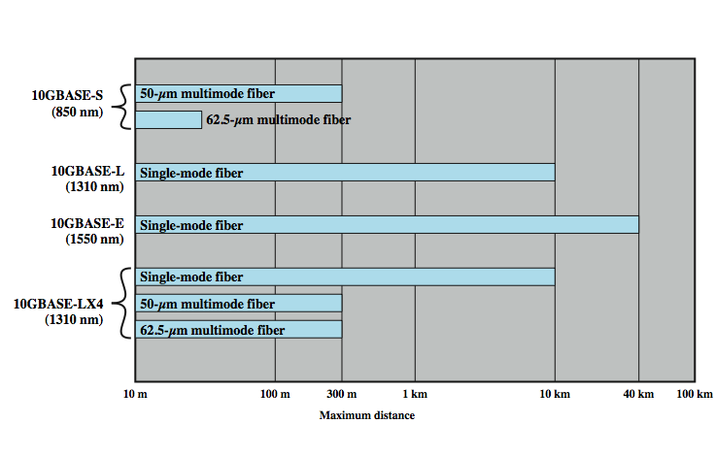
10Gbps Ethernet Options
Notes:
Four physical layer options are defined for 10-Gbps Ethernet, as shown in Stallings DCC8e Figure 16.). The first three of these have two suboptions: an "R" suboption and a "W" suboption. The R designation refers to a family of physical layer implementations that use a signal encoding technique known as 64B/66B. The R implementations are designed for use over dark fiber, meaning a fiber optic cable that is not in use and that is not connected to any other equipment. The W designation refers to a family of physical layer implementations that also use 64B/66B signaling but that are then encapsulated to connect to SONET equipment. The four physical layer options are:
• 10GBASE-S (short): Designed for 850-nm transmission on multimode fiber. This medium can achieve distances up to 300 m. There are 10GBASE-SR and 10GBASE-SW versions.
• 10GBASE-L (long): Designed for 1310-nm transmission on single-mode fiber. This medium can achieve distances up to 10 km. There are 10GBASE-LR and 10GBASE-LW versions.
• 10GBASE-E (extended): Designed for 1550-nm transmission on single-mode fiber. This medium can achieve distances up to 40 km. There are 10GBASE-ER and 10GBASE-EW versions.
• 10GBASE-LX4: Designed for 1310-nm transmission on single-mode or multimode fiber. This medium can achieve distances up to 10 km. This medium uses wavelength-division multiplexing (WDM) to multiplex the bit stream across four light waves.

Slide 32
Fibre Channel - Background
I/O channel
  direct point to point or multipoint comms link
  hardware based, high speed, very short distances
network connection
  based on interconnected access points
  software based protocol with flow control, error detection & recovery
  for end systems connections
Notes:
As the speed and memory capacity of personal computers, workstations, and servers have grown, and as applications have become ever more complex with greater reliance on graphics and video, the requirement for greater speed in delivering data to the processor has grown. This requirement affects two methods of data communications with the processor: I/O channel and network communications.
An I/O channel is a direct point-to-point or multipoint communications link, predominantly hardware based and designed for high speed over very short distances. The I/O channel transfers data between a buffer at the source device and a buffer at the destination device, moving only the user contents from one device to another, without regard to the format or meaning of the data. The logic associated with the channel typically provides the minimum control necessary to manage the transfer plus hardware error detection. I/O channels typically manage transfers between processors and peripheral devices, such as disks, graphics equipment, CD-ROMs, and video I/O devices.
A network is a collection of interconnected access points with a software protocol structure that enables communication. The network typically allows many different types of data transfer, using software to implement the networking protocols and to provide flow control, error detection, and error recovery. As we have discussed in this book, networks typically manage transfers between end systems over local, metropolitan, or wide area distances.

Slide 33
Fibre Channel
combines best of both technologies
channel oriented
  data type qualifiers for routing frame payload
  link level constructs associated with I/O ops
  protocol interface specifications to support existing I/O architectures
network oriented
  full multiplexing between multiple destinations
  peer to peer connectivity
  internetworking to other connection technologies
Notes:
Fibre Channel is designed to combine the best features of both technologies—the simplicity and speed of channel communications with the flexibility and interconnectivity that characterize protocol-based network communications. This fusion of approaches allows system designers to combine traditional peripheral connection, host-to-host internetworking, loosely coupled processor clustering, and multimedia applications in a single multiprotocol interface. The types of channel-oriented facilities incorporated into the Fibre Channel protocol architecture include:
• Data-type qualifiers for routing frame payload into particular interface buffers
• Link-level constructs associated with individual I/O operations
• Protocol interface specifications to allow support of existing I/O channel architectures, such as the Small Computer System Interface (SCSI)
The types of network-oriented facilities incorporated into the Fibre Channel protocol architecture include
• Full multiplexing of traffic between multiple destinations
• Peer-to-peer connectivity between any pair of ports on a Fibre Channel network
• Capabilities for internetworking to other connection technologies

Slide 34
Fibre Channel Requirements
full duplex links with two fibers per link
100 Mbps to 800 Mbps on single line
support distances up to 10 km
small connectors
high-capacity utilization, distance insensitivity
greater connectivity than existing multidrop channels
broad availability
multiple cost/performance levels
carry multiple existing interface command sets for existing channel and network protocols
Notes:
Depending on the needs of the application, either channel or networking approaches can be used for any data transfer. The Fibre Channel Industry Association, which is the industry consortium promoting Fibre Channel, lists the following ambitious requirements that Fibre Channel is intended to satisfy [FCIA01]:
• Full duplex links with two fibers per link
• Performance from 100 Mbps to 800 Mbps on a single line (full-duplex 200 Mbps to 1600 Mbps per link)
• Support for distances up to 10 km
• Small connectors
• High-capacity utilization with distance insensitivity
• Greater connectivity than existing multidrop channels
• Broad availability (i.e., standard components)
• Support for multiple cost/performance levels, from small systems to supercomputers
• Ability to carry multiple existing interface command sets for existing channel and network protocols

Slide 35
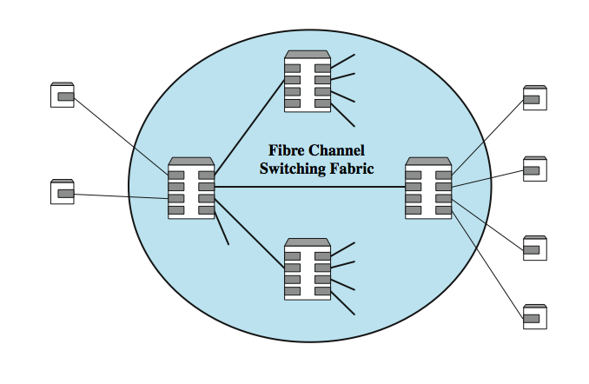
Fibre Channel Network
Notes:
The solution was to develop a simple generic transport mechanism based on point-to-point links and a switching network. This underlying infrastructure supports a simple encoding and framing scheme that in turn supports a variety of channel and network protocols. The key elements of a Fibre Channel network are the end systems, called nodes, and the network itself, which consists of one or more switching elements. The collection of switching elements is referred to as a fabric. These elements are interconnected by point-to-point links between ports on the individual nodes and switches. Communication consists of the transmission of frames across the point-to-point links.
Each node includes one or more ports, called N_ports, for interconnection. Similarly, each fabric-switching element includes multiple ports, called F_ports. Interconnection is by means of bidirectional links between ports. Any node can communicate with any other node connected to the same fabric using the services of the fabric. All routing of frames between N_ports is done by the fabric. Frames may be buffered within the fabric, making it possible for different nodes to connect to the fabric at different data rates. A fabric can be implemented as a single fabric element with attached nodes (a simple star arrangement) or as a more general network of fabric elements, as shown in Stallings DCC8e Figure 16.8. In either case, the fabric is responsible for buffering and for routing frames between source and destination nodes.

Slide 36
Fibre Channel Protocol Architecture
FC-0 Physical Media
FC-1 Transmission Protocol
FC-2 Framing Protocol
FC-3 Common Services
FC-4 Mapping
Notes:
The Fibre Channel standard is organized into five levels. Each level defines a function or set of related functions. The standard does not dictate a correspondence between levels and actual implementations, with a specific interface between adjacent levels. Rather, the standard refers to the level as a “document artifice” used to group related functions. The layers are:
• FC-0 Physical Media: Includes optical fiber for long-distance applications, coaxial cable for high speeds over short distances, and shielded twisted pair for lower speeds over short distances
• FC-1 Transmission Protocol: Defines the signal encoding scheme
• FC-2 Framing Protocol: Deals with defining topologies, frame format, flow and error control, and grouping of frames into logical entities called sequences and exchanges
• FC-3 Common Services: Includes multicasting
• FC-4 Mapping: Defines the mapping of various channel and network protocols to Fibre Channel, including IEEE 802, ATM, IP, and the Small Computer System Interface (SCSI)

Slide 37
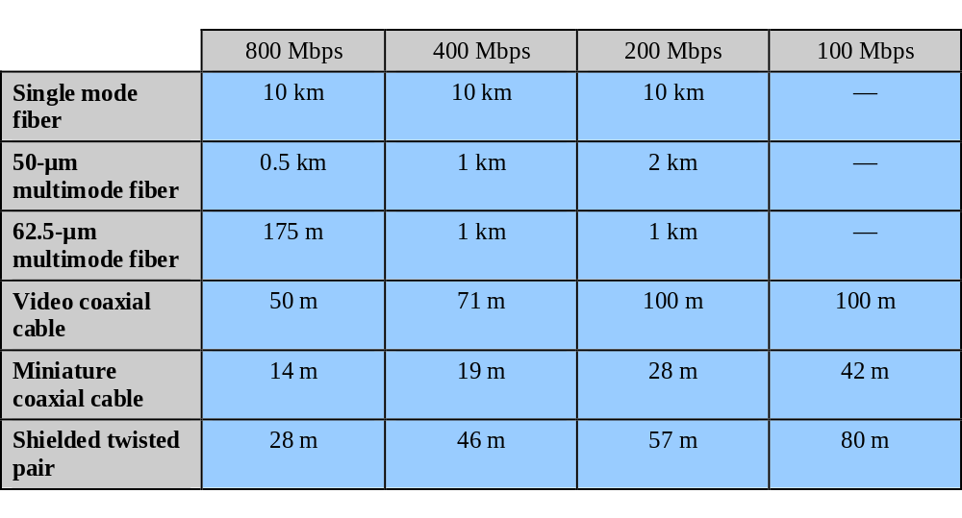
Fibre Channel Physical Media
Notes:
One of the major strengths of the Fibre Channel standard is that it provides a range of options for the physical medium, the data rate on that medium, and the topology of the network, as shown in Stallings DCC8e Table 16.4. The transmission media options that are available under Fibre Channel include shielded twisted pair, video coaxial cable, and optical fiber. Standardized data rates range from 100 Mbps to 3.2 Gbps. Point-to-point link distances range from 33 m to 10 km.

Slide 38
Fibre Channel Fabric
most general supported topology is fabric or switched topology
  arbitrary topology with at least one switch to interconnect number of end systems
  may also consist of switched network
routing transparent to nodes
  when data transmitted into fabric, edge switch uses destination port address to determine location
  either deliver frame to node attached to same switch or transfers frame to adjacent switch
Notes:
The most general topology supported by Fibre Channel is referred to as a fabric or switched topology. This is an arbitrary topology that includes at least one switch to interconnect a number of end systems. The fabric topology may also consist of a number of switches forming a switched network, with some or all of these switches also supporting end nodes.
Routing in the fabric topology is transparent to the nodes. Each port in the configuration has a unique address. When data from a node are transmitted into the fabric, the edge switch to which the node is attached uses the destination port address in the incoming data frame to determine the destination port location. The switch then either delivers the frame to another node attached to the same switch or transfers the frame to an adjacent switch to begin routing the frame to a remote destination.

Slide 39
Fabric Advantages
scalability of capacity
protocol independent
distance insensitive
switch and transmission link technologies may change without affecting overall configuration
burden on nodes minimized
Notes:
The fabric topology provides scalability of capacity: as additional ports are added, the aggregate capacity of the network increases, thus minimizing congestion and contention and increasing throughput. The fabric is protocol independent and largely distance insensitive. The technology of the switch itself and of the transmission links connecting the switch to nodes may be changed without affecting the overall configuration. Another advantage of the fabric topology is that the burden on nodes is minimized. An individual Fibre Channel node (end system) is only responsible for managing a simple point-to-point connection between itself and the fabric; the fabric is responsible for routing between ports and error detection.

Slide 40
Alternative Topologies
Point-to-point topology
  only two ports
  directly connected, so no routing needed
Arbitrated loop topology
  simple, low-cost topology
  up to 126 nodes in loop
  operates roughly equivalent to token ring
topologies, transmission media, and data rates may be combined
Notes:
In addition to the fabric topology, the Fibre Channel standard defines two other topologies. With the point-to-point topology there are only two ports, and these are directly connected, with no intervening fabric switches. In this case there is no routing. The arbitrated loop topology is a simple, low-cost topology for connecting up to 126 nodes in a loop. The arbitrated loop operates in a manner roughly equivalent to the token ring protocols that we have seen.
Topologies, transmission media, and data rates may be combined to provide an optimized configuration for a given site.

Slide 41
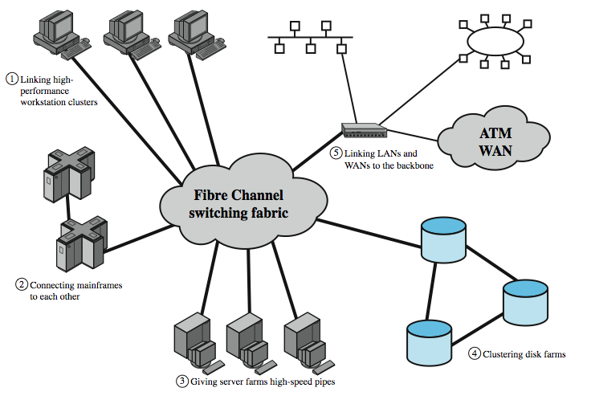
Fibre Channel Applications
Notes:
Topologies, transmission media, and data rates may be combined to provide an optimized configuration for a given site. Stallings DCC8e Figure 16.9 is an example that illustrates the principal applications of Fiber Channel.

Slide 42
Fibre Channel Prospects
backed by Fibre Channel Association
various interface cards available
widely accepted as peripheral device interconnect
technically attractive to general high-speed LAN requirements
must compete with Ethernet and ATM LANs
cost and performance issues will dominate consideration of competing technologies
Notes:
Fibre Channel is backed by an industry interest group known as the Fibre Channel Association and a variety of interface cards for different applications are available. Fibre Channel has been most widely accepted as an improved peripheral device interconnect, providing services that can eventually replace such schemes as SCSI. It is a technically attractive solution to general high-speed LAN requirements but must compete with Ethernet and ATM LANs. Cost and performance issues should dominate the manager's consideration of these competing technologies.

Slide 43
Summary
High speed LANs emergence
Ethernet technologies
  CSMA & CSMA/CD media access
  10Mbps ethernet
  100Mbps ethernet
  1Gbps ethernet
  10Gbps ethernet
Fibre Channel
Notes:
Chapter16 summary.

