Slide 1
Data and Computer Communications
Chapter 19 – Internetwork Operation
Eighth Edition
by William Stallings
Lecture slides by Lawrie Brown
Notes:
Lecture slides prepared by Dr Lawrie Brown (UNSW@ADFA) for “Data and Computer Communications”, 8/e, by William Stallings, Chapter 19 “Internetwork Operation”.

Slide 2
Multicasting-1
S
S
R1
R1
R2
R3
R2
R3
m1
m2
m3
m1
m2
m3
Multiple Unicast
True Multicast
(IP Multicast)

Slide 3
Multicasting-2
Element-1: Group ID (IP Multicast Address)
Element-2: Group Membership Management (IGMP)
Element-3: Multicast Routing Protocols
S
R1
Multicast Routing Protocol
R1
R4
R3
IGMP
IGMP
IGMP
m1
m3
m2

Slide 4
Multicasting-3
Multicast Routing Tree
Source-based Tree
Group Shared Tree
S1
S2
S1
S2
m1
m2
m3
m1
m2
m3
E.g. DVMRP, MOSPF
E.g. CBT

Slide 5
Internet QoS
RSVP
Per Flow
Integrated Service Architecture
Datagram + QoS
Complicated
Per Class
Differentiated Service
Flow
Manageable
(Im/Ex-plicit)
IPv4
IPv6
DS Codepoint
Sevice Level Agreement
IP Performance Metric

Slide 6
Internetwork Operation
She occupied herself with studying a map on the opposite wall because she knew she would have to change trains at some point. Tottenham Court Road must be that point, an interchange from the black line to the red. This train would take her there, was bearing her there rapidly now, and at the station she would follow the signs, for signs there must be, to the Central Line going westward —King Solomon's Carpet, Barbara Vine (Ruth Rendell)
Notes:
This quote is from the start of Stallings DCC8e Chapter 19.

Slide 7
Internetwork Operation
consider mechanisms for handling growth in network traffic
  from low-volume text based terminal/email
  to high volume multi-media web/voice/video
historically IP nets gave best-effort datagram delivery to all services
now want variety of QoS in IP networks
explore some new network services / functions
Notes:
As the Internet and private internets grow in scale, a host of new demands march steadily into view, from low-volume terminal/email traffic to high-volume client/server applications & real-time voice and video applications. To cope with these demands, it is not enough to increase internet capacity. Sensible and effective methods for managing the traffic and controlling congestion are needed. Historically, IP-based internets have been able to provide a simple best-effort delivery service to all applications using an internet. Thus, there is a strong need to be able to support a variety of traffic with a variety of quality-of-service (QoS) requirements, within the TCP/IP architecture. This chapter looks at the internetwork functions and services designed to meet this need.

Slide 8
Multicasting
sending packet to addresses referring to group of hosts on one or more networks
  multimedia “broadcast”
  teleconferencing
  database
  distributed computing
  real time workgroups
have design issues in addressing / routing
Notes:
 act of sending a packet from a source to multiple destinations is referred to as multicasting. Multicasting raises design issues in the areas of addressing and routing. IP accommodates addresses that refer to a group of hosts on one or more networks, known as multicast addresses. Multicasting has a number of practical applications. For example:
• Multimedia: A number of users "tune in" to a video or audio transmission from a multimedia source station.
• Teleconferencing: A group of workstations form a multicast group such that a transmission from any member is received by all other group members.
• Database: All copies of a replicated file or database are updated at the same time.
• Distributed computation: Intermediate results are sent to all participants.
• Real-time workgroup: Files, graphics, and messages are exchanged among active group members in real time

Slide 9
LAN Multicast
LAN multicast is easy
  send to IEEE 802 multicast MAC address
  since broadcast all stations will see packet
  those in multicast group will accept it
  only single copy of packet is needed
but much harder in internetwork
Notes:
Multicasting done within the scope of a single LAN segment is straightforward. IEEE 802 and other LAN protocols include provision for MAC-level multicast addresses. A packet with a multicast address is transmitted on a LAN segment. Those stations that are members of the corresponding multicast group recognize the multicast address and accept the packet. In this case, only a single copy of the packet is ever transmitted. This technique works because of the broadcast nature of a LAN: a transmission from any one station is received by all other stations on the LAN. In an internet environment, multicasting is a far more difficult undertaking.

Slide 10
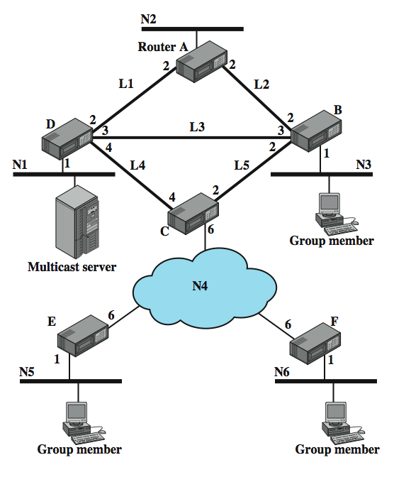
Example
Config
Notes:
In an internet environment, multicasting is a far more difficult undertaking. To see this, consider the configuration of Stallings DCC8e Figure 19.1. Routers connect to each other either over high-speed links or across a wide area network (N4). A cost is associated with each link or network in each direction. Suppose that the multicast server on network N1 is transmitting packets to a multicast address that represents the workstations indicated on networks N3, N5, N6.

Slide 11
Broadcast / Multiple Unicast / Multicast
could broadcast packet to each network
  if server does not know members of group
  requires 13 packets
could send multiple unicast packets
  to each net with members in multicast group
  requires 11 packets
or use true multicast
  which send single packets over any link
  duplicating as needed to reach dest nets
  requires 8 packets
Notes:
Consider figure 19.1 on the previous slide, and table 19.1 in the text.
Suppose that the server does not know the location of the members of the multicast group. Then one way to assure that the packet is received by all members of the group is to broadcast a copy of each packet to each network in the configuration, over the least-cost route for each network. A total of 13 copies of the packet are required for the broadcast technique, as shown in Stallings DCC8e Table 19.1.
Now suppose the source system knows the location of each member of the multicast group. That is, the source has a table that maps a multicast address into a list of networks that contain members of that multicast group. In that case, the source need only send packets to those networks that contain members of the group. We could refer to this as the multiple unicast strategy, and 11 packets are required for it.
Both the broadcast and multiple unicast strategies are inefficient because they generate unnecessary copies of the source packet. In a true multicast strategy the minimum number of packets is sent. The true multicast technique requires only eight copies of the packet.

Slide 12
True Multicast
determine least cost path to each network that has host in group
  results in a spanning tree
  of just those nets with members in group
transmit single packet along spanning tree
routers replicate packets at branch points of spanning tree
Notes:
In a true multicast strategy, the following method is used:
1. The least-cost path from the source to each network that includes members of the multicast group is determined. This results in a spanning tree (see chapter 15) of the configuration that includes only those networks containing group members.
2. The source transmits a single packet along the spanning tree.
3. The packet is replicated by routers only at branch points of the spanning tree.

Slide 13
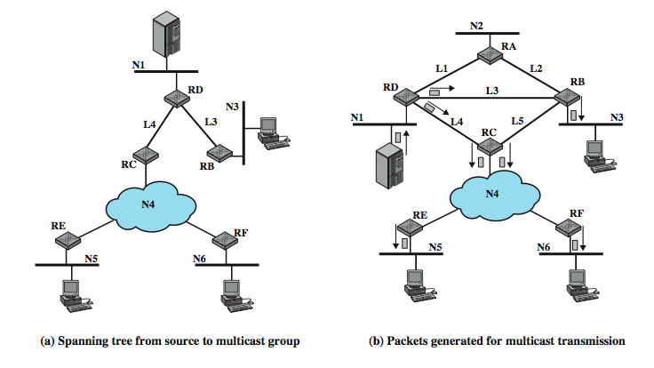
Multicast Example
Notes:
Stallings DCC8e Figure 19.2a shows the spanning tree for transmissions from the source to the multicast group, and Figure 19.2b shows this method in action. The source transmits a single packet over N1 to router D. D makes two copies of the packet, to transmit over links L3 and L4. B receives the packet from L3 and transmits it on N3, where it is read by members of the multicast group on the network. Meanwhile, C receives the packet sent on L4. It must now deliver that packet to both E and F. If network N4 were a broadcast network (e.g., an IEEE 802 LAN), then C would only need to transmit one instance of the packet for both routers to read. If N4 is a packet-switching WAN, then C must make two copies of the packet and address one to E and one to F. Each of these routers, in turn, retransmits the received packet on N5 and N6, respectively. As Table 19.1 shows, the multicast technique requires only eight copies of the packet.

Slide 14
Requirements for Multicasting
router may have to forward more than one copy of packet
need convention to identify multicast addresses (IPv4 Class D or IPv6 prefix)
nodes translate between IP multicast addresses and list of networks containing group members
router must translate between IP multicast address and network multicast address
Notes:
With multicast transmission, the router may be required to forward two or more copies of an incoming datagram, and hence the overall functionality of multicast routing is more complex than unicast routing. The following is a list of required functions:
1. A convention is needed for identifying a multicast address. In IPv4, Class D addresses are reserved for this purpose. These are 32-bit addresses with 1110 as their high-order 4 bits, followed by a 28-bit group identifier. In IPv6, a 128-bit multicast address consists of an 8-bit prefix of all ones, a 4-bit flags field, a 4-bit scope field, and a 112-bit group identifier.
2. Each node (router or source node participating in the routing algorithm) must translate between an IP multicast address and a list of networks that contain members of this group. This information allows the node to construct a shortest-path spanning tree to all of the networks containing group members.
3. A router must translate between an IP multicast address and a network multicast address in order to deliver a multicast IP datagram on the destination network. For example, in IEEE 802 networks, a MAC-level address is 48 bits long; if the highest-order bit is 1, then it is a multicast address. Thus, for multicast delivery, a router attached to an IEEE 802 network must translate a 32-bit IPv4 or a 128-bit IPv6 multicast address into a 48-bit IEEE 802 MAC-level multicast address.

Slide 15
Requirements for Multicasting
mechanism required for hosts to join and leave multicast group
routers must exchange info
  which networks include members of given group
  sufficient info to work out shortest path to each network
routing algorithm to work out shortest path
routers must determine routing paths based on source and destination addresses
Notes:
The list of required functions continues with:
4. Although some multicast addresses may be assigned permanently, the more usual case is that multicast addresses are generated dynamically and that individual hosts may join and leave multicast groups dynamically. Thus, a mechanism is needed by which an individual host informs routers attached to the same network as itself of its inclusion in and exclusion from a multicast group. IGMP, described subsequently, provides this mechanism.
5. Routers must exchange two sorts of information. First, routers need to know which networks include members of a given multicast group. Second, routers need sufficient information to calculate the shortest path to each network containing group members. These requirements imply the need for a multicast routing protocol. A discussion of such protocols is beyond the scope of this book.
6. A routing algorithm is needed to calculate shortest paths to all group members.
7. Each router must determine multicast routing paths on the basis of both source and destination addresses.

Slide 16
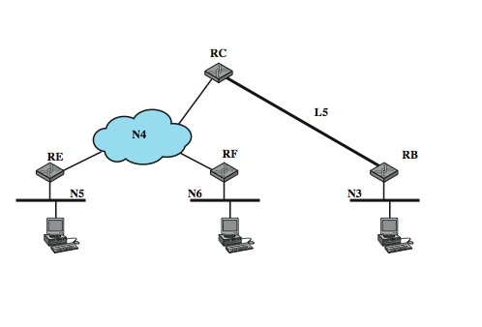
Spanning Tree from Router C to Multicast Group
Notes:
The last requirement is a subtle consequence of the use of multicast addresses. To illustrate the point, consider again Stallings DCC8e Figure 19.1. If the multicast server transmits a unicast packet addressed to a host on network N5, the packet is forwarded by router D to C, which then forwards the packet to E. Similarly, a packet addressed to a host on network N3 is forwarded by D to B. But now suppose that the server transmits a packet with a multicast address that includes hosts on N3, N5, and N6. As we have discussed, D makes two copies of the packet and send one to B and one to C. What will C do when it receives a packet with such a multicast address? C knows that this packet is intended for networks N3, N5, and N6. A simple-minded approach would be for C to calculate the shortest path to each of these three networks. This produces the shortest-path spanning tree shown in Stallings DCC8e Figure 19.3. As a result, C sends two copies of the packet out over N4, one intended for N5 and one intended for N6. But it also sends a copy of the packet to B for delivery on N3. Thus B will receive two copies of the packet, one from D and one from C. This is clearly not what was intended by the host on N1 when it launched the packet. To avoid unnecessary duplication of packets, each router must route packets on the basis of both source and multicast destination. When C receives a packet intended for the multicast group from a source on N1, it must calculate the spanning tree with N1 as the root (shown in Figure 19.2a) and route on the basis of that spanning tree.

Slide 17
Internet Group Management Protocol (IGMP)
RFC 3376 to exchange multicast group info between hosts & routers on a LAN
hosts send messages to routers to subscribe to and unsubscribe from multicast group
routers check which multicast groups of interest to which hosts
IGMP currently version 3
Notes:
IGMP, defined in RFC 3376, is used by hosts and routers to exchange multicast group membership information over a LAN. IGMP takes advantage of the broadcast nature of a LAN to provide an efficient technique for the exchange of information among multiple hosts and routers. IGMP is currently at version 3. In general, IGMP supports two principle operations:
1. Hosts send messages to routers to subscribe to and unsubscribe from a multicast group defined by a given multicast address.
2. Routers periodically check which multicast groups are of interest to which hosts.

Slide 18
Operation of IGMPv1 & v2
IGMPv1
  hosts could join group
  routers used timer to unsubscribe members
IGMPv2 enabled hosts to unsubscribe
operational model:
  receivers have to subscribe to groups
  sources do not have to subscribe to groups
  any host can send traffic to any multicast group
problems:
  spamming of multicast groups
  establishment of distribution trees is problematic
  finding globally unique multicast addresses difficult
Notes:
In IGMPv1, hosts could join a multicast group and routers used a timer to unsubscribe group members. IGMPv2 enabled a host to specifically unsubscribe from a group. The first two versions used essentially the following operational model:
• Receivers have to subscribe to multicast groups.
• Sources do not have to subscribe to multicast groups.
• Any host can send traffic to any multicast group.
This paradigm is very general, but it also has some weaknesses:
1. Spamming of multicast groups is easy. Even if there are application level filters to drop unwanted packets, still these packets consume valuable resources in the network and in the receiver that has to process them.
2. Establishment of the multicast distribution trees is problematic. This is mainly because the location of sources is not known.
3. Finding globally unique multicast addresses is difficult. It is always possible that another multicast group uses the same multicast address.

Slide 19
IGMP v3
addresses weaknesses:
  allows hosts to specify list from which they want to receive traffic
  traffic from other hosts blocked at routers
  allows hosts to block packets from sources that send unwanted traffic
Notes:
IGMPv3 addresses these weaknesses by:
1. Allowing hosts to specify the list of hosts from which they want to receive traffic. Traffic from other hosts is blocked at routers.
2. Allowing hosts to block packets that come from sources that send unwanted traffic.
The remainder of this section discusses IGMPv3.

Slide 20
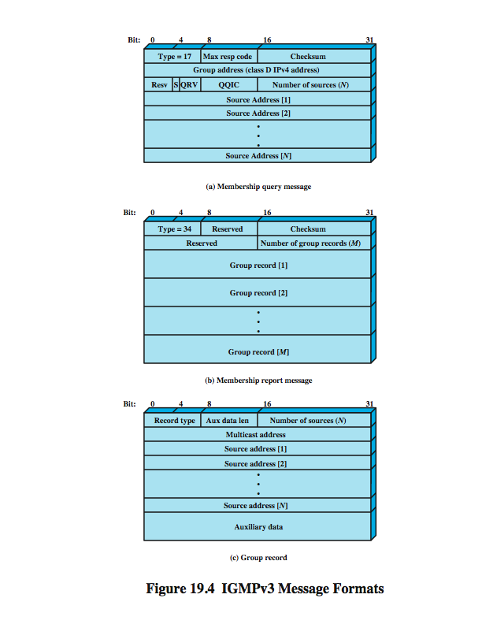
IGMP Message Formats
Membership Query
sent by multicast router
three types: general query, group-specific query, group-and-source specific query
Notes:
All IGMP messages are transmitted in IP datagrams. The current version defines two message types: Membership Query and Membership Report. A Membership Query message is sent by a multicast router. There are three subtypes: a general query, used to learn which groups have members on an attached network; a group-specific query, used to learn if a particular group has any members on an attached network; and a group-and-source specific query, used to learn if any attached device desires reception of packets sent to a specified multicast address, from any of a specified list of sources. Stallings DCC8e Figure 19.4a shows the message format of an IGMP Membership Query message.

Slide 21
Membership Query Fields
Type
Max Response Time
Checksum
Group Address
S Flag
QRV (querier's robustness variable)
QQIC (querier's querier interval code)
Number of Sources
Source addresses
Notes:
The IGMP membership query message has the following fields:
Type: message type.
Max Response Code: maximum allowed time before sending a responding report in units of 1/10 second.
Checksum: error-detecting code, calculated as the 16-bit ones complement sum of all 16-bit words in message. This is the same as used in IPv4.
Group Address: Zero for a general query message; a valid IP multicast address for a group-specific query or group-and-source-specific query.
S Flag: indicates to any receiving multicast routers that they are to suppress the normal timer updates they perform upon hearing a query.
QRV (querier's robustness variable): If nonzero, the QRV field contains the RV value used by the querier (i.e., the sender of the query). The RV dictates how many times a host will retransmit a report to assure that it is not missed by any attached multicast routers.
QQIC (querier's querier interval code): Specifies the QI value used by the querier, which is a timer for sending multiple queries.
Number of Sources: Specifies number source addresses in this query. This value is nonzero only for a group-and-source specific query.
Source addresses: If the number of sources is N, then there are N 32-bit unicast addresses appended to the message.

Slide 22
IGMP Message Formats
Membership Report
Notes:
Stallings DCC8e Figure 19.4b shows the message format of an IGMP Membership Report message, which has the following fields:
Type: Defines this message type.
Checksum: An error-detecting code, calculated as the 16-bit ones complement addition of all the 16-bit words in the message.
Number of Group Records: Specifies how many group records are present in this report.
Group Records: If the number of group records is M, then there are M 32-bit unicast group records appended to the message.

Slide 23
IGMP Message Formats
Group Record
Notes:
Stallings DCC8e Figure 19.4c shows the format of the group record in an IGMP Membership Report message. This has the following fields:
Record Type: Defines this record type, as described subsequently.
Aux Data Length: Length of the auxiliary data field, in 32-bit words.
Number of Sources: Specifies how many source addresses are present in this record.
Multicast Address: The IP multicast address to which this record pertains.
Source Addresses: If the number of sources is N, then there are N 32-bit unicast addresses appended to the message.
Auxiliary Data: Additional information pertaining to this record. Currently, no auxiliary data values are defined.

Slide 24
IGMP Operation - Joining
IGMP host wants to make itself known as group member to other hosts and routers on LAN
IGMPv3 can signal group membership with filtering capabilities with respect to sources
  EXCLUDE mode – all members except those listed
  INCLUDE mode – only from group members listed
to join send IGMP membership report message
  address field multicast address of group
  sent in IP datagram
  current group members receive & learn new member
  routers listen to all IP multicast addresses to hear all reports
Notes:
The objective of each host in using IGMP is to make itself known as a member of a group with a given multicast address to other hosts on the LAN and to all routers on the LAN. IGMPv3 introduces the ability for hosts to signal group membership with filtering capabilities with respect to sources. A host can either signal that it wants to receive traffic from all sources sending to a group except for some specific sources (called EXCLUDE mode) or that it wants to receive traffic only from some specific sources sending to the group (called INCLUDE mode). To join a group, a host sends an IGMP membership report message, in which the group address field is the multicast address of the group. This message is sent in an IP datagram with the same multicast destination address. In other words, the Group Address field of the IGMP message and the Destination Address field of the encapsulating IP header are the same. All hosts that are currently members of this multicast group will receive the message and learn of the new group member. Each router attached to the LAN must listen to all IP multicast addresses in order to hear all reports.

Slide 25
IGMP Operation –
Keeping Lists Valid
routers periodically issue IGMP general query message
  in datagram with all-hosts multicast address
  hosts must read such datagrams
  hosts respond with report message
router don’t know every host in a group
  needs to know at least one group member still active
  each host in group sets timer with random delay
  host hearing another report cancels own
  if timer expires, host sends report
  only one member of each group reports to router
Notes:
To maintain a valid current list of active group addresses, a multicast router periodically issues an IGMP general query message, sent in an IP datagram with an all-hosts multicast address. Each host that still wishes to remain a member of one or more multicast groups must read datagrams with the all-hosts address. When such a host receives the query, it must respond with a report message for each group to which it claims membership.
Note that the multicast router does not need to know the identity of every host in a group. Rather, it needs to know that there is at least one group member still active. Therefore, each host in a group that receives a query sets a timer with a random delay. Any host that hears another host claim membership in the group will cancel its own report. If no other report is heard and the timer expires, a host sends a report. With this scheme, only one member of each group should provide a report to the multicast router.

Slide 26
IGMP Operation - Leaving
host leaves group by sending leave group message to all-routers static multicast address
  sends a membership report message with EXCLUDE option and null list of source addresses
router determines if have any remaining group members using group-specific query message
Notes:
When a host leaves a group, it sends a leave group message to the all-routers static multicast address. This is accomplished by sending a membership report message with the INCLUDE option and a null list of source addresses; that is, no sources are to be included, effectively leaving the group. When a router receives such a message for a group that has group members on the reception interface, it needs to determine if there are any remaining group members. For this purpose, the router uses the group-specific query message.

Slide 27
Group Membership with IPv6
IGMP defined for IPv4
  uses 32-bit addresses
IPv6 internets need functionality
IGMP functions included in Internet Control Message Protocol v 6 (ICMPv6)
  ICMPv6 has functionality of ICMPv4 & IGMP
ICMPv6 includes group-membership query and group-membership report message
Notes:
IGMP was defined for operation with IPv4 and makes use of 32-bit addresses. IPv6 internets need this same functionality. Rather than to define a separate version of IGMP for IPv6, its functions have been incorporated into the new version of the Internet Control Message Protocol (ICMPv6). ICMPv6 includes all of the functionality of ICMPv4 and IGMP. For multicast support, ICMPv6 includes both a group-membership query and a group-membership report message, which are used in the same fashion as in IGMP.

Slide 28
Routing Protocols
routers receive and forward packets
make decisions based on knowledge of topology and traffic/delay conditions
use dynamic routing algorithm
distinguish between:
  routing information - about topology & delays
  routing algorithm - that makes routing decisions based on information
Notes:
The routers in an internet are responsible for receiving and forwarding packets through the interconnected set of networks. Each router makes routing decision based on knowledge of the topology and traffic/delay conditions of the internet. In more complex internets, a degree of dynamic cooperation is needed among the routers. In particular, the router must avoid portions of the network that have failed and should avoid portions of the network that are congested. To make such dynamic routing decisions, routers exchange routing information using a special routing protocol for that purpose. Information is needed about the status of the internet, in terms of which networks can be reached by which routes, and the delay characteristics of various routes. In considering the routing function, it is important to distinguish two concepts:
• Routing information: Information about the topology and delays of the internet
• Routing algorithm: The algorithm used to make a routing decision for a particular datagram, based on current routing information

Slide 29
Autonomous Systems (AS)
is a group of routers and networks managed by single organization
which exchange information via a common routing protocol
form a connected network
  at least one path between any pair of nodes
  except in times of failure
Notes:
An autonomous system (AS) exhibits the following characteristics:
1. An AS is a set of routers and networks managed by a single organization.
2. An AS consists of a group of routers exchanging information via a common routing protocol.
3. Except in times of failure, an AS is connected (in a graph-theoretic sense); that is, there is a path between any pair of nodes.

Slide 30
Interior Router Protocol &
Exterior Routing Protocol
interior router protocol (IRP)
  passes routing information between routers within AS
  can be tailored to specific applications
  needs detailed model of network to function
may have more than one AS in internet
  routing algorithms & tables may differ between them
routers need info on networks outside own AS
use an exterior router protocol (ERP) for this
  supports summary information on AS reachability
Notes:
A shared routing protocol, which we shall refer to as an interior router protocol (IRP), passes routing information between routers within an AS. The protocol used within the AS does not need to be implemented outside of the system. This flexibility allows IRPs to be custom tailored to specific applications and requirements.
It is likely that an internet will be constructed of more than one AS. In this case, the routing algorithms and information in routing tables used by routers in different ASs may differ. Buts, the routers in one AS need at least a minimal level of information concerning networks outside the system that can be reached. We refer to the protocol used to pass routing information between routers in different ASs as an exterior router protocol (ERP).
We can expect that an ERP will need to pass less information than an IRP, for the following reason. If a datagram is to be transferred from a host in one AS to a host in another AS, a router in the first system need only determine the target AS and devise a route to get into that target system. Once the datagram enters the target AS, the routers within that system can cooperate to deliver the datagram; the ERP is not concerned with, and does not know about, the details of the route followed within the target AS.

Slide 31
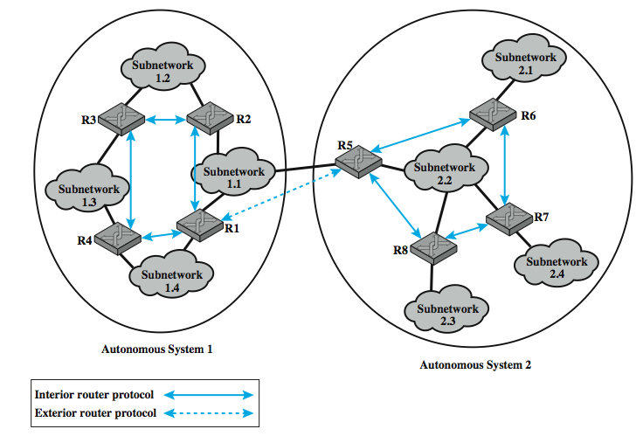
Application of IRP and ERP
Notes:
Illustrate the use of an interior router protocol (IRP) vs an exterior router protocol (ERP) in this example. Here, all of the LANs at a site, such as an office complex or campus, could be linked by routers to form an AS. This system might be linked through a wide area network to other ASs. The situation is illustrated in Stallings DCC8e Figure 19.5.

Slide 32
Approaches to Routing –
Distance-vector
each node (router or host) exchange information with neighboring nodes
first generation routing algorithm for ARPANET
  eg. used by Routing Information Protocol (RIP)
each node maintains vector of link costs for each directly attached network and distance and next-hop vectors for each destination
requires transmission of much info by routers
  distance vector & estimated path costs
changes take long time to propagate
Notes:
Internet routing protocols employ one of three approaches to gathering and using routing information: distance-vector routing, link-state routing, and path-vector routing.
Distance-vector routing requires that each node (router or host that implements the routing protocol) exchange information with its neighboring nodes. Two nodes are said to be neighbors if they are both directly connected to the same network. This approach is that used in the first generation routing algorithm for ARPANET, as described in Section 12.2. For this purpose, each node maintains a vector of link costs for each directly attached network and distance and next-hop vectors for each destination. The relatively simple Routing Information Protocol (RIP) uses this approach.
Distance-vector routing requires the transmission of a considerable amount of information by each router. Each router must send a distance vector to all of its neighbors, and that vector contains the estimated path cost to all networks in the configuration. Furthermore, when there is a significant change in a link cost or when a link is unavailable, it may take a considerable amount of time for this information to propagate through the internet.

Slide 33
Approaches to Routing –
Link-state
designed to overcome drawbacks of distance-vector
each router determines link cost on each interface
advertises set of link costs to all other routers in topology
if link costs change, router advertises new values
each router constructs topology of entire configuration
  can calculate shortest path to each dest
  use to construct routing table with first hop to each dest
do not use distributed routing algorithm, but any suitable alg to determine shortest paths, eg. Dijkstra's algorithm
Open Shortest Path First (OSPF) is a link-state protocol
Notes:
Link-state routing is designed to overcome the drawbacks of distance-vector routing. When a router is initialized, it determines the link cost on each of its network interfaces. The router then advertises this set of link costs to all other routers in the internet topology, not just neighboring routers. From then on, the router monitors its link costs. Whenever there is a significant change (a link cost increases or decreases substantially, a new link is created, an existing link becomes unavailable), the router again advertises its set of link costs to all other routers in the configuration.
Because each router receives the link costs of all routers in the configuration, each router can construct the topology of the entire configuration and then calculate the shortest path to each destination network. Having done this, the router can construct its routing table, listing the first hop to each destination. Because the router has a representation of the entire network, it does not use a distributed version of a routing algorithm, as is done in distance-vector routing. Rather, the router can use any routing algorithm to determine the shortest paths. In practice, Dijkstra's algorithm is used. The open shortest path first (OSPF) protocol is an example of a routing protocol that uses link-state routing. The second generation routing algorithm for ARPANET also uses this approach.

Slide 34
What Exterior Routing Protocols are not
link-state and distance-vector not effective for exterior router protocol
distance-vector
  assumes routers share common distance metric
  but different ASs may have different priorities & needs
  but have no info on AS’s visited along route
link-state
  different ASs may use different metrics and have different restrictions
  flooding of link state information to all routers unmanageable
Notes:
Both link-state and distance-vector approaches have been used for interior router protocols. Neither approach is effective for an exterior router protocol.
In a distance-vector routing protocol, each router advertises to its neighbors a vector listing each network it can reach, together with a distance metric associated with the path to that network. This distance-vector protocol assumes that all routers share a common distance metric with which to judge router preferences. This may not be the case among different ASs. A given AS may have different priorities from other ASs and may have restrictions that prohibit the use of certain other AS. A distance-vector algorithm gives no information about the ASs that will be visited along a route.
In a link-state routing protocol, each router advertises its link metrics to all other routers. Each router builds up a picture of the complete topology of the configuration and then performs a routing calculation. Different ASs may use different metrics and have different restrictions. Although the link-state protocol does allow a router to build up a picture of the entire topology, the metrics used may vary from one AS to another, making it impossible to perform a consistent routing algorithm. The flooding of link state information to all routers implementing an exterior router protocol across multiple ASs may be unmanageable.

Slide 35
Exterior Router Protocols –
Path-vector
alternative path-vector routing protocol
  provides info about which networks can be reached by a given router and ASs crossed to get there
  does not include distance or cost estimate
  hence dispenses with concept of routing metrics
have list of all ASs visited on a route
enables router to perform policy routing
  eg. avoid path to avoid transiting particular AS
  eg. link speed, capacity, tendency to become congested, and overall quality of operation, security
  eg. minimizing number of transit ASs
Notes:
An alternative, known as path-vector routing, is to dispense with routing metrics and simply provide information about which networks can be reached by a given router and the ASs that must be crossed to get there. The approach differs from a distance-vector algorithm in two respects: First, the path-vector approach does not include a distance or cost estimate. Second, each block of routing information lists all of the ASs visited in order to reach the destination network by this route.
Because a path vector lists the ASs that a datagram must traverse if it follows this route, the path information enables a router to perform policy routing. That is, a router may decide to avoid a particular path in order to avoid transiting a particular AS. For example, information that is confidential may be limited to certain kinds of ASs. Or a router may have information about the performance or quality of the portion of the internet that is included in an AS that leads the router to avoid that AS. Examples of performance or quality metrics include link speed, capacity, tendency to become congested, and overall quality of operation. Another criterion that could be used is minimizing the number of transit ASs.

Slide 36
Border Gateway Protocol (BGP)
developed for use with TCP/IP internets
is preferred EGP of the Internet
uses messages sent over TCP connection
current version is BGP-4 (RFC1771)
functional procedures
  neighbor acquisition - when agree to exchange info
  neighbor reachability - to maintain relationship
  network reachability - to update database of routes
Notes:
The Border Gateway Protocol (BGP) was developed for use in conjunction with internets that employ the TCP/IP suite, although the concepts are applicable to any internet. BGP has become the preferred exterior router protocol for the Internet. BGP was designed to allow routers, called gateways in the standard, in different autonomous systems (ASs) to cooperate in the exchange of routing information. The protocol operates in terms of messages, which are sent over TCP connections. The current version of BGP is known as BGP-4 (RFC 1771).
Three functional procedures are involved in BGP First it is necessary to perform neighbor acquisition, which occurs when two neighboring routers in different autonomous systems agree to exchange routing information regularly. A formal acquisition procedure is needed because one of the routers may not wish to participate. To perform neighbor acquisition, two routers send Open messages to each other after a TCP connection is established. If each router accepts the request, it returns a Keepalive message in response.
Once a neighbor relationship is established, the neighbor reachability procedure is used to maintain the relationship. For this purpose, the two routers periodically issue Keepalive messages to each other.
The final procedure is network reachability. Each router maintains a database of the networks that it can reach and the preferred route for reaching each network. When a change is made to this database, the router issues an Update message that is broadcast to all other routers implementing BGP.

Slide 37
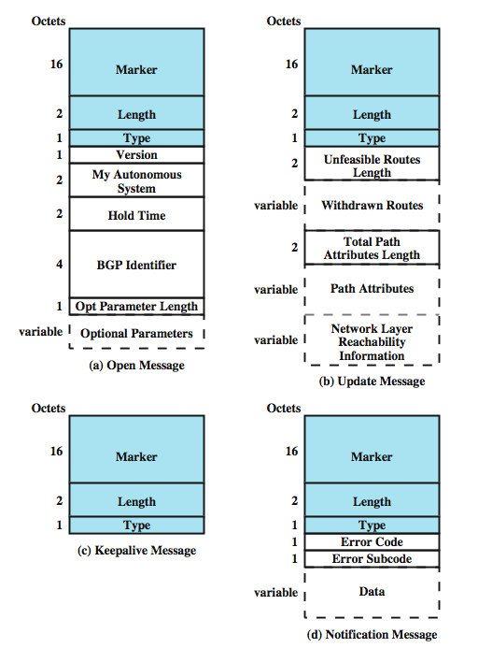
BGP Messages
Open
Update
Keep alive
Notification
Notes:
The repertoire of messages is summarized in Stallings DCC8e Table 19.2:
Open - to open a neighbor relationship with another router
Update - to (1) transmit information about a single route and/or (2) list multiple routes to be withdrawn.
Keepalive - to (1) acknowledge an Open message and (2) periodically confirm the neighbor relationship.
Notification - is sent when an error condition is detected.
Stallings DCC8e Figure 19.6 illustrates the formats of all of the BGP messages. Each message begins with a 19-octet header containing three fields, as indicated by the shaded portion of each message in the figure:
• Marker: Reserved for authentication. The sender may insert a value in this field that would be used as part of an authentication mechanism to enable the recipient to verify the identity of the sender.
• Length: Length of message in octets.
Type: Type of message: Open, Update, Notification, Keepalive.

Slide 38
Message Types -
Open & KeepAlive
router makes TCP connection to neighbor
Open message
  sent by connection initiator
  includes proposed hold time
  receiver uses minimum of own/sent hold time
  max time between Keepalive and/or Update
Keep Alive message
  To tell other routers that this router is still here
Notes:
To acquire a neighbor, a router first opens a TCP connection to the neighbor router of interest. It then sends an Open message. This message identifies the AS to which the sender belongs and provides the IP address of the router. It also includes a Hold Time parameter, which indicates the number of seconds that the sender proposes for the value of the Hold Timer. If the recipient is prepared to open a neighbor relationship, it calculates a value of Hold Timer that is the minimum of its Hold Time and the Hold Time in the Open message. This calculated value is the maximum number of seconds that may elapse between the receipt of successive Keepalive and/or Update messages by the sender.
The Keepalive message consists simply of the header. Each router issues these messages to each of its peers often enough to prevent the Hold Timer from expiring.

Slide 39
Message Types - Update
Update message conveys two info types:
  Info about single routes through internet
  List of routes being withdrawn
info on a route uses 3 fields:
  Network Layer Reachability Information (NLRI)
  Total Path Attributes Length
  Path Attributes
withdraw route identified by dest IP address
Notes:
The Update message communicates two types of information: Information about a single route through the internet, which may be added to the database of any recipient router, and a list of routes previously advertised by this router that are being withdrawn.
An Update message may contain one or both types of information. Information about a single route through the network involves three fields: the Network Layer Reachability Information (NLRI) field, the Total Path Attributes Length field, and the Path Attributes field. The NLRI field consists of a list of identifiers of networks that can be reached by this route. Each network is identified by its IP address, which is actually a portion of a full IP address. Recall that an IP address is a 32-bit quantity of the form {network, host}. The left-hand or prefix portion of this quantity identifies a particular network. The Path Attributes field contains a list of attributes that apply to this particular route.
The second type of update information is the withdrawal of one or more routes. In this case, the route is identified by the IP address of the destination network.

Slide 40
Message Types - Update
Origin - IGP or EGP
AS_Path - list of AS traversed
Next_hop - IP address of border router
Multi_Exit_Disc - info on routers internal to AS
Local_pref - inform routers in AS of route pref
Atomic_Aggregate, Aggregator - implement route aggregation to reduce amount of info
Notes:
The defined attributes used in the Path Attributes field are:
• Origin: Indicates whether this information was generated by an interior router protocol (e.g., OSPF) or an exterior router protocol (in particular, BGP).
• AS_Path: A list of the ASs that are traversed for this route.
• Next_Hop: The IP address of the border router that should be used as the next hop to the destinations listed in the NLRI field.
• Multi_Exit_Disc: Used to communicate some information about routes internal to an AS. This is described later in this section.
• Local_Pref: Used by a router to inform other routers within the same AS of its degree of preference for a particular route. It has no significance to routers in other ASs.
• Atomic_Aggregate, Aggregator: These two fields implement the concept of route aggregation. In essence, an internet and its corresponding address space can be organized hierarchically (i.e., as a tree). In this case, network addresses are structured in two or more parts. All of the networks of a given subtree share a common partial internet address. Using this common partial address, the amount of information that must be communicated in NLRI can be significantly reduced.

Slide 41
AS_Path and Next_Hop Use
AS_Path
  used to implement routing policies
    eg. to avoid a particular AS, security, performance, quality, number of AS crossed
Next_Hop
  only a few routers implement BGP
  responsible for informing outside routers of routes to other networks in AS
Notes:
The AS_Path attribute actually serves two purposes. Because it lists the ASs that a datagram must traverse if it follows this route, the AS_Path information enables a router to implement routing policies. That is, a router may decide to avoid a particular path to avoid transiting a particular AS. For example, information that is confidential may be limited to certain kinds of ASs. Or a router may have information about the performance or quality of the portion of the internet that is included in an AS that leads the router to avoid that AS. Examples of performance or quality metrics include link speed, capacity, tendency to become congested, and overall quality of operation. Another criterion that could be used is minimizing the number of transit ASs.
Typically, most of the routers in an autonomous system will not implement BGP. Only a few routers will be assigned responsibility for communicating with routers in other autonomous systems. The Next_Hop attribute is used to convey the identity of the next hop border router, independent of whether it implements BGP (though it must use an IRP to relay this info to a BGP router in its AS).

Slide 42
Notification Message
sent when some error condition detected:
Message header error
Open message error
Update message error
Hold time expired
Finite state machine error
Cease
Notes:
The Notification Message is sent when an error condition is detected. The following errors may be reported:
• Message header error: Includes authentication and syntax errors.
• Open message error: Includes syntax errors and options not recognized in an Open message. This message can also be used to indicate that a proposed Hold Time in an Open message is unacceptable.
• Update message error: Includes syntax and validity errors in an Update message.
• Hold timer expired: If the sending router has not received successive Keepalive and/or Update and/or Notification messages within the Hold Time period, then this error is communicated and the connection is closed.
• Finite state machine error: Includes any procedural error.
• Cease: Used by a router to close a connection with another router in the absence of any other error.

Slide 43
BGP Routing Information Exchange
within AS a router builds topology picture using IGP
router issues Update message to other routers outside AS using BGP
these routers exchange info with other routers in other AS
  AS_Path field used to prevent loops
routers must then decide best routes
Notes:
The essence of BGP is the exchange of routing information among participating routers in multiple ASs. This process can be quite complex. In what follows, we provide a simplified overview. To begin, a router that implements BGP will also implement an internal routing protocol such as OSPF. This is used to exchange routing information with other routers within the AS, to build up a picture of the topology of the networks and routers in AS, and to construct a routing table. Next, the router can issue an Update message to its neighbors that informs them that all of the networks listed in NLRI are reachable via this router, and that the only autonomous system traversed is it’s AS. In turn these routers can forward the information just received in a new Update message to its neighbors. They must now decide if this route is its preferred route to the networks listed. It may have knowledge of an alternate route to some or all of these networks that it prefers for reasons of performance or some other policy metric. In this fashion, routing update information is propagated through the larger internet, consisting of a number of interconnected autonomous systems. The AS_Path field is used to assure that such messages do not circulate indefinitely: if an Update message is received by a router in an AS that is included in the AS_Path field, that router will not forward the update information to other routers.
Routers within the same AS, called internal neighbors, may exchange BGP information. In this case, the sending router does not add the identifier of the common AS to the AS_Path field. When a router has selected a preferred route to an external destination, it transmits this route to all of its internal neighbors.

Slide 44
BGP Example Figure 19.5
R1 can issue an Update message to R5 in AS2:
  AS_Path: The identity of AS1
  Next_Hop: The IP address of R1
  NLRI: A list of all of the networks in AS1
R5 also has a neighbor relationship with R9 in AS3, R5 will forward a new Update msg to R9:
  AS_Path: The list of identifiers [AS2, AS1]
  Next_Hop: The IP address of R5
  NLRI: A list of all of the networks in AS1

Slide 45
Open Shortest Path First (RFC2328)
IGP of Internet
replaced Routing Information Protocol (RIP)
uses Link State Routing Algorithm
  each router keeps list of state of local links to network
  transmits update state info
  little traffic as messages are small and not sent often
uses least cost based on user cost metric
topology stored as directed graph
  vertices or nodes (router, transit or stub network)
  edges (between routers or router to network)
Notes:
The OSPF protocol (RFC 2328) is now widely used as the interior router protocol in TCP/IP networks. OSPF computes a route through the internet that incurs the least cost based on a user-configurable metric of cost. The user can configure the cost to express a function of delay, data rate, dollar cost, or other factors. OSPF is able to equalize loads over multiple equal-cost paths.
Each router maintains a database that reflects the known topology of the autonomous system of which it is a part. The topology is expressed as a directed graph. The graph consists of: Vertices, or nodes (router, transit or stub networks); and edges (directly connected routers, router to network).

Slide 46
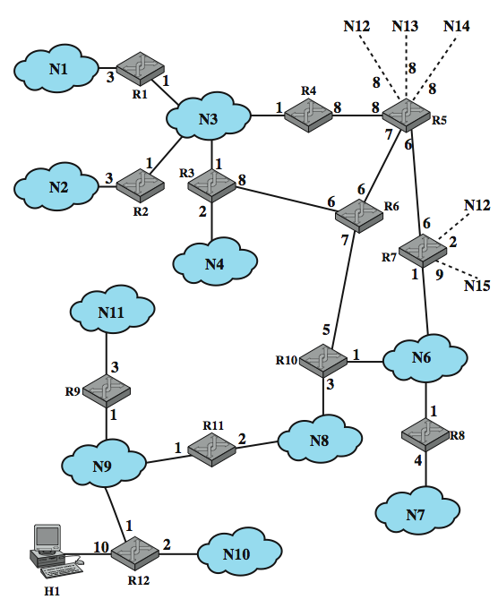
Example OSPF AS
Notes:
Stallings DCC8e Figure 19.7, based on one in RFC 2328, shows an example of an autonomous system.

Slide 47
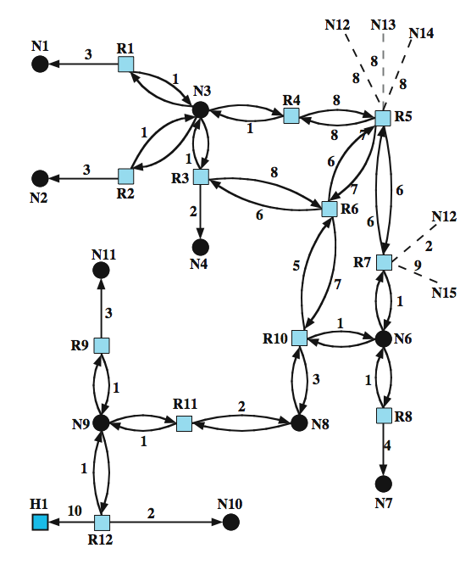
Directed
Graph of AS
Notes:
Stallings DCC8e Figure 19.8 is the resulting directed graph, mapped using:
• Two routers joined by a point-to-point link are represented in the graph as being directly connected by a pair of edges, one in each direction (e.g., routers 6 and 10).
• When multiple routers are attached to a network (such as a LAN or packet-switching network), the directed graph shows all routers bidirectionally connected to the network vertex (e.g., routers 1, 2, 3, and 4 all connect to network 3).
• If a single router is attached to a network, the network will appear in the graph as a stub connection (e.g., network 7).
• An end system, called a host, can be directly connected to a router, in which case it is depicted in the corresponding graph (e.g., host 1).
• If a router is connected to other autonomous systems, then the path cost to each network in the other system must be obtained by some exterior router protocol (ERP). Each such network is represented on the graph by a stub and an edge to the router with the known path cost (e.g., networks 12 through 15).
A cost is associated with the output side of each router interface. This cost is configurable by the system administrator. Arcs on the graph are labeled with the cost of the corresponding router output interface. Arcs having no labeled cost have a cost of 0. Note that arcs leading from networks to routers always have a cost of 0.

Slide 48
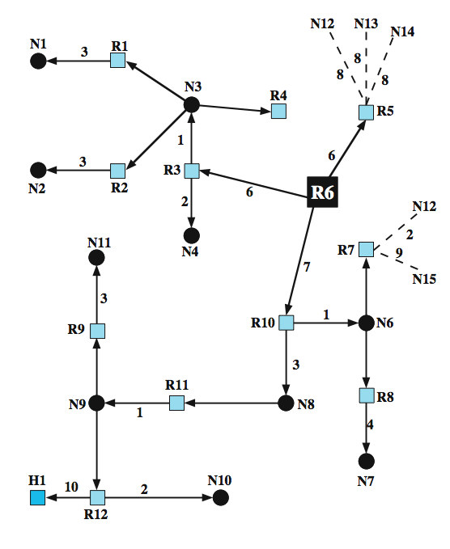
SPF Tree for Router 6
Notes:
A database corresponding to the directed graph is maintained by each router. It is pieced together from link state messages from other routers in the internet. Using Dijkstra's algorithm (see Stallings DCC8e Section 12.3), a router calculates the least-cost path to all destination networks. The result for router 6 of Figure 19.7 is shown as a tree in Stallings DCC8e Figure 19.9, with R6 as the root of the tree. The tree gives the entire route to any destination network or host. However, only the next hop to the destination is used in the forwarding process. The resulting routing table for router 6 is shown in Stallings DCC8e Table 19.3. The table includes entries for routers advertising external routes (routers 5 and 7). For external networks whose identity is known, entries are also provided.

Slide 49
Integrated Services Architecture
changes in traffic demands require variety of quality of service
  eg. internet phone, multimedia, multicast
new functionality required in routers
new means of requesting QoS
IETF developing a suite of Integrated Services Architecture (ISA) standards
RFC 1633 defines overall view of ISA
Notes:
To meet the requirement for QoS-based service, the IETF is developing a suite of standards under the general umbrella of the Integrated Services Architecture (ISA). ISA, intended to provide QoS transport over IP-based internets, is defined in overall terms in RFC 1633, while a number of other documents are being developed to fill in the details. Already, a number of vendors have implemented portions of the ISA in routers and end-system software.

Slide 50
Internet Traffic Categories
elastic traffic
  can cope with wide changes in delay and/or throughput
  traditional TCP/IP traffic
  eg. FTP, email, telnet, SNMP, HTTP
  different sensitivity to throughput, delay, congestion
inelastic traffic
  does not easily adapt to variations
Notes:
Traffic on a network or internet can be divided into two broad categories: elastic and inelastic.
Elastic traffic is that which can adjust, over wide ranges, to changes in delay and throughput across an internet and still meet the needs of its applications. This is the traditional type of traffic supported on TCP/IP-based internets and is the type of traffic for which internets were designed. Applications that generate such traffic typically use TCP or UDP as a transport protocol. Applications that can be classified as elastic include the common applications that operate over TCP or UDP, including file transfer (FTP), electronic mail (SMTP), remote login (TELNET), network management (SNMP), and Web access (HTTP). However, there are differences among the requirements of these applications.
Inelastic traffic does not easily adapt, if at all, to changes in delay and throughput across an internet. The prime example is real-time traffic.

Slide 51
Inelastic Traffic Requirements
throughput
delay
jitter
packet loss
need preferential treatment for some traffic types
require elastic traffic to be supported
Notes:
The requirements for inelastic traffic may include the following:
• Throughput: Unlike most elastic traffic, many inelastic applications absolutely require a given minimum throughput.
• Delay:
• Jitter: The magnitude of delay variation, called jitter, is a critical factor in real-time applications. Real-time interactive applications, such as teleconferencing, may require a reasonable upper bound on jitter.
• Packet loss: Real-time applications vary in the amount of packet loss, if any, that they can sustain.
These requirements are difficult to meet in an environment with variable queuing delays and congestion losses. Accordingly, inelastic traffic introduces two new requirements into the internet architecture. First, some means is needed to give preferential treatment to applications with more demanding requirements. A second requirement in supporting inelastic traffic in an internet architecture is that elastic traffic must still be supported. Inelastic applications typically do not back off and reduce demand in the face of congestion, in contrast to TCP-based applications. Therefore, in times of congestion, inelastic traffic will continue to supply a high load, and elastic traffic will be crowded off the internet.

Slide 52
ISA Approach
IP nets control congestion by
  routing algorithms
  packet discard
ISA provides enhancements to traditional IP
in ISA associate each packet with a flow
ISA functions:
  admission control
  routing algorithm
  queuing discipline
  discard policy
Notes:
The purpose of ISA is to enable the provision of QoS support over IP-based internets. The central design issue for ISA is how to share the available capacity in times of congestion. For an IP-based internet that provides only a best-effort service, the tools for controlling congestion and providing service are limited. In essence, routers have two mechanisms to work with: routing algorithm & packet discard.
ISA is an overall architecture within which a number of enhancements to the traditional best-effort mechanisms are being developed. In ISA, each IP packet can be associated with a flow. RFC 1633 defines a flow as a distinguishable stream of related IP packets that results from a single user activity and requires the same QoS.
ISA makes use of the following functions to manage congestion and provide QoS transport:
• Admission control: For QoS transport ISA requires that a reservation be made for a new flow. The protocol RSVP is used to make reservations.
• Routing algorithm: The routing decision may be based on a variety of QoS parameters, not just minimum delay.
• Queuing discipline: an effective queuing policy that considers differing requirements of different flows.
• Discard policy: determines which packets to drop when a buffer is full and new packets arrive.

Slide 53
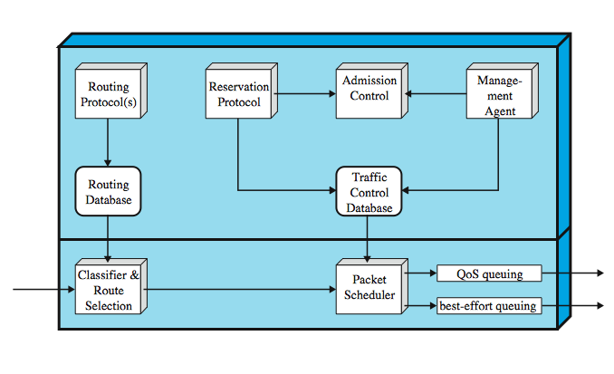
ISA in Router
Notes:
Stallings DCC8e Figure 19.10 is a general depiction of the implementation architecture for ISA within a router. Below the thick horizontal line are the forwarding functions of the router; these are executed for each packet and therefore must be highly optimized. The remaining functions, above the line, are background functions that create data structures used by the forwarding functions. The principal background functions are:
• Reservation protocol: used to reserve resources for a new flow at a given level of QoS, among routers and between routers and end systems. RSVP is used for this purpose.
• Admission control: determines if sufficient resources are available for a new flow at the requested QoS.
• Management agent: is able to modify the traffic control database and to direct the admission control module in order to set admission control policies.
• Routing protocol: is responsible for maintaining a routing database that gives the next hop to be taken for each destination address and each flow.
These background functions support the main task of the router, forwarding packets. The two principal functional areas that do this are:
• Classifier and route selection: maps incoming packets into classes, which may correspond to a single flow or to flows with the same QoS requirements.
• Packet scheduler: manages one or more queues for each output port.

Slide 54
ISA Services
Guaranteed
  assured data rate
  upper bound on queuing delay
  no queuing loss
Controlled load
  approximates best effort behavior on unloaded net
  no specific upper bound on queuing delay
  very high delivery success
Best Effort
  traditional IP service
Notes:
ISA service for a flow of packets is defined on two levels: a general category of service which provides a certain general type of service guarantees; and within each category, the service for a particular flow is specified by the values of certain parameters; the traffic specification (TSpec). Currently, three categories of service are defined: Guaranteed, Controlled load & Best effort.
The guaranteed service is the most demanding service provided by ISA. Uses include real-time playback of incoming data. Its key elements are:
• it provides assured capacity, or data rate.
• it has a specified upper bound on the queuing delay through the network.
• it has are no queuing losses.
The controlled load service is useful for adaptive real-time applications. Its key elements are:
• it tightly approximates the behavior visible to applications receiving best-effort service under unloaded conditions
• no specified upper bound on the queuing delay through the network but ensures a very high percentage of the packets dont experience excessive delays
• a very high percentage of transmitted packets will be successfully delivered

Slide 55
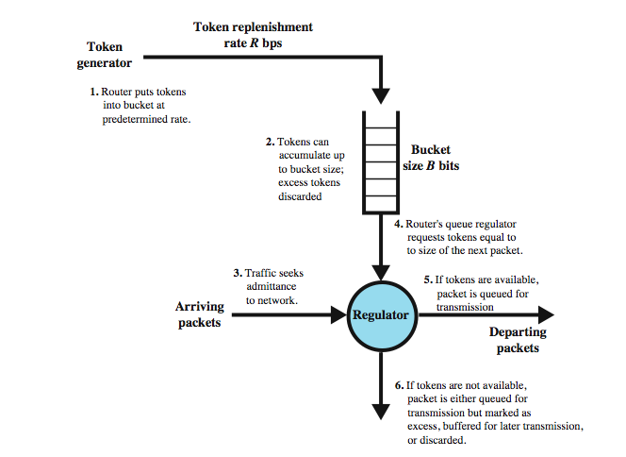
Token Bucket Scheme
For T_{spec}
Notes:
Before looking at the ISA service categories, one general concept should be defined: the token bucket traffic specification. This is a way of characterizing traffic that has advantages in the context of ISA. A token bucket traffic specification consists of two parameters: a token rate R that specifies the continually sustainable data rate; that is, over a relatively long period of time, the average data rate to be supported for this flow is R; and the bucket size B tat specifies the amount by which the data rate can exceed R for short periods of time.
Stallings DCC8e Figure 19.11 illustrates this scheme. The bucket represents a counter that indicates the allowable number of octets of IP data that can be sent at any time. The bucket fills with octet tokens at the rate of R up to the bucket capacity. IP packets arrive and are queued for processing. An IP packet may be processed if there are sufficient octet tokens to match the IP data size. If so, the packet is processed and the bucket is drained of the corresponding number of tokens. If a packet arrives and there are insufficient tokens available, then the packet exceeds the TSpec for this flow, it could be relegated to best-effort service, discarded, or marked as eligible for discard in future.
Over the long run, the rate of IP data allowed by the token bucket is R. However, if there is an idle or relatively slow period, the bucket capacity builds up, so that at most an additional B octets above the stated rate can be accepted. Thus, B is a measure of the degree of burstiness of the data flow that is allowed.

Slide 56
Queuing Discipline
traditionally FIFO
  no special treatment for high priority flow packets
  large packet can hold up smaller packets
  greedy connection can crowd out less greedy connection
need some form of fair queuing
  multiple queues used on each output port
  packet is placed in queue for its flow
  round robin servicing of queues
  can have weighted fair queuing
Notes:
An important component of an ISA implementation is the queuing discipline used at the routers. Routers traditionally have used a first-in-first-out (FIFO) queuing discipline using a single queue at each output port. There are several drawbacks to the FIFO queuing discipline:
• No special treatment is given to packets from flows that are of higher priority or are more delay sensitive.
• If a number of smaller packets are queued behind a long packet, then FIFO queuing results in a larger average delay per packet than if the shorter packets were transmitted before the longer packet.
• A greedy TCP connection can crowd out more altruistic connections.
To overcome the drawbacks of FIFO queuing, some sort of fair queuing scheme is used, in which a router maintains multiple queues at each output port. With simple fair queuing, each incoming packet is placed in the queue for its flow. The queues are serviced in round-robin fashion, taking one packet from each nonempty queue in turn. Empty queues are skipped over. This scheme is fair in that each busy flow gets to send exactly one packet per cycle. Further, this is a form of load balancing among the various flows. There is no advantage in being greedy. A greedy flow finds that its queues become long, increasing its delays, whereas other flows are unaffected by this behavior.
A number of vendors have implemented a refinement of fair queuing known as weighted fair queuing (WFQ), which takes into account the amount of traffic through each queue and gives busier queues more capacity without completely shutting out less busy queues.

Slide 57
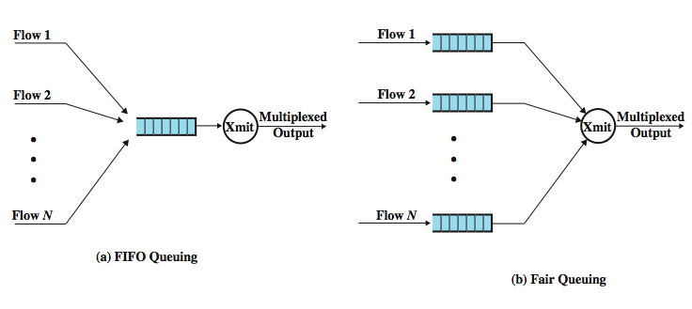
FIFO and Fair Queue
Notes:
Stallings DCC8e Figure 19.12 illustrates the difference between FIFO & Fair Queuing.

Slide 58
Resource Reservation: RSVP
RFC 2205
unicast applications can reserve resources in routers to meet QoS
  if router can not meet request, application informed
multicast more demanding, but may be reduced
  some members of group may not require delivery from particular source over given time
  some group members may only be able to handle a portion of the transmission
  reservation means routers can decide in advance if can meet requirements
Notes:
RFC 2205 defines the Resource ReSerVation Protocol (RSVP), which provides supporting functionality for ISA, by allowing applications to reserve network resources at a given QoS.
For unicast, two applications agree on a specific quality of service for a session and expect the internetwork to support that quality of service. If the internetwork is heavily loaded, it may not provide the desired QOS and instead deliver packets at a reduced QOS. In that case, the applications may have preferred to wait before initiating the session or at least to have been alerted to the potential for reduced QOS.
Multicast transmission presents a much more compelling case for implementing resource reservation. A multicast transmission can generate a tremendous amount of internetwork traffic if either the application is high-volume or the group of multicast destinations is large and scattered, or both. Much of the potential load generated by a multicast source may easily be prevented because some members of an existing multicast group may not require delivery from a particular source over some given period of time, and some members of a group may only be able to handle a portion of the source transmission. Thus, the use of resource reservation can enable routers to decide ahead of time if they can meet the requirement to deliver a multicast transmission to all designated multicast receivers and to reserve the appropriate resources if possible.

Slide 59
Soft State
have different resource reservation needs to traditional connection-oriented networks
  must dynamically change
use concept of Soft State
  set of state info in router that expires unless refreshed
applications must periodically renew requests during transmission
Notes:
Internet resource reservation differs from the type of resource reservation that may be implemented in a connection-oriented network, such as ATM or frame relay. An internet resource reservation scheme must interact with a dynamic routing strategy that allows the route followed by packets of a given transmission to change. When the route changes, the resource reservations must be changed. To deal with this dynamic situation, the concept of soft state is used. A soft state is simply a set of state information at a router that expires unless regularly refreshed from the entity that requested the state. If a route for a given transmission changes, then some soft states will expire and new resource reservations will invoke the appropriate soft states on the new routers along the route. Thus, the end systems requesting resources must periodically renew their requests during the course of an application transmission.

Slide 60
RSVP Characteristics
unicast and multicast
simplex
receiver initiated reservation
maintain soft state in the internet
provide different reservation styles
transparent operation through non-RSVP routers
support for IPv4 and IPv6
Notes:
The specification lists the following characteristics of RSVP:
• Unicast and multicast: RSVP makes reservations for both unicast and multicast transmissions, adapting dynamically to changing group membership as well as to changing routes, and reserving resources based on the individual requirements of multicast members.
• Simplex: RSVP makes reservations for unidirectional data flow. Need separate reservations in two directions for two way flow.
• Receiver-initiated reservation: The receiver of a data flow initiates and maintains the resource reservation for that flow.
• Maintaining soft state in the internet: RSVP maintains a soft state at intermediate routers and leaves the responsibility for maintaining these reservation states to end users.
• Providing different reservation styles: allow RSVP users to specify how reservations for the same multicast group should be aggregated at the intermediate switches.
• Transparent operation through non-RSVP routers: Because reservations and RSVP are independent of routing protocol, there is no fundamental conflict in a mixed environment in which some routers do not employ RSVP. These routers will simply use a best-effort delivery technique.
• Support for IPv4 and IPv6: RSVP can exploit the Type-of-Service field in the IPv4 header and the Flow Label field in the IPv6 header.

Slide 61
Differentiated Services
simple, easily implemented, low overhead tool to support a range of differentiated network services
IP Packets labeled for differing QoS using existing IPv4 Type of Service or IPv6 DS field
have service level agreement established between provider and customer prior to use of DS
have built in aggregation
implemented by queuing and forwarding based on DS octet
most widely used QoS mechanism today
Notes:
As Internet traffic grows, and as the variety of applications grow, there is an immediate need to provide differing levels of QoS to different traffic flows. The differentiated services (DS) architecture (RFC 2475) is designed to provide a simple, easy-to-implement, low-overhead tool to support a range of network services that are differentiated on the basis of performance. Several key characteristics of DS contribute to its efficiency and ease of deployment:
• IP packets are labeled for differing QoS treatment using the existing IPv4 or IPv6 DS field. Thus, no change is required to IP.
• A service level agreement (SLA) is established between the service provider (internet domain) and the customer prior to the use of DS. This avoids the need to incorporate DS mechanisms in applications. Thus, existing applications need not be modified to use DS.
• DS provides a built-in aggregation mechanism. All traffic with the same DS octet is treated the same by the network service. For example, multiple voice connections are not handled individually but in the aggregate. This provides for good scaling to larger networks and traffic loads.
• DS is implemented in individual routers by queuing and forwarding packets based on the DS octet. Routers deal with each packet individually and do not have to save state information on packet flows.
DS is the most widely accepted QoS mechanism in enterprise networks today.

Slide 62
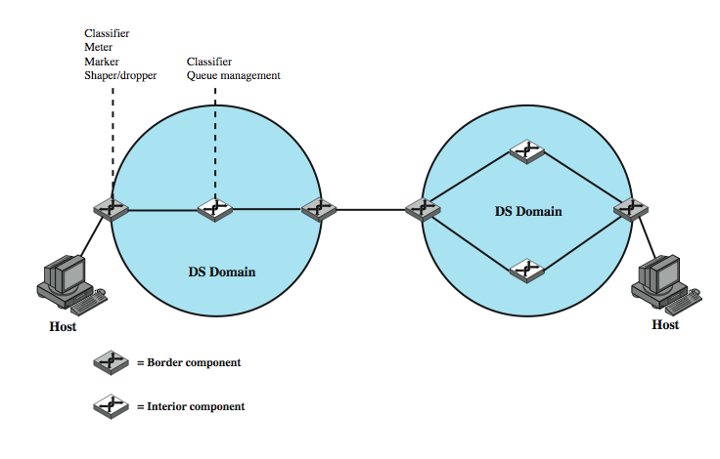
DS Domains
Traffic Conditioner
Per Hop Behavior (PHB)
Notes:
The DS type of service is provided within a DS domain, as shown in Stallings DCC8e Figure 19.14. This illustrates the type of configuration envisioned in the DS documents. A DS domain consists of a set of contiguous routers; that is, it is possible to get from any router in the domain to any other router in the domain by a path that does not include routers outside the domain. Within a domain, the interpretation of DS codepoints is uniform, so that a uniform, consistent service is provided.

Slide 63
DS Services
is defined within a DS domain
  a contiguous portion of internet over which consistent set of DS policies are administered
  typically under control of one organization
  defined by service level agreements (SLA)
  specify service received for classes of packets
once established customer submits packets with DS marked indicating class
  service provider ensures agreed QoS within domain
  if transit other domains, provider chooses closest QoS
Notes:
The DS type of service is provided within a DS domain, which is defined as a contiguous portion of the Internet over which a consistent set of DS policies are administered. Typically, a DS domain would be under the control of one administrative entity. The services provided across a DS domain are defined in a service level agreement (SLA), which is a service contract between a customer and the service provider that specifies the forwarding service that the customer should receive for various classes of packets. A customer may be a user organization or another DS domain. Once the SLA is established, the customer submits packets with the DS octet marked to indicate the packet class. The service provider must assure that the customer gets at least the agreed QoS for each packet class. To provide that QoS, the service provider must configure the appropriate forwarding policies at each router (based on DS octet value) and must measure the performance being provided for each class on an ongoing basis.
If a customer submits packets intended for destinations within the DS domain, then the DS domain is expected to provide the agreed service. If the destination is beyond the customer's DS domain, then the DS domain will attempt to forward the packets through other domains, requesting the most appropriate service to match the requested service.

Slide 64
SLA Parameters
detailed service performance such as:
  expected throughput
  drop probability
  latency
constraints on ingress and egress points
traffic profiles
disposition of traffic in excess of profile
Notes:
A draft DS framework document lists the following detailed performance parameters that might be included in an SLA:
• Detailed service performance parameters such as expected throughput, drop probability, latency
• Constraints on the ingress and egress points at which the service is provided, indicating the scope of the service
• Traffic profiles that must be adhered to for the requested service to be provided, such as token bucket parameters
• Disposition of traffic submitted in excess of the specified profile

Slide 65
Example Services
level A - low latency
level B - low loss
level C - 90% of traffic < 50ms latency
level D - 95% in profile traffic delivered
level E - allotted twice bandwidth of level F
level F - with drop precedence X has higher probability of delivery than that of Y
Qualitative
Quantitative
Mixture
Notes:
The framework document also gives some examples of services that might be provided:
1. Traffic offered at service level A will be delivered with low latency.
2. Traffic offered at service level B will be delivered with low loss.
3. Ninety percent of in-profile traffic delivered at service level C will experience no more than 50 ms latency.
4. Ninety-five percent of in-profile traffic delivered at service level D will be delivered.
5. Traffic offered at service level E will be allotted twice the bandwidth of traffic delivered at service level F.
6. Traffic with drop precedence X has a higher probability of delivery than traffic with drop precedence Y.
The first two examples are qualitative and are valid only in comparison to other traffic, such as default traffic that gets a best-effort service. The next two examples are quantitative and provide a specific guarantee that can be verified by measurement on the actual service without comparison to any other services offered at the same time. The final two examples are a mixture of quantitative and qualitative.

Slide 66
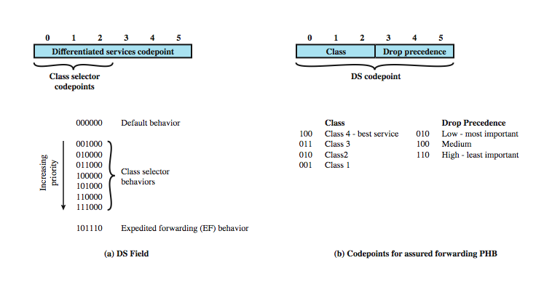
DS Field
Notes:
Packets are labeled for service handling by means of the 6-bit DS field in the IPv4 header or the IPv6 header. Stallings DCC8e Figure 19.13a Shows the DS field.

Slide 67
DS Field - DS Codepoint
6 bit field in IPv4 & IPv6 header
3 pools of code points
  xxxxx0 - assignment as standards
    000000 - default best effort
    xxx000 - IPv4 precedence compatibility
  xxxx11 - experimental or local use
  xxxx01 - experimental or local but may be allocated for standards in future
Notes:
Packets are labeled for service handling by means of the 6-bit DS field in the IPv4 header or the IPv6 header. The value of the DS field, referred to as the DS codepoint, is the label used to classify packets for differentiated services. Figure 19.13a Shows the DS field. With a 6-bit codepoint, there are in principle 64 different classes of traffic that could be defined. These 64 codepoints are allocated across three pools of codepoints, as follows:
• Codepoints of the form xxxxx0, where x is either 0 or 1, are reserved for assignment as standards.
• Codepoints of the form xxxx11 are reserved for experimental or local use.
• Codepoints of the form xxxx01 are also reserved for experimental or local use but may be allocated for future standards action as needed.
Within the first pool, several assignments are made in RFC 2474. The codepoint 000000 is the default packet class. The default class is the best-effort forwarding behavior in existing routers. Codepoints of the form xxx000 are reserved to provide backward compatibility with the IPv4 precedence service. The DS codepoints of the form xxx000 should provide a service that at minimum is equivalent to that of the IPv4 precedence functionality.

Slide 68
IPv4 Precedence Service
IPv4 TOS field included subfields
  precedence (3 bit) - datagram urgency/priority
  TOS(4 bit) - guidance on selecting next hop
can respond with
  route selection - smaller queue, has priority
  network service - supports precedence
  queuing discipline - support precedence ordered queueing & discard lower precedence
Notes:
Need an explanation of the IPv4 precedence service. The IPv4 type of service (TOS) field includes two subfields: a 3-bit precedence subfield and a 4-bit TOS subfield. These subfields serve complementary functions. The TOS subfield provides guidance to the IP entity (in the source or router) on selecting the next hop for this datagram, and the precedence subfield provides guidance about the relative allocation of router resources for this datagram. The precedence field is set to indicate the degree of urgency or priority to be associated with a datagram. If a router supports the precedence subfield, there are three approaches to responding:
• Route selection: A particular route may be selected if the router has a smaller queue for that route or if the next hop on that route supports network precedence or priority (e.g., a token ring network supports priority).
• Network service: If the network on the next hop supports precedence, then that service is invoked.
• Queuing discipline: A router may use precedence to affect how queues are handled. For example, a router may give preferential treatment in queues to datagrams with higher precedence. RFC 1812, Requirements for IP Version 4 Routers, provides recommendations for queuing discipline based on queue service (Routers SHOULD implement precedence-ordered queue service) & congestion control (If precedence-ordered queue service is implemented and enabled, the router MUST NOT discard a packet whose IP precedence is higher than that of a packet that is not discarded).

Slide 69
DS Configuration and Operation
within domain, interpretation of DS code points is uniform
interior nodes
  implement simple mechanisms
  per-hop behavior (PHB) on all routers
boundary nodes
  have PHB & more sophisticated mechanisms
  hence most of complexity
Notes:
A DS domain (like that shown in Stallings DCC8e Figure 19.14. previously) consists of a set of contiguous routers; that is, it is possible to get from any router in the domain to any other router in the domain by a path that does not include routers outside the domain. Within a domain, the interpretation of DS codepoints is uniform, so that a uniform, consistent service is provided.
Routers in a DS domain are either boundary nodes or interior nodes. Typically, the interior nodes implement simple mechanisms for handling packets based on their DS codepoint values. This includes queuing discipline to give preferential treatment depending on codepoint value, and packet dropping rules to dictate which packets should be dropped first in the event of buffer saturation. The DS specifications refer to the forwarding treatment provided at a router as per-hop behavior (PHB). This PHB must be available at all routers, and typically PHB is the only part of DS implemented in interior routers.
The boundary nodes include PHB mechanisms but more sophisticated traffic conditioning mechanisms are also required to provide the desired service. Thus, interior routers have minimal functionality and minimal overhead in providing the DS service, while most of the complexity is in the boundary nodes. The boundary node function can also be provided by a host system attached to the domain, on behalf of the applications at that host system.

Slide 70
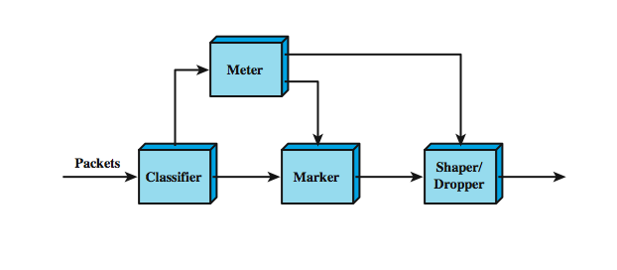
DS Traffic Conditioner
Notes:
The boundary router traffic conditioning function consists of five elements. Stallings DCC8e Figure 19.15 illustrates the relationship between them:
• Classifier: Separates submitted packets into different classes. A classifier may separate traffic only on the basis of the DS codepoint (behavior aggregate classifier) or based on multiple fields within the packet header or even the packet payload (multifield classifier).
• Meter: Measures submitted traffic for conformance to a profile. The meter determines whether a given packet stream class is within or exceeds the service level guaranteed for that class.
• Marker: Re-marks packets with a different codepoint as needed. This may be done for packets that exceed the profile; for example, if a given throughput is guaranteed for a particular service class, any packets in that class that exceed the throughput in some defined time interval may be re-marked for best effort handling. Also, re-marking may be required at the boundary between two DS domains. For example, if a given traffic class is to receive the highest supported priority, and this is a value of 3 in one domain and 7 in the next domain, then packets with a priority 3 value traversing the first domain are remarked as priority 7 when entering the second domain.
• Shaper: Delays packets as necessary so that the packet stream in a given class does not exceed the traffic rate specified in the profile for that class.
• Dropper: Drops packets when the rate of packets of a given class exceeds that specified in the profile for that class.

Slide 71
Per Hop Behavior –
Expedited Forwarding
specific PHBs defined
expedited forwarding (EF) PHB (RFC 3246)
  low-loss, low-delay, low-jitter, assured bandwidth, end-to-end service through DS domains
  simulates a point-to-point connection or leased line
difficult in internet or packet-switching network
  queues on node/router result in loss, delays, and jitter
  unless internet grossly oversized, care needed in handling premium service traffic
EF PHB intent is to use empty/short queues to minimise delay, jitter & packet loss.
Notes:
As part of the DS standardization effort, specific types of PHB need to be defined, associated with specific differentiated services. RFC 3246 defines the expedited forwarding (EF) PHB as a building block for low-loss, low-delay, and low-jitter end-to-end services through DS domains (simulates a point-to-point connection or leased line). Is difficult to achieve in an internet or packet-switching network because an internet involves queues at each node, or router, where packets are buffered waiting to use a shared output link. It is the queuing behavior at each node that results in loss, delays, and jitter. Thus, unless the internet is grossly oversized to eliminate all queuing effects, care must be taken in handling traffic for EF PHB. The intent of the EF PHB is to provide a PHB in which suitably marked packets usually encounter short or empty queues. The relative absence of queues minimizes delay and jitter. Furthermore, if queues remain short relative to the buffer space available, packet loss is also kept to a minimum.

Slide 72
Expedited Forwarding Requirements
EF PHB designed to configure nodes so traffic aggregate has minimum departure rate
border routers condition traffic aggregate (via policing / shaping) so arrival rate is less than minimum departure rate for nodes
interior nodes treat traffic so no queuing effects
no specific queuing policy set for interior nodes
note a simple priority scheme can achieve this
  EF traffic given absolute priority
  EF traffic must not overwhelm interior node
  but packet flows for other PHB traffic disrupted
Notes:
The EF PHB is designed to configure nodes so that the traffic aggregate has a well-defined minimum departure rate. (Well-defined means "independent of the dynamic state of the node." In particular, independent of the intensity of other traffic at the node.) The general concept outlined in RFC 3246 is this: the border nodes control the traffic aggregate to limit its characteristics (rate, burstiness) to some predefined level. Interior nodes must treat the incoming traffic in such a way that queuing effects do not appear. In general terms, the requirement on interior nodes is that the aggregate's maximum arrival rate must be less than the aggregate's minimum departure rate.
RFC 3246 does not mandate a specific queuing policy at the interior nodes to achieve the EF PHB. The RFC notes that a simple priority scheme could achieve the desired effect, with the EF traffic given absolute priority over other traffic. So long as the EF traffic itself did not overwhelm an interior node, this scheme would result in acceptable queuing delays for the EF PHB. However, the risk of a simple priority scheme is that packet flows for other PHB traffic would be disrupted. Thus, some more sophisticated queuing policy might be warranted.

Slide 73
Assured Forwarding PHB
provide service superior to best-effort
without needing reservation of resources or detailed flow discrimination
based on explicit allocation
  users offered choice of classes of service
  traffic monitored at boundary node, marked in/out
  inside network, no separation of traffic from different users or classes
  when congested, drop out packets before in packets
  different users will see different levels of service
advantage is simplicity
Notes:
The assured forwarding (AF) PHB is designed to provide a service superior to best-effort but one that does not require the reservation of resources within an internet and does not require the use of detailed discrimination among flows from different users. The concept behind the AF PHB is referred to as explicit allocation:
1. Users are offered the choice of a number of classes of service for their traffic. Each class describes a different traffic profile in terms of an aggregate data rate and burstiness.
2. Traffic from a user within a given class is monitored at a boundary node. Each packet in a traffic flow is marked in or out based on whether it does or does not exceed the traffic profile.
3. Inside the network, there is no separation of traffic from different users or even traffic from different classes. Instead, all traffic is treated as a single pool of packets, with the only distinction being whether each packet has been marked in or out.
4. When congestion occurs, the interior nodes implement a dropping scheme in which out packets are dropped before in packets.
5. Different users will see different levels of service because they will have different quantities of in packets in the service queues.
The advantage of this approach is its simplicity. Very little work is required by the internal nodes. Marking of the traffic at the boundary nodes based on traffic profiles provides different levels of service to different classes.

Slide 74
AF PHB RFC 2597
four AF classes / traffic profiles are defined
within each class, packets marked with three drop precedence values
  in congestion determines relative importance
simpler, more flexible than resource reservation
within interior DS node, traffic from different classes is treated separately
  different resources (buffer space, data rate)
hence forwarding assurance depends on resources, current load & drop precedence
Notes:
The AF PHB defined in RFC 2597 expands on the preceding approach in the following ways:
1. Four AF classes are defined, for four distinct traffic profiles. A user may select one or more of these classes to satisfy requirements.
2. Within each class, packets are marked by the customer or by the service provider with one of three drop precedence values. In case of congestion, the drop precedence of a packet determines the relative importance of the packet within the AF class. A congested DS node tries to protect packets with a lower drop precedence value from being lost by preferably discarding packets with a higher drop precedence value.
This approach is still simpler to implement than any sort of resource reservation scheme but provides considerable flexibility. Within an interior DS node, traffic from the four classes can be treated separately, with different amounts of resources (buffer space, data rate) assigned to the four classes. Within each class, packets are handled based on drop precedence. Thus the level of forwarding assurance of an IP packet depends on how much forwarding resources has been allocated to the AF class, the current load of the AF class, and in case of congestion the drop precedence of the packet. RFC 2597 does not mandate any mechanisms at the interior nodes to manage the AF traffic. It does reference the RED algorithm as a possible way of managing congestion. Stallings DCC8e Figure 19.13b shows the recommended codepoints for AF PHB in the DS field.

Slide 75
Service Level Agreements
is a contract between network provider and customer for aspects of service
typically includes:
  description of nature of service
  expected performance level of service
  process for monitoring & reporting service level
similar to frame relay / ATM SLA’s
but more difficult to realize (∵Datagram)
Notes:
A service level agreement (SLA) is a contract between a network provider and a customer that defines specific aspects of the service that is to be provided. The definition is formal and typically defines quantitative thresholds that must be met. An SLA typically includes the following information:
• A description of the nature of service to be provided: A basic service would be IP-based network connectivity of enterprise locations plus access to the Internet. The service may include additional functions such as Web hosting, maintenance of domain name servers, and operation and maintenance tasks.
• The expected performance level of the service: The SLA defines a number of metrics, such as delay, reliability, and availability, with numerical thresholds.
• The process for monitoring and reporting the service level: This describes how performance levels are measured and reported.
The types of service parameters included in an SLA for an IP network are similar to those provided for frame relay and ATM networks. A key difference is that, because of the unreliable datagram nature of an IP network, it is more difficult to realize tightly defined constraints on performance, compared to the connection-oriented frame relay and ATM networks.

Slide 76
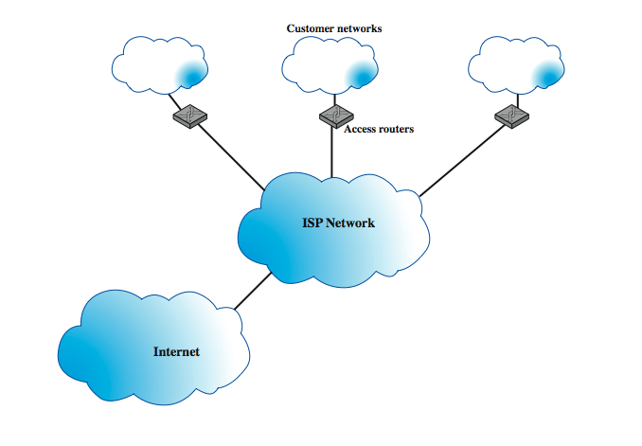
Service Level Agreements
SLA
SLA
Notes:
Stallings DCC8e Figure 19.16 shows a typical configuration that lends itself to an SLA. A customer has a number of private networks (e.g., LANs) at various sites. Customer networks are connected to the provider via access routers at the access points. In addition, the provider network links to the Internet and thus provides Internet access for the enterprise. The SLA dictates service and performance levels for traffic between access routers across the provider network. These might include:
• Availability: 100% availability.
• Latency (delay): Average round-trip transmissions of ≤ 45 ms between access routers in the contiguous U.S. Average round-trip transmissions of ≤ 90 ms between an access router in the New York metropolitan area and an access router in the London metropolitan area. Latency is calculated by averaging sample measurements taken during a calendar month between routers.
• Network packet delivery (reliability): Successful packet delivery rate of ≥ 99.5%.
• Denial of service (DoS): Responds to DoS attacks reported by customer within 15 minutes of customer opening a complete trouble ticket.
• Network jitter: Jitter is defined as the variation or difference in the end-to-end delay between received packets of an IP or packet stream. Jitter performance will not exceed 1 ms between access routers.

Slide 77
IP Performance Metrics
IP Performance Metrics working group is developing a standard set of metrics
  on quality, performance, reliability
  to provide common understanding
3 stages of metrics
  singleton metric - elementary / atomic quantity
  sample metric - taken over time period
  statistical metric - derived from sample
active or passive measurement
Notes:
The IPPM Performance Metrics Working Group (IPPM) is chartered by IETF to develop standard metrics that relate to the quality, performance, and reliability of Internet data delivery. These enable users and service providers to have an accurate common understanding of the performance of the Internet and private internets.
The metrics are defined in three stages:
• Singleton metric: the most elementary, or atomic, quantity that can be measured for a given performance metric. For example, the delay experienced by a single packet.
• Sample metric: a collection of singleton measurements taken during a given time period. For example, the set of delay values for all of the measurements taken during a one-hour period.
• Statistical metric: a value derived from a given sample metric. by computing some statistic of the values defined by the singleton metric on the sample. For example, the mean of all the one-way delay values on a sample
The measurement technique can be either active or passive. Active techniques require injecting packets into the network for the sole purpose of measurement. There are several drawbacks, as the load on the network is increased. This in turn can affect the desired result. Passive techniques observe and extract metrics from existing traffic. This approach can expose the contents of Internet traffic to unintended recipients, creating security and privacy concerns. So far, the metrics defined by the IPPM working group are all active.

Slide 78
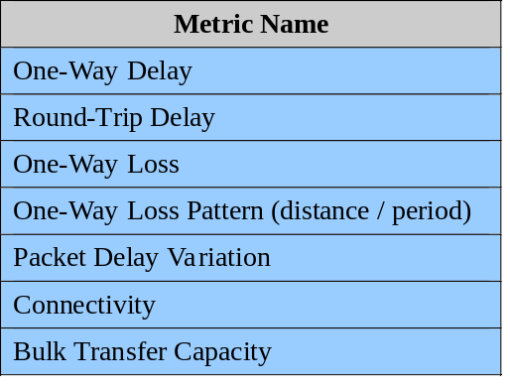
IP Performance Metrics
Notes:
Stallings DCC8e Table 19.5 lists the metrics that have been defined in RFCs at the time of writing. Most of the statistical metrics listed are self-explanatory. The packet delay variation metric is used to measure jitter, or variability, in the delay of packets traversing the network. The singleton metric is defined by selecting two packet measurements and measuring the difference in the two delays. The statistical measures make use of the absolute values of the delays. The table also lists two metrics that are not defined statistically. Connectivity deals with the issue of whether a transport-level connection is maintained by the network, and is is determined by the ability to deliver a packet across a connection within a specified time limit. The other metric, bulk transfer capacity, addresses the issue of measuring the transfer capacity of a network service over long periods.

Slide 79
Summary
reviewed various internetwork services & functions to support varying services
multicasting
routing protocols
integrated services architecture
differentiated services
service level agreements
IP performance metrics
Notes:
Chapter19 summary.

