Slide 1
Data and Computer Communications
Chapter 24 – Internet Applications –
Multimedia
Eighth Edition
by William Stallings
Lecture slides by Lawrie Brown
Notes:
Lecture slides prepared by Dr Lawrie Brown (UNSW@ADFA) for “Data and Computer Communications”, 8/e, by William Stallings, Chapter 24 “Internet Applications - Multimedia”.

Slide 2
Internet Applications – Multimedia
Prior to the recent explosion of sophisticated research, scientists believed that birds required no special awareness or intelligence to perform their migrations and their navigational and homing feats. Accumulated research shows that in addition to performing the difficult tasks of correcting for displacement (by storms, winds, mountains, and other hindrances), birds integrate an astonishing variety of celestial, atmospheric, and geological information to travel between their winter and summer homes. In brief, avian navigation is characterized by the ability to gather a variety of informational cues and to interpret and coordinate them so as to move closer toward a goal.
—The Human Nature of Birds, Theodore Barber
Notes:
This quote is from the start of Stallings DCC8e Chapter 24.
With the increasing availability of broadband access to the Internet has come an increased interest in Web-based and Internet-based multimedia applications. The term multimedia refers to the use of multiple forms of information, including text, still images, audio, and video. In this chapter, we focus on a few key topics. First, we look at audio and video compression, which is quite common in multimedia applications. Then, we examine some of the key characteristics of real-time traffic. Next we look at SIP and its use to support voice over IP. Finally, the chapter examines the real-time transport protocol.

Slide 3
Audio and Video Compression
multimedia applications need efficient use of transmission capacity
hence audio/video compression algorithms
techniques standardized by MPEG
lossless compression loses no information
  limited by redundancy in original data
lossy compression provides acceptable approximation to original (typically use)
Notes:
For multimedia applications, it is important to make the most efficient use of transmission capacity as possible. Accordingly, much attention has been paid to the development of compression algorithms for both audio and video transmissions. The techniques discussed in this section were standardized by the Moving Picture Experts Group (MPEG). MPEG, under the auspices of the International Organization for Standardization (ISO), has developed standards for video and associated audio in digital form. The MPEG effort covers not only video compression, but also audio compression and associated system issues and formats. The premise of the MPEG effort is that a video signal can be compressed to a bit rate of about 1.5 Mbps with acceptable quality and that corresponding efficiencies are achievable for audio transmission.
First we introduce two terms. Data compression falls into two broad categories: lossless and lossy. With lossless compression, no information is lost and the decompressed data are identical to the original uncompressed data. The efficiency of lossless compression is limited to the process of eliminating some or all of the redundancy in a bit stream, so that no information is lost. With lossy compression, the decompressed data may be an acceptable approximation (according to some fidelity criterion) to the original uncompressed data. We will see that lossy compression is used for both audio and video. However, in the case of audio, the fidelity of the output is so high that, for all practical purposes, the compression is lossless.

Slide 4
Simple Audio Compression
must first digitize audio signal, eg. PCM
  sample at twice highest frequency
  then quantize using fixed number of bits
  effectively compression algorithm
  otherwise need unlimited number of bits
compress further by reducing sampling frequency or number of bits
or use more sophisticated approaches
  as in MPEG Layer 3 (MP3) giving 10:1 compression
Notes:
The first step in the development of an audio compression algorithm is to digitize the audio signal, using a technique such as PCM. It is important to note that PCM or a similar technique does in fact provide a measure of compression. Recall from Chapter 5 that the sampling theorem states that if a signal f(t) is sampled at regular intervals of time and at a rate higher than twice the highest signal frequency, then the samples contain all the information of the original signal. The function f(t) may be reconstructed from these samples by the use of a lowpass filter. To create a digital signal, each sample is quantized to a value that can be represented by a fixed number of bits, producing pulse code modulation (PCM). A PCM-encoded signal produces only an approximation of the original signal. If unlimited fidelity were required, then an unlimited number of bits would be needed for each sample. The fact that a fixed, finite number of bits is used per sample results, in effect, in compression.
Taking a simple-minded approach, further compression could be achieved by reducing the frequency of sampling or reducing the number of bits per sample. However, there is another approach that can produce significant compression and at the same time retain a fidelity that is equivalent to lossless compression. Such an approach is taken in the MPEG standard. The MPEG standard for audio compression is quite complex and beyond our scope. In fact, the standard provides for three layers of compression. Layer 3, popularly known as MP3, provides a compression ratio of 10:1.

Slide 5
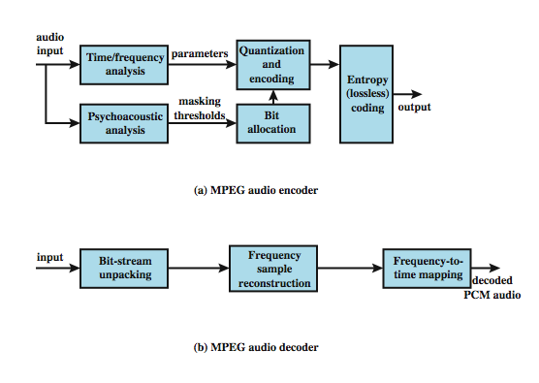
Effective Audio Compression
Notes:
Effective audio compression takes into account the physiology of human hearing. The compression algorithm exploits a phenomenon known as simultaneous auditory masking. This masking is an effect produced by the way the human nervous system perceives sound. In essence, if two signals are sufficiently near to one another and one tone is stronger, the weaker signal is simply not perceived at all; the human hearing apparatus masks it. Thus, what the percipient hears is exactly the same whether the weaker tone is there or not. Stallings DCC8e Figure 24.1a shows, in general terms, how masking is used to encode audio signals. The input is partitioned into time frames ranging in duration from 2 to 50 ms. A time-frequency analysis module decomposes each frame. At its simplest, this module determines the amplitude in each of a sequence of narrow frequency subbands; more complex analysis algorithms are typical. In any case, the output of this module is a set of parameters that define the acoustic signal in that particular time frame and that can be quantized. In parallel, a psychoacoustic module analyzes the time frame for masking effects and other properties that can be exploited to achieve compression. Based on this analysis, a bit allocation module decides how to apportion the total number of code bits available for the quantization of the subband signals. The resulting quantized signal is then fed into a lossless coding module that eliminates any redundancies in the digital signal to achieve maximum compression. Figure 24.1b shows the inverse operation performed at a destination system to reproduce the original audio signal. The unpacking module recovers the quantized signal by inverting the lossless compression. The resulting signal is then processed to produce the audio output.

Slide 6
Video Compression
moving picture a sequence of still images
hence can compress each individually
but get greater efficiency by using similarities between adjacent images
encode just differences between them
approach used in MPEG
Notes:
A moving picture is simply a succession of still pictures. Accordingly, one can achieve a degree of compression by independently compressing each still picture in the sequence that makes up the moving picture. But much more can be done. Even in a moving picture with a lot of action, the differences between adjacent still pictures are generally small compared to the amount of information in a single still picture. This suggests that an encoding of the differences between adjacent still pictures is a fruitful approach to compression; this is a tool used in MPEG.

Slide 7
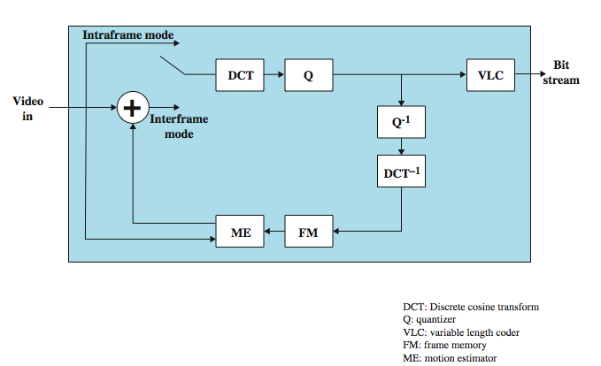
MPEG Video Compression
Notes:
Stallings DCC8e Figure 24.2 illustrates the MPEG video compression scheme. The input to the MPEG compression module is a sequence of video frames. Each frame is processed separately, being treated as a single still image. While operating on a single frame, the MPEG coder is in intraframe mode. In this mode, the algorithm performs the following steps:
1. Preliminary scaling and color conversion. Each frame is converted into a standardized representation known as Source Input Format (SIF), and color information is translated into a scheme known as YUV.
2. Color subsampling. Brightness is the dominant component of color seen by the human eye, while hue is less important. So the algorithm is able to reduce the hue information by about 75% with little effect on subjective fidelity.
3. Discrete cosine transformation (DCT). maps each 8 × 8 block of points (pixels) into a set of numbers similar to a Fourier transform of the block. In essence, the DCT provides a frequency-domain representation of the image.
4. Quantization. The DCT values are quantized into a finite number of possible values. The more quantization levels that are used, the greater the picture fidelity, but the less the amount of compression.
5. Run-length encoding. The quantized DCT values are represented using a run-length encoding technique.
6. Huffman coding. The data stream is compressed using Huffman coding, a lossless compression technique that assigns the most common bit sequences from the preceding step to symbols that are as short as possible.

Slide 8
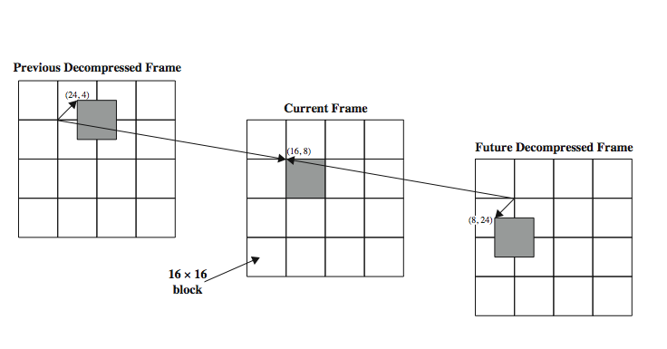
MPEG Video Compression
Notes:
Although significant compression can be achieved by simply processing a video signal as a sequence of still images, as just described, this approach fails to exploit the considerable redundancy present in all video sequences. The MPEG studies indicate an additional compression on the order of a factor of 3 by exploiting these redundancies in an interframe mode. For interframe mode, similar blocks of pixels common to two or more successive frames are replaced by a pointer that references one of the blocks. The major complication has to do with the order of the frames. Sometimes it is convenient to refer to a block in a preceding frame. At other times it is convenient to refer to a block in a future frame. In this latter case, the encoder replaces the block with a pointer and also reverses the order of the frame. The decompression routine must put the frames back in proper order prior to display.
Stallings DCC8e Figure 24.3 shows the interframe technique in a very general way. After the DCT and quantization phases in the processing of a frame, the frame goes through the reverse process (dequantization, inverse DCT) in order to recover a frame that is identical to that which will be recovered by the decompression algorithm. This frame is then stored and used in the interframe mode to compare to succeeding frames.

Slide 9
MPEG Video Compression
important features in video compression
  random access - needs access frames
  fast forward / reverse - scan stream using access frames
MPEG foundation is motion compensation
  prediction
  interpolation
Notes:
In designing the video compression algorithm, the MPEG study group identified a number of features that are important in order to meet the range of applications of MPEG. Two of these are relevant to our discussion:
• Random access: A compressed video bit stream should be accessible at any point in the sequence of video frames, and any frame should be decodable in a limited amount of time. This implies the existence of access frames, which are frames coded only in intraframe mode and that therefore can be decoded without reference to other frames.
• Fast forward/reverse searches: It should be possible to scan a compressed bit stream and, using the appropriate access frames, display selected frames to obtain a fast forward or fast reverse effect. This feature is essentially a more demanding form of the random access feature.
The foundation of MPEG interframe compression is motion compensation. The idea behind motion compensation is that a portion of an image in one frame will be the same as or very similar to an equal-sized portion in a nearby frame. The MPEG scheme makes use of two forms of motion compensation: prediction and interpolation.

Slide 10
Prediction
MPEG uses 16x16 pixel macroblocks for motion compensation
each block encoded separately
with reference to preceeding anchor frame most closely matching it
  matching block not on 16-pixel boundary
  compare against decompressed frame
MPEG then records motion vector and prediction error for current frame
Notes:
MPEG makes use of blocks of 16 × 16 pixels, called macroblocks (in contrast to the smaller 8 × 8 blocks used in the DCT coding), for purposes of motion compensation. A frame processed in prediction mode is divided into its macroblocks, each of which is encoded separately. The encoding is done with reference to an anchor frame that precedes the current frame. Each macroblock in the current frame is to be represented by a pointer, called the motion vector, to that macroblock in the anchor frame that most closely matches this macroblock. The motion vector gives the displacement of the macroblock in the current frame with respect to its match in the anchor frame. This is shown in the left two-thirds of Stallings DCC8e Figure 24.3 (on previous slide). In this example, each video frame consist of 64 × 64 pixels grouped into 16 macroblocks. The shaded portion of the current frame is the macroblock whose upper left-hand pixel is in the x-y position (16, 8). The match for this block in the previous frame is in position (24, 4). The short arrowed line in the left-hand frame represents the motion vector, which in this case is (8, –4). Key aspects of predictive coding are that the matching macroblock in the previous frame need not be on a 16-pixel boundary, and that the matching is not done against a previous source video frame but rather against a video frame that has been through compression and decompression. Having determined the matching block from the preceding frame, the MPEG algorithm records the motion vector and the prediction error, which is 16 × 16 matrix of differences between the current macroblock, in frame c, and the reference macroblock, in frame r

Slide 11
Interpolation
have further compression improvement by using two reference frames
  bidirectional interpolation
process current against frames before and after
encode using:
  block from before (forward prediction)
  block from after (backward prediction)
  average of blocks before and after (averaging)
interpolation encodes more info than prediction
Notes:
Although prediction results in higher compression ratios than a simple frame-by-frame compression, more can be done. In particular, MPEG allows some video frames to be encoded using two reference frames, one in the past and one in the future. This approach, called bidirectional interpolation, results in higher compression ratios than prediction based on one reference frame. To see why, consider a scene that is moving at a rate of one half pixel per frame. If we try to predict a macroblock in the current frame based on the preceding or following frame, no exact matching block will be found. However, an average of the best match from the preceding and following frames provides an exact prediction, so that the error matrix is all zeroes.
Stallings DCC8e Figure 24.3 illustrates the technique used in bidirectional interpolation. The current frame, referred to as a B frame, is processed against two reference frames, one before and one after this frame in time. Each macroblock can be encoded using a block from the preceding frame (forward prediction), the following frame (backward prediction), or one block from each reference frame (averaging), whichever gives the minimum error matrix.
In the case of bidirectional interpolation, more information must be encoded. As with predicted frames, a matrix of differences is produced and then encoded using DCT. In addition, each macroblock is encoded with an indication of the prediction mode (forward, backward, average) and one or two motion vectors.

Slide 12
MPEG Frame Ordering
MPEG uses three types of frames:
  intraframe (I)
  predicted (P)
  bidirectional interpolated (B)
relative frequency is configurable
  balance need for random access and FF/Rev with computational complexity and size
  noting B frames rely only on I and P frames
Notes:
Three types of frames are defined in MPEG:
• Intraframe (I): Encoded in JPEG style as an independent still image
• Predicted (P): Encoded with reference to the preceding anchor frame
• Bidirectional interpolated (B): Encoded with reference to the preceding and the following anchor frames
The relative frequency of these types of frames within a video stream is a configurable parameter and must satisfy several tradeoffs. First, there is the need to satisfy the requirements for random access and fast forward/reverse searches, described earlier. These requirements place a lower bound on the fraction of I frames in the encoded stream. Second, there is a tradeoff between computational complexity and the number of B frames: more B frames means more computation. Finally, B frames can only be processed with respect to I and P frames; that is, one B frame can not serve as a reference frame for another B frame. Therefore, the higher the fraction of B frames, the greater the average distance between a B frame and its references and the less the correlation between the B frame and its reference frames.

Slide 13
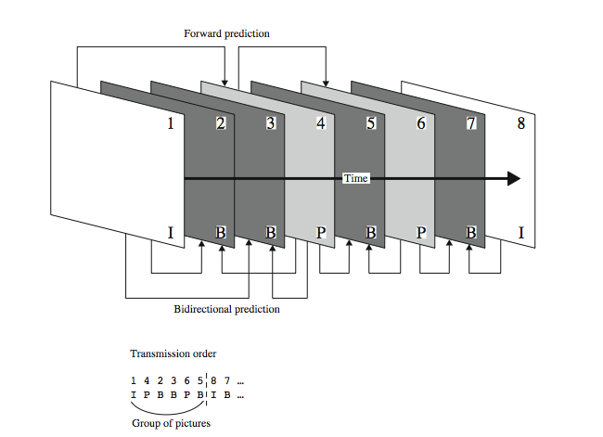
MPEG Frame Ordering
Notes:
The rules for encoding are as follows. Each I frame is encoded using intraframe coding only. Each P frame is encoded based on the most recent preceding I or P frame, whichever is closest. Each B frame is encoded with the closest preceding and following I or P frames.
Picture frames in MPEG are organized into groups. Each group consists of a single I frame followed by a number of P frames and B frames. Because a B frame cannot be decoded until both its preceding and following reference frames are decoded, the members of a group are reorganized so that each B frame follows both of its reference frames. Stallings DCC8e Figure 24.4 provides an example. The first six frames form a group. Frame 4 is stored after frame 1, because it is used as the forward prediction frame for B frames 2 and 3. Frames 5 and 6 are interchanged for the same reason. B frame 7 is recorded as part of the next group because it is encoded after I frame 8.

Slide 14
Real-Time Traffic
increasing deployment of high-speed nets sees increasing real-time traffic use
has different requirements to traditional non real-time traffic
  traditionally throughput, delay, reliability
  real-time more concerned with timing issues
  with deadline for delivery of data block
Notes:
The widespread deployment of high-speed LANs and WANs and the increase in the line capacity on the Internet and other internets has opened up the possibility of using IP-based networks for the transport of real-time traffic. However, it is important to recognize that the requirements of real-time traffic differ from those of high-speed but non-real-time traffic. With traditional internet applications, such as file transfer, electronic mail, and client/server applications including the Web, the performance metrics of interest are generally throughput and delay. There is also a concern with reliability, and mechanisms are used to make sure that no data are lost, corrupted, or misordered during transit. By contrast, real-time applications are more concerned with timing issues. In most cases, there is a requirement that data be delivered at a constant rate equal to the sending rate. In other cases, a deadline is associated with each block of data, such that the data are not usable after the deadline has expired.

Slide 15
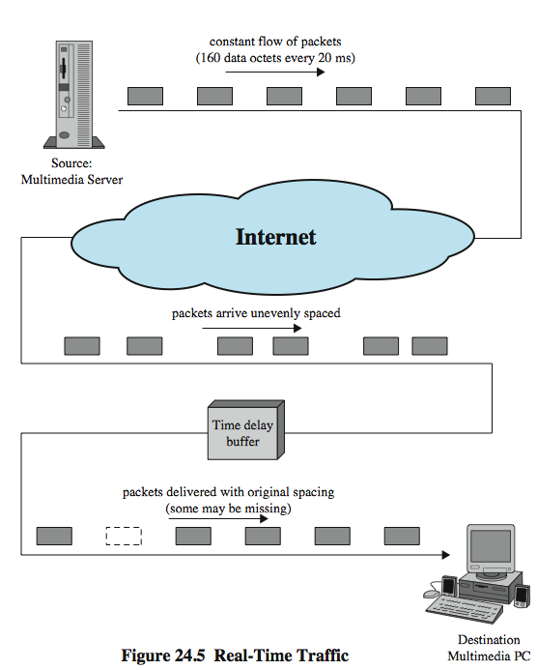
Real-Time Traffic
Example
Notes:
Stallings DCC8e Figure 24.5 illustrates a typical real-time environment. Here, a server is generating audio to be transmitted at 64 kbps. The digitized audio is transmitted in packets containing 160 octets of data, so that one packet is issued every 20 ms. These packets are passed through an internet and delivered to a multimedia PC, which plays the audio in real time as it arrives. However, because of the variable delay imposed by the Internet, the interarrival times between packets are not maintained at a fixed 20 ms at the destination. To compensate for this, the incoming packets are buffered, delayed slightly, and then released at a constant rate to the software that generates the audio.
The compensation provided by the delay buffer is limited. To understand this, we need to define the concept of delay jitter, which is the maximum variation in delay experienced by packets in a single session. For example, if the minimum end-to-end delay seen by any packet is 1 ms and the maximum is 6 ms, then the delay jitter is 5 ms. As long as the time delay buffer delays incoming packets by at least 5 ms, then the output of the buffer will include all incoming packets. However, if the buffer delayed packets only by 4 ms, then any incoming packets that had experienced a relative delay of more than 4 ms (an absolute delay of more than 5 ms) would have to be discarded so as not to be played back out of order.

Slide 16
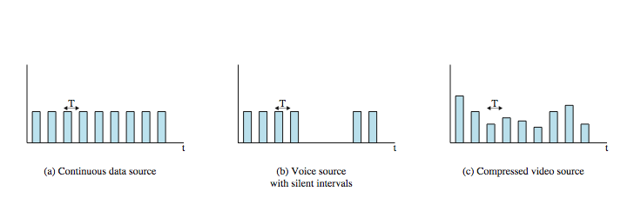
Real-Time Traffic Profiles
Notes:
The description of real-time traffic so far implies a series of equal-size packets generated at a constant rate. This is not always the profile of the traffic.
Stallings DCC8e Figure 24.6 illustrates some of the common possibilities:
• Continuous data source: Fixed-size packets are generated at fixed intervals. This characterizes applications that are constantly generating data, have few redundancies, and that are too important to compress in a lossy way. Examples are air traffic control radar and real-time simulations.
• On/off source: The source alternates between periods when fixed-size packets are generated at fixed intervals and periods of inactivity. A voice source, such as in telephony or audio conferencing, fits this profile.
• Variable packet size: The source generates variable-length packets at uniform intervals. An example is digitized video in which different frames may experience different compression ratios for the same output quality level.

Slide 17
Real-Time Traffic Requirements
low jitter
low latency
integrate non-real-time and real-time services
adapts to changing network / traffic conditions
good performance for large nets / connections
modest buffer requirements within the network
high effective capacity utilization
low overhead in header bits per packet
low processing overhead
Notes:
[ARAS94] lists the following as desirable properties for real-time communication:
• Low jitter
• Low latency
• Ability to easily integrate non-real-time and real-time services
• Adaptable to dynamically changing network and traffic conditions
• Good performance for large networks and large numbers of connections
• Modest buffer requirements within the network
• High effective capacity utilization
• Low overhead in header bits per packet
• Low processing overhead per packet within the network and at the end system
These requirements are difficult to meet in a wide area IP-based network or internet. Neither TCP nor UDP by itself is appropriate. We will see that RTP provides a reasonable foundation for addressing these issues.

Slide 18
Hard vs Soft Real-Time Apps
soft real-time applications
  tolerate loss of some data
  hence impose fewer requirements on network
  can focus on maximizing network utilization
hard real-time applications
  zero loss tolerance
  hence deterministic upper bound on jitter and high reliability take precedence over utilization
Notes:
A distinction needs to be made between hard and soft real-time communication applications. Soft real-time applications can tolerate the loss of some portion of the communicated data, while hard real-time applications have zero loss tolerance. In general, soft real-time applications impose fewer requirements on the network, and it is therefore permissible to focus on maximizing network utilization, even at the cost of some lost or misordered packets. In hard real-time applications, a deterministic upper bound on jitter and high reliability take precedence over network utilization considerations.

Slide 19
Session Initiation Protocol (SIP)
control protocol for setting up, modifying, and terminating real-time sessions
defined in RFC 3261
five multimedia communications facets:
  user location
  user availablility
  user capabilities
  session setup
  session management
Notes:
The Session Initiation Protocol (SIP), defined in RFC 3261, is an application-level control protocol for setting up, modifying, and terminating real-time sessions between participants over an IP data network. The key driving force behind SIP is to enable Internet telephony, also referred to as voice over IP (VoIP). SIP can support any type of single media or multimedia session, including teleconferencing. SIP supports five facets of establishing and terminating multimedia communications:
• User location: Users can move to other locations and access their telephony or other application features from remote locations.
• User availability: Determination of the willingness of the called party to engage in communications.
• User capabilities: Determination of the media and media parameters to be used.
• Session setup: Setup up point-to-point and multiparty calls, with agreed session parameters.
• Session management: Including transfer and termination of sessions, modifying session parameters, and invoking services.

Slide 20
SIP Design Elements
based on earlier protocols
HTTP request/response transaction model
  client invokes server method/function
  receives at least one response
  using most header fields, encoding rules, and status codes of HTTP
DNS like recursive and iterative searches
incorporates the use of a Session Description Protocol (SDP)
Notes:
SIP employs design elements developed for earlier protocols. SIP is based on an HTTP-like request/response transaction model. Each transaction consists of a client request that invokes a particular method, or function, on the server and at least one response. SIP uses most of the header fields, encoding rules, and status codes of HTTP. This provides a readable text-based format for displaying information. SIP also uses concepts similar to the recursive and iterative searches of DNS. SIP incorporates the use of a Session Description Protocol (SDP), which defines session content using a set of types similar to those used in MIME.

Slide 21
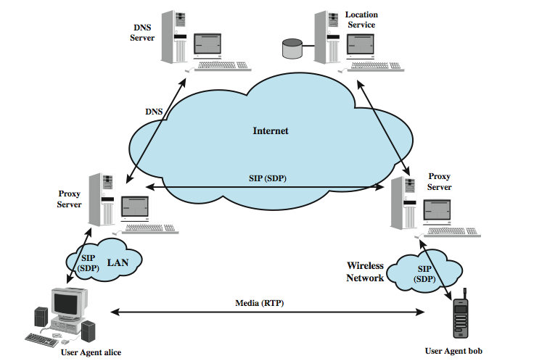
SIP Components
Notes:
An SIP network can be viewed of consisting of components defined on two dimensions: client/server and individual network elements. A client is any network element that sends SIP requests and receives SIP responses. A server is a network element that receives requests in order to service them and sends back responses to those requests. Stallings DCC8e Figure 24.7 shows how some of the SIP components relate to one another and the protocols that are employed. These include:
• User Agent: Resides in every SIP end station.
• Redirect Server: Used during session initiation to determine the address of the called device, which it returns to the calling device, directing the UAC to contact an alternate URI. This is analogous to iterative searches in DNS.
• Proxy Server: An intermediary entity that acts as both a server and a client for the purpose of making requests on behalf of other clients. A proxy server primarily ensures that a request is sent to another entity closer to the targeted user. Proxies are also useful for enforcing policy. A proxy interprets, and, if necessary, rewrites specific parts of a request message before forwarding it.
• Registrar: accepts REGISTER requests and places the information it receives in those requests into the location service for the domain it handles.
• Location Service: is used by a SIP redirect or proxy server to obtain information about a callee's possible location(s). For this purpose, the location service maintains a database of SIP-address/IP-address mappings.

Slide 22
SIP Servers and Protocols
servers are logical devices
  may be distinct servers or combined in one
user agent uses SIP to setup session
initiation dialogue uses SIP involving one or more proxies to relay to remote agent
proxies act as redirect servers if needed
  consulting location service DB
  protocol used here outside SIP
  DNS also important
SIP uses UDP for performance reasons
can use TLS for security if desired
Notes:
The various servers are defined as logical devices. They may be implemented as separate servers configured on the Internet or they may be combined into a single application that resides in a physical server. Stallings DCC8e Figure 24.7 (previous slide) shows some of the SIP components. A user agent acting as a client (in this case UAC alice) uses SIP to set up a session with a user agent that will act as a server (in this case UAS bob). The session initiation dialogue uses SIP and involves one or more proxy servers to forward requests and responses between the two user agents. The user agents also make use of the Session Description Protocol (SDP), which is used to describe the media session. The proxy servers may also act as redirect servers as needed. If redirection is done, a proxy server will need to consult the location service database, which may be collocated with a proxy server or not. The communication between the proxy server and the location service is beyond the scope of the SIP standard. DNS is also an important part of SIP operation. Typically, a UAC will make a request using the domain name of the UAS, rather than an IP address. A proxy server will need to consult a DNS server to find a proxy server for the target domain. SIP typically runs on top of UDP for performance reasons, and provides its own reliability mechanisms, but may also use TCP. If a secure, encrypted transport mechanism is desired, SIP messages may alternatively be carried over the Transport Layer Security (TLS) protocol

Slide 23
Session Description Protocol (SDP)
defined in RFC 2327
have SDP encoded body in SIP message
specifies information on media encodings parties can and will use
after exchange parties know IP addresses, transmission capacity, media types
may then exchange data using a suitable transport protocol, eg. RTP
change session parameters with SIP messages
Notes:
Associated with SIP is the Session Description Protocol (SDP), defined in RFC 2327. SIP is used to invite one or more participants to a session, while the SDP-encoded body of the SIP message contains information about what media encodings (e.g., voice, video) the parties can and will use. Once this information is exchanged and acknowledged, all participants are aware of the participants' IP addresses, available transmission capacity, and media type. Then, data transmission begins, using an appropriate transport protocol. Typically, the Real-Time Transport Protocol (RTP), described subsequently, is used. Throughout the session, participants can make changes to session parameters, such as new media types or new parties to the session, using SIP messages.

Slide 24
SIP Uniform Resource Identifier (URI)
identifies a resource within a SIP network
  eg. user, mailbox, phone number, group
format based on email address
  eg. sip:bob@biloxi.com
may also include password, port number and other parameters
“sips” for secure transmission over TLS
Notes:
A resource within a SIP network is identified by a Uniform Resource Identifier (URI). Examples of communications resources include the following: A user of an online service; An appearance on a multiline phone; A mailbox on a messaging system; A telephone number at a gateway service; A group (such as "sales" or "helpdesk") in an organization.
SIP URIs have a format based on email address formats, namely user@domain. There are two common schemes. An ordinary SIP URI is of the form:
sip:bob@biloxi.com
The URI may also include a password, port number, and related parameters. If secure transmission is required, "sip:" is replaced by "sips:". In the latter case, SIP messages are transported over TLS.

Slide 25
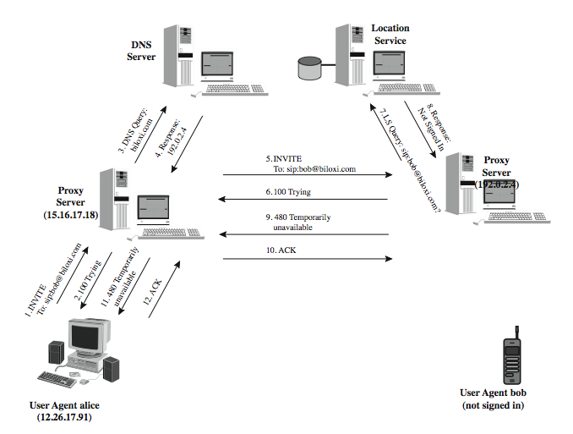
SIP Example
Notes:
Stallings DCC8e Figure 24.8 shows an unsuccessful attempt by user Alice to establish a session with user Bob, whose URI is bob@biloxi.com. Alice's UAC is configured to communicate with a proxy server (the outbound server) in its domain and begins by sending an INVITE message to the proxy server that indicates its desire to invite Bob's UAS into a session (1); the server acknowledges the request (2). Although Bob's UAS is identified by its URI, the outbound proxy server needs to take into account the possibility that Bob is not currently available or that Bob has moved. Accordingly, the outbound proxy server should forward the INVITE request to the proxy server that is responsible for the domain biloxi.com. The outbound proxy thus consults a local DNS server to obtain the IP address of the biloxi.com proxy server (3), by asking for the SRV resource record that contains information on the proxy server for biloxi.com. The DNS server responds (4) with the IP address of the biloxi.com proxy server (the inbound server). Alice's proxy server can now forward the INVITE message to the inbound proxy server (5), which acknowledges the message (6). The inbound proxy server now consults a location server to determine the location of Bob (7), and the location server responds that Bob is not signed in, and therefore not available for SIP messages (8). This information is communicated back to the outbound proxy server (9, 10) and then to Alice (11, 12).

Slide 26
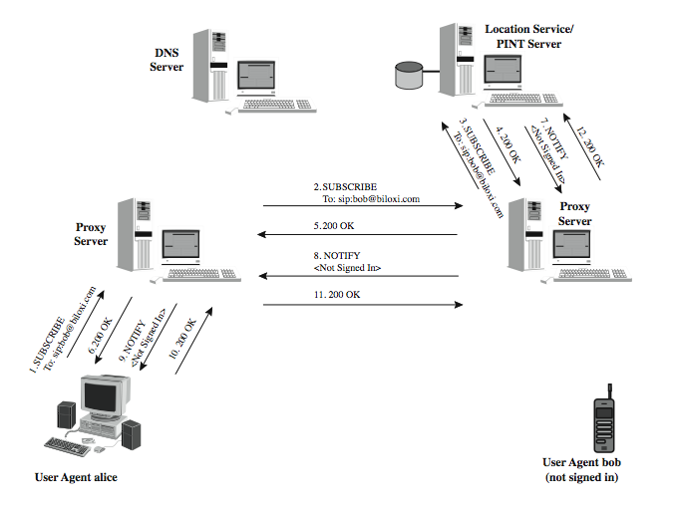
SIP Example
Notes:
Stallings DCC8e Figure 24.9, then demonstrates the use of two message types that are not yet part of the SIP standard but that are documented in RFC 2848 and are likely to be incorporated in a later revision of SIP. These message types support telephony applications. At the end of the preceding example, Alice was informed that Bob was not available. Alice's UAC then issues a SUBSCRIBE message (1), indicating that it wants to be informed when Bob is available. This request is forwarded through the two proxies in our example to a PINT (PSTN-Internet Networking) server (2, 3, nb PSTN refers to the public switched telephone network. A PINT server acts as a gateway between an IP network from which comes a request to place a telephone call and a telephone network that executes the call by connecting to the destination telephone. In this example, we assume that the PINT server logic is collocated with the location service. It could also be the case that Bob is attached to the Internet rather than a PSTN, in which case, the equivalent of PINT logic is needed to handle SUBSCRIBE requests. In this example, we assume that latter and assume that the PINT functionality is implemented in the location service. In any case, the location service authorizes subscription by returning an OK message (4), which is passed back to Alice (5, 6). The location service then immediately sends a NOTIFY message with Bob's current status of not signed in (7, 8, 9), which Alice's UAC acknowledges (10, 11, 12).

Slide 27
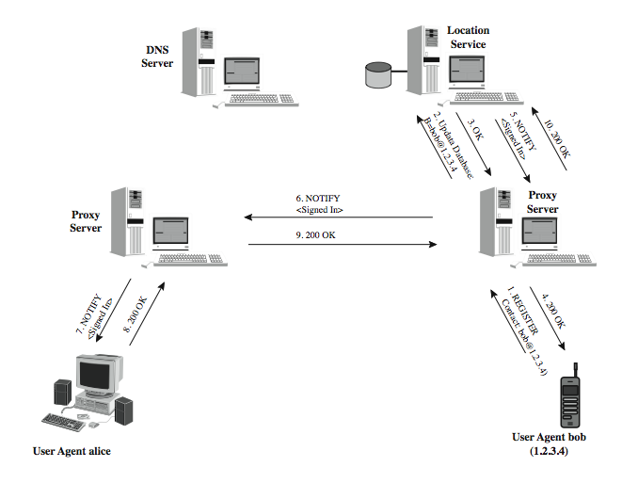
SIP Example
Notes:
Stallings DCC8e Figure 24.10 continues the example of Figure 24.9. Bob signs on by sending a REGISTER message to the proxy in its domain (1). The proxy updates the database at the location service to reflect registration (2). The update is confirmed to the proxy (3), which confirms the registration to Bob (4). The PINT functionality learns of Bob's new status from the location server (here we assume that they are collocated) and sends a NOTIFY message containing the new status of Bob (5), which is forwarded to Alice (6, 7). Alice's UAC acknowledges receipt of the notification (8, 9, 10).

Slide 28
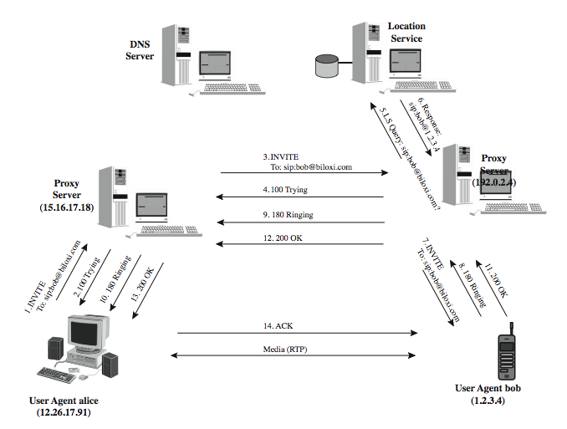
SIP Example
Notes:
Now that Bob is registered, Alice can try again to establish a session, as shown in Stallings DCC8e Figure 24.11. This figure shows the same flow as Figure 24.8, with a few differences. We assume that Alice's proxy server has cached the IP address of the proxy server for domain biloxi.com, and therefore need not consult the DNS server. A ringing response is sent from Bob back to Alice (8, 9, 10) while the UAS at Bob is alerting the local media application (e.g., telephony). When the media application accepts the call, Bob's UAS sends back an OK response to Alice (11, 12, 13). Finally, Alice's UAC sends an acknowledgement message to Bob's UAS to confirm the reception of the final response (14). In this example, the ACK is sent directly from Alice to Bob, bypassing the two proxies. This occurs because the endpoints have learned each other's address from the INVITE/200 (OK) exchange, which was not known when the initial INVITE was sent. The media session has now begun, and Alice and Bob can exchange data over an RTP connection.

Slide 29
SIP Messages
SIP a text based protocol, cf. HTTP
have request messages
  first line a method name and request-URI
have response messages
  first line a response code
Notes:
As was mentioned, SIP is a text-based protocol with a syntax similar to that of HTTP. There are two different types of SIP messages, requests and responses. The format difference between the two types of messages is seen in the first line. The first line of a request has a method, defining the nature of the request and a Request-URI, indicating where the request should be sent. The first line of a response has a response code. All messages include a header, consisting of a number of lines, each line beginning with a header label. A message can also contain a body, such as an SDP media description.

Slide 30
SIP Requests
defined by RFC 3261
REGISTER
INVITE
ACK
CANCEL
BYE
OPTIONS
Notes:
RFC 3261 defines the following methods:
• REGISTER: Used by a user agent to notify a SIP network of its current IP address and the URLs for which it would like to receive calls
• INVITE: Used to establish a media session between user agents
• ACK: Confirms reliable message exchanges
• CANCEL: Terminates a pending request, but does not undo a completed call
• BYE: Terminates a session between two users in a conference
• OPTIONS: Solicits information about the capabilities of the callee, but does not set up a call
The lines that followthis are a list of header fields. The example on the next slide contains the minimum required set.

Slide 31
SIP Request Example
INVITE sip:bob@biloxi.com SIP/2.0
Via: SIP/2.0/UDP 12.26.17.91:5060
Max-Forwards: 70
To: Bob <sip:bob@biloxi.com>
From: Alice <sip:alice@atlanta.com>;tag=1928301774
Call-ID: a84b4c76e66710@12.26.17.91
CSeq: 314159 INVITE
Contact: <sip:alice@atlanta.com>
Content-Type: application/sdp
Content-Length: 142
Notes:
For example, the header of message (1) in Stallings DCC8e Figure 24.11 (previous slide) might look as shown. The first line contains the method name (INVITE), a SIP URI, and the version number of SIP that is used.
The Via headers show the path the request has taken in the SIP network and is used to route responses back along the same path. It contains the IP address (12.26.17.91), port number (5060), and transport protocol (UDP) that Alice wants Bob to use in his response. Subsequent proxies add additional headers.
Max-Forwards limist the number of hops a request can make on the way to its destination. It consists of an integer that is decremented by one by each proxy that forwards the request. If it reaches 0 before the request reaches its destination, it will be rejected with a 483 (Too Many Hops) error response.
To contains a display name (Bob) and a SIP/SIPS URI toward which the request was originally directed. From also contains a display name (Alice) and a SIP/SIPS URI that indicate the originator of the request. It also has a tag with a random string added to the URI by the UAC to identify the session.
Call-ID contains a globally unique identifier for this call, generated by the combination of a random string and the host name or IP address.
CSeq or Command Sequence contains an integer and a method name. The CSeq is used to distinguish a retransmission from a new request.
The Contact header contains a SIP URI for direct comms between UAs.
The Content-Type indicates the type of the message body. Content-Length gives the length in octets of the message body.

Slide 32
SIP Response
Provisional (1xx)
Success (2xx)
Redirection (3xx)
Client Error (4xx)
Server Error (5xx)
Global Failure (6xx)
Notes:
The SIP response types defined in RFC 3261 are in the following categories:
• Provisional (1xx): Request received and being processed.
• Success (2xx): The action was successfully received, understood, and accepted.
• Redirection (3xx): Further action needs to be taken in order to complete the request.
• Client Error (4xx): The request contains bad syntax or cannot be fulfilled at this server.
• Server Error (5xx): The server failed to fulfill an apparently valid request.
• Global Failure (6xx): The request cannot be fulfilled at any server.

Slide 33
SIP Response Example
SIP/2.0 200 OK
Via: SIP/2.0/UDP server10.biloxi.com
Via: SIP/2.0/UDP bigbox3.site3.atlanta.com
Via: SIP/2.0/UDP 12.26.17.91:5060
To: Bob <sip:bob@biloxi.com>;tag=a6c85cf
From: Alice <sip:alice@atlanta.com>;tag=1928301774
Call-ID: a84b4c76e66710@12.26.17.91
CSeq: 314159 INVITE
Contact: <sip:bob@biloxi.com>
Content-Type: application/sdp
Content-Length: 131
Notes:
For example, the header of message (11) in Stallings DCC8e Figure 24.11 (previous slide) might look as shown.
The first line contains the version number of SIP that is used and the response code and name. The lines that follow are a list of header fields. The Via, To, From, Call-ID, and CSeq header fields are copied from the INVITE request. (There are three Via header field values - one added by Alice's SIP UAC, one added by the atlanta.com proxy, and one added by the biloxi.com proxy.) Bob's SIP phone has added a tag parameter to the To header field. This tag will be incorporated by both endpoints into the dialog and will be included in all future requests and responses in this call.

Slide 34
Session Description Protocol (SDP)
describes content of sessions
includes information on:
  media streams
  addresses
  ports
  payload types
  start and stop times
  originator
Notes:
The Session Description Protocol (SDP) describes the content of sessions, including telephony, Internet radio, and multimedia applications. SDP includes information about the following:
• Media streams: A session can include multiple streams of differing content. SDP currently defines audio, video, data, control, and application as stream types, similar to the MIME types used for Internet mail (see Stallings DCC8e Table 22.3).
• Addresses: Indicates the destination addresses, which may be a multicast address, for a media stream.
• Ports: For each stream, the UDP port numbers for sending and receiving are specified.
• Payload types: For each media stream type in use (e.g., telephony), the payload type indicates the media formats that can be used during the session.
• Start and stop times: These apply to broadcast sessions, like a television or radio program. The start, stop, and repeat times of the session are indicated.
• Originator: For broadcast sessions, the originator is specified, with contact information. This may be useful if a receiver encounters technical difficulties.

Slide 35
Real-Time Transport Protocol (RTP)
TCP has disadvantages for real-time use
  is point-to-point, not suitable for multicast
  includes retransmission mechanisms
  has no timing mechanisms
UDP can address some needs but not all
have Real-Time Transport Protocol (RTP)
  defined in RFC 1889
  best suited to soft real-time applications
  data transfer (RTP) & control (RTCP) protocols
Notes:
The most widely used transport-level protocol is TCP. Although TCP has proven its value in supporting a wide range of distributed applications, it is not suited for use with real-time distributed applications, including because:
1. TCP is a point-to-point protocol that sets up a connection between two end points. Therefore, it is not suitable for multicast distribution.
2. TCP includes mechanisms for retransmission of lost segments, which arrive out of order. Such segments are not usable in most real-time applications.
3. TCP contains no convenient mechanism for associating timing information with segments, which is another real-time requirement.
The other widely used transport protocol, UDP, does not exhibit the first two characteristics but also does not provide timing information. By itself, UDP does not provide any general-purpose tools useful for real-time applications.
Although each real-time application could include its own mechanisms for supporting real-time transport, there are a number of common features that warrant the definition of a common protocol. A protocol designed for this purpose is the Real-Time Transport Protocol (RTP), defined in RFC 1889. RTP is best suited to soft real-time communication. It lacks the necessary mechanisms to support hard real-time traffic. Will now provide an overview of RTP, discussing real-time transport requirements, the philosophical approach of RTP. Then consider the two protocols that make up RTP: the first is called RTP and is a data transfer protocol; the other is a control protocol known as RTCP (RTP Control Protocol).

Slide 36
RTP Protocol Architecture
have close coupling between RTP and application-layer functionality
  view RTP as framework used by applications
imposes structure and defines common functions
key concepts:
  application-level framing
  integrated layer processing
Notes:
In RTP, there is close coupling between the RTP functionality and the application-layer functionality. Indeed, RTP is best viewed as a framework that applications can use directly to implement a single protocol. Without the application-specific information, RTP is not a full protocol. On the other hand, RTP imposes a structure and defines common functions so that individual real-time applications are relieved of part of their burden. RTP follows the principles of protocol architecture design outlined in a paper by Clark and Tennenhouse [CLAR90]. The two key concepts presented in that paper are application-level framing and integrated layer processing.

Slide 37
Application-Level Framing
TCP transparently performs data recovery
have scenarios where more appropriately done by application layer
  when less than perfect delivery acceptable
  when application can better provide data
have application-level data units (ADUs)
  preserved by lower layer processing
  form unit of error recovery
  if lose part of ADU discard and retransmit entire ADU
Notes:
In a traditional transport protocol, such as TCP, the responsibility for recovering from lost portions of data is performed transparently at the transport layer. [CLAR90] lists two scenarios in which it might be more appropriate for recovery from lost data to be performed by the application: when it, within limits, may accept less than perfect delivery and continue unchecked, as is the case for real-time audio and video; and whenit may be preferable to have the application rather than the transport protocol provide data for retransmission.
To enable the application to have control over the retransmission function, Clark and Tennenhouse propose that lower layers, such as presentation and transport, deal with data in units that the application specifies. The application should break the flow of data into application-level data units (ADUs), and the lower layers must preserve these ADU boundaries as they process the data. The application-level frame is the unit of error recovery. Thus, if a portion of an ADU is lost in transmission, the application will typically be unable to make use of the remaining portions. In such a case, the application layer will discard all arriving portions and arrange for retransmission of the entire ADU, if necessary.

Slide 38
Integrated Layer Processing
layered protocols have sequential processing of functions in each layer
  limits parallel or re-ordered functions
instead integrated layer processing allows tight coupling between adjacent layers for greater efficiency
concept that strict layering is inefficient is not new, cf. RPC implementation
Notes:
In a typical layered protocol architecture, such as TCP/IP or OSI, each layer of the architecture contains a subset of the functions to be performed for communications, and each layer must logically be structured as a separate module in end systems. Thus, on transmission, a block of data flows down through and is sequentially processed by each layer of the architecture. This structure restricts the implementer from invoking certain functions in parallel or out of the layered order to achieve greater efficiency. Integrated layer processing, as proposed in [CLAR90], captures the idea that adjacent layers may be tightly coupled and that the implementer should be free to implement the functions in those layers in a tightly coupled manner.
The idea that a strict protocol layering may lead to inefficiencies has been propounded by a number of researchers. For example, [CROW92] examined the inefficiencies of running a remote procedure call (RPC) on top of TCP and suggested a tighter coupling of the two layers. The researchers argued that the integrated layer processing approach is preferable for efficient data transfer.

Slide 39
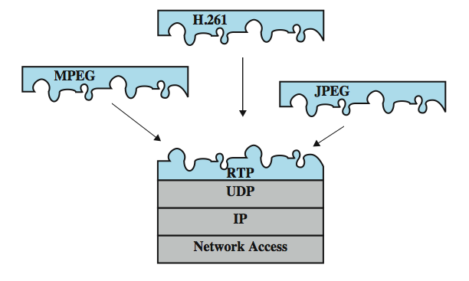
Integrated Layer Processing
Notes:
Stallings DCC8e Figure 24.12 illustrates the manner in which RTP realizes the principle of integrated layer processing. RTP is designed to run on top of a connectionless transport protocol such as UDP. UDP provides the basic port addressing functionality of the transport layer. RTP contains further transport-level functions, such as sequencing. However, RTP by itself is not complete. It is completed by modifications and/or additions to the RTP headers to include application-layer functionality. The figure indicates that several different standards for encoding video data can be used in conjunction with RTP for video transmission.

Slide 40
RTP Data Transfer Protocol
supports transfer of real-time data
amongst participants in a session
define session by
  RTP port (UDP dest port)
  RTCP port (dest port for RTCP transfers)
  participant IP addresses (multicast or unicast)
strength is multicast transmission
  includes identity of source, timestamp, payload format
Notes:
We first look at the basic concepts of the RTP data transfer protocol and then examine the protocol header format. RTP supports the transfer of real-time data among a number of participants in a session. A session is simply a logical association among two or more RTP entities that is maintained for the duration of the data transfer. A session is defined by: RTP port number (destination port address used by all participants for RTP transfers, DestPort field of UDP header); RTCP port number (destination port address is used by all participants for RTCP transfers); Participant IP addresses (either be a multicast IP address, so that the multicast group defines the participants, or a set of unicast IP addresses).
Although RTP can be used for unicast real-time transmission, its strength lies in its ability to support multicast transmission. For this purpose, each RTP data unit includes a source identifier that identifies which member of the group generated the data. It also includes a timestamp so that the proper timing can be re-created on the receiving end using a delay buffer. RTP also identifies the payload format of the data being transmitted.

Slide 41
RTP Relays
relay on intermediary system
  acts as both destination and source
  to relay data between systems
mixer
  combines streams from multiple sources
  forwards new stream to one or more dests
  may change data format if needed
translator
  simpler, sends 1+ RTP packets for each 1 in
Notes:
RTP allows the use of two kinds of RTP relays: translators and mixers. A relay operating at a given protocol layer is an intermediate system that acts as both a destination and a source in a data transfer. For example, suppose that system A wishes to send data to system B but cannot do so directly. Possible reasons are that B may be behind a firewall or B may not be able to use the format transmitted by A. In such a case, A may be able to send the data to an intermediate relay R. R accepts the data unit, makes any necessary changes or performs any necessary processing, and then transmits the data to B.
A mixer is an RTP relay that receives streams of RTP packets from one or more sources, combines these streams, and forwards a new RTP packet stream to one or more destinations. The mixer may change the data format or simply perform the mixing function. Because the timing among the multiple inputs is not typically synchronized, the mixer provides the timing information in the combined packet stream and identifies itself as the source of synchronization. eg. example of mixer is to combine of a number of on/off sources such as audio. The RTP header generated by the mixer includes the identifier(s) of the source(s) that contributed to the data in each packet.
The translator is a simpler device that produces one or more outgoing RTP packets for each incoming RTP packet. The translator may change the format of the data in the packet or use a different lower-level protocol suite to transfer from one domain to another.

Slide 42
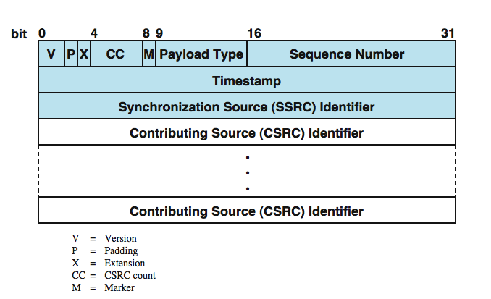
RTP Data Transfer Header
Notes:
Each RTP packet includes a fixed header and may also include additional application-specific header fields. Stallings DCC8e Figure 24.13 shows the fixed header. The first twelve octets (shaded portion) are always present and consist of the following fields:
• Version (2 bits): Current version is 2.
• Padding (1 bit): whether padding octets appear at the end of the payload.
• Extension (1 bit): If set, the fixed header is followed by exactly one extension header, which is used for experimental extensions to RTP.
• CSRC Count (4 bits): no of contributing source identifiers following header
• Marker (1 bit): typically used to indicate a boundary in the data stream
• Payload Type (7 bits): identifies the format of the RTP payload, the media type of the payload and the format of the data, including the use of compression or encryption, which follows the RTP header.
• Sequence Number (16 bits): random sequence number, incrementing
• Timestamp (32 bits): generation instant of first octet of data in the payload.
• Synchronization Source Identifier: randomly generated value that uniquely identifies the source within a session
Following the fixed header, there may be one or more of the following field:
• Contributing Source Identifier: Identifies a contributing source for the payload. These identifiers are supplied by a mixer.

Slide 43
RTP Control Protocol (RTCP)
separate control protocol
  same transport (eg. UDP) but different port
  packets sent periodically to all members
RTCP functions:
  Quality of Service (QoS), congestion control
  identification
  session size estimation and scaling
  session control
Notes:
A separate control protocol (RTCP) also operates in a multicast fashion to provide feedback to RTP data sources as well as all session participants. RTCP uses the same underlying transport service as RTP (usually UDP) and a separate port number. Each participant periodically issues an RTCP packet to all other session members. RFC 1889 outlines four RTCP functions:
• Quality of Service (QoS) and congestion control: RTCP provides feedback on the quality of data distribution. Because RTCP packets are multicast, all session members can assess how well other members are performing and receiving. Sender reports enable receivers to estimate data rates and the quality of the transmission. Receiver reports indicate any problems encountered by receivers, including missing packets and excessive jitter.
• Identification: RTCP packets carry a persistent textual description of the RTCP source. This provides more information about the source of data packets than the random SSRC identifier and enables a user to associate multiple streams from different sessions.
• Session size estimation and scaling: The rate of transmission of RTCP packets must be scaled down as the number of participants increases. RFC 1889 includes a relatively complex algorithm by which each participant limits its RTCP rate to <5% traffic on the basis of the total session population.
• Session control: RTCP optionally provides minimal session control info. An example is a participant identification to be displayed in the user interface.

Slide 44
RTCP Packet Types
have multiple RTCP packets in datagram
Sender Report (SR)
Receiver Report (RR)
Source Description (SDES)
Goodbye (BYE)
Application Specific
Notes:
An RTCP transmission consists of a number of separate RTCP packets bundled in a single UDP datagram (or other lower-level data unit). The following packet types are defined in RFC 1889:
• Sender Report (SR) - provides reception quality feedback. The Sender Report consists of a header, already described; a sender information block; and zero or more reception report blocks. The values in the Sender Report enable senders, receivers, and network managers to monitor conditions on the network as they relate to a particular session.
• Receiver Report (RR) - the format for the Receiver Report is the same as that for a Sender Report, except that the Packet Type field has a different value and there is no sender information block.
• Source Description (SDES) - is used by a source to provide more information about itself. The packet consists of a 32-bit header followed by zero or more chunks, each of which contains information describing this source. Each chunk begins with an identifier for this source, followed by a list of descriptive items.
• Goodbye (BYE) - indicates that one or more sources are no longer active. This confirms to receivers that a prolonged silence is due to departure rather than network failure. If a BYE packet is received by a mixer, it is forwarded with the list of sources unchanged. The format of the BYE packet consists of a 32-bit header followed by one or more source identifiers. Optionally, the packet may include a textual description of the reason for leaving.
• Application Specific - is intended for experimental use for functions and features that are application specific.

Slide 45
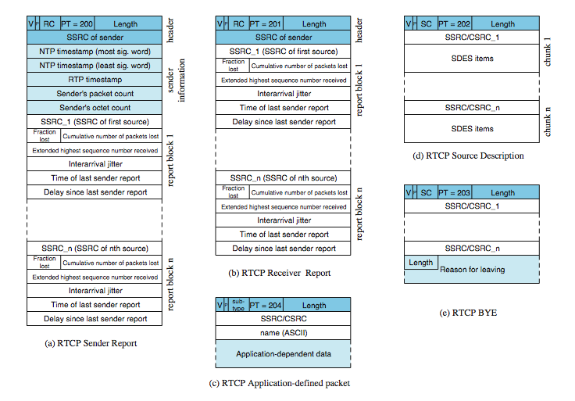
RCTP Packets
Notes:
Stallings DCC8e Figure 24.14 depicts the formats of these packet types. Each type begins with a 32-bit word containing the following fields:
• Version (2 bits): Current version is 2.
• Padding (1 bit): If set, indicates that this packet contains padding octets at the end of the control information.
• Count (5 bits): The number of reception report blocks contained in an SR or RR packet (RC), or the number of source items contained in an SDES or BYE packet.
• Packet Type (8 bits): Identifies RTCP packet type.
• Length (16 bits): Length of this packet in 32 bit words, minus one.
In addition, the Sender Report and Receiver Report packets contain the following field:
• Synchronization Source Identifier: Identifies the source of this RTCP packet.

Slide 46
Summary
audio and video compression
real-time traffic
session initiation protocol (SIP)
real-time transport protocol (RTP)
Notes:
Chapter24 summary.

