Slide 1
CSCI 465
Data Communications and Networks
Lecture 4
Martin van Bommel
CSCI 465
Data Communications & Networks
Notes:
Data Transmission

Slide 2
Data Transmission
What we’ve got here is a failure to communicate.
Paul Newman
“Cool Hand”
CSCI 465
Data Communications & Networks

Slide 3
Data Transmission (2)
The successful transmission of data depends on two factors:
  The quality of the signal being transmitted
  The characteristics of the transmission medium
CSCI 465
Data Communications & Networks
Notes:
The successful transmission of data depends principally on two factors: the quality of the signal being transmitted and the characteristics of the transmission medium. The objective of this chapter and the next is to provide the reader with an intuitive feeling for the nature of these two factors.

Slide 4
Data Transmission (3)
Data transmission occurs between a transmitter and a receiver over some transmission medium.
  Guided media – physical path
    twisted pair, coaxial cable, optical fiber
  Unguided (wireless) media
    Air, water , vacuum
CSCI 465
Data Communications & Networks
Notes:
Transmission Terminology
Data transmission occurs between transmitter and receiver over some transmission medium. Transmission media may be classified as guided or unguided. In both cases, communication is in the form of electromagnetic waves.
With guided media, the waves are guided along a physical path; examples of guided media are twisted pair, coaxial cable, and optical fiber.
Unguided media, also called wireless, provide a means for transmitting electromagnetic waves but do not guide them; examples are propagation through air, vacuum, and water.

Slide 5
Transmission Terminology
Direct link
  Transmission path from transmitter to receiver with no intermediate devices (other than amplifiers)
Point to point
  Direct link between the only two devices sharing the medium (Note: can apply to unguided media)
Multipoint
  More than two devices share the same medium
CSCI 465
Data Communications & Networks
Notes:
The term direct link is used to refer to the transmission path between two devices in which signals propagate directly from transmitter to receiver with no intermediate devices, other than amplifiers or repeaters used to increase signal strength. Note that this term can apply to both guided and unguided media.
A guided transmission medium is point to point if it provides a direct link between two devices and those are the only two devices sharing the medium. In a multipoint guided configuration, more than two devices share the same medium.

Slide 6
Transmission Terminology (2)
Simplex
  Signal transmitted in one direction
    e.g. cable television
Half-duplex
  Both stations may transmit, but one at a time
    e.g. police radio
Full-duplex
  Both stations may transmit simultaneously
    e.g. telephone
CSCI 465
Data Communications & Networks
Notes:
A transmission may be simplex, half duplex, or full duplex. In simplex transmission, signals are transmitted in only one direction; one station is transmitter and the other is receiver. In half-duplex operation, both stations may transmit, but only one at a time. In full-duplex operation, both stations may transmit simultaneously. In the latter case, the medium is carrying signals in both directions at the same time. How this can be is explained in due course.
We should note that the definitions just given are the ones in common use in the United States (ANSI definitions). Elsewhere (ITU-T definitions), the term simplex is used to correspond to half duplex as defined previously, and duplex is used to correspond to full duplex as just defined

Slide 7
Analog vs Digital
Analog signal
  Signal intensity varies in a smooth, continuous, fashion over time – no breaks
Digital signal
  Signal intensity maintains constant level for some period of time and then abruptly changes to another constant level – discrete signals
CSCI 465
Data Communications & Networks
Notes:
Viewed as a function of time, an electromagnetic signal can be either analog or digital.
An analog signal is one in which the signal intensity varies in a smooth, or continuous, fashion over time. In other words, there are no breaks or discontinuities in the signal.
A digital signal is one in which the signal intensity maintains a constant level for some period of time and then abruptly changes to another constant level, in a discrete fashion.

Slide 8
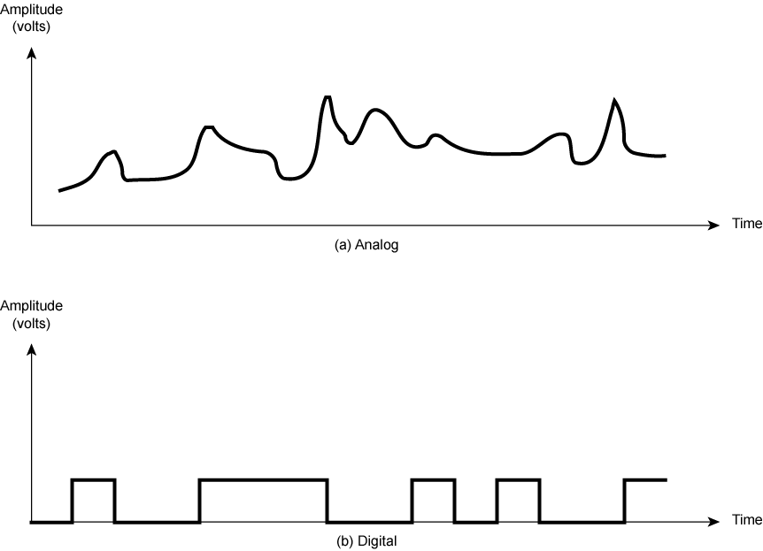
Analog vs Digital (2)
Notes:
Stalling DCC9e Figure 3.1 shows an example of each kind of signal. The analog signal might represent speech, and the digital signal might represent binary 1s and 0s.

Slide 9
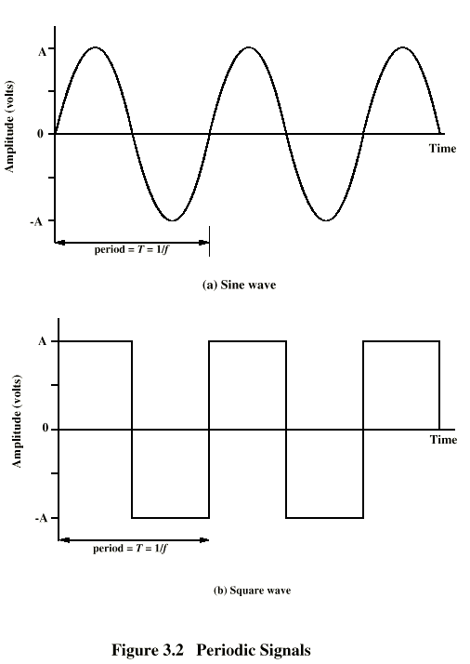
Periodic Signals
Notes:
The simplest sort of signal is a periodic signal, in which the same signal pattern repeats over time. Stallings DDC9e Figure 3.2 shows an example of a periodic continuous signal (sine wave) and a periodic discrete signal (square wave). Mathematically, a signal s(t) is defined to be periodic if and only if
s(t + T) = s(t) –∞ < t < +∞
where the constant T is the period of the signal (T is the smallest value that satisfies the equation).
Otherwise, a signal is aperiodic.

Slide 10
Sine Wave
(periodic continuous signal)
Peak amplitude (A)
  Maximum strength of signal
  Typically measured in volts
Frequency (f)
  Rate at which signal repeats
  Hertz (Hz) or cycles per second
  Period (T) is time to repeat T = 1 / f
Phase (φ)
  Relative position in time within a single period
CSCI 465
Data Communications & Networks
Notes:
The sine wave is the fundamental periodic signal. A general sine wave can be represented by three parameters: peak amplitude (A), frequency (f), and phase (f).
The peak amplitude is the maximum value or strength of the signal over time; typically, this value is measured in volts.
The frequency is the rate [in cycles per second, or hertz (Hz)] at which the signal repeats. An equivalent parameter is the period (T) of a signal, which is the amount of time it takes for one repetition; therefore, T = 1/f.
Phase (Greek phi) is a measure of the relative position in time within a single period of a signal, as is illustrated subsequently. More formally, for a periodic signal f(t), phase is the fractional part t/T of the period T through which t has advanced relative to an arbitrary origin. The origin is usually taken as the last previous passage through zero from the negative to the positive direction.

Slide 11
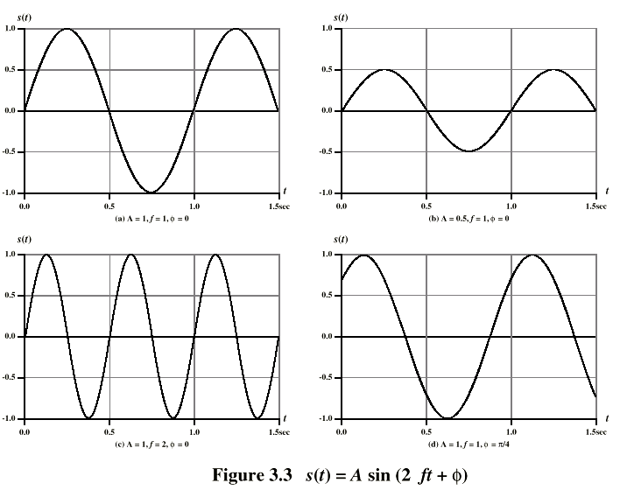
Varying Sine Waves s(t) = A sin(2πft +Φ)
Notes:
The general sine wave can be written s(t) = A sin(2πft + f) - sinusoid (sinusoidal wave)
Stallings DCC9e Figure 3.3 shows the effect of varying each of the three parameters.
In part (a) of the figure, the frequency is 1 Hz; thus the period is T = 1 second.
Part (b) has the same frequency and phase but a peak amplitude of 0.5.
In part (c) we have f = 2, which is equivalent to T = 0.5.
Finally, part (d) shows the effect of a phase shift of π/4 radians, which is 45 degrees (2π radians = 360˚ = 1 period).
In Stallings DCC9e Figure 3.3, the horizontal axis is time; the graphs display the value of a signal at a given point in space as a function of time. These same graphs, with a change of scale, can apply with horizontal axes in space. In this case, the graphs display the value of a signal at a given point in time as a function of distance. For example, for a sinusoidal transmission (e.g., an electromagnetic radio wave some distance from a radio antenna, or sound some distance from a loudspeaker), at a particular instant of time, the intensity of the signal varies in a sinusoidal way as a function of distance from the source.

Slide 12
Wavelength (λ)
Distance occupied by a single cycle
or
Distance between two points of corresponding phase of two consecutive cycles
Signal with velocity v, then wavelength is
λ = vT or λf = v
Consider signal travelling at speed of light
v = c = 3 x 10⁸ m/s
CSCI 465
Data Communications & Networks
Notes:
There is a simple relationship between the two sine waves, one in time and one in space.
The wavelength (λ) of a signal is the distance occupied by a single cycle, or, put another way, the distance between two points of corresponding phase of two consecutive cycles. Assume that the signal is traveling with a velocity v. Then the wavelength is related to the period as follows: l = vT. Equivalently, lf = v.

Slide 13
Frequency Domain Concepts
Signals are made up of many frequencies
Components are sine waves
Fourier analysis can show any signal is made up of components at various frequencies
Each component is a sinusoid
Can plot frequency domain functions
CSCI 465
Data Communications & Networks
Notes:
In practice, an electromagnetic signal will be made up of many frequencies. For example, the signal
s(t) = [(4/π) × (sin(2πft) + (1/3) sin(2π(3f)t)]
is shown in Stallings DCC9e Figure 3.4c.

Slide 14
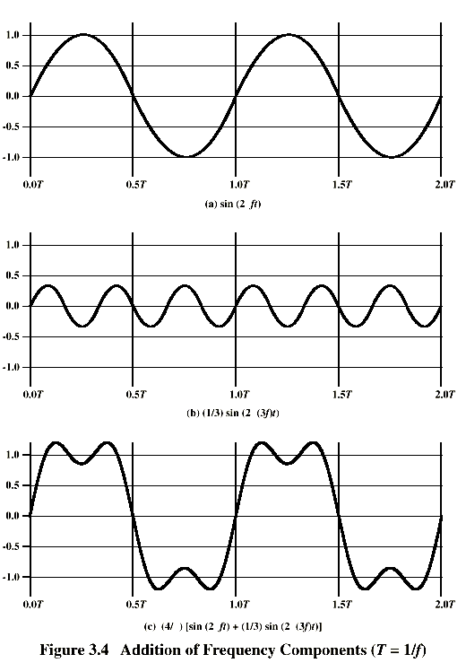
Addition of Frequency Components (T = 1/f) c is sum of f & 3f
Notes:
The components of this signal are just sine waves of frequencies f and 3f; parts (a) and (b) of the figure show these individual components. There are two interesting points that can be made about this figure:
The second frequency is an integer multiple of the first frequency. When all of the frequency components of a signal are integer multiples of one frequency, the latter frequency is referred to as the fundamental frequency. Each multiple of the fundamental frequency is referred to as a harmonic frequency of the signal.
The period of the total signal is equal to the period of the fundamental frequency. The period of the component sin (2πft) is T = 1/f, and the period of s(t) is also T

Slide 15
Spectrum & Bandwidth
Spectrum
  Range of frequencies contained in a signal
  e.g. f and 3f on previous slide
Absolute bandwidth
  Width of the spectrum
  e.g. 2f
Effective bandwidth (or just “bandwidth”)
  Narrow band of frequencies containing most of the energy in the signal
CSCI 465
Data Communications & Networks
Notes:
The spectrum of a signal is the range of frequencies that it contains. For the signal of Stallings DCC9e Figure 3.4c, the spectrum extends from f to 3f.
The absolute bandwidth of a signal is the width of the spectrum. In the case of Stallings DCC9e Figure 3.4c, the bandwidth is 3f – f = 2f.
Many signals have an infinite bandwidth. However, most of the energy in the signal is contained in a relatively narrow band of frequencies. This band is referred to as the effective bandwidth, or just bandwidth.

Slide 16
Data Rate and Bandwidth
Any transmission system can carry only a limited band of frequencies
  Limits the data rate that can be carried
Square waves have infinite components
  Infinite bandwidth
Most energy in first few components
Limiting bandwidth creates distortions
CSCI 465
Data Communications & Networks
Notes:
To try to explain these relationships, consider the square wave of Stallings DCC9e Figure 3.2b. Suppose that we let a positive pulse represent binary 0 and a negative pulse represent binary 1. Then the waveform represents the binary stream 0101…. The duration of each pulse is 1/(2f); thus the data rate is 2f bits per second (bps). What are the frequency components of this signal? To answer this question, consider again Stallings DCC9e Figure 3.4. By adding together sine waves at frequencies f and 3f, we get a waveform that begins to resemble the original square wave. Let us continue this process by adding a sine wave of frequency 5f, as shown in Stallings DCC9e Figure 3.7a, and then adding a sine wave of frequency 7f, as shown in Stallings DCC9e Figure 3.7b. As we add additional odd multiples of f, suitably scaled, the resulting waveform approaches that of a square wave more and more closely.

Slide 17
Data, Signals, and Transmission
Data
  Entities that convey information
Signals
  Electric or electromagnetic representations of data
Signaling
  Physical propagation of signal along medium
Transmission
  Communication of data by propagation and processing of signals
CSCI 465
Data Communications & Networks
Notes:
Briefly, we define data as entities that convey meaning, or information. Signals are electric or electromagnetic representations of data. Signaling is the physical propagation of the signal along a suitable medium. Transmission is the communication of data by the propagation and processing of signals.
In what follows, we try to make these abstract concepts clear by discussing the terms analog and digital as applied to data, signals, and transmission.

Slide 18
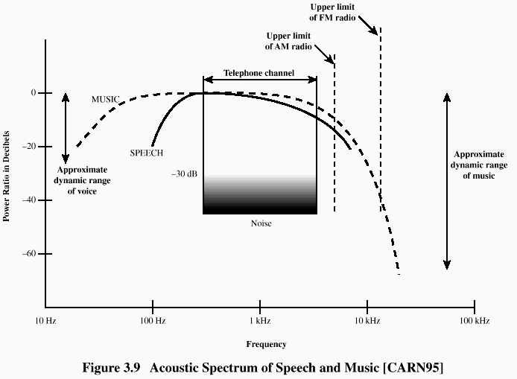
Acoustic Spectrum (Analog)
Notes:
The most familiar example of analog data is audio, which, in the form of acoustic sound waves, can be perceived directly by human beings. Stallings DCC9e Figure 3.9 shows the acoustic spectrum for human speech and for music. Frequency components of typical speech may be found between approximately 100 Hz and 7 kHz. Although much of the energy in speech is concentrated at the lower frequencies, tests have shown that frequencies below 600 or 700 Hz add very little to the intelligibility of speech to the human ear. Typical speech has a dynamic range of about 25 dB; that is, the power produced by the loudest shout may be as much as 300 times greater than the least whisper. Stallings DCC9e Figure 3.9 also shows the acoustic spectrum and dynamic range for music.
Another common example of analog data is video. Here it is easier to characterize the data in terms of the TV screen (destination) rather than the original scene (source) recorded by the TV camera. To produce a picture on the screen, an electron beam scans across the surface of the screen from left to right and top to bottom. For black-and-white television, the amount of illumination produced (on a scale from black to white) at any point is proportional to the intensity of the beam as it passes that point. Thus at any instant in time the beam takes on an analog value of intensity to produce the desired brightness at that point on the screen. Further, as the beam scans, the analog value changes. Thus the video image can be thought of as a time-varying analog signal.

Slide 19
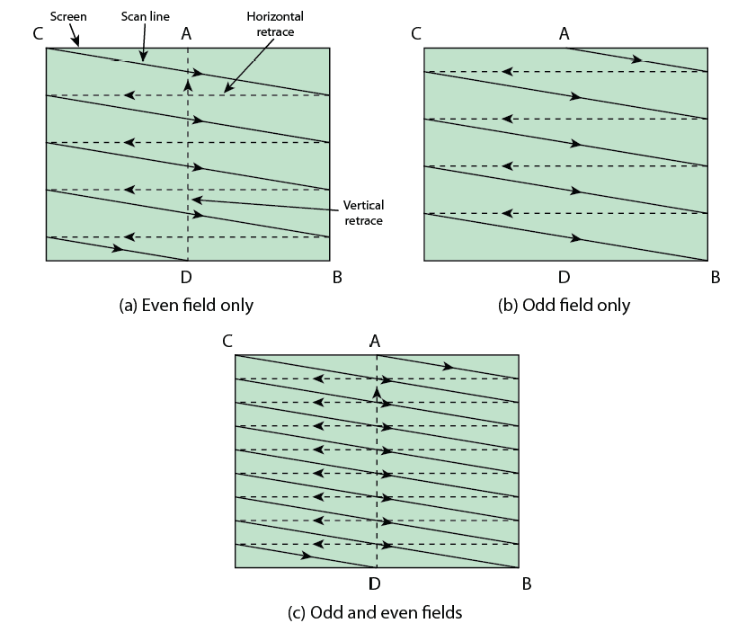
Video Interlaced Scanning
Notes:
Stallings DCC9e Figure 3.10 depicts the scanning process. At the end of each scan line, the beam is swept rapidly back to the left (horizontal retrace). When the beam reaches the bottom, it is swept rapidly back to the top (vertical retrace). The beam is turned off (blanked out) during the retrace intervals.
To achieve adequate resolution, the beam produces a total of 483 horizontal lines at a rate of 30 complete scans of the screen per second. Tests have shown that this rate will produce a sensation of flicker rather than smooth motion. To provide a flicker-free image without increasing the bandwidth requirement, a technique known as interlacing is used.
As Stallings DCC9e Figure 3.10 shows, the odd numbered scan lines and the even numbered scan lines are scanned separately, with odd and even fields alternating on successive scans. The odd field is the scan from A to B and the even field is the scan from C to D. The beam reaches the middle of the screen's lowest line after 241.5 lines. At this point, the beam is quickly repositioned at the top of the screen and recommences in the middle of the screen's topmost visible line to produce an additional 241.5 lines interlaced with the original set. Thus the screen is refreshed 60 times per second rather than 30, and flicker is avoided.

Slide 20
Digital Data
Text (character strings)
  Coded into sequence of bits
    IRA – International Reference Alphabet (ASCII)
  7-bit code with parity bit
Image
  Coded into pixels with number of bits per pixel
  May then be compressed
Notes:
A familiar example of digital data is text or character strings. While textual data are most convenient for human beings, they cannot, in character form, be easily stored or transmitted by data processing and communications systems. Such systems are designed for binary data. Thus a number of codes have been devised by which characters are represented by a sequence of bits. Perhaps the earliest common example of this is the Morse code. Today, the most commonly used text code is the International Reference Alphabet (IRA). Each character in this code is represented by a unique 7-bit pattern; thus 128 different characters can be represented. This is a larger number than is necessary, and some of the patterns represent invisible control characters. IRA-encoded characters are almost always stored and transmitted using 8 bits per character. The eighth bit is a parity bit used for error detection. This bit is set such that the total number of binary 1s in each octet is always odd (odd parity) or always even (even parity). Thus a transmission error that changes a single bit, or any odd number of bits, can be detected.
Data and Computer Communications, Ninth Edition by William Stallings, (c) Pearson Education - Prentice Hall, 2011

Slide 21
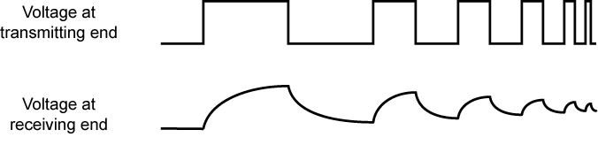
Digital Signals
Advantages
  Cheaper
  Less susceptible to noise interference
Disadvantages
  Suffer more from attenuation (strength loss)
Notes:
A digital signal is a sequence of voltage pulses that may be transmitted over a wire medium; for example, a constant positive voltage level may represent binary 0 and a constant negative voltage level may represent binary 1.
The principal advantages of digital signaling are that it is generally cheaper than analog signaling and is less susceptible to noise interference. The principal disadvantage is that digital signals suffer more from attenuation than do analog signals.
Stallings DCC9e Figure 3.11 shows a sequence of voltage pulses, generated by a source using two voltage levels, and the received voltage some distance down a conducting medium. Because of the attenuation, or reduction, of signal strength at higher frequencies, the pulses become rounded and smaller. It should be clear that this attenuation can lead rather quickly to the loss of the information contained in the propagated signal.
In what follows, we first look at some specific examples of signal types and then discuss the relationship between data and signals.
Data and Computer Communications, Ninth Edition by William Stallings, (c) Pearson Education - Prentice Hall, 2011

Slide 22
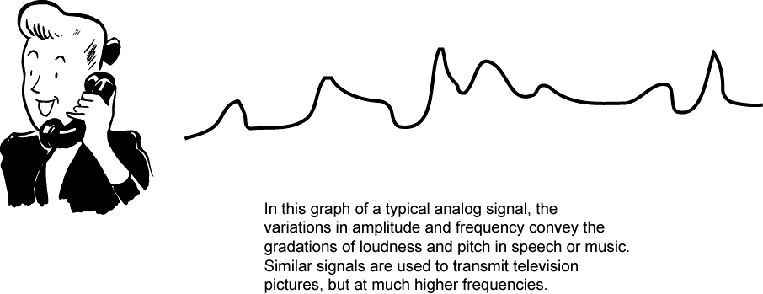
Audio Signals
frequency range of typical speech is 100Hz-7kHz
easily converted into electromagnetic signals
varying volume converted to varying voltage
can limit frequency range for voice channel to
300-3400Hz
Notes:
Let us return to our three examples of the preceding subsection. For each example, we will describe the signal and estimate its bandwidth.
The most familiar example of analog information is audio, or acoustic, information, which, in the form of sound waves, can be perceived directly by human beings. One form of acoustic information, of course, is human speech. This form of information is easily converted to an electromagnetic signal for transmission (Stallings DCC9e Figure 3.12). In essence, all of the sound frequencies, whose amplitude is measured in terms of loudness, are converted into electromagnetic frequencies, whose amplitude is measured in volts. The telephone handset contains a simple mechanism for making such a conversion.
In the case of acoustic data (voice), the data can be represented directly by an electromagnetic signal occupying the same spectrum. However, there is a need to compromise between the fidelity of the sound as transmitted electrically and the cost of transmission, which increases with increasing bandwidth. As mentioned, the spectrum of speech is approximately 100 Hz to 7 kHz, although a much narrower bandwidth will produce acceptable voice reproduction. The standard spectrum for a voice channel is 300 to 3400 Hz. This is adequate for speech transmission, minimizes required transmission capacity, and allows the use of rather inexpensive telephone sets. The telephone transmitter converts the incoming acoustic voice signal into an electromagnetic signal over the range 300 to 3400 Hz. This signal is then transmitted through the telephone system to a receiver, which reproduces it as acoustic sound.
Data and Computer Communications, Ninth Edition by William Stallings, (c) Pearson Education - Prentice Hall, 2011

Slide 23

Video Signals
to produce a video signal a TV camera is used
USA standard is 483 lines per frame, at a rate of 30 complete frames per second
  actual standard is 525 lines but 42 lost during vertical retrace
horizontal scanning frequency is 525 lines x 30 scans = 15750 lines per second
max frequency if line alternates black and white
max frequency of 4.2MHz
Notes:
Now let us look at the video signal. To produce a video signal, a TV camera, which performs similar functions to the TV receiver, is used. One component of the camera is a photosensitive plate, upon which a scene is optically focused. An electron beam sweeps across the plate from left to right and top to bottom, in the same fashion as depicted in Figure 3.10 for the receiver. As the beam sweeps, an analog electric signal is developed proportional to the brightness of the scene at a particular spot. We mentioned that a total of 483 lines are scanned at a rate of 30 complete scans per second. This is an approximate number taking into account the time lost during the vertical retrace interval. The actual U.S. standard is 525 lines, but of these about 42 are lost during vertical retrace. Thus the horizontal scanning frequency is (525 lines) × (30 scan/s) = 15,750 lines per second, or 63.5 µs/line. Of the 63.5 µs, about 11 µs are allowed for horizontal retrace, leaving a total of 52.5 µs per video line.
Now we are in a position to estimate the bandwidth required for the video signal. To do this we must estimate the upper (maximum) and lower (minimum) frequency of the band. We use the following reasoning to arrive at the maximum frequency: The maximum frequency would occur during the horizontal scan if the scene were alternating between black and white as rapidly as possible. We can estimate this maximum value by considering the resolution of the video image. In the vertical dimension, there are 483 lines, so the maximum vertical resolution would be 483. Experiments have shown that the actual subjective resolution is about 70% of that number, or about 338 lines. In the interest of a balanced picture, the horizontal and vertical resolutions should be about the same. Because the ratio of width to height of a TV screen is 4 : 3, the horizontal resolution should be about 4/3 ´ 338 = 450 lines. As a worst case, a scanning line would be made up of 450 elements alternating black and white. The scan would result in a wave, with each cycle of the wave consisting of one higher (black) and one lower (white) voltage level. Thus there would be 450/2 = 225 cycles of the wave in 52.5 µs, for a maximum frequency of about 4.2 MHz. This rough reasoning, in fact, is fairly accurate. The lower limit is a dc or zero frequency, where the dc component corresponds to the average illumination of the scene (the average value by which the brightness exceeds the reference black level). Thus the bandwidth of the video signal is approximately 4 MHz – 0 = 4 MHz.
Data and Computer Communications, Ninth Edition by William Stallings, (c) Pearson Education - Prentice Hall, 2011

Slide 24
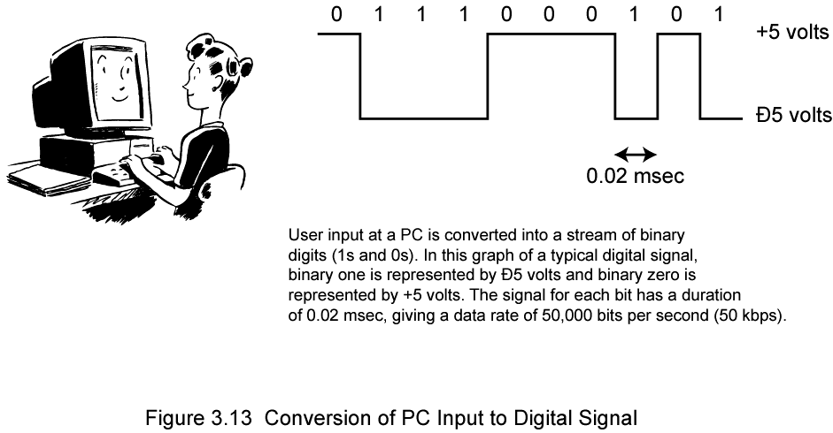
Conversion of PC Input to Digital Signal
Notes:
Finally, the third example described is the general case of binary data. Binary data is generated by terminals, computers, and other data processing equipment and then converted into digital voltage pulses for transmission, as illustrated in Stallings DCC9e Figure 3.13. A commonly used signal for such data uses two constant (dc) voltage levels, one level for binary 1 and one level for binary 0. (In Chapter 5, we shall see that this is but one alternative, referred to as NRZ.) Again, we are interested in the bandwidth of such a signal. This will depend, in any specific case, on the exact shape of the waveform and the sequence of 1s and 0s. As we have seen, the greater the bandwidth of the signal, the more faithfully it approximates a digital pulse stream.
Data and Computer Communications, Ninth Edition by William Stallings, (c) Pearson Education - Prentice Hall, 2011

Slide 25
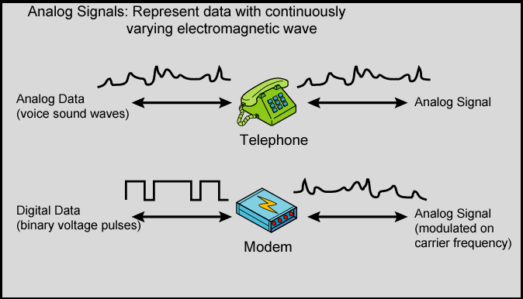
Analog Signals
Notes:
Stallings DCC9e Figure 3.14a shows a communications system, data are propagated from one point to another by means of electromagnetic signals. An analog signal is a continuously varying electromagnetic wave that may be propagated over a variety of media, depending on spectrum; examples are wire media, such as twisted pair and coaxial cable; fiber optic cable; and unguided media, such as atmosphere or space propagation

Slide 26
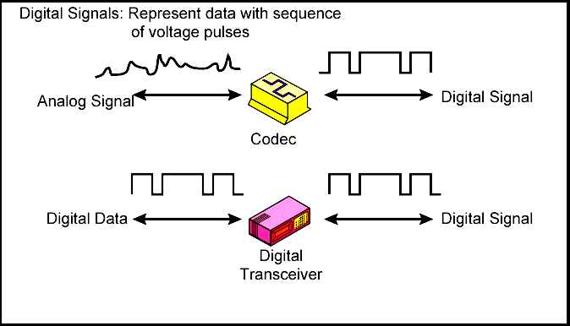
Digital Signals
Notes:
In the foregoing discussion, we have looked at analog signals used to represent analog data and digital signals used to represent digital data. Generally, analog data are a function of time and occupy a limited frequency spectrum; such data can be represented by an electromagnetic signal occupying the same spectrum. Digital data can be represented by digital signals, with a different voltage level for each of the two binary digits.
As Stallings DCC9e Figure 3.14 illustrates, these are not the only possibilities. Digital data can also be represented by analog signals by use of a modem (modulator/demodulator). The modem converts a series of binary (two-valued) voltage pulses into an analog signal by encoding the digital data onto a carrier frequency. The resulting signal occupies a certain spectrum of frequency centered about the carrier and may be propagated across a medium suitable for that carrier. The most common modems represent digital data in the voice spectrum and hence allow those data to be propagated over ordinary voice-grade telephone lines. At the other end of the line, another modem demodulates the signal to recover the original data.
In an operation very similar to that performed by a modem, analog data can be represented by digital signals. The device that performs this function for voice data is a codec (coder-decoder). In essence, the codec takes an analog signal that directly represents the voice data and approximates that signal by a bit stream. At the receiving end, the bit stream is used to reconstruct the analog data.
Thus, Stallings DCC9e Figure 3.14 suggests that data may be encoded into signals in a variety of ways. We will return to this topic in Chapter 5.

Slide 27
Data and Signals
 | Analog Signal | Digital Signal
Analog Data | Two alternatives: Signal occupies the same spectrum as the analog data. Analog data are encoded to occupy a different portion of the spectrum. | Analog data are encoded using a codec to produce a digital bit stream.
Digital Data | Digital data are encoded using a modem to produce analog signal. | Two alternatives: Signal consists of two voltage levels to represent the two binary values Digital data are encoded to produce a digital signal with desired properties.
CSCI 465
Data Communications & Networks

Slide 28
Treatment of Signals
 | Analog Transmission | Digital Transmission
Analog Signal | Is propagated through amplifiers; same treatment whether signal is used to represent analog or digital data. | Assumes analog signal represents digital data. Signal propagated through repeaters, where digital data are recovered and used to generate new outbound signal.
Digital Signal | Not used. | Digital signal represents a stream of 0s and 1s, which may represent digital data or may be an encoding of analog data. Signal is propagated through repeaters, where new outbound signal is generated from 0s and 1s.
CSCI 465
Data Communications & Networks
Notes:
Stallings DCC9e Table 3.1 summarizes the methods of data transmission.
Analog transmission is a means of transmitting analog signals without regard to their content; the signals may represent analog data (e.g., voice) or digital data (e.g., binary data that pass through a modem). In either case, the analog signal will become weaker (attenuate) after a certain distance. To achieve longer distances, the analog transmission system includes amplifiers that boost the energy in the signal. Unfortunately, the amplifier also boosts the noise components. With amplifiers cascaded to achieve long distances, the signal becomes more and more distorted. For analog data, such as voice, quite a bit of distortion can be tolerated and the data remain intelligible. However, for digital data, cascaded amplifiers will introduce errors.
Digital transmission, in contrast, assumes a binary content to the signal. A digital signal can be transmitted only a limited distance before attenuation, noise, and other impairments endanger the integrity of the data. To achieve greater distances, repeaters are used. A repeater receives the digital signal, recovers the pattern of 1s and 0s, and retransmits a new signal. Thus the attenuation is overcome.
The same technique may be used with an analog signal if it is assumed that the signal carries digital data. At appropriately spaced points, the transmission system has repeaters rather than amplifiers. The repeater recovers the digital data from the analog signal and generates a new, clean analog signal. Thus noise is not cumulative.
The question naturally arises as to which is the preferred method of transmission. The answer being supplied by the telecommunications industry and its customers is digital. Both long-haul telecommunications facilities and intrabuilding services have moved to digital transmission and, where possible, digital signaling techniques.

Slide 29
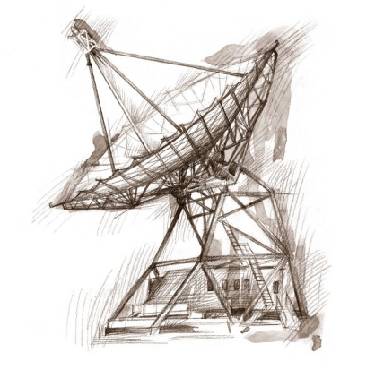
Transmission Impairments
signal received may differ from signal transmitted causing:
  analog - degradation of signal quality
  digital - bit errors
most significant impairments are
  attenuation and attenuation distortion
  delay distortion
  noise
Notes:
With any communications system, the signal that is received may differ from the signal that is transmitted due to various transmission impairments. For analog signals, these impairments introduce various random modifications that degrade the signal quality. For digital signals, bit errors may be introduced, such that a binary 1 is transformed into a binary 0 or vice versa. In this section, we examine the various impairments and how they may affect the information-carrying capacity of a communication link; Chapter 5 looks at measures that can be taken to compensate for these impairments.
The most significant impairments are
Attenuation and attenuation distortion
Delay distortion
Noise
Data and Computer Communications, Ninth Edition by William Stallings, (c) Pearson Education - Prentice Hall, 2011

Slide 30
Attenuation
Signal strength falls off with distance over any communications medium
Varies with frequency – higher has more
Received signal strength must be:
  strong enough to be detected
  sufficiently higher than noise to be received without error
Strength increased with repeaters or amplifiers
Adjust for attenuation by amplifying more at higher frequencies
CSCI 465
Data Communications & Networks
Notes:
The strength of a signal falls off with distance over any transmission medium. For guided media (e.g., twisted-pair wire, optical fiber), this reduction in strength, or attenuation, is generally exponential and thus is typically expressed as a constant number of decibels per unit distance. For unguided media (wireless transmission), attenuation is a more complex function of distance and the makeup of the atmosphere. Attenuation introduces three considerations for the transmission engineer.
A received signal must have sufficient strength so that the electronic circuitry in the receiver can detect and interpret the signal.
The signal must maintain a level sufficiently higher than noise to be received without error.
Attenuation is greater at higher frequencies, and this causes distortion.
The first and second considerations are dealt with by attention to signal strength and the use of amplifiers or repeaters. For a point-to-point link, the signal strength of the transmitter must be strong enough to be received intelligibly, but not so strong as to overload the circuitry of the transmitter or receiver, which would cause distortion. Beyond a certain distance, the attenuation becomes unacceptably great, and repeaters or amplifiers are used to boost the signal at regular intervals. These problems are more complex for multipoint lines where the distance from transmitter to receiver is variable.
The third consideration, known as attenuation distortion, is particularly noticeable for analog signals. Because attenuation is different for different frequencies, and the signal is made up of a number of components at different frequencies, the received signal is not only reduced in strength but is also distorted. To overcome this problem, techniques are available for equalizing attenuation across a band of frequencies. This is commonly done for voice-grade telephone lines by using loading coils that change the electrical properties of the line; the result is to smooth out attenuation effects. Another approach is to use amplifiers that amplify high frequencies more than lower frequencies.

Slide 31
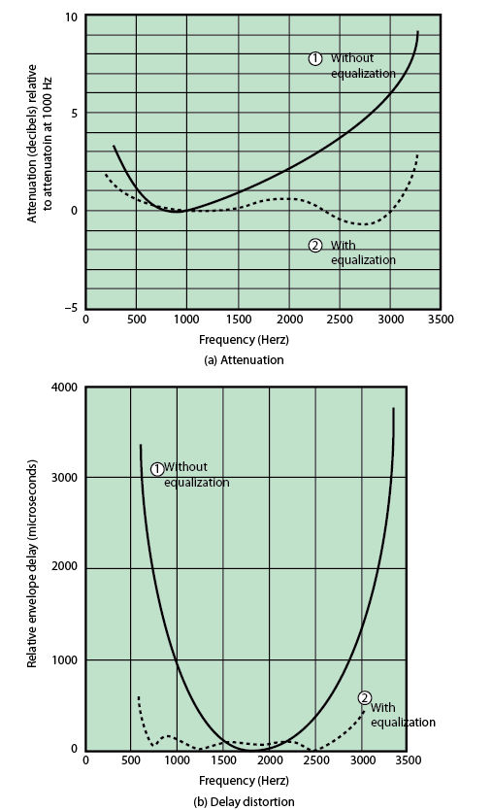
Attenuation Distortion
Notes:
An example is provided in Stallings DCC9e Figure 3.15a, which shows attenuation as a function of frequency for a typical leased line. In the figure, attenuation is measured relative to the attenuation at 1000 Hz. Positive values on the y-axis represent attenuation greater than that at 1000 Hz. A 1000-Hz tone of a given power level is applied to the input, and the power, P1000, is measured at the output
The solid line in Figure 3.15a shows attenuation without equalization. As can be seen, frequency components at the upper end of the voice band are attenuated much more than those at lower frequencies. It should be clear that this will result in a distortion of the received speech signal. The dashed line shows the effect of equalization. The flattened response curve improves the quality of voice signals. It also allows higher data rates to be used for digital data that are passed through a modem.
Attenuation distortion can present less of a problem with digital signals. As we have seen, the strength of a digital signal falls off rapidly with frequency (Stallings DCC9e Figure 3.5b); most of the content is concentrated near the fundamental frequency or bit rate of the signal.
Data and Computer Communications, Ninth Edition by William Stallings, (c) Pearson Education - Prentice Hall, 2011

Slide 32
Delay Distortion
occurs because propagation velocity of a signal through a guided medium varies with frequency
various frequency components arrive at different times resulting in phase shifts between the frequencies
particularly critical for digital data since parts of one bit spill over into others causing intersymbol interference
Notes:
Delay distortion is a phenomenon that occurs in transmission cables (such as twisted pair, coaxial cable, and optical fiber); it does not occur when signals are transmitted through the air by means of antennas. Delay distortion is caused by the fact that the velocity of propagation of a signal through a cable is different for different frequencies. For a signal with a given bandwidth, the velocity tends to be highest near the center frequency of the signal and to fall off toward the two edges of the band. Thus, various components of a signal will arrive at the receiver at different times.
This effect is referred to as delay distortion because the received signal is distorted due to varying delays experienced at its constituent frequencies. Delay distortion is particularly critical for digital data. Consider that a sequence of bits is being transmitted, using either analog or digital signals. Because of delay distortion, some of the signal components of one bit position will spill over into other bit positions, causing intersymbol interference, which is a major limitation to maximum bit rate over a transmission channel.
Equalizing techniques can also be used for delay distortion. Again using a leased telephone line as an example, Stallings DCC9e Figure 3.15b shows the effect of equalization on delay as a function of frequency.
Data and Computer Communications, Ninth Edition by William Stallings, (c) Pearson Education - Prentice Hall, 2011

Slide 33
Noise
Unwanted signals that are inserted somewhere between transmission and reception
Major limiting factor in communications system performance
Notes:
Noise
For any data transmission event, the received signal will consist of the transmitted signal, modified by the various distortions imposed by the transmission system, plus additional unwanted signals that are inserted somewhere between transmission and reception. The latter, undesired signals are referred to as noise. Noise is the major limiting factor in communications system performance.
Noise may be divided into four categories:
Thermal noise
Intermodulation noise
Crosstalk
Impulse noise
Data and Computer Communications, Ninth Edition by William Stallings, (c) Pearson Education - Prentice Hall, 2011

Slide 34
Categories of Noise
Thermal Noise
  Thermal agitation of electrons
  Uniformly distributed across bandwidths
  Referred to as “white noise”
Intermodulation Noise
  Produce unwanted signals at a frequency that is the sum or difference of two original frequencies
    e.g. signals at 4 KHz and 8 KHz may add noise at 12 KHz
    and interfere with a 12 KHz signal
CSCI 465
Data Communications & Networks
Notes:
Thermal noise is due to thermal agitation of electrons. It is present in all electronic devices and transmission media and is a function of temperature. Thermal noise is uniformly distributed across the bandwidths typically used in communications systems and hence is often referred to as white noise. Thermal noise cannot be eliminated and therefore places an upper bound on communications system performance. Because of the weakness of the signal received by satellite earth stations, thermal noise is particularly significant for satellite communication.
The amount of thermal noise to be found in a bandwidth of 1 Hz in any device or conductor is N0 = kT (W/Hz)
where
N0 = noise power density in watts per 1 Hz of bandwidth
k = Boltzmann's constant = 1.38 ´ 10–23 J/K
T = temperature, in kelvins (absolute temperature), where the symbol K is used to represent 1 kelvin
When signals at different frequencies share the same transmission medium, the result may be intermodulation noise. The effect of intermodulation noise is to produce signals at a frequency that is the sum or difference of the two original frequencies or multiples of those frequencies. For example, if two signals, one at 4000 Hz and one at 8000 Hz, share the same transmission facility, they might produce energy at 12,000 Hz. This noise could interfere with an intended signal at 12,000 Hz.
Intermodulation noise is produced by nonlinearities in the transmitter, receiver, and/or intervening transmission medium. Ideally, these components behave as linear systems; that is, the output is equal to the input times a constant. However, in any real system, the output is a more complex function of the input. Excessive nonlinearity can be caused by component malfunction or overload from excessive signal strength. It is under these circumstances that the sum and difference frequency terms occur.

Slide 35
Categories of Noise (2)
Crosstalk
  a signal from one line is picked up by another
  can occur by electrical coupling between nearby twisted pairs or when microwave antennas pick up unwanted signals
Impulse Noise
  caused by external electromagnetic interferences
  noncontinuous, consisting of irregular pulses or spikes
  short duration and high amplitude
  minor annoyance for analog signals but a major source of error in digital data
CSCI 465
Data Communications & Networks
Notes:
Crosstalk has been experienced by anyone who, while using the telephone, has been able to hear another conversation; it is an unwanted coupling between signal paths. It can occur by electrical coupling between nearby twisted pairs or, rarely, coax cable lines carrying multiple signals. Crosstalk can also occur when microwave antennas pick up unwanted signals; although highly directional antennas are used, microwave energy does spread during propagation. Typically, crosstalk is of the same order of magnitude as, or less than, thermal noise.
All of the types of noise discussed so far have reasonably predictable and relatively constant magnitudes. Thus it is possible to engineer a transmission system to cope with them. Impulse noise, however, is noncontinuous, consisting of irregular pulses or noise spikes of short duration and of relatively high amplitude. It is generated from a variety of causes, including external electromagnetic disturbances, such as lightning, and faults and flaws in the communications system.
Impulse noise is generally only a minor annoyance for analog data. For example, voice transmission may be corrupted by short clicks and crackles with no loss of intelligibility. However, impulse noise is the primary source of error in digital data communication. For example, a sharp spike of energy of 0.01 s duration would not destroy any voice data but would wash out about 560 bits of digital data being transmitted at 56 kbps

Slide 36
Channel Capacity
Maximum rate at which data can be transmitted over a given communications channel under given conditions
Four concepts
  Data rate - bits per second (bps))
  Bandwidth - cycles per second – Hertz (Hz)
  Noise – average noise level over path
  Error rate – rate of corrupted bits
Limitations are due to physical properties
Main constraint on achieving efficiency is noise
Notes:
The maximum rate at which data can be transmitted over a given communication path, or channel, under given conditions, is referred to as the channel capacity.
There are four concepts here that we are trying to relate to one another.
Data rate: The rate, in bits per second (bps), at which data can be communicated
Bandwidth: The bandwidth of the transmitted signal as constrained by the transmitter and the nature of the transmission medium, expressed in cycles per second, or hertz
Noise: The average level of noise over the communications path
Error rate: The rate at which errors occur, where an error is the reception of a 1 when a 0 was transmitted or the reception of a 0 when a 1 was transmitted
The problem we are addressing is this: Communications facilities are expensive and, in general, the greater the bandwidth of a facility, the greater the cost. Furthermore, all transmission channels of any practical interest are of limited bandwidth. The limitations arise from the physical properties of the transmission medium or from deliberate limitations at the transmitter on the bandwidth to prevent interference from other sources. Accordingly, we would like to make as efficient use as possible of a given bandwidth. For digital data, this means that we would like to get as high a data rate as possible at a particular limit of error rate for a given bandwidth. The main constraint on achieving this efficiency is noise.
Data and Computer Communications, Ninth Edition by William Stallings, (c) Pearson Education - Prentice Hall, 2011

Slide 37
Nyquist Bandwidth
In the case of a channel that is noise free:
if rate of signal transmission is 2B then can carry signal with frequencies no greater than B
  given bandwidth B, highest signal rate is 2B
for binary signals, 2B bps needs bandwidth B Hz
can increase rate by using M signal levels
Nyquist Formula is: C = 2B log₂M
data rate can be increased by increasing signals
  however this increases burden on receiver
  noise & other impairments limit the value of M
Notes:
Nyquist Bandwidth
To begin, let us consider the case of a channel that is noise free. In this environment, the limitation on data rate is simply the bandwidth of the signal. A formulation of this limitation, due to Nyquist, states that if the rate of signal transmission is 2B, then a signal with frequencies no greater than B is sufficient to carry the signal rate. The converse is also true: Given a bandwidth of B, the highest signal rate that can be carried is 2B. This limitation is due to the effect of intersymbol interference, such as is produced by delay distortion. The result is useful in the development of digital-to-analog encoding schemes and is, in essence, based on the same derivation as that of the sampling theorem, described in Appendix G.
Note that in the preceding paragraph, we referred to signal rate. If the signals to be transmitted are binary (two voltage levels), then the data rate that can be supported by B Hz is 2B bps. However, as we shall see in Chapter 5, signals with more than two levels can be used; that is, each signal element can represent more than one bit. For example, if four possible voltage levels are used as signals, then each signal element can represent two bits. With multilevel signaling, the Nyquist formulation becomes
C = 2B log2 M
where M is the number of discrete signal or voltage levels.
So, for a given bandwidth, the data rate can be increased by increasing the number of different signal elements. However, this places an increased burden on the receiver: Instead of distinguishing one of two possible signal elements during each signal time, it must distinguish one of M possible signal elements. Noise and other impairments on the transmission line will limit the practical value of M.
Data and Computer Communications, Ninth Edition by William Stallings, (c) Pearson Education - Prentice Hall, 2011

Slide 38
Shannon Capacity Formula
considering the relation of data rate, noise and error rate:
  faster data rate shortens each bit so bursts of noise corrupts more bits
  given noise level, higher rates mean higher errors
Shannon developed formula relating these to signal to noise ratio (in decibels)
SNR_{db} = 10 log₁₀ (signal/noise)
capacity C = B log₂(1+SNR)
  theoretical maximum capacity
  get much lower rates in practice
Notes:
Nyquist's formula indicates that, all other things being equal, doubling the bandwidth doubles the data rate. Now consider the relationship among data rate, noise, and error rate. The presence of noise can corrupt one or more bits. If the data rate is increased, then the bits become "shorter" so that more bits are affected by a given pattern of noise Stallings DCC9e Figure 3.16 illustrates this relationship. If the data rate is increased, then more bits will occur during the interval of a noise spike, and hence more errors will occur.
All of these concepts can be tied together neatly in a formula developed by the mathematician Claude Shannon. As we have just illustrated, the higher the data rate, the more damage that unwanted noise can do. For a given level of noise, we would expect that a greater signal strength would improve the ability to receive data correctly in the presence of noise. The key parameter involved in this reasoning is the signal-to-noise ratio (SNR, or S/N), which is the ratio of the power in a signal to the power contained in the noise that is present at a particular point in the transmission. Typically, this ratio is measured at a receiver, because it is at this point that an attempt is made to process the signal and recover the data. For convenience, this ratio is often reported in decibels:
This expresses the amount, in decibels, that the intended signal exceeds the noise level. A high SNR will mean a high-quality signal and a low number of required intermediate repeaters. The signal-to-noise ratio is important in the transmission of digital data because it sets the upper bound on the achievable data rate. Shannon's result is that the maximum channel capacity, in bits per second, obeys the equation
C = B log2 (1 + SNR) (3.1)
where C is the capacity of the channel in bits per second and B is the bandwidth of the channel in hertz. The Shannon formula represents the theoretical maximum that can be achieved. In practice, however, only much lower rates are achieved. One reason for this is that the formula assumes white noise (thermal noise). Impulse noise is not accounted for, nor are attenuation distortion or delay distortion. Even in an ideal white noise environment, present technology still cannot achieve Shannon capacity due to encoding issues, such as coding length and complexity.
The capacity indicated in the preceding equation is referred to as the error-free capacity. Shannon proved that if the actual information rate on a channel is less than the error-free capacity, then it is theoretically possible to use a suitable signal code to achieve error-free transmission through the channel. Shannon's theorem unfortunately does not suggest a means for finding such codes, but it does provide a yardstick by which the performance of practical communication schemes may be measured.
Several other observations concerning the preceding equation may be instructive. For a given level of noise, it would appear that the data rate could be increased by increasing either signal strength or bandwidth. However, as the signal strength increases, so do the effects of nonlinearities in the system, leading to an increase in intermodulation noise. Note also that, because noise is assumed to be white, the wider the bandwidth, the more noise is admitted to the system. Thus, as B increases, SNR decreases.
Data and Computer Communications, Ninth Edition by William Stallings, (c) Pearson Education - Prentice Hall, 2011

