Slide 1
Data and Computer Communications
Chapter 4 –Transmission Media
Eighth Edition
by William Stallings
Lecture slides by Lawrie Brown
Notes:
Lecture slides prepared by Dr Lawrie Brown (UNSW@ADFA) for “Data and Computer Communications”, 8/e, by William Stallings, Chapter 4 “Transmission Media”.

Slide 2
Transmission Media
Communication channels in the animal world include touch, sound, sight, and scent. Electric eels even use electric pulses. Ravens also are very expressive. By a combination voice, patterns of feather erection and body posture ravens communicate so clearly that an experienced observer can identify anger, affection, hunger, curiosity, playfulness, fright, boldness, and depression. —Mind of the Raven, Bernd Heinrich
Notes:
This quote is from the start of Stallings DCC8e Ch4, and indicates that communications can occur using a variety of signals & media.

Slide 3
Overview
guided - wire / optical fibre
unguided - wireless
characteristics and quality determined by medium and signal
  in unguided media - bandwidth produced by the antenna is more important
  in guided media - medium is more important
key concerns are data rate and distance
Notes:
The transmission media that are used to convey information can be classified as guided or unguided. Guided media provide a physical path along which the signals are propagated; these include twisted pair, coaxial cable, and optical fiber. Unguided media employ an antenna for transmitting through air, vacuum, or water.
The characteristics and quality of a data transmission are determined both by the characteristics of the medium and the characteristics of the signal. In the case of guided media, the medium itself is more important in determining the limitations of transmission.
For unguided media, the bandwidth of the signal produced by the transmitting antenna is more important than the medium in determining transmission characteristics. One key property of signals transmitted by antenna is directionality. In general, signals at lower frequencies are omnidirectional; that is, the signal propagates in all directions from the antenna. At higher frequencies, it is possible to focus the signal into a directional beam. In considering the design of data transmission systems, key concerns are data rate and distance: the greater the data rate and distance the better.

Slide 4
Design Factors
bandwidth
  higher bandwidth gives higher data rate
transmission impairments
  eg. attenuation
interference
number of receivers in guided media
  more receivers introduces more attenuation
Notes:
A number of design factors relating to the transmission medium and the signal determine the data rate and distance:
• Bandwidth: All other factors remaining constant, the greater the bandwidth of a signal, the higher the data rate that can be achieved.
• Transmission impairments: Impairments, such as attenuation, limit the distance. For guided media, twisted pair generally suffers more impairment than coaxial cable, which in turn suffers more than optical fiber.
• Interference: Interference from competing signals in overlapping frequency bands can distort or wipe out a signal. Interference is of particular concern for unguided media, but is also a problem with guided media. For guided media, interference can be caused by emanations from nearby cables. For example, twisted pairs are often bundled together and conduits often carry multiple cables. Interference can also be experienced from unguided transmissions. Proper shielding of a guided medium can minimize this problem.
• Number of receivers: A guided medium can be used to construct a point-to-point link or a shared link with multiple attachments. In the latter case, each attachment introduces some attenuation and distortion on the line, limiting distance and/or data rate.

Slide 5
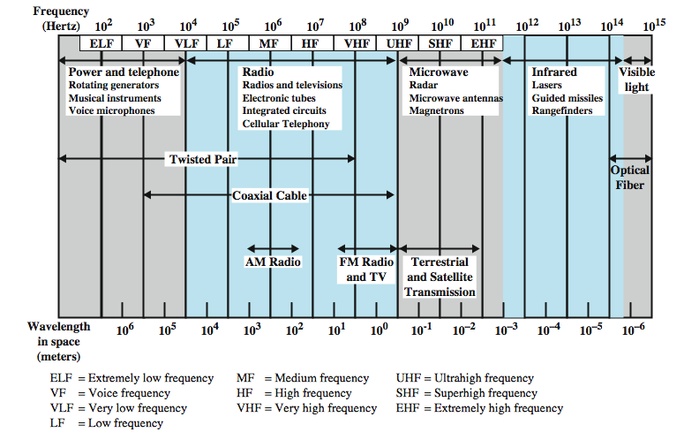
Electromagnetic Spectrum
Notes:
Figure 4.1 depicts the electromagnetic spectrum and indicates the frequencies at which various guided media and unguided transmission techniques operate. In this chapter we examine these guided and unguided alternatives. In all cases, we describe the systems physically, briefly discuss applications, and summarize key transmission characteristics.

Slide 6
Transmission Characteristics of Guided Media
Frequency Range
Typical Attenuation
Typical Delay
Repeater Spacing
Twisted pair (with loading)
0 to 3.5 kHz
0.2 dB/km @ 1 kHz
50 µs/km
2 km
Twisted pairs (multi-pair cables)
0 to 1 MHz
0.7 dB/km @ 1 kHz
5 µs/km
2 km
Coaxial cable
0 to 500 MHz
7 dB/km @ 10 MHz
4 µs/km
1 to 9 km
Optical fiber
186 to 370 THz
0.2 to 0.5 dB/km
5 µs/km
40 km
Notes:
For guided transmission media, the transmission capacity, in terms of either data rate or bandwidth, depends critically on the distance and on whether the medium is point-to-point or multipoint. Stallings DCC8e Table 4.1(shown above) indicates the characteristics typical for the common guided media for long-distance point-to-point applications; we defer a discussion of the use of these media for LANs to Part Four. The three guided media commonly used for data transmission are twisted pair, coaxial cable, and optical fiber. We examine each of these in turn.

Slide 7
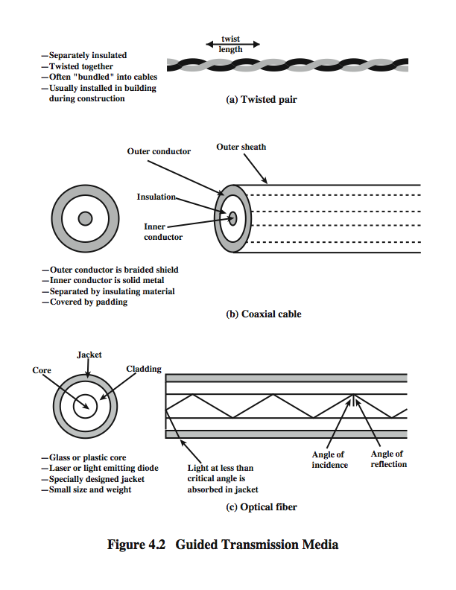
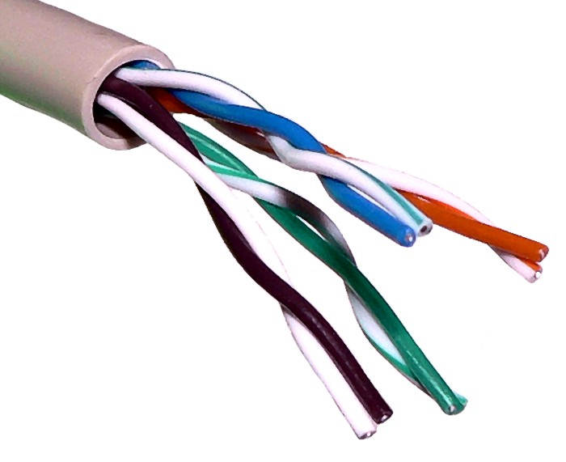
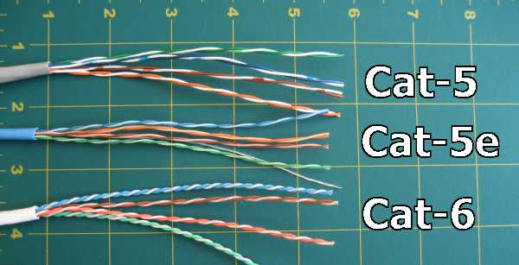
Twisted Pair
Reduce Electromagnetic Interference
Notes:
By far the most common guided transmission medium for both analog and digital signals is twisted pair. It is the most commonly used medium in the telephone network (linking residential telephones to the local telephone exchange, or office phones to a PBX), and for communications within buildings (for LANs running at 10-100Mbps). Twisted pair is much less expensive than the other commonly used guided transmission media (coaxial cable, optical fiber) and is easier to work with.
A twisted pair consists of two insulated copper wires arranged in a regular spiral pattern. A wire pair acts as a single communication link. Typically, a number of these pairs are bundled together into a cable by wrapping them in a tough protective sheath. The twisting tends to decrease the crosstalk interference between adjacent pairs in a cable. Neighboring pairs in a bundle typically have somewhat different twist lengths to reduce the crosstalk interference. On long-distance links, the twist length typically varies from 5 to 15 cm. The wires in a pair have thicknesses of from 0.4 to 0.9 mm.

Slide 8
Twisted Pair - Transmission Characteristics
analog
  needs amplifiers every 5km to 6km
digital
  can use either analog or digital signals
  needs a repeater every 2-3km
limited distance
limited bandwidth (1MHz)
limited data rate (100MHz)
susceptible to interference and noise
Notes:
Twisted pair may be used to transmit both analog and digital transmission. For analog signals, amplifiers are required about every 5 to 6 km. For digital transmission (using either analog or digital signals), repeaters are required every 2 or 3 km.
Compared to other commonly used guided transmission media (coaxial cable, optical fiber), twisted pair is limited in distance, bandwidth, and data rate. The attenuation for twisted pair is a very strong function of frequency. Other impairments are also severe for twisted pair. The medium is quite susceptible to interference and noise because of its easy coupling with electromagnetic fields. Several measures are taken to reduce impairments. Shielding the wire with metallic braid or sheathing reduces interference. The twisting of the wire reduces low-frequency interference, and the use of different twist lengths in adjacent pairs reduces crosstalk.
For point-to-point analog signaling, a bandwidth of up to about 1 MHz is possible. For long-distance digital point-to-point signaling, data rates of up to a few Mbps are possible; for very short distances, data rates of up to 10 Gbps have been achieved in commercially available products.

Slide 9
Unshielded vs Shielded TP
unshielded Twisted Pair (UTP)
  ordinary telephone wire
  cheapest
  easiest to install
  suffers from external EM interference
shielded Twisted Pair (STP)
  metal braid or sheathing that reduces interference
  more expensive
  harder to handle (thick, heavy)
in a variety of categories - see EIA-568
Notes:
Twisted pair comes in two varieties: unshielded and shielded.
Unshielded twisted pair (UTP) is ordinary telephone wire. Office buildings, by universal practice, are prewired with excess unshielded twisted pair, more than is needed for simple telephone support. This is the least expensive of all the transmission media commonly used for local area networks and is easy to work with and easy to install. However UTP is subject to external electromagnetic interference, including interference from nearby twisted pair and from noise generated in the environment.
A way to improve the characteristics of this medium is to shield the twisted pair with a metallic braid or sheathing that reduces interference. This shielded twisted pair (STP) provides better performance at higher data rates. However, it is more expensive and more difficult to work with than unshielded twisted pair.
Twisted Pair cables come in a variety of categories. Originally most office buildings were prewired with a type of 100-ohm twisted pair cable commonly referred to as voice grade. Because voice-grade twisted pair was already installed, it was an attractive alternative for use as a LAN medium, and this use was recognised by the Electronic Industries Association standard EIA-568, Commercial Building Telecommunications Cabling Standard, published in 1991. Unfortunately, the data rates and distances achievable with voice-grade twisted pair are limited. As users migrated to higher-performance workstations and applications, there was increasing interest in providing LANs that could operate up to 100 Mbps over inexpensive cable.

Slide 10
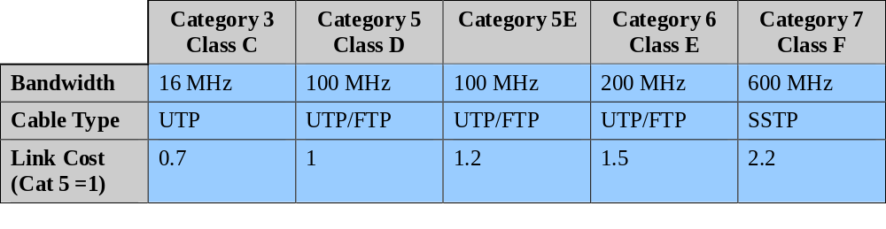
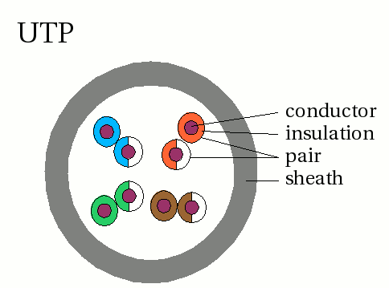
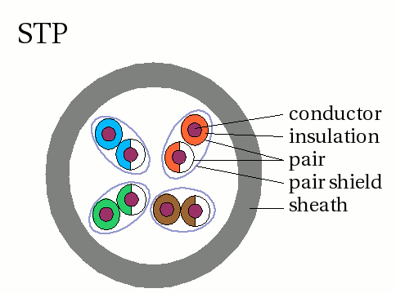
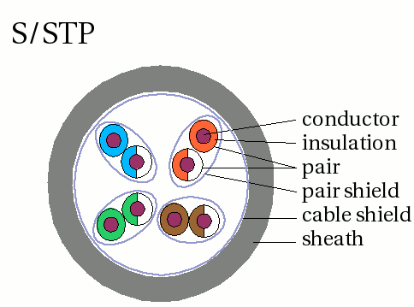
UTP Categories
7.5~10 cm
0.6~0.85cm
Notes:
In response to the need to support higher speeds, EIA-568-A was issued in 1995. The new standard reflects advances in cable and connector design and test methods. It covers 150-ohm shielded twisted pair and 100-ohm unshielded twisted pair. EIA-568-A recognizes three categories of UTP cabling:
• Category 3: UTP cables and associated connecting hardware whose transmission characteristics are specified up to 16 MHz
• Category 4: UTP cables and associated connecting hardware whose transmission characteristics are specified up to 20 MHz
• Category 5: UTP cables and associated connecting hardware whose transmission characteristics are specified up to 100 MHz
Of these, it is Category 3 and Category 5 cable that have received the most attention for LAN applications. Category 3 corresponds to the voice-grade cable found in abundance in most office buildings. Over limited distances, and with proper design, data rates of up to 16 Mbps should be achievable with Category 3. Category 5 is a data-grade cable that is becoming standard for preinstallation in new office buildings. Over limited distances, and with proper design, data rates of up to 100 Mbps are achievable with Category 5.
Since the publication of EIA-568-A, there has been ongoing work on the development of standards for premises cabling, driven by two issues. First, the Gigabit Ethernet specification requires the definition of parameters that are not specified completely in any published cabling standard. Second, there is a desire to specify cabling performance to higher levels, namely Enhanced Category 5 (Cat 5E), Category 6, and Category 7. Stallings DCC8e Table 4.3 compares these new cabling schemes to the existing standards.

Slide 11
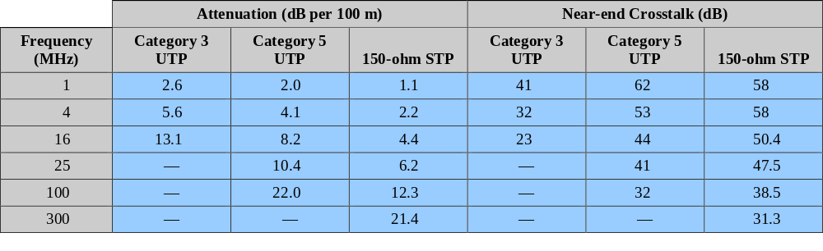
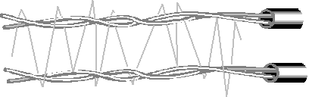
Comparison of Shielded and Unshielded Twisted Pair
Notes:
Stallings DCC8e Table 4.2 summarizes the performance of Category 3 and 5 UTP, as well as the STP specified in EIA-568-A
The first parameter used for comparison, attenuation, is fairly straightforward. The strength of a signal falls off with distance over any transmission medium. For guided media attenuation is generally exponential and therefore is typically expressed as a constant number of decibels per unit distance.
Near-end crosstalk as it applies to twisted pair wiring systems is the coupling of the signal from one pair of conductors to another pair. These conductors may be the metal pins in a connector or wire pairs in a cable. The near end refers to coupling that takes place when the transmit signal entering the link couples back to the receive conductor pair at that same end of the link (i.e., the near transmitted signal is picked up by the near receive pair).

Slide 12
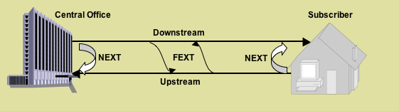
Near End Crosstalk
coupling of signal from one pair to another
occurs when transmit signal entering the link couples back to receiving pair
ie. near transmitted signal is picked up by near receiving pair
Notes:
Near-end crosstalk as it applies to twisted pair wiring systems is the coupling of the signal from one pair of conductors to another pair. These conductors may be the metal pins in a connector or wire pairs in a cable. The near end refers to coupling that takes place when the transmit signal entering the link couples back to the receive conductor pair at that same end of the link (ie. the near end transmitted signal is picked up by the near receive pair).

Slide 13
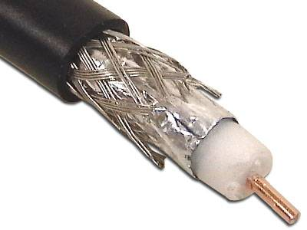
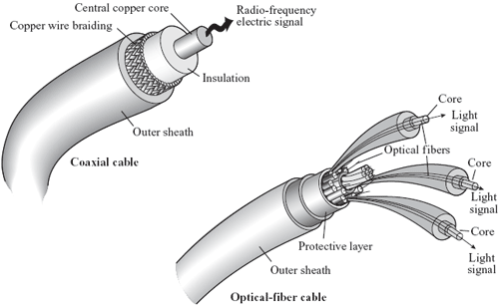
Coaxial Cable
Notes:
Coaxial cable, like twisted pair, consists of two conductors, but is constructed differently to permit it to operate over a wider range of frequencies. It consists of a hollow outer cylindrical conductor that surrounds a single inner wire conductor (Stallings DCC8e Figure 4.2b). The inner conductor is held in place by either regularly spaced insulating rings or a solid dielectric material. The outer conductor is covered with a jacket or shield. A single coaxial cable has a diameter of from 1 to 2.5 cm. Coaxial cable can be used over longer distances and support more stations on a shared line than twisted pair.
Coaxial cable is a versatile transmission medium, used in a wide variety of applications, including:
• Television distribution - aerial to TV & CATV systems
• Long-distance telephone transmission - traditionally used for inter-exchange links, now being replaced by optical fiber/microwave/satellite
• Short-run computer system links
• Local area networks

Slide 14
Coaxial Cable - Transmission Characteristics
superior frequency characteristics to TP
performance limited by attenuation & noise
analog signals
  amplifiers every few km
  closer if higher frequency
  up to 500MHz
digital signals
  repeater every 1km
  closer for higher data rates
Notes:
Coaxial cable is used to transmit both analog and digital signals. It has frequency characteristics that are superior to those of twisted pair and can hence be used effectively at higher frequencies and data rates. Because of its shielded, concentric construction, coaxial cable is much less susceptible to interference and crosstalk than twisted pair. The principal constraints on performance are attenuation, thermal noise, and intermodulation noise. The latter is present only when several channels (FDM) or frequency bands are in use on the cable.
For long-distance transmission of analog signals, amplifiers are needed every few kilometers, with closer spacing required if higher frequencies are used. The usable spectrum for analog signaling extends to about 500 MHz. For digital signaling, repeaters are needed every kilometer or so, with closer spacing needed for higher data rates.

Slide 15
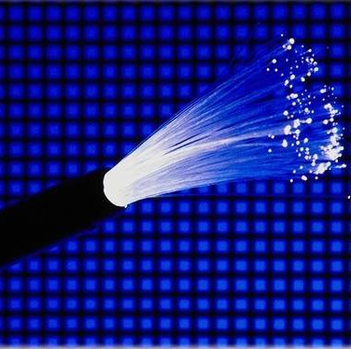
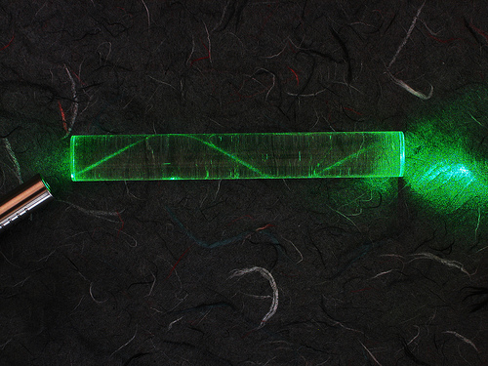
Optical Fiber
Notes:
An optical fiber is a thin (2 to 125 µm), flexible medium capable of guiding an optical ray. Various glasses and plastics can be used to make optical fibers. An optical fiber cable has a cylindrical shape and consists of three concentric sections: the core, the cladding, and the jacket (Stallings DCC8e Figure 4.2c). The core is the innermost section and consists of one or more very thin strands, or fibers, made of glass or plastic; the core has a diameter in the range of 8 to 50 µm. Each fiber is surrounded by its own cladding, a glass or plastic coating that has optical properties different from those of the core and a diameter of 125 µm. The interface between the core and cladding acts as a reflector to confine light that would otherwise escape the core. The outermost layer, surrounding one or a bundle of cladded fibers, is the jacket. The jacket is composed of plastic and other material layered to protect against moisture, abrasion, crushing, and other environmental dangers.
Optical fiber already enjoys considerable use in long-distance telecommunications, and its use in military applications is growing. The continuing improvements in performance and decline in prices, together with the inherent advantages of optical fiber, have made it increasingly attractive for local area networking. Five basic categories of application have become important for optical fiber: Long-haul trunks, Metropolitan trunks, Rural exchange trunks, Subscriber loops & Local area networks.

Slide 16
Optical Fiber - Benefits
greater capacity
  data rates of hundreds of Gbps
smaller size & weight
lower attenuation
electromagnetic isolation
greater repeater spacing
  10s of km at least
Notes:
The following characteristics distinguish optical fiber from twisted pair or coaxial cable:
• Greater capacity: The potential bandwidth, and hence data rate, of optical fiber is immense; data rates of hundreds of Gbps over tens of kilometers have been demonstrated. Compare this to the practical maximum of hundreds of Mbps over about 1 km for coaxial cable and just a few Mbps over 1 km or up to 100 Mbps to 10 Gbps over a few tens of meters for twisted pair.
• Smaller size and lighter weight: Optical fibers are considerably thinner than coaxial cable or bundled twisted-pair cable. For cramped conduits in buildings and underground along public rights-of-way, the advantage of small size is considerable. The corresponding reduction in weight reduces structural support requirements.
• Lower attenuation: Attenuation is significantly lower for optical fiber than for coaxial cable or twisted pair, and is constant over a wide range.
• Electromagnetic isolation: Optical fiber systems are not affected by external electromagnetic fields. Thus the system is not vulnerable to interference, impulse noise, or crosstalk. By the same token, fibers do not radiate energy, so there is little interference with other equipment and there is a high degree of security from eavesdropping. In addition, fiber is inherently difficult to tap.
• Greater repeater spacing: Fewer repeaters mean lower cost and fewer sources of error. The performance of optical fiber systems from this point of view has been steadily improving. Repeater spacing in the tens of kilometers for optical fiber is common, and repeater spacings of hundreds of kilometers have been demonstrated.

Slide 17
Optical Fiber - Transmission Characteristics
uses total internal reflection to transmit light
  effectively acts as wave guide for 10¹⁴ to 10¹⁵ Hz
can use several different light sources
  Light Emitting Diode (LED)
    cheaper, wider operating temp range, lasts longer
  Injection Laser Diode (ILD)
    more efficient, has greater data rate
relation of wavelength, type & data rate
Notes:
Optical fiber transmits a signal-encoded beam of light by means of total internal reflection. Total internal reflection can occur in any transparent medium that has a higher index of refraction than the surrounding medium. In effect, the optical fiber acts as a waveguide for frequencies in the range of about 10¹⁴ to 10¹⁵ Hertz; this covers portions of the infrared and visible spectra.
Two different types of light source are used in fiber optic systems: the light-emitting diode (LED) and the injection laser diode (ILD). Both are semiconductor devices that emit a beam of light when a voltage is applied. The LED is less costly, operates over a greater temperature range, and has a longer operational life. The ILD, which operates on the laser principle, is more efficient and can sustain greater data rates.
There is a relationship among the wavelength employed, the type of transmission, and the achievable data rate. Both single mode and multimode can support several different wavelengths of light and can employ laser or LED light sources.

Slide 18
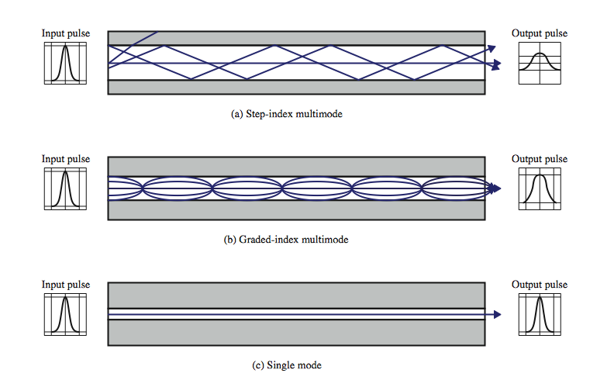
Optical Fiber Transmission Modes
Notes:
Stallings DCC8e Figure 4.4 shows the principle of optical fiber transmission. Light from a source enters the cylindrical glass or plastic core. Rays at shallow angles are reflected and propagated along the fiber; other rays are absorbed by the surrounding material. This form of propagation is called step-index multimode, referring to the variety of angles that will reflect. With multimode transmission, multiple propagation paths exist, each with a different path length and hence time to traverse the fiber. This causes signal elements (light pulses) to spread out in time, which limits the rate at which data can be accurately received. This type of fiber is best suited for transmission over very short distances.
When the fiber core radius is reduced, fewer angles will reflect. By reducing the radius of the core to the order of a wavelength, only a single angle or mode can pass: the axial ray. This single-mode propagation provides superior performance for the following reason. Because there is a single transmission path with single-mode transmission, the distortion found in multimode cannot occur. Single-mode is typically used for long-distance applications, including telephone and cable television.
Finally, by varying the index of refraction of the core, a third type of transmission, known as graded-index multimode, is possible. The higher refractive index (discussed subsequently) at the center makes the light rays moving down the axis advance more slowly than those near the cladding. Rather than zig-zagging off the cladding, light in the core curves helically because of the graded index, reducing its travel distance. The shortened path and higher speed allows light at the periphery to arrive at a receiver at about the same time as the straight rays in the core axis. Graded-index fibers are often used in local area networks.

Slide 19
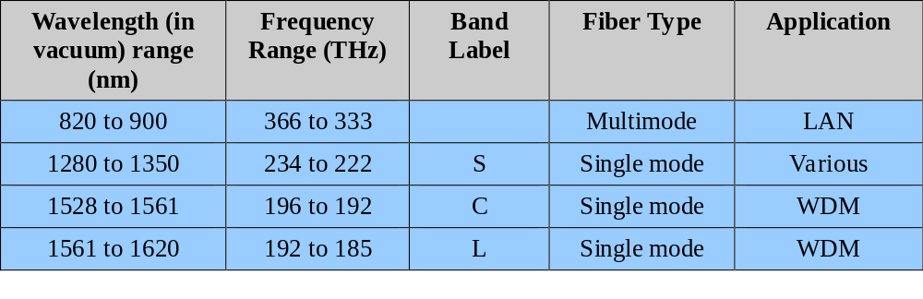
Frequency Utilization for Fiber Applications
Notes:
In optical fiber, based on the attenuation characteristics of the medium and on properties of light sources and receivers, four transmission windows are appropriate, as shown in Stallings DCC8e Table 4.5. Note the tremendous bandwidths available. For the four windows, the respective bandwidths are 33 THz, 12 THz, 4 THz, and 7 THz. This is several orders of magnitude greater than the bandwidth available in the radio-frequency spectrum.
The four transmission windows are in the infrared portion of the frequency spectrum, below the visible-light portion, which is 400 to 700 nm. The loss is lower at higher wavelengths, allowing greater data rates over longer distances. Many local applications today use 850-nm LED light sources. Although this combination is relatively inexpensive, it is generally limited to data rates under 100 Mbps and distances of a few kilometers. To achieve higher data rates and longer distances, a 1300-nm LED or laser source is needed. The highest data rates and longest distances require 1500-nm laser sources. nb. WDM = wavelength division multiplexing (see Chapter 8).

Slide 20
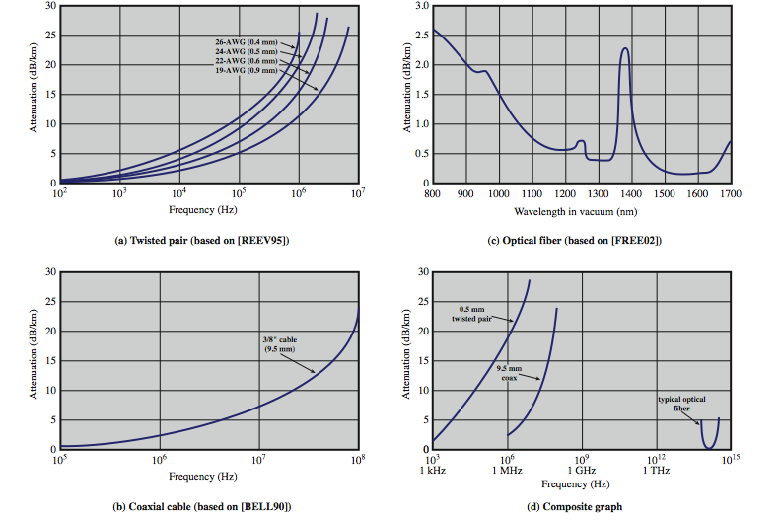
Attenuation in Guided Media
Notes:
Stallings DCC8e Figure 4.3 shows attenuation versus wavelength for the various types of wired media we have discussed.
Fig 4.3a shows that attenuation for twisted pair is a very strong function of frequency.
As Fig 4.3b shows, coaxial cable has frequency characteristics that are superior to those of twisted pair and can hence be used effectively at higher frequencies and data rates.
Fig 4.3c shows the attenuation vs wavelength for a typical optical fiber. The unusual shape of the curve is due to the combination of a variety of factors that contribute to attenuation. The two most important of these are absorption and scattering, which is the change in direction of light rays after they strike small particles or impurities in the medium.

Slide 21
Wireless Transmission Frequencies
30MHz to 1GHz
  Broadcast radio, omni-directional
2GHz to 40GHz
  Microwave, highly directional
  point to point
  satellite
3 x 10¹¹ to 2 x 10¹⁴
  infrared
  local
Notes:
Unguided transmission techniques commonly used for information communications include broadcast radio, terrestrial microwave, and satellite. Infrared transmission is used in some LAN applications. Three general ranges of frequencies are of interest in our discussion of wireless transmission.
Frequencies in the range of about 1 to 40 GHz are referred to as microwave frequencies. At these frequencies, highly directional beams are possible, and microwave is quite suitable for point-to-point transmission. Microwave is also used for satellite communications.
Frequencies in the range of 30 MHz to 1 GHz are suitable for omnidirectional applications. We refer to this range as the radio range.
Another important frequency range is the infrared portion of the spectrum, roughly from 3 × 10¹¹ to 2 × 10¹⁴ Hz. Infrared is useful to local point-to-point and multipoint applications within confined areas, such as a single room.

Slide 22
Antennas
electrical conductor used to radiate or collect electromagnetic energy
transmission antenna
  radio frequency energy from transmitter
  converted to electromagnetic energy by antenna
  radiated into surrounding environment
reception antenna
  electromagnetic energy impinging on antenna
  converted to radio frequency electrical energy
  fed to receiver
same antenna is often used for both purposes
Notes:
For unguided media, transmission and reception are achieved by means of an antenna. An antenna can be defined as an electrical conductor or system of conductors used either for radiating electromagnetic energy or for collecting electromagnetic energy.
For transmission of a signal, radio-frequency electrical energy from the transmitter is converted into electromagnetic energy by the antenna and radiated into the surrounding environment.
For reception of a signal, electromagnetic energy impinging on the antenna is converted into radio-frequency electrical energy and fed into the receiver.
In two-way communication, the same antenna can be and often is used for both transmission and reception. This is possible because antenna characteristics are essentially the same whether an antenna is sending or receiving electromagnetic energy.

Slide 23
Radiation Pattern
power radiated in all directions
not same performance in all directions
  as seen in a radiation pattern diagram
an isotropic antenna is a (theoretical) point in space
  radiates in all directions equally
  with a spherical radiation pattern
Notes:
An antenna will radiate power in all directions but, typically, does not perform equally well in all directions. A common way to characterize the performance of an antenna is the radiation pattern, which is a graphical representation of the radiation properties of an antenna as a function of space coordinates.
The simplest pattern is produced by an idealized antenna known as the isotropic antenna. An isotropic antenna is a point in space that radiates power in all directions equally. The actual radiation pattern for the isotropic antenna is a sphere with the antenna at the center.

Slide 24
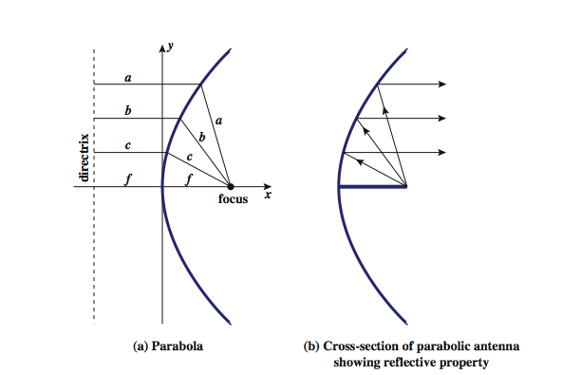
Parabolic Reflective Antenna
Notes:
An important type of antenna is the parabolic reflective antenna, which is used in terrestrial microwave and satellite applications. A parabola is the locus of all points equidistant from a fixed line (the directrix) and a fixed point (the focus) not on the line, as shown in Stallings DCC8e Figure 4.5a above. If a parabola is revolved about its axis, the surface generated is called a paraboloid.
Paraboloid surfaces are used in headlights, optical and radio telescopes, and microwave antennas because: If a source of electromagnetic energy (or sound) is placed at the focus of the paraboloid, and if the paraboloid is a reflecting surface, then the wave will bounce back in lines parallel to the axis of the paraboloid; as shown in Stallings DCC8e Figure 4.5b above. In theory, this effect creates a parallel beam without dispersion. In practice, there will be some dispersion, because the source of energy must occupy more than one point. The larger the diameter of the antenna, the more tightly directional is the beam. On reception, if incoming waves are parallel to the axis of the reflecting paraboloid, the resulting signal will be concentrated at the focus.

Slide 25
Antenna Gain
measure of directionality of antenna
power output in particular direction verses that produced by an isotropic antenna
measured in decibels (dB)
results in loss in power in another direction
effective area relates to size and shape
  related to gain
Notes:
Antenna gain is a measure of the directionality of an antenna. Antenna gain is defined as the power output, in a particular direction, compared to that produced in any direction by a perfect omnidirectional antenna (isotropic antenna). For example, if an antenna has a gain of 3 dB, that antenna improves upon the isotropic antenna in that direction by 3 dB, or a factor of 2. The increased power radiated in a given direction is at the expense of other directions. In effect, increased power is radiated in one direction by reducing the power radiated in other directions. It is important to note that antenna gain does not refer to obtaining more output power than input power but rather to directionality.
A concept related to that of antenna gain is the effective area of an antenna. The effective area of an antenna is related to the physical size of the antenna and to its shape, as shown in equation 4.1.

Slide 26
Broadcast Radio
radio is 3kHz to 300GHz
use broadcast radio, 30MHz - 1GHz, for:
  FM radio
  UHF and VHF television
is omnidirectional
still need line of sight
suffers from multipath interference
  reflections from land, water, other objects
Notes:
Radio is a general term used to encompass frequencies in the range of 3 kHz to 300 GHz. We are using the informal term broadcast radio to cover the VHF and part of the UHF band: 30 MHz to 1 GHz. This range covers FM radio and UHF and VHF television. This range is also used for a number of data networking applications. The principal difference between broadcast radio and microwave is that the former is omnidirectional and the latter is directional. Thus broadcast radio does not require dish-shaped antennas, and the antennas need not be rigidly mounted to a precise alignment.
The range 30 MHz to 1 GHz is an effective one for broadcast communications. Unlike the case for lower-frequency electromagnetic waves, the ionosphere is transparent to radio waves above 30 MHz. Thus transmission is limited to the line of sight, and distant transmitters will not interfere with each other due to reflection from the atmosphere. Unlike the higher frequencies of the microwave region, broadcast radio waves are less sensitive to attenuation from rainfall. A prime source of impairment for broadcast radio waves is multipath interference. Reflection from land, water, and natural or human-made objects can create multiple paths between antennas, eg ghosting on TV pictures.

Slide 27
Terrestrial Microwave
used for long haul telecommunications
and short point-to-point links
requires fewer repeaters but line of sight
use a parabolic dish to focus a narrow beam onto a receiver antenna
1-40GHz frequencies
higher frequencies give higher data rates
main source of loss is attenuation
  distance, rainfall
also interference
Notes:
The primary use for terrestrial microwave systems is in long haul telecommunications service, as an alternative to coaxial cable or optical fiber. The microwave facility requires far fewer amplifiers or repeaters than coaxial cable over the same distance, (typically every 10-100 km) but requires line-of-sight transmission. Microwave is commonly used for both voice and television transmission. Another increasingly common use of microwave is for short point-to-point links between buildings, for closed-circuit TV or as a data link between local area networks.
The most common type of microwave antenna is the parabolic "dish”, fixed rigidly to focus a narrow beam on a receiving antenna A typical size is about 3 m in diameter. Microwave antennas are usually located at substantial heights above ground level to extend the range between antennas and to be able to transmit over intervening obstacles. To achieve long-distance transmission, a series of microwave relay towers is used, and point-to-point microwave links are strung together over the desired distance.
Microwave transmission covers a substantial portion of the electromagnetic spectrum, typically in the range 1 to 40 GHz, with 4-6GHz and now 11GHz bands the most common. The higher the frequency used, the higher the potential bandwidth and therefore the higher the potential data rate. As with any transmission system, a main source of loss is attenuation, related to the square of distance. The effects of rainfall become especially noticeable above 10 GHz. Another source of impairment is interference.

Slide 28
Satellite Microwave
satellite is relay station
receives on one frequency, amplifies or repeats signal and transmits on another frequency
  eg. uplink 5.925-6.425 GHz & downlink 3.7-4.2 GHz
typically requires geo-stationary orbit
  height of 35,784km
  spaced at least 3-4° apart
typical uses
  television
  long distance telephone
  private business networks
  global positioning
Notes:
A communication satellite is, in effect, a microwave relay station. It is used to link two or more ground-based microwave transmitter/receivers, known as earth stations, or ground stations. The satellite receives transmissions on one frequency band (uplink), amplifies or repeats the signal, and transmits it on another frequency (downlink). A single orbiting satellite will operate on a number of frequency bands, called transponder channels, or simply transponders. The optimum frequency range for satellite transmission is in the range 1 to 10 GHz. Most satellites providing point-to-point service today use a frequency bandwidth in the range 5.925 to 6.425 GHz for transmission from earth to satellite (uplink) and a bandwidth in the range 3.7 to 4.2 GHz for transmission from satellite to earth (downlink). This combination is referred to as the 4/6-GHz band, but has become saturated. So the 12/14-GHz band has been developed (uplink: 14 - 14.5 GHz; downlink: 11.7 - 12.2 GHz).
For a communication satellite to function effectively, it is generally required that it remain stationary with respect to its position over the earth to be within the line of sight of its earth stations at all times. To remain stationary, the satellite must have a period of rotation equal to the earth's period of rotation, which occurs at a height of 35,863 km at the equator. Two satellites using the same frequency band, if close enough together, will interfere with each other. To avoid this, current standards require a 4° spacing in the 4/6-GHz band and a 3° spacing at 12/14 GHz. Thus the number of possible satellites is quite limited.
Among the most important applications for satellites are: Television distribution, Long-distance telephone transmission, Private business networks, and Global positioning.

Slide 29
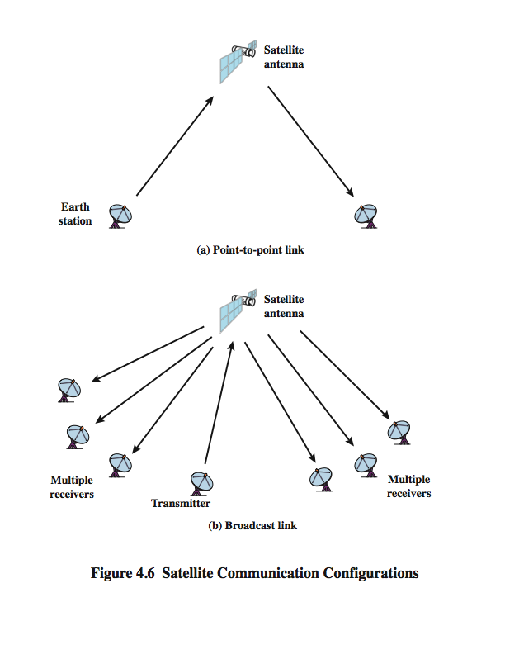
Satellite Point to Point Link
Notes:
Stallings DCC8e Figure 4.6 depicts in a general way two common configurations for satellite communication. In the first, the satellite is being used to provide a point-to-point link between two distant ground-based antennas.

Slide 30
Satellite Broadcast Link
Notes:
Stallings DCC8e Figure 4.6 depicts in a general way two common configurations for satellite communication. In the second, the satellite provides communications between one ground-based transmitter and a number of ground-based receivers.

Slide 31
Infrared
modulate non-coherent infrared light
end line of sight (or reflection)
are blocked by walls
no licenses required
typical uses
  TV remote control
  IRD port
Notes:
Infrared communications is achieved using transmitters/receivers (transceivers) that modulate noncoherent infrared light. Transceivers must be within the line of sight of each other either directly or via reflection from a light-colored surface such as the ceiling of a room.
One important difference between infrared and microwave transmission is that the former does not penetrate walls. Thus the security and interference problems encountered in microwave systems are not present. Furthermore, there is no frequency allocation issue with infrared, because no licensing is required.

Slide 32
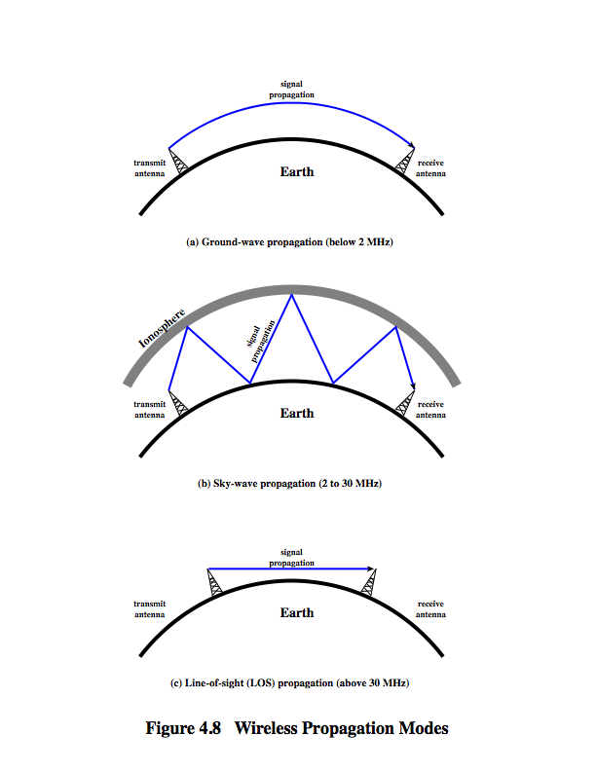
Wireless Propagation
Ground Wave
Notes:
A signal radiated from an antenna travels along one of three routes: ground wave, sky wave, or line of sight (LOS), as shown in Stallings DCC8e Figure 4.8.
Ground wave propagation more or less follows the contour of the earth and can propagate considerable distances, well over the visual horizon. This effect is found in frequencies up to about 2 MHz. Several factors account for the tendency of electromagnetic wave in this frequency band to follow the earth's curvature. One factor is that the electromagnetic wave induces a current in the earth's surface, the result of which is to slow the wavefront near the earth, causing the wavefront to tilt downward and hence follow the earth's curvature. Another factor is diffraction, which is a phenomenon having to do with the behavior of electromagnetic waves in the presence of obstacles. Electromagnetic waves in this frequency range are scattered by the atmosphere in such a way that they do not penetrate the upper atmosphere. The best-known example of ground wave communication is AM radio.

Slide 33
Wireless Propagation
Sky Wave
Notes:
Sky wave propagation is used for amateur radio, CB radio, and international broadcasts such as BBC and Voice of America. With sky wave propagation, a signal from an earth-based antenna is reflected from the ionized layer of the upper atmosphere (ionosphere) back down to earth. Although it appears the wave is reflected from the ionosphere as if the ionosphere were a hard reflecting surface, the effect is in fact caused by refraction. Refraction is described subsequently. A sky wave signal can travel through a number of hops, bouncing back and forth between the ionosphere and the earth's surface, as shown in Stallings DCC8e Figure 4.8b. With this propagation mode, a signal can be picked up thousands of kilometers from the transmitter.

Slide 34
Wireless Propagation
Line of Sight
Notes:
Above 30 MHz, neither ground wave nor sky wave propagation modes operate, and communication must be by line of sight (Stallings DCC8e Figure 4.8c). For satellite communication, a signal above 30 MHz is not reflected by the ionosphere and therefore a signal can be transmitted between an earth station and a satellite overhead that is not beyond the horizon. For ground-based communication, the transmitting and receiving antennas must be within an effective line of sight of each other. The term effective is used because microwaves are bent or refracted by the atmosphere. The amount and even the direction of the bend depends on conditions, but generally microwaves are bent with the curvature of the earth and will therefore propagate farther than the optical line of sight. In this book, we are almost exclusively concerned with LOS communications.

Slide 35
Refraction
velocity of electromagnetic wave is a function of density of material
  ~3 x 10⁸ m/s in vacuum, less in anything else
speed changes as move between media
Index of refraction (refractive index) is
  sin(incidence)/sin(refraction)
  varies with wavelength
have gradual bending if medium density varies
  density of atmosphere decreases with height
  results in bending towards earth of radio waves
  hence optical and radio horizons differ
Notes:
Before proceeding, a brief discussion of refraction is warranted. Refraction occurs because the velocity of an electromagnetic wave is a function of the density of the medium through which it travels. In a vacuum, an electromagnetic wave (such as light or a radio wave) travels at approximately 3 × 10⁸ m/s, the constant c. In air, water, glass, and other transparent or partially transparent media, electromagnetic waves travel at speeds less than c.
When an electromagnetic wave moves from a medium of one density to a medium of another density, its speed changes. The effect is to cause a one-time bending of the direction of the wave at the boundary between the two media.
The index of refraction, or refractive index, of one medium relative to another is the sine of the angle of incidence divided by the sine of the angle of refraction. The index of refraction is also equal to the ratio of the respective velocities in the two media. The absolute index of refraction of a medium is calculated in comparison with that of a vacuum. Refractive index varies with wavelength, so that refractive effects differ for signals with different wavelengths.
Although an abrupt, one-time change in direction occurs as a signal moves from one medium to another, a continuous, gradual bending of a signal will occur if it is moving through a medium in which the index of refraction gradually changes. Under normal propagation conditions, the refractive index of the atmosphere decreases with height so that radio waves travel more slowly near the ground than at higher altitudes. The result is a slight bending of the radio waves toward the earth, which causes a difference between the optical and radio horizons fpr LOS transmissions.

Slide 36
Line of Sight Transmission
Free space loss
  loss of signal with distance
Atmospheric Absorption
  from water vapour and oxygen absorption
Multipath
  multiple interfering signals from reflections
Refraction
  bending signal away from receiver
Notes:
Stallings DCC8e section 3.3 discussed various transmission impairments common to both guided and wireless transmission. In this section, we extend the discussion to examine some impairments specific to wireless line-of-sight transmission.
For any type of wireless communication the signal disperses with distance. Therefore, an antenna with a fixed area will receive less signal power the farther it is from the transmitting antenna. For satellite communication this is the primary mode of signal loss. Even if no other sources of attenuation or impairment are assumed, a transmitted signal attenuates over distance because the signal is being spread over a larger and larger area. This form of attenuation is known as free space loss.
An additional loss between the transmitting and receiving antennas is atmospheric absorption. Water vapor and oxygen contribute most to attenuation. A peak attenuation occurs in the vicinity of 22 GHz due to water vapor. At frequencies below 15 GHz, the attenuation is less. The presence of oxygen results in an absorption peak in the vicinity of 60 GHz but contributes less at frequencies below 30 GHz. Rain and fog (suspended water droplets) cause scattering of radio waves that results in attenuation.
For some wireless systems, there are obstacles in abundance. The signal can be reflected by such obstacles so that multiple copies of the signal with varying delays can be received, resulting in multipath interference. Depending on the differences in the path lengths of the direct and reflected waves, the composite signal can be either larger or smaller than the direct signal.
Radio waves are refracted (or bent) when they propagate through the atmosphere. Normally, the speed of the signal increases with altitude, causing radio waves to bend downward. However, on occasion, weather conditions may lead to variations in speed with height that differ significantly from the typical variations. This may result in a situation in which only a fraction or no part of the line-of-sight wave reaches the receiving antenna.

Slide 37
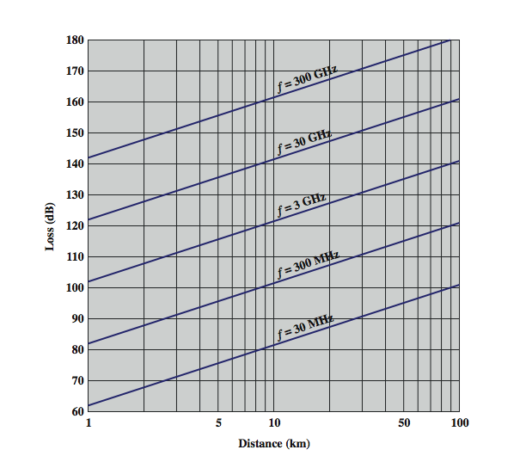
Free Space Loss
Notes:
Free space loss can be expressed in terms of the ratio of the radiated power P_{t} to the power P_{r} received by the antenna or, in decibels, by taking 10 times the log of that ratio, as shown in equation 4.3. Stallings DCC8e Figure 4.10 illustrates the free space loss equation for various frequencies.
See from equation 4.3 that as the frequency increases, the free space loss also increases, which would suggest that at higher frequencies, losses become more burdensome. However, equation 4.) shows that we can easily compensate for this increased loss with antenna gains.

Slide 38
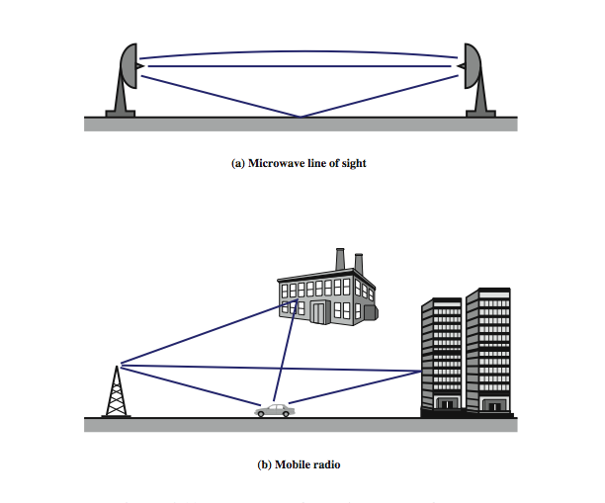
Multipath Interference
Notes:
Stallings DCC8e Figure 4.11 illustrates in general terms the types of multipath interference typical in terrestrial, fixed microwave and in mobile communications. For fixed microwave, in addition to the direct line of sight, the signal may follow a curved path through the atmosphere due to refraction and the signal may also reflect from the ground. For mobile communications, structures and topographic features provide reflection surfaces.

Slide 39
Summary
looked at data transmission issues
frequency, spectrum & bandwidth
analog vs digital signals
transmission impairments
Notes:
Stallings DCC8e Chapter 4 summary.

