Slide 1
Data and Computer Communications
Chapter 20 – Transport Protocols
Eighth Edition
by William Stallings
Lecture slides by Lawrie Brown
Notes:
Lecture slides prepared by Dr Lawrie Brown (UNSW@ADFA) for “Data and Computer Communications”, 8/e, by William Stallings, Chapter 20 “Transport Protocols”.

Slide 2
TCP: L4, Connection-oriented, Reliable
End-to-End, Port #
Connection setup/termination
2-way handshake
→ 3-way
Flow/Error/Congestion Control
Credit-based
Persist Timer
Window
Management
ReTx Timer (RTT)
Exp. RTO Backoff
Karn’s Algorithm

Slide 3
Transport Protocols
The foregoing observations should make us reconsider the widely held view that birds live only in the present. In fact, birds are aware of more than immediately present stimuli; they remember the past and anticipate the future.
—The Minds of Birds, Alexander Skutch
Notes:
This quote is from the start of Stallings DCC8e Chapter 20.

Slide 4
Transport Protocols
end-to-end data transfer service
shield upper layers from network details
reliable, connection oriented
  has greater complexity
  eg. TCP
best effort, connectionless
  datagram
  eg. UDP
Notes:
The transport protocol provides an end-to-end data transfer service that shields upper layer protocols from the details of the intervening network or networks. The transport protocol provides services to transport service (TS) users, such as FTP, SMTP, and TELNET. The local transport entity communicates with some remote transport entity, using the services of some lower layer, such as the Internet Protocol. A transport protocol can be either connection oriented, such as TCP, or connectionless, such as UDP. Find that most of the complexity relates to reliable connection-oriented services. The less the network service provides, the more the transport protocol must do.

Slide 5
Connection Oriented Transport Protocols
provides establishment, maintenance & termination of a logical connection
most common service
used for a wide variety of applications
is reliable
but complex
first discuss evolution from reliable to unreliable network services
Notes:
A connection-oriented service provides for the establishment, maintenance, and termination of a logical connection between TS users, and has been the most common type of protocol service available and has a wide variety of applications. The connection-oriented service generally implies that the service is reliable. This section looks at the transport protocol mechanisms needed to support the connection-oriented service.
A full-feature connection-oriented transport protocol, such as TCP, is very complex. For purposes of clarity we present the transport protocol mechanisms in an evolutionary fashion. We begin with a network service that makes life easy for the transport protocol, by guaranteeing the delivery of all transport data units in order and defining the required mechanisms. Then we will look at the transport protocol mechanisms required to cope with an unreliable network service. All of this discussion applies in general to transport-level protocols.

Slide 6
Reliable Sequencing Network Service
assume virtually 100% reliable delivery by network service of arbitrary length messages
  eg. reliable packet switched network with X.25
  eg. frame relay with LAPF control protocol
  eg. IEEE 802.3 with connection oriented LLC service
transport service is a simple, end to end protocol between two systems on same network
issues are: addressing, multiplexing, flow control, connection establishment and termination
Notes:
Assume the network service accepts messages of arbitrary length and, with virtually 100% reliability, delivers them in sequence to the destination. Examples of such networks are: a highly reliable packet-switching network with an X.25 interface, aframe relay network using the LAPF control protocol, an IEEE 802.3 LAN using the connection-oriented LLC service.
In all of these cases, the transport protocol is used as an end-to-end protocol between two systems attached to the same network, rather than across an internet. The assumption of a reliable sequencing networking service allows the use of a quite simple transport protocol. Four issues need to be addressed: Addressing, Multiplexing, Flow control, & Connection establishment/termination.

Slide 7
Addressing
establish identity of other transport entity by:
  user identification (host, port)
    a socket in TCP
  transport entity identification (on host)
    specify transport protocol (TCP, UDP)
  host address of attached network device
    in an internet, a global internet address
  network number
transport layer passes host to network layer
Notes:
The issue concerned with addressing is simply this: a user of a given transport entity wishes either to establish a connection with or make a data transfer to a user of some other transport entity using the same transport protocol. The target user needs to be specified by all of the following: User identification, Transport entity identification, Host address, & Network number.
The transport protocol must be able to derive the information listed above from the TS user address. Typically, the user address is specified as (Host, Port). The Port variable represents a particular TS user at the specified host. Generally, there will be a single transport entity at each host, so a transport entity identification is not needed. If more than one transport entity is present, there is usually only one of each type. In this latter case, the address should include a designation of the type of transport protocol (e.g., TCP, UDP). In the case of a single network, Host identifies an attached network device. In the case of an internet, Host is a global internet address. In TCP, the combination of port and host is referred to as a socket.
Because routing is not a concern of the transport layer, it simply passes the Host portion of the address down to the network service. Port is included in a transport header, to be used at the destination by the destination transport protocol entity.

Slide 8
Finding Addresses
know address ahead of time
well known addresses
  eg. common servers like FTP, SMTP etc
name server
  does directory lookup
sending request to well known address which spawns new process to handle it
Notes:
One question remains to be addressed: How does the initiating TS user know the address of the destination TS user? Two static and two dynamic strategies suggest themselves:
1. TS user knows the address it wishes to use ahead of time. This is basically a system configuration function.
2. Some commonly used services are assigned "well-known addresses." Examples include the server side of FTP, SMTP, and some other standard protocols.
3. A name server is provided. The TS user requests a service by some generic or global name. The request is sent to the name server, which does a directory lookup and returns an address. The transport entity then proceeds with the connection. This service is useful for commonly used applications that change location from time to time.
4. In some cases, the target user is to be a process that is spawned at request time. The initiating user can send a process request to a well-known address. The user at that address is a privileged system process that will spawn the new process and return an address.

Slide 9
Multiplexing
of upper layers (downward multiplexing)
  so multiple users employ same transport protocol
  user identified by port number or service access point
may also multiplex with respect to network services used (upward multiplexing)
  eg. multiplexing a single virtual X.25 circuit to a number of transport service user
Notes:
The transport protocol performs a multiplexing/demultiplexing function for the interface between the transport protocol and higher-level protocols, so multiple users can employ the same transport protocol and are distinguished by port numbers or service access points.The transport entity may also perform a multiplexing function with respect to the network services that it uses. Recall that we defined upward multiplexing as the multiplexing of multiple connections on a single lower-level connection, and downward multiplexing as the splitting of a single connection among multiple lower-level connections (Section 18.1).
Consider, for example, a transport entity making use of an X.25 service. Why should the transport entity employ upward multiplexing? There are, after all, 4095 virtual circuits available. In the typical case, this is more than enough to handle all active TS users. However, most X.25 networks base part of their charge on virtual circuit connect time, because each virtual circuit consumes some node buffer resources. Thus, if a single virtual circuit provides sufficient throughput for multiple TS users, upward multiplexing is indicated.
On the other hand, downward multiplexing or splitting might be used to improve throughput. For example, each X.25 virtual circuit is restricted to a 3-bit or 7-bit sequence number. A larger sequence space might be needed for high-speed, high-delay networks.

Slide 10
Flow Control
issues:
  longer transmission delay between transport entities compared with actual transmission time delays communication of flow control info
  variable transmission delay so difficult to use timeouts
want TS flow control because:
  receiving user can not keep up
  receiving transport entity can not keep up
which can result in buffer overflowing
managing flow difficult because of gap between sender and receiver
Notes:
Whereas flow control is a relatively simple mechanism at the link layer, it is a rather complex mechanism at the transport layer, for two main reasons:
• The transmission delay between transport entities is generally long compared to actual transmission time. This means that there is a considerable delay in the communication of flow control information.
• Because the transport layer operates over a network or internet, the amount of the transmission delay may be highly variable. This makes it difficult to effectively use a timeout mechanism for retransmission of lost data.
In general, there are two reasons why one transport entity would want to restrain the rate of segment transmission :
• user of the receiving transport entity cannot keep up with the flow of data.
• receiving transport entity itself cannot keep up with the flow of segments.
These problems manifest themselves in that a transport entity has a certain amount of buffer space. Incoming segments are added to the buffer. Each buffered segment is processed (i.e., the transport header is examined) and the data are sent to the TS user. Either of the two problems just mentioned will cause the buffer to fill up. Thus, the transport entity needs to take steps to stop or slow the flow of segments to prevent buffer overflow. This requirement is difficult to fulfill because of the annoying time gap between sender and receiver.

Slide 11
Coping with Flow Control Requirements
do nothing
  segments that overflow are discarded
  sender fail to get ACK and will retransmit
refuse further segments
  triggers network flow control but clumsy
use fixed sliding window protocol
  works well on reliable network
  does not work well on unreliable network
use credit scheme
Notes:
First, we present four ways of coping with the flow control requirement. The receiving transport entity can:
1. Do nothing - which means that the segments that overflow the buffer are discarded. The sending transport entity, failing to get an acknowledgment, will retransmit. This negates the advantage of a reliable network. Also the sender has increased output to include new segments plus retransmitted old segments.
2. Refuse to accept further segments from the network service - a backpressure mechanism that relies on the network service to do the work. When a buffer of a transport entity is full, it refuses additional data from the network service. This triggers flow control procedures within the network that throttle the network service at the sending end. This is clumsy and coarse grained.
3. Use a fixed sliding-window protocol - as discussed regarding of link layer protocols in Chapter 7. The key ingredients are: the use of sequence numbers on data units, the use of a window of fixed size, and use of acknowledgments to advance the window. With a reliable network service, the sliding-window technique would work quite well. because the sender will not time out and retransmit., If sending transport entity may has a number of segments outstanding, it will assume that the lack of acknowledgment is a flow control tactic. This tactic would not work well in an unreliable network.
4. Use a credit scheme - which provides the receiver with a greater degree of control over data flow. Although it is not strictly necessary with a reliable network service, a credit scheme should result in a smoother traffic flow. Further, it is a more effective scheme with an unreliable network service.

Slide 12
Credit Scheme
decouples flow control from ACK
each octet has sequence number
each transport segment has seq number (SN), ack number (AN) and window size (W) in header
sends seq number of first octet in segment
ACK includes (AN=i, W=j) which means
  all octets through SN=i-1 acknowledged, want i next
  permission to send additional window of W=j octets
Notes:
The credit scheme decouples acknowledgment from flow control. In a credit scheme, a segment may be acknowledged without granting new credit, and vice versa. For the credit scheme, each individual octet of data that is transmitted is considered to have a unique sequence number. In addition to data, each transmitted segment includes in its header three fields related to flow control: sequence number (SN), acknowledgment number (AN), and window (W). When a transport entity sends a segment, it includes the sequence number of the first octet in the segment data field. Implicitly, the remaining data octets are numbered sequentially following the first data octet. A transport entity acknowledges an incoming segment with a return segment that includes (AN = i, W = j), with the following interpretation:
• All octets through sequence number SN = i – 1 are acknowledged; the next expected octet has sequence number i.
• Permission is granted to send an additional window of W = j octets of data; that is, the j octets corresponding to sequence numbers i through i + j – 1.

Slide 13
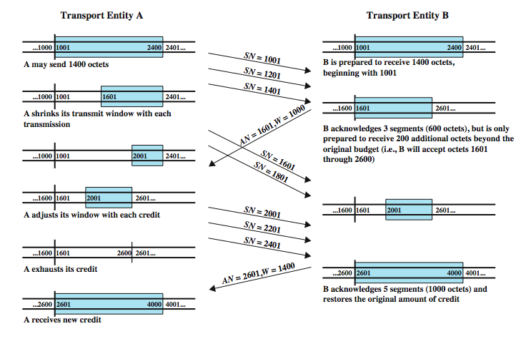
Credit Allocation
Notes:
Stallings DCC8e Figure 20.1 illustrates the mechanism (compare Figure 7.4). For simplicity, we show data flow in one direction only and assume that 200 octets of data are sent in each segment. Initially, through the connection establishment process, the sending and receiving sequence numbers are synchronized and A is granted an initial credit allocation of 1400 octets, beginning with octet number 1001. The first segment transmitted by A contains data octets numbered 1001 through 1200. After sending 600 octets in three segments, A has shrunk its window to a size of 800 octets (numbers 1601 through 2400). After B receives these three segments, 600 octets out of its original 1400 octets of credit are accounted for, and 800 octets of credit are outstanding. Now suppose that, at this point, B is capable of absorbing 1000 octets of incoming data on this connection. Accordingly, B acknowledges receipt of all octets through 1600 and issues a credit of 1000 octets. This means that A can send octets 1601 through 2600 (5 segments). However, by the time that B's message has arrived at A, A has already sent two segments, containing octets 1601 through 2000 (which was permissible under the initial allocation). Thus, A's remaining credit upon receipt of B's credit allocation is only 600 octets (3 segments). As the exchange proceeds, A advances the trailing edge of its window each time that it transmits and advances the leading edge only when it is granted credit.

Slide 14
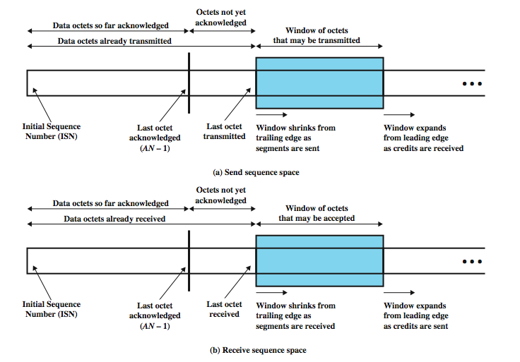
Sending and Receiving Perspectives
Notes:
Stallings DCC8e Figure 20.2 shows the view of this mechanism from the sending and receiving sides (compare Figure 7.3). Typically, both sides take both views because data may be exchanged in both directions. Note that the receiver is not required to immediately acknowledge incoming segments but may wait and issue a cumulative acknowledgment for a number of segments. The receiver needs to adopt some policy concerning the amount of data it permits the sender to transmit. The conservative approach is to only allow new segments up to the limit of available buffer space. If this policy were in effect in Figure 20.1, the first credit message implies that B has 1000 available octets in its buffer, and the second message that B has 1400 available octets. A conservative flow control scheme may limit the throughput of the transport connection in long-delay situations. The receiver could potentially increase throughput by optimistically granting credit for space it does not have. For example, if a receiver's buffer is full but it anticipates that it can release space for 1000 octets within a round-trip propagation time, it could immediately send a credit of 1000. If the receiver can keep up with the sender, this scheme may increase throughput and can do no harm. If the sender is faster than the receiver, however, some segments may be discarded, necessitating a retransmission. Because retransmissions are not otherwise necessary with a reliable network service (in the absence of internet congestion), an optimistic flow control scheme will complicate the protocol.

Slide 15
Establishment and Termination
need connection establishment and termination procedures to allow:
  each end to know the other exists
  negotiation of optional parameters
  triggers allocation of transport entity resources
Notes:
Even with a reliable network service, there is a need for connection establishment and termination procedures to support connection-oriented service. Connection establishment serves three main purposes:
• It allows each end to assure that the other exists.
• It allows exchange or negotiation of optional parameters (e.g., maximum segment size, maximum window size, quality of service).
• It triggers allocation of transport entity resources (e.g., buffer space, entry in connection table).

Slide 16
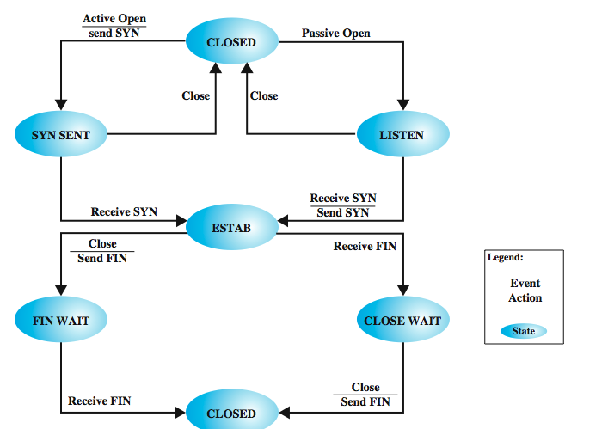
Connection State Diagram
Notes:
Connection establishment is by mutual agreement and can be accomplished by a simple set of user commands and control segments, as shown in the state diagram of Stallings DCC8e Figure 20.3. To begin, a TS user is in an CLOSED state. The TS user can signal to the local TCP entity that it will passively wait for a request with a Passive Open command. The TS user may change its mind by sending a Close command. After the Passive Open command is issued, the transport entity creates a connection object of some sort that is in the LISTEN state. From the CLOSED state, a TS user may open a connection by issuing an Active Open command, which instructs the transport entity to attempt connection establishment with a designated remote TS user, which triggers the transport entity to send a SYN (for synchronize) segment. This segment is carried to the receiving transport entity and interpreted as a request for connection to a particular port. If the destination transport entity is in the LISTEN state for that port, then a connection is established by the following actions by the receiving transport entity:
• Signal the local TS user that a connection is open.
• Send a SYN as confirmation to the remote transport entity.
• Put the connection object in an ESTAB (established) state.
When the responding SYN is received by the initiating transport entity, it too can move the connection to an ESTAB state. The connection is prematurely aborted if either TS user issues a Close command.

Slide 17
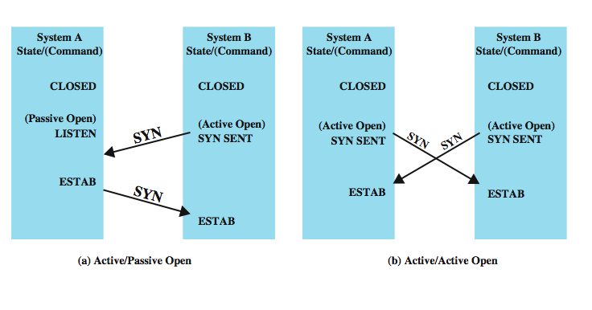
Connection Establishment
Notes:
Stallings DCC8e Figure 20.4 shows the robustness of this protocol. Either side can initiate a connection. Further, if both sides initiate the connection at about the same time, it is established without confusion. This is because the SYN segment functions both as a connection request and a connection acknowledgment.
Consider what happens if a SYN comes in while the requested TS user is idle (not listening). Three courses may be followed:
• The transport entity can reject the request by sending a RST (reset) segment back to the other transport entity.
• The request can be queued until the local TS user issues a matching Open.
• The transport entity can interrupt or otherwise signal the local TS user to notify it of a pending request.
Note that if the third mechanism is used, a Passive Open command is not strictly necessary but may be replaced by an Accept command, which is a signal from the user to the transport entity that it accepts the request for connection.

Slide 18
Connection Termination
either or both sides by mutual agreement
graceful or abrupt termination
if graceful, initiator must:
  send FIN to other end, requesting termination
  place connection in FIN WAIT state
  when FIN received, inform user and close connection
other end must:
  when receives FIN must inform TS user and place connection in CLOSE WAIT state
  when TS user issues CLOSE primitive, send FIN & close connection
Notes:
Connection termination is handled similarly. Either side, or both sides, may initiate a close. The connection is closed by mutual agreement. This strategy allows for either abrupt or graceful termination. With abrupt termination, data in transit may be lost; a graceful termination prevents either side from closing the connection until all data have been delivered. To achieve the latter, a connection in the FIN WAIT state must continue to accept data segments until a FIN (finish) segment is received. The procedure for graceful termination is as follows. First, on the side that initiates the termination procedure:
1. In response to a TS user's Close primitive, a transport entity sends a FIN segment to the other side of the connection, requesting termination.
2. Having sent the FIN, the transport entity places the connection in the FIN WAIT state. In this state, the transport entity must continue to accept data from the other side and deliver that data to its user.
3. When a FIN is received in response, the transport entity informs its user and closes the connection.
On the side that does not initiate a termination:
1. When a FIN segment is received, the transport entity informs its user of the termination request and places the connection in the CLOSE WAIT state. In this state, the transport entity must continue to accept data from its user and transmit it in data segments to the other side.
2. When the user issues a Close primitive, the transport entity sends a responding FIN segment to the other side and closes the connection.

Slide 19
Unreliable Network Service
more difficult case for transport protocol since
  segments may get lost
  segments may arrive out of order
examples include
  IP internet, frame relay using LAPF, IEEE 802.3 with unacknowledge connectionless LLC
issues:
  ordered delivery, retransmission strategy, duplication detection, flow control, connection establishment & termination, crash recovery
Notes:
A more difficult case for a transport protocol is that of an unreliable network service. The problem is not just that segments are occasionally lost, but that segments may arrive out of sequence due to variable transit delays. Examples of such networks: An internetwork using IP, A frame relay network using only the LAPF core protocol, An IEEE 802.3 LAN using the unacknowledged connectionless LLC service
Elaborate machinery is required to cope with these two interrelated network deficiencies. The combination of unreliability and nonsequencing creates problems with every mechanism we have discussed so far. Generally, the solution to each problem raises new problems. Although there are problems to be overcome for protocols at all levels, it seems that there are more difficulties with a reliable connection-oriented transport protocol than any other sort of protocol. Seven issues at least need to be addressed:
• Ordered delivery
• Retransmission strategy
• Duplicate detection
• Flow control
• Connection establishment
• Connection termination
• Failure recovery

Slide 20
Ordered Delivery
segments may arrive out of order
hence number segments sequentially
TCP numbers each octet sequentially
and segments are numbered by the first octet number in the segment
Notes:
With an unreliable network service, it is possible that segments, even if they are all delivered, may arrive out of order. The required solution to this problem is to number segments sequentially. We have seen that for data link control protocols, such as HDLC, and for X.25, each data unit (frame, packet) is numbered sequentially with each successive sequence number being one more than the previous sequence number. This scheme is used in some transport protocols, such as the ISO transport protocols. However, TCP uses a somewhat different scheme in which each data octet that is transmitted is implicitly numbered. Thus, the first segment may have a sequence number of 1. If that segment has 200 octets of data, then the second segment would have the sequence number 201, and so on. For simplicity in the discussions of this section, we will continue to assume that each successive segment's sequence number is 200 more than that of the previous segment; that is, each segment contains exactly 200 octets of data.

Slide 21
Retransmission Strategy
retransmission of segment needed because
  segment damaged in transit
  segment fails to arrive
transmitter does not know of failure
receiver must acknowledge successful receipt
  can use cumulative acknowledgement for efficiency
sender times out waiting for ACK triggers
re-transmission
Notes:
Two events necessitate the retransmission of a segment. First, a segment may be damaged in transit but nevertheless arrive at its destination. If a checksum is included with the segment, the receiving transport entity can detect the error and discard the segment. The second contingency is that a segment fails to arrive. In either case, the sending transport entity does not know that the segment transmission was unsuccessful. To cover this contingency, a positive acknowledgment scheme is used: The receiver must acknowledge each successfully received segment by returning a segment containing an acknowledgment number. For efficiency, we do not require one acknowledgment per segment. Rather, a cumulative acknowledgment can be used, as we have seen many times in this book. Thus, the receiver may receive segments numbered 1, 201, and 401, but only send AN = 601 back. The sender must interpret AN = 601 to mean that the segment with SN = 401 and all previous segments have been successfully received.
If a segment does not arrive successfully, no acknowledgment will be issued and a retransmission is in order. To cope with this situation, there must be a timer associated with each segment as it is sent. If the timer expires before the segment is acknowledged, the sender must retransmit.

Slide 22
Timer Value
fixed timer
  based on understanding of network behavior
  can not adapt to changing network conditions
  too small leads to unnecessary re-transmissions
  too large and response to lost segments is slow
  should be a bit longer than round trip time
adaptive scheme
  may not ACK immediately
  can not distinguish between ACK of original segment and re-transmitted segment
  conditions may change suddenly
Notes:
At what value should the timer be set? Two strategies suggest themselves. A fixed timer value could be used, based on an understanding of the network's typical behavior. This suffers from an inability to respond to changing network conditions. If the value is too small, there will be many unnecessary retransmissions, wasting network capacity. If the value is too large, the protocol will be sluggish in responding to a lost segment. The timer should be set at a value a bit longer than the round trip time (send segment, receive ACK). Of course, this delay is variable even under constant network load. Worse, the statistics of the delay will vary with changing network conditions.
An adaptive scheme has its own problems. Suppose that the transport entity keeps track of the time taken to acknowledge data segments and sets its retransmission timer based on the average of the observed delays. This value cannot be trusted because the peer transport entity may not acknowledge a segment immediately, because if a segment has been retransmitted, the sender cannot know whether the received acknowledgment is a response to the initial transmission or the retransmission, and because network conditions may change suddenly.
Each of these problems is a cause for some further tweaking of the transport algorithm, but the problem admits of no complete solution. There will always be some uncertainty concerning the best value for the retransmission timer.

Slide 23
Duplication Detection
if ACK lost, segment duplicated & re-transmitted
receiver must recognize duplicates
if duplicate received prior to closing connection
  receiver assumes ACK lost and ACKs duplicate
  sender must not get confused with multiple ACKs
  need a sequence number space large enough to not cycle within maximum life of segment
Notes:
If a segment is lost and then retransmitted, no confusion will result. If, however, one or more segments in sequence are successfully delivered, but the corresponding ACK is lost, then the sending transport entity will time out and one or more segments will be retransmitted. If these retransmitted segments arrive successfully, they will be duplicates of previously received segments. Thus, the receiver must be able to recognize duplicates. The fact that each segment carries a sequence number helps, but, nevertheless, duplicate detection and handling is not simple. There are two cases: a duplicate is received prior to the close of the connection, or a duplicate is received after the close of the connection (discussed in the subsection on connection establishment). Notice that we say "a" duplicate rather than "the" duplicate. From the sender's point of view, the retransmitted segment is the duplicate. However, the retransmitted segment may arrive before the original segment, in which case the receiver views the original segment as the duplicate. In any case, two tactics are needed to cope with a duplicate received prior to the close of a connection:
• The receiver must assume that its acknowledgment was lost and therefore must acknowledge the duplicate.
• Consequently, the sender must not get confused if it receives multiple acknowledgments to the same segment.
• The sequence number space must be long enough so as not to "cycle" in less than the maximum possible segment lifetime (time it takes segment to transit network).

Slide 24
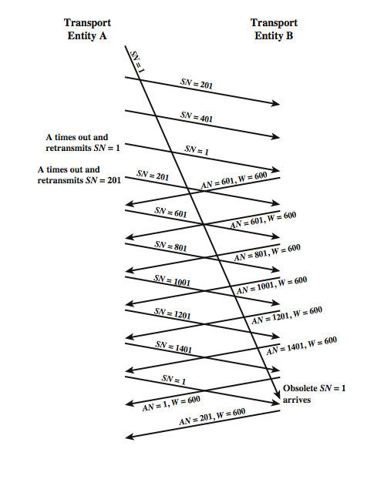
Incorrect
Duplicate
Detection
Notes:
Stallings DCC8e Figure 20.5 illustrates the reason for the latter requirement. In this example, the sequence space is of length 1600; that is, after SN = 1600, the sequence numbers cycle back and begin with SN = 1. For simplicity, we assume the receiving transport entity maintains a credit window size of 600. Suppose that A has transmitted data segments with SN = 1, 201, and 401. B has received the two segments with SN = 201 and SN = 401, but the segment with SN = 1 is delayed in transit. Thus, B does not send any acknowledgments. Eventually, A times out and retransmits segment SN = 1. When the duplicate segment SN = 1 arrives, B acknowledges 1, 201, and 401 with AN = 601. Meanwhile, A has timed out again and retransmits SN = 201, which B acknowledges with another AN = 601. Things now seem to have sorted themselves out and data transfer continues. When the sequence space is exhausted, A cycles back to SN = 1 and continues. Alas, the old segment SN = 1 makes a belated appearance and is accepted by B before the new segment SN = 1 arrives. When the new segment SN = 1 does arrive, it is treated as a duplicate and discarded.
It should be clear that the untimely emergence of the old segment would have caused no difficulty if the sequence numbers had not yet wrapped around. The larger the sequence number space (number of bits used to represent the sequence number), the longer the wraparound is avoided. How big must the sequence space be? This depends on, among other things, whether the network enforces a maximum packet lifetime, and the rate at which segments are being transmitted. Fortunately, each addition of a single bit to the sequence number field doubles the sequence space, so it is rather easy to select a safe size.

Slide 25
Flow Control
credit allocation quite robust with unreliable net
  can ack data & grant credit
  or just one or other
  lost ACK recovers on next received
have problem if AN=i, W=0 closing window
  then send AN=i, W=j to reopen, but this is lost
  sender thinks window closed, receiver thinks it open
solution is to use persist timer
if timer expires, send something
  could be re-transmission of previous segment
Notes:
The credit allocation flow control mechanism described earlier is quite robust in the face of an unreliable network service and requires little enhancement. As was mentioned, a segment containing (AN = i, W = j) acknowledges all octets through number i – 1 and grants credit for an additional j octets beginning with octet i. The credit allocation mechanism is quite flexible, as can increase credit when no additional data have arrived, or acknowledge an incoming segment containing m octets of data (m < j) without granting additional credit. If an ACK/CREDIT segment is lost, little harm is done. Future acknowledgments will resynchronize the protocol. Further, if no new acknowledgments are forthcoming, the sender times out and retransmits a data segment, which triggers a new acknowledgment. However, it is still possible for deadlock to occur. Consider a situation in which B sends (AN = i, W = 0), temporarily closing the window. Subsequently, B sends (AN = i, W = j), but this segment is lost. A is awaiting the opportunity to send data and B thinks that it has granted that opportunity. To overcome this problem, a persist timer can be used. This timer is reset with each outgoing segment (all segments contain the AN and W fields). If the timer ever expires, the protocol entity is required to send a segment, even if it duplicates a previous one. This breaks the deadlock and also assures the other end that the protocol entity is still alive.

Slide 26
Connection Establishment
two way handshake
  A send SYN, B replies with SYN
  lost SYN handled by re-transmission
  ignore duplicate SYNs once connected
lost or delayed data segments can cause connection problems
  eg. segment from old connection
Notes:
As with other protocol mechanisms, connection establishment must take into account the unreliability of a network service. Recall that a connection establishment calls for the exchange of SYNs, a procedure sometimes referred to as a two-way handshake. Suppose that A issues a SYN to B. It expects to get a SYN back, confirming the connection. Two things can go wrong: A's SYN can be lost or B's answering SYN can be lost. Both cases can be handled by use of a retransmit-SYN timer. After A issues a SYN, it will reissue the SYN when the timer expires. This gives rise, potentially, to duplicate SYNs. If A's initial SYN was lost, there are no duplicates. If B's response was lost, then B may receive two SYNs from A. Further, if B's response was not lost, but simply delayed, A may get two responding SYNs. All of this means that A and B must simply ignore duplicate SYNs once a connection is established.
There are other problems to contend with. Just as a delayed SYN or lost response can give rise to a duplicate SYN, a delayed data segment or lost acknowledgment can give rise to duplicate data segments, as seen previously in Figure 20.5.

Slide 27
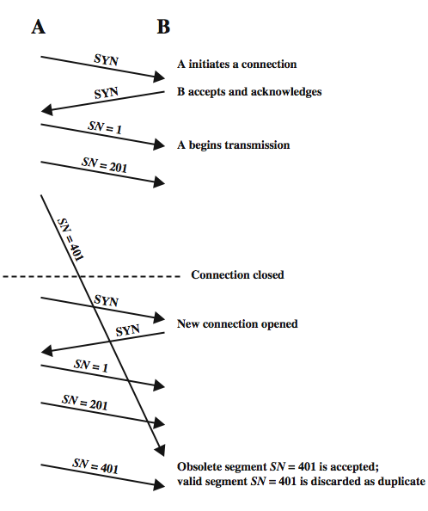
Two Way
Handshake:
Obsolete
Data
Segment
Solution: start each new connection with a different seq. no. that is far removed from the last seq. no. of the most recent connection.
Notes:
Such a delayed or duplicated data segment can interfere with data transfer, as illustrated in Stallings DCC8e Figure 20.6. Assume that with each new connection, each transport protocol entity begins numbering its data segments with sequence number 1. In the figure, a duplicate copy of segment SN = 401 from an old connection arrives during the lifetime of a new connection and is delivered to B before delivery of the legitimate data segment SN = 401. One way of attacking this problem is to start each new connection with a different sequence number that is far removed from the last sequence number of the most recent connection. For this purpose, the connection request is of the form SYN i+1, where i is the sequence number of the first data segment that will be sent on this connection.

Slide 28
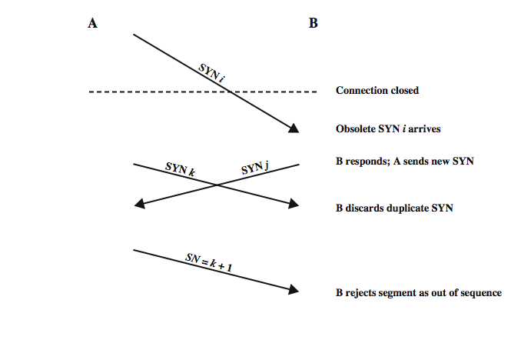
Two Way Handshake:
Obsolete SYN Segment
Solution: to acknowledge explicitly the other’s SYN and seq. number
➔ Three way handshake
Notes:
Now consider that a duplicate SYN i may survive past the termination of the connection. Stallings DCC8e Figure 20.7 depicts the problem that may arise. An old SYN i arrives at B after the connection is terminated. B assumes that this is a fresh request and responds with SYN j, meaning that B accepts the connection request and will begin transmitting with SN = j+1. Meanwhile, A has decided to open a new connection with B and sends SYN k. B discards this as a duplicate. Now both sides have transmitted and subsequently received a SYN segment, and therefore think that a valid connection exists. However, when A initiates data transfer with a segment numbered k+1. B rejects the segment as being out of sequence.

Slide 29
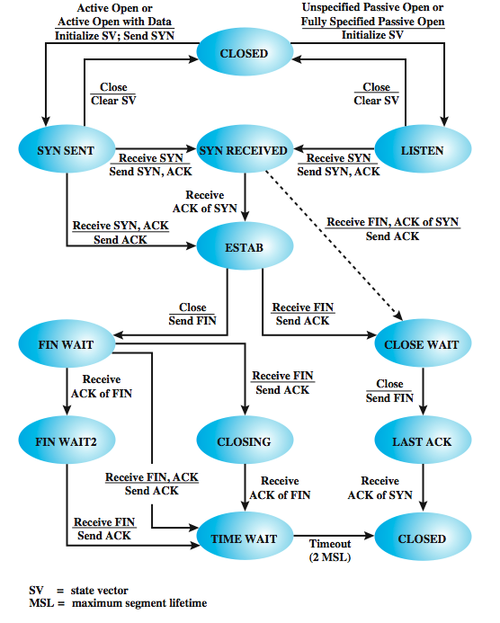
Three Way
Handshake:
State
Diagram
Notes:
The way out of this problem is for each side to acknowledge explicitly the other's SYN and sequence number. The procedure is known as a three-way handshake. The revised connection state diagram, which is the one employed by TCP, is shown in the upper part of Stallings DCC8e Figure 20.8. A new state (SYN RECEIVED) is added. In this state, the transport entity hesitates during connection opening to assure that the SYN segments sent by the two sides have both been acknowledged before the connection is declared established. In addition to the new state, there is a control segment (RST) to reset the other side when a duplicate SYN is detected.
For simplicity, the upper part of Figure 20.8 does not include transitions in which RST is sent. The basic rule is as follows: Send an RST if the connection state is not yet OPEN and an invalid ACK (one that does not reference something that was sent) is received. The reader should try various combinations of events to see that this connection establishment procedure works in spite of any combination of old and lost segments.

Slide 30
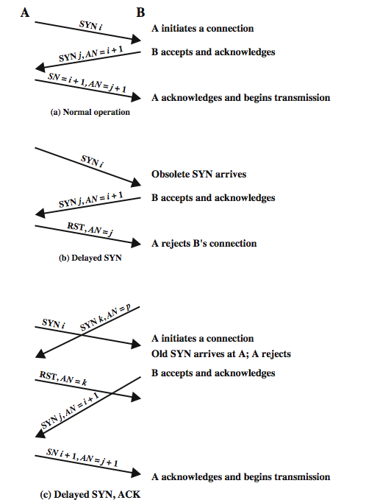
Three Way
Handshake:
Examples
Notes:
Stallings DCC8e Figure 20.9 illustrates typical three-way handshake operations. In Figure 20.9a, transport entity A initiates the connection, with a SYN including the sending sequence number, i. The value i is referred to as the initial sequence number (ISN) and is associated with the SYN; the first data octet to be transmitted will have sequence number i + 1. The responding SYN acknowledges the ISN with (AN = i + 1) and includes its ISN. A acknowledges B's SYN/ACK in its first data segment, which begins with sequence number i + 1. Figure 20.9b shows a situation in which an old SYN i arrives at B after the close of the relevant connection. B assumes that this is a fresh request and responds with SYN j, AN = i + 1. When A receives this message, it realizes that it has not requested a connection and therefore sends an RST, AN = j. Note that the AN = j portion of the RST message is essential so that an old duplicate RST does not abort a legitimate connection establishment. Figure 20.9c shows a case in which an old SYN/ACK arrives in the middle of a new connection establishment. Because of the use of sequence numbers in the acknowledgments, this event causes no mischief.

Slide 31
Connection Termination
like connection need 3-way handshake
misordered segments could cause:
  entity in CLOSE WAIT state sends last data segment, followed by FIN
  FIN arrives before last data segment
  receiver accepts FIN, closes connection, loses data
need to associate sequence number with FIN
receiver waits for all segments before FIN sequence number
Notes:
The state diagram of Figure 20.3 defines the use of a simple two-way handshake for connection establishment, which was found to be unsatisfactory in the face of an unreliable network service. Similarly, the two-way handshake defined in that diagram for connection termination is inadequate for an unreliable network service. Misordering of segments could cause the following scenario. A transport entity in the CLOSE WAIT state sends its last data segment, followed by a FIN segment, but the FIN segment arrives at the other side before the last data segment. The receiving transport entity will accept that FIN, close the connection, and lose the last segment of data. To avoid this problem, a sequence number can be associated with the FIN, which can be assigned the next sequence number after the last octet of transmitted data. With this refinement, the receiving transport entity, upon receiving a FIN, will wait if necessary for the late-arriving data before closing the connection.

Slide 32
Connection Termination Graceful Close
also have problems with loss of segments and obsolete segments
need graceful close which will:
send FIN i and receive AN i+1 (close S -> R)
receive FIN j and send AN j+1 (close S <- R)
wait twice maximum expected segment lifetime
Notes:
A more serious problem is the potential loss of segments and the potential presence of obsolete segments. Figure 20.8 shows that the termination procedure adopts a similar solution to that used for connection establishment. Each side must explicitly acknowledge the FIN of the other, using an ACK with the sequence number of the FIN to be acknowledged. For a graceful close, a transport entity requires the following:
• It must send a FIN i and receive AN = i + 1.
• It must receive a FIN j and send AN = j + 1.
• It must wait an interval equal to twice the maximum expected segment lifetime.

Slide 33
Failure Recovery
after restart all state info is lost
may have half open connection
  as side that did not crash still thinks it is connected
close connection using keepalive timer
  wait for ACK for (time out) * (number of retries)
  when expired, close connection and inform user
send RST i in response to any i segment arriving
user must decide whether to reconnect
  have problems with lost or duplicate data
Notes:
When the system upon which a transport entity is running fails and subsequently restarts, the state information of all active connections is lost. The affected connections become half open because the side that did not fail does not yet realize the problem. The still active side of a half-open connection can close the connection using a keepalive timer. This timer measures the time the transport machine will continue to await an acknowledgment (or other appropriate reply) of a transmitted segment after the segment has been retransmitted the maximum number of times. When the timer expires, the transport entity assumes that the other transport entity or the intervening network has failed, closes the connection, and signals an abnormal close to the TS user. In the event that a transport entity fails and quickly restarts, half-open connections can be terminated more quickly by the use of the RST segment. The failed side returns an RST i to every segment i that it receives. When the RST i reaches the other side, it must be checked for validity based on the sequence number i, because the RST could be in response to an old segment. If the reset is valid, the transport entity performs an abnormal termination.
These measures clean up the situation at the transport level. The decision as to whether to reopen the connection is up to the TS users. The problem is one of synchronization. At the time of failure, there may have been one or more outstanding segments in either direction. The TS user on the side that did not fail knows how much data it has received, but the other user may not, if state information were lost. Thus, there is the danger that some user data will be lost or duplicated.

Slide 34
TCP
Transmission Control Protocol (RFC 793)
connection oriented, reliable communication
over reliable and unreliable (inter)networks
two ways of labeling data:
data stream push
  user requires transmission of all data up to push flag
  receiver will deliver in same manner
  avoids waiting for full buffers
urgent data signal
  indicates urgent data is upcoming in stream
  user decides how to handle it
Notes:
Now look at TCP (RFC 793), at the service it provides to the TS user and then at the internal protocol details. TCP is designed to provide reliable communication between pairs of processes (TCP users) across a variety of reliable and unreliable networks and internets. TCP provides two useful facilities for labeling data: push and urgent:
• Data stream push: Ordinarily, TCP decides when sufficient data have accumulated to form a segment for transmission. The TCP user can require TCP to transmit all outstanding data up to and including that labeled with a push flag. On the receiving end, TCP will deliver these data to the user in the same manner. A user might request this if it has come to a logical break in the data.
• Urgent data signaling: This provides a means of informing the destination TCP user that significant or "urgent" data is in the upcoming data stream. It is up to the destination user to determine appropriate action.

Slide 35
TCP Services
a complex set of primitives:
  incl. passive & active open, active open with data, send, allocate, close, abort, status
  passive open indicates will accept connections
  active open with data sends data with open
and parameters:
  incl. source port, destination port & address, timeout, security, data, data length, PUSH & URGENT flags, send & receive windows, connection state, amount awaiting ACK
Notes:
As with IP, the services provided by TCP are defined in terms of primitives and parameters. The services provided by TCP are considerably richer than those provided by IP, and hence the set of primitives and parameters is more complex. Stallings DCC8e Table 20.2 lists TCP service request primitives, which are issued by a TCP user to TCP, and Stallings DCC8e Table 20.3 lists TCP service response primitives, which are issued by TCP to a local TCP user. Stallings DCC8e Table 20.4 provides a brief definition of the parameters involved. The two passive open commands signal the TCP user's willingness to accept a connection request. The active open with data allows the user to begin transmitting data with the opening of the connection.

Slide 36
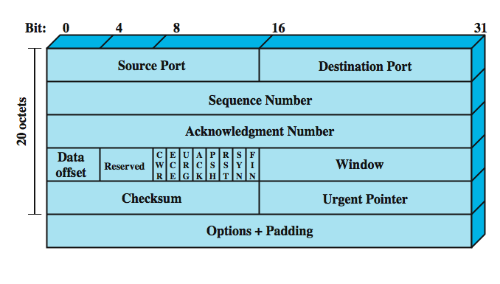
TCP Header
Notes:
TCP uses only a single type of protocol data unit, a TCP segment. The header is shown in Stallings DCC8e Figure 20.10. This header performs all protocol mechanisms, and is large, with a min length of 20 octets. The fields are:
• Source Port (16 bits): Source TCP user. eg. Telnet = 23; HTTP = 80.
• Destination Port (16 bits): Destination TCP user.
• Sequence Number (32 bits): of first data octet in this segment except when the SYN flag is set. when it contains the initial sequence number (ISN) and the first data octet in this segment has sequence number ISN + 1.
• Acknowledgment Number (32 bits): Contains the sequence number of the next data octet that the TCP entity expects to receive.
• Data Offset (4 bits): Number of 32-bit words in the header.
• Reserved (4 bits): Reserved for future use.
• Flags (6 bits):
• Window (16 bits): Flow control credit allocation, in octets.
• Checksum (16 bits): The ones complement of the ones complement sum of all the 16-bit words in the segment plus a pseudoheader.
• Urgent Pointer (16 bits): This value, when added to the segment sequence number, contains the sequence number of the last octet in a sequence of urgent data. This allows the receiver to know how much urgent data is coming.
• Options (Variable): eg. option that specifies the maximum segment size.

Slide 37
TCP and IP
not all parameters used by TCP are in its header
TCP passes some parameters down to IP
  precedence
  normal delay/low delay
  normal throughput/high throughput
  normal reliability/high reliability
  security
min overhead for each PDU is 40 octets
Notes:
By comparing the TCP header to the TCP user interface defined in Stallings DCC8e Tables 20.2 and 20.3, the reader may feel that some items are missing from the TCP header; that is indeed the case. TCP is intended to work with IP. Hence, some TCP user parameters are passed down by TCP to IP for inclusion in the IP header. The precedence parameter can be mapped into the DS (differentiated services) field, and the security parameter into the optional security field in the IP header. Note that this TCP/IP linkage means that the required minimum overhead for every data unit is actually 40 octets.

Slide 38
TCP Mechanisms
Connection Establishment
three way handshake
  SYN, SYN-ACK, ACK
connection determined by source and destination sockets (host, port)
can only have a single connection between any unique pairs of ports
but one port can connect to multiple different destinations (different ports)
Notes:
Connection establishment in TCP always uses a three-way handshake. When the SYN flag is set, the segment is essentially a request for connection and functions as explained in Stallings DCC8e Section 20.1. To initiate a connection, an entity sends a SYN, SN = X, where X is the initial sequence number. The receiver responds with SYN, SN = Y, AN = X + 1 by setting both the SYN and ACK flags. Note that the acknowledgment indicates that the receiver is now expecting to receive a segment beginning with data octet X + 1, acknowledging the SYN, which occupies SN = X. Finally, the initiator responds with AN = Y + 1. If the two sides issue crossing SYNs, no problem results: Both sides respond with SYN/ACKs (Stallings DCC8e Figure 20.4).
A connection is uniquely determined by the source and destination sockets (host, port). Thus, at any one time, there can only be a single TCP connection between a unique pair of ports. However, a given port can support multiple connections, each with a different partner port.

Slide 39
TCP Mechanisms
Data Transfer
data transfer a logical stream of octets
octets numbered modulo 2³²
flow control uses credit allocation of number of octets
data buffered at transmitter and receiver
  sent when transport entity ready
  unless PUSH flag used to force send
can flag data as URGENT, sent immediately
if receive data not for current connection, RST flag is set on next segment to reset connection
Notes:
Although data are transferred in segments over a transport connection, data transfer is viewed logically as consisting of a stream of octets. Hence every octet is numbered, modulo 2³². Each segment contains the sequence number of the first octet in the data field. Flow control is exercised using a credit allocation scheme in which the credit is a number of octets rather than a number of segments, as explained in Stallings DCC8e Section 20.1.
Data are buffered by the transport entity on both transmission and reception. TCP normally exercises its own discretion as to when to construct a segment for transmission and when to release received data to the user. The PUSH flag is used to force the data so far accumulated to be sent by the transmitter and passed on by the receiver. This serves an end-of-block function.
The user may specify a block of data as urgent. TCP will designate the end of that block with an urgent pointer and send it out in the ordinary data stream. The receiving user is alerted that urgent data are being received.
If, during data exchange, a segment arrives that is apparently not meant for the current connection, the RST flag is set on an outgoing segment. Examples of this situation are delayed duplicate SYNs and an acknowledgment of data not yet sent.

Slide 40
TCP Mechanisms
Connection Termination
graceful close
  TCP user issues CLOSE primitive
  transport entity sets FIN flag on last segment sent with last of data
abrupt termination by ABORT primitive
  entity abandons all attempts to send or receive data
  RST segment transmitted to other end
Notes:
The normal means of terminating a connection is a graceful close. Each TCP user must issue a CLOSE primitive. The transport entity sets the FIN bit on the last segment that it sends out, which also contains the last of the data to be sent on this connection.
An abrupt termination occurs if the user issues an ABORT primitive. In this case, the entity abandons all attempts to send or receive data and discards data in its transmission and reception buffers. An RST segment is sent to the other side.

Slide 41
TCP Implementation Options
TCP standard precisely specifies protocol
have some implementation policy options:
  send
  deliver
  accept
  retransmit
  acknowledge
implementations may choose alternative options which may impact performance
Notes:
The TCP standard provides a precise specification of the protocol to be used between TCP entities. However, certain aspects of the protocol admit several possible implementation options. Although two implementations that choose alternative options will be interoperable, there may be performance implications. The design areas for which options are specified are the following: Send policy, Deliver policy, Accept policy, Retransmit policy, Acknowledge policy.

Slide 42
Send Policy
if no push or close TCP entity transmits at its own convenience in credit allocation
data buffered in transmit buffer
may construct segment per batch of data from user
  quick response but higher overheads
may wait for certain amount of data
  slower response but lower overheads
Notes:
In the absence of both pushed data and a closed transmission window (see Stallings DCC8e Figure 20.2a), a sending TCP entity is free to transmit data at its own convenience, within its current credit allocation. As data are issued by the user, they are buffered in the transmit buffer. TCP may construct a segment for each batch of data provided by its user or it may wait until a certain amount of data accumulates before constructing and sending a segment. The actual policy will depend on performance considerations. If transmissions are infrequent and large, there is low overhead in terms of segment generation and processing. On the other hand, if transmissions are frequent and small, the system is providing quick response.

Slide 43
Deliver Policy
in absence of push, can deliver data at own convenience
may deliver from each segment received
  higher O/S overheads but more responsive
may buffer data from multiple segments
  less O/S overheads but slower
Notes:
In the absence of a Push, a receiving TCP entity is free to deliver data to the user at its own convenience. It may deliver data as each in-order segment is received, or it may buffer data from a number of segments in the receive buffer before delivery. The actual policy will depend on performance considerations. If deliveries are infrequent and large, the user is not receiving data as promptly as may be desirable. On the other hand, if deliveries are frequent and small, there may be unnecessary processing both in TCP and in the user software, as well as an unnecessary number of operating system interrupts.

Slide 44
Accept Policy
segments may arrive out of order
in order
  only accept segments in order
  discard out of order segments
  simple implementation, but burdens network
in windows
  accept all segments within receive window
  reduce transmissions
  more complex implementation with buffering
Notes:
When all data segments arrive in order over a TCP connection, TCP places the data in a receive buffer for delivery to the user. It is possible, however, for segments to arrive out of order. In this case, the receiving TCP entity has two options:
• In-order: Accept only segments that arrive in order; any segment that arrives out of order is discarded. The in-order policy makes for a simple implementation but places a burden on the networking facility, as the sending TCP must time out and retransmit segments that were successfully received but discarded because of misordering. Furthermore, if a single segment is lost in transit, then all subsequent segments must be retransmitted once the sending TCP times out on the lost segment.
• In-window: Accept all segments that are within the receive window (see Stallings DCC8e Figure 20.2b). The in-window policy may reduce transmissions but requires a more complex acceptance test and a more sophisticated data storage scheme to buffer and keep track of data accepted out of order.

Slide 45
Retransmit Policy
TCP has a queue of segments transmitted but not acknowledged
will retransmit if not ACKed in given time
  first only - single timer, send one segment only when timer expires, efficient, has delays
  batch - single timer, send all segments when timer expires, has unnecessary transmissions
  individual - timer for each segment, complex
effectiveness depends in part on receiver’s accept policy
Notes:
TCP maintains a queue of segments that have been sent but not yet acknowledged. The TCP specification states that TCP will retransmit a segment if it fails to receive an acknowledgment within a given time. A TCP implementation may employ one of three retransmission strategies:
• First-only: Maintain one retransmission timer for the entire queue. If an acknowledgment is received, remove the appropriate segment or segments from the queue and reset the timer. If the timer expires, retransmit the segment at the front of the queue and reset the timer. The first-only policy is efficient in terms of traffic. Because timer for second segment in the queue is not set until the first segment is acknowledged, however, there can be considerable delays.
• Batch: Maintain one retransmission timer for the entire queue. if an acknowledgment is received, remove the appropriate segment or segments from the queue and reset the timer. If the timer expires, retransmit all segments in the queue and reset the timer. The batch policy also reduces the likelihood of long delays but may result in unnecessary retransmissions.
• Individual: Maintain one timer for each segment in the queue. If an acknowledgment is received, remove the appropriate segment or segments from the queue and destroy the corresponding timer or timers. If any timer expires, retransmit the corresponding segment individually and reset its timer. The individual policy solves the delay problem at the expense of a more complex implementation.
The actual effectiveness of the retransmit policy depends in part on the accept policy of the receiver.

Slide 46
Acknowledgement Policy
immediate
  send empty ACK for each accepted segment
  simple at cost of extra transmissions
cumulative
  piggyback ACK on suitable outbound data segments unless persist timer expires
  when send empty ACK
  more complex but efficient
Notes:
When a data segment arrives that is in sequence, the receiving TCP entity has two options concerning the timing of acknowledgment:
• Immediate: When data are accepted, immediately transmit an empty (no data) segment containing the appropriate acknowledgment number.
• Cumulative: When data are accepted, record the need for acknowledgment, but wait for an outbound segment with data on which to piggyback the acknowledgment. To avoid long delay, set a persist timer (Table 20.1); if the timer expires before an acknowledgment is sent, transmit an empty segment containing the appropriate acknowledgment number.
The immediate policy is simple and keeps the remote TCP entity fully informed, which limits unnecessary retransmissions. However, this policy results in extra segment transmissions, namely, empty segments used only to ACK. Furthermore, the policy can cause a further load on the network. Consider that a TCP entity receives a segment and immediately sends an ACK. Then the data in the segment are released to the application, which expands the receive window, triggering another empty TCP segment to provide additional credit to the sending TCP entity.
Because of the potential overhead of the immediate policy, the cumulative policy is typically used. Recognize, however, that the use of this policy requires more processing at the receiving end and complicates the task of estimating round-trip time by the sending TCP entity.

Slide 47
Congestion Control
flow control also used for congestion control
  recognize increased transit times & dropped packets
  react by reducing flow of data
RFC’s 1122 & 2581 detail extensions
  Tahoe, Reno & NewReno implementations
two categories of extensions:
  retransmission timer management
  window management
Notes:
The credit-based flow control mechanism of TCP was designed to enable a destination to restrict the flow of segments from a source to avoid buffer overflow at the destination. This same flow control mechanism is now used in ingenious ways to provide congestion control over the Internet between the source and destination. As congestion begins to occur, the transit time across a network or internetwork increases, and network or internet nodes drop packets. The TCP flow control mechanism can be used to recognize the onset of congestion (by recognizing increased delay times and dropped segments) and to react by reducing the flow of data. If many of the TCP entities operating across a network exercise this sort of restraint, internet congestion is relieved.
Since the publication of RFC 793, a number of techniques have been implemented that are intended to improve TCP congestion control characteristics. None of these extend or violate the original TCP standard; rather they represent implementation policies that are within the scope of the TCP specification. Many of these techniques are mandated for use with TCP in RFC 1122 (Requirements for Internet Hosts) while some of them are specified in RFC 2581. The techniques fall roughly into two categories: retransmission timer management and window management. In this section, we look at some of the most important and most widely implemented of these techniques.
Since the publication of RFC 793, a number of techniques have been implemented that are intended to improve TCP congestion control characteristics.

Slide 48
Retransmission Timer Management
static timer likely too long or too short
estimate round trip delay by observing pattern of delay for recent segments
set time to value a bit greater than estimate
simple average over a number of segments
exponential average using time series (RFC793)
RTT Variance Estimation (Jacobson’s algorithm)
Notes:
As network or internet conditions change, a static retransmission timer is likely to be either too long or too short. Accordingly, virtually all TCP implementations attempt to estimate the current round-trip time by observing the pattern of delay for recent segments, and then set the timer to a value somewhat greater than the estimated round-trip time.
A simple approach is to take the average of observed round-trip times over a number of segments. If the average accurately predicts future round-trip times, then the resulting retransmission timer will yield good performance.
Note that each term in the simple average is given equal weight. Typically, we would like to give greater weight to more recent instances because they are more likely to reflect future behavior. A common technique for predicting the next value on the basis of a time series of past values, and the one specified in RFC 793, is exponential averaging.

Slide 49
Retransmission Timer (cont)
Simple Average
  RTT(i): round-trip time observed for the i^{th} transmitted segment
  ARTT(K): average round-trip time for the first K segments
or

Slide 50
Retransmission Timer (cont)
Exponential Average
  SRTT: smoothed round-trip time estimate
  RTO: retransmission timer
RFC793:
Example values: α: 0.8 ~ 0.9, β: 1.3 ~ 2.0

Slide 51
RTT Variance Estimation
AERR(K): sample mean deviation measured at time K

Slide 52
RTT Variance Estimation (cont)
Jacobson’s Algorithm
g = 1/8 = 0.125, h = ¼ = 0.25, f = 2

Slide 53
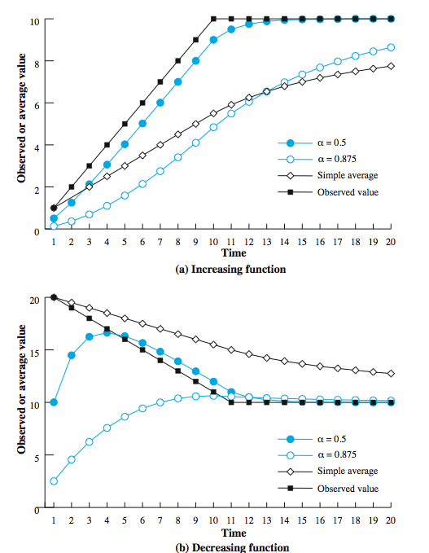
Use of
Exponential
Averaging
Notes:
Stallings DCC8e Figure 20.11 compares simple averaging with exponential averaging (for two different values of α). In part (a) of the figure, the observed value begins at 1, grows gradually to a value of 10, and then stays there. In part (b) of the figure, the observed value begins at 20, declines gradually to 10, and then stays there. Note that exponential averaging tracks changes in RTT faster than does simple averaging and that the smaller value of α results in a more rapid reaction to the change in the observed value.
As was mentioned, the retransmission timer should be set at a value somewhat greater than the estimated round-trip time. One possibility is to use a constant value. The disadvantage of this is that Δ is not proportional to SRTT. For large values of SRTT, it is relatively small and fluctuations in the actual RTT will result in unnecessary retransmissions. For small values of SRTT, it is relatively large and causes unnecessary delays in retransmitting lost segments. Accordingly, RFC 793 specifies the use of a timer whose value is proportional to SRTT, within limits.

Slide 54
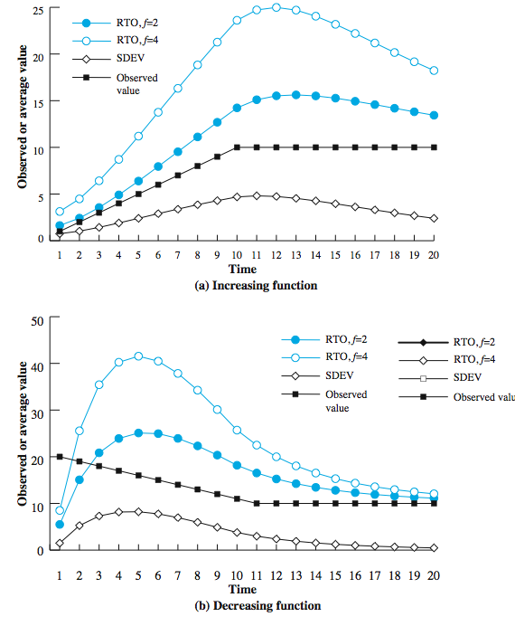
Jacobson’s
RTO
Calculation
Notes:
The technique specified in the TCP standard enables a TCP entity to adapt to changes in round-trip time. However, it does not cope well with a situation in which the round-trip time exhibits a relatively high variance. The original TCP specification tries to account for this variability by multiplying the RTT estimator by a constant factor. In a stable environment, with low variance of RTT, this formulation results in an unnecessarily high value of RTO, and in an unstable environment a value of β = 2 may be inadequate to protect against unnecessary retransmissions. A more effective approach is to estimate the variability in RTT values and to use that as input into the calculation of an RTO. Jacobson, who proposed the use of a dynamic estimate of variability in estimating RTT [JACO88], suggests using the same exponential smoothing technique as is used for the calculation of SRTT. Experience has shown that Jacobson's algorithm can significantly improve TCP performance. . However, it does not stand by itself. Two other factors must be considered: What RTO value should be used on a retransmitted segment? Which round-trip samples should be used as input to Jacobson's algorithm?
Stallings DCC8e Figure 20.12 illustrates the use of this algorithm on the same data set used in Figure 20.11. Once the arrival times stabilize, the variation estimate SDEV declines. The values of RTO for both f = 2 and f = 4 are quite conservative as long as RTT is changing, but then begin to converge to RTT when it stabilizes.

Slide 55
Exponential RTO Backoff
timeout probably due to congestion
  dropped packet or long round trip time
hence maintaining RTO is not good idea
better to increase RTO each time a segment is re-transmitted
  RTO = q*RTO
  commonly q=2 (binary exponential backoff)
  as in ethernet CSMA/CD
Notes:
When a TCP sender times out on a segment, it must retransmit that segment. RFC 793 assumes that the same RTO value will be used for this retransmitted segment. However, because the timeout is probably due to network congestion, manifested as a dropped packet or a long delay in round-trip time, maintaining the same RTO value is ill advised. A more sensible policy dictates that a sending TCP entity increase its RTO each time a segment is retransmitted; this is referred to as a backoff process. If a second retransmission is required, each sending TCP entity will wait an even longer time before timing out for a third retransmission, giving the internet an even longer period to recover. A simple technique for implementing RTO backoff is to multiply the RTO for a segment by a constant value for each retransmission, which causes RTO to grow exponentially with each retransmission. The most commonly used value of q is 2. With this value, the technique is referred to as binary exponential backoff. This is the same technique used in the Ethernet CSMA/CD protocol.

Slide 56
Karn’s Algorithm
if segment is re-transmitted, ACK may be for:
  first copy of the segment (longer RTT than expected)
  second copy
no way to tell
don’t measure RTT for re-transmitted segments
calculate backoff when re-transmission occurs
use backoff RTO until ACK arrives for segment that has not been re-transmitted
Notes:
If no segments are retransmitted, the sampling process for Jacobson's algorithm is straightforward. The RTT for each segment can be included in the calculation. Suppose a segment times out and must be retransmitted. If an acknowledgment is subsequently received, there are two possibilities: it is the ACK to the first transmission of the segment. In this case, the RTT is simply longer than expected but is an accurate reflection of network conditions, or This is the ACK to the second transmission. The sending TCP entity cannot distinguish between these two cases.
If the second case is true and the TCP entity simply measures the RTT from the first transmission until receipt of the ACK, the measured time will be much too long. The measured RTT will be on the order of the actual RTT plus the RTO. Feeding this false RTT into Jacobson's algorithm will produce an unnecessarily high value of SRTT and therefore RTO. An even worse approach would be to measure the RTT from the second transmission to the receipt of the ACK. If this is in fact the ACK to the first transmission, then the measured RTT will be much too small, producing a too low value of SRTT and RTO. This is likely to have a positive feedback effect, causing additional retransmissions and additional false measurements.
Karn's algorithm [KARN91] solves this problem with the following rules:
1. Don’t use measured RTT for a retransmitted segment to update values
2. Calculate the backoff RTO when a retransmission occurs.
3. Use the backoff RTO value for succeeding segments until an acknowledgment arrives for a segment that has not been retransmitted.

Slide 57
Window Management
slow start
  larger windows cause problem on connection created
  at start limit TCP to 1 segment
  increase when data ACK, exponential growth
dynamic windows sizing on congestion
  when a timeout occurs perhaps due to congestion
  set slow start threshold to half current congestion window
  set window to 1 and slow start until threshold
  beyond threshold, increase window by 1 for each RTT
Notes:
In addition to the previous, a number of approaches to managing the send window have been examined.
The larger the send window used in TCP, the more segments that a sending TCP entity can send before it must wait for an acknowledgment. This can create a problem when a TCP connection is first established, because the TCP entity is free to dump the entire window of data onto the internet. A means is needed of gradually expanding the window until acknowledgments are received. This is the purpose of the slow start mechanism. When a new connection is opened, TCP is only allowed to send 1 segment and then must wait for an acknowledgment before transmitting a second segment. Each time an acknowledgment to new data is received, the window value is increased by 1, up to some maximum value. In effect, the slow-start mechanism probes the internet to make sure that the TCP entity is not sending too many segments into an already congested environment. As acknowledgments arrive, TCP is able to open up its window until the flow is controlled by the incoming ACKs rather than by the window. The term slow start is a bit of a misnomer, because it actually grows exponentially.
The slow-start algorithm has been found to work effectively for initializing a connection. It enables the TCP sender to determine quickly a reasonable window size for the connection. But once congestion occurs, it may take a long time for the congestion to clear. So Jacobson proposed the use of slow start to begin with, followed by a linear growth of the window, as described.

Slide 58
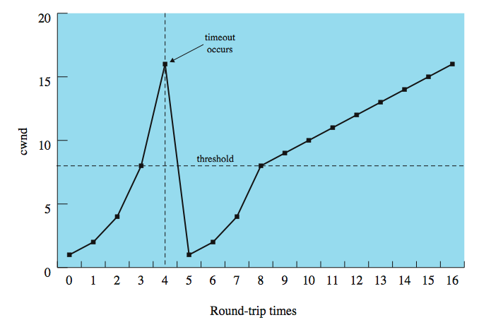
Window Management
Notes:
Stallings DCC8e Figure 20.13 illustrates slow-start and dynamic window resizing on congestion. Note that it takes 11 round-trip times to recover to the window level that initially took 4 round-trip times to achieve.

Slide 59
Fast Retransmit
Fast Recovery
retransmit timer rather longer than RTT
if segment lost TCP slow to retransmit
fast retransmit
  if receive 4 ACKs for same segment then immediately retransmit since likely lost
fast recovery
  lost segment means some congestion
  halve window then increase linearly
  avoids slow-start
Notes:
The retransmission timer (RTO) that is used by a sending TCP entity to determine when to retransmit a segment will generally be noticeably longer than the actual round-trip time (RTT) that the ACK for that segment will take to reach the sender. Both the original RFC 793 algorithm and the Jacobson algorithm set the value of RTO at somewhat greater than the estimated round-trip time SRTT. A consequence of these factors is that if a segment is lost, TCP may be slow to retransmit. Jacobson proposed two procedures, called fast retransmit and fast recovery, that under some circumstances improve on the performance provided by RTO.
Fast retransmit takes advantage of the rule if a TCP entity receives a segment out of order, it must immediately issue an ACK for the last in-order segment that was received. When a source TCP receives a duplicate ACK, it means that either (1) the segment following the ACKed segment was delayed so that it ultimately arrived out of order, or (2) that segment was lost. To make sure that TCP that a segment has been lost and must be retransmitted, Jacobson recommends that a TCP sender wait until it receives three duplicate ACKs to the same segment (that is, a total of four ACKs to the same segment).
When a TCP entity retransmits a segment using fast retransmit, it knows (or rather assumes) that a segment was lost, even though it has not yet timed out on that segment. Accordingly, the TCP entity should take congestion avoidance measures. Jacobson proposes a fast recovery technique: retransmit the lost segment, cut window in half, and then proceed with the linear increase of it. This technique avoids the initial exponential slow-start process.

Slide 60
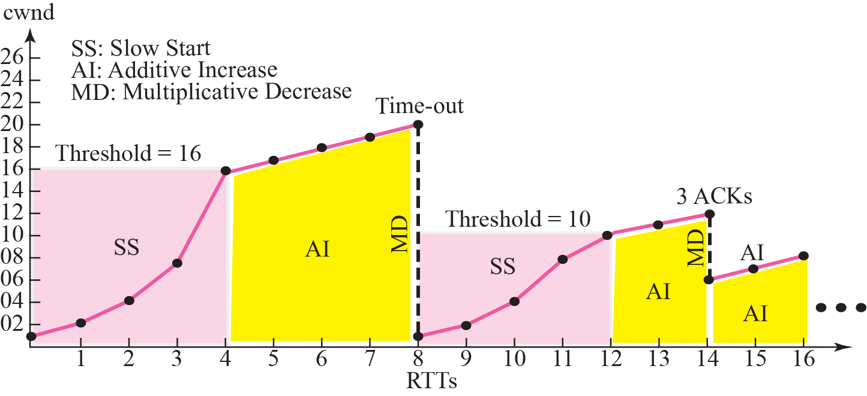
TCP Congestion Control
Fast retransmit
(Receiver)
Fast Recovery
(Sender cwnd)

Slide 61
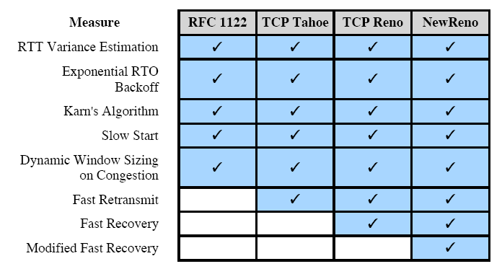
Implementation of TCP Congestion Control Measures

Slide 62
Flow Ctrl vs. Congestion Ctrl
Why Flow Control?
Why Congestion Control?
Prevent Receiver
Buffer Overflow
Try Not To Cause
Congestion
Receiver-based
window size
(rwnd)
Network-based
window size
(cwnd)
Sender’s window = Min (cwnd, rwnd)

Slide 63
User Datagram Protocol
(UDP)
connectionless service for application level procedures specified in RFC 768
  unreliable
  delivery & duplication control not guaranteed
reduced overhead
least common denominator service
uses:
  inward data collection
  outward data dissemination
  request-response
  real time application
Notes:
In addition to TCP, there is one other transport-level protocol that is in common use as part of the TCP/IP protocol suite: the user datagram protocol (UDP), specified in RFC 768. UDP provides a connectionless service for application-level procedures. UDP is basically an unreliable service; delivery and duplicate protection are not guaranteed. However, this does reduce the overhead of the protocol and may be adequate in many cases. A connectionless service is more appropriate in some contexts. It represents a "least common denominator" of service to be expected at higher layers. Some examples:
• Inward data collection: the periodic active or passive sampling of data sources, such as sensors, and automatic self-test reports from security equipment or network components.
• Outward data dissemination: Includes broadcast messages to network users, the announcement of a new node or the change of address of a service, and the distribution of real-time clock values.
• Request-response: in which a transaction service is provided by a common server to a number of distributed TS users, and for which a single request-response sequence is typical. Use of the service is regulated at the application level, and lower-level connections are often unnecessary and cumbersome.
• Real-time applications: Such as voice and telemetry, involving a degree of redundancy and/or a real-time transmission requirement. These must not have connection-oriented functions such as retransmission.

Slide 64
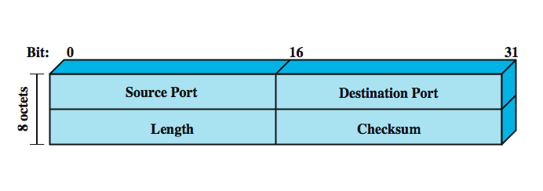
UDP Header
Notes:
UDP sits on top of IP. Because it is connectionless, UDP has very little to do. Essentially, it adds a port addressing capability to IP. This is best seen by examining the UDP header, shown in Stallings DCC8e Figure 20.14. The header includes a source port and destination port. The length field contains the length of the entire UDP segment, including header and data. The checksum is the same algorithm used for TCP and IP. For UDP, the checksum applies to the entire UDP segment plus a pseudoheader prefixed to the UDP header at the time of calculation and which is the same pseudoheader used for TCP. If an error is detected, the segment is discarded and no further action is taken.
The checksum field in UDP is optional. If it is not used, it is set to zero. However, it should be pointed out that the IP checksum applies only to the IP header and not to the data field, which in this case consists of the UDP header and the user data. Thus, if no checksum calculation is performed by UDP, then no check is made on the user data at either the transport or internet protocol layers.

Slide 65
Summary
connection-oriented network and transport mechanisms and services
TCP services, mechanisms, policies
TCP congestion control
UDP
Notes:
Chapter20 summary.

Slide 66
期末考加分題 10% = 3% + 4% + 3%
只針對「計算機網路」這門課程：
有關老師的教學，你覺得哪一些是好的方式，為什麼？
就你的觀察，老師的教學過程中有哪一些是不合適這門課的，為什麼？
請提供其他可以改進教學的建議。

