Slide 1
Data and Computer Communications
Chapter 23 – Internet Applications
Internet Directory Service and
the World Wide Web
Eighth Edition
by William Stallings
Lecture slides by Lawrie Brown
Notes:
Lecture slides prepared by Dr Lawrie Brown (UNSW@ADFA) for “Data and Computer Communications”, 8/e, by William Stallings, Chapter 23 “Internet Applications - Internet Directory Service and the World Wide Web”.

Slide 2
Internet Applications
Internet Directory Service and the World Wide Web
Life in the modern world is coming to depend more and more upon technical means of communication. Without such technical aids the modern city-state could not exist, for it is only by means of them that trade and business can proceed; that goods and services can be distributed where needed; that railways can run on schedule; that law and order are maintained; that education is possible. Communication renders true social life practicable, for communication means organization.
—On Human Communication, Colin Cherry
Notes:
This quote is from the start of Stallings DCC8e Chapter 23.
This chapter looks at two of the most widely used and more advanced Internet application areas: DNS - the essential name/address directory lookup service for the Internet; and HTTP - the support protocol on which the World Wide Web (WWW) depends.

Slide 3
DNS
The Internet Directory Service
the Domain Name Service (DNS) provides mapping between host name & IP address
defined in RFCs 1034 / 1035
key elements
  domain name space
  DNS database
  name servers
  name resolvers
Notes:
The Domain Name System (DNS) is a directory lookup service that provides a mapping between the name of a host on the Internet and its numerical address. DNS is essential to the functioning of the Internet. It is defined in RFCs 1034 and 1035. Four elements comprise the DNS:
• Domain name space: DNS uses a tree-structured name space to identify resources on the Internet.
• DNS database: Conceptually, each node and leaf in the name space tree structure names a set of information (e.g., IP address, type of resource) that is contained in a resource record (RR). The collection of all RRs is organized into a distributed database.
• Name servers: These are server programs that hold information about a portion of the domain name tree structure and the associated RRs.
• Resolvers: These are programs that extract information from name servers in response to client requests. A typical client request is for an IP address corresponding to a given domain name.

Slide 4
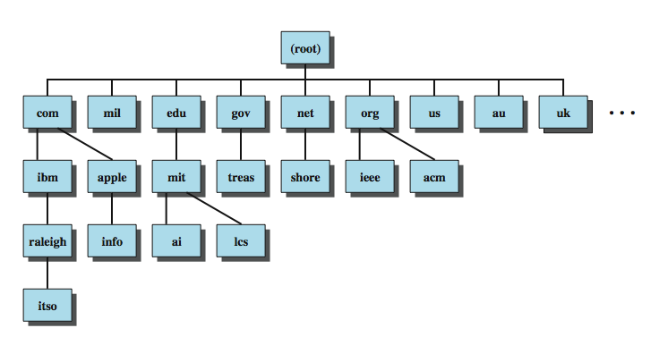
Domain Names
Notes:
The 32-bit IP address provides a way of uniquely identifying devices attached to the Internet. This address is interpreted as having two components: a network number, which identifies a network on the Internet, and a host address, which identifies a unique host on that network. A domain refers to a group of hosts that are under the administrative control of a single entity, such as a company or government agency. Domains are organized hierarchically, so that a given domain may consist of a number of subordinate domains. Names are assigned to domains and reflect this hierarchical organization. Stallings DCC8e Figure 23.1 shows a portion of the domain naming tree. At the very top level are a small number of domains that encompass the entire Internet. Each subordinate level is named by prefixing a subordinate name to the name at the next highest level. As you move down the naming tree, you eventually get to leaf nodes that identify specific hosts on the Internet. These hosts are assigned Internet addresses. An Internet-wide organization is responsible for assigning domain names so that every domain name is unique. The actual assignment of addresses is delegated down the hierarchy. For example, the main host at MIT, with a domain name of mit.edu, has four IP addresses: 18.7.21.77, 18.7.21.69, 18.7.21.70, and 18.7.21.110. The subordinate domain lcs.mit.edu has the IP address 18.26.0.36

Slide 5
DNS Database
hierarchical database
containing resource records (RRs)
features
  variable-depth hierarchy for names
  distributed database
  distribution controlled by database
provides name-to-address directory service for network applications
Notes:
DNS is based on a hierarchical database containing resource records (RRs) that include the name, IP address, and other information about hosts. The key features of the database are:
• Variable-depth hierarchy for names: DNS allows essentially unlimited levels and uses the period (.) as the level delimiter in printed names, as described earlier.
• Distributed database: The database resides in DNS servers scattered throughout the Internet and private intranets.
• Distribution controlled by the database: The DNS database is divided into thousands of separately managed zones, which are managed by separate administrators. The database software controls distribution and update of records.
Using this database, DNS servers provide a name-to-address directory service for network applications that need to locate specific servers. For example, every time an e-mail message is sent or a Web page is accessed, there must be a DNS name lookup to determine the IP address of the e-mail server or Web server.

Slide 6
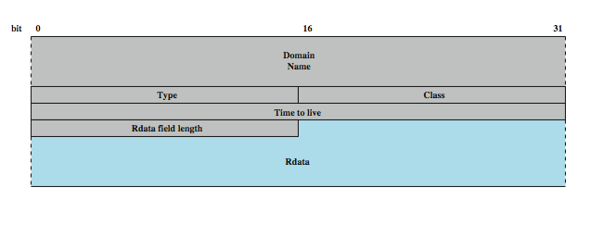
Resource Records (RRs)
Notes:
Stallings DCC8e Figure 23.2 shows the structure of a RR. It consists of the following elements:
• Domain name: Although the syntax of domain names in messages, described subsequently, is precisely defined, the form of the domain name in a RR is described in general terms. In essence, the domain name in a RR must correspond to the human readable form, which consists of a series of labels of alphanumeric characters or hyphens, separated by a period.
• Type: Identifies the type of resource in this RR. The various types are listed in Stallings DCC8e Table 23.2.
• Class: Identifies the protocol family. The only commonly used value is IN, for the Internet.
• Time to live: Typically, when a RR is retrieved from a name server, the retriever will cache the RR so that it need not query the name server repeatedly. This field specifies the time interval that the resource record may be cached before the source of the information should again be consulted. A zero value is interpreted to mean that the RR can only be used for the transaction in progress, and should not be cached.
• Rdata field length: Length of the Rdata field in octets.
• Rdata: A variable length string of octets that describes the resource. The format of this information varies according to the type of the RR. For example, for the A type, the Rdata is a 32-bit IP address, and for the CNAME type, the Rdata is a domain name.

Slide 7
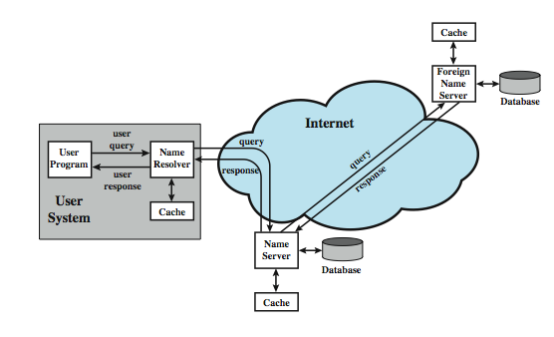
DNS Operation
Notes:
DNS operation typically includes the following steps, as shown in Stallings DCC8e Figure 23.3:
1. A user program requests an IP address for a domain name.
2. A resolver module in the local host or local ISP formulates a query for a local name server in the same domain as the resolver.
3. The local name server checks to see if the name is in its local database or cache, and, if so, returns the IP address to the requestor. Otherwise, the name server queries other available name servers, starting down from the root of the DNS tree or as high up the tree as possible.
4. When a response is received at the local name server, it stores the name/address mapping in its local cache and may maintain this entry for the amount of time specified in the time to live field of the retrieved RR.
5. The user program is given the IP address or an error message.
Typically, single queries are carried over UDP. Queries for a group of names are carried over TCP. The distributed DNS database that supports the DNS functionality must be updated frequently because of the rapid and continued growth of the Internet. Accordingly, dynamic updating functions for DNS have been defined. In essence, DNS name servers automatically send out updates to other relevant name servers as conditions warrant.

Slide 8
DNS Server Hierarchy
DNS database is distributed hierarchically
  may extend as deep as needed
any organization owning a domain can run name servers
each server manages authoritative name data for a zone
13 root name servers at top of hierarchy share responsibility for top level zones
Notes:
The DNS database is distributed hierarchically, residing in DNS name servers scattered throughout the Internet. Name servers can be operated by any organization that owns a domain; that is, any organization that has responsibility for a subtree of the hierarchical domain name space. Each name server is configured with a subset of the domain name space, known as a zone, which is a collection of one or more (or all) subdomains within a domain, along with the associated RRs. This set of data is called authoritative, because this name server is responsible for maintaining an accurate set or RRs for this portion of the domain name hierarchy. The hierarchical structure can extend to any depth. Thus, a portion of the name space assigned to an authoritative name server can be delegated to a subordinate name server in a way that corresponds to the structure of the domain name tree. For example, a name server corresponds to the domain ibm.com. A portion of that domain is defined by the name watson.ibm.com, which corresponds to the node watson.ibm.com and all of the branches and leaf nodes underneath the node watson.ibm.com.
At the top of the server hierarchy are 13 root name servers that share responsibility for the top level zones (Table 23.3). This replication is to prevent the root server from becoming a bottleneck. Even so, each individual root server is quite busy. For example, the Internet Software Consortium reports that its server (F) answers almost 300 million DNS requests daily (www.isc.org/services/public/F-root-server.html).

Slide 9
Name Resolution
query begins with name resolver on host
knows name/address of local DNS server
given a name request, the resolver can:
  return name from cache if already known
  send DNS query to local server which may return answer, or query other servers
recursive technique - server queries other servers for resolver
iterative technique - resolver queries servers in turn as needed
Notes:
As Stallings DCC8e Figure 23.3 (previous slide) shows, each query begins at a name resolver located in the user host system (e.g., gethostbyname in UNIX). Each resolver is configured to know the name and address of a local DNS name server. If the resolver does not have the requested name in its cache, it sends a DNS query to the local DNS server, which either returns an address immediately, or does so after querying one or more other servers. Again, resolvers use UDP for single queries and TCP for group queries. There are two methods by which queries are forwarded and results returned. Suppose a name server (A) forwards a DNS request to another name server (B). If B has the name/address in its local cache or local database, it can return the IP address to A. If not, then B can do either of the following:
1. Query another name server for the desired result and then send the result back to A. This is known as a recursive technique.
2. Return to A the address of the next server (C) to whom the request should be sent. A then sends out a new DNS request to C. This is known as the iterative technique.
In exchanges between name servers, either the iterative or recursive technique may be used. For requests sent by a name resolver, the recursive technique is used.

Slide 10
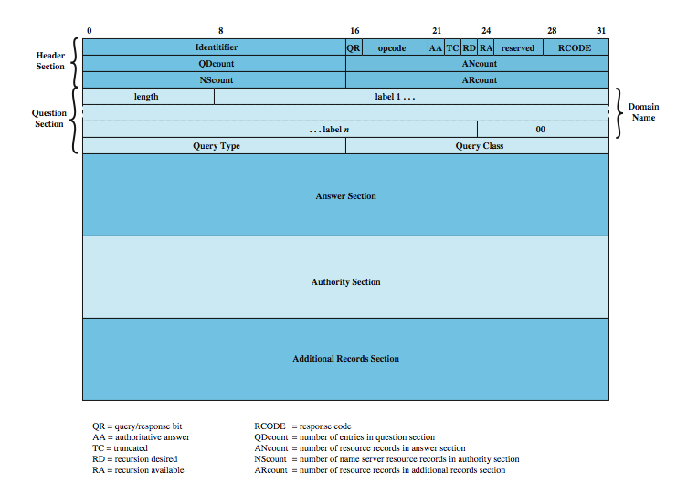
DNS Messages
Notes:
DNS messages use a single format, shown in Stallings DCC8e Figure 23.5. There are five possible sections to a DNS message: header, question, answer, authority, and additional records. The header section consists of:
• Identifier: Assigned by sender so can match queries and responses.
• Query Response: Indicates whether this message is a query or response.
• Opcode: standard query, an inverse query, or a server status request.
• Authoritative Answer: if responding name server is an authority
• Truncated: if response message was truncated due to length
• Recursion Desired: If set, directs the server to pursue the query recursively.
• Recursion Available: if recursive query support is available
• Response Code: no error, format error, server failure, name error, not implemented, or refused
• Qdcount, Ancount, Nscount, ARcount: no RRs in the question/ answer/ authority/ additional records section (zero or more).
The question section contains the (usually one) query for the name server, with the Domain Name, Query Type, and Query Class.
The answer section contains RRs that answer the question; the authority section contains RRs that point toward an authoritative name server; the additional records section contains RRs that relate to the query but are not strictly answers for the question.

Slide 11
Hypertext Transfer Protocol
HTTP
base protocol for World Wide Web
for any hypertext client/server application
is a protocol for efficiently transmitting information to make hypertext jumps
  can transfer plain text, hypertext, audio, images, and Internet accessible information
versions 0.9, 1.0, & now 1.1 (RFC2616)
Notes:
The Hypertext Transfer Protocol (HTTP) is the foundation protocol of the World Wide Web (WWW) and can be used in any client/server application involving hypertext. The name is somewhat misleading in that HTTP is not a protocol for transferring hypertext; rather it is a protocol for transmitting information with the efficiency necessary for making hypertext jumps. The data transferred by the protocol can be plaintext, hypertext, audio, images, or any Internet-accessible information.
We begin with an overview of HTTP concepts and operation and then look at some of the details, basing our discussion on the most recent version to be put on the Internet standards track, HTTP 1.1 (RFC 2616).

Slide 12
HTTP Overview
transaction oriented client/server protocol
between Web browser (client) and Web server
uses TCP connections
stateless
  each transaction treated independently
  each new TCP connection for each transaction
  terminate connection when transaction complete
flexible format handling
  client may specify supported formats
Notes:
HTTP is a transaction-oriented client/server protocol. The most typical use of HTTP is between a Web browser and a Web server. To provide reliability, HTTP makes use of TCP. Nevertheless, HTTP is a "stateless" protocol: Each transaction is treated independently. Accordingly, a typical implementation will create a new TCP connection between client and server for each transaction and then terminate the connection as soon as the transaction completes, although the specification does not dictate this one-to-one relationship between transaction and connection lifetimes.
The stateless nature of HTTP is well suited to its typical application. A normal session of a user with a Web browser involves retrieving a sequence of Web pages and documents. The sequence is, ideally, performed rapidly, and the locations of the various pages and documents may be a number of widely distributed servers.
Another important feature of HTTP is that it is flexible in the formats that it can handle. When a client issues a request to a server, it may include a prioritized list of formats that it can handle, and the server replies with the appropriate format. For example, a lynx browser cannot handle images, so a Web server need not transmit any images on Web pages. This arrangement prevents the transmission of unnecessary information and provides the basis for extending the set of formats with new standardized and proprietary specifications.

Slide 13
Key Terms
cache
client
connection
entity
gateway
message
origin server
proxy
resource
server
tunnel
user agent
Notes:
A number of important terms defined in the HTTP specification are summarized in Stallings DCC8e Table 23.4.
Cache - A program's local store of response messages and the subsystem that controls its message storage, retrieval, and deletion.
Client - program that establishes connections for sending requests.
Connection - A transport layer virtual circuit between two programs
Entity - A particular representation or rendition of a data resource, it consists of entity headers and an entity body.
Gateway - A server that acts as an intermediary for some other server. Message - The basic unit of HTTP communication, consisting of a structured sequence of octets transmitted via the connection.
Origin Server - server on which a given resource resides or is to be created.
Proxy - intermediary program that acts as both a server and a client for the purpose of making requests on behalf of other clients.
Resource - A network data object or service which can be identified by a URI.
Server - application program that accepts connections in order to service requests by sending back responses
Tunnel - intermediary program that is a blind relay between two connections
User Agent - client that initiates a request eg. browsers, editors, spiders, etc

Slide 14
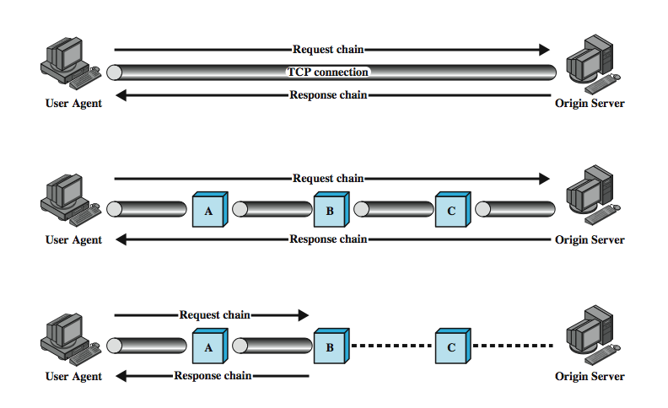
Examples of HTTP Operation
Notes:
Stallings DCC8e Figure 23.6 illustrates three examples of HTTP operation. The simplest case is one in which a user agent establishes a direct connection with an origin server. The user agent is the client (eg. web browser) that initiates the request. The origin server is the web server on which a resource of interest resides. The client opens a TCP connection that is end-to-end between the client and the server. The client then issues an HTTP request. The request consists of a specific command (method), an address ( Uniform Resource Locator (URL)), and a MIME-like message containing request parameters, information about the client, and perhaps some additional content information. When the server receives the request, it attempts to perform the requested action and then returns an HTTP response. The response includes status information, a success/error code, and a MIME-like message containing information about the server, information about the response itself, and possible body content. The TCP connection is then closed.
The middle part of Figure 23.6 shows a case in which there are one or more intermediate systems with TCP connections between logically adjacent systems. Each intermediate system acts as a relay, so that a request initiated by the client is relayed through the intermediate systems to the server, and the response from the server is relayed back to the client.

Slide 15
HTTP Operation - Caches
often have a web cache
stores previous requests/ responses
may return stored response to subsequent requests
may be a client, server or intermediary system
not all requests can be cached
Notes:
The lowest portion of Stallings DCC8e Figure 23.6 (previous slide) shows an example of a cache. A cache is a facility that may store previous requests and responses for handling new requests. If a new request arrives that is the same as a stored request, then the cache can supply the stored response rather than accessing the resource indicated in the URL. The cache can operate on a client or server or on an intermediate system other than a tunnel. In the figure, intermediary B has cached a request/response transaction, so that a corresponding new request from the client need not travel the entire chain to the origin server, but is handled by B. Not all transactions can be cached, and a client or server can dictate that a certain transaction may be cached only for a given time limit.

Slide 16
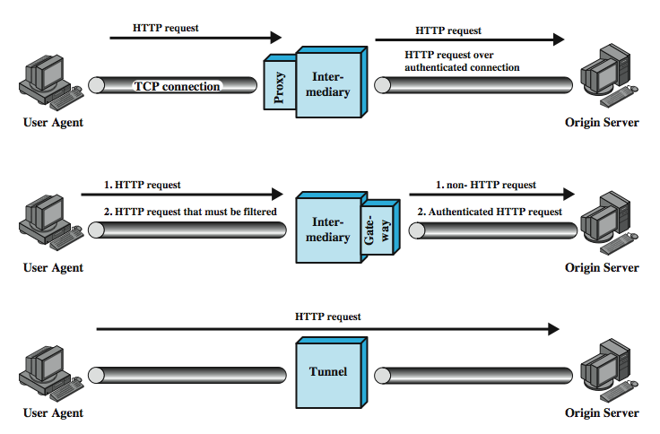
Intermediate HTTP Systems
Notes:
Three forms of intermediate system are defined in the HTTP specification: proxy, gateway, and tunnel, as shown in Stallings DCC8e Figure 23.7.
A proxy acts on behalf of other clients and presents requests from other clients to a server. The proxy is a forwarding agent, receiving a request for a URL object, modifying the request, and forwarding the request toward the server identified in the URL. There are two typical scenarios: a security intermediary: client and server are separated by a security intermediary, eg. firewall, with the proxy on the client side of the firewall; or when have different versions of HTTP: where the proxy implements different versions of HTTP used by client & server, and performs the required mapping.
A gateway is a server that appears to the client as if it were an origin server. It acts on behalf of other servers that may not be able to communicate directly with a client. There are two typical scenarios: a security intermediary: where client and server are separated by a security intermediary, eg. firewall; or need to access a non-HTTP server: the gateway can contact servers for protocols other than HTTP, such as FTP and Gopher servers. The client makes an HTTP request to a gateway server. The gateway server then contacts the relevant FTP or Gopher server to obtain the desired result. This result is then converted into a form suitable for HTTP and transmitted back to the client.
A tunnel is simply a relay point between two TCP connections, and the HTTP messages are passed unchanged as if there were a single HTTP connection between user agent and origin server.

Slide 17
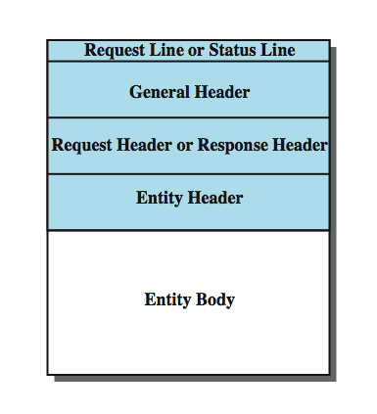
HTTP Messages
Notes:
The best way to describe the functionality of HTTP is to describe the individual elements of the HTTP message. HTTP consists of two types of messages: requests from clients to servers, and responses from servers to clients. The general structure of such messages is shown in Stallings DCC8e Figure 23.8. It may be a Simple-Request, a Simple-Response, a Full-Request, or a Full-Response. The Simple-Request and Simple-Response messages were defined in HTTP/0.9. The request is a simple GET command with the requested URL; the response is simply a block containing the information identified in the URL. In HTTP/1.1, the use of these simple forms is discouraged because it prevents the client from using content negotiation and the server from identifying the media type of the returned entity.
With full requests and responses, the following fields are used:
• Request-Line: Identifies the message type and the requested resource
• Status-Line: Provides status information about this response
• General-Header: Contains fields that are applicable to both request and response messages but that do not apply to the entity being transferred
• Request-Header: Contains information about the request and the client
• Response-Header: Contains information about the response
• Entity-Header: Contains information about the resource identified by the request and information about the entity body
• Entity-Body: The body of the message

Slide 18
HTTP Messages BNF Format
HTTP-Message = Simple-Request | Simple-Response | Full-Request | Full-Response
Full-Request = Request-Line
*( General-Header | Request-Header | Entity-Header )
CRLF
[ Entity-Body ]
Full-Response = Status-Line
*( General-Header | Response-Header | Entity-Header )
CRLF
[ Entity-Body ]
Simple-Request = "GET" SP Request-URL CRLF
Simple-Response = [ Entity-Body ]
Notes:
More formally, using enhanced BNF (Backus-Naur Form) notation (Stallings DCC8e Table 23.5), can describe HTTP messages as:
HTTP-Message = Simple-Request | Simple-Response |
Full-Request | Full-Response
Full-Request = Request-Line
*( General-Header | Request-Header | Entity-Header )
CRLF
[ Entity-Body ]
Full-Response = Status-Line
*( General-Header | Response-Header | Entity-Header )
CRLF
[ Entity-Body ]
Simple-Request = "GET" SP Request-URL CRLF
Simple-Response = [ Entity-Body ]

Slide 19
HTTP General Header Fields
Cache-Control
Connection
Data
Forwarded
Keep-Alive
Mime-Version
Pragma
Upgrade
Notes:
All of the HTTP headers consist of a sequence of fields, following the same generic format as RFC 822 (described in Stallings DCC8e Chapter 22). Each field begins on a new line and consists of the field name followed by a colon and the field value. There is a large number of fields and parameters defined in HTTP: general header fields, request headers, response headers, and entities.
General header fields can be used in both request and response messages. These fields are applicable in both types of messages and contain information that does not directly apply to the entity being transferred. The fields are:
• Cache-Control: Specifies directives that must be obeyed by any caching mechanisms along the request/response chain.
• Connection: Contains list of keywords and header field names applying only to this TCP connection between the sender and nearest nontunnel recipient.
• Date: Date and time at which the message originated.
• Forwarded: Used by gateways and proxies to indicate intermediate steps along a request or response chain. Each gateway or proxy that handles a message may attach a Forwarded field that gives its URL.
• Keep-Alive: may indicate a max time that sender will keep connection open or max number of additional requests that will be allowed
• MIME-Version: Indicates version of MIME used by message
• Pragma: Contains implementation-specific directives
• Upgrade: Used to specify what additional protocols the client supports and would like to use; used in a response to indicate which protocol will be used.

Slide 20
Request Methods
request-line has
  method
  Request URL
  HTTP version
  Request-Line = Method Request-URL HTTP-Version CRLF
HTTP/1.1 methods:
  OPTIONS, GET, HEAD, POST, PUT, PATCH, COPY, MOVE, DELETE, LINK, UNLINK, TRACE, WRAPPED, Extension-method
Notes:
A full request message consists of a status line followed by one or more general, request, and entity headers, followed by an optional entity body. A full request message always begins with a Request-Line, with format: Request-Line = Method SP Request-URL SP HTTP-Version CRLF
The Method parameter indicates the actual request command, called a method in HTTP.The Request-URL is the URL of the requested resource, and HTTP-Version is the version number of HTTP used by the sender. The following request methods are defined in HTTP/1.1:
• OPTIONS: request info about the options available for URL
• GET: request to retrieve info information identified in the URL
• HEAD: request to get info about a resource without transferring its body.
• POST: accept attached entity as a new subordinate to URL
• PUT: accept attached entity and store as supplied URL
• PATCH: like PUT, but contains a list of differences from original URL
• COPY/ MOVE : request copy/move of the URL to Entity-Header loc
• DELETE: request server delete the URL
• LINK/ UNLINK : make/remove link from URL to Entity-Header loc
• TRACE: request server return received entity body for test/diagnostic use
• WRAPPED: to send one or more encapsulated requests
• Extension-method: additional methods, may not be recognized by recipient

Slide 21
Request Header Fields
Accept, Accept-Charset, Accept-Encoding, Accept-Language, Authorization, From, Host, If-Modified-Since, Proxy-Authentication, Range, Referrer, Unless, User-Agent
Notes:
Request header fields provide additional information and parameters related to the request. The following fields are defined in HTTP/1.1:
• Accept: list of media types and ranges acceptable in response to this request
• Accept-Charset: list of character sets acceptable for the response
• Accept-Encoding: list of acceptable content encodings for entity body
• Accept-Language: set of natural languages preferred for the response
• Authorization: provide credentials for client to authenticate to server
• From: Internet e-mail address for human user running requesting user agent
• Host: specifies the Internet host of the resource being requested
• If-Modified-Since: with GET method, resource is transferred only if it has been modified since the date/time specified
• Proxy-Authorization: allow client to authenticate itself to proxy
• Range: in GET message allow client to request portion of identified resource
• Referrer: URL of resource from which the Request-URL was obtained
• Unless: Similar to If-Modified-Since field,but not just GET method and comparison based on any Entity-Header field value
• User-Agent: contains info about the user agent originating this request

Slide 22
Response Messages
status line plus one or more general, response, entity headers, then optional entity body
status line contains
  HTTP version
  status code
  reason phrase
  Status-Line = HTTP-Version SP Status-Code SP Reason-Phrase CRLF
Notes:
A full response message consists of a status line followed by one or more general, response, and entity headers, followed by an optional entity body.
A full response message always begins with a Status-Line, which has the following format: Status-Line = HTTP-Version SP Status-Code SP Reason-Phrase CRLF
The HTTP-Version value is the version number of HTTP used by the sender. The Status-Code is a three-digit integer that indicates the response to a received request, and the Reason-Phrase provides a short textual explanation of the status code.

Slide 23
Status Codes
informational - headers only
successful - headers & body if relevant
redirection - further action needed
client error - has syntax or other error
server error - failed to satisfy valid request
Notes:
HTTP/1.1 includes a rather large number of status codes, organized into the following categories:
• Informational: The request has been received and processing continues. No entity body accompanies this response.
• Successful: The request was successfully received, understood, and accepted. The information returned in the response message depends on the request method, as follows:
— GET: contents of the entity-body corresponds to the requested resource.
— HEAD: No entity body is returned.
— POST: The entity describes or contains the result of the action.
— TRACE: The entity contains the request message.
— Other methods: The entity describes the result of the action.
• Redirection: Further action is required to complete the request.
• Client Error: The request contains a syntax error or the request cannot be fulfilled.
• Server Error: The server failed to fulfill an apparently valid request.

Slide 24
Response Header Fields
Location
Proxy-Authentication
Public
Retry-After
Server
WWW-Authenticate
Notes:
Response header fields provide additional information related to the response that cannot be placed in the Status-Line. The following fields are defined in HTTP/1.1:
• Location: Defines the exact location of the resource identified by the Request-URL.
• Proxy-Authenticate: Included with a response that has a status code of Proxy Authentication Required. This field contains a "challenge" that indicates the authentication scheme and parameters required.
• Public: Lists the nonstandard methods supported by this server.
• Retry-After: Included with a response that has a status code of Service Unavailable, and indicates how long the service is expected to be unavailable.
• Server: Identifies the software product used by the origin server to handle the request.
• WWW-Authenticate: Included with a response that has a status code of Unauthorized. This field contains a "challenge" that indicates the authentication scheme and parameters required.

Slide 25
Entity Header Fields
Allow
Content-Encoding
Content-Language
Content-Length
Content-MD5
Content-Range
Content-Type
Content-Version
Derived-From
Expires
Last-Modified
Link
Title
Transfer-Encoding
URL-Header
Extension-Header
Notes:
An entity consists of an entity header and an entity body in a request or response message. Entity header fields provide optional information about the entity body or resource. The following fields are defined in HTTP/1.1:
• Allow: lists methods supported by resource identified in Request-URL.
• Content-Encoding: Indicates content encodings applied to resource
• Content-Language: Identifies natural language(s) of enclosed entity.
• Content-Length: The size of the entity body in octets.
• Content-MD5: MD5 hash (see ch 21) of resource
• Content-Range: indicate portion of identified resource included in response
• Content-Type: the media type of the entity body
• Content-Version: version tag associated with an evolving entity
• Derived-From: version tag of resource this entity was derived from
• Expires: Date/time after which the entity should be considered stale.
• Last-Modified: Date/time that resource was last modified.
• Link: Defines links to other resources.
• Title: A textual title for the entity.
• Transfer-Encoding: type of transformation applied to message body
• URL-Header: Informs recipient of other URLs used for this resource
• Extension-Header: additional fields, may not be recognized by recipient

Slide 26
Entity Body
entity body is an arbitrary sequence of octets
HTTP can transfer any type of data including:
  text, binary data, audio, images, video
data is content of resource identified by URL
interpretation data determined by header fields:
  Content-Type - defines data interpretation
  Content-Encoding - applied to data
  Transfer-Encoding - used to form entity body
Notes:
An entity may represent a data resource, or it may constitute other information supplied with a request or response. An entity body consists of an arbitrary sequence of octets. HTTP is designed to be able to transfer any type of content, including text, binary data, audio, images, and video. When an entity body is present in a message, the interpretation of the octets in the body is determined by the entity header fields Content-Encoding, Content-Type, and Transfer-Encoding. These define a three-layer, ordered encoding model: entity-body := Transfer-Encoding( Content-Encoding( Content-Type( data ) ) )
The data are the content of a resource identified by a URL. The Content-Type field determines the way in which the data are interpreted. A Content-Encoding may be applied to the data and stored at the URL instead of the data. Finally, on transfer, a Transfer-Encoding may be applied to form the entity body of the message.

Slide 27
Summary
domain name service (DNS)
  names, database, name resolution, messages
HyperText Transfer Protocol (HTTP )
  overview
  request and response messages
Notes:
Chapter23 summary.

