Slide 1
REALIZATION OF DIGITAL FILTERS
Mifta Nur Farid

Slide 2
INTRODUCTION

Slide 3
Introduction
Basic steps to design of digital filters
  Approximation
  Realization
  Study of arithmetic errors
  Implementation

Slide 4
Approximation
The process of generating a transfer function that would satisfy the desired speciﬁcations, which may concern the amplitude or phase response or even the time-domain response of the ﬁlter.
Can be classiﬁed as direct or indirect.

Slide 5
Approximation
In direct methods, the problem is solved directly in the z domain.
In indirect methods, a continuous-time transfer function is ﬁrst obtained and then converted into a corresponding discrete-time transfer function.

Slide 6
Realization
The process of generating a digital-ﬁlter network or structure from the transfer function or some other characterization of the ﬁlter.
Can be classiﬁed as direct or indirect.
In direct methods the realization is obtained directly from a given discrete-time transfer function
In indirect realizations, the ﬁlter structure is obtained indirectly from an equivalent prototype analog ﬁlter.

Slide 7
  Study of arithmetic errors
During the approximation step, the coefﬁcients of the transfer function are determined to a high degree of precision.
In practice, however, digital hardware have ﬁnite precision that depends on the length of registers used to store numbers; the type of number system used (e.g., signed-magnitude, two’s complement); the type of arithmetic used (e.g., ﬁxed-point or ﬂoating-point), and so on.

Slide 8
  Study of arithmetic errors
Consequently, ﬁlter coefﬁcients must be quantized (e.g., rounded or truncated) before they can be stored in registers.
When the transfer function coefﬁcients are quantized, errors are introduced in the amplitude and phase responses of the ﬁlter, which are commonly referred to as quantization errors.

Slide 9
  Study of arithmetic errors
Under these circumstances, the design process cannot be deemed to be complete until the effects of arithmetic errors on the performance of the ﬁlter are investigated and ways are found to mitigate any problems associated with numerical imprecision.

Slide 10
  Implementation
Implementation of a digital ﬁlter can assume two forms, namely, software or hardware.
Software: implementation involves the simulation of the ﬁlter network on a general-purpose digital computer, workstation, or DSP chip.
Hardware: it involves the conversion of the ﬁlter network into a dedicated piece of hardware.

Slide 11
  Implementation
In nonreal-time applications where a record of the data to be processed is available, a software implementation may be entirely satisfactory.
In real-time applications, however, where data must be processed at a very high rate (e.g., in communication systems), a hardware implementation is mandatory.

Slide 12
Realization
The natural order of the four basic design steps is as stated in the preceding discussion, namely, approximation, realization, study of imperfections, and implementation.
However, realization is that much easier to learn than the approximation process and for this reason it will be treated ﬁrst.

Slide 13
REALIZATION

Slide 14
Realization
The most frequently used direct realization methods of this class are
  Direct
  Direct canonic
  State-space
  Lattice
  Parallel
  Cascade

Slide 15
DIRECT REALIZATION

Slide 16
Realization
In indirect methods, on the other hand, a given analog-ﬁlter network is represented by the so-called wave characterization, which is normally used to represent microwave circuits and systems, and through the use of a certain transformation the analog-ﬁlter network is converted into a topologically related digital-ﬁlter network

Slide 17
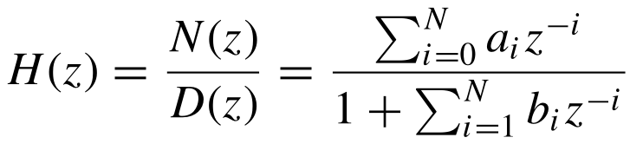
Direct Realization
A ﬁlter characterized by the N th-order transfer function

Slide 18
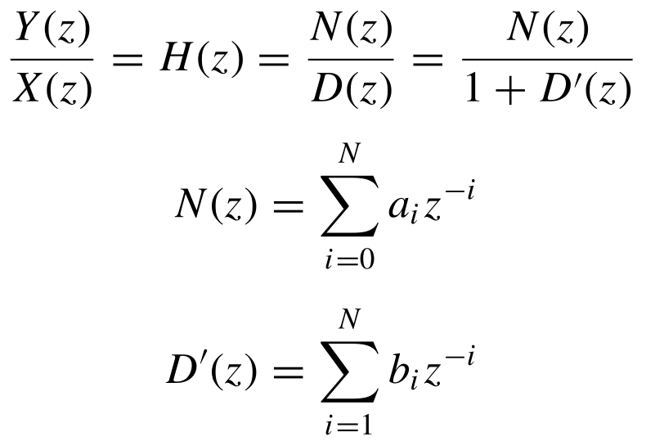
Direct Realization

Slide 19
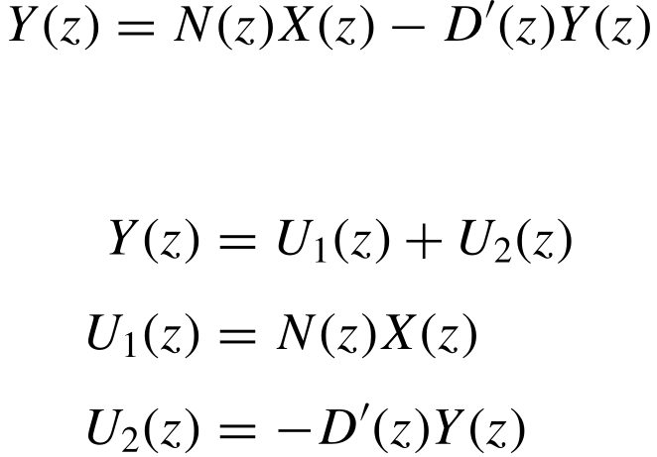
Direct Realization

Slide 20
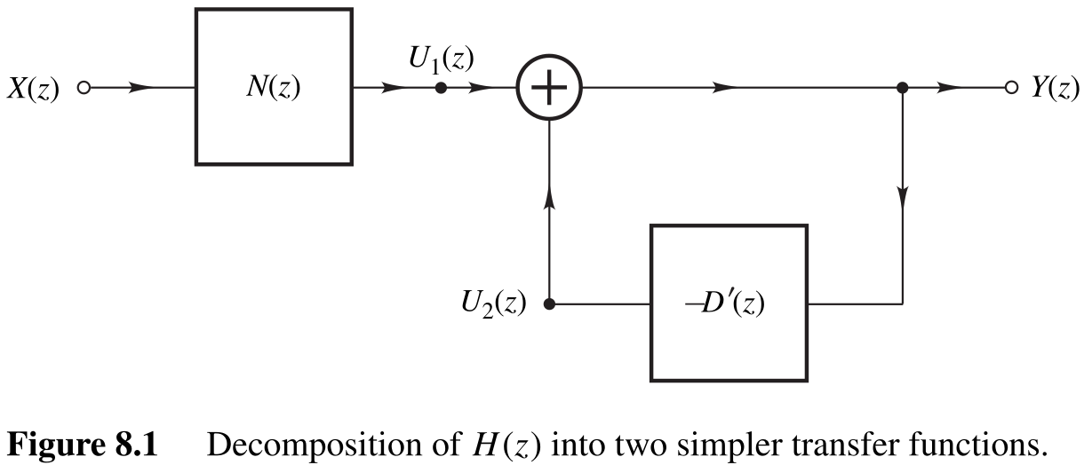
Direct Realization

Slide 21
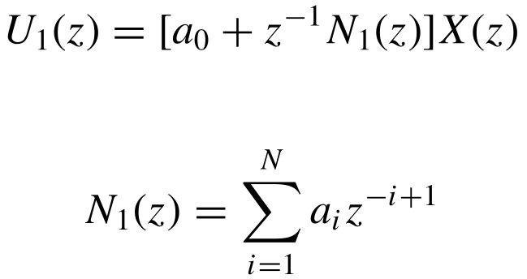
Direct Realization

Slide 22
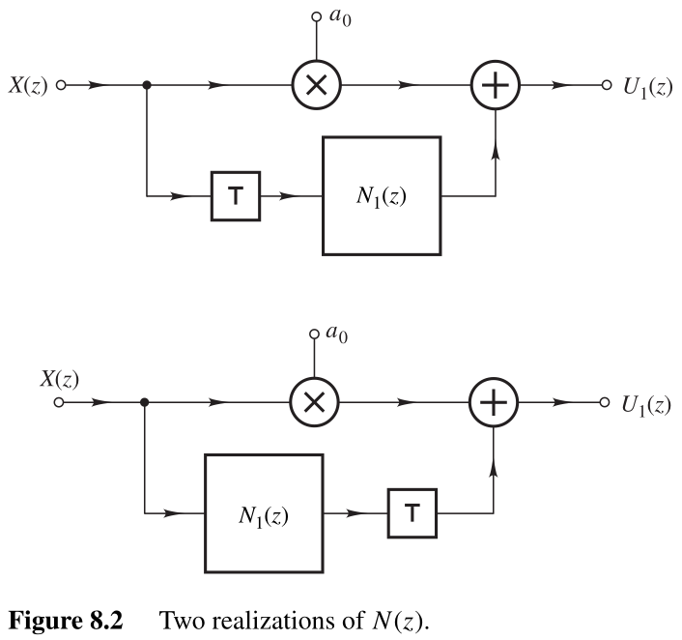
Direct Realization

Slide 23
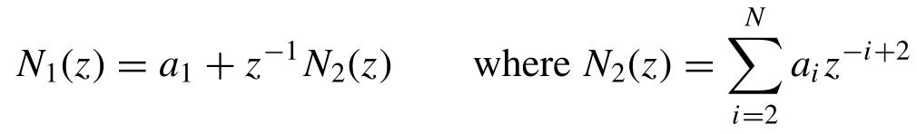
Direct Realization

Slide 24
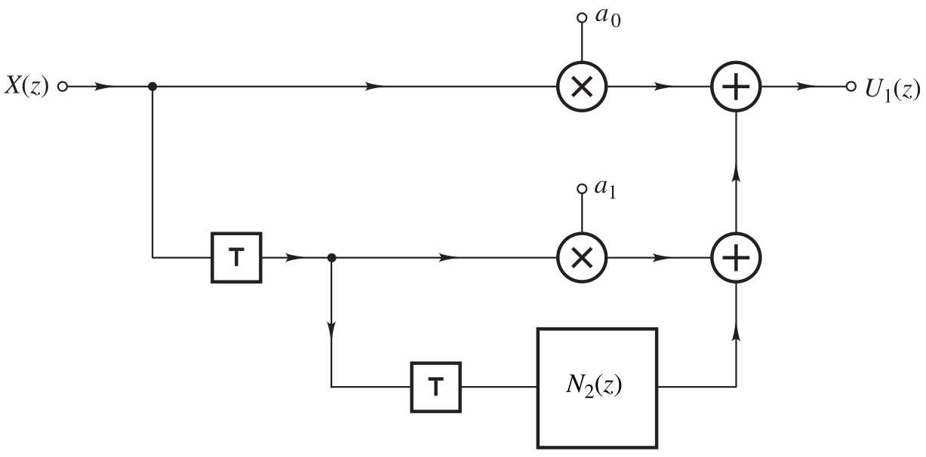
Direct Realization

Slide 25
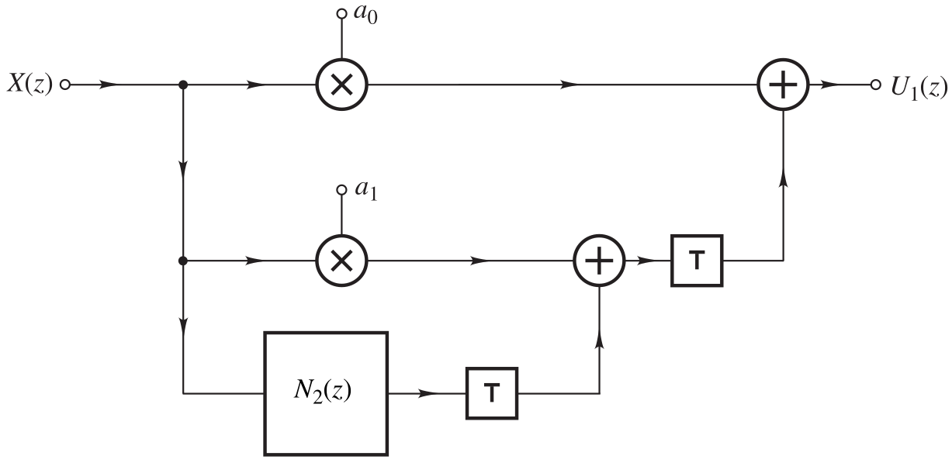
Direct Realization

Slide 26
Direct Realization
The above cycle of activities can be repeated N times whereupon NN(z) will reduce to a single multiplier.
In each cycle of the procedure there are two possibilities, and since there are N cycles, a total of 2^{N} distinct networks can be deduced for N(z).

Slide 27
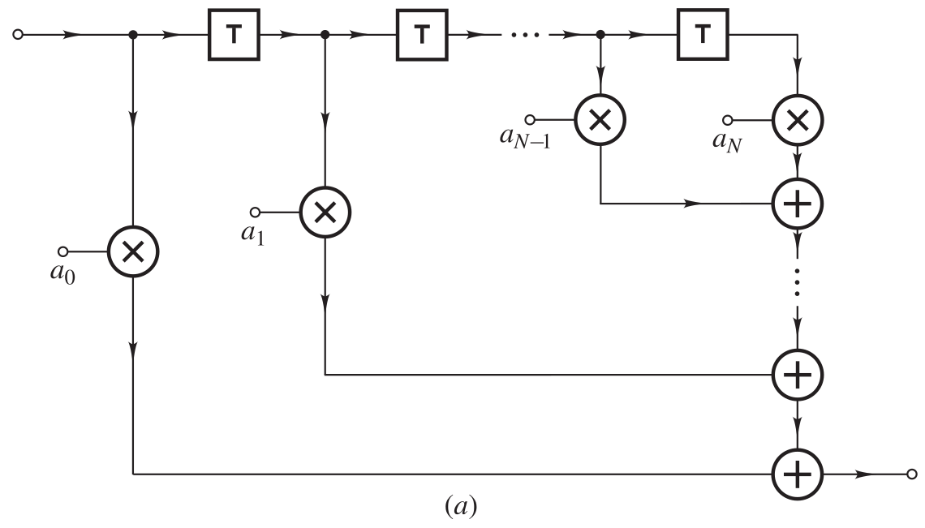
Direct Realization

Slide 28
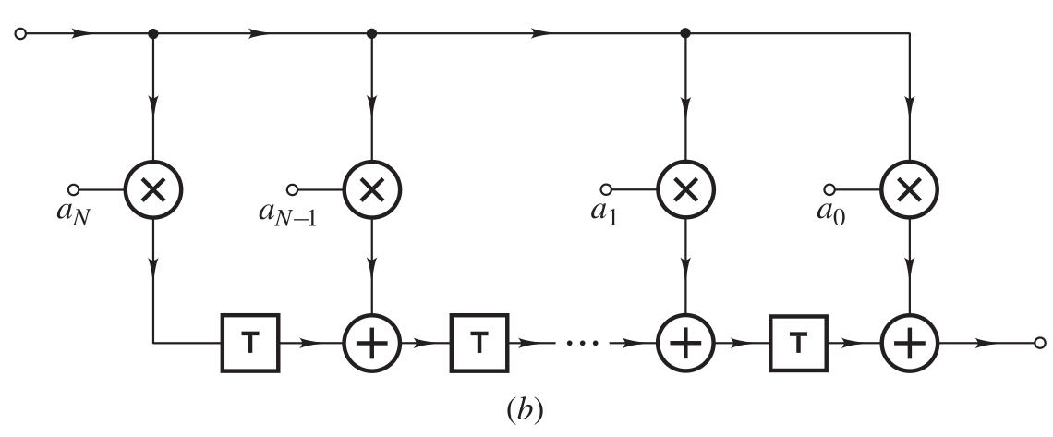
Direct Realization

Slide 29
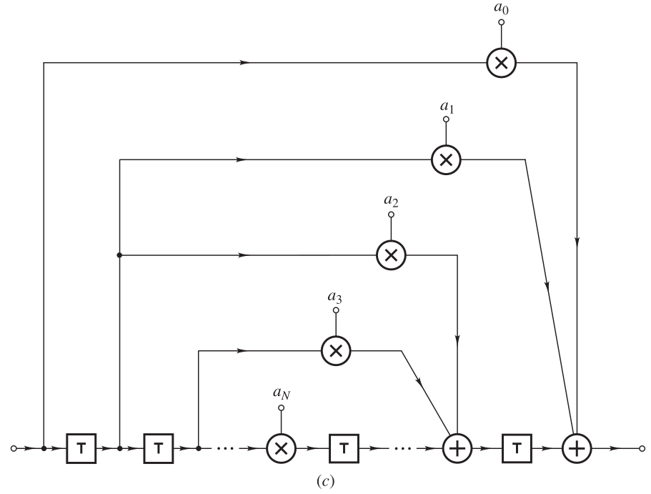
Direct Realization

Slide 30
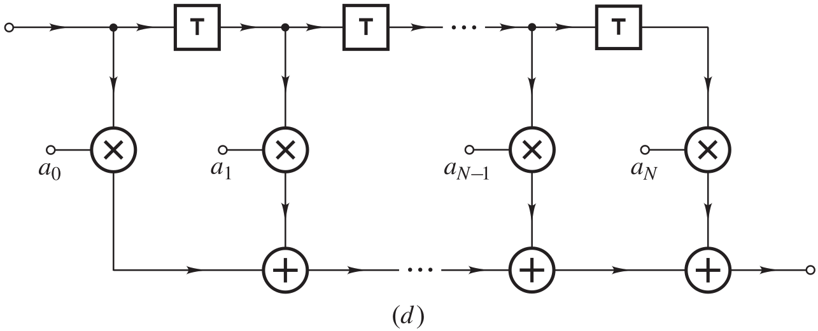
Direct Realization

Slide 31
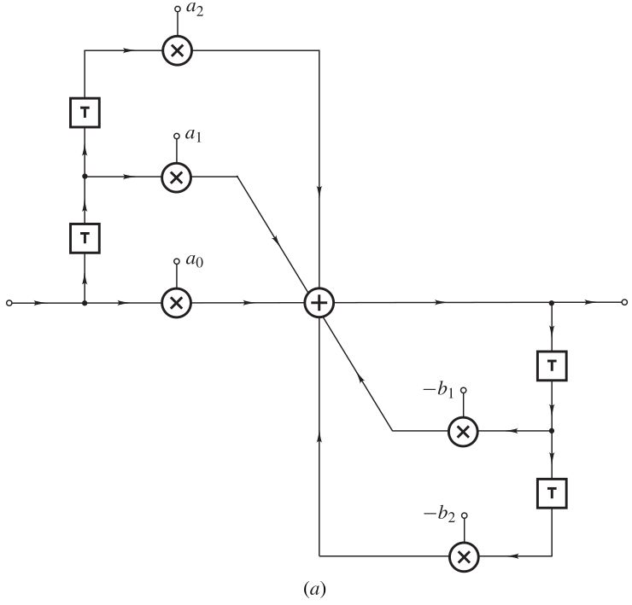
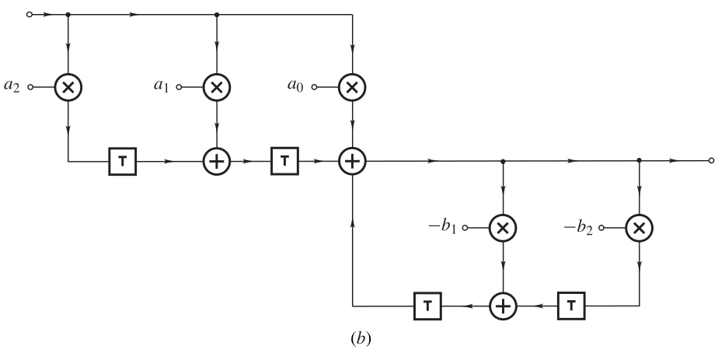
Direct Realization

Slide 32
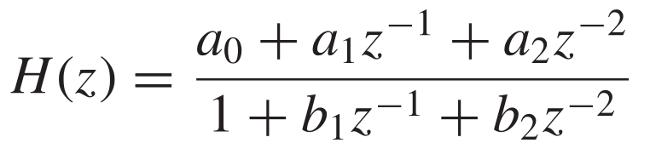
Example 1
Realize the transfer function

Slide 33
DIRECT CANONIC REALIZATION

Slide 34
Direct Canonic Realization
The smallest number of unit delays required to realize an N th-order transfer function is N.
An N th-order discrete-time network that employs just N unit delays is said to be canonic with respect to the number of unit delays.

Slide 35
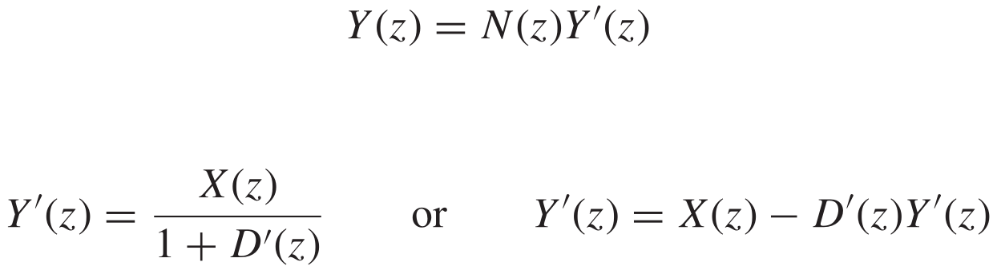
Direct Canonic Realization

Slide 36
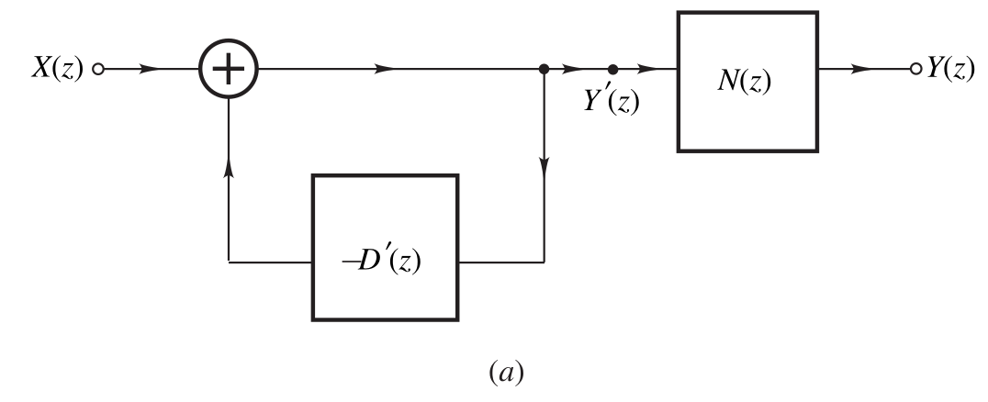
Direct Canonic Realization

Slide 37
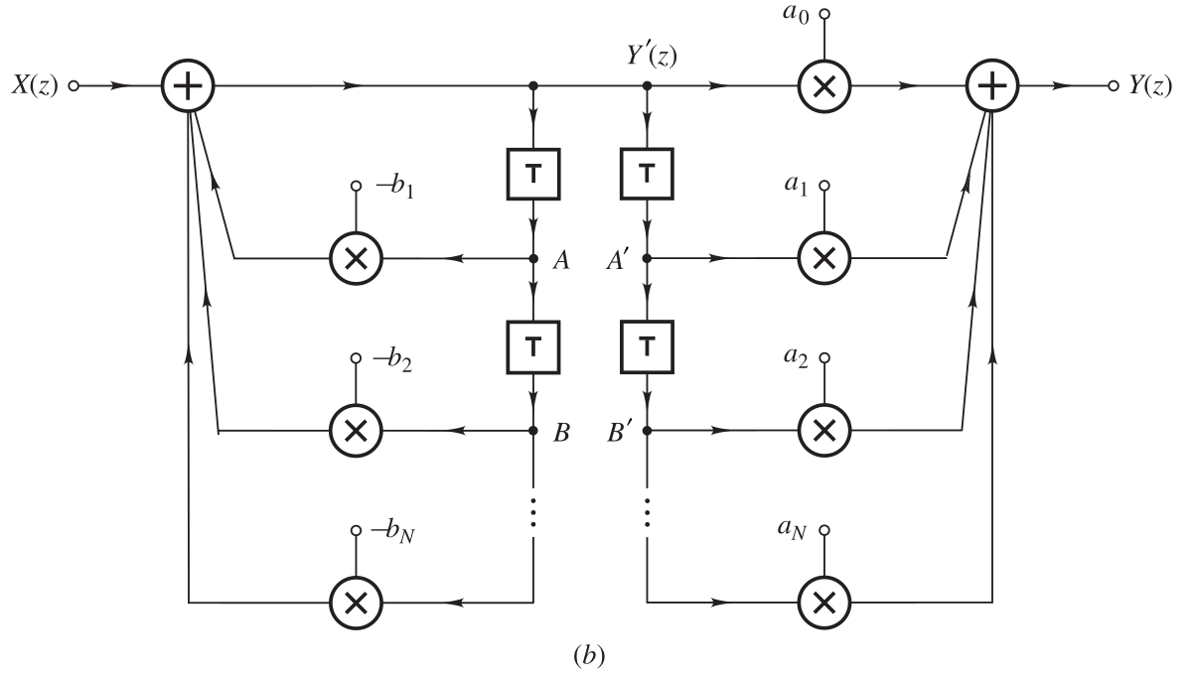
Direct Canonic Realization

Slide 38
Direct Canonic Realization

Slide 39
STATE-SPACE REALIZATION

Slide 40
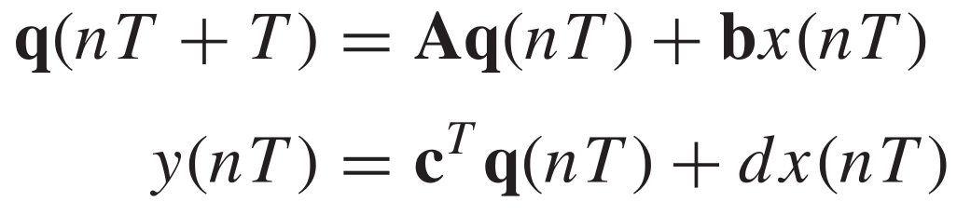
State-Space Realization
Another approach to the realization of digital ﬁlters is to start with the state-space characterization

Slide 41
State-Space Realization
Another approach to the realization of digital ﬁlters is to start with the state-space characterization

Slide 42
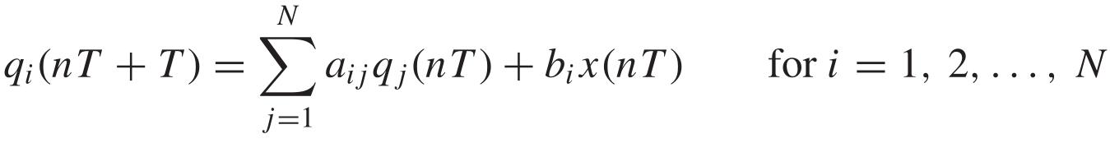
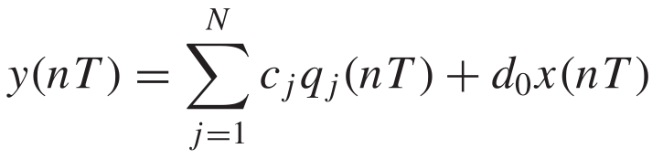
State-Space Realization
For an N th-order ﬁlter

Slide 43
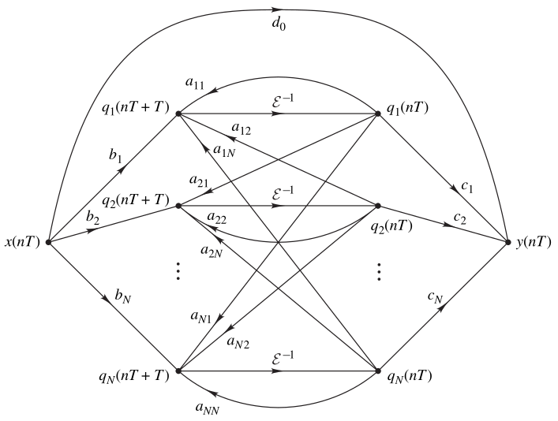
State-Space Realization
state-space signal ﬂow graph

Slide 44
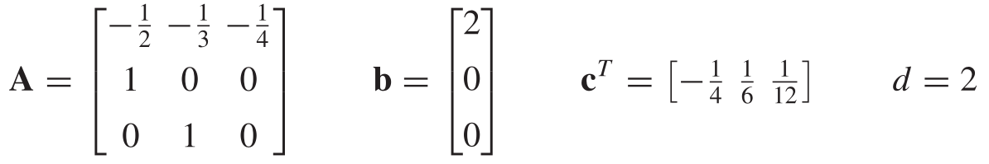
Example 2
A digital ﬁlter is characterized by the state-space equations
Obtain a direct canonic realization.

Slide 45
LATTICE REALIZATION

Slide 46
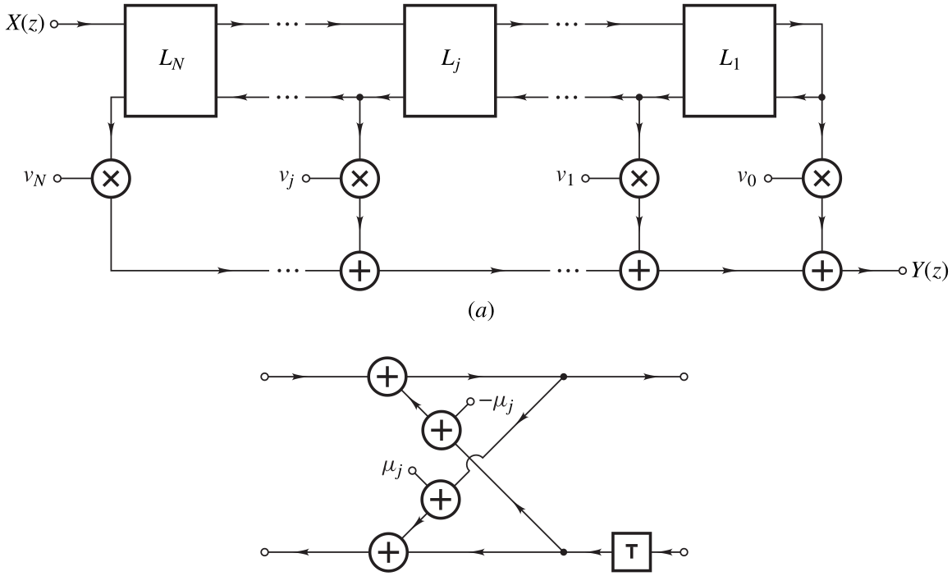
Lattice Realization

Slide 47
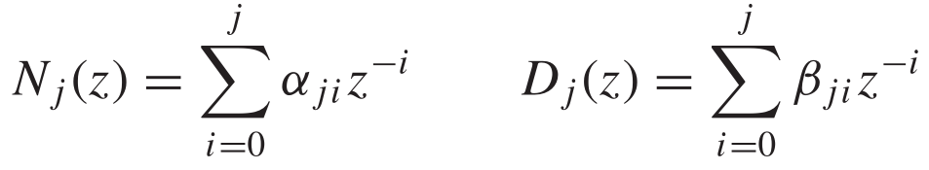
Lattice Realization
The realization can be accomplished by using a recursive algorithm comprising N iterations whereby polynomials of the form
are generated for j = N , N − 1, . . . , 0, and for each value of j the multiplier constants νj and µj are evaluated using coefﬁcients αjj and βjj in the above polynomials

Slide 48
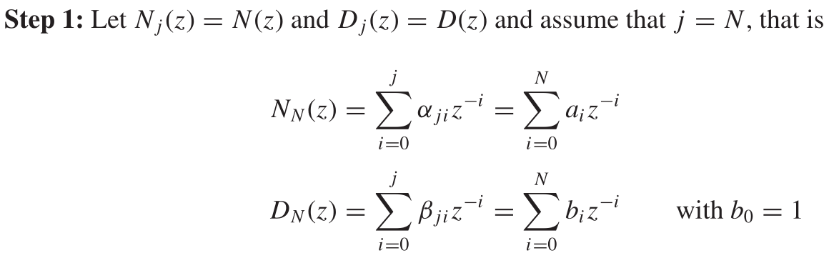
Lattice Realization

Slide 49
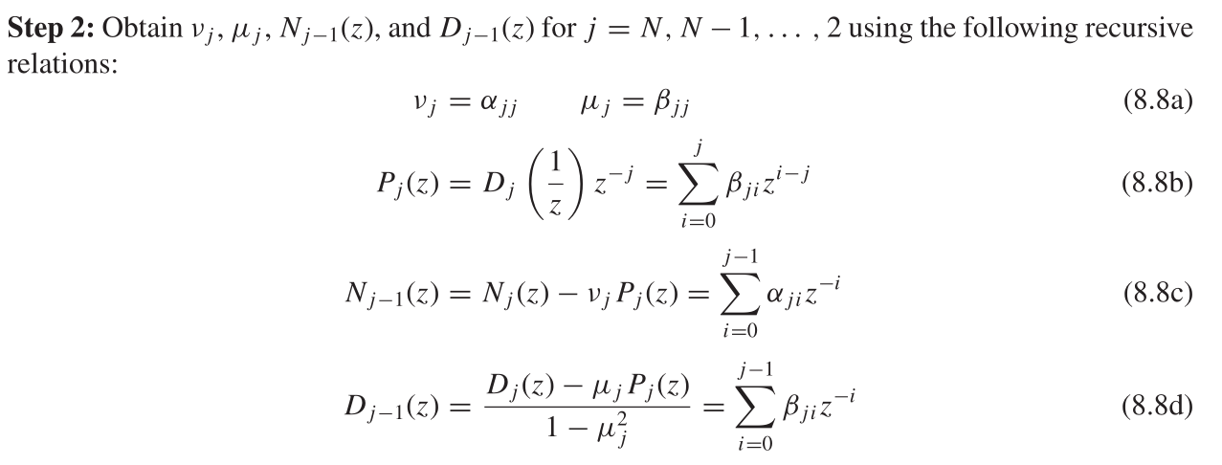
Lattice Realization

Slide 50
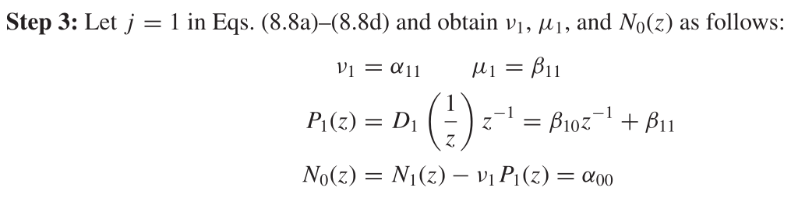
Lattice Realization

Slide 51
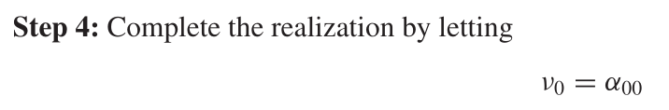
Lattice Realization

Slide 52
Example 3
Realize the transfer function’
using the lattice method

Slide 53
Lattice Realization
The 2-multiplier section yields structures that are canonic with respect to the number of unit delays.
However, the number of multipliers can be quite large, as can be seen in Example 3.

Slide 54
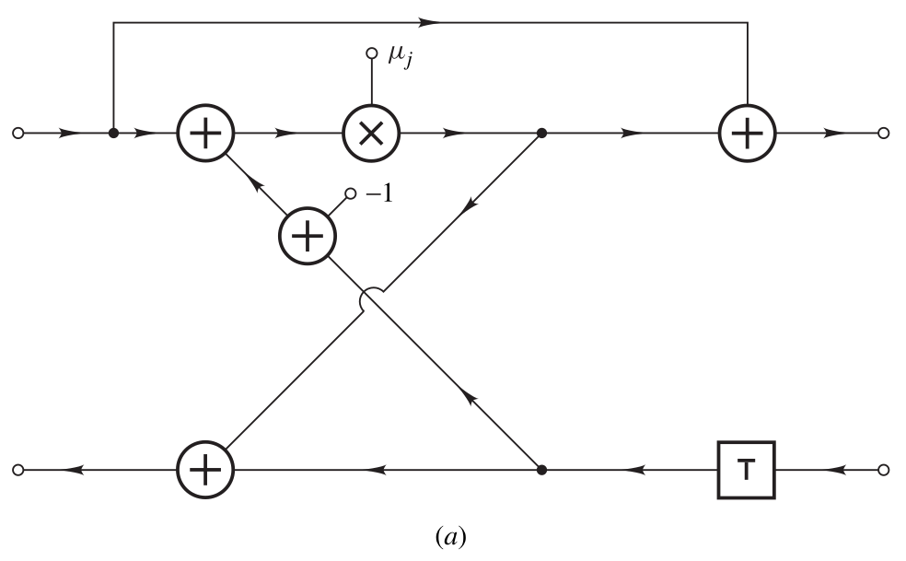
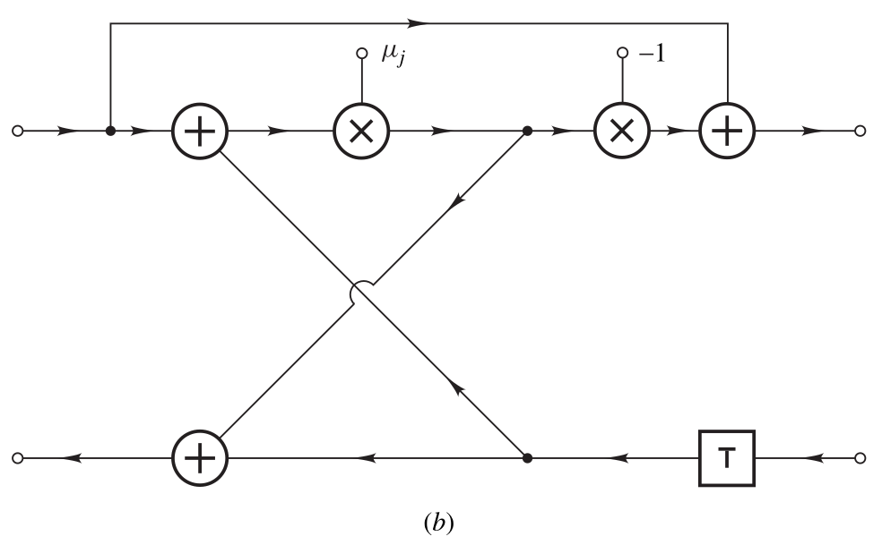
Lattice Realization
More economical realizations can be obtained by using 1-multiplier ﬁrst-order sections of the type shown below

Slide 55
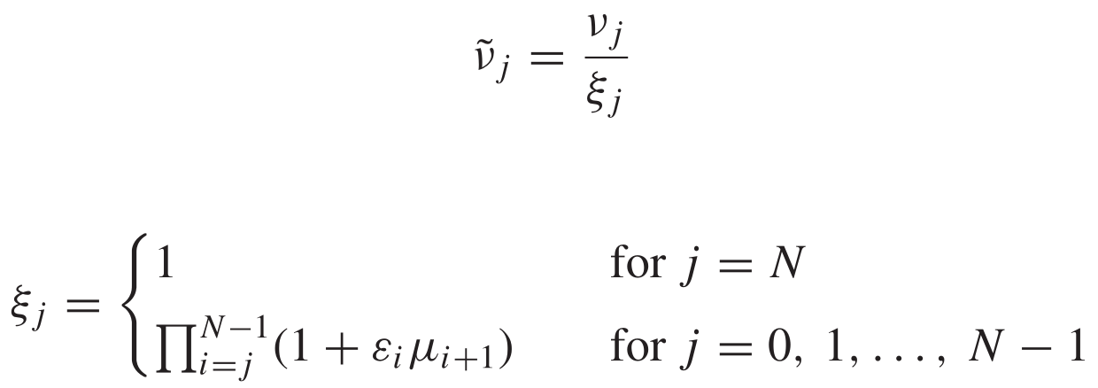
Lattice Realization
Such realizations can be obtained by ﬁrst realizing the transfer function in terms of 2-multiplier sections as described above and then replacing each of the 2-multiplier sections by either of the 1-multiplier sections
The denominator multiplier constants µ1, µ2, . . . , µN remain the same as before. However, the numerator multiplier constants ν0, ν1, . . . , νN must be modiﬁed as

Slide 56
Lattice Realization
Each parameter εi is a constant which is equal to +1 or −1 depending on whether the ith 2-multiplier section is replaced by the 1-multiplier section of Fig. a or that of Fig. b.

Slide 57
CASCADE REALIZATION

Slide 58
Cascade Realization
When the transfer function coefﬁcients are quantized, errors are introduced in the amplitude and phase responses of the ﬁlter.
When a transfer function is realized directly in terms of a single N th-order network using any one of the methods described so far, the sensitivity of the structure to coefﬁcient quantization increases rapidly with N
Consequently, small errors introduced by coefﬁcient quantization give rise to large errors in the amplitude and phase responses.

Slide 59
Cascade Realization
This problem can to some extent be overcome by realizing high-order ﬁlters as interconnections of ﬁrst- and second-order networks.
In this and the next section, it is shown that an arbitrary transfer function can be realized by connecting a number of ﬁrst- and second-order structures in cascade or in parallel.

Slide 60
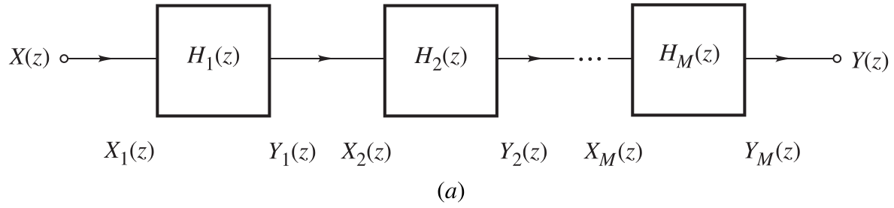

Cascade Realization
Consider an arbitrary number of ﬁlter sections connected in cascade as
and assume that the ith section is characterized by

Slide 61
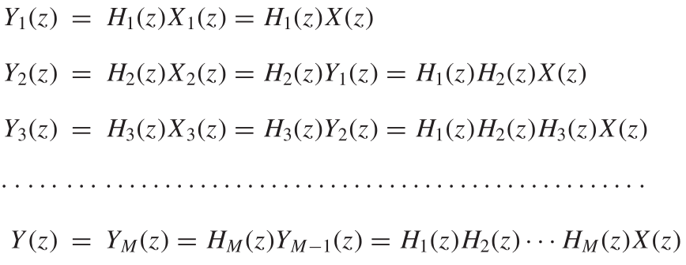
Cascade Realization

Slide 62
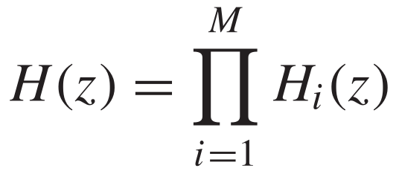


Cascade Realization
The overall transfer function of a cascade arrangement of ﬁlter sections is equal to the product of the individual transfer functions, that is,
An N th-order transfer function can be factorized into a product of ﬁrst- and second-order transfer functions of the form

Slide 63
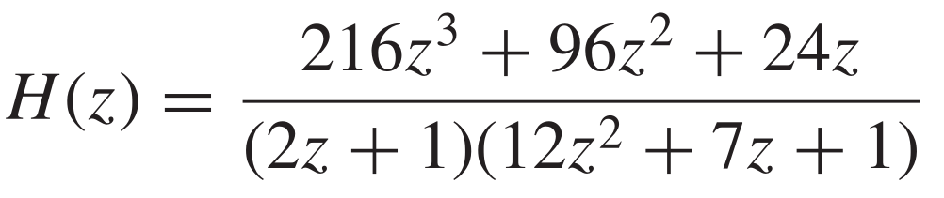
Example 4
Obtain a cascade realization of the transfer function
using canonic sections.

Slide 64
PARALLEL REALIZATION

Slide 65
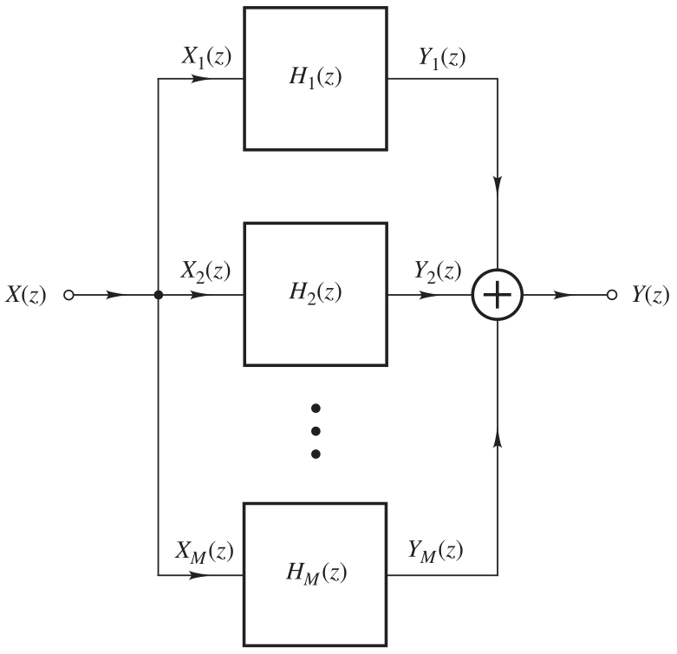
Parallel Realization
Another realization comprising ﬁrst- and second-order ﬁlter sections is based on the parallel conﬁguration

Slide 66
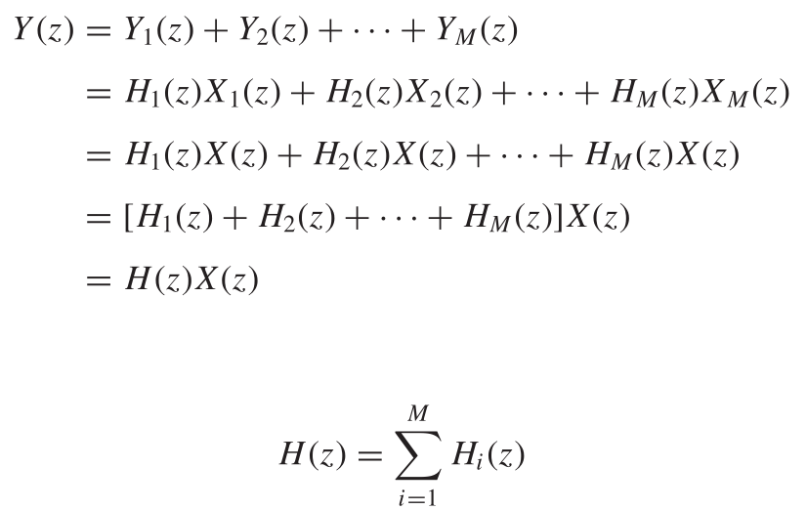
Parallel Realization

Slide 67
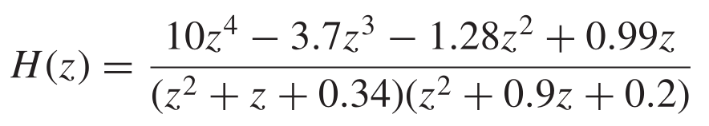
Example 5
Obtain a parallel realization of the transfer function
using canonic sections.

