Slide 1
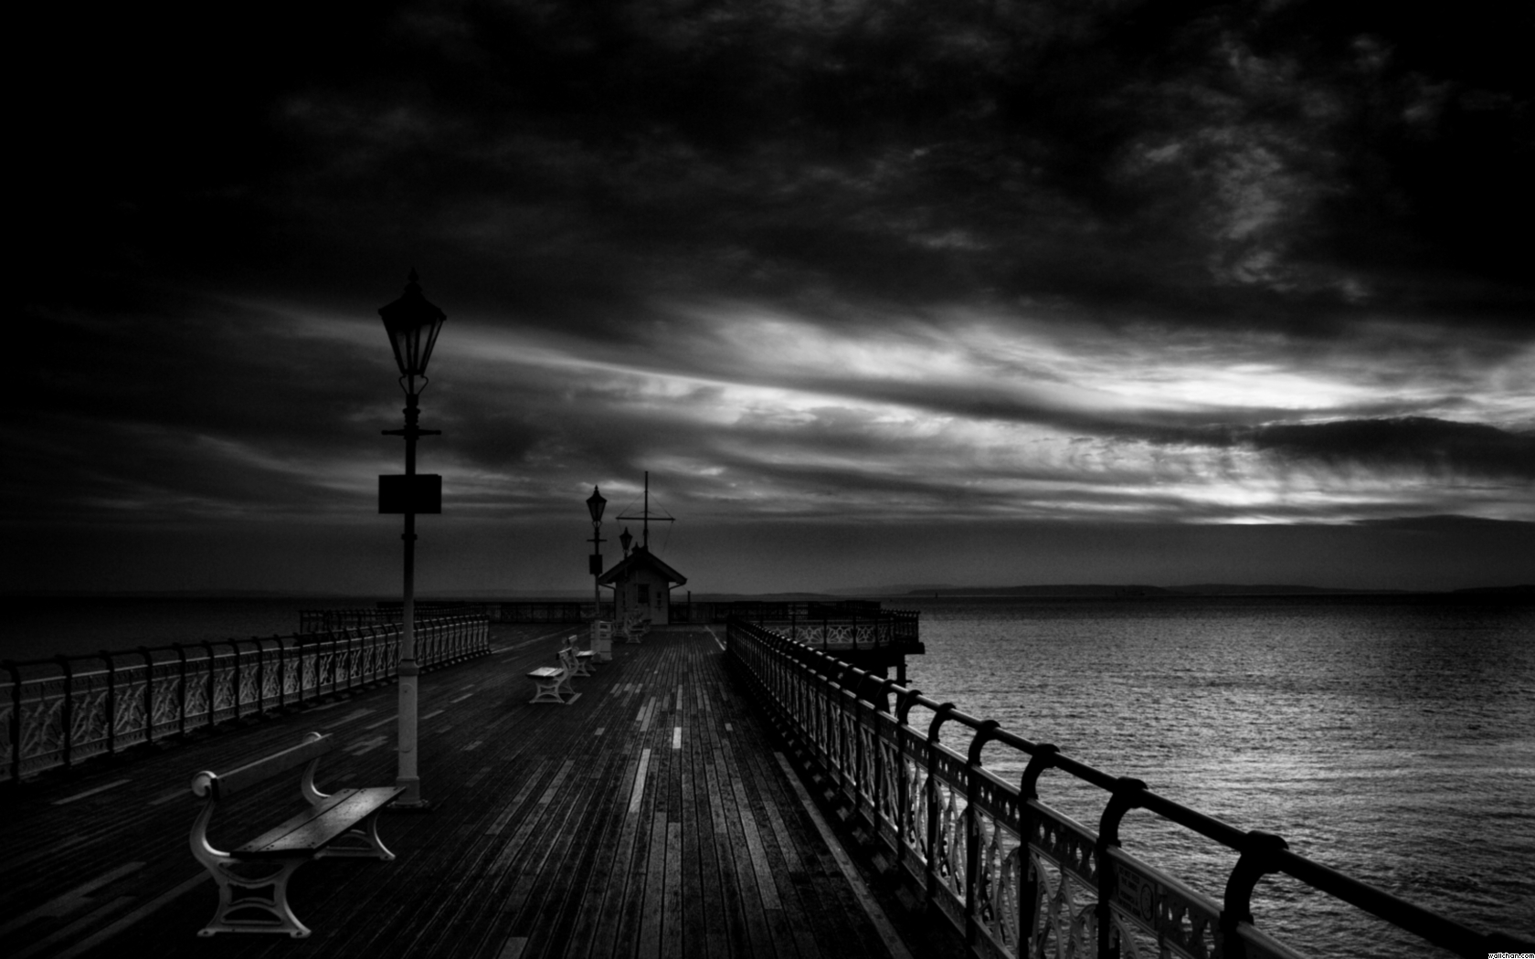


Underwater Source Separation Using Multi-Stage Independent Component Analysis in Semi-Anechoic Water Tank
Regional Conference of Acoustic and Vibraton 2017
Bali - November 2017
Ridhwan Juniarga Pribadi, Wiratno Argo Asmoro.
Wirawan, Dhany Arifianto, Endang Widjiati, Mifta Nur Farid

Slide 2
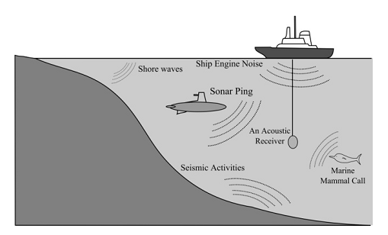
Background
Suraj Kamal and Supriya M.H, 2011.“Blind Source Separation of Nonlinearly Mixed Ocean Acoustic Signals Using Slow Feature Analysis”

Slide 3
Imagine when we have to put the sensor in different condition
Then we will have….

Slide 4
Background
Different sound speed
Different temperature
multi channel propagation profile
Different salinity
Suraj Kamal and Supriya M.H, 2011.“Blind Source Separation of Nonlinearly Mixed Ocean Acoustic Signals Using Slow Feature Analysis”

Slide 5
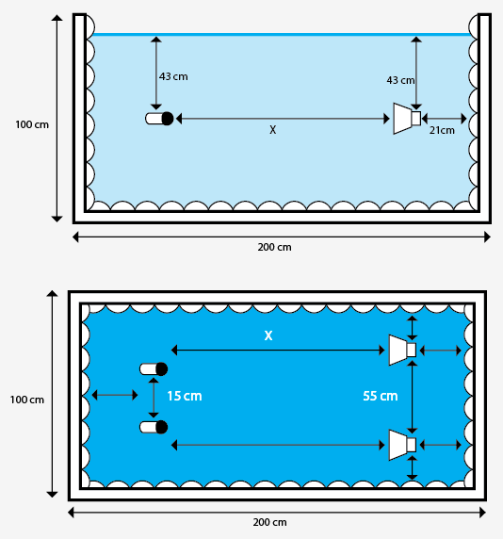
Background
Capturing small portion, to make lab scale experiment
Water tank was covered with absorber to avoid the reflection of sound wave
The salinity and water temperature can be controlled

Slide 6
Then, how do we separate this mixed sound from different sources?

Slide 7
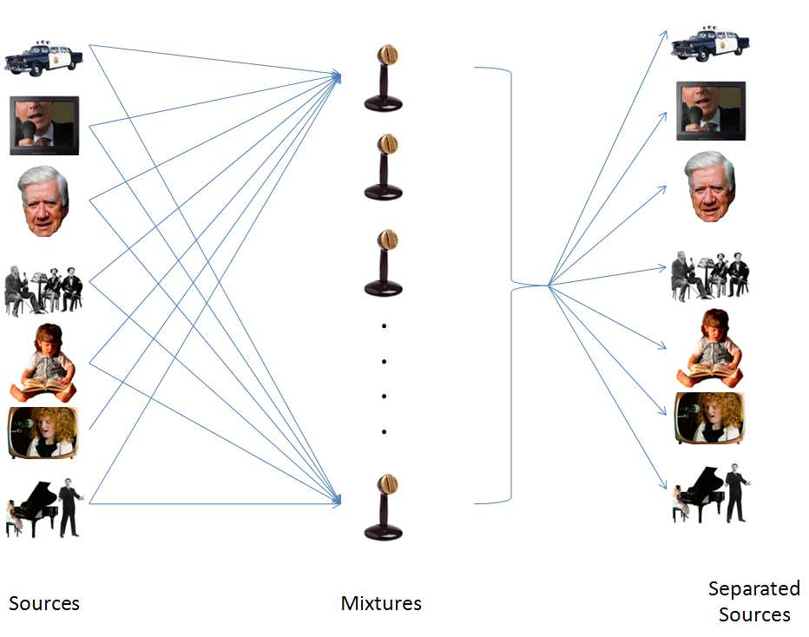

Blind Source Separation / Independent Component Analysis (ICA)
Simplification of separation model
Blindly decomposing mixed sound without any prior information of the sources
$$\left.X\left(t\right)=A.S(t\right)$$
Linear mixture model

Slide 8
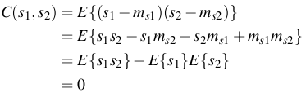

Assumption of ICA
.......................(1)
Signals must be statistically independent
Signal must be non-Gaussian

Slide 9
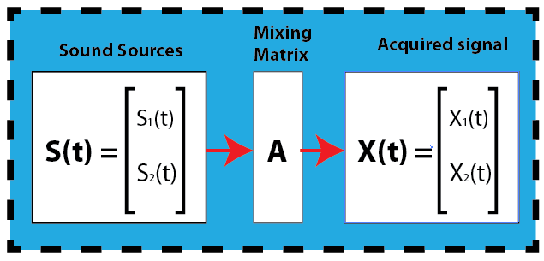
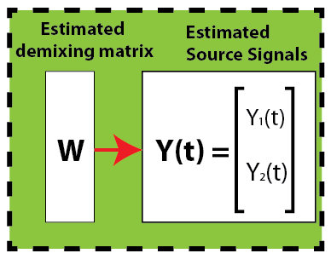
Time Domain ICA (TDICA)

Slide 10
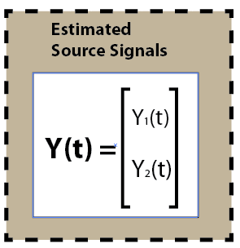
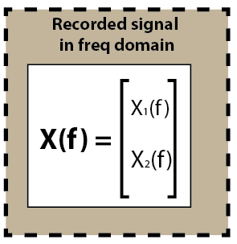
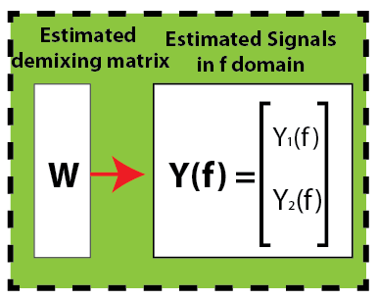
Frequency Domain ICA (FDICA)

Slide 11
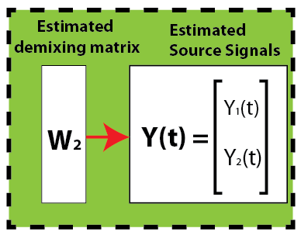
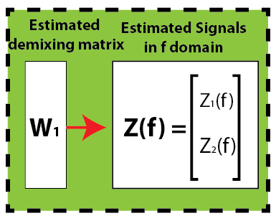
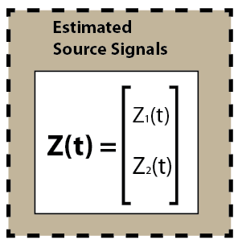
MuItistage ICA (MSICA)

Slide 12
So now our black box is complete
Experiment were performed in underwater tank
3 different methods of ICA were applied to estimate source signals

Slide 13
Experiment setup
Side view
sensors
sources
Top view
sensors
sources

Slide 14
Configuration of Test Signal
No | Signal | Note
1 | Puretone 500hz | Narrow Band
2 | Puretone 600hz | Narrow Band
3 | Puretone 700hz | Narrow Band
4 | Puretone 800hz | Narrow Band
5 | Puretone 900hz | Narrow Band
6 | Puretone 1 khz | Narrow Band
7 | Ship noise | Wideband Stationary
8 | Sonar Pinging | Wideband Non-Stationary

Slide 15
How was the result then?

Slide 16
Result of TDICA

Slide 17
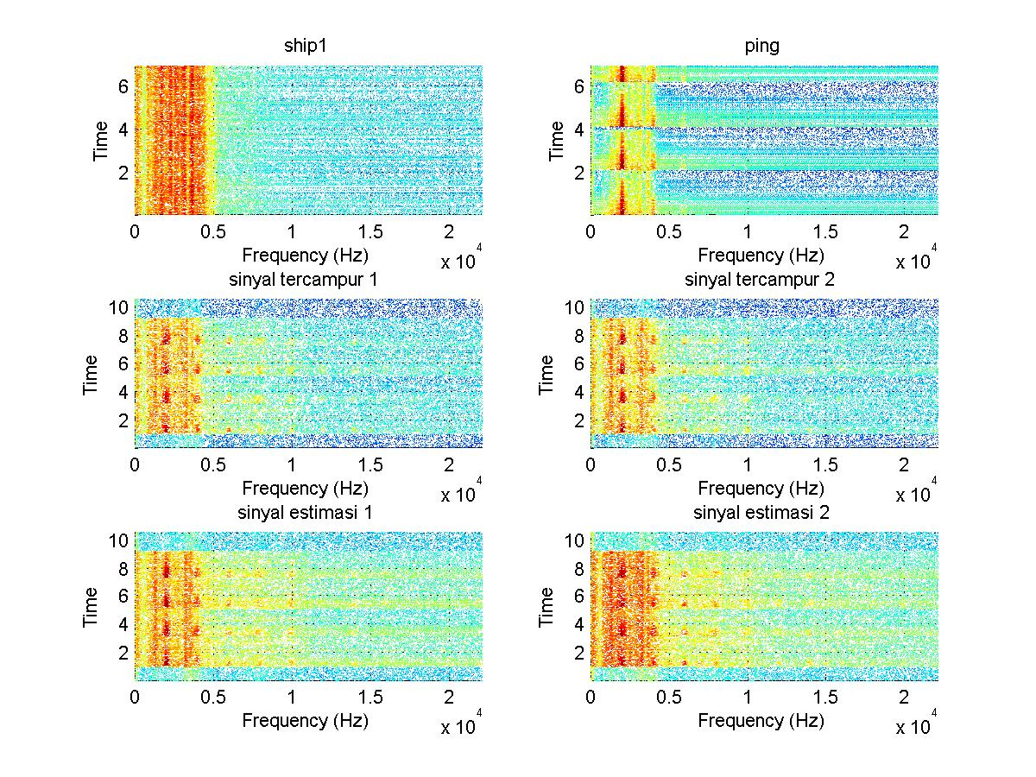
Result of source separation (time-freq representation)
Intensity of signal 2 increased in this part
Each signal not decomposed perfectly

Slide 18
Result of FDICA

Slide 19
Result of MSICA

Slide 20
Comparison of 3 methods
Performance of TDICA decaying as distance of sources-sensors increased

Slide 21
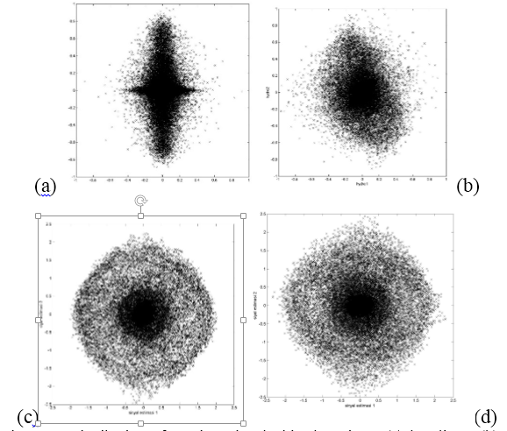
Distribution of testing signal
Distribution of Testing Signal Ship dan Ping ; (a) baseline ; (b) distance 85 cm; (c) dnstance 100 cm; (d) distance 150 cm

Slide 22
Conclusion
MSICA and FDICA shows almost equal value of MSE, and the TDICA method shows significant decreasing of performance for each addition of recorded distance.
The signals still not well-reconstructed.
There was some reflected sound in water tank captured by sensors

Slide 23
Kurtosis test signal
gaussian

Slide 24
Covariance of test signal
sinyal | 1000Hz | 500Hz | 600Hz | 700Hz | 800Hz | 900Hz | ping | ship
1000Hz |  | -0.011 | 0.0007 | -4E-05 | 6E-05 | -6E-05 | -7E-04 | 3E-05
500Hz | -0.011 |  | 0.0027 | 0.001 | 5E-05 | 0.0003 | 0.0003 | -1E-04
600Hz | 0.0007 | 0.003 |  | -0.003 | 1E-05 | 0.0174 | -6E-05 | 3E-05
700Hz | -4E-05 | 0.001 | -0.003 |  | -2E-05 | -5E-05 | 7E-05 | -5E-06
800Hz | 6E-05 | 5E-05 | 1E-05 | -2E-05 |  | -2E-04 | 1E-05 | 0.0002
900Hz | -6E-05 | 3E-04 | 0.0174 | -5E-05 | -0.0002 |  | -1E-04 | -5E-05
ping | -7E-04 | 3E-04 | -6E-05 | 7E-05 | 1E-05 | -1E-04 |  | -6E-05
ship | 3E-05 | -1E-04 | 3E-05 | -5E-06 | 0.0002 | -5E-05 | -6E-05

Slide 25


2012
Ridasari Fatma,
Menggunakan TFICA untuk memisahkan suara pompa tercampur
1998
TUGAS AKHIR
SAYA
Belouchrani Amin
Memperkenalkan TFICA
2011
Signal
Processing (BSS)
Wahyu Indra
Memisahkan sinyal tercampur sintetsis bawah air
Yuwono, niken
Mencari nilai redaman dan kecepatan suara di akuarium objek
Pratiwi Indan,
Melakukan uji waktu dengung di akuarium objek
underwater acoustic
2013
2012
2013

Slide 26


Simulasi Pencampuran Suara
Mixing matrix
Mixed signal
source signal
A. Belouchrani and M. G. Amin, 1998“Blind Source Separation Based on Time-Frequency Signal Representations”

Slide 27

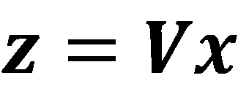
Preprocessing
centering
Whitening(sphering)

Slide 28
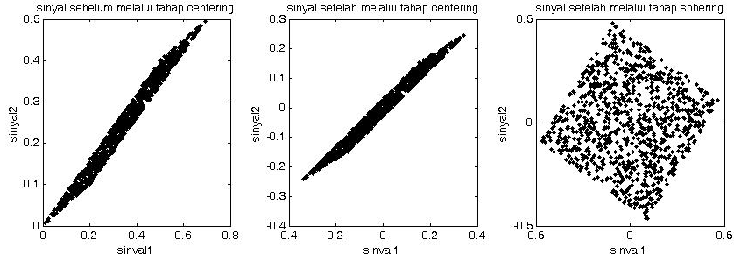
Preprocessing
http://www.cs.bham.ac.uk/~axk/ML_ICA.ppt [diaksesFebruari, 2013]

Slide 29

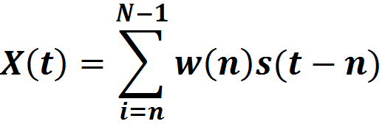
Mixture
LINEAR MIXTURE
CONVOLUTIVE MIXTURE

