Slide 1
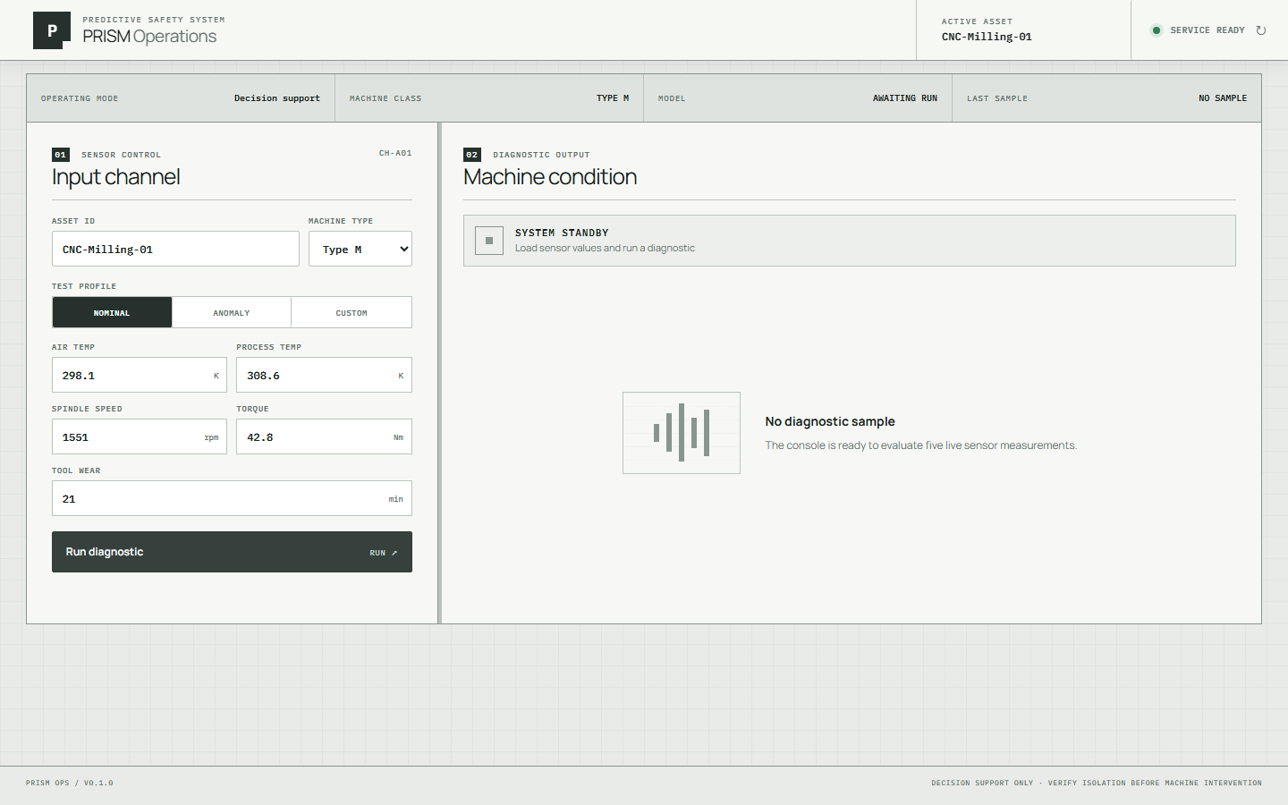
P
PRISM / PORTFOLIO SYSTEM BRIEF
01
P.R.I.S.M.
Predictive Retrieval for
Industrial Safety & Maintenance
An offline-first system that turns machine signals into traceable, validated safety guidance.
PREDICTIVE ML
HYBRID RAG
LOCAL LLM
INDUSTRIAL HMI
MIFTAH RIZKY
ML & FULL-STACK ENGINEERING

Slide 2
P
PRISM / OPERATIONAL CONTEXT
02
01 / THE PROBLEM
An alarm is not
an action plan.
Industrial telemetry can reveal that something is wrong—yet still leave the operator without context, evidence, or a safe next step.
01
SIGNAL
Measurements arrive continuously, but raw numbers do not explain failure risk.
Sensor values
02
DECISION
A useful system must distinguish nominal operation from likely failure signatures.
Failure context
03
ACTION
Safety recommendations need source evidence, validation, and human authorization.
Verified guidance
SAFETY BOUNDARY
Decision support only. PRISM never commands machinery, PLCs, or safety systems.
Project scope and safety constraints: README.md

Slide 3
P
PRISM / CONDITIONAL INFERENCE
03
02 / WHAT PRISM DOES
One request.
Two intentional paths.
A calibrated probability gate keeps nominal responses fast and reserves retrieval plus generation for critical conditions.
FIVE MACHINE MEASUREMENTS
AIR TEMP
PROCESS TEMP
SPEED
TORQUE
TOOL WEAR
Predictive engine
Calibrated failure probability + multi-label failure signatures
BELOW THRESHOLD
AT OR ABOVE THRESHOLD
HEALTHY
CRITICAL
Return ML result immediately.
Retrieval and generation are skipped.
Classify → retrieve evidence → generate → validate before display.
OPERATIONAL THRESHOLD 0.01326
Model threshold and routing: artifacts/model_metadata.json, src/prism/api/

Slide 4
P
PRISM / SYSTEM ARCHITECTURE
04
03 / ARCHITECTURE
Local-first by design.
The browser reaches a single orchestration boundary. Models, evidence, generation, and validation remain inside the local runtime.
Industrial HMI
Server proxy
Orchestration API
Next.js 16
Route handlers
FastAPI
Predictive ML
Hybrid RAG
Local LLM
Calibrated RF
E5 + FAISS + BM25
Qwen2.5 3B
MODEL ARTIFACTS
VERIFIED SOURCES
Versioned bundle, metadata, thresholds
OSHA PDFs, page metadata, checksums
VALIDATION GATE → MITIGATION_READY / MANUAL_REVIEW_REQUIRED
Runtime architecture: README.md and compose.yaml

Slide 5
P
PRISM / VALIDATED RESULTS
05
04 / EVIDENCE
Measured, not imagined.
The portfolio claims below are taken directly from committed model, retrieval, and acceptance artifacts.
0.9604
91.18%
HOLDOUT ROC-AUC
FAILURE RECALL
2,000-row holdout set
62 of 68 failures detected
100%
100%
RAG RECALL@5
SCHEMA VALIDATION
8/8 evaluation queries hit
Deterministic acceptance run
715.238 ms
ANOMALY ORCHESTRATION P95
100 deterministic critical-path runs; target < 3 seconds
BENCHMARK SCOPE
This measures orchestration with a deterministic valid generator—not live Qwen/Ollama inference.
Sources: artifacts/acceptance_report.json and artifacts/model_metadata.json

Slide 6
P
PRISM / GROUNDED SAFETY
06
05 / GUARDRAILS
Generation is the last step—
not the source of truth.
Critical guidance must remain traceable to retrieved safety evidence and survive strict machine validation.
01
RETRIEVE
Multilingual E5
FAISS IndexFlatIP
02
FUSE
BM25 + dense results
Reciprocal Rank Fusion
03
GENERATE
Qwen2.5 3B
Local through Ollama
04
VALIDATE
Pydantic schema
Citation grounding
334
PAGE-PRESERVING
CHUNKS
4
VERIFIED OSHA
PUBLICATIONS
LOCKOUT STATE
MANUAL REVIEW
Sources: knowledge index metadata and RAG evaluation report

Slide 7
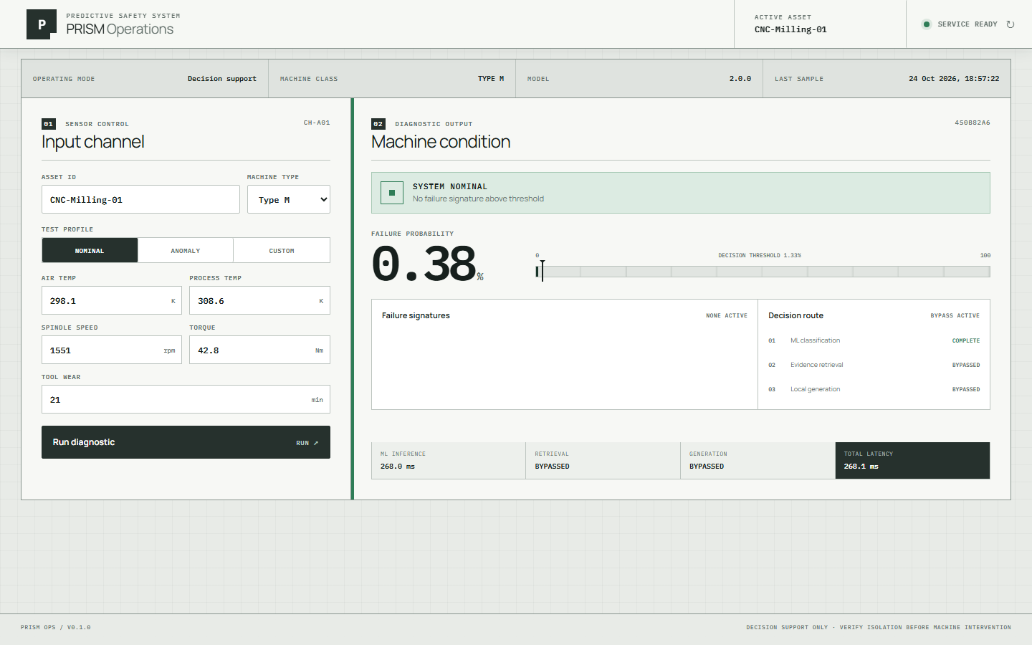
P
PRISM / OPERATOR EXPERIENCE
07
06 / INDUSTRIAL HMI
Designed for the
first operational glance.
The interface exposes readiness, sensor bounds, risk, routing, and latency without inventing fleet or historical data.
API READY
SYSTEM NOMINAL
STAGE TELEMETRY
Connection and model readiness
Probability below learned threshold
ML, retrieval, generation, total
REAL LOCAL DASHBOARD / 1440 × 900 CAPTURE
Source image: docs/assets/prism-dashboard-nominal.png

Slide 8
P
PRISM / ENGINEERING SYSTEM
08
07 / DELIVERY
Built as a system,
not a notebook demo.
Training, inference, knowledge retrieval, validation, deployment, and UI are versioned as one reproducible project.
MODEL
QUALITY
Deterministic splits
Candidate comparison
Calibrated probabilities
Unit + integration
Acceptance + fault injection
Frontend production build
OPERATIONS
DELIVERY
Docker Compose
Persistent model caches
NVIDIA runtime profile
GitHub Actions
Non-root containers
Operations runbook
TECH STACK
Python · scikit-learn · XGBoost · FAISS · FastAPI · Ollama
Next.js 16 · React 19 · TypeScript 5 · Docker Compose
CI GATE → PYTHON LINT + TESTS + ACCEPTANCE | WEB LINT + BUILD
Sources: pyproject.toml, web/package.json, compose.yaml, .github/workflows/

Slide 9

P
PRISM / PROJECT ACCESS
09
P.R.I.S.M.
Prediction with context.
Evidence before guidance.
Human authorization by design.
PREDICT
Calibrated machine-failure risk
TRACE
Verified page-level safety evidence
VALIDATE
Schema and citation guardrails
OPERATE
Purpose-built industrial HMI
EXPLORE THE PROJECT
Architecture, benchmarks, source code.
github.com/mifthrizky/P.R.I.S.M.
MIFTAH RIZKY
ML & FULL-STACK ENGINEERING
Decision support only — qualified humans authorize every intervention.

