Slide 1









PEER Performance Database
Simulation Model
Bayesian Calibration
Hysteresis data
Cantilever column w/P.H.
TMCMC
$$V=V\left(Δ, \dot{z} | \left\{θ,EI,L\right\}\right)$$
$$V$$
$$Δ$$
$$EI, L$$
x290
Best fit parameters
$$\{θ_{j}^{∗}\}$$
Metadata
Modified Bouc-Wen P.H.
Non-dimensional parameters
$$\{p_{i}\}$$
Training Data
$$X={\left\{x_{i}\right\}}_{6×290} θ={\left\{θ_{j}^{∗}\right\}}_{12×290}$$
x290
New column
$$\{{\hat{p}}_{i}\}$$
Gaussian Process
Regression
Simulation model parameters
$$\{{\hat{θ}}_{j}\}$$

Slide 2






$$Δ$$
$$Δ_{p}$$
$$Δ_{el}$$
$$P$$
$$EI, L$$
Elastic frame element
$$θ_{p}$$
Bouc-Wen moment-rotation spring

Slide 3
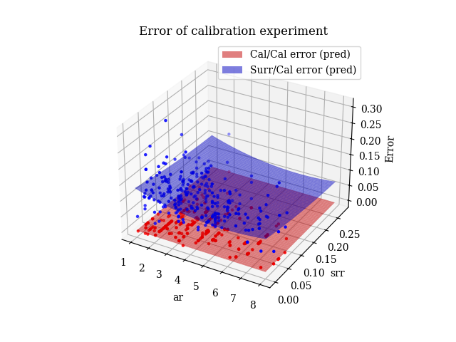

Slide 4
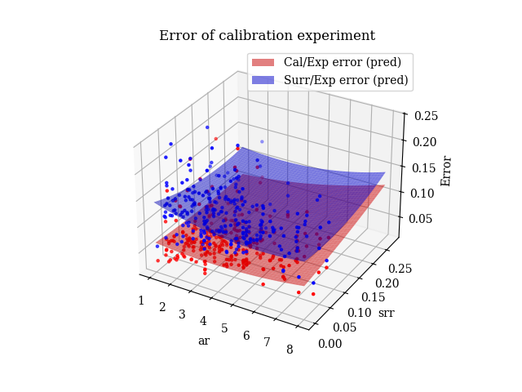
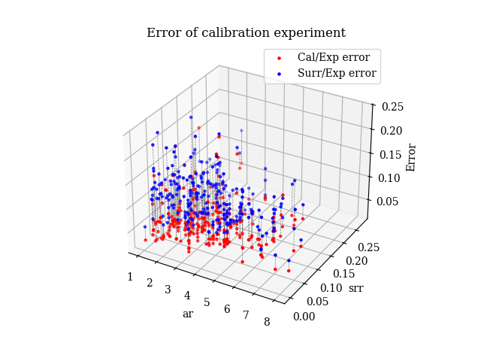
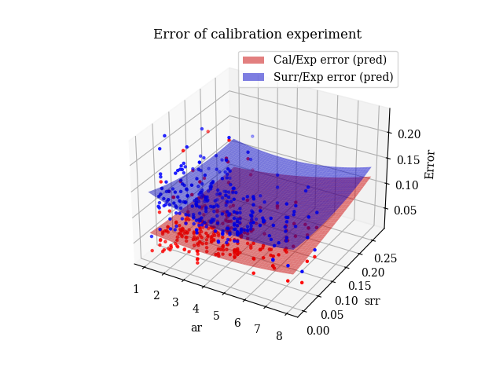


Slide 5
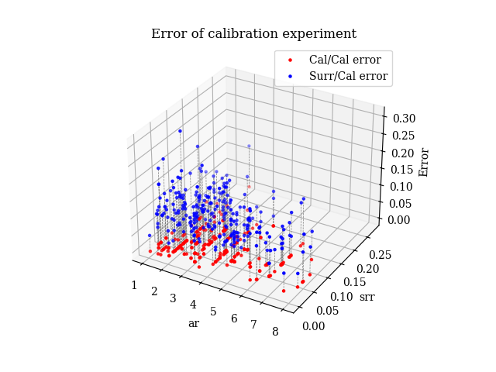
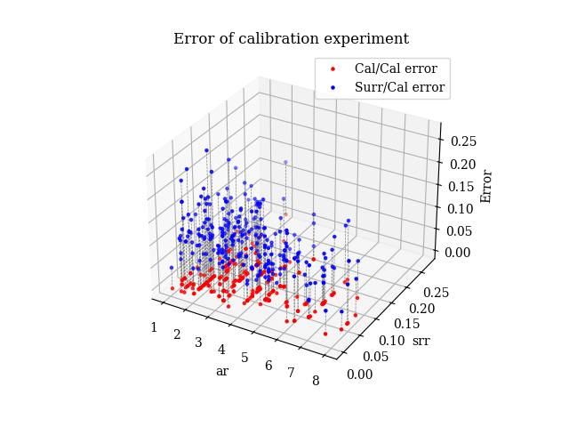
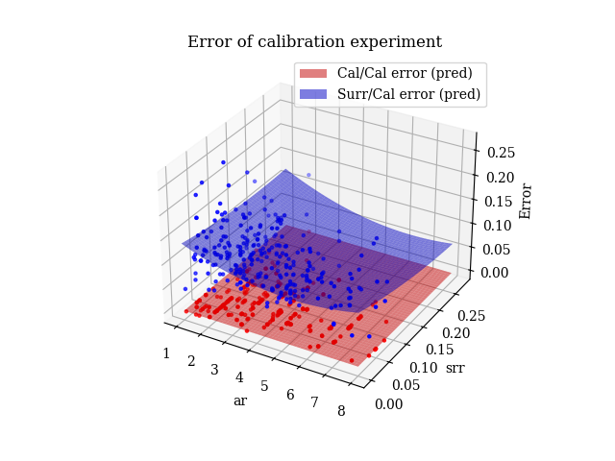

Slide 6
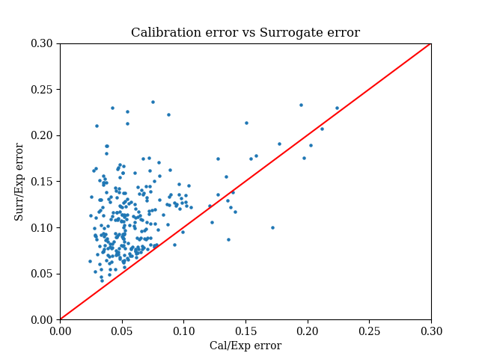
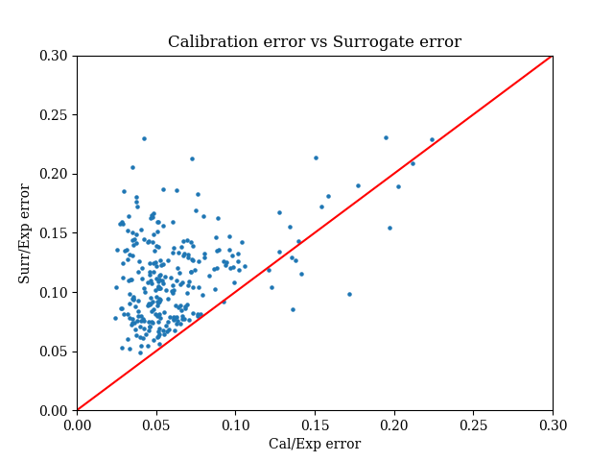

Slide 7
