Slide 1
BASICS

Slide 2
BASICS
Introduction

Slide 3
Masculine and Feminine Nouns
In Spanish all nouns are masculine or feminine. Usually, nouns that end with an "o" are masculine, and nouns that end with an "a" are feminine. For example, "manzana" (apple) is feminine and "diario" (newspaper) is masculine.

Slide 4
Articles
The articles "el" and "un" are used with masculine nouns, and the articles "la" and "una" are used with feminine nouns. "The apple" is "la manzana" and "a newspaper" is "un diario."

Slide 5
Verb Conjugation
Verb conjugation in Spanish is more complicated than in English. In Spanish, the verb endings change in order to describe who is doing the action and when. For example, for "comer," "I eat" is "yo como" and "you eat" is "tú comes."

Slide 6
Conjugation of ‘Hablar’ - present indicative
Yo hablo
Tu hablas
Usted habla
El habla
Ella habla
Nosotros/as hablamos
Ustedes hablan
Ellos/as hablan

Slide 7
BASICS
Words and images

Slide 8
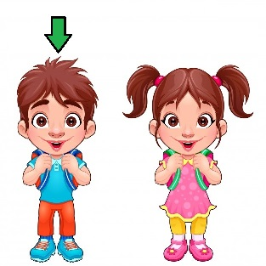
boy – el niño

Slide 9
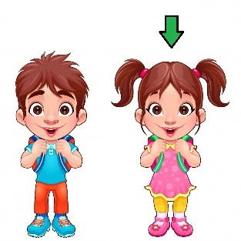
girl – la niña

Slide 10
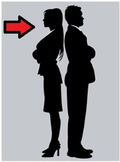
woman – la mujer

Slide 11
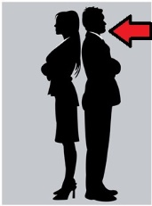
man – el hombre

Slide 12

letter – la carta

Slide 13

book – el libro

Slide 14
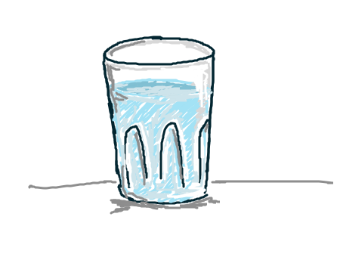
water – el agua

Slide 15

milk – la leche

Slide 16
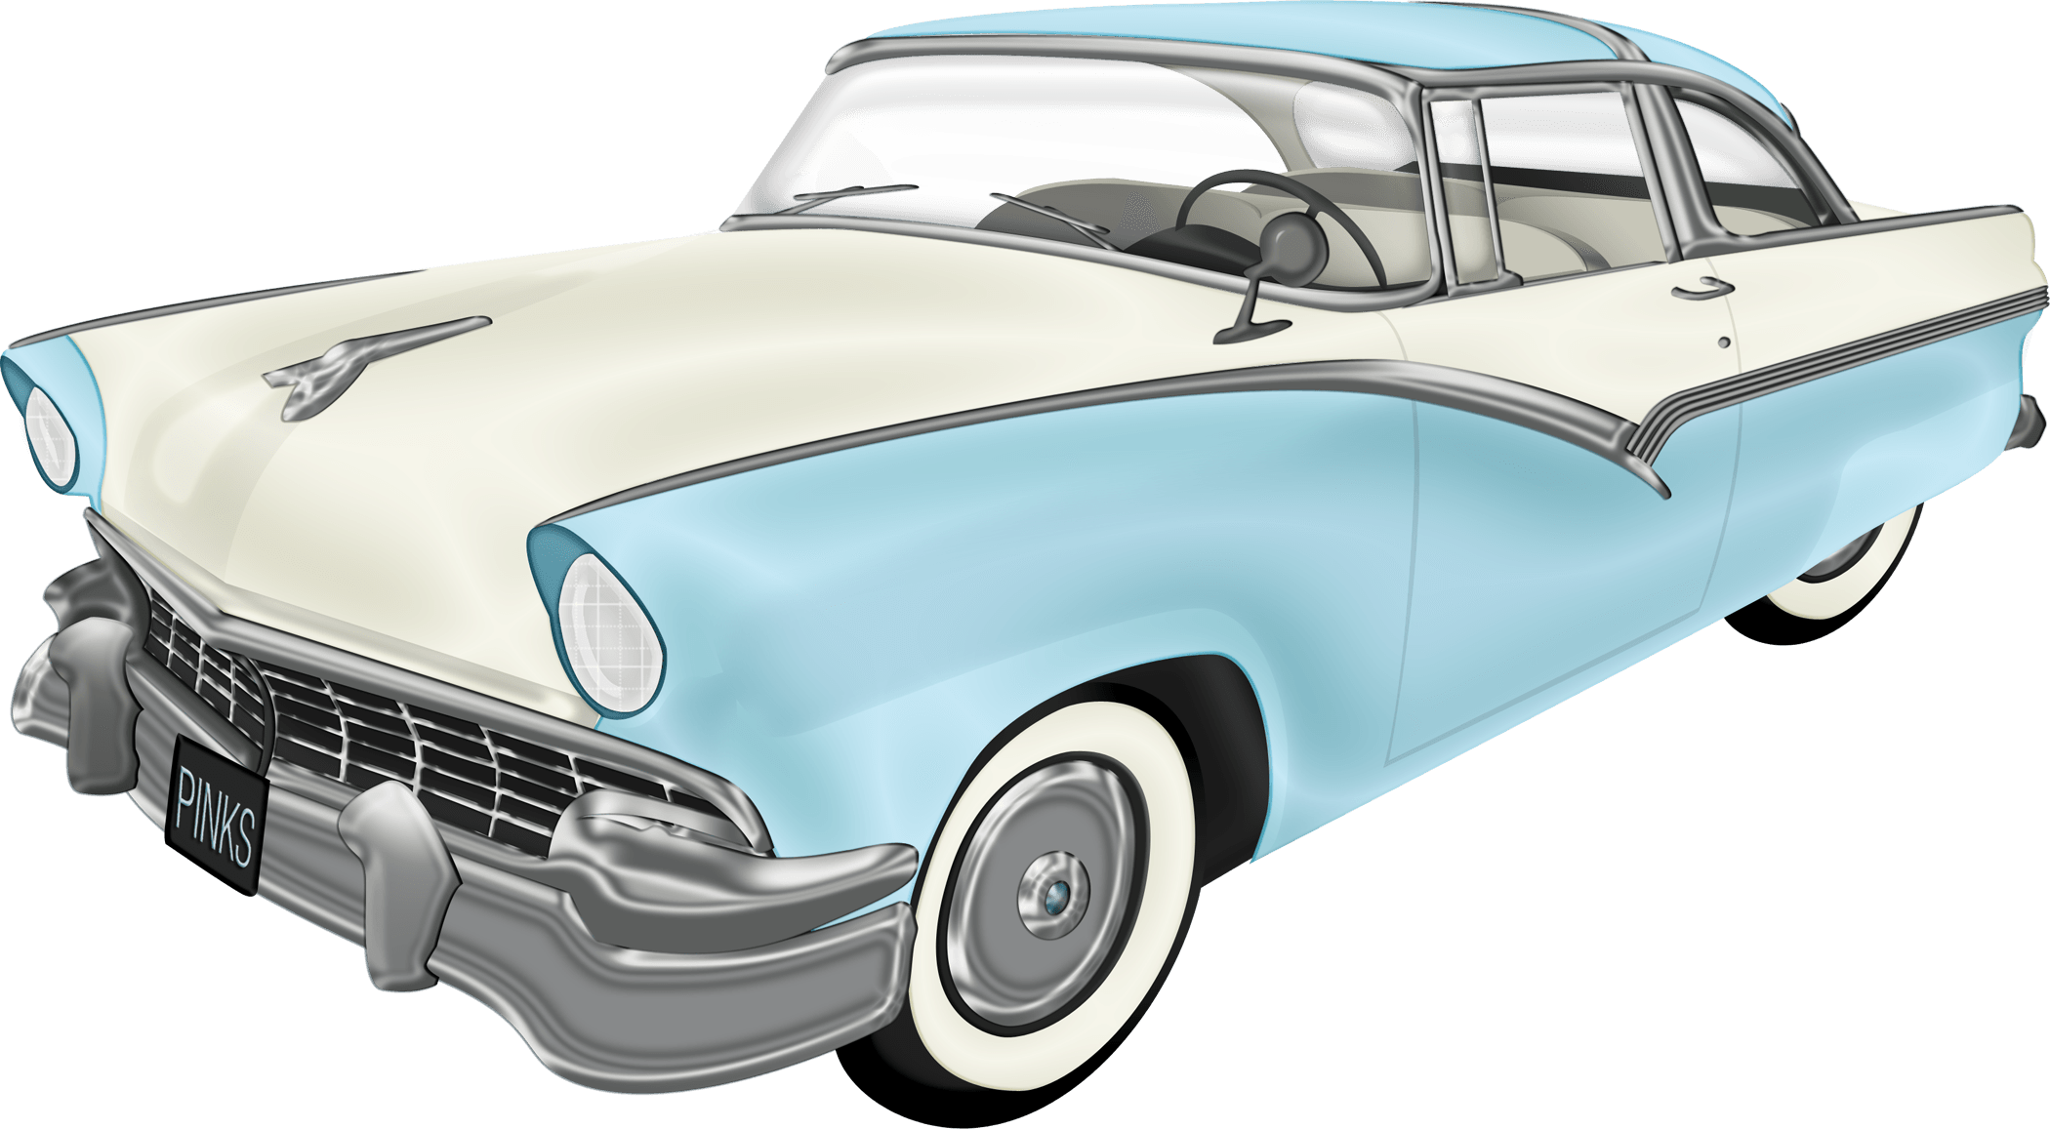
car – el coche

Slide 17
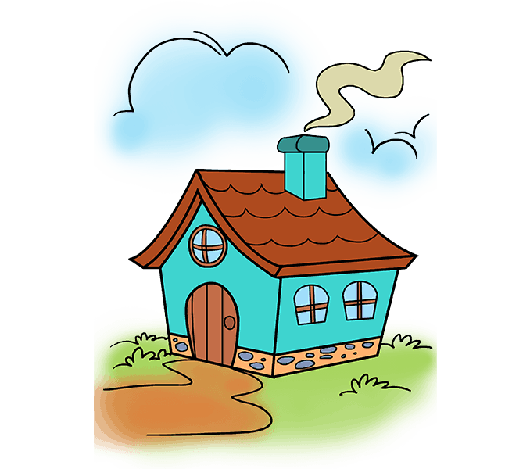
house – la casa

Slide 18
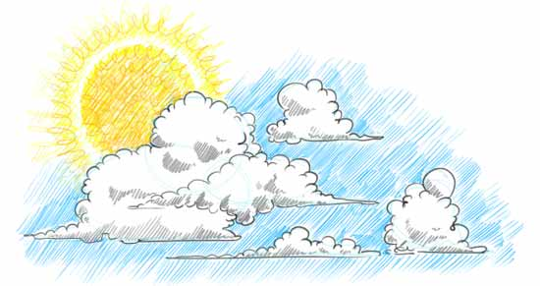
sky – el cielo

Slide 19

sun – el sol

Slide 20
BASICS
Sentences

Slide 21
Greetings
Buenos días. – Good morning.
Buenas tardes. – Good afternoon.
Buenas noches. – Good evening.
Adiós. – Goodbye.
Hasta luego. - See you later.

Slide 22
Greetings
Hola, me llamo Juan. – Hello, my name is John.
¿Cómo se llama usted? – What is your name?
Mucho gusto. – Nice to meet you.
¿Cómo está usted? – How are you?
Estoy bien. – I am fine.

Slide 23
Phrases
Perdóname. – Excuse me.
Lo siento. – I am sorry.
Por favor. – Please.
Gracías. – Thank you.
De nada. – You are welcome.

Slide 24
Sentences
Yo soy un niño. – I am a boy.
Tu eres una mujer. – You are a woman.
Nosotros somos hombres. – We are men.
Ustedes son mujeres. – You are women.
Ellas son niñas. – They are girls.

Slide 25
Sentences
Nosotros bebemos leche. – We drink milk.
Las niñas beben agua. – The girls drink water.
Nosotros escribimos una carta – We write a letter.
Ustedes beben vino. – You drink wine.
El escribe un libro. – He writes a book.

Slide 26
Sentences
Esta es mi casa. – This is my house.
Ese es tu coche. – That is your car.
El cielo es azul. – Sky is blue.
El sol es amarillo. – Sun is yellow.

