Slide 1
Math

Slide 2
MATH
Introduction

Slide 3
Spanish numbers
1. Learn the numbers for 1-15. There's no real pattern, you just have to learn
them: uno, dos, tres, cuatro, cinco, seis, siete, ocho, nueve, diez, once, doce,
trece, catorce, quince.
2. Learn the numbers for the multiples of ten: veinte, treinta, cuarenta, cincuenta,
sesenta, setenta, ochenta, noventa. A few tips to help you remember:
- Other than veinte, they all end in -enta
- Other than veinte (again), they all have a clear relationship with the related smaller number: cuatro cuarenta, ocho ochenta, etc.

Slide 4
Spanish numbers
Once you've memorized the above, you can fill in the gaps with a simple formula:
For numbers from 16-19, take the rightmost digit and say “diez + y + (digit)”. E.g.
17 = “diez + y + siete” = “diez y siete”, which contracts to diecisiete. This is much
like how in English 16 is “six-ten” i.e. “sixteen”.
- For numbers above twenty, simply take the “tens” number (veinte, treinta, etc.)
and the “ones” number (uno, dos, tres, etc.) and stick “y” (“and”) in the middle. E.g. 31 =
“thirty and one” = treinta y uno. 98 = “ninety and eight” = noventa y ocho.
The only extra thing to be aware of is that numbers from 21-29 get contracted into a
single word – so instead of “veinte y cuatro”, it's “veinticuatro”.

Slide 5
MATH
Words and images

Slide 6
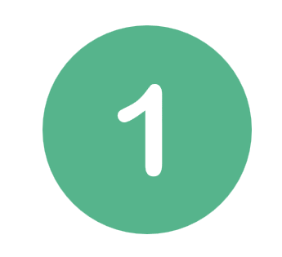

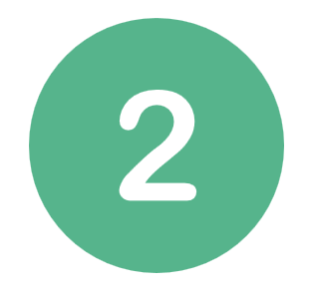







uno
sies
dos
siete
tres
ocho
cuatro
nueve
cinco
diez

Slide 7
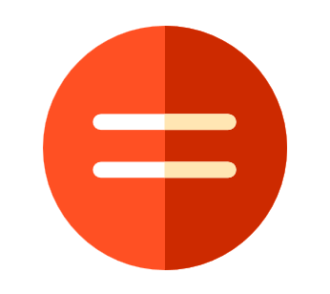
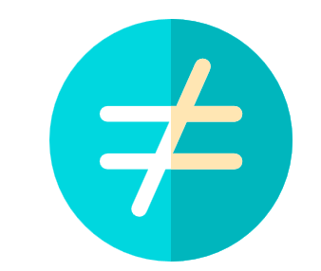
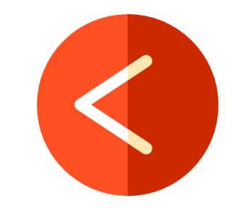
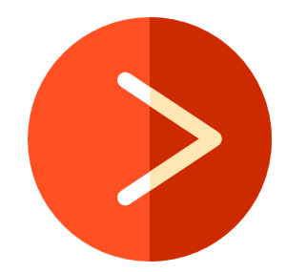
equals sign- signo de igualdad
inequality sign- signo de desigualdad
less-than sign- menor que
greater-than sign-mayor que

Slide 8
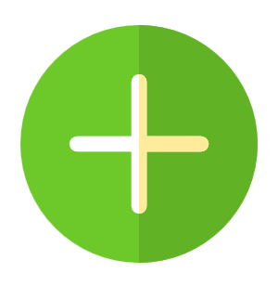
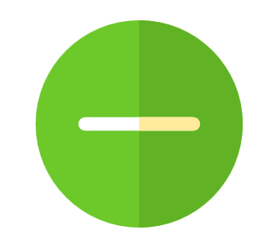

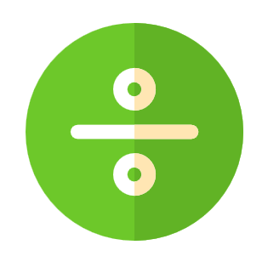
plus sign - signo más
minus sign - signo menos
multiplication sign - signo de multiplicación
division sign - signo de división

Slide 9
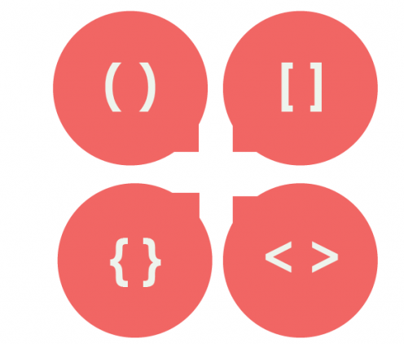
parentheses - paréntesis

Slide 10
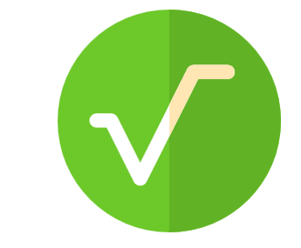
square root sign - signo de raíz cuadrada

Slide 11
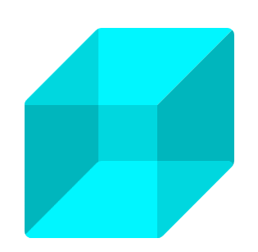
cube – el cubo

Slide 12
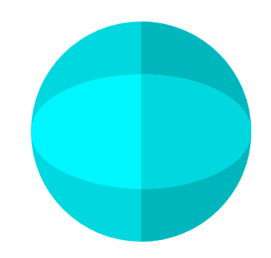
sphere - la esfera

Slide 13
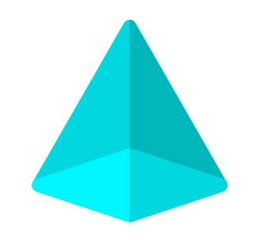
pyramid - la pirámide

Slide 14
MATH
Sentences

Slide 15
Sentences
Mi clase favorita es matemáticas. - My favorite class is math.
Me gustan las mates. - I like math.
Soy bueno en las mates. - I am good at math.
Tengo clase de mate. - I have math class.
No me gustan las mates. - I don't like math.
Problema de matemáticas. - Math problem.
Sabe de matemáticas. - He knows math.

Slide 16
Sentences
Matemáticas – mathematics
Número – number
número par – even number
número impar – odd number
uno más uno es igual a dos - 1 + 1 = 2
seis no es igual a ocho - 6 ≠ 8
tres es menor que cinco - 3 < 5
la raíz cuadrada de cuatro es dos - √4 = 2

Slide 17
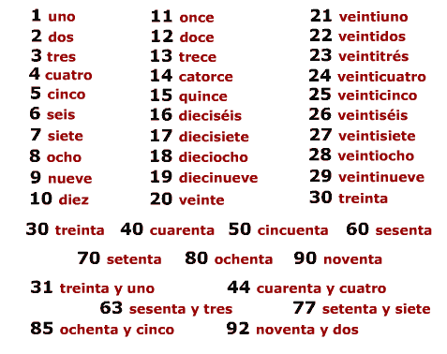
100 cien

