Slide 1
FUZZY Logic for Game Programmers
By André LaMothe

Slide 2
What is Fuzzy Logic?
Fuzzy logic is a method of performing conditional logic test based on input that are not "crisp".
Fuzzy logic is based on fuzzy set theory which is a type of set theory developed to deal with sets with the property that objects can be partially obtained in a set.
Fuzzy logic is applicable to AI programming since it's a way to describe the types of conditionals that we would really like to ask in a conditional logic chain.

Slide 3
Where Crisp Logic Fails?
Crisp logic is the standard logic you are used to using. It's based on standard set theory. Either an object is contained in a set or it is not. For example, the following expression:
if (player_x > 100 && energy < 50)
output = 1;
else
output = 0;
This expression is very clear. It only works for a single case, and has two outputs. Hence the antecedent (player_x > 100) is either completely TRUE or completely FALSE.
But why throw all that information away?

Slide 4
Fuzzy Logic Allows us to:
Ask general questions and get general or specific answers.
Handle inputs that aren't exactly what we were expecting and do the right thing.
Use very high level rules that ultimately result in either a crisp or fuzzy output.

Slide 5
What Fuzzy Logic is Not:
Fuzzy logic is not random.
In fact, fuzzy logic is completely deterministic.
If you run a fuzzy logic algorithm on a data set the result will be the same each time.

Slide 6
Conventional Set Theory
A set is a collection of objects. The objects can be anything you wish. However, under the rules of conventional set theory and object must either be in a set or not.
For example, you could write A= {3,4,5,20} and
B={1,3,9}

Slide 7
Operations on Normal Sets
Given A={3,4,5,20} and set B={1,3,9}.
Element of "∈": Example, 3 ∈ A.
Union "∪": Example: A ∪ B = {1,3,4,5,9,20}.
Intersection "∩": Example A ∩ B = {3}.
Subset of: "⊂": Example {1,3} ⊂ B, which reads "the set {1,3} is a subset of B.

Slide 8
      Fuzzy Set Theory (1)
When talking about fuzzy set theory we don’t focus so much on the
whether an object in a set anymore, but we focus on the (Degree of
Membership) any particular object is within a certain class. For example,
let's create a fuzzy class or category called "Computer Special FX".
Example: Degrees of Membership:
Movie DOM
ANTZ 100% (1.0)
Forrest Gump 20% (.20)
Terminator 75% (.75)
Aliens 50% (.50)
The Matrix 90% (.90)

Slide 9
Fuzzy Set Theory (2)
We write each fuzzy degree of membership as an ordered pair of
the form: {candidate for inclusion, degree of membership}.
Therefore, for our movie example we would write:
{ANTZ, 1.00},
{Forrest Gump, 0.20},
{Terminator, 0.75},
{Aliens, 0.50},
{The Matrix, 0.9}.
Finally, if we had the fuzzy class "Rainy" what would you include
"today" as? {today, ?}.

Slide 10
Fuzzy Set Theory (3)
Now, we can add a little more abstraction and create a full fuzzy set. A
fuzzy set (in most cases) is a ordered collection of the degrees of
membership (DOM) of a set of objects in a specific class. For example, in
the class "Computer Special FX" we have the set composed of the
degrees of membership:
A= {1.0, 0.20, 0.75, 0.50, 0.90} .
One entry for each movie respectively.
Now, suppose that we have another set of movies that all have their own
degrees of membership as:
B= {0.2, 0.45, 0.5, 0.9, 0.15}.

Slide 11
Fuzzy Set Theory (4)
Fuzzy Union "∪": The union of two fuzzy sets is the MAX of each
element from the two sets. For example, with fuzzy sets:
A={1.0, 0.20, 0.75, 0.50, 0.90}.
B={0.2, 0.45, 0.5, 0.9, 0.15}.
The resulting fuzzy union would be the max of each pair:
A ∪ B = {MAX(1.0, 0.2), MAX(0.20, 0.45), MAX(0.75, 0.5), MAX(0.90, 0.15)}
  = {1.0, 0.45, 0.75, 0.90}
Fuzzy Intersection "∩": The intersection of two fuzzy sets is just MIN of
each element from the two sets. For example, with fuzzy sets:
A ∩ B = {MIN(1.0, 0.2), MIN(0.20, 0.45), MIN(0.75, 0.5), MIN(0.90, 0.15)}
  = {0.2, 0.20, 0.5, 0.15}

Slide 12
Fuzzy Set Theory (5)
Subsets and elements of fuzzy sets have less meaning that with
standard sets. However complement of a fuzzy variable with
degree of membership x is (1-x), thus the complement of A written
A' is computed as:
Given A = {1.0, 0.20, 0.75, 0.50, 0.90}
Therefore,
A' = {1.0 - 1.0, 1.0 - 0.20, 1.0 - 0.75, 1.0 - 0.50, 1.0 - 0.90}
= {0.0, 0.8, 0.25, 0.5, 0.1}

Slide 13
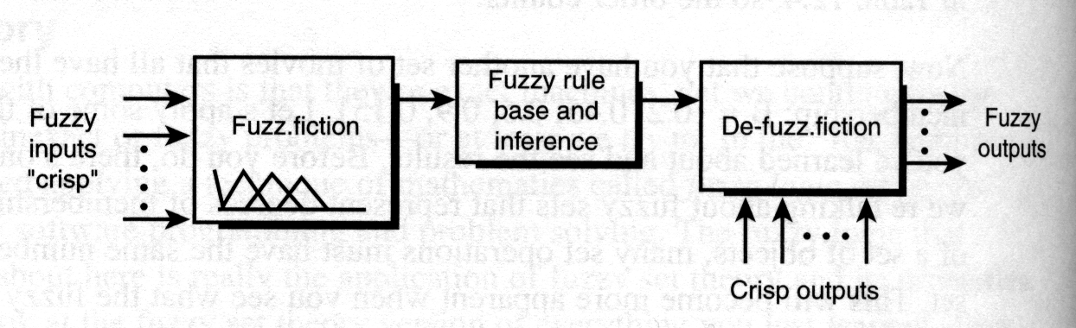
      Fuzzy Linguistic Variables (1)
The idea is that we are going to create an AI engine that uses fuzzy rules
and then applies fuzzy logic to inputs and then outputs fuzzy (or crisp)
outputs to the game object being controlled.
(Figure 12.36)

Slide 14
Fuzzy Linguistic Variables and Rules (2)
When you put together normal conditional logic you create a number of
statements or a tree with propositions of the form:
if X AND Y then Z
or
if X OR Y then Z
The (X,Y) variables are called the antecedents and Z is called the
consequence. However, with fuzzy logic, X and Y are Fuzzy Linguistic
Variables or FLVs.
Furthermore, Z can also be a FLV or a crisp value.

Slide 15
Fuzzy Linguistic Variables and Rules (3)
Hence X and Y represent fuzzy variables and hence are not crisp. Fuzzy
propositions of this form are called Rules and ultimately are evaluated in a
number of steps. We can't just evaluate them like this:
  if EXPLOSION AND DAMAGE then RUN
And execute RUN, if EXPLOSION is TRUE and DAMAGE is TRUE.
Instead, with fuzzy logic the rules are only part of the final solution, the
fuzzification and de-fuzzifaction is what gets us our final result. It's shades of
truth we are interested in.

Slide 16
A Fuzzy Manifold Composed of Range FLVs (1)
FLVs represent fuzzy concepts that have to do with a range. For example,
let's say that we want to classify the distance from the player and AI object
with 3 different fuzzy linguistic variables:
NEAR: Domain range (0 to 300 )
CLOSE: Domain range (250 to 700)
FAR: Domain range (500 to 1000)

Slide 17
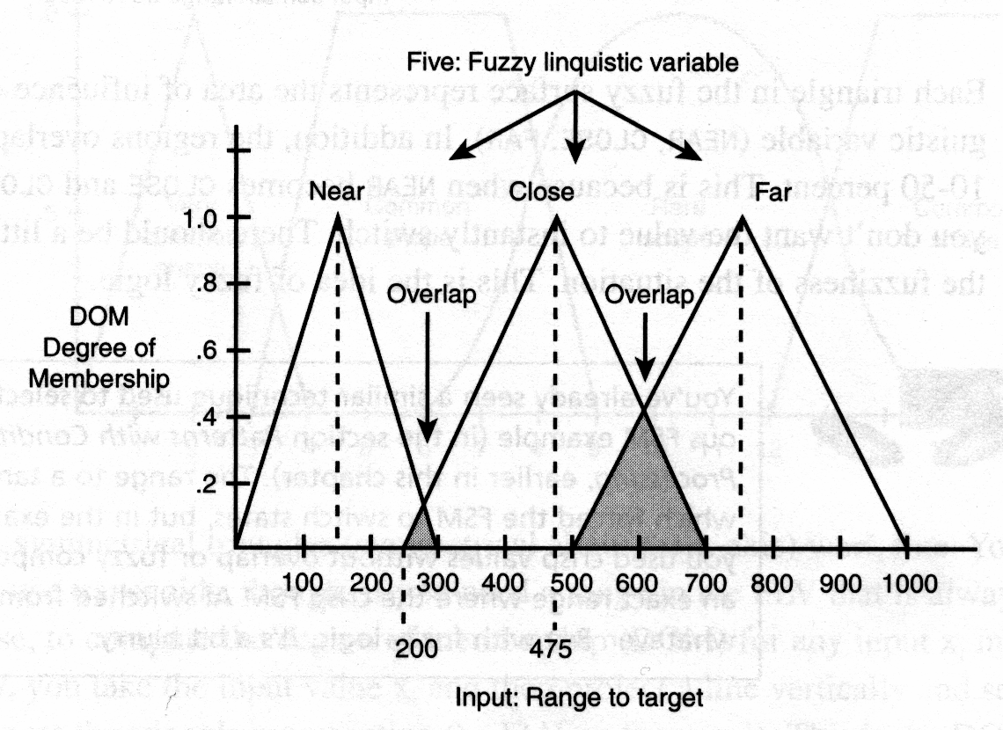
A Fuzzy Manifold Composed of Range FLVs (2)
Figure 12.37
The input variable is shown on the X-axis and can range from 0 to 1000 this
is called the Domain. The output of the fuzzy manifold is the Y-axis and ranges
from 0.0 to 1.0 always this is the degree of membership.

Slide 18
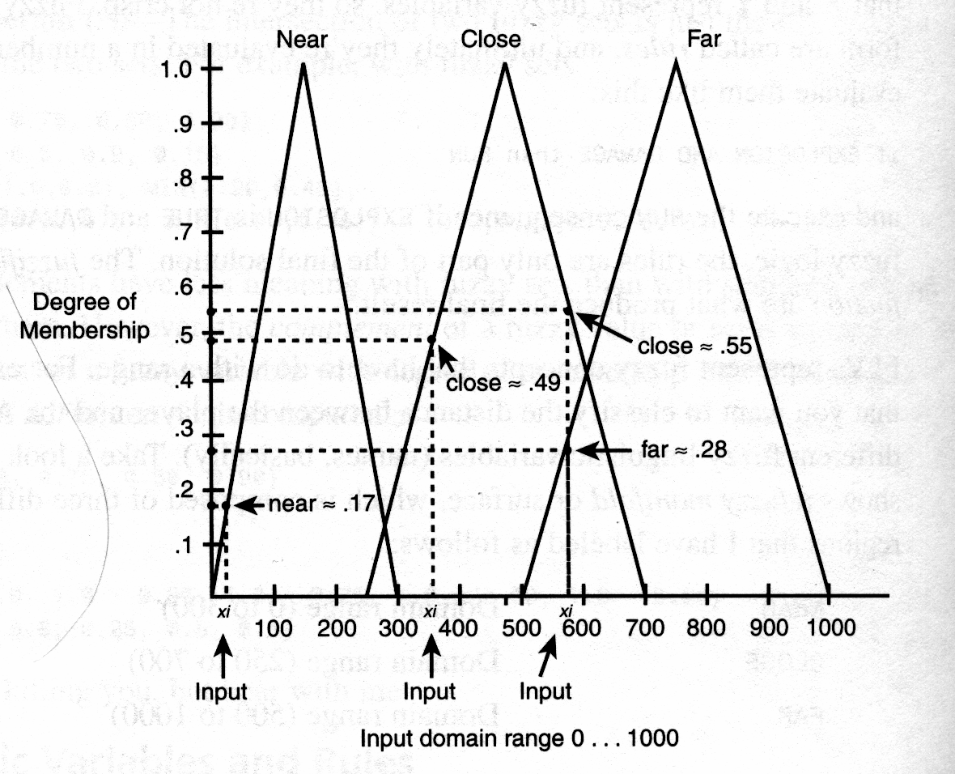
Computing the DOMs
Figure 12.38
For any input value x_{i}, you compute the degree of membership (DOM) by
striking a line vertically as shown in the figure above and computing the Y
value(s) at the intersection(s) with each fuzzy linguistic variable's
triangular area curve.

Slide 19
Computing the DOMs (2)
Each triangle in the fuzzy surface represents the area of
influence of each fuzzy linguistic variable (NEAR, CLOSE,
FAR).
In addition, the regions all overlap a little – usually 10-50%.
This is because when NEAR becomes CLOSE and CLOSE
becomes FAR. We don’t want the value to instantly switch,
there should be a little overlap to model the fuzziness of the
situation. This is the idea of fuzzy logic.

Slide 20
Fuzzy Logic So Far
We have rules that are based on fuzzy inputs from the game
engine, environment etc. These rules may look like normal
conditional logic statements, but must be computed using
fuzzy logic since they are really FLVs that classify the input(s)
with various degrees of membership.
Furthermore, the final results of the fuzzy logic process may
be converted into a discrete crisp values such as: "fire
phasors", "run", "stand still", or converted into a continuous
values such as a power level from 0 – 100. Or you might
leave it fuzzy for another stage of fuzzy processing.

Slide 21
Fuzzy Manifolds and Membership – Solving the First Part of the Problem
Fuzzy inputs are going to be classified into one or more fuzzy
linguistic variables FLVs (that represent some fuzzy range).
For each input the degree of membership is computed.
In other words for an input x_{i}, what is the degree of
membership in each fuzzy linguistic variable?
We need a mathematical way to compute this based on the
geometric construction of the fuzzy manifold.

Slide 22
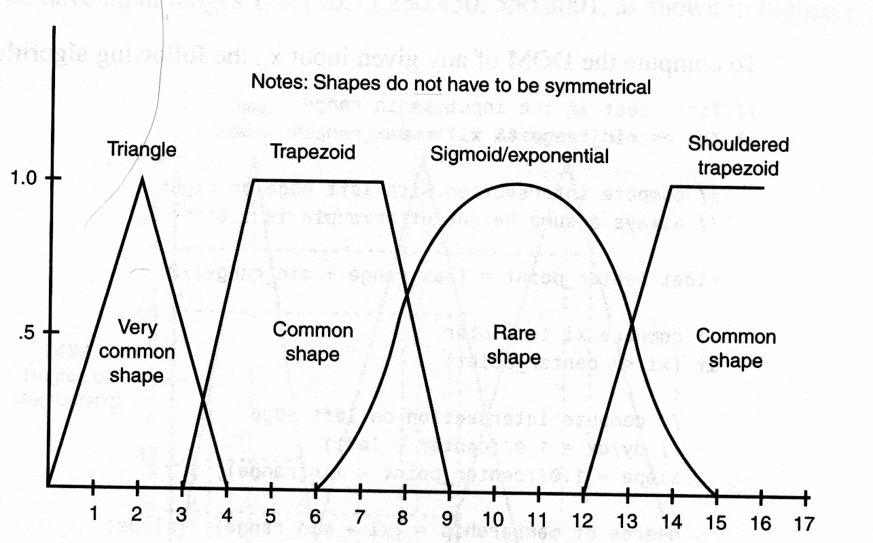
Fuzzy Manifold Shapes
Figure 12.39
In most cases symmetrical triangles work fine. Trapezoids are used if you
need a range in the FLV that is always 1.0.

Slide 23
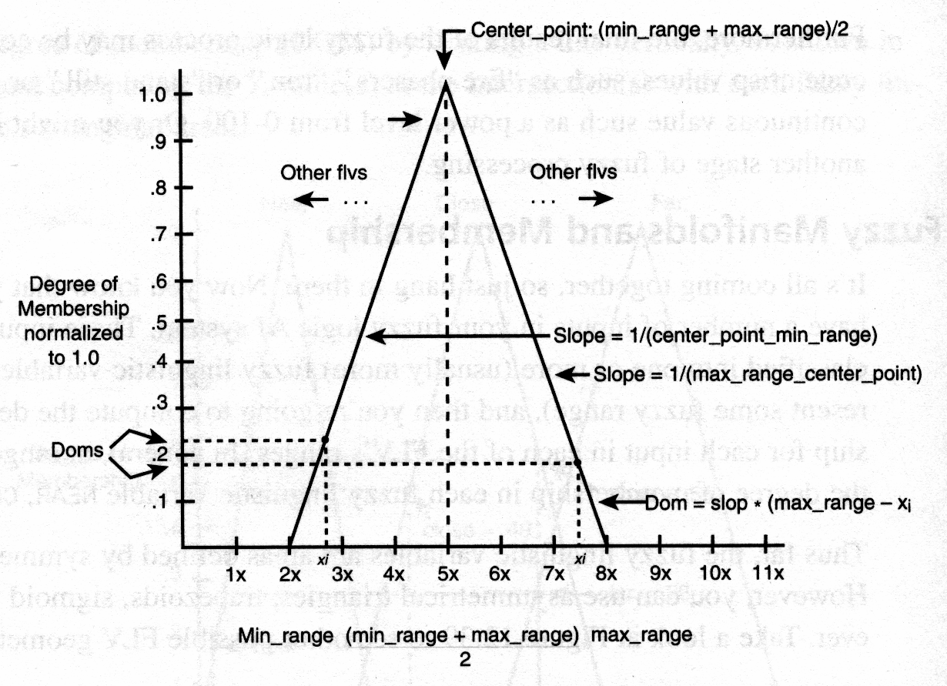
Computing the DOM (1)
Figure 12.40
To compute the degree of membership (DOM) for input x_{i} in a particular
FLV, you take the input value x_{i} and then project a line vertically and see
where it intersects the triangle representing the FLV on the Y-axis and this
is the DOM.

Slide 24
Computing the DOM (2)
Given the triangular geometry for each FLV with the left and right starting
points defining the triangle labeled by min_range, max_range then to
compute the DOM of any given input x_{i} the following algorithm can be
used:
// first test if the input is in range
if (xi >= min_range && xi <= max_range)
{
// compute intersection with left edge or right always assume height of triangle is 1.0
float center_point = (max_range + min_range)/2;
// compare xi to center
if (xi <= center_point)
{ // compute intersection on left edge, / dy/dx = 1.0/(center – left)
slope = 1.0/(center_point – min_range);
degree_of_membership = (xi – min_range) * slope;
} // end if
else { // compute intersection on right edge, dy/dx = 1.0/(center – right)
slope = 1.0/(center_point – max_range);
degree_of_membership = (xi – max_range) * slope;
} // end else
} // end if
else // not in range
degree_of_membership = 0.0;

Slide 25
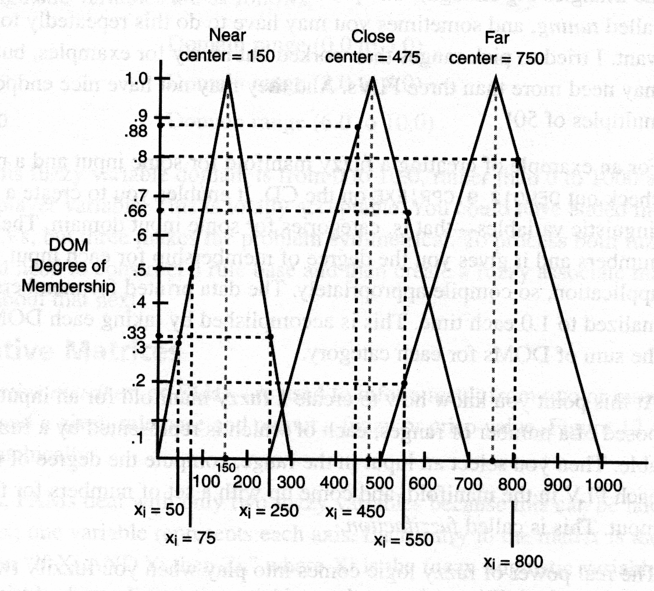
Fuzzification with a Fuzzy Input Set (1)
Figure 12.41
Assume that we have input ranges:
x_{i} = {50,75,250,450,550,800}

Slide 26
Fuzzification with a Fuzzy Input Set (1)
Then the degrees of membership for each FLV; NEAR, CLOSE, FAR, can
be computed with the algorithm or read off graphically and are:
Input xi DOMs NEAR CLOSE FAR
50 0.33 0.0 0.0
75 0.5 0.0 0.0
250 0.33 0.0 0.0
450 0.0 0.88 0.0
550 0.0 0.66 0.20
800 0.0 0.0 0.80
Note: This step is called the fuzzification process.

Slide 27
Another Fuzzy Recap
At this point we know how to create a fuzzy manifold for an
input x_{i} that is composed of a number of ranges that each are
represented by a fuzzy linguistic variable. Then we select an
input in the range and compute the degree of membership for
each FLV in the manifold and come up with a set of numbers
for that particular input. This is called fuzzifaction.

Slide 28
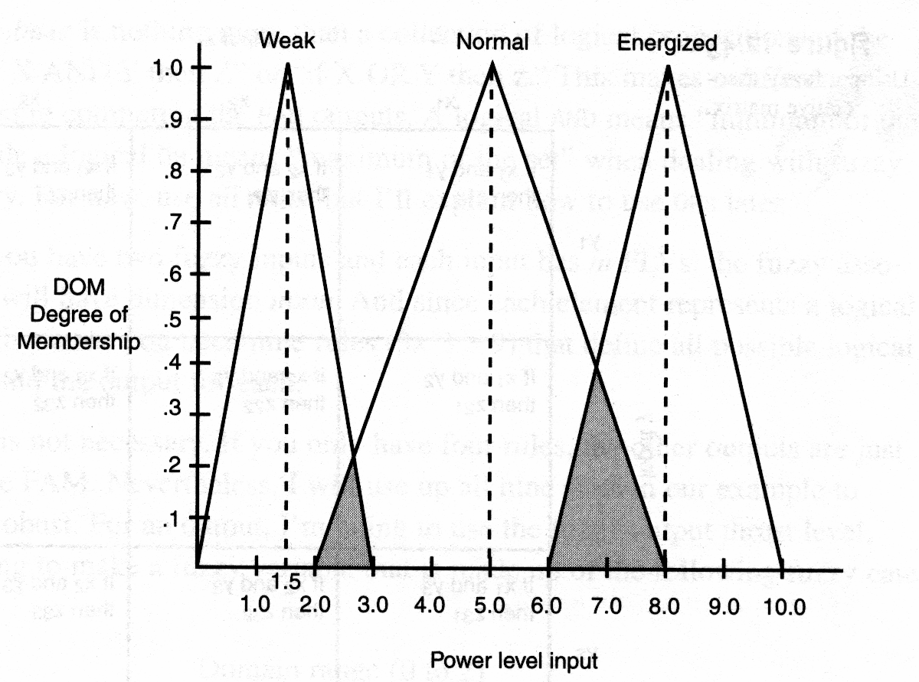
Adding Another Fuzzy Manifold (1)
Figure 12.42

Slide 29
Adding Another Fuzzy Manifold (2)
The real power of fuzzy logic comes into play when we fuzzify
two or more variables then connect them with "if" rules and
see the output. To accomplish this step in our example we
have to first come up with another input to fuzzify – let's call it
the "power level" of the AI bot that we are moving around. the
Figure above shows the fuzzy manifold for the "power
level" input. The fuzzy linguistic variables are:
WEAK: Domain Range (0.0 to 3.0)
NORMAL: Domain Range (2.0 to 8.0)
ENERGIZED: Domain Range (6.0 to 10.0)

Slide 30
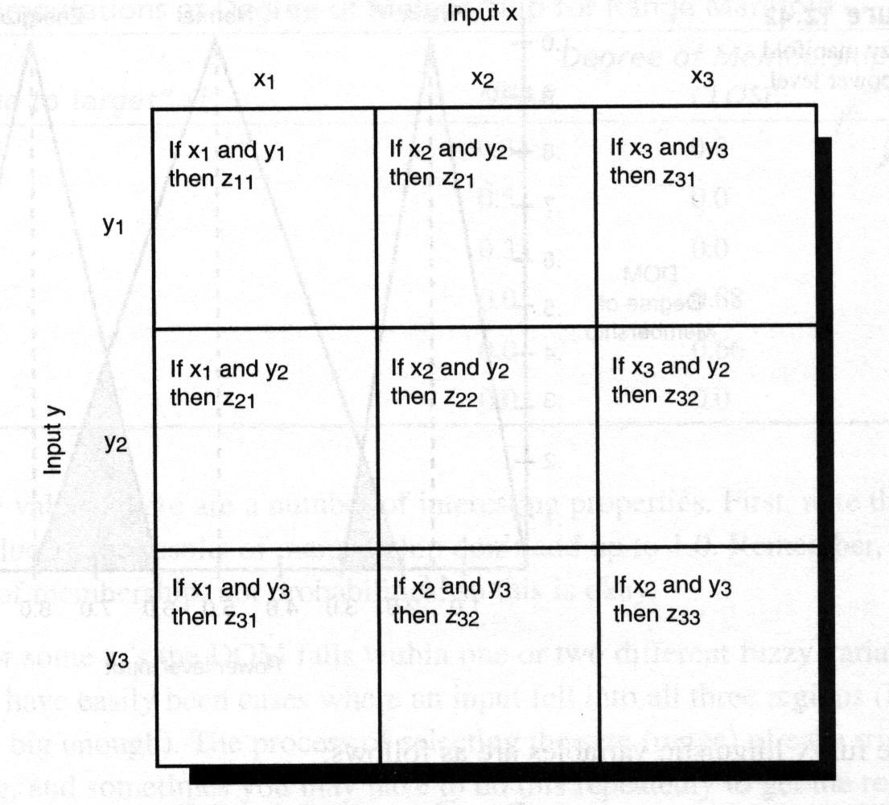
      Fuzzy Associative Matrices (1)
Figure 12.43
Fuzzy associative matrices or FAMs are used to "infer" a result from two
or more fuzzy inputs and a given rule base and output a fuzzy or crisp
value. The figure above shows this graphically.

Slide 31
Fuzzy Associative Matrices (2)
In most cases, FAMs deal with only two fuzzy variables since
this can be laid out in a 2D matrix where one variable
represents each axis.
Each entry in the matrix is the logical proposition:
if Xi AND Yi then Zi
Where:
Xi is the fuzzy linguistic variable on the X axis
Yi is the fuzzy linguistic variable on the Y axis
Zi is the outcome, which may be a fuzzy variable or crisp
value.

Slide 32
Building the Fuzzy Associative Matrix
To build the FAM we need to know:
The rules to put in each one of the matrix entries.
The outputs to put in each one of the matrix entries.
Hence, we need to make a rule base and and decide on an output
variable that is either crisp or linear. A crisp output set might be:
{"ATTACK", "WANDER", "SEARCH"}.
While a linear output might be a thrust level from:
0..10.0.
Regardless of the output type, we will have to defuzzify the output of the
FAM to find the final output.

Slide 33
Computing a Linear Range Output from the FAM (1)
Step 1: Select your inputs and define the FLVs and build your manifolds.
The inputs to our fuzzy system are going to be the range to the player and
the power level of the AI controlled bot.
Input X: Range to player.
Input Y: Powel level of self.
Referring back to Figure 12.37 (slide 17), and 12.42 (slide 28) these are
the Fuzzy manifolds that we are using.

Slide 34
Computing a Linear Range Output
from the FAM (2)
Step 2: Create a rule base for the inputs that tie them to an output.
The rule base is nothing more than a collection of logical propositions of
the form :
if X AND Y then Z
or
if X OR Y then Z
This makes a difference when computing the FAM outputs though. A
logical AND means "minimum of the set" while a logical OR means
"maximum of the set".

Slide 35
Computing a Linear Range Output from the FAM (3)
In general, if you have 2 fuzzy inputs and each input has m FLVs then the fuzzy associative matrix will have dimension m x m.
And in our example since each element represents a logical proposition this means we need 9 rules (3 x 3 = 9) that define all possible logical combinations and the output for each.
However, this is not necessary. If you only have 4 rules then the other outputs are just set to 0.0 in the FAM.

Slide 36
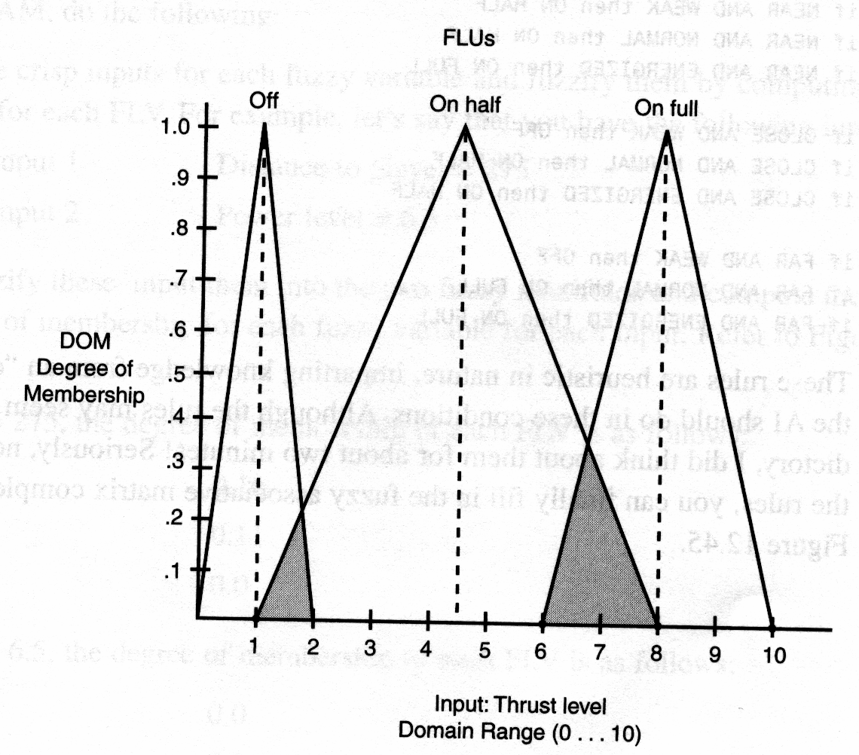
Computing a Linear Range Output from the FAM -
Creating an Output Fuzzy Variable (4)
For an output I'm going to use the fuzzy output "thrust level" which I'm
going to make a fuzzy variable that is made up of the following fuzzy
categories (FLVs):
Figure 12.44
OFF: Domain Range (0 to 2)
ON HALF: Domain Range (1 to 8)
ON FULL : Domain Range (6 to 10)

Slide 37
Computing a Linear Range Output from the FAM – Complete System view (5)
Input 1: Distance to Player.
NEAR
CLOSE
FAR
Input 2: Power Level of Self.
WEAK
NORMAL
ENERGIZED
Output: Internal navigational thrust level, i.e, speed.
OFF
ON HALF
ON FULL

Slide 38
Computing a Linear Range Output from the FAM – The
Rule Base (6)
The next component of the fuzzy logic system we need is the actual rule
base.
if NEAR AND WEAK then ON HALF
if NEAR AND NORMAL then ON HALF
if NEAR AND ENERGIZED then ON FULL
if CLOSE AND WEAK then OFF
if CLOSE AND NORMAL then ON HALF
if CLOSE AND ENERGIZED then ON HALF
if FAR AND WEAK then OFF
if FAR AND NORMAL then ON FULL
if FAR AND ENERGIZED then ON FULL

Slide 39
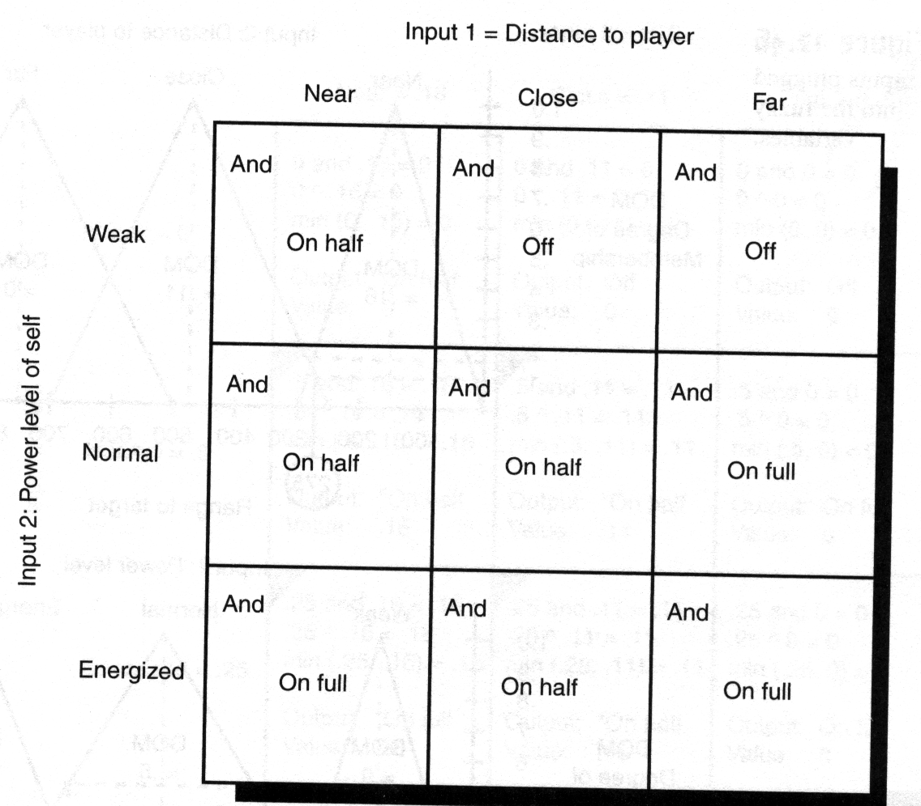
Computing a Linear Range Output from the FAM -
Processing the FAM with the Fuzzified Inputs (7)
Figure 12.45

Slide 40
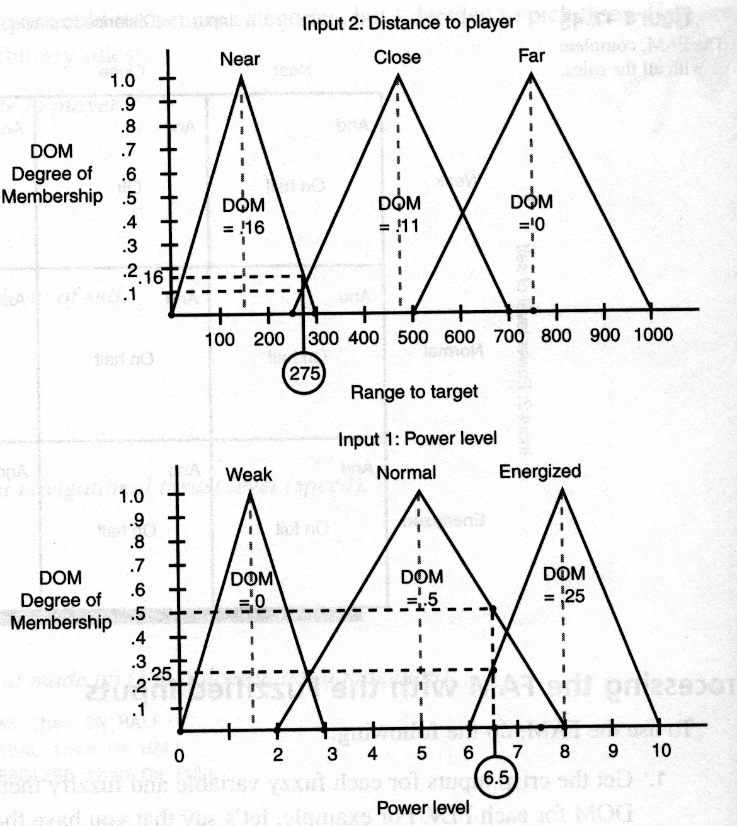
Computing a Linear Range Output from the FAM - Processing the
FAM with the Fuzzified Inputs (8)
To use the FAM you must Fuzzify the crisp inputs them by computing their
DOM for each FLV. For example, if the inputs were:
Input 1: Distance to player = 275
Input 2: Power level = 6.5
Figure 12.46

Slide 41
Computing a Linear Range Output from the FAM –
Computing the Degree of membership of each input (9)
For Input 1 = 275, the degree of membership of each FLV is:
NEAR: 0.16
CLOSE: 0.11
FAR: 0.0
For Input 2 = 6.5, the degree of membership of each FLV is:
WEAK: 0.0
NORMAL: 0.5
ENERGIZED: 0.25

Slide 42
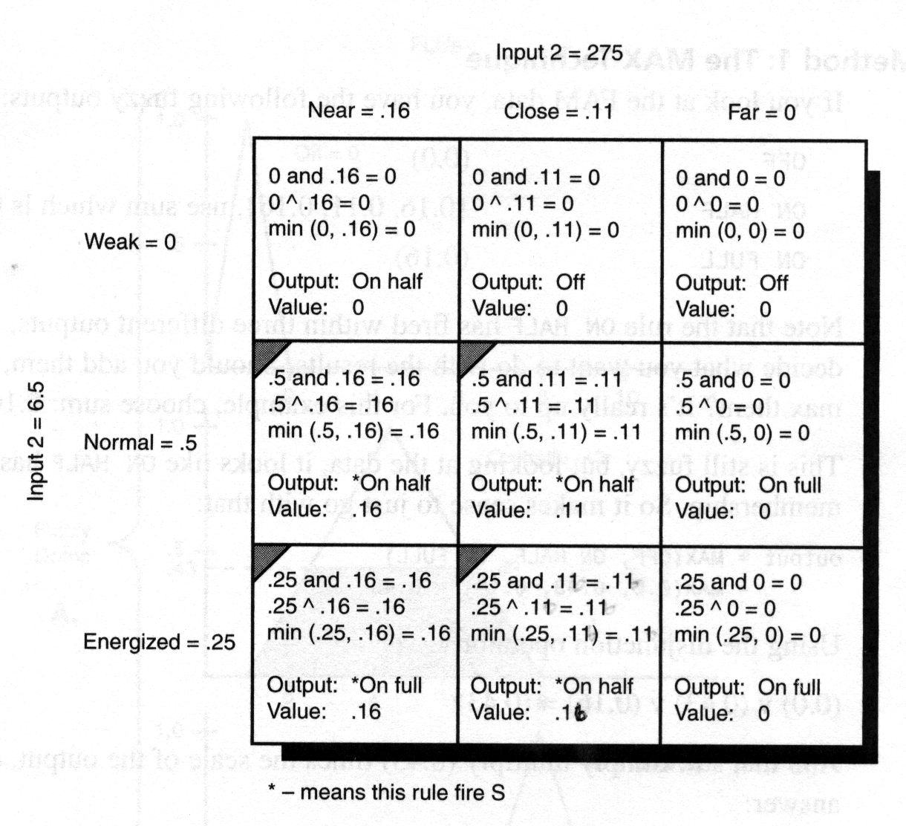
Computing a Linear Range Output from the FAM –
Generating the outputs of the Fuzzy Associative Matrix (10)
Figure 12.47
Step 2: Refer to the fuzzy associative matrix and test the rule in each cell to
see what its output value is based on the above fuzzy values. Note many of the
FAM's cells will be 0.0 since two of the FLVs (one from each input are 0.0).

Slide 43
Computing a Linear Range Output from the FAM – Generating the
outputs of the Fuzzy Associative Matrix (11)
Each one of those cells in the FAM represents a rule. For example, the
upper left hand cell represents:
if NEAR AND WEAK then ON HALF
So to evaluate this rule, we take the antecedents and test them using a
MIN() rule for the logical AND. In this case, we have that NEAR = 0.16
and WEAK = 0.0, hence:
if (0.16) AND (0.0) then ON HALF
which is computed using the MIN() function as:
(0.16) ∧ (0.0) = (0.0)

Slide 44
Computing a Linear Range Output from the FAM –
Generating the outputs of the Fuzzy Associative Matrix (12)
On the other hand, let's take a look at the rule:
if CLOSE AND ENERGIZED then ON HALF
means,
if (0.11) AND (0.25) then ON HALF
Which computed using the MIN() function is:
(0.11) ∧ (0.25) = (0.11)
Thus, the rule "ON HALF" fires at a level of 0.11, so we place that
value in the FAM associated with the rule "ON HALF" at the intersection of
CLOSE and ENERGIZED.

Slide 45
Computing a Linear Range Output from the FAM
– Building the final Fuzzy Associative Output
Matrix (13)
Continue this process for the whole matrix until you have found all 9
entries. Figure 12.47

Slide 46
Defuzzifying the FAM
We are ready to Defuzzify the FAM. This can be
accomplished in a number of ways. Basically, we need a final
crisp value that represents the thrust level from (0.0 to 10.0).
There are two common methods to compute this:
Use the disjunction or MAX() method to find the value
Use use an averaging technique based on the "fuzzy centroid".

Slide 47
Defuzzifying the FAM using the MAX method (1)
If you look at the FAM data in figure, basically we have the following fuzzy
outputs:
OFF: (0.0)
ON HALF: (0.16, 0.11, 0.16), use sum which is 0.43
ON FULL: (0.16)
Note that the rule "ON HALF" has fired within 3 different outputs, thus, we
have to make a decision what we want to do with the results. Should we
add them, average them, or max them? It's really up to you. For this
example, let's take sum: 0.16 + 0.11 + 0.16 = .43.

Slide 48
Defuzzifying the FAM using the MAX
method (2)
The data is still fuzzy, but looking at it, it looks like ON HALF has the
strongest membership, so it makes sense to just go with that, or
mathematically:
output = MAX(OFF, ON HALF, ON FULL)
= MAX(0.0, 0.43, 0.16) = 0.43
or using the disjunction (MAX) operator ∨:
(0.0) ∨ (0.43) ∨ (0.16) = (0.43)

Slide 49
Defuzzifying the FAM using the MAX
method – the final output (3)
IMPORTANT!!!
We simply multiply (0.43) times the scale of the output (10.0 in this case)
and that's the answer:
(0.43) * (10) = (4.3)
Set the thrust to (4.3).

Slide 50
Problem with MAX method
The only problem with this method is that even though we are taking the
variable that has the most membership, it's total "area of influence" in the
fuzzy space may be very small. For example, a 40% NORMAL is definitely
stronger than a 50% WEAK.
It might be more accurate to plug some the values into the output fuzzy
manifold for (OFF, ON HALF, ON FULL), compute the area of influence
and then compute the centroid of the whole thing and use that as the final
output?

Slide 51
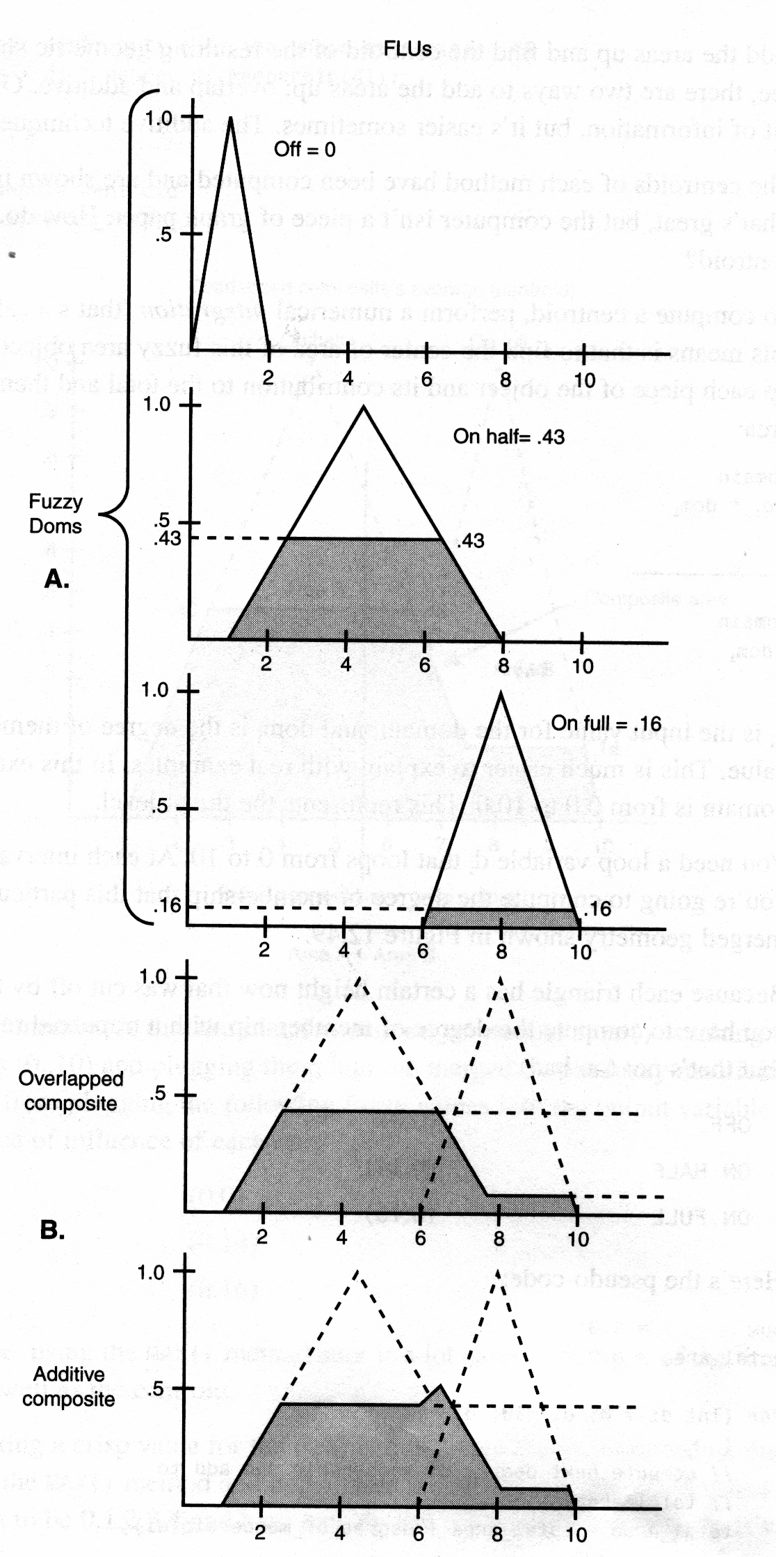
Centroid Method
The final outputs are used to compute the area of contribution of each
FLV.
Figure 12.48

Slide 52
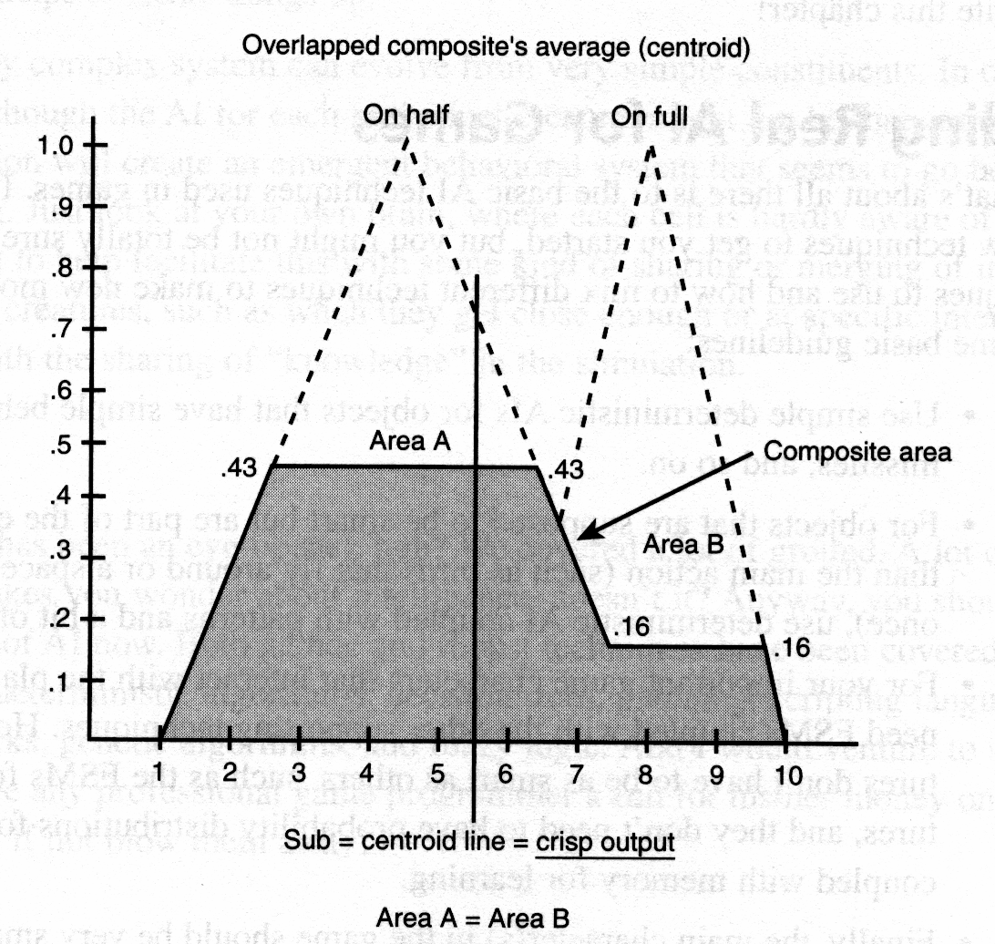
Computing the Centroid
Once the shapes are overlaid or added then the centroid or center of
mass is computed and this is the Final output.
Figure 12.49
Set the thrust to (5.5).

