Slide 1
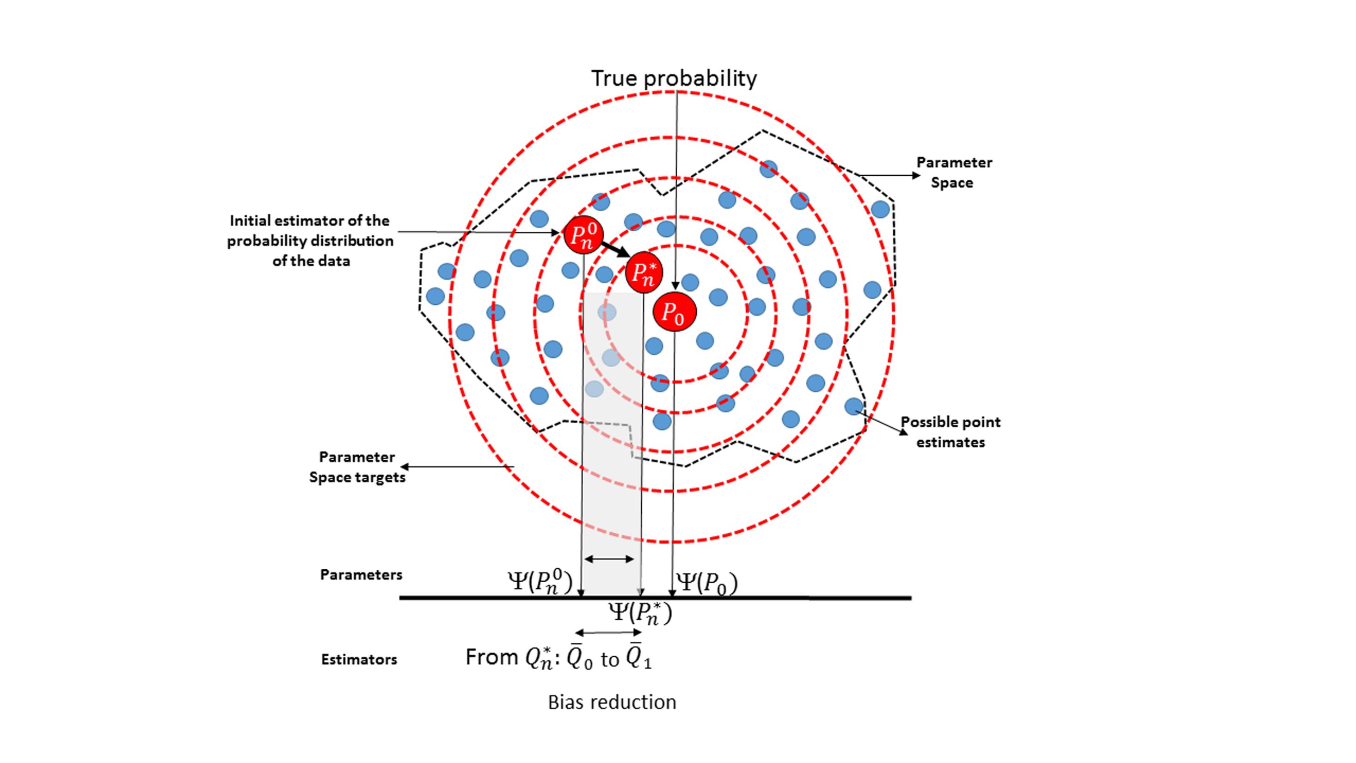
Estimation outside
the parameter space
https://migariane.github.io/TMLE.nb.html

