Slide 1
The Picky Builder
How Decision Trees Decide
Machine Learning – Master in Artificial Intelligence
Ricardo Tavares, 2026133913 – André Leão, 2023210870 – José Miguel Antunes, 2023211288
Notes:
A opens. ~20 s. Introduce the group and the topic, then go straight to the hook.

Slide 2

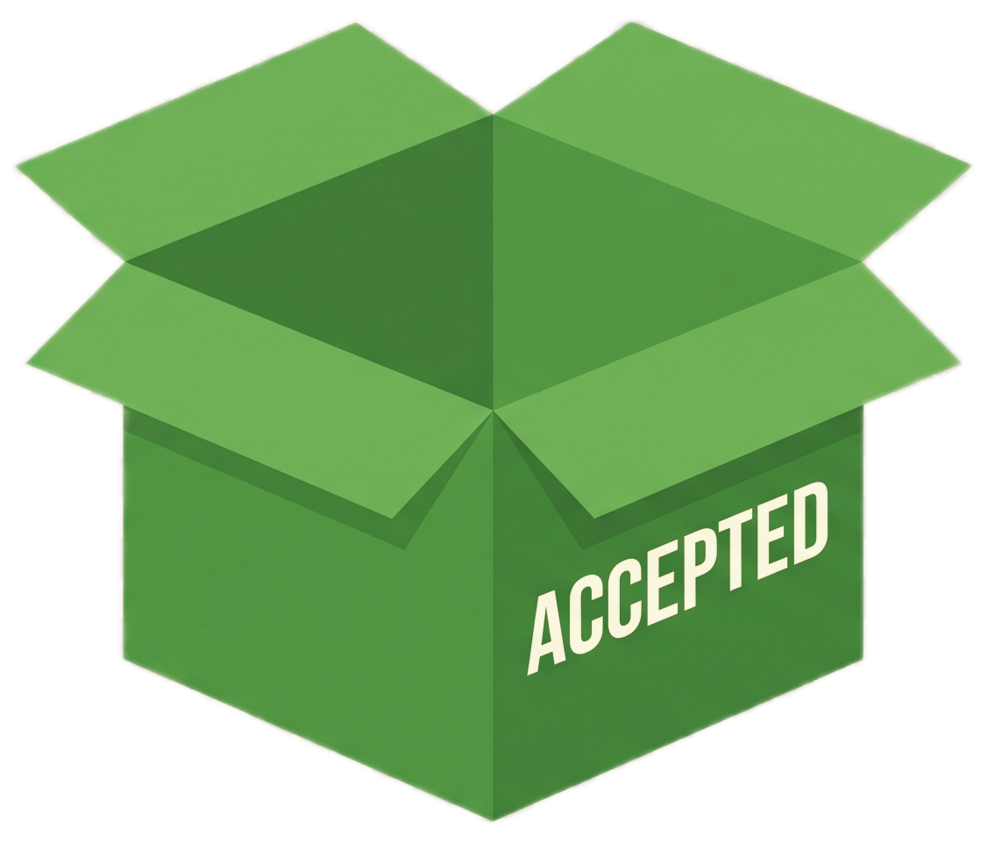

Would you accept this brick?
A picky builder sorts every brick into one of two boxes:
The rule to accept the brick is secret.
You may only ask yes or no questions about the brick.
How few questions do you need?
Notes:
A, ~1 min. Ask the room, don't answer. The hook is the whole talk in one question: a decision tree is the shortest list of yes/no questions that sorts the data. Hand over to B for the race.

Slide 3
The race: build the builder's tree
1
2
3
Open your kit
What can you ask?
Draw your tree
14 bricks. Flip each one:
✓ accepted ✗ rejected
Colour, rows or columns
On the paper, keep asking until every pile is all ✓ or all ✗
Fewest questions wins.
2 rows
4 columns
e.g. “Is it blue?”
2 min
Tie? The first hand up wins.
Notes:
B. A and C hand out kits while B reads the rules (~1 min). Check step 2 wording against B's final race script: adjust if the audience should infer labels differently. One brick in each kit is deliberately mislabeled.

Slide 4
Go!
Time’s up!
Pencils down.
Fewest questions wins.
1 brick = 15 s
Notes:
B. Click to start: the title moves aside, the tower builds and the 2-minute timer starts. The top brick flies off every 15 s; the last brick wobbles in the final 15 s. At 'Time’s up!', stop everyone and move on, whatever state their trees are in.

Slide 5
One last brick
Run it down your tree.
Accepted or rejected?
✓ Accepted
beige · 2 rows · 4 columns
Did every tree get it right?

Slide 6
What you just did is what a tree does
IN THE RACE
IN THE ALGORITHM
You asked the most useful question first
Root split: the question with the highest information gain
Then you asked again inside each pile
Recursive splitting, one branch at a time
You stopped when a pile was all one label
Leaf: predicts the majority label
Starting with colour can take fewer questions
Greedy: best question now, not smallest tree
Notes:
B, ~1.5 min. Ask 2-3 people what their first question was. If someone asked about colour first, ask why. Point out the mislabeled brick: did anyone add a question just for it? That's the failure we'll show in Exp. 2. Hand over to A.

Slide 7
From bricks to data
stud_rows
stud_cols
colour
label
Short side of the brick
Long side of the brick
One-hot encoded
What we predict
1, 2
2, 3, 4, 6, 8, 10
8 colours
Accepted / Rejected
~300 synthetic bricks, labelled by the builder's rule (Can be changed by the user)
Stratified 70/30 train/test split
Using random_state = 42
Notes:
A. Bricks in the race = rows in the dataset. Rows is always the short side so 2x4 and 4x2 are the same brick. Colour is one-hot so the tree asks 'is it red?' not 'colour <= 1.5'. Delete the red warning line once B confirms the ranges.

Slide 8


A split is one yes/no question
10 bricks · 5 ACC / 5 REJ
H = 1.00
Entropy: how mixed is one pile
= share of Acc. or Rej. bricks in pile S
: 0 = pure, 1 = 50/50, [0,1]
stud_cols ≥ 6 ?
Information gain: how much a split helps
yes
no
= the pile on each side of the split
4 ACC / 0 REJ
H = 0
1 ACC / 5 REJ
H = 0.65
For this split: G = 1.00 − (0.4 × 0 + 0.6 × 0.65) = 0.61
The tree tries every feature and threshold, keeping the split with highest gain.
Illustrative numbers, not our data

Slide 9
Exp. 1 · When a tree works well
OUR PREDICTION
(written before running)
SETUP
Clean labels
We believe the model will achieve an almost perfect train and test accuracy. We expect a yellow colour split near the root and all three features to be used.
Full training set, n = 210
Why we expect this:
The labels are clean (noise = 0), and training and test come from the same 80 brick types, so what holds on train should hold on test.
Colour decides which half of the rule applies: once you know whether a brick is yellow, one more question settles the label.
The rule depends on all three features and none of them can stand in for another.
max_depth = None
Notes:
A. Read the prediction aloud before switching to the notebook. Then run the Exp. 1 cells live.

Slide 10
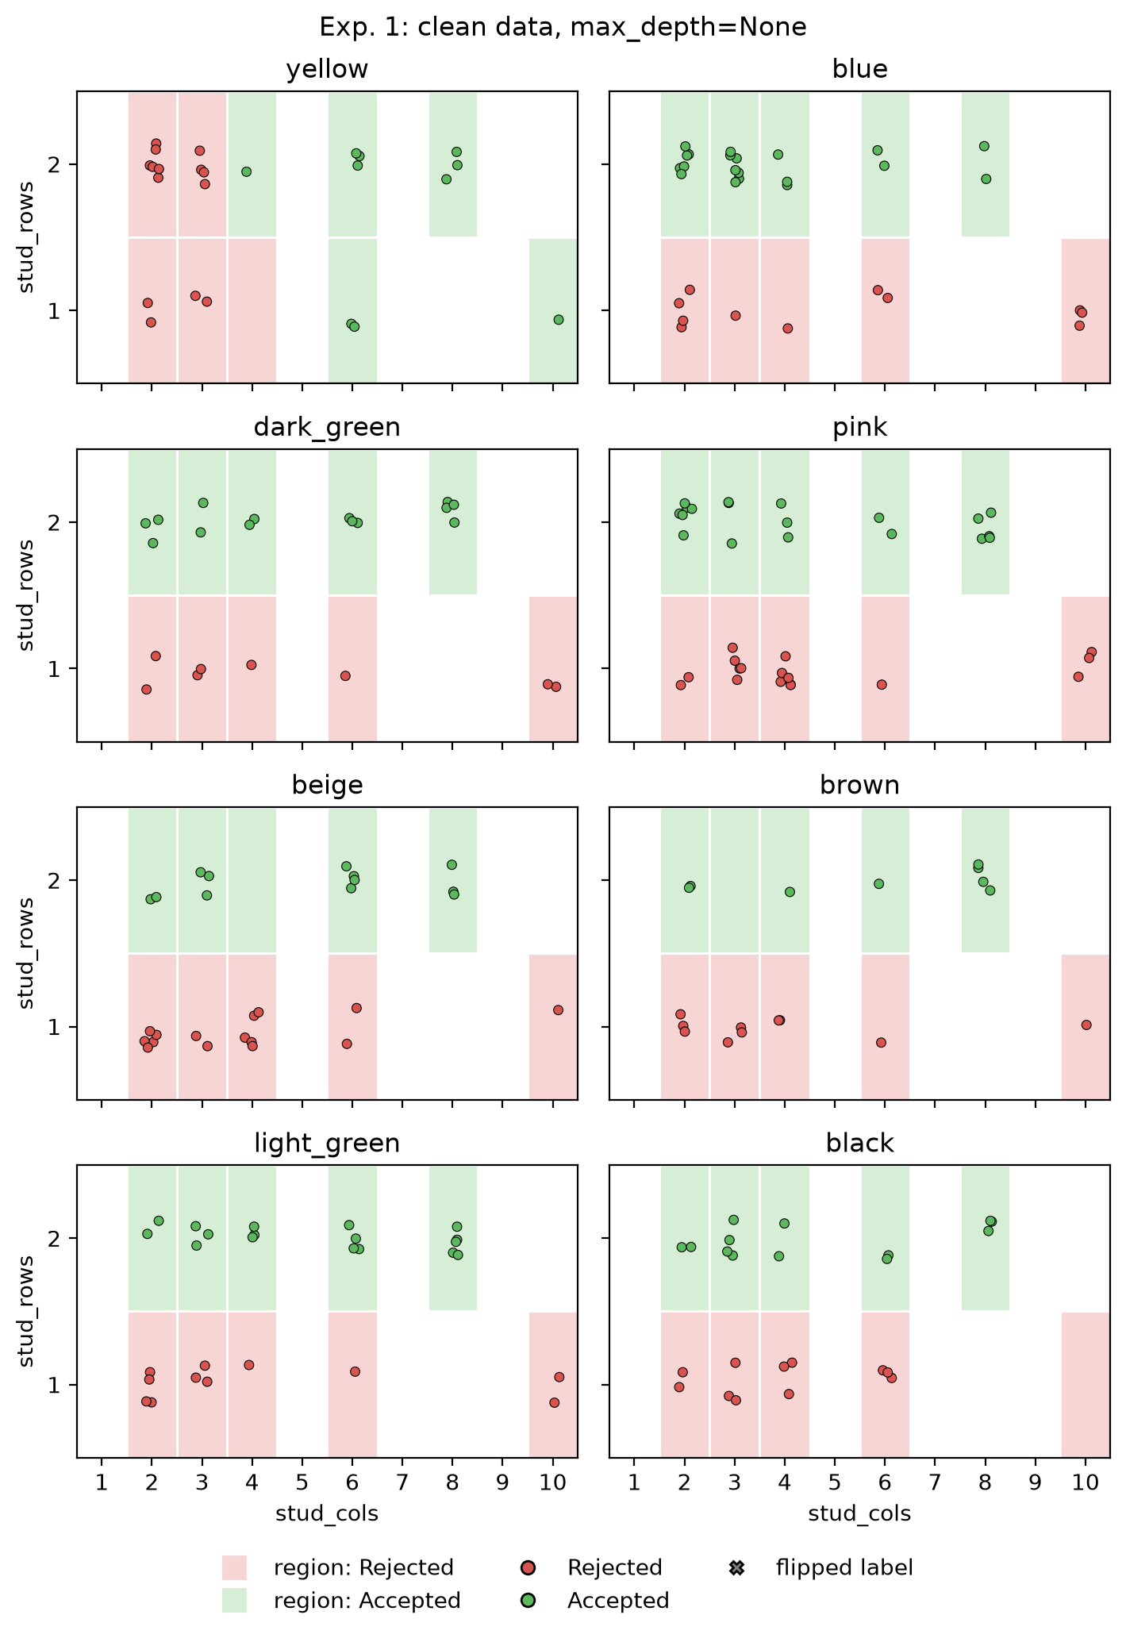
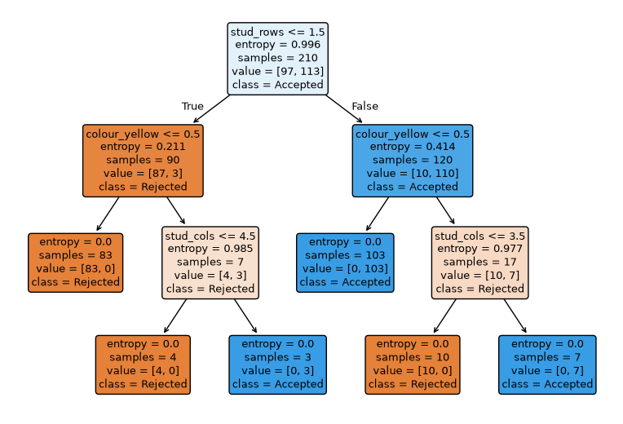
Exp. 1 · The tree recovers the builder's rule
True Rule:
(is yellow and (stud_cols >= 4)) or
(is not yellow and (stud_rows == 2))
100%
Train accuracy (= F1)
98.9%
Test accuracy (= F1)
6
Fig.1: Learned Tree
Fig.2: Decision Regions
Leaves
Notes:
A. Show it in the notebook, then come back here as the summary. Was the prediction right? Say so either way. Point to feature importances: all three features used because the rule uses all three.

Slide 11
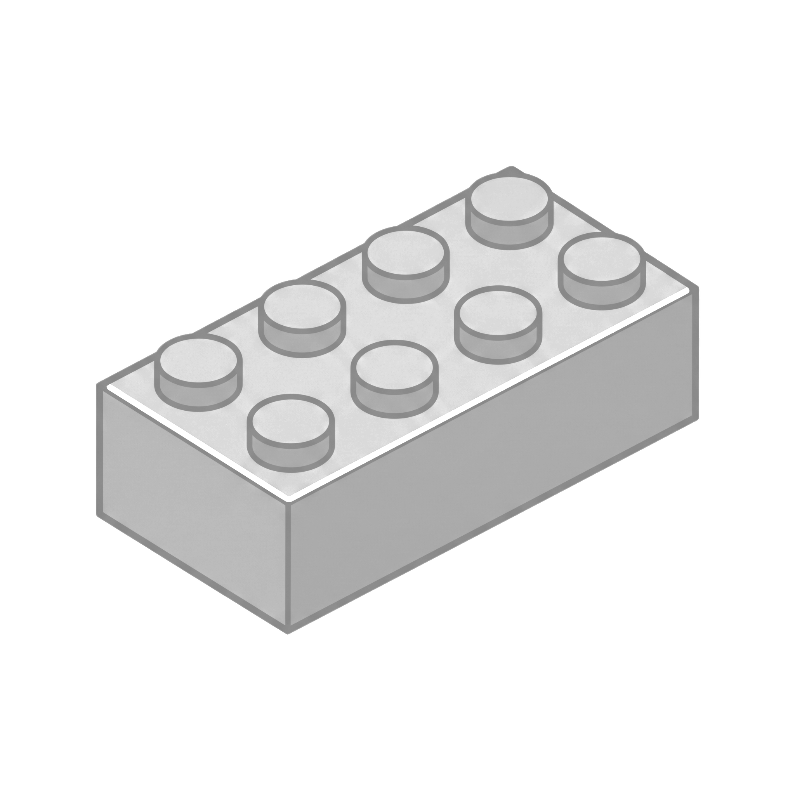
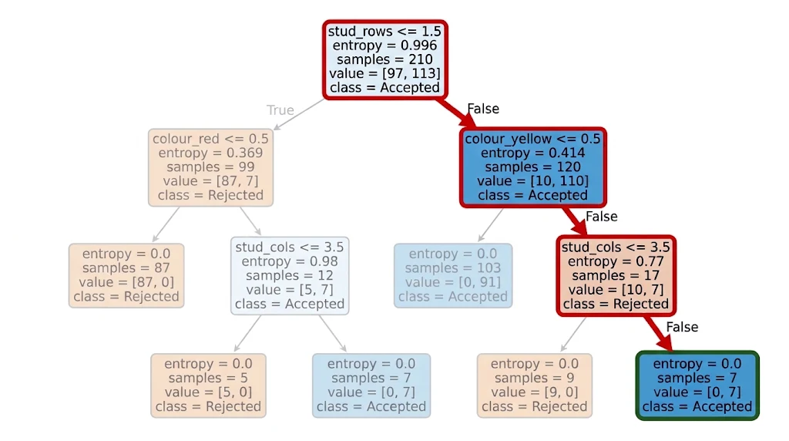
Following one brick through our tree
stud_rows = 2
stud_cols = 4
colour = yellow
Q1: stud_rows <= 1.5
False
Q2: colour_yellow <= 0.5
False
Q3: stud_columns <= 3.5
Fig.3: Highlighted path of the brick in the tree
False
Prediction: Accepted
11 of 11 of the bricks in the leaf are accepted
Q&A pause
Notes:
A. This covers brief requirement 4 (show how one prediction is made). Fill in from the notebook once the rule is fixed. The leaf's class fraction is also the predicted probability.

Slide 12
Back to your trees
Run this brick through your tree.
Accepted or Rejected?
Same brick, same rule… same answer?
dark green · 2 rows · 4 columns
Notes:
B, ~30 s. Hand one dark green 2-row brick to each kit (2x4 ideally; any dark green 2-row except the 2x6 already in the kit). Each group runs it through the tree they built in the race. Ask each group, one by one: Accepted or Rejected? Don't explain yet. If answers differ, say: same brick, same builder - why different answers? Next slide. If all groups say Accepted: the noisy groups also isolated the odd brick, but with a different question (e.g. by size), so the island sits elsewhere and the answer for a new brick changes. The algorithm picks by entropy and uses colour. Next slide.

Slide 13
One wrong sticker, one extra question
Clean kit
Noisy kit
All 14 stickers correct · 6 leaves, depth 3
Dark green 2×6 sticker flipped to ✗ · 7 leaves, depth 4
2 rows?
2 rows?
no
yes
no
yes
1 row:
same questions
yellow?
1 row:
same questions
dark green?
no
yes
no
yes
✓ 5
cols > 3?
yellow?
✗ 1
no
yes
no
yes
a leaf for
one brick
✗ 1
✓ 1
✓ 4
cols > 3?
no
yes
Mystery: dark green 2×4
→ ✓ Accepted (right)
Mystery: dark green 2×4
→ ✗ Rejected (wrong)
✗ 1
✓ 1
Notes:
B, ~30 s. Bridge from the race to Exp. 2. Left: the tree scikit-learn builds on the clean kit - the same 6-leaf tree as Exp. 1. Right: the same kit with one wrong sticker (dark green 2x6 marked rejected). The algorithm adds a whole question, 'dark green?', just for that brick: a leaf for one brick. Cost: the mystery dark green 2x4 is now rejected - the tree learned 'dark green is bad', which is false. Ask the noisy-kit groups: which question did you use to isolate the odd brick? People rarely pick colour (many colours are unique); the algorithm does, because 'dark green?' has the highest information gain right after '2 rows?'. Then: Exp. 2 does exactly this, with 300 bricks and 15% wrong stickers.

Slide 14
Exp. 2 · Breaking it on purpose
OUR PREDICTION
(written before running)
SETUP
15% label noise
the only change
Train close to 100%, but not exactly.
Identical bricks with different stickers can't be split.
Test lower than Exp. 1. Against the stickers, ceiling ≈ 85%.
A correct answer on a flipped brick counts as an error.
Size many more leaves than Exp. 1's 6.
The tree keeps splitting to isolate each noisy brick.
Same 300 bricks, same split
70/30, stratified, seed 42
max_depth = None, entropy
as in Exp. 1
Notes:
B, ~45 s. Same protocol as Exp. 1; the only change is 15% of the stickers flipped (on the whole dataset, so the test stickers are noisy too). Read the three lines. Then switch to the notebook: dev_b / demo, cell 'Fit and scores'.

Slide 15
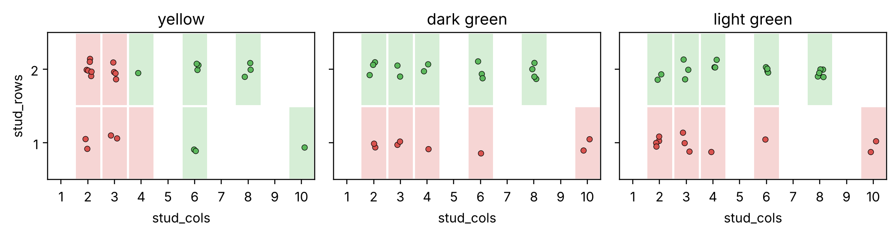
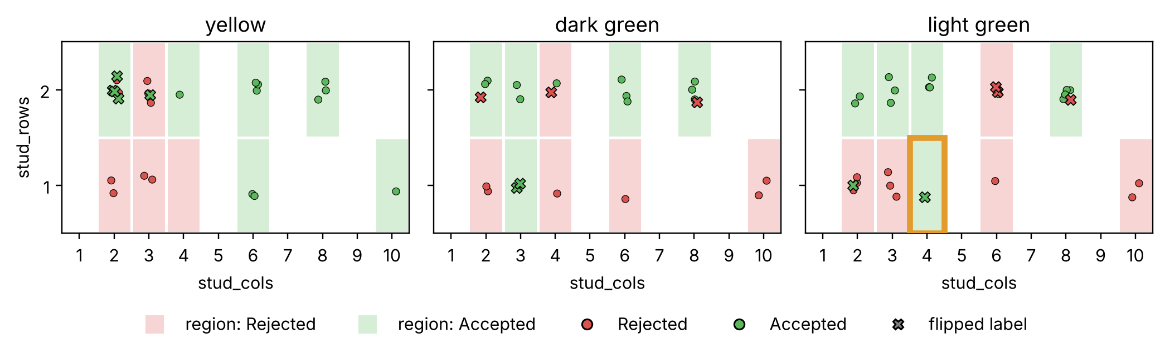
Exp. 2 · The tree memorises the noise
Exp. 1 · clean labels 6 leaves
0.900
Train accuracy (Exp. 1: 1.000)
prediction: partly wrong
0.778 / 0.900
Test: vs stickers (ceiling 0.811) / vs truth
prediction: right
6 → 48
Leaves
prediction: right
Exp. 2 · 15% label noise 48 leaves
1 → 10
Brick types predicted against the rule (of 80)
Each noisy brick gets its own island, and the islands spill onto new bricks: 10 brick types now go against the rule.
Notes:
B, ~45 s. Summary after the notebook. Figures: same 3 colours, Exp. 1 on top, Exp. 2 below. X = flipped sticker. Orange box: the light green 1x4 island (the brick traced in the notebook) - every new light green 1x4 will be Accepted, against the rule. Numbers: train 0.900, not 1.0 - identical bricks with conflicting stickers can't be split (prediction partly wrong). Test 0.778 vs stickers: even a perfect model would get only 0.811, because 17 of the 90 test stickers are wrong. Against the truth: 0.900. Leaves 6 -> 48; 10 brick types now predicted against the builder's rule. Close: with no depth limit, the tree fits every sticker, including the wrong ones - overfitting. Q&A pause, then hand over to C.

Slide 16
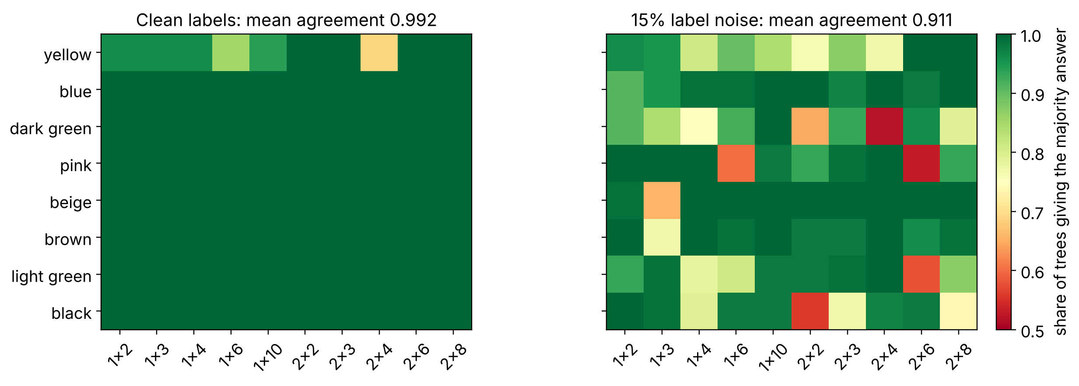
Exp. 2 · Is the tree even stable?
Exp. 2 setup, training set resampled 100 times (bootstrap). Each square is one brick type: green = all trees agree, red = coin flip.
100 / 100
trees with stud_rows at the root (clean and noisy)
5.8 → 35.6
leaves, clean → noisy (noisy range 24–44)
6 → 55
brick types where the trees disagree (of 80)
The root never moves; everything below it does.
Q&A pause
Notes:
B, ~45 s (Task 8). Same noisy training set as Exp. 2, but each of 100 trees sees a bootstrap resample: 210 draws with replacement, so ~1/3 of the bricks are left out each time. Same draws for clean and noisy. Root: stud_rows in all 100 trees, clean and noisy - the information-gain gap at the top is too big for a resample to close. Below the root: clean trees have 4-6 leaves (rare yellow bricks sometimes missing); noisy trees 24-44 leaves. Map: clean is green except the yellow row (bricks with 1-2 copies: when missing, the threshold moves). Noisy: disagreement everywhere. Close B's part: a deep tree overfits AND is unstable. Q&A pause, then hand over to C: can limiting the tree fix both?

Slide 17
Exp. 3 · Can we fix it?
OUR PREDICTION
(written before running)
SETUP
15% labels noise, n = 210
The Accuracy for the Test data will be better than in Exp. 2 but still worse than in Exp. 1.
5-fold CV on training data
Why we expect this:
Better than in Experiment 2 due to the optimized hyperparameters, and worse than in Experiment 1 due to noise.
Tune max_depth, min_samples_leaf
Notes:
C. Stress that CV uses training data only; the test set is touched once, at the end.

Slide 18
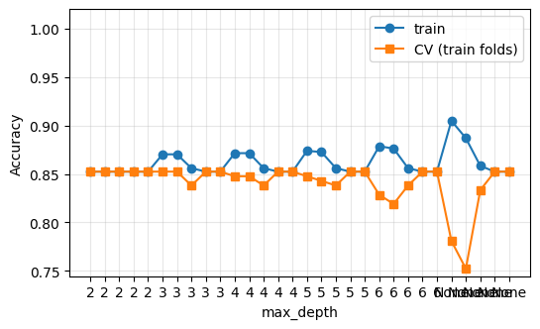
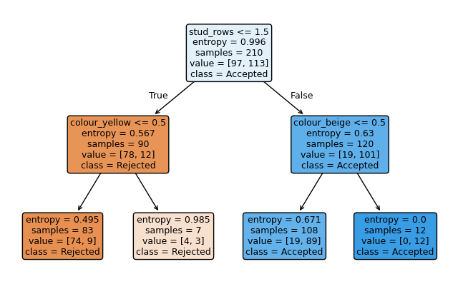
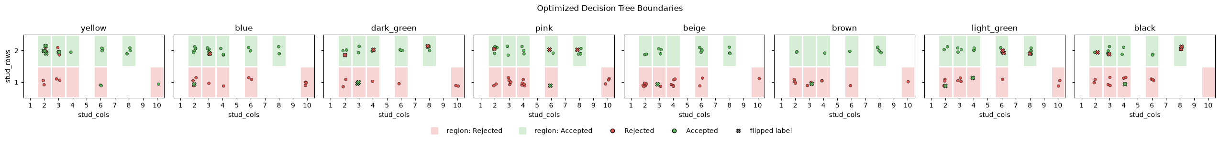
Exp. 3 · Limiting the tree helps
max_depth = 2
min_sample_leaf = 1
Test Accuracy:
Stickers: 77.8%
Truth: 96.7%
Q&A pause
Notes:
C. Left side of the curve = underfitting, right side = overfitting. If the fix only partly works, say why: the brief accepts an unsuccessful correction if it's analysed well.

Slide 19
Is the tree stable?
NO
Deep tree, 5 resamples of the training data: Across all seeds, the trees always check if stud_rows <= 1.5 at their root split.
Small changes in the data can change the whole tree below the root. A pruned tree moves less.
Notes:
C (B built this). Covers the topic's 'stability of the learned tree'. If time is short, this is the first slide to skip.

Slide 20
Three lessons for using trees
1
2
3
Never trust a fully grown tree
No scaling needed, but encode categories
One tree is fragile
Limit depth or leaf size, and choose them with cross-validation on training data.
Splits are thresholds, so scale doesn't matter. One-hot categories so questions make sense.
Check it across seeds. When stability matters, average many trees (bagging, random forests).
Notes:
C. Draft lessons: rewrite them in your own words once the results are in, so they match what the experiments actually showed.

Slide 21
Change a parameter. Predict. Rerun.
Questions? The notebook is open.
Notes:
All, 28:00-30:00 buffer. Whoever is asked answers. Use the Q&A drill table from the plan.

