Slide 1
Using Block Matrices to Provide Erasure Capabilities to Blockchains Without Losing Integrity
Arsen Klyuev
Computer Security
Security Components & Mechanisms
August 1st, 2018

Slide 2
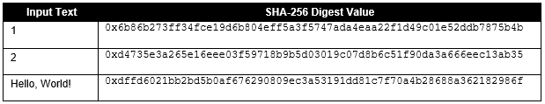
Hashing and Hash Functions
Hashing: “A method of calculating a relatively unique output for an input of any size.”
Any change to the input, no matter how small, will result in a completely different output
Preimage resistant
Second preimage resistant
Collision resistant
SHA-256
Notes:
-Explain hash functions and their properties here (similar to bc wp)
-”So I know for a lot of people this will be a repeat of things you already know, but understanding hash functions is essential for understanding this topic so I’ll explain how they work and a few properties of them which make them such a key tool for security.
Preimage resistant: it is computationally infeasible to find any input that maps to any pre-specified output (e.g., given the digest, find x such that hash(x) = digest)
Second preimage resistant: given a particular input, it is computationally infeasible to find a second input which produces the same output (e.g., given x, find y such that hash(x) = hash(y)).
Collision resistant: : it is computationally infeasible to find two inputs that produce the same output (e.g., find an x and y which hash(x) = hash(y)).
2²⁵⁶ ≈ 10⁷⁷ possible digest values
Generally a 64 character hexadecimal as one hexadecimal is 4 bits and 64*4 = 256

Slide 3
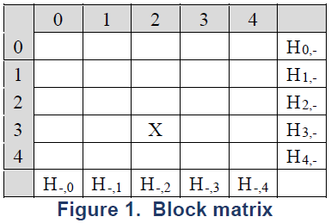
What is a Block Matrix?
A data structure which supports addition of hash-linked records while also allowing the deletion of records yet still maintaining assurance other blocks are unchanged
Stores hashes of each row and column
Notes:
Block Matrices at they’re core are a newly designed data structure that are designed to be secure despite allowing deletion or modification of existing items in them.
The structure can be seen in the top right: Essentially, it is a matrix which stores the hash of the each of its rows and columns. The way it could be actually implemented in code
could vary, but for the sake of this image and conceptually, you can imagine that each row and column is terminated with a hash of that row and column. More specifically, it
Would be the hash of the combined contents of each block in that row and each block in that column.
The size can vary, but in this case it is a 4x4 block matrix. This data structure comes from a NIST CyberSecurity White Paper I have included as a reference at the end of this presentation.

Slide 4
How do Block Matrices Maintain Security?
Hashes provide us assurance information in every other block is unchanged if one block is modified
Notes:
The reason block matrices are secure is due to the way the hashes are arranged. For example, imagine if we deleted or modified data in Block X, labeled here. The hash for the second column and third row would change. Now if we only had row hashes, or only had column hashes, then we would no longer have integrity for all of the blocks in row 3 or column 2 since the only hash for that row or column would be invalidated. But since each block has both a row hash and a column hash that “represents” its row and column, for every single other block in the matrix, at least one of its row or column hash will remain unchanged, meaning we still have integrity protection for that block.

Slide 5
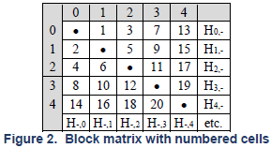

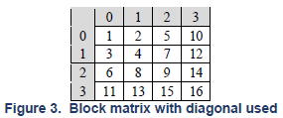
Block Matrix Population Algorithm
Algorithm:
Special ordering creates certain desirable properties
Balance
Capability of deleting consecutive blocks
Vs.
Notes:
Beyond this, block matrices can be improved further by populating them in a specific way using the above algorithm. Essentially, what this does is populate the block matrix in the manner you can see in the top block matrix. The numbers represent which block is added where, in order. This creates a few desirable properties that can be useful in some situations. Even though they don’t necessarily make block matrices more useful to the blockchain use case, the block matrix is a general data structure that can be used for different applications and these properties may be useful in other situations.
For one, the block matrix is balanced when it gets filled, in that the half above the diagonal has at most 1 additional cell more than the half below the diagonal. For example, if, say, 9 items have been inserted, we can see that 5 of these would be above the diagonal, and 4 would be below.
Another useful property that this special ordering creates is that it is even possible to delete two consecutive blocks at a time, without recalculating hashes between each deletion, and still maintain integrity. This is due to the empty diagonal, which prevents 2 consecutive blocks from ever being diagonal to each other. We can see the difference between a block matrix with and without the empty diagonal here. Without the diagonal, if you, for example, deleted blocks 7 and 8 without recalculating hashes in between each deletion, we would no longer have integrity for blocks 4 and 9 as both their column and row hashes would be modified, meaning we could no longer be assured they were not modified just from checking their row and column hashes. However, with the empty diagonal, if you delete 1 and 2, or 5 and 6, or any other 2 blocks that are consecutive but also directly diagonal to each other, the empty diagonal prevents any other blocks from losing integrity protection.

Slide 6
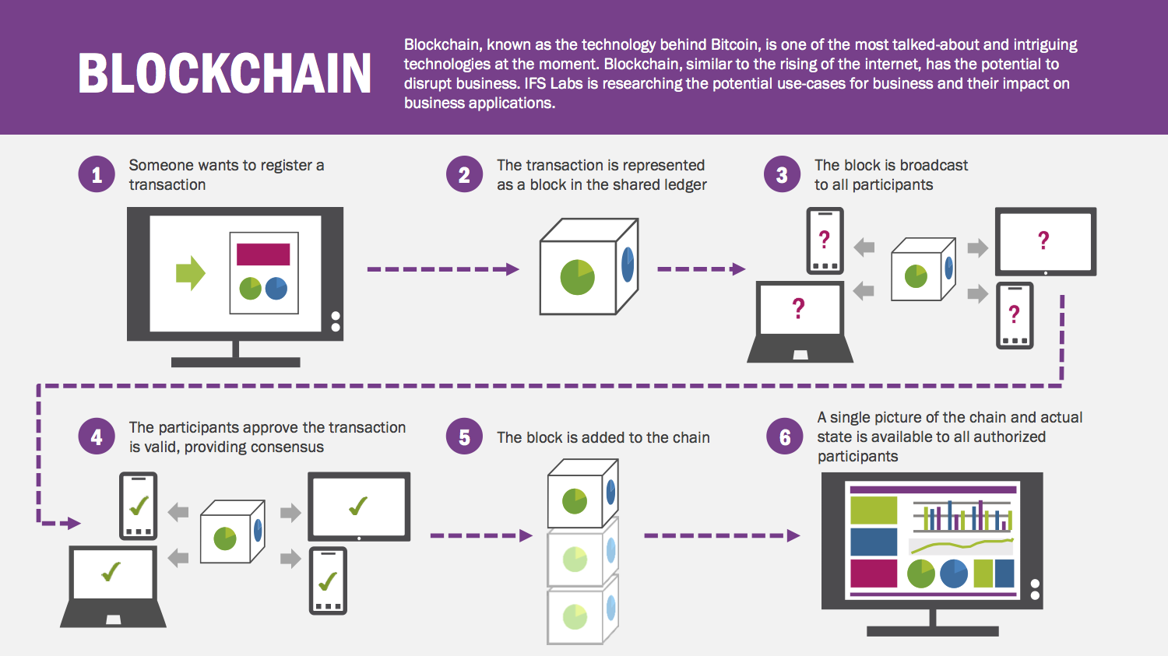
What are blockchain networks?
Distributed digital ledger systems
Tamper evident
Transactions are public
Each member of the network has a full record of transactions
Notes:
Now, what are blockchain networks? This is a topic too complex to be fully explained in a few slides, but I’ll explain the general concept and some of their security features. At their lowest level, blockchains are distributed digital ledger systems that are designed to resist tampering by people with more nefarious intentions. In blockchains, transactions represent an interaction between two parties. In cryptocurrencies, which is likely the primary use of blockchains you are most aware of, this will be transactions of the type you are thinking – i.e. sending “coins” or some asset from one person to another. Blockchain networks don’t have a central authority, and each member of the network has a full list of transactions, meaning generally everyone at any given moment will know the state of the blockchain.
This graphic breaks down how this plays out. If someone makes a transaction, this transaction is added to a “block.” Blocks can hold multiple, or even no transactions. This block is broadcast to all participants in the network, who then verify the transaction. The way this verification is done depends on the “consensus model” of this specific network, an agreed upon way on how to decide if a block is “valid” and can be added to the chain.
Once a block is added to the chain, it is added to the chain for everyone. A single picture of the chain and state of the chain is visible to all participants

Slide 7
Proof of Work Consensus Model
Blocks will contain a nonce, an arbitrary number that is only used once
hash(data + nonce)=digest
Need to meet a target criteria:
E.g. SHA256(“blockchain” + Nonce) = Hash Value starting with “000000”
SHA256("blockchain0") = 0xbd4824d8ee63fc82392a6441444166d22ed84eaa6dab11d4923075975acab938
(not solved)
SHA256("blockchain1") = 0xdb0b9c1cb5e9c680dfff7482f1a8efad0e786f41b6b89a758fb26d9e223e0a10
(not solved)
SHA256("blockchain10730895") = 0x000000ca1415e0bec568f6f605fcc83d18cac7a4e6c219a957c10c6879d67587
(solved!)
Once this is solved, the block can be added to the blockchain and people get to work on mining the next “block”
Generally there is an incentive for mining a block (e.g. some part of the asset a.k.a some “coins”
Notes:
Consensus models are an important part of blockchains, so it is good to touch upon proof of work as an example.
In a blockchain network that uses a proof of work consensus model, each block has a “nonce” that will be stored. This is an arbitrary number. For the block to be “mined,” the correct nonce that will make
The hash value meet a certain criteria must be found. This criteria will often be that the hash of the block combined with the nonce must start with a certain number of 0s.
This is a case where it is likely easier to show rather than explain, so I will demonstrate here, where instead of use hashing the contents of a block our puzzle will consist of hashing the word “blockchain” and a nonce, trying to get a hash value that starts with 000000. Starting with a nonce value of 0 and repeatedly incrementing it until the hash meets our criteria, we can see only once our nonce was 10,730,895 did we meet the criteria.
This means we had to recalculate hash values over 10 million times. On the computer this was run on, this took 54 seconds. Increasing the target criteria by just one more 0 can make it significantly more time (in this case, an increase of one 0 made the time become more than an hour.)
However, to verify if the nonce works, the hash only needs to be calculated once. In a way, this is sort of a race to see who can solve this computationally expensive puzzle first. And when a user receives a completed block from another user with a correct nonce, they are incentivized to immediately include the new block because they know other users will also include that block and get to work on calculating the nonce for the next block first in order to receive the reward.

Slide 8
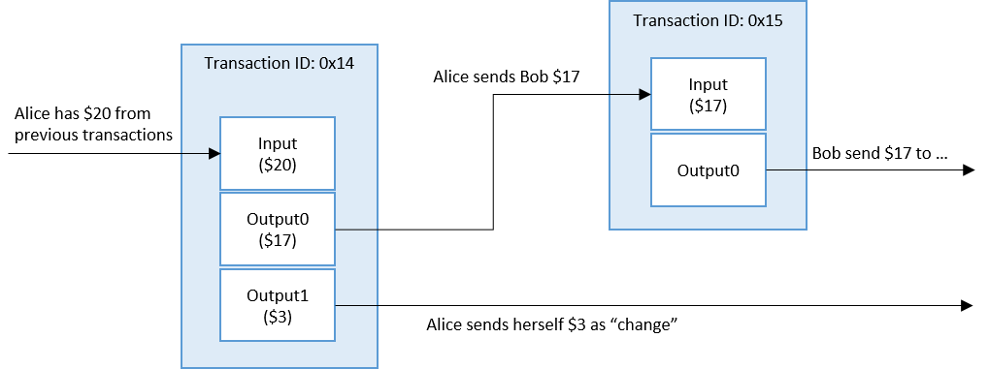
Transactions
Notes:
One of the key parts of blockchain networks is transaction immutability. Blockchains protect against tampering in their transactions in an interesting but intuitive way: to send an asset to another user (an “output”), you need to prove you have that asset to spend by showing where you got it from (“the input”). This prevents people from being able to spend any assets they do not actually have.
We can see here what this looks like. Lets say Alice has $20 from previous transactions and wants to send Bob 17$. This isn’t as simple as just decreasing Alice’s balance by 17 and increasing Bobs by 17. Instead, we need to view a Transaction like an object. This transaction object will collect outputs from previous transactions where Alice has received money, such that we have collected enough inputs in the transaction to equal or be greater than the amount Alice wants to send. In this case, at some point in the past Alice received $20, so we take that as the input to this transaction. Then the Transaction produces the output, which is our sending Bob $17. We need to use up the entire input in the transaction, so the transaction will send $3 back to Alice (this part is automatic). Then, when Bob wants to send someone else some money, that $17 output from the previous transaction will be used in Bobs transaction when he wants to send money to someone else.
Essentially, you can’t toy with transactions since spending an asset requires proof that you have it and where you got it from. It is secure against people trying to make any money “out of thin air.”

Slide 9
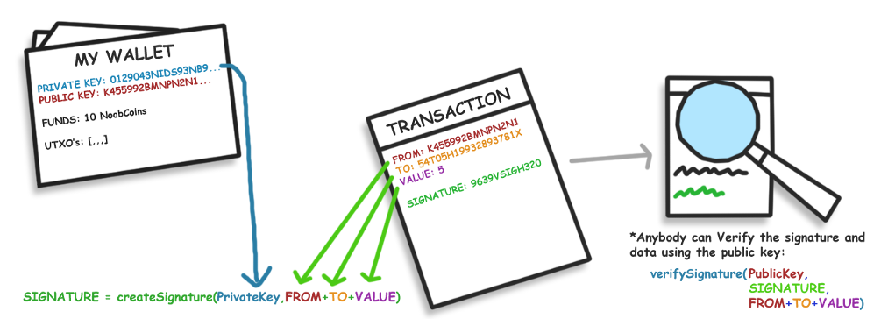
Public and Private Keys
Notes:
Furthermore, the recipients or senders of transactions can not be modified because each blockchain user has a Public Key and a Private Key. When someone creates a transaction, the transaction is signed with their Private Key, and other users can verify the transaction is legitimate with that users Public Key.

Slide 10
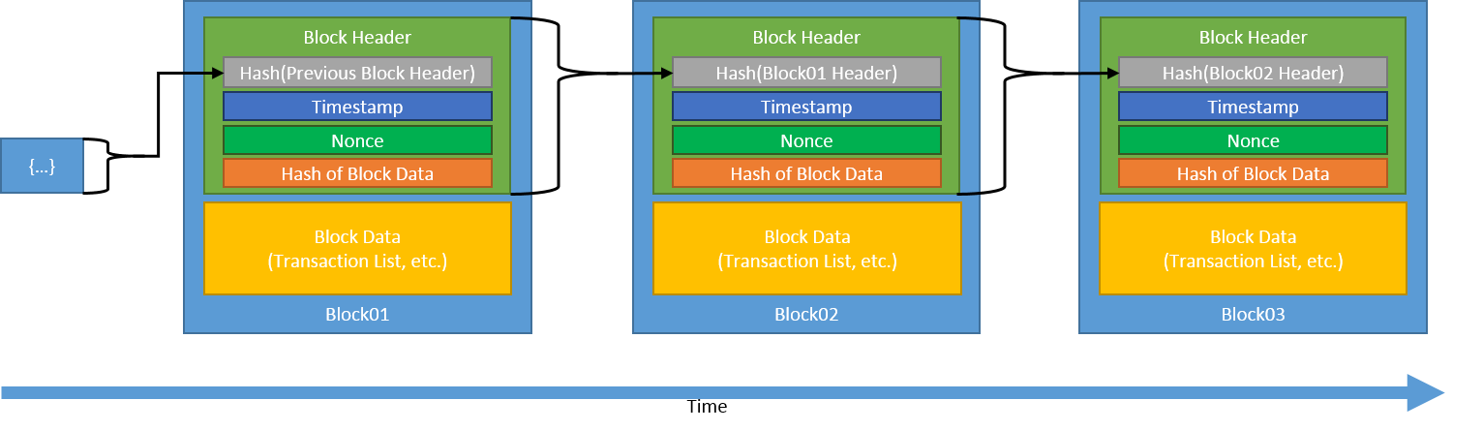
Structure of a Traditional Blockchain
Notes:
So here, finally, we can take a look at what a traditional proof of work blockchain looks like. Each block consists of 2 major parts: the block header and the block data. The block header contains a timestamp (when the block was made), the nonce, a hash of the block data, and finally, a hash of the previous block header. The block data will generally be the transaction list, but might contain other things as well.
The key thing to focus on is that each block contains a hash of the previous blocks header. This is why a blockchain is a CHAIN, and is what makes blockchains so secure: the smallest change in any block makes a chain reaction (excuse the pun) in every single subsequent block. We can trace through this here:
Imagine the data in block 1 changed somehow. Then, the hash of the block data in the block header of block 01 would change. Subsequently, the hash of block 01s header would change since the hash of the block data has changed, and the hash of the block01’s header which block02 contains would be completely different! This would mean the hash of block02’s header, which block03 holds, would also be completely different, and so on and so forth until the end of the chain. As soon as one thing changes after mining, the entire rest of the chain is invalidated!

Slide 11
The Problem
Immutability means any information on a blockchain can never be removed
Increasing privacy regulations make this a problem
EU General Data Protection Regulation (GDPR)
Notes:
What we can take from this is that blockchains are immutable. Very, very immutable, as they were designed to be so and their immutability is one of the key reasons why it is such a secure technology. The reason this is a problem is that people have privacy needs, and a data structure literally designed to not allow any data be changed after it has been written is far from ideal in terms of privacy! Increasing privacy regulations make this be not only a moral problem, but also a legal one.
One of the most important examples is the EU General Data Protection Regulation (the GDPR). The GDPR requires that organizations make it possible to delete all of the information related to a particular individual at that persons request. This is not possible with current blockchains, however. Any information stored in a block currently can not be removed or modified without invalidating all other blocks in the blockchain, due to how the hashes are linked together. If someone's private info, or any info they don’t want to be public is in a block on an existing blockchain, there is no possible way they can remove it without losing the security for all blocks that were produced after the block or blocks that individuals data existed in. So how do we combat this?

Slide 12
Applying Block Matrices to Blockchains
Similar structure and security as a blockchain
capability of deleting or modifying certain parts of a transaction or block
Same transaction model, same cryptographic key/address model
Empty | Block 1 | Block 3 | Block 7 | Block 13
Block 2 | Empty | Block 5 | Block 9 | Block 15
Block 4 | Block 6 | Empty | Block 11 | Block 17
Block 8 | Block 10 | Block 12 | Empty | Block 19
Block 14 | Block 16 | Block 18 | Block 20 | Empty
Row 0 Hash
Row 1 Hash
Row 2 Hash
Row 3 Hash
Row 4 Hash
Col 0 Hash | Col 1 Hash | Col 2 Hash | Col 3 Hash | Col 4 Hash
Notes:
We use a block matrix to store the blocks instead of the aforementioned “chain,” and instead of having assuring integrity of each block by having them contain the hash of the previous block, the row and column hashes of the block matrix do this for us!
This allows us to delete or modify parts of a block, without losing security of all other blocks. It is important to note that the key parts of transactions – the amount that has been transferred, the sender, and the recipient - still can not be modified due to how transactions work in blockchains (where to send assets you must reference where you got it from) but other information or messages in transactions can be modified while still being a part of the block.
That way, if someone who has passed a message along with a transaction decides the information is too sensitive to be a part of public record or wants it removed for whatever reason, it is simply a matter of modifying the information in that transaction. Although that blocks hash may change, the rest of the blocks will still be secure, protected by at least one hash.

Slide 13
Block 2
Transactions
Transaction 1
Transaction 1
Hash of Transaction
Transaction 2
Sender Public Key
Recipient Public Key
Value
Timestamp
Info
Hash of Block
Transaction Inputs
Transaction Outputs
 | Genesis Block | Etc.
Block 2 |  | Etc..
Etc. | Etc.
Structure of the Block Matrix “blockchain”
Notes:
We can see the structure more closely here. Blocks are no longer split into Block Data and Block Header. Blocks no longer hold the hashes of previous blocks. Blocks can hold multiple transactions, which consist of the usual parts of a transaction, including the info, or any message, passed along with the transaction.
Note here there is a “genesis block” here, something we did not touch upon – this is something that exists in every blockchain, a “genesis block” in which the assets are created and where the blockchain begins. This is the only block where an asset or “coins” are “made out of thin air,” and is the one block in violation of that rule. Essentially, it is what “initializes” our blockchain.

Slide 14
Java BlockMatrix Package
A mutable blockchain you can use yourself!
import blockmatrix.*; public class Main { public static void main(String[] args) { BlockMatrix bm = new BlockMatrix(5); bm.setUpSecurity(); //Create wallets: Wallet walletA = new Wallet(); bm.generate(walletA, 200f);
Making our block matrix with our desired dimensions
Creating our initial wallet that starts with all of the “coins”
Making our genesis transaction with the desired number of “coins”
SHA-256 hashing
Elliptic-Curve Keypairs
Notes:
I created a basic blockchain which uses a blockmatrix to provide mutability to show how this concept works. It’s very easy to use, and is a java package people can import to actually use, or look at if they want to see how such a blockchain would actually be implemented in code. It’s far from a fully working peer to peer blockchain that multiple computers can attach to, but it is, essentially, a blockchain you can use on your very own computer in a java program.
It uses java Security API to perform hashing using SHA-256, and provides Private and Public Keys for wallets using Elliptic-Curve cryptography.
To use it, you need to include the blockmatrix jar file in your program, then import the package at the top of the file, just like any other java package. Once you’ve done that, you can create a blockmatrix with whatever size you would like specifying a dimension N. Remember, your blockmatrix will be able to hold at most N^2 – N blocks due to the need for the diagonal to be empty. Don’t worry too much about bm.setUpSecurity, it will just initialize a security provider for the java security API. The next two steps will be to create our starting wallet, and to run bm.generate with the wallet and the amount of asset you want the blockchain network to hold (in this case, 200 coins).

Slide 15
How to use it
Create wallets: Wallet walletB = new Wallet();
Create Blocks: Block block2 = new Block();
Create transactions
Transaction tr = walletA.sendFunds(walletB.getPublicKey(), 40f, “This is for the bananas!");
Add the transactions to blocks: block2.addTransaction(tr);
Add the blocks to the block matrix! bm.addBlock(block2);
//testing Wallet walletB = new Wallet(); Block block2 = new Block(); System.out.println("\nWalletA's balance is: " + walletA.getBalance()); System.out.println("\nWalletA is sending 40 coins to WalletB..."); block2.addTransaction(walletA.sendFunds(walletB.getPublicKey(), 40f, “This is for the bananas!")); bm.addBlock(block2); System.out.println("\nWalletA's balance is: " + walletA.getBalance()); System.out.println("WalletB's balance is: " + walletB.getBalance());
Clearing info in blocks: bm.clearInfoInTransaction(2, 0);
Notes:
Once that is done, we can create wallets, create blocks, create transactions sending funds from one wallet to another, add as many transactions to a block as we want, and add those blocks to our block matrix! For example, here we make a new wallet called walletB and a new block called block2. You can get a wallets balance with the getBalance() method, which will count through every single unused transaction output a wallet has received and add up the total value in all of those unused outputs. When we make a transaction with .sendFunds and add it to block2, wallet A and wallet B’s values will change! To finally add this block to our block matrix we just run bm.addBlock with the block we want to add as the parameter.
After this is done, we can see that the balance of walletA will have become 160, and the balance of walletB will have become 40!
Finally, if we want to clear the info in a block, we simply write bm.clearInfoInBlock with the index of the block for which we’d like to have transaction info cleared, and it will be cleared!

Slide 16
walletA
BlockMatrix bm = new BlockMatrix(3);
bm.setUpSecurity();
Wallet walletA = new Wallet();
bm.generate(walletA, 200f);
Balance: 200
Balance: 0
Genesis Transaction
Row Hashes
Genesis Block
Genesis Block
099a..
e3b0..
Genesis Transaction
e3b0..
Hash: d6nt..
Sender: Coinbase
Recipient: walletA
e3b0..
Value: 200f
Info: null
Inputs: null
Column Hashes
e3b0..
099a..
e3b0..
e3b0..
Outputs: …
Notes:
Here is a demo to break this down a bit more, going step by step through the process of creating transactions and blocks and adding them to our matrix, and what this process looks like.
First, you can see us creating our block matrix. This one is only 3x3, and is small for demonstration purposes. We run setUpSecurity() to get our security provider up and running, and the we make our first wallet, walletA. It’s balance begins at 0. Next, we run bm.generate(walletA, 200f), which does a few things at once. It creates our “genesis transaction,” which, unlike every other transaction that will happen, has no inputs despite having an output. The user can’t see this, but although every other transaction will be made with the sendFunds method, inside of the generate method we are actually manually signing this genesis transaction and manually adding its outputs.
After the transaction is made in the generate method, we create the genesis block and add the genesis transaction to it, and finally our wallet receives the decided upon funds and the block is added to the block matrix. Note when the block is added the hashes for that row and that column change.

Slide 17
walletA
walletB
Balance:160
Balance: 40
Balance: 200
Balance: 0
Wallet walletB = new Wallet();
Block block2 = new Block();
Transaction tr = walletA.sendFunds(walletB.getPublicKey(), 40f, “This is for the bananas!");
block2.addTransaction(tr);
Bm.addBlock(block2);
Row Hashes
tr
Genesis Block
Genesis Block
099a..
block2
tr
block2
e3b0..
Hash: a4sc…
Sender: walletA
Recipient: walletB
e3b0..
Value: 40f
Info: “This is for the...!”
Inputs: …
Column Hashes
e3b0..
099a..
e3b0..
Outputs: …
Notes:
The entire point of setting this up is to send funds between wallets securely, so our next step is to create another wallet, walletB. We make our wallet, and make a new block to hold transactions. Now, we make a transaction the way we would traditionally: using the sendFunds method. We can see here the message we passed along with the transaction. This transaction will actually have inputs, which will be the transaction output from the previous transaction where walletA was sent 200 coins. Since we are sending walletB 40 coins, our outputs would be sending walletB 40 coins, and sending ourselves (walletA) 160 coins as change. We then add this transaction to the block, which causes the change in our wallet balances.
Afterwards, we add the block to our block matrix. Note again how the row and column hashes change.

Slide 18
walletA
walletB
Balance: 200
Balance: 0
Wallet walletB = new Wallet();
Block block2 = new Block();
Transaction tr = walletA.sendFunds(walletB.getPublicKey(), 40f, “This is for the bananas!");
block2.addTransaction(tr);
bm.addBlock(block2);
bm.clearInfoInTransaction(2, 0);
Row Hashes
tr
Genesis Block
Hash: 2he1..
Genesis Block
099a..
block2
tr
block2
719c..
Hash: a4sc…
Sender: walletA
Recipient: walletB
e3b0..
Value: 40f
Info: “This is for the…!”
Inputs: …
Column Hashes
719c..
099a..
e3b0..
Outputs: …
Notes:
Finally, lets say we decide we no longer want people to know this transaction was for bananas! We can clear the info in a transaction by specifying which block the transaction is in, and the index of the transaction(in this case it is in block 2, and is transaction 0 since the transactions are zero-indexed). I have expanded block2 so we can see the hash of the block, and we can trace through how the hashes change all the way to the block matrix.

Slide 19
walletA
walletB
Balance: 200
Balance: 0
Wallet walletB = new Wallet();
Block block2 = new Block();
Transaction tr = walletA.sendFunds(walletB.getPublicKey(), 40f, “This is for the bananas!");
block2.addTransaction(tr);
bm.addBlock(block2);
bm.clearInfoInTransaction(2, 0);
Row Hashes
tr
Genesis Block
Hash: 2he1..
Genesis Block
099a..
block2
tr
block2
719c..
Hash: a4sc…
Sender: walletA
Recipient: walletB
e3b0..
Value: 40f
Info: “CLEARED”
Inputs: …
Column Hashes
719c..
099a..
e3b0..
Outputs: …
Notes:
First, we see how the info gets overwritten and is changed to “CLEARED.”

Slide 20
walletA
walletB
Balance: 200
Balance: 0
Wallet walletB = new Wallet();
Block block2 = new Block();
Transaction tr = walletA.sendFunds(walletB.getPublicKey(), 40f, “This is for the bananas!");
block2.addTransaction(tr);
bm.addBlock(block2);
bm.clearInfoInTransaction(2, 0);
Row Hashes
tr
Genesis Block
Hash: 2he1..
Genesis Block
099a..
block2
tr
block2
719c..
Hash: 34ds…
Sender: walletA
Recipient: walletB
e3b0..
Value: 40f
Info: “CLEARED”
Inputs: …
Column Hashes
719c..
099a..
e3b0..
Outputs: …
Notes:
This causes the hash of the transaction to change

Slide 21
walletA
walletB
Balance: 200
Balance: 0
Wallet walletB = new Wallet();
Block block2 = new Block();
Transaction tr = walletA.sendFunds(walletB.getPublicKey(), 40f, “This is for the bananas!");
block2.addTransaction(tr);
bm.addBlock(block2);
bm.clearInfoInTransaction(2, 0);
Row Hashes
tr
Genesis Block
Hash: 84g5..
Genesis Block
099a..
block2
tr
block2
719c..
Hash: 34ds…
Sender: walletA
Recipient: walletB
e3b0..
Value: 40f
Info: “CLEARED”
Inputs: …
Column Hashes
719c..
099a..
e3b0..
Outputs: …
Notes:
Which then causes the hash of the block to change, as the blocks hash is calculated partially from the info in the blocks transactions.

Slide 22
walletA
walletB
Balance: 200
Balance: 0
Wallet walletB = new Wallet();
Block block2 = new Block();
Transaction tr = walletA.sendFunds(walletB.getPublicKey(), 40f, “This is for the bananas!");
block2.addTransaction(tr);
bm.addBlock(block2);
bm.clearInfoInTransaction(2, 0);
Row Hashes
tr
Genesis Block
Hash: 84g5..
Genesis Block
099a..
block2
tr
block2
f84w..
Hash: 34ds…
Sender: walletA
Recipient: walletB
e3b0..
Value: 40f
Info: “CLEARED”
Inputs: …
Column Hashes
f84w..
099a..
e3b0..
Outputs: …
Notes:
Finally, just like with any addition or modification of a block in our block matrix, since the hash of block2 is modified, the row and column hashes in our block matrix update recalculate based off the new block hash of block 2.

Slide 23
Ensuring Matrix Validity
isMatrixValid() method
Encompassing function which checks if blockmatrix is secure
Features:
Checks every block and ensures its hash is what it should be
Checks every row and column and ensures its hash is what it should be
Checks every transaction in each block and makes sure that
The transactions signature is valid
Inputs are equal to outputs in the transaction
Etc.
Checks that all deletions/modifications of data changed only one row and column hash, and the rest are unchanged
Notes:
The way security is ensured in the BlockMatrix package is one all-encompassing method, isMatrixValid(). It checks numerous things, and outputs true if the matrix is still valid and has not been tampered with, or false if it has not. It features (above features), as well as
For transactions:
Checks every transaction in each block and makes sure that
The transactions signature is valid
Inputs are equal to outputs in the transaction
Each referenced input exists
Each referenced input value is valid
The transaction output recipient is who is should be
The remaining “change” is sent back to the sender

Slide 24
Future of BlockMatrix
For the package:
Option to make BlockMatrix use proof of work or alternate consensus schemes
Web tool to easily see structure of your BlockMatrix
General code:
Extension to peer-to-peer system
Creation of generic BlockMatrix data structure which can be used for any purpose
For the concept:
Implementation in existing blockchains
Multichain
Hyperledger Fabric
Notes:
The blockmatrix package still isn’t close to full blockchains such as Bitcoin Core, for which the source code is near 100,000 lines of code, but the next steps could bring it a lot closer. For the package, the first step would be an option to make it have a proof of work or alternate consensus scheme would make it usable for permissionless and permissioned blockchain networks. In a permissionless network, a small reward would be implemented to provide incentive to mining. Furthermore, a web tool could be made to more easily view your block matrix.
After that, it would be essential to make this be peer-to-peer, so users on different computers could send funds to and from each other. A generic BlockMatrix data structure could also be made for people who want to experiment with Block Matrices themselves.
Finally, in a more general sense for where this idea is heading, one step that will be taken in the future is implementation of block matrices in existing open-source blockchains such as Multichain or Hyperledger Fabric, replacing the chain in these systems with a block matrix as we have done here.

Slide 25
Acknowledgements
Rick Kuhn, National Institute of Standards & Technology
Dylan Yaga, National Institute of Standards & Technology
SURF Undergraduate Research Program, National Institute of Standards & Technology

Slide 26
References
Kuhn, D. Richard, A Data Structure for Integrity Protection with Erasure Capability, May 2018.
Yaga, Dylan, et al. Blockchain Technology Overview Draft NISTIR 8202 v2, January 2018

