Slide 1
ACS

Slide 2
What is the Bidecennial ACS?

Slide 3
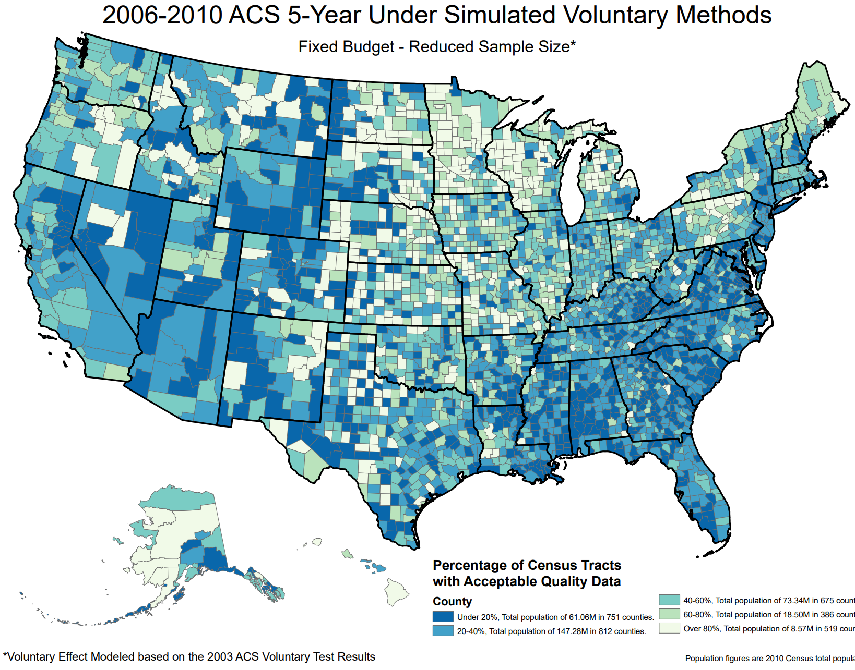
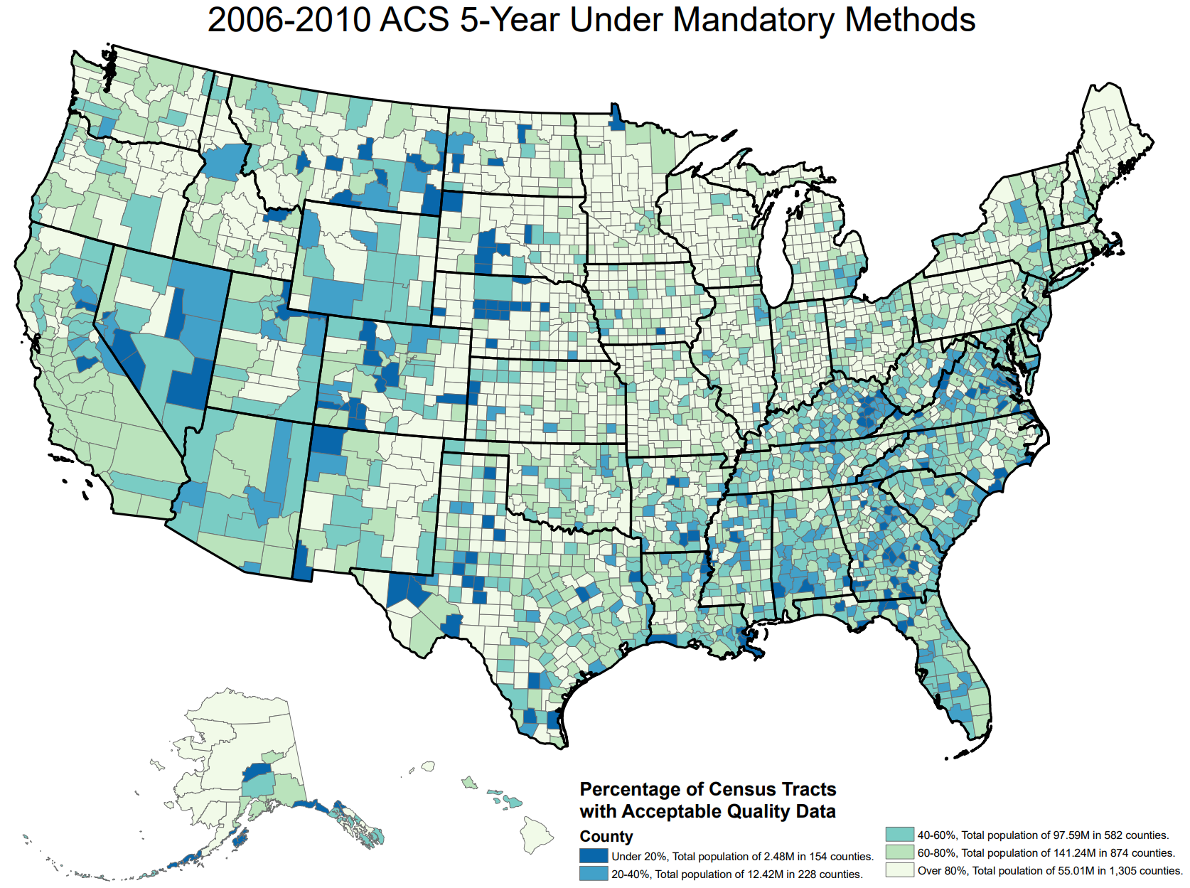
What is the Bidecennial ACS?
5-year rolling sample survey conducted by the US Census Bureau to improve the accuracy of the main US census.
Samples 250,000 housing units every month (3m per year) by mail, phone or in-person interview.
Data Collection Failure Rates under Voluntary vs Mandatory Implementation

