Slide 1
Conformal Prediction
Michael Ghattas
Mike Worden

Slide 2
Topics
Purpose (motivation)
More efficient approach than Bayesian Estimation
Learn from/Experiment with <author> found on Social Media
Overview of Bayesian Estimation
Introduction to Bayesian Estimation
From Bayesian Estimation to Conformal Prediction
Bayesian must go through prior to provide distribution… (describe difference from confidence interval (Bayes) to credible interval (Conf Pred))
Overview of Conformal Prediction Basics of Conformal Prediction
Nonconformity Scores
Algorithmic Steps
Complexity Analysis (compare using sentiment analysis)
Applications of Conformal Prediction (Show CODE snippet)
(Defense – sentiment analysis of data feeds on industry trends, RFIs, etc., ) (Manufacturing telemetry, fault prediction..)
Application Demo
Point to github…
Conclusion/Next steps

Slide 3

Motivations
Both of us have motivations to find efficient classification algorithms
Michael G – Works in data science
Mike W – Interested in applications of classifiers in cybersecurity logs analysis
Both interested in finding an improvement over Bayesian methods
Learned of conformal prediction through interaction with Valeriy Manokhin on Social Media. (LinkedIn)
Reviewed his papers & publications, including
Practical Guide to Applied Conformal Prediction in Python: Learn and apply the best uncertainty frameworks to your industry applications. (ISBN: 1805122762)
Conformal Prediction was a suitable topic for investigation both for education, but also our existing careers.
Valeriy Manokhin, PhD, MBA, CQF

Slide 4

Overview of Bayesian Estimation
Bayes' Theorem - The probability of event A, given that event B has occurred:
Key Concept - Updates prior beliefs based on new evidence.
Key Terms:
Posterior Distribution: Bayesian inference relies on updating beliefs through the posterior distribution, which combines the likelihood of the observed data with the prior distribution
Credible Intervals: Unlike frequentist confidence intervals, Bayesian credible intervals offer a probability-based interpretation of parameter uncertainty

Slide 5
PROS/CONS OF Bayesian Estimation
Advantages of Bayesian Methods
Probabilistic framework for inference.
Intuitive interpretation of uncertainty.
Flexibility in model updating
Critiques of Bayesian Methods
Subjectivity in Prior Selection: Researcher intuition & common heuristics (e.g., principle of indifference).
Computational Complexity: High-dimensional models require costly calculations.
Example: Use of Markov Chain Monte Carlo (MCMC) used to explore priors.
Scalability Issues: High-dimensional Bayesian models struggle to scale efficiently for big data.

Slide 6
ALTERNATIVE – CONFORMAL PREDICTION (CP)
Key Idea: Constructs prediction sets without requiring a full probability distribution,
Computes nonconformity scores to measure deviations.
Uses empirical quantiles to form prediction sets.
Feature | Bayesian Inference | Conformal Prediction
Prior Knowledge | Required | Not Needed
Uncertainty Estimation | Posterior Distributions | Prediction Sets
Computational Cost | H (MCMC) | Efficient (Quartile Based)
Scalability | Limited for Big Data | Highly Scalable

Slide 7
Applications of Conformal Prediction
Healthcare: Medical diagnostics with uncertainty estimation
Finance: Stock market risk assessment
Cybersecurity: Anomaly detection in network traffic
Our Project: Forecasting news article counts across:
Entertainment, Politics, Sports, Technology

Slide 8
Approach and Computational Complexity
Train a base model (linear regression).
Compute residuals (nonconformity scores).
Estimate threshold using empirical quantiles.
Construct prediction intervals.
CP Method | Complexity | Pros | Cons
Inductive CP (ICP) | O(n) | Fast, Scalable | Wider Intervals
Transductive CP (TCP) | O(nk) | Tighter Intervals | Computationally Expensive
Mondrian CP | O(n log n) | Efficient & adaptive | Assumes conditional independence

Slide 9
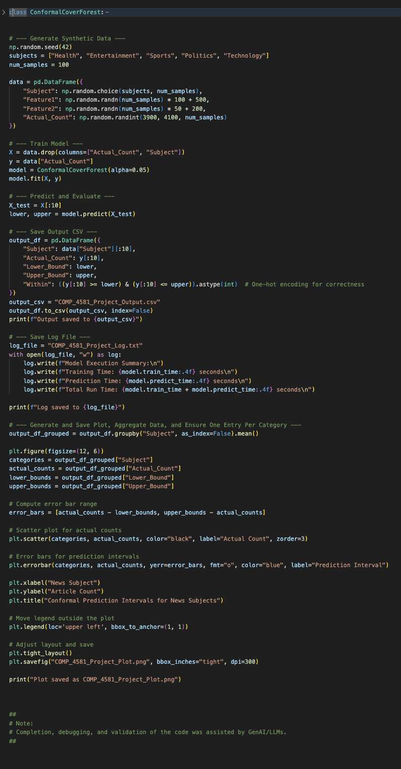
Example: Classification of News StoRies

Slide 10
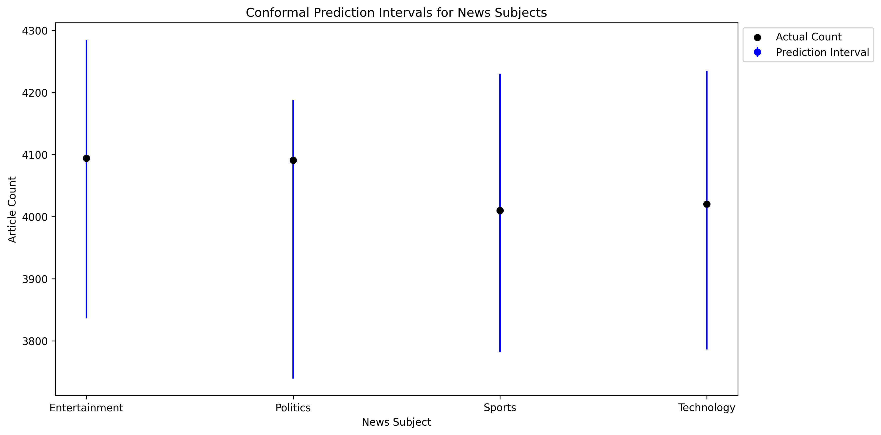
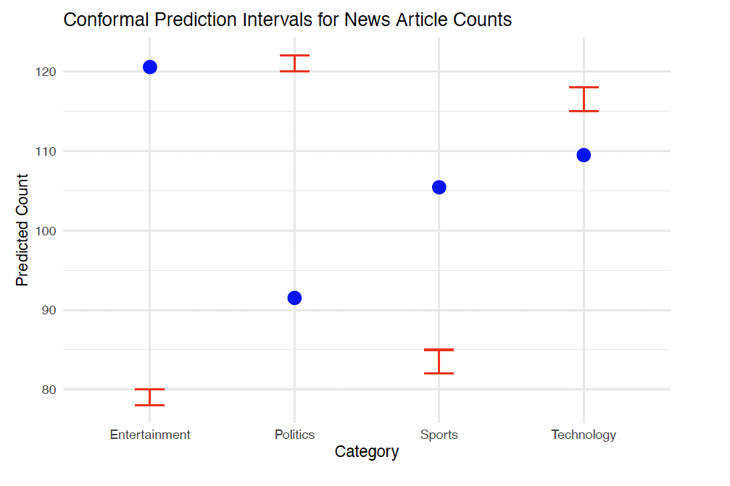
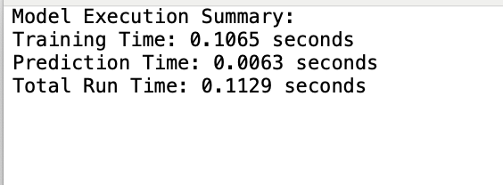
Example: Classification of News StoRies

Slide 11
Conclusion/Next steps
Conclusion
Conformal Prediction (CP) ensures reliable prediction sets with finite-sample validity
Advancements have made CP feasible for large-scale applications despite computational challenges.
See github repo for practical example
Future Considerations:
Improving Interval Tightness: Adaptive nonconformity scores.
Comparing CP with Bayesian Methods: Performance trade-offs.
Scaling CP for Big Data: Efficient parallel processing.

Slide 12
Thank You
Michael Ghattas
michael.Ghattas@du.edu
Mike Worden
mike.worden@du.edu

Slide 13
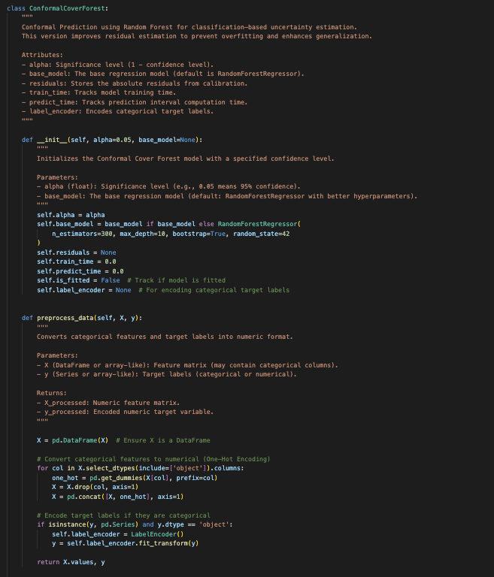
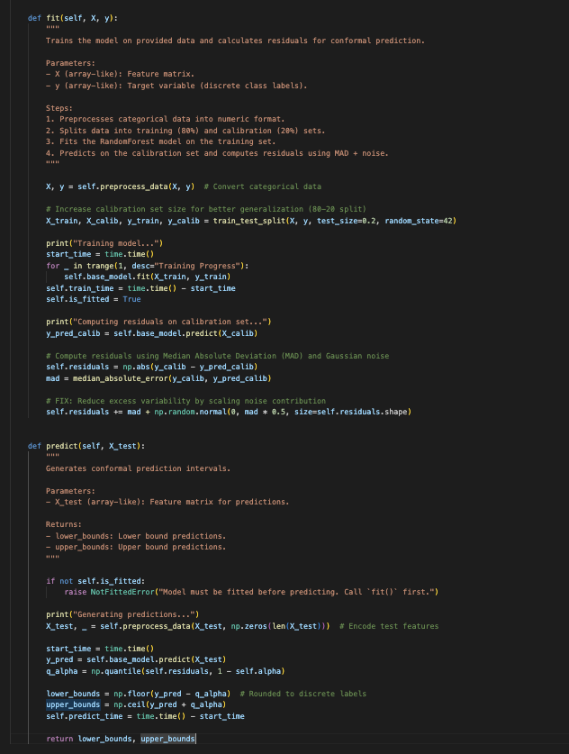
CLASS DEFINITION

