Slide 1

S.A.M. Tool
Contributors:
Sarah Kang
Aaron Montano
Might Lee

Slide 2

Description / Usage
First time investor
Benchmarking Tool

Slide 3

Profile Questionnaire – User Input pt. 1
Determine Risk Profile
Determine Investor’s Net Worth
Positive Net Worth = Initial Investment Amount
Negative Net Worth = Insufficient Funds

Slide 4


Profile Questionnaire – User Input pt. 2
Determine Investor’s Risk Ability (Investment Time Horizon)
65 - {Age}
Determine Risk Willingness (Level of comfort with loss)

Slide 5
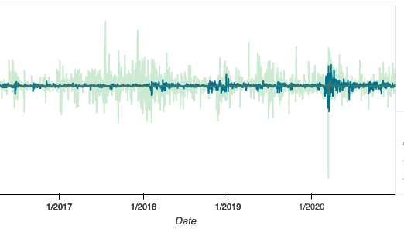
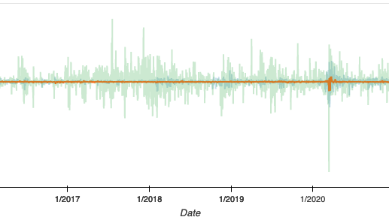
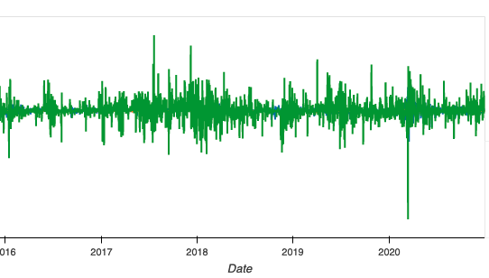
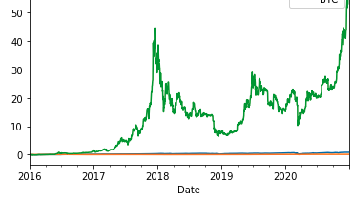
Assets – SPY, AGG, BTC
Stocks = S&P 500 Index (SPY)
Bonds = US Aggregate Bond Index (AGG)
Crypto Assets = Bitcoin (BTC)
SPY
AGG
Cumulative Returns
BTC

Slide 6
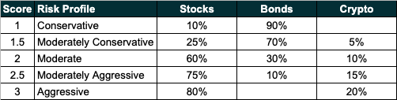
Risk Profile - Input

Slide 7
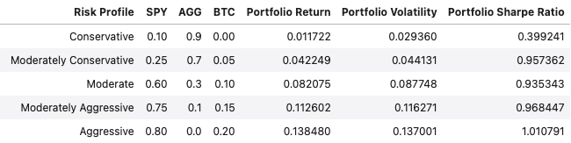
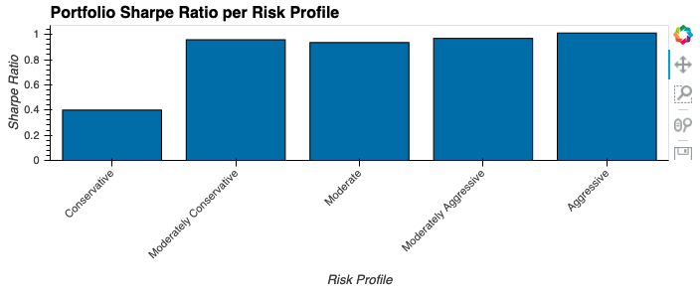
Portfolio Statistics per Risk Profile

Slide 8
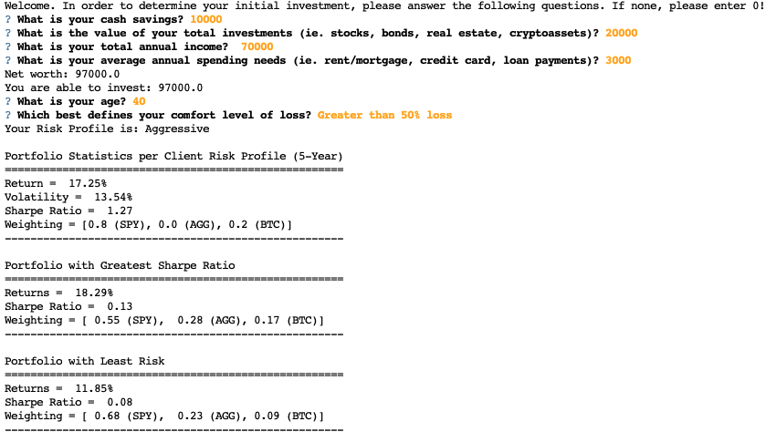
User Interface Sample

Slide 9
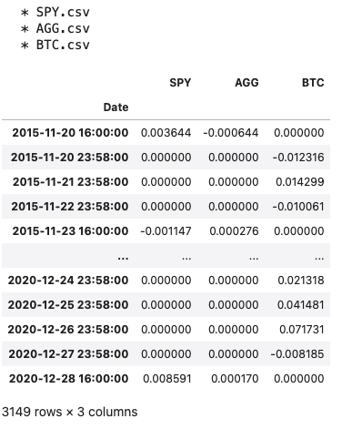
Data Retrieval

Slide 10
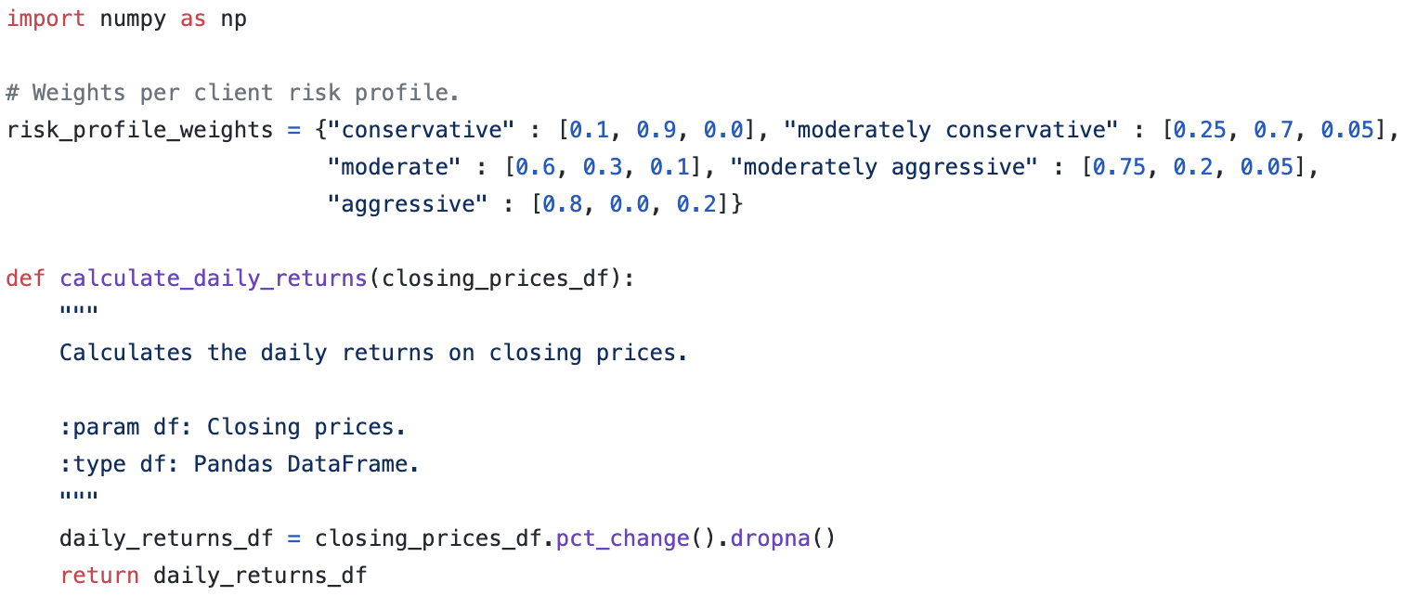
Data Retrieval / Calculations

Slide 11
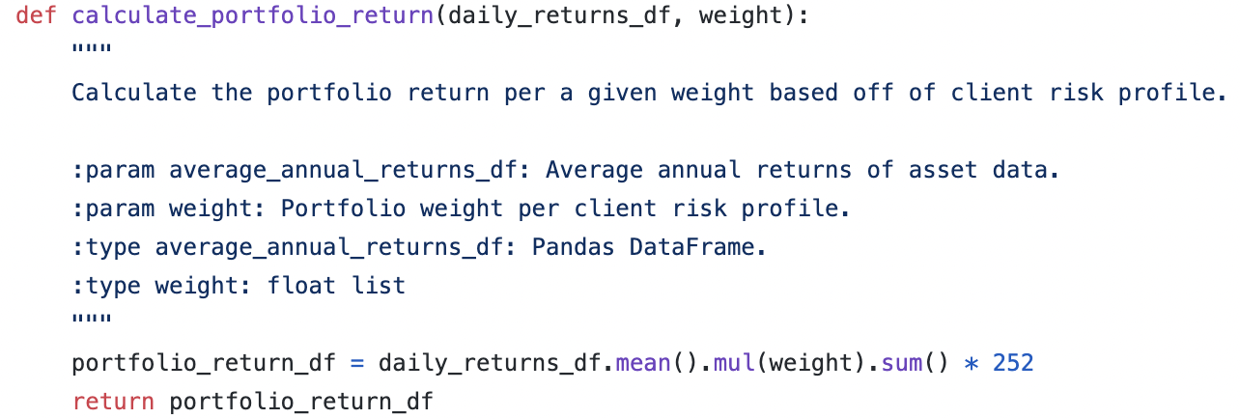
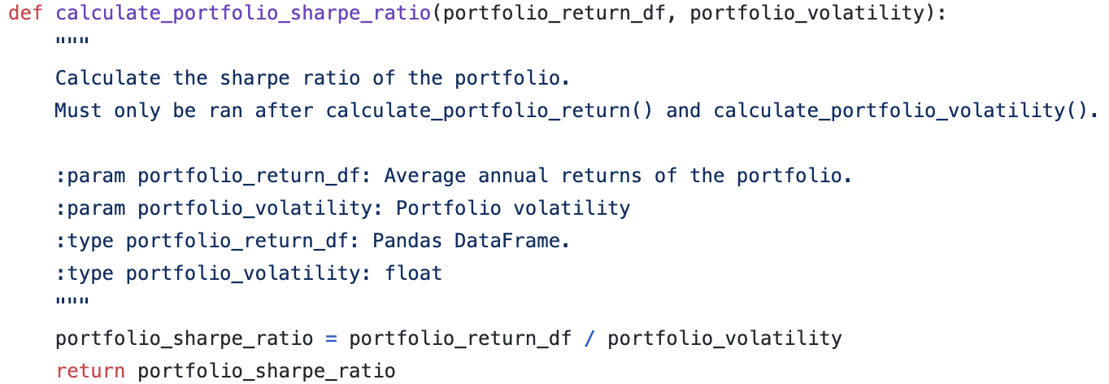
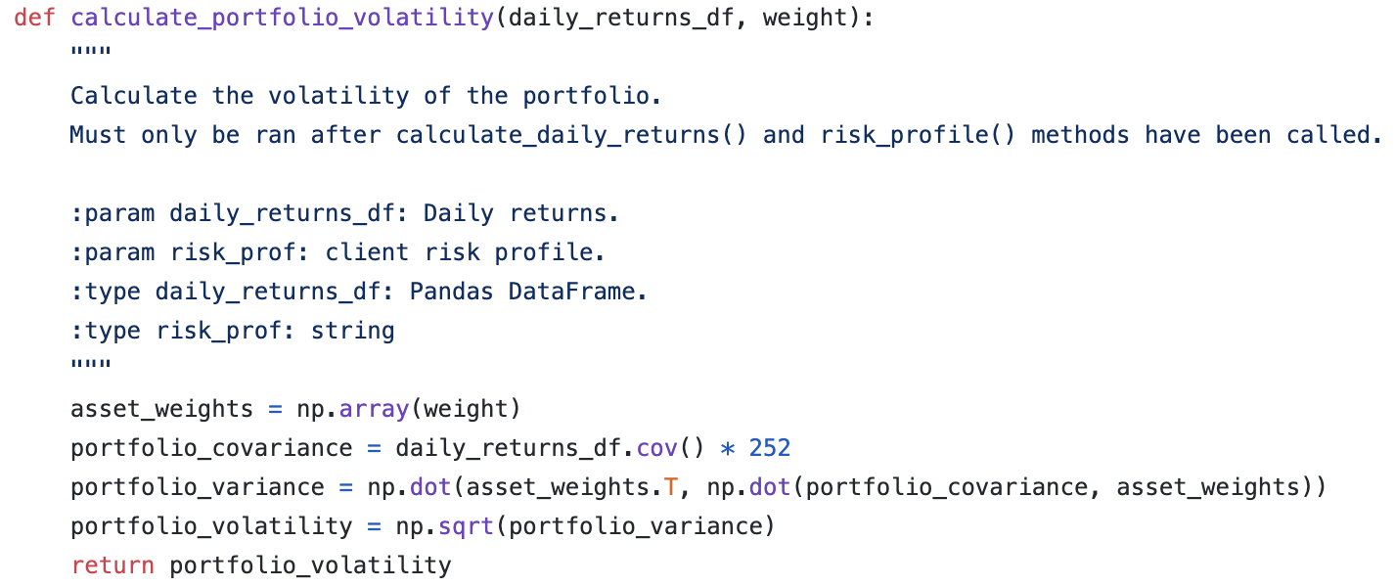
Calculations continued…

Slide 12
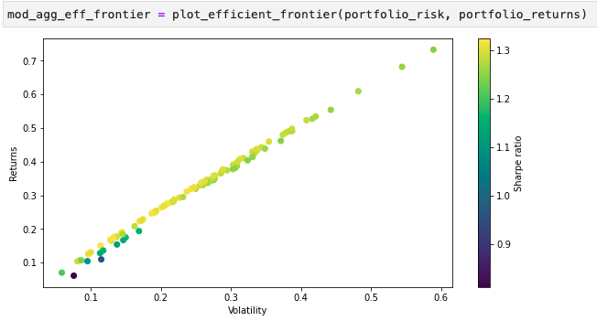
Efficient Frontier

Slide 13
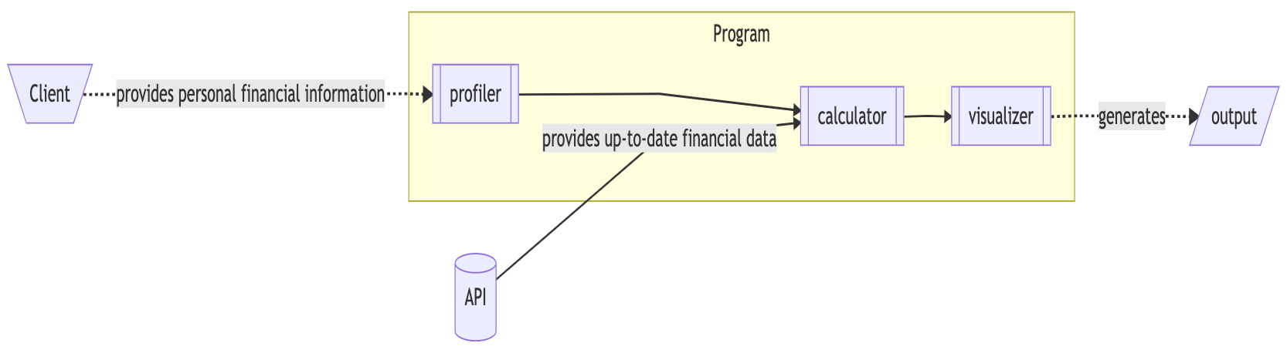
Systems Diagram

Slide 14
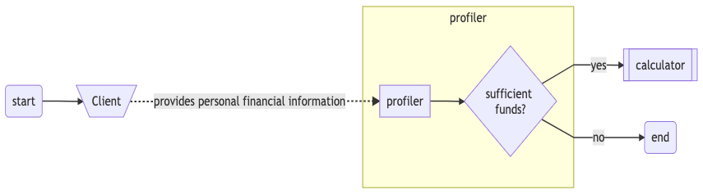
Profiler Pipeline

Slide 15
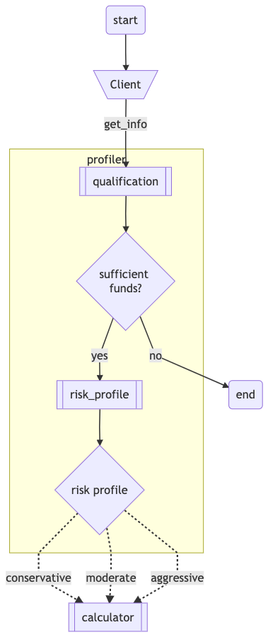
Client Profiler

Slide 16
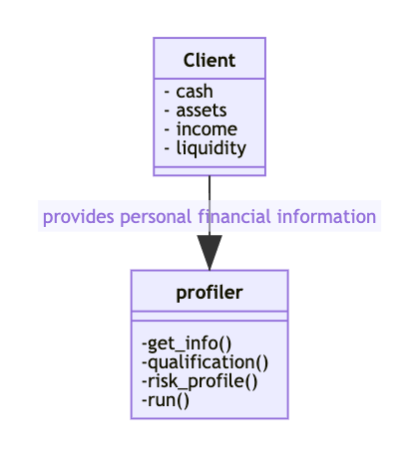
Class Diagrams

