Slide 1
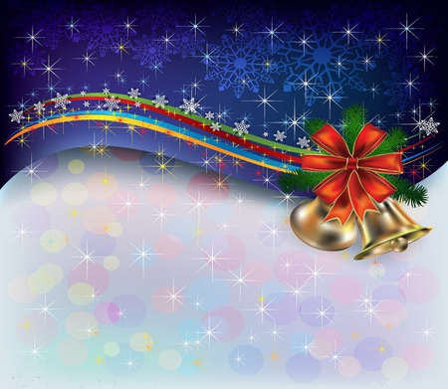
Jingle Bells

Slide 2
Dashing through
the snow
In a one-horse open sleigh.
O'er the fields we go. Laughing all the way.

Slide 3
Bells on
bobtails ring.
Making spirits bright.
What fun it is to ride
and sing.
A sleighing song tonight.

Slide 4
Jingle bells,
jingle bells.
Jingle all the way.
Oh, what fun it is to ride.
In a one-horse open sleigh

