Slide 1
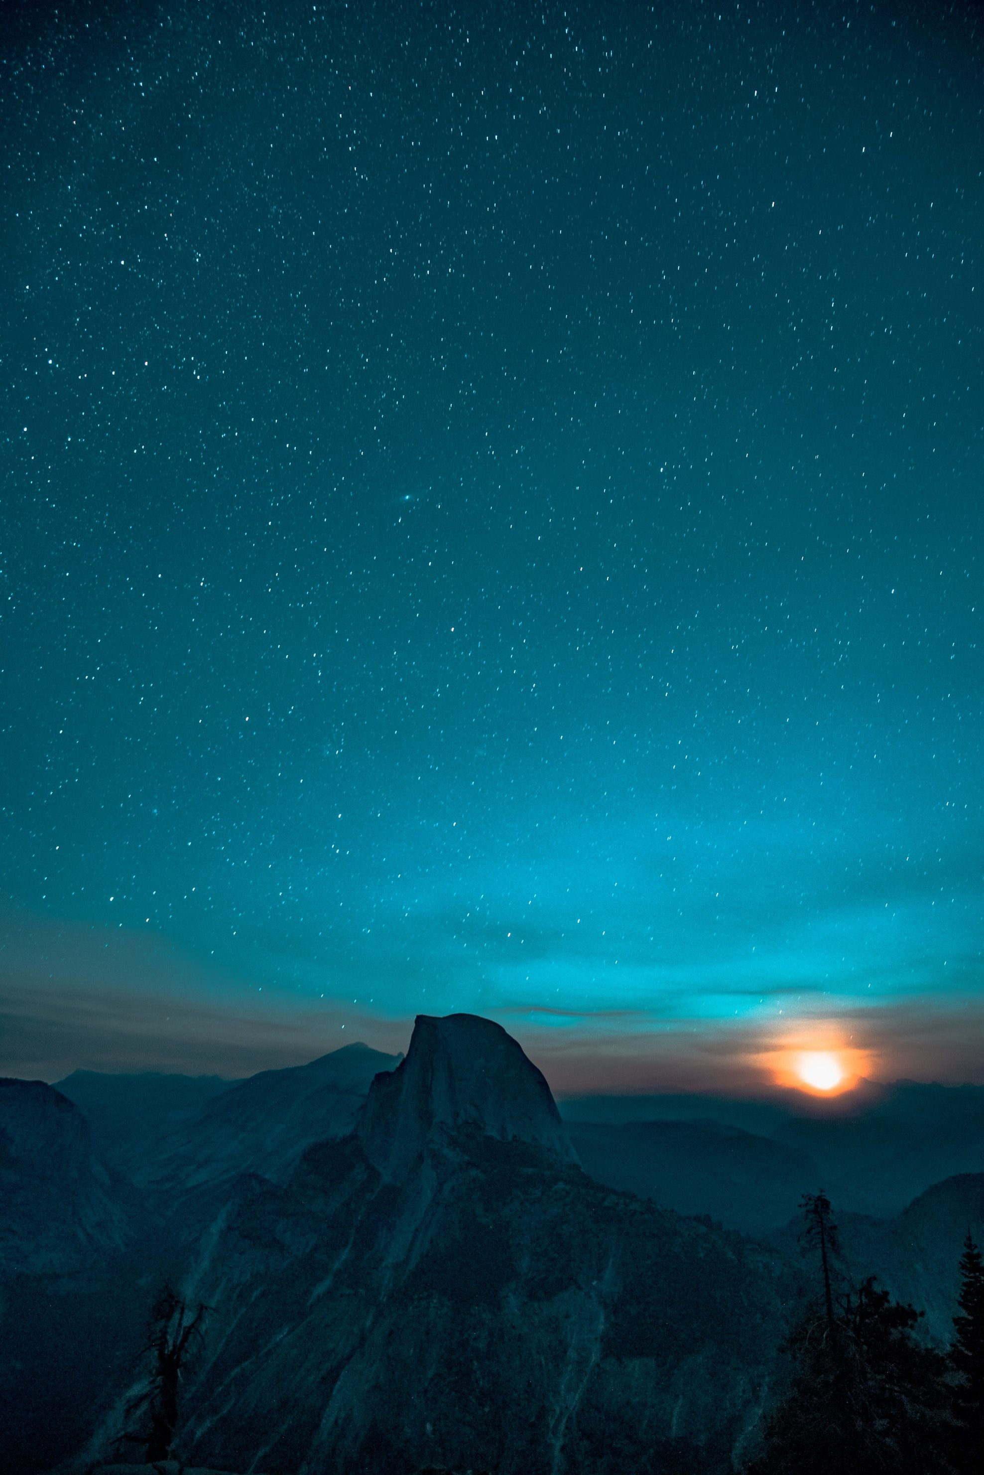
Step by Step

Slide 2
Oh God,
You are my God.
And I will ever
praise You.

Slide 3
I will seek
You in the morning.
And I will learn to walk in Your ways.

Slide 4
And Step by step You'll lead me.
And I will follow You all of my days.

