Slide 1
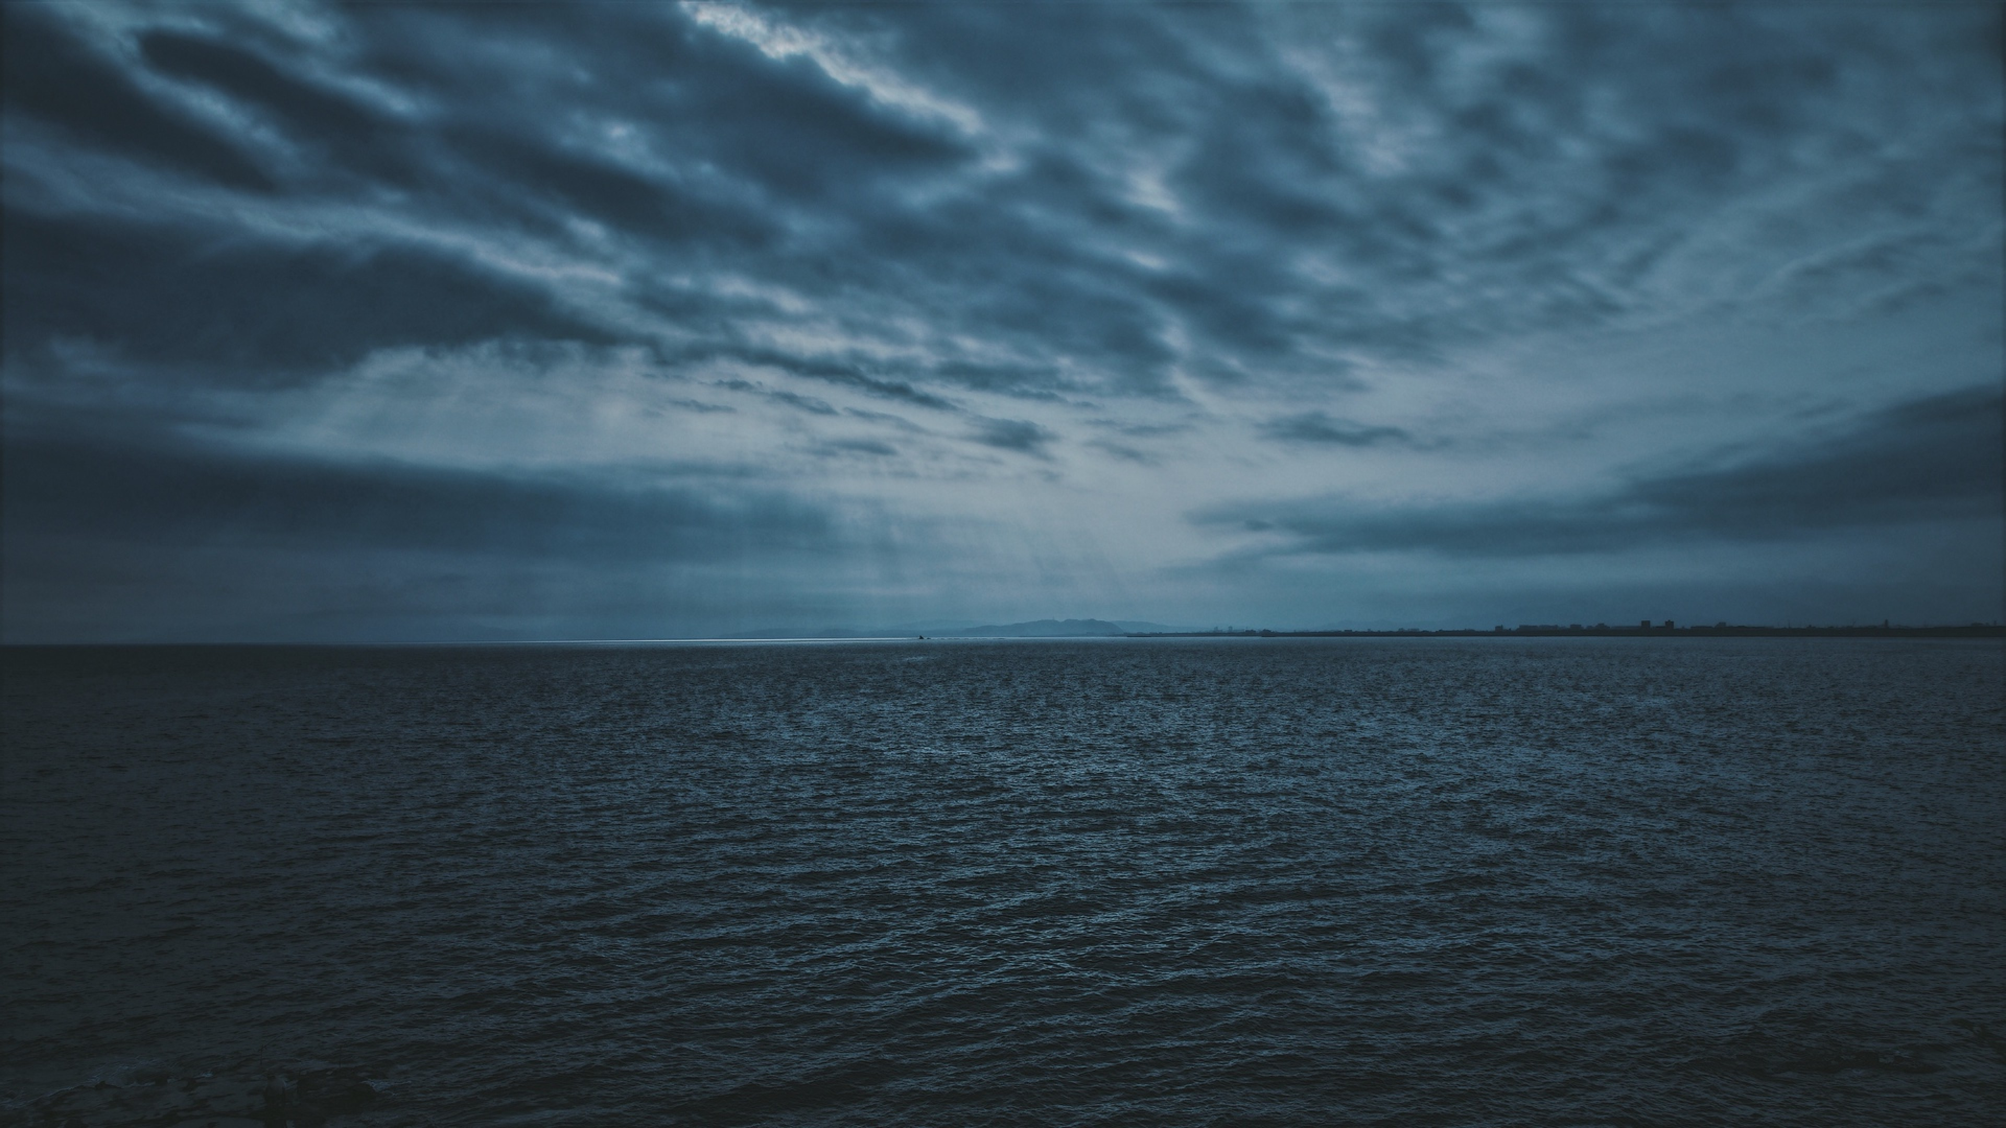
Oceans (Where Feet May Fail)

Slide 2
You call me out
upon the waters.
The great unknown where feet may fail

Slide 3
And there I find You in the mystery.
In oceans deep my faith will stand.

Slide 4
I will call upon
Your Name.
And keep my eyes above the waves.

Slide 5
When oceans rise.
My soul will rest
in Your embrace.
For I am Yours
and You are mine.

Slide 6
Your grace abounds
in deepest waters.
Your sovereign hand
will be my guide.

Slide 7
Where feet may fail
and fear surrounds me. You’ve never failed
and You won’t start now.

Slide 8
Spirit lead me where my trust is without borders. Let me walk upon the waters.
Wherever You would call me.

Slide 9
Take me deeper than my feet could ever wander. And my faith will be made stronger.
In the presence of my Saviour.

Slide 10
I will call upon Your Name.
Keep my eyes above the waves.

Slide 11
My soul will rest in Your embrace.
I am Yours and You are mine.

