Slide 1
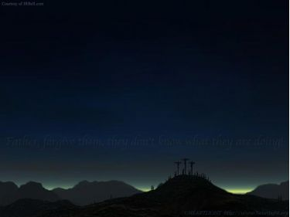
Forgiven

Slide 2
I'm the one who
held the nail.
It was cold between my fingertips.
I've hidden
in the garden.

Slide 3
I've denied You
with my very lips.
God, I fall down to my knees with a hammer in my hand. You look at me, arms open.

Slide 4
Forgiven! Forgiven!
Child there is freedom from all of it.
Say goodbye to every sin.
You are forgiven.

Slide 5
I've done things
I wish I hadn't done. I've seen things
I wish I hadn't seen. Just the thought of Your amazing grace.

Slide 6
And I cry
”Jesus, forgive me!”
God, I fall down to my knees with a hammer in my hand. You look at me, arms open.

Slide 7
Forgiven! Forgiven!
Child there is freedom from all of it.
Say goodbye to every sin.
You are forgiven.

Slide 8
I could've been
six feet under.
I could've been
lost forever.
Yeah I should be
in that fire.

Slide 9
But now there's fire inside of me.
Here I am a dead man walking.
No grave gonna hold God's people.

Slide 10
All the weight
of all our evil.
Lifted away
forever free.
Who could believe, who could believe?.

Slide 11
Forgiven! Forgiven! You love me even when I don't
deserve it.
Forgiven!
I'm Forgiven!

Slide 12
Jesus Your blood makes me innocent. So I will say goodbye to every sin.
I am forgiven!

