Slide 1
DECODER
A binary code of n-bits is capable of representing 2^{n} distinct elements of coded information. A decoder is a combinational circuit that converts binary information from n – input lines to a maximum of 2^{n} unique output lines.
Ex;- BCD- to seven segment-decoder

Slide 2
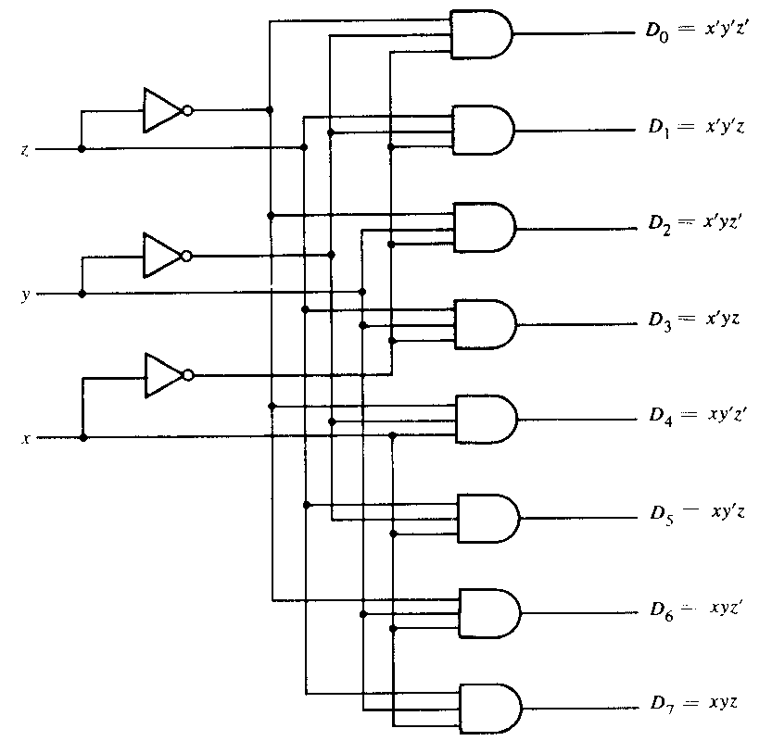
Three- to -eight -line decoder

Slide 3
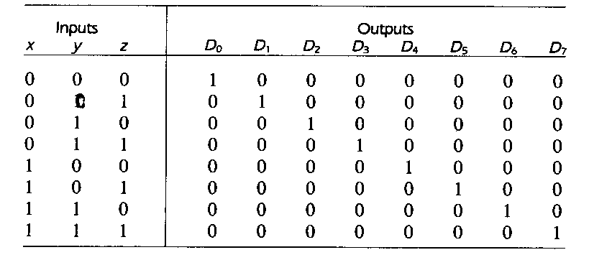
The three inputs are decoded into eight outputs, each representing one of the minterms of the three input variables. A particular application of this decoder is binary- to- octal- conversion.
Truth table of 3-to-8- line Decoder

Slide 4
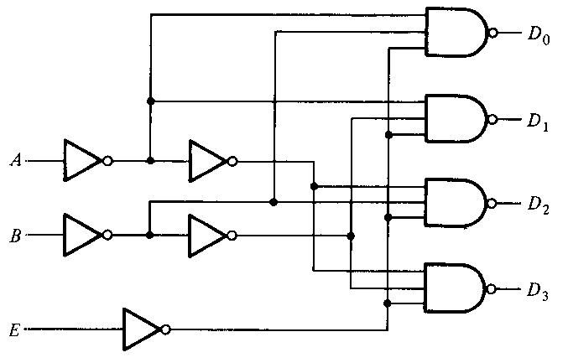
Some decoders are constructed with NAND gates. Since a NAND gate produces the AND operation with an inverted output, it becomes more economical to generate the decoder minterms in their complemented form.
Decoders include one or more enable input to control the circuit operation.
A 2-to- 4-line decoder with an enable input constructed with NAND gates is shown in figure

Slide 5
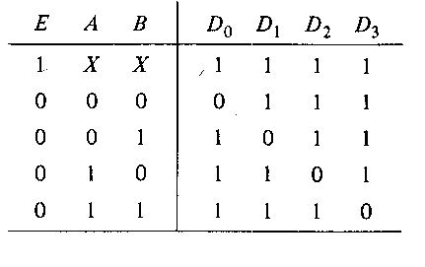
The circuits operates with complemented outputs and a complemented enable input. The decoder is enabled when E is equal to 0. As in the truth Table, only one output can be equal to 0 at any given time, all other outputs are equal to one.
The circuit is disabled when E is equal to 1, regardless of the values of the other inputs.

Slide 6
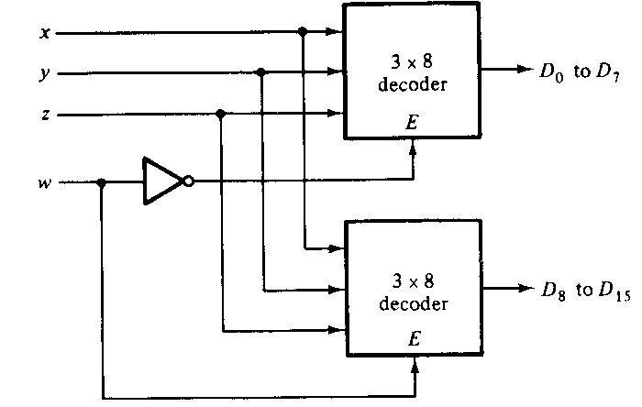
Decoders with enable inputs can be connected together to form a larger decoder circuit. Figure as below, shows two 3-to-8-line decoders with enable inputs connected to form a 4-to-16-line decoder.

Slide 7
Working:-
When w=0, the top decoder is enabled and the other is disabled. The bottom decoder outputs are all 0’s , and the top eight outputs generate minterms 0000 to 0111. When w = 1, the enable conditions are reversed, the bottom decoder outputs generate minterms 1000 to 1111, while the outputs of the top decoder are all 0’s.
In general, enable inputs are convenient feature for interconnecting two or more standard components for the purpose of combining them into a similar function with more inputs and outputs.

Slide 8
Combinational logic Implementation
Since any Boolean function can be expressed in sum- of –minterms form, a decoder that generates the minterms of the function, together with an external OR gate that forms their logical sum, provides a hardware implementation of the function. In this way, any combinational circuit with n -inputs and m - outputs can be implemented with an n-to-2^{n} – line decider and m - OR gates.
For implementation, first express the Boolaen function as a sum of minterms then a decoder is chosen that generates all the minterms of the input variables. The inputs of each OR gate are selected from the decoder outputs according to the list of minterms of each function.

Slide 9
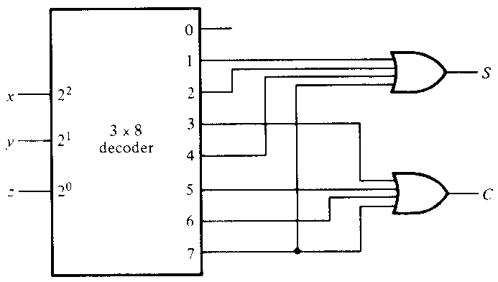
Implementation of Full adder with 3-to-8-line decoder and OR gate
From the truth table of the full adder , we obtain the functions for the combinational circuit in sum-of-minterms form:
S(x,y,z) = Σ (1,2,4,7)
C(x,y,z) = Σ (3,5,6,7)

Slide 10
ENCODERS
An encoder is a digital circuit that performs the inverse operation of a decoder.
An encoder has 2^{n} (or fewer input lines an n-output lines. The output lines, as an aggregate, generate the binary code corresponding to the input value.
An example of an encoder is the octal – to –binary encoder. It has eight inputs and three outputs that generate the corresponding binary number. It is assumed that only one input has a value of 1 at any given time. The encoders can be implemented with OR gates whose inputs are determined directly from the truth table. Output z is equal to 1 when the input octal digit is 1, 3 ,5 or 7. Output y is 1 for octal digits 2, 3, 6, 7 and output x is 1 for digits 4,5, 6 or 7.

Slide 11
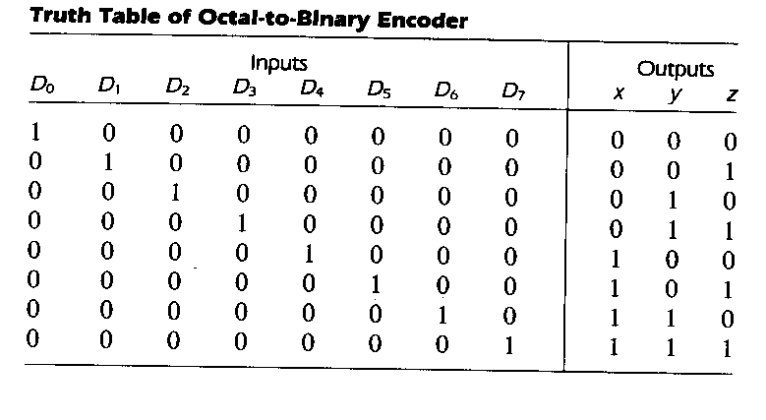
These conditions can be expressed by the following Boolean output functions:-
Z = D₁+D₃+D₅+D₇
Y = D₂+D₃+D₆+D₇
X = D₄+D₅+D₆+D₇

Slide 12
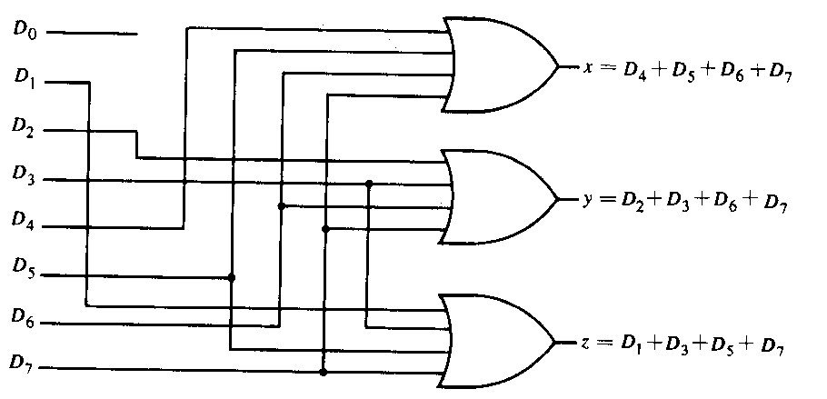
Octal – to – binary encoder

Slide 13
The encoder defined in above table has the limitation that only one input can be active at any given time. If two inputs are active simultaneously, the output produces an undefined combination. For ex, if D₃ and D₆ are 1 simultaneously, the output of the encoder will be 111 because all three outputs are equal to 1. The output 111 does not represent either binary 3 or binary 6. To resolve this ambiguity, encoder circuits must establish an input priority to ensure that only one input is encoded. If we establish a higher priority for inputs with higher subscript numbers, and if both D₃ and D₆ are 1 at the same time, the output will be 110 because D₆ has higher priority than D₃.
Another ambiguity in the octal-to-binary encoder is that an output with all 0’s is generated when all the inputs are 0, but this output is the input as when D₀ is equal to 1. It can be resolved by providing one more output to indicate whether at least one input is equal to 1.

Slide 14
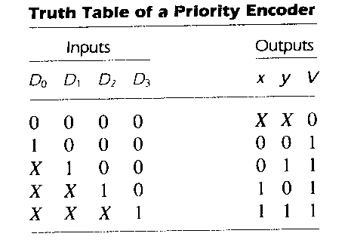
Priority encoder
A priority is encoder is an encoder ckt that includes the priority function. The operation of the priority encoder is such that if two or more inputs are equal to 1 at the same time , the input having the highest priority will take precedence. The truth table of a four –input priority encoder is given.

Slide 15
In addition to the two outputs x and y , the ckt has a third output designated by V: this is a valid bit indicator that is set to 1 when one or more inputs are equal to 1. If all inputs are 0. there is no valid input and V = 0. The other two outputs are not inspected when V = 0 and are specified as don’ts – care conditions and is represented by X in outputs columns.
According to the above table, the higher the subscript number, the higher the priority of the input. Input D₃ has the highest priority, so, regardless of the values of the other inputs, when this input is 1., the output for xy is 11. D₂ has the next priority level. The out is 10 if D₂ =1 provided that D₃ = 0, regardless of the values of the other two lower priority inputs. The output for D₁ is generated only if higher priority inputs are 1, and the on down the priority levels.

Slide 16
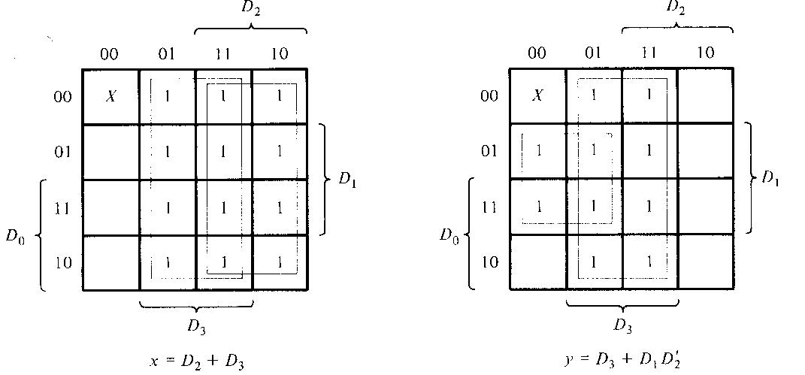
The k-maps to simplify the truth table is shown as below:

Slide 17
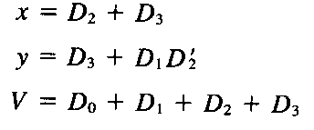
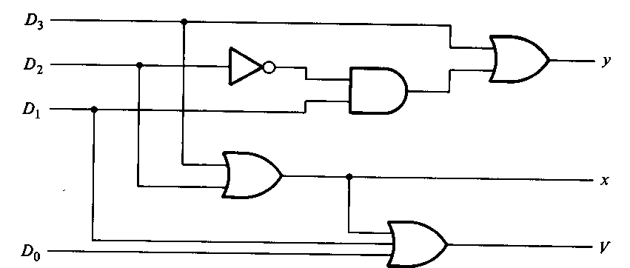
The ckt of four input priority encoder according to the following Boolean functions:-

Slide 18
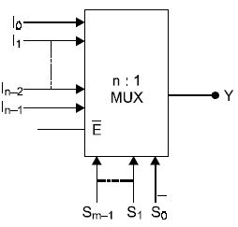
The Digital Multiplexer
A digital multiplexer (MUX) is a combinational circuits that selects one input (binary information) out of several inputs and direct it to a single output. The particular input selection is controlled by a set of select inputs. The block diagram of a digital multiplexer with n inputs lines and single output line.
For selecting one out of n input, a set of m select inputs is required where n = 2^{m}

Slide 19
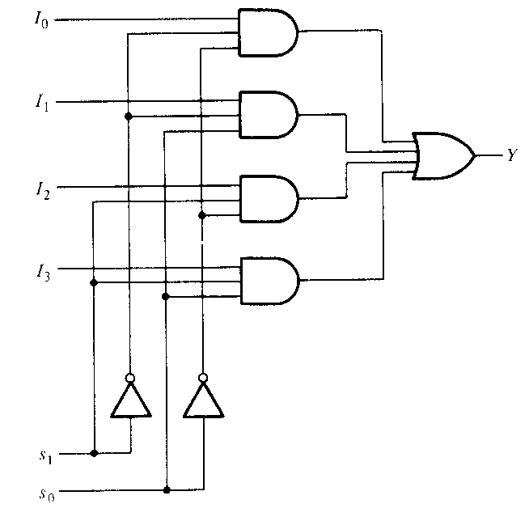
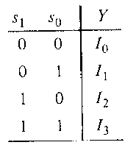
A circuit diagram for a 4-line to 1-line multiplexer (MUX) is shown in Figure.
Here, the output Y is equal to the input I₀, I₁, I₂, I₃ depending on whether the select lines S₁ and S₀ have values 00, 01, 10, 11 for S₁ and S₀ , respectively.
i.e., the output Y is selected to be equal to the input of the line given by
the binary value of the select lines S₁S₀.
The logic equation for the circuit shown in Figure is:
A multiplexer is also called a data selector, since it selects one of many inputs and steers the binary information to the output lines.

Slide 20
Boolean Function Implementation
The minterms of a function are generated in a multiplexer by the circuit associated with the selection inputs. The individual minterms can be selected by the data inputs, thereby providing a method of implementing a Boolean function of n-variables with a multiplexer that has n selection inputs and 2^{n} data inputs, one for each mintem.
A more efficient method for implementing a Boolean function of n variables with a multiplexer that has n-1 selection inputs. The first n-1 variables of the function are connected to the selection inputs of the multiplexer. The remaining single variable of the function is used for the data inputs.

Slide 21
To demonstrate the above procedure, consider the Boolean function
F(x, y, z) = Σ ( 1,2,6,7)
This function of three variables can be implemented with a four-to-one-line multiplexer as shown in fig.

Slide 22
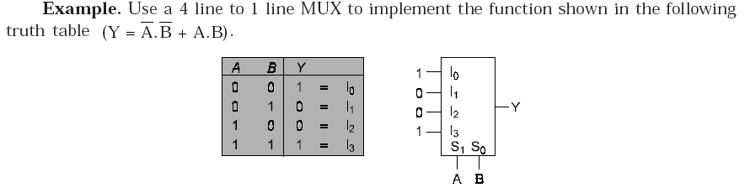
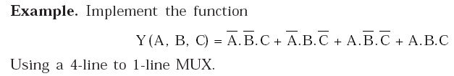
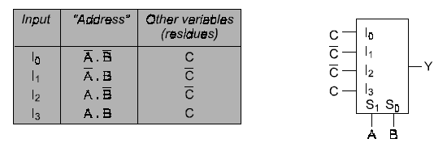

Slide 23

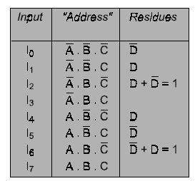
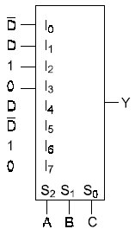
Solution:-we will use A, B, C as data select inputs, or address inputs, connected to S₂, S₁ and S₀, respectively.

