Slide 1
Outline
Dictionary ADT
Binary Search
Hashing
<number>/51

Slide 2
What is Dictionary
<number>/51

Slide 3
Dictionary
A dictionary is an abstract data type that stores elements which can be located very quickly.
One example that we can have for a dictionary is to store bank accounts.
<number>/51

Slide 4
What is a Key
<number>/51

Slide 5
Dictionary
What is the notion of the key, when you store bank accounts?
The notion of a key is your account number, bank account has lots of information associated with it, but you are going to access the bank account or data associated with that account by using the account numbers.
Thus the account number becomes the key.
<number>/51

Slide 6
Dictionary
Any application that wishes to do any kind of operation on an account, will have to provide the account number as key.
The process cannot be continued without a key.
<number>/51

Slide 7
Dictionary
The dictionary is basically an abstract model of a database.
It is going to store the key element pairs.
Anything uniquely identifies particular student or particular account becomes the key.
<number>/51

Slide 8
Characteristics of Dictionary
<number>/51

Slide 9
Dictionary
A dictionary is a collection of elements
Each element has a field called key
  (key, value)
Every key is usually distinct
Typical dictionary operations are:
  Determine whether or not the dictionary is empty
  Determine the dictionary size (i.e., # of pairs)
  Insert a pair into the dictionary
  Search the pair with a specified key
  Delete the pair with a specified key

Slide 10
Applications of Dictionary
<number>/51

Slide 11
Examples
Telephone directory
Library catalogue
Books in print: key ISBN
FAT (File Allocation Table)
<number>/51

Slide 12
Main Issues of Dictionary
<number>/51

Slide 13
Main Issues
Size
Operations: search, insert, delete, ??? Create reports??? List?
What will be stored in the dictionary?
How will be items identified?
<number>/51

Slide 14
What is Dictionary ADT
<number>/51

Slide 15
The Dictionary ADT
A dictionary (table) is an abstract model of a database
A dictionary stores key-element pairs.
The main operation supported by a dictionary is searching by key.
<number>/51

Slide 16
The Dictionary ADT
simple container methods
query methods
update methods
special element
<number>/51

Slide 17
The Dictionary ADT
simple container methods:
  size() : how many elements are there in the dictionary
  isEmpty() :whether the dictionary is empty or not
  elements(): returns all the elements in the dictionary.
<number>/51

Slide 18
The Dictionary ADT
query methods:
  findElement(k) : Given a particular key find the element corresponding to this key (findElem (k)).
  findAllElements(k) : given a particular key, you want to return all elements who have that key.
<number>/51

Slide 19
The Dictionary ADT
update methods:
  insertItem(k, e)
  removeElement(k)
  removeAllElements(k)
special element
  NO_SUCH_KEY, or NIL returned by an unsuccessful search
<number>/51

Slide 20
How to access Dictionary Elements
<number>/51

Slide 21
Accessing Dictionary Elements
Random Access
  Any element in the dictionary can be retrieved by simply performing a search on its key
Sequential Access
  Elements are retrieved one by one in ascending order of the key field
  Sequential Access Operations:
    Begin – retrieves the element with smallest key
    Next – retrieves the next element

Slide 22
Dictionary with Duplicates
Example?
<number>/51

Slide 23
Dictionary with Duplicates
Keys are not required to be distinct
Word dictionary is such an example
  Pairs are of the form (word, meaning)
  May have two or more entries for the same word
  For example, the meanings of the word, rank:
    (rank, a relative position in a society)
    (rank, an official position or grade)
    (rank, to give a particular order or position to)
    etc.

Slide 24
Types of Dictionary
<number>/51

Slide 25
Types of Dictionary
Ordered Dictionary
Unordered Dictionary
<number>/51

Slide 26
Example of unordered dictionary
Consider an empty unordered dictionary and the following set of operations:
Operation Dictionary Output
insertItem(5,A) {(5,A)}
insertItem(7,B) {(5,A), (7,B)}
insertItem(2,C) {(5,A), (7,B), (2,C)}
insertItem(8,D) {(5,A), (7,B), (2,C), (8,D)}
insertItem(2,E) {(5,A), (7,B), (2,C), (8,D), (2,E)}
findItem(7) {(5,A), (7,B), (2,C), (8,D), (2,E)} B
findItem(4) {(5,A), (7,B), (2,C), (8,D), (2,E)} NO_SUCH_KEY
findItem(2) {(5,A), (7,B), (2,C), (8,D), (2,E)} C
findAllItems(2) {(5,A), (7,B), (2,C), (8,D), (2,E)} C, E
size() {(5,A), (7,B), (2,C), (8,D), (2,E)} 5
removeItem(5) {(7,B), (2,C), (8,D), (2,E)} A
removeAllItems(2) {(7,B), (8,D)} C, E
findItem(4) {(7,B), (8,D)} NO_SUCH_KEY

Slide 27
Example of ordered dictionary
Consider an empty ordered dictionary and the following set of operations:
Operation Dictionary Output
insertItem(5,A) {(5,A)}
insertItem(7,B) {(5,A), (7,B)}
insertItem(2,C) {(2,C), (5,A), (7,B)}
insertItem(8,D) {(2,C), (5,A), (7,B), (8,D)}
insertItem(2,E) {(2,C), (2,E), (5,A), (7,B), (8,D)}
findItem(7) {(2,C), (2,E), (5,A), (7,B), (8,D)} B
findItem(4) {(2,C), (2,E), (5,A), (7,B), (8,D)} NO_SUCH_KEY
findItem(2) {(2,C), (2,E), (5,A), (7,B), (8,D)} C
findAllItems(2) {(2,C), (2,E), (5,A), (7,B), (8,D)} C, E
size() {(2,C), (2,E), (5,A), (7,B), (8,D)} 5
removeItem(5) {(2,C), (2,E), (7,B), (8,D)} A
removeAllItems(2) {(7,B), (8,D)} C, E
findItem(4) {(7,B), (8,D)} NO_SUCH_KEY

Slide 28
Implementations of the Dictionary ADT
Unordered sequence implementation
Ordered sequence implementation
Array-based ranked sequence implementation
<number>/51

Slide 29
Unordered sequence implementation
Features?
<number>/51

Slide 30
Unordered sequence implementation
Items are added to the initially empty dictionary as they arrive.
insertItem(key, element) method is O(1) no matter whether the new item is added at the beginning or at the end of the dictionary.
findItem(key), findAllItems(key), removeItem(key) and removeAllItems(key) methods, however, have O(n) efficiency.
Therefore, this implementation is appropriate in applications where the number of insertions is very large in comparison to the number of searches and removals.

Slide 31
Ordered sequence implementation
Features?
<number>/51

Slide 32
Ordered sequence implementation
Items are added to the initially empty dictionary in increasing order of their keys.
insertItem(key, element) method is O(n), because a search for the proper place of the item is required.
If the sequence is implemented as an ordered array, removeItem(key) and removeAllItems(key) take O(n) time, because all items following the item removed must be shifted to fill in the gap.
If the sequence is implemented as a doubly linked list , all methods involving search also take O(n) time.
Therefore, this implementation is inferior compared to unordered sequence implementation.
However, the efficiency of the search operation can be considerably improved, in which case an ordered sequence implementation will become a better choice.

Slide 33
Implementations of the Dictionary ADT (contd.)
Array-based ranked sequence implementation
A search for an item in a sequence by its rank takes O(1) time.
We can improve search efficiency in an ordered dictionary by using binary search; thus improving the run time efficiency of insertItem(key, element), removeItem(key) and removeAllItems(key) to O(log n).

Slide 34
Dictionary Types
ordered dictionary
  are binary search trees and AVL trees
unordered dictionary
  is by means of a hash table.
<number>/51

Slide 35
Dictionary Implemantation
If Array and Linked List used as Dictionary?
<number>/51

Slide 36
Implementing a Dictionary with a Sequence
unordered sequence
  searching and removing takes O(n) time
  inserting takes O(1) time
  applications to log files (frequent insertions, rare searches and removals) 34 14 12 22 18
34
14
12
22
18
<number>/51

Slide 37
More Arrays
Ordered array
searching takes O(log n) time (binary search)
inserting and removing takes O(n) time
application to look-up tables (frequent searches, rare insertions and removals)
Apply binary search

Slide 38
Types of Search
Sequential
Binary
How to analyze the performance?
<number>/51

Slide 39
Search Analysis
the average time
the worst-case time and
the best possible time.
Which one is most generalized?

Slide 40

What is worst case in searching
<number>/51

Slide 41
Worst Case
If there are n items in our collection - whether it is stored as an array or as a linked list - then it is obvious that in the worst case, when there is no item in the collection with the desired key, then n comparisons of the key with keys of the items in the collection will have to be made.
<number>/51

Slide 42
What is Best Case in Searching
<number>/51

Slide 43
Best Case
The best case - in which the first comparison returns a match - requires a single comparison and is O(1).

Slide 44
What is Average Case in Searching
The average time depends on the probability that the key will be found in the collection - this is something that we would not expect to know in the majority of cases. Thus in this case, as in most others, estimation of the average time is of little utility. If the performance of the system is vital, i.e. it's part of a life-critical system, then we must use the worst case in our design calculations as it represents the best guaranteed performance.
<number>/51

Slide 45
What is Binary Serach
<number>/51

Slide 46
Binary Search
However, if we place our items in an array and sort them in either ascending or descending order on the key first, then we can obtain much better performance with an algorithm called binary search.
<number>/51

Slide 47
Binary Search Steps
In binary search, we first compare the key with the item in the middle position of the array.
If there's a match, we can return immediately.
If the key is less than the middle key, then the item sought must lie in the lower half of the array;
if it's greater then the item sought must lie in the upper half of the array.
So we repeat the procedure on the lower (or upper) half of the array
<number>/51

Slide 48
Binary Search
Binary search. Given a key and sorted array a[], find index I such that a[i] = key, or report that no such index exists.
Invariant. Algorithm maintains a[lo] ≤ key ≤ a[hi].
Ex. Binary search or 33.
6
13
14
25
33
43
51
53
64
72
84
93
95
96
97
0
1
2
3
4
5
6
7
8
9
10
11
12
13
14
lo
hi

Slide 49
Binary Search
Binary search. Given a key and sorted array a[], find index I such that a[i] = key, or report that no such index exists.
Invariant. Algorithm maintains a[lo] ≤ key ≤ a[hi].
Ex. Binary search for 33.
6
13
14
25
33
43
51
53
64
72
84
93
95
96
97
0
1
2
3
4
5
6
7
8
9
10
11
12
13
14
lo
mid
hi

Slide 50
Binary Search
Binary search. Given a key and sorted array a[], find index I such that a[i] = key, or report that no such index exists.
Invariant. Algorithm maintains a[lo] ≤ key ≤ a[hi].
Ex. Binary search for 33.
6
13
14
25
33
43
51
53
64
72
84
93
95
96
97
0
1
2
3
4
5
6
7
8
9
10
11
12
13
14
lo
hi

Slide 51
Binary Search
Binary search. Given a key and sorted array a[], find index I such that a[i] = key, or report that no such index exists.
Invariant. Algorithm maintains a[lo] ≤ key ≤ a[hi].
Ex. Binary search for 33.
6
13
14
25
33
43
51
53
64
72
84
93
95
96
97
0
1
2
3
4
5
6
7
8
9
10
11
12
13
14
lo
mid
hi

Slide 52
Binary Search
Binary search. Given a key and sorted array a[], find index I such that a[i] = key, or report that no such index exists.
Invariant. Algorithm maintains a[lo] ≤ key ≤ a[hi].
Ex. Binary search for 33.
6
13
14
25
33
43
51
53
64
72
84
93
95
96
97
0
1
2
3
4
5
6
7
8
9
10
11
12
13
14
lo
hi

Slide 53
Binary Search
Binary search. Given a key and sorted array a[], find index I such that a[i] = key, or report that no such index exists.
Invariant. Algorithm maintains a[lo] ≤ key ≤ a[hi].
Ex. Binary search for 33.
6
13
14
25
33
43
51
53
64
72
84
93
95
96
97
0
1
2
3
4
5
6
7
8
9
10
11
12
13
14
lo
mid
hi

Slide 54
Binary Search
Binary search. Given a key and sorted array a[], find index I such that a[i] = key, or report that no such index exists.
Invariant. Algorithm maintains a[lo] ≤ key ≤ a[hi].
Ex. Binary search for 33.
6
13
14
25
33
43
51
53
64
72
84
93
95
96
97
0
1
2
3
4
5
6
7
8
9
10
11
12
13
14
lo
hi

Slide 55
Binary Search
Binary search. Given a key and sorted array a[], find index I such that a[i] = key, or report that no such index exists.
Invariant. Algorithm maintains a[lo] ≤ key ≤ a[hi].
Ex. Binary search for 33.
6
13
14
25
33
43
51
53
64
72
84
93
95
96
97
0
1
2
3
4
5
6
7
8
9
10
11
12
13
14
lo
hi
mid

Slide 56
Binary Search
Binary search. Given a key and sorted array a[], find index I such that a[i] = key, or report that no such index exists.
Invariant. Algorithm maintains a[lo] ≤ key ≤ a[hi].
Ex. Binary search for 33.
6
13
14
25
33
43
51
53
64
72
84
93
95
96
97
0
1
2
3
4
5
6
7
8
9
10
11
12
13
14
lo
hi
mid

Slide 57
More About Binary Search
bin_search is recursive: it determines whether the search key lies in the lower or upper half of the array, then calls itself on the appropriate half.
There is a termination condition
  If there is a match with the element in the middle of the current partition, then we can return immediately.

Slide 58
const int arraySize = 13;
int a[arraySize] = {1, 2, 9, 12, 23, 44, 45, 55, 66, 77, 87, 88, 100 };
int key = 23 , low = 0, middle, high = (arraySize - 1);
while (low <= high) {
middle = (low + high) / 2;
if (key == a[middle]) {
cout << “Found element “ << key << “ at index “ << middle << endl;
break;
}
else if (key < a [middle])
high = middle -1; // search low end of array
else
low = middle + 1; // search high end of array
}

Slide 59
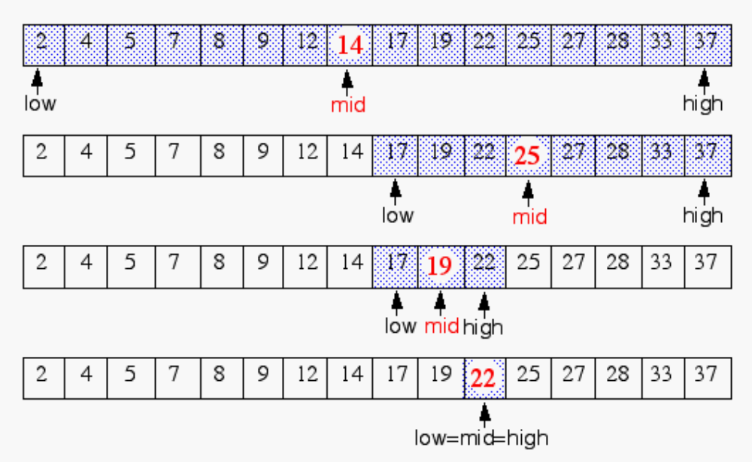
Binary Search
Idea: Divide and conquer, a key design technique
narrow down the search range in stages
findElement(22)

Slide 60
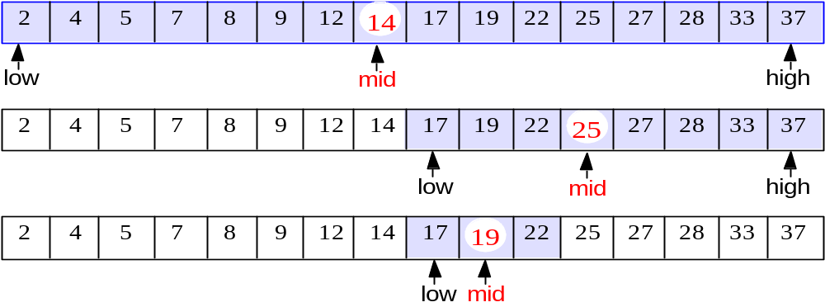
A recursive procedure
Algorithm BinarySearch(A, k, low, high)
if low > high then return Nil
else mid ← (low+high) / 2
if k = A[mid] then return mid
elseif k < A[mid] then
return BinarySearch(A, k, low, mid-1)
else return BinarySearch(A, k, mid+1, high)

Slide 61
An iterative procedure
INPUT: A[1..n] – a sorted (non-decreasing) array of integers, key – an integer.
OUTPUT: an index j such that A[j] = k.
NIL, if ∀j (1 ≤ j ≤ n): A[j] ≠ k
low ←1
high ← n
do
mid ← (low+high)/2
if A[mid] = k then return mid
else if A[mid] > k then high ← mid-1
else low ← mid+1
while low <= high
return NIL

Slide 62
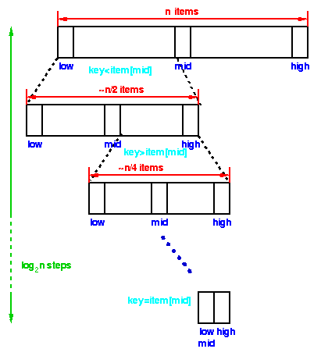
 | Each step of the algorithm divides the block of items being searched in half. We can divide a set of n items in half at most log₂ n times. Thus the running time of a binary search is proportional to log n and we say this is a O(log n) algorithm.

Slide 63
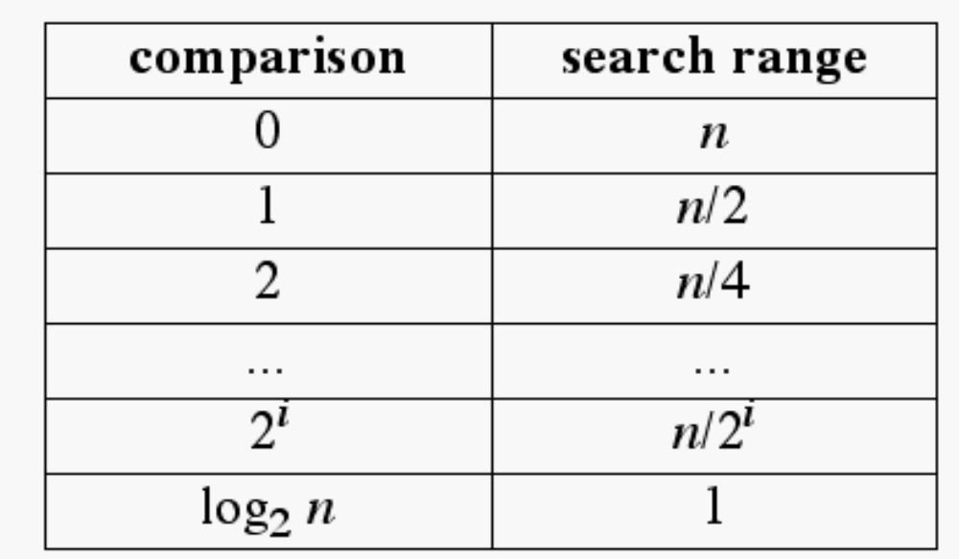
Running Time of Binary Search
The range of candidate items to be searched is halved after each comparison
In the array-based implementation, access by rank takes O(1) time, thus binary search runs in O(log n) time

Slide 64
Hashing
Implementation of unordered dictionaries: hash tables

Slide 65
Hash Tables
A data structure
The location of an item is determined
  directly as a function of the item itself
  Not by a sequence of trial and error comparisons
Commonly used to provide faster searching
  O(n) for linear searches
  O (logn) for binary search
  O(1) for hash table
<number>/51

Slide 66
Example:
A symbol table constructed by a compiler
  Stores identifiers and information about them
<number>/51

Slide 67
What is a Hash Table ?
The simplest kind of hash table is an array of records.
This example has 701 records.
[ 0 ]
[ 1 ]
[ 2 ]
[ 3 ]
[ 4 ]
[ 5 ]
[ 700]
. . .
An array of records
Notes:
This lecture introduces hash tables, which are an array-based method for implementing a Dictionary. You should recall that we have seen dictionaries implemented in other ways, for example with a binary search tree. The abstract properties of a dictionary remain the same: We can insert items in the dictionary, and each item has a key associated with it. When we want to retrieve an item, we specify only the key, and the retrieval process finds the associated data.
What we do now is use an array to implement the dictionary. The array is an array of records. In this example, we could store up to 701 records in the array.

Slide 68
What is a Hash Table ?
[ 4 ]
Number 506643548
Each record has a special field, called its key.
In this example, the key is a long integer field called Number.
[ 0 ]
[ 1 ]
[ 2 ]
[ 3 ]
[ 4 ]
[ 5 ]
[ 700]
. . .
Notes:
Each record in the array contains two parts. The first part is a number that we'll use for the key of the item. We could use something else for the keys, such as a string. But for a hash table, numbers make the most convenient keys.

Slide 69

What is a Hash Table ?
[ 4 ]
Number 506643548
The number might be a person's identification number, and the rest of the record has information about the person.
[ 0 ]
[ 1 ]
[ 2 ]
[ 3 ]
[ 4 ]
[ 5 ]
[ 700]
. . .
Notes:
The numbers might be identification numbers of some sort, and the rest of the record contains information about a person. So the pattern that you see here is the same pattern that you've seen in other dictionaries: Each entry in the dictionary has a key (in this case an identifying number) and some associated data.

Slide 70



What is a Hash Table ?
When a hash table is in use, some spots contain valid records, and other spots are "empty".
[ 0 ]
[ 1 ]
[ 2 ]
[ 3 ]
[ 4 ]
[ 5 ]
[ 700]
Number 281942902
Number 233667136
Number 506643548
. . .
Number 155778322
Notes:
When a hash table is being used as a dictionary, some of the array locations are in use, and other spots are "empty", waiting for a new entry to come along.
Oftentimes, the empty spots are identified by a special key. For example, if all our identification numbers are positive, then we could use 0 as the Number that indicates an empty spot.
With this drawing, locations [0], [4], [6], and maybe some others would all have Number=0.

Slide 71
Implementation of unordered dictionaries: hash tables
Hashing is a method for directly referencing an element in table by performing arithmetic transformations on keys into table addresses. This is carried out in two steps:
Step 1: Computing the so-called hash function H: K -> A.
Step 2: Collision resolution, which handles cases where two or more different keys
hash to the same table address.

Slide 72
Implementation of hash tables
Hash tables consist of two components:
a bucket array and
a hash function.

Slide 73
Bucket Array
Each cell is thought of as a bucket or a container
  Holds key element pairs
  In array A of size N, an element e with key k is inserted in A[k].
(null)
(null)
…
Roberto
…
(null)
000-000-0000 000-000-0001 401-863-7639 ... 999-999-9999
<number>/51

Slide 74
Generalized indexing
Hash table
  Data storage associated with a key
  The key need not be an integer
<number>/51

Slide 75
Hash functions
We can limit the size of the bucket array to almost any size; however, we must provide a way to map key values into array index values. This is done by an appropriately selected hash function, h(k). The simplest hash function is
h(k) = k mod N
where k can be very large, while N can be as small as we want it to be. That is, the hush function converts a large number (the key) into a smaller number serving as an index in the bucket array.

Slide 76
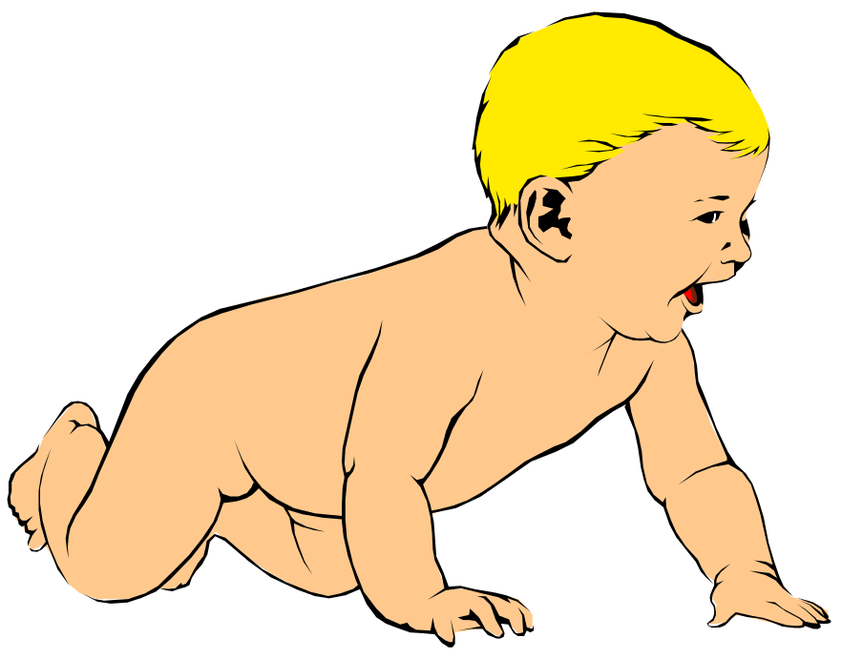
Inserting a New Record
Number 580625685
In order to insert a new record, the key must somehow be converted to an array index.
The index is called the hash value of the key.
[ 0 ]
[ 1 ]
[ 2 ]
[ 3 ]
[ 4 ]
[ 5 ]
[ 700]
Number 281942902
Number 233667136
Number 506643548
. . .
Number 155778322
Notes:
In order to insert a new entry, the key of the entry must somehow be converted to an index in the array. For our example, we must convert the key number into an index between 0 and 700. The conversion process is called hashing and the index is called the hash value of the key.

Slide 77
Inserting a New Record
Number 580625685
Typical way create a hash value:
(Number mod 701)
What is (580625685 mod 701) ?
[ 0 ]
[ 1 ]
[ 2 ]
[ 3 ]
[ 4 ]
[ 5 ]
[ 700]
Number 281942902
Number 233667136
Number 506643548
. . .
Number 155778322
Notes:
There are many ways to create hash values. Here is a typical approach.
a. Take the key mod 701 (which could be anywhere from 0 to 700).
So, quick, what is (580,625,685 mod 701) ?

Slide 78
Inserting a New Record
Number 580625685
Typical way to create a hash value:
(Number mod 701)
3
What is (580625685 mod 701) ?
[ 0 ]
[ 1 ]
[ 2 ]
[ 3 ]
[ 4 ]
[ 5 ]
[ 700]
Number 281942902
Number 233667136
Number 506643548
. . .
Number 155778322
Notes:
Three.

Slide 79
Inserting a New Record
Number 580625685
The hash value is used for the location of the new record.
[3]
[ 0 ]
[ 1 ]
[ 2 ]
[ 3 ]
[ 4 ]
[ 5 ]
[ 700]
Number 281942902
Number 233667136
Number 506643548
. . .
Number 155778322
Notes:
So, this new item will be placed at location [3] of the array.

Slide 80
Inserting a New Record
The hash value is used for the location of the new record.
[ 0 ]
[ 1 ]
[ 2 ]
[ 3 ]
[ 4 ]
[ 5 ]
[ 700]
Number 281942902
Number 233667136
Number 580625685
Number 506643548
. . .
Number 155778322
Notes:
The hash value is always used to find the location for the record.

Slide 81

Collisions
Number 701466868
Here is another new record to insert, with a hash value of 2.
My hash
value is [2].
[ 0 ]
[ 1 ]
[ 2 ]
[ 3 ]
[ 4 ]
[ 5 ]
[ 700]
Number 281942902
Number 233667136
Number 580625685
Number 506643548
. . .
Number 155778322
Notes:
Sometimes, two different records might end up with the same hash value.

Slide 82

Collisions
Number 701466868
This is called a collision, because there is already another valid record at [2].
When a collision occurs,
move forward until you
find an empty spot.
[ 0 ]
[ 1 ]
[ 2 ]
[ 3 ]
[ 4 ]
[ 5 ]
[ 700]
Number 281942902
Number 233667136
Number 580625685
Number 506643548
. . .
Number 155778322
Notes:
This is called a collision.
When a collision occurs, the insertion process will move forward through the array until an empty spot is found. Sometimes you will have a second collision...

Slide 83
Collisions
Number 701466868
This is called a collision, because there is already another valid record at [2].
When a collision occurs,
move forward until you
find an empty spot.
[ 0 ]
[ 1 ]
[ 2 ]
[ 3 ]
[ 4 ]
[ 5 ]
[ 700]
Number 281942902
Number 233667136
Number 580625685
Number 506643548
. . .
Number 155778322
Notes:
...and a third collision...

Slide 84
Collisions
Number 701466868
This is called a collision, because there is already another valid record at [2].
When a collision occurs,
move forward until you
find an empty spot.
[ 0 ]
[ 1 ]
[ 2 ]
[ 3 ]
[ 4 ]
[ 5 ]
[ 700]
Number 281942902
Number 233667136
Number 580625685
Number 506643548
. . .
Number 155778322
Notes:
But if there are any empty spots, eventually you will reach an empty spot, and the new item is inserted here.

Slide 85
Collisions
This is called a collision, because there is already another valid record at [2].
The new record goes
in the empty spot.
[ 0 ]
[ 1 ]
[ 2 ]
[ 3 ]
[ 4 ]
[ 5 ]
[ 700]
Number 281942902
Number 233667136
Number 580625685
Number 506643548
Number 701466868
. . .
Number 155778322
Notes:
The new record is always placed in the first available empty spot, after the hash value.

Slide 86
Searching for a Key
Number 701466868
The data that's attached to a key can be found fairly quickly.
[ 0 ]
[ 1 ]
[ 2 ]
[ 3 ]
[ 4 ]
[ 5 ]
[ 700]
Number 281942902
Number 233667136
Number 580625685
Number 506643548
Number 701466868
. . .
Number 155778322
Notes:
It is fairly easy to search for a particular item based on its key.

Slide 87
Searching for a Key
Number 701466868
Calculate the hash value.
Check that location of the array for the key.
My hash
value is [2].
Not me.
[ 0 ]
[ 1 ]
[ 2 ]
[ 3 ]
[ 4 ]
[ 5 ]
[ 700]
Number 281942902
Number 233667136
Number 580625685
Number 506643548
Number 701466868
. . .
Number 155778322
Notes:
Start by computing the hash value, which is 2 in this case. Then check location 2. If location 2 has a different key than the one you are looking for, then move forward...

Slide 88
Searching for a Key
Number 701466868
Keep moving forward until you find the key, or you reach an empty spot.
My hash
value is [2].
Not me.
[ 0 ]
[ 1 ]
[ 2 ]
[ 3 ]
[ 4 ]
[ 5 ]
[ 700]
Number 281942902
Number 233667136
Number 580625685
Number 506643548
Number 701466868
. . .
Number 155778322
Notes:
...if the next location is not the one we are looking for, then keep moving forward...

Slide 89
Searching for a Key
Number 701466868
Keep moving forward until you find the key, or you reach an empty spot.
My hash
value is [2].
Not me.
[ 0 ]
[ 1 ]
[ 2 ]
[ 3 ]
[ 4 ]
[ 5 ]
[ 700]
Number 281942902
Number 233667136
Number 580625685
Number 506643548
Number 701466868
. . .
Number 155778322
Notes:
Keep moving forward until you find the sought-after key...

Slide 90
Searching for a Key
Number 701466868
Keep moving forward until you find the key, or you reach an empty spot.
My hash
value is [2].
Yes!
[ 0 ]
[ 1 ]
[ 2 ]
[ 3 ]
[ 4 ]
[ 5 ]
[ 700]
Number 281942902
Number 233667136
Number 580625685
Number 506643548
Number 701466868
. . .
Number 155778322
Notes:
In this case we find the key at location [5].

Slide 91
Searching for a Key
Number 701466868
When the item is found, the information can be copied to the necessary location.
My hash
value is [2].
Yes!
[ 0 ]
[ 1 ]
[ 2 ]
[ 3 ]
[ 4 ]
[ 5 ]
[ 700]
Number 281942902
Number 233667136
Number 580625685
Number 506643548
Number 701466868
. . .
Number 155778322
Notes:
The data from location [5] can then be copied to to provide the result of the search function.
What happens if a search reaches an empty spot? In that case, it can
halt and indicate that the key was not in the hash table.

Slide 92
Deleting a Record
Records may also be deleted from a hash table.
Please
delete me.
[ 0 ]
[ 1 ]
[ 2 ]
[ 3 ]
[ 4 ]
[ 5 ]
[ 700]
Number 281942902
Number 233667136
Number 580625685
Number 506643548
Number 701466868
. . .
Number 155778322
Notes:
Records can be deleted from a hash table...

Slide 93
Deleting a Record
Records may also be deleted from a hash table.
But the location must not be left as an ordinary "empty spot" since that could interfere with searches.
[ 0 ]
[ 1 ]
[ 2 ]
[ 3 ]
[ 4 ]
[ 5 ]
[ 700]
Number 281942902
Number 233667136
Number 580625685
Number 701466868
. . .
Number 155778322
Notes:
But the spot of the deleted record cannot be left as an ordinary empty spot, since that would interfere with searches. (Remember that a search can stop when it reaches an empty spot.)

Slide 94
Deleting a Record
Records may also be deleted from a hash table.
But the location must not be left as an ordinary "empty spot" since that could interfere with searches.
The location must be marked in some special way so that a search can tell that the spot used to have something in it.
[ 0 ]
[ 1 ]
[ 2 ]
[ 3 ]
[ 4 ]
[ 5 ]
[ 700]
Number 281942902
Number 233667136
Number 580625685
Number 701466868
. . .
Number 155778322
Notes:
Instead we must somehow mark the location as "a location that used to have something here, but no longer does."
We might do this by using some other special value for the Number field of the record.
In any case, a search can not stop when it reaches "a location that used to have something here". A search can only stop when it reaches a true empty spot.

Slide 95
Collision Resolution
How to deal with two keys which map to the same cell of the array?
Use chaining
  Set up lists of items with the same index
<number>/51

Slide 96
Chaining
0
1
2
3
4
<number>/51

Slide 97
More on Collisions
A key is mapped to an already occupied table location
  what to do?!?
Use a collision handling technique
  Chaining
  Open Addressing
<number>/51

Slide 98
Summary
Hash tables store a collection of records with keys.
The location of a record depends on the hash value of the record's key.
When a collision occurs, the next available location is used.
Searching for a particular key is generally quick.
When an item is deleted, the location must be marked in a special way, so that the searches know that the spot used to be used.
Notes:
A quick summary . . .

Slide 99
Exercise
Consider a list of 12 integer items.
  Give a best case scenario of binary search!
  Give a worst case scenario of binary search! How many comparisons are performed?
<number>/51

Slide 100
Hashing
Implementation of unordered dictionaries: hash tables.
The ideal hash table structure is merely an array of some fixed size, containing the items.
A stored item needs to have a data member, called key, that will be used in computing the index value for the item.
  Key could be an integer, a string, etc
  e.g. a name or Id that is a part of a large employee structure

Slide 101
Hashing
The size of the array is TableSize.
The items that are stored in the hash table are indexed by values from 0 to TableSize – 1.
Each key is mapped into some number in the range 0 to TableSize – 1.
The mapping is called a hash function.

Slide 102
What is a Hash Table ?
The simplest kind of hash table is an array of records.
This example has 701 records.
[ 0 ]
[ 1 ]
[ 2 ]
[ 3 ]
[ 4 ]
[ 5 ]
[ 700]
. . .
An array of records
Notes:
This lecture introduces hash tables, which are an array-based method for implementing a Dictionary. You should recall that we have seen dictionaries implemented in other ways, for example with a binary search tree. The abstract properties of a dictionary remain the same: We can insert items in the dictionary, and each item has a key associated with it. When we want to retrieve an item, we specify only the key, and the retrieval process finds the associated data.
What we do now is use an array to implement the dictionary. The array is an array of records. In this example, we could store up to 701 records in the array.

Slide 103
What is a Hash Table ?
[ 4 ]
Number 506643548
Each record has a special field, called its key.
In this example, the key is a long integer field called Number.
[ 0 ]
[ 1 ]
[ 2 ]
[ 3 ]
[ 4 ]
[ 5 ]
[ 700]
. . .
Notes:
Each record in the array contains two parts. The first part is a number that we'll use for the key of the item. We could use something else for the keys, such as a string. But for a hash table, numbers make the most convenient keys.

Slide 104
What is a Hash Table ?
[ 4 ]
Number 506643548
The number might be a person's identification number, and the rest of the record has information about the person.
[ 0 ]
[ 1 ]
[ 2 ]
[ 3 ]
[ 4 ]
[ 5 ]
[ 700]
. . .
Notes:
The numbers might be identification numbers of some sort, and the rest of the record contains information about a person. So the pattern that you see here is the same pattern that you've seen in other dictionaries: Each entry in the dictionary has a key (in this case an identifying number) and some associated data.

Slide 105
What is a Hash Table ?
When a hash table is in use, some spots contain valid records, and other spots are "empty".
[ 0 ]
[ 1 ]
[ 2 ]
[ 3 ]
[ 4 ]
[ 5 ]
[ 700]
Number 281942902
Number 233667136
Number 506643548
. . .
Number 155778322
Notes:
When a hash table is being used as a dictionary, some of the array locations are in use, and other spots are "empty", waiting for a new entry to come along.
Oftentimes, the empty spots are identified by a special key. For example, if all our identification numbers are positive, then we could use 0 as the Number that indicates an empty spot.
With this drawing, locations [0], [4], [6], and maybe some others would all have Number=0.

Slide 106
Example
Hash
Table
0
1
Items
Hash
Function
2
john 25000
3
john 25000
phil 31250
key
4
phil 31250
dave 27500
5
mary 28200
6
dave 27500
7
mary 28200
key
8
9

Slide 107
Hash function
Problems:
Keys may not be numeric.
Number of possible keys is much larger than the space available in table.
Different keys may map into same location
  Hash function is not one-to-one => collision.
  If there are too many collisions, the performance of the hash table will suffer dramatically.

Slide 108
Hash Functions
If the input keys are integers then simply Key mod TableSize is a general strategy.
  Unless key happens to have some undesirable properties. (e.g. all keys end in 0 and we use mod 10)
    10 mod 10
    20 mod 10
    30 mod 10 etc.
If the keys are strings, hash function needs more care.
  First convert it into a numeric value.

Slide 109
Some methods
Truncation:
  e.g. 123456789 map to a table of 1000 addresses by picking 3 digits of the key.
Folding:
  e.g. 123|456|789: add them and take mod.
Key mod N:
  N is the size of the table, better if it is prime.
Squaring:
  Square the key and then truncate

Slide 110
Implementation of unordered dictionaries: hash tables
Hashing is a method for directly referencing an element in table by performing arithmetic transformations on keys into table addresses. This is carried out in two steps:
Step 1: Computing the so-called hash function H: K -> A.
Step 2: Collision resolution, which handles cases where two or more different keys
hash to the same table address.

Slide 111
Implementation of hash tables
Hash tables consist of two components:
a bucket array and
a hash function.

Slide 112
Bucket Array
Each cell is thought of as a bucket or a container
  Holds key element pairs
  In array A of size N, an element e with key k is inserted in A[k].
(null)
(null)
…
Roberto
…
(null)
000-000-0000 000-000-0001 401-863-7639 ... 999-999-9999

Slide 113
Inserting a New Record
Number 580625685
In order to insert a new record, the key must somehow be converted to an array index.
The index is called the hash value of the key.
[ 0 ]
[ 1 ]
[ 2 ]
[ 3 ]
[ 4 ]
[ 5 ]
[ 700]
Number 281942902
Number 233667136
Number 506643548
. . .
Number 155778322
Notes:
In order to insert a new entry, the key of the entry must somehow be converted to an index in the array. For our example, we must convert the key number into an index between 0 and 700. The conversion process is called hashing and the index is called the hash value of the key.

Slide 114
Inserting a New Record
Number 580625685
Typical way create a hash value:
(Number mod 701)
What is (580625685 mod 701) ?
[ 0 ]
[ 1 ]
[ 2 ]
[ 3 ]
[ 4 ]
[ 5 ]
[ 700]
Number 281942902
Number 233667136
Number 506643548
. . .
Number 155778322
Notes:
There are many ways to create hash values. Here is a typical approach.
a. Take the key mod 701 (which could be anywhere from 0 to 700).
So, quick, what is (580,625,685 mod 701) ?

Slide 115
Inserting a New Record
Number 580625685
Typical way to create a hash value:
(Number mod 701)
3
What is (580625685 mod 701) ?
[ 0 ]
[ 1 ]
[ 2 ]
[ 3 ]
[ 4 ]
[ 5 ]
[ 700]
Number 281942902
Number 233667136
Number 506643548
. . .
Number 155778322
Notes:
Three.

Slide 116
Inserting a New Record
Number 580625685
The hash value is used for the location of the new record.
[3]
[ 0 ]
[ 1 ]
[ 2 ]
[ 3 ]
[ 4 ]
[ 5 ]
[ 700]
Number 281942902
Number 233667136
Number 506643548
. . .
Number 155778322
Notes:
So, this new item will be placed at location [3] of the array.

Slide 117
Inserting a New Record
The hash value is used for the location of the new record.
[ 0 ]
[ 1 ]
[ 2 ]
[ 3 ]
[ 4 ]
[ 5 ]
[ 700]
Number 281942902
Number 233667136
Number 580625685
Number 506643548
. . .
Number 155778322
Notes:
The hash value is always used to find the location for the record.

Slide 118
Collisions
Number 701466868
Here is another new record to insert, with a hash value of 2.
My hash
value is [2].
[ 0 ]
[ 1 ]
[ 2 ]
[ 3 ]
[ 4 ]
[ 5 ]
[ 700]
Number 281942902
Number 233667136
Number 580625685
Number 506643548
. . .
Number 155778322
Notes:
Sometimes, two different records might end up with the same hash value.

Slide 119
Collisions
Number 701466868
This is called a collision, because there is already another valid record at [2].
When a collision occurs,
move forward until you
find an empty spot.
[ 0 ]
[ 1 ]
[ 2 ]
[ 3 ]
[ 4 ]
[ 5 ]
[ 700]
Number 281942902
Number 233667136
Number 580625685
Number 506643548
. . .
Number 155778322
Notes:
This is called a collision.
When a collision occurs, the insertion process will move forward through the array until an empty spot is found. Sometimes you will have a second collision...

Slide 120
Collisions
Number 701466868
This is called a collision, because there is already another valid record at [2].
When a collision occurs,
move forward until you
find an empty spot.
[ 0 ]
[ 1 ]
[ 2 ]
[ 3 ]
[ 4 ]
[ 5 ]
[ 700]
Number 281942902
Number 233667136
Number 580625685
Number 506643548
. . .
Number 155778322
Notes:
...and a third collision...

Slide 121
Collisions
Number 701466868
This is called a collision, because there is already another valid record at [2].
When a collision occurs,
move forward until you
find an empty spot.
[ 0 ]
[ 1 ]
[ 2 ]
[ 3 ]
[ 4 ]
[ 5 ]
[ 700]
Number 281942902
Number 233667136
Number 580625685
Number 506643548
. . .
Number 155778322
Notes:
But if there are any empty spots, eventually you will reach an empty spot, and the new item is inserted here.

Slide 122
Collisions
This is called a collision, because there is already another valid record at [2].
The new record goes
in the empty spot.
[ 0 ]
[ 1 ]
[ 2 ]
[ 3 ]
[ 4 ]
[ 5 ]
[ 700]
Number 281942902
Number 233667136
Number 580625685
Number 506643548
Number 701466868
. . .
Number 155778322
Notes:
The new record is always placed in the first available empty spot, after the hash value.

Slide 123
Searching for a Key
Number 701466868
The data that's attached to a key can be found fairly quickly.
[ 0 ]
[ 1 ]
[ 2 ]
[ 3 ]
[ 4 ]
[ 5 ]
[ 700]
Number 281942902
Number 233667136
Number 580625685
Number 506643548
Number 701466868
. . .
Number 155778322
Notes:
It is fairly easy to search for a particular item based on its key.

Slide 124
Searching for a Key
Number 701466868
Calculate the hash value.
Check that location of the array for the key.
My hash
value is [2].
Not me.
[ 0 ]
[ 1 ]
[ 2 ]
[ 3 ]
[ 4 ]
[ 5 ]
[ 700]
Number 281942902
Number 233667136
Number 580625685
Number 506643548
Number 701466868
. . .
Number 155778322
Notes:
Start by computing the hash value, which is 2 in this case. Then check location 2. If location 2 has a different key than the one you are looking for, then move forward...

Slide 125
Searching for a Key
Number 701466868
Keep moving forward until you find the key, or you reach an empty spot.
My hash
value is [2].
Not me.
[ 0 ]
[ 1 ]
[ 2 ]
[ 3 ]
[ 4 ]
[ 5 ]
[ 700]
Number 281942902
Number 233667136
Number 580625685
Number 506643548
Number 701466868
. . .
Number 155778322
Notes:
...if the next location is not the one we are looking for, then keep moving forward...

Slide 126
Searching for a Key
Number 701466868
Keep moving forward until you find the key, or you reach an empty spot.
My hash
value is [2].
Not me.
[ 0 ]
[ 1 ]
[ 2 ]
[ 3 ]
[ 4 ]
[ 5 ]
[ 700]
Number 281942902
Number 233667136
Number 580625685
Number 506643548
Number 701466868
. . .
Number 155778322
Notes:
Keep moving forward until you find the sought-after key...

Slide 127
Searching for a Key
Number 701466868
Keep moving forward until you find the key, or you reach an empty spot.
My hash
value is [2].
Yes!
[ 0 ]
[ 1 ]
[ 2 ]
[ 3 ]
[ 4 ]
[ 5 ]
[ 700]
Number 281942902
Number 233667136
Number 580625685
Number 506643548
Number 701466868
. . .
Number 155778322
Notes:
In this case we find the key at location [5].

Slide 128
Searching for a Key
Number 701466868
When the item is found, the information can be copied to the necessary location.
My hash
value is [2].
Yes!
[ 0 ]
[ 1 ]
[ 2 ]
[ 3 ]
[ 4 ]
[ 5 ]
[ 700]
Number 281942902
Number 233667136
Number 580625685
Number 506643548
Number 701466868
. . .
Number 155778322
Notes:
The data from location [5] can then be copied to to provide the result of the search function.
What happens if a search reaches an empty spot? In that case, it can
halt and indicate that the key was not in the hash table.

Slide 129
Deleting a Record
Records may also be deleted from a hash table.
Please
delete me.
[ 0 ]
[ 1 ]
[ 2 ]
[ 3 ]
[ 4 ]
[ 5 ]
[ 700]
Number 281942902
Number 233667136
Number 580625685
Number 506643548
Number 701466868
. . .
Number 155778322
Notes:
Records can be deleted from a hash table...

Slide 130
Deleting a Record
Records may also be deleted from a hash table.
But the location must not be left as an ordinary "empty spot" since that could interfere with searches.
[ 0 ]
[ 1 ]
[ 2 ]
[ 3 ]
[ 4 ]
[ 5 ]
[ 700]
Number 281942902
Number 233667136
Number 580625685
Number 701466868
. . .
Number 155778322
Notes:
But the spot of the deleted record cannot be left as an ordinary empty spot, since that would interfere with searches. (Remember that a search can stop when it reaches an empty spot.)

Slide 131
Deleting a Record
Records may also be deleted from a hash table.
But the location must not be left as an ordinary "empty spot" since that could interfere with searches.
The location must be marked in some special way so that a search can tell that the spot used to have something in it.
[ 0 ]
[ 1 ]
[ 2 ]
[ 3 ]
[ 4 ]
[ 5 ]
[ 700]
Number 281942902
Number 233667136
Number 580625685
Number 701466868
. . .
Number 155778322
Notes:
Instead we must somehow mark the location as "a location that used to have something here, but no longer does."
We might do this by using some other special value for the Number field of the record.
In any case, a search can not stop when it reaches "a location that used to have something here". A search can only stop when it reaches a true empty spot.

Slide 132
Collision Resolution
If, when an element is inserted, it hashes to the same value as an already inserted element, then we have a collision and need to resolve it.
There are several methods for dealing with this:
  Separate chaining
  Open addressing

Slide 133
Separate Chaining
The idea is to keep a list of all elements that hash to the same value.
  The array elements are pointers to the first nodes of the lists.
  A new item is inserted to the front of the list.
Advantages:
  Better space utilization for large items.
  Simple collision handling: searching linked list.
  Overflow: we can store more items than the hash table size.
  Deletion is quick and easy: deletion from the linked list.

Slide 134
Example
Keys: 0, 1, 4, 9, 16, 25, 36, 49, 64, 81
hash(key) = key % 10.
0
0
1
81
1
2
3
4
64
4
5
25
6
36
16
7
8
9
49
9

Slide 135
Operations
Initialization: all entries are set to NULL
Find:
  locate the cell using hash function.
  sequential search on the linked list in that cell.
Insertion:
  Locate the cell using hash function.
  (If the item does not exist) insert it as the first item in the list.
Deletion:
  Locate the cell using hash function.
  Delete the item from the linked list.

Slide 136
Cost of searching
Cost = Constant time to evaluate the hash function + time to traverse the list.

Slide 137
Collision Resolution with
Open Addressing
Separate chaining has the disadvantage of using linked lists.
  Requires the implementation of a second data structure.
In an open addressing hashing system, all the data go inside the table.
  Thus, a bigger table is needed.
  If a collision occurs, alternative cells are tried until an empty cell is found.

Slide 138
Open Addressing
More formally:
  Cells h₀(x), h₁(x), h₂(x), …are tried in succession where h_{i}(x) = (hash(x) + f(i)) mod TableSize, with f(0) = 0.
  The function f is the collision resolution strategy.
There are three common collision resolution strategies:
  Linear Probing

Slide 139
Linear Probing
In linear probing, collisions are resolved by sequentially scanning an array (with wraparound) until an empty cell is found.
  i.e. f is a linear function of i, typically f(i)= i.
Example:
  Insert items with keys: 89, 18, 49, 58, 9 into an empty hash table.
  Table size is 10.
  Hash function is hash(x) = x mod 10.
    f(i) = i;

Slide 140
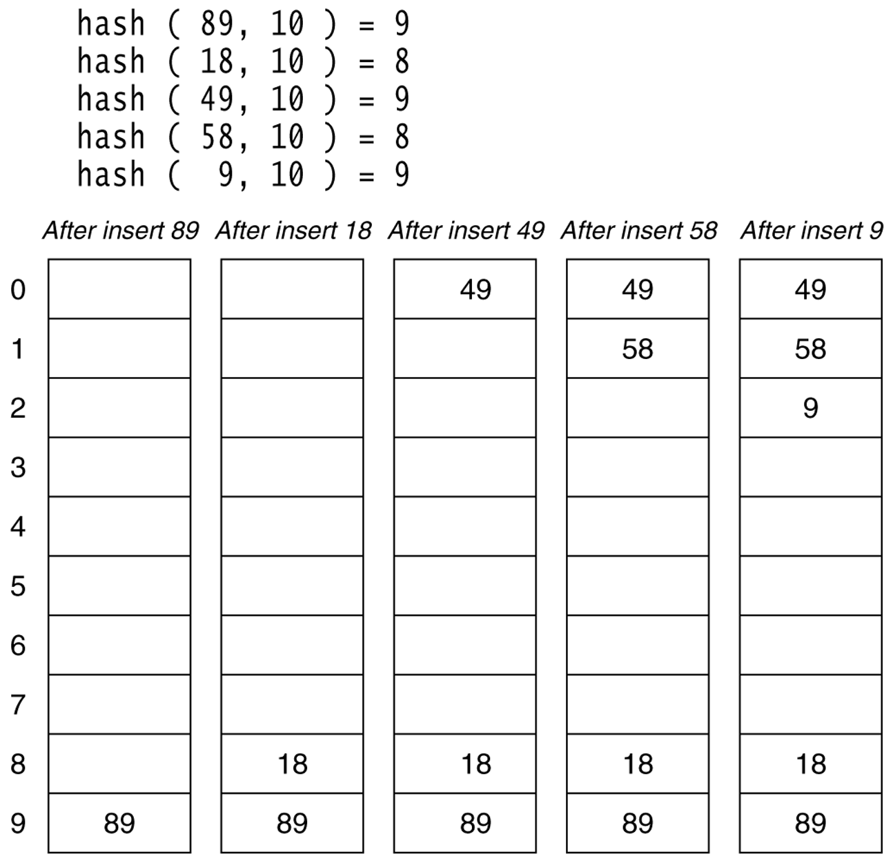
Linear probing hash table after each insertion

Slide 141
Find and Delete
The find algorithm follows the same probe sequence as the insert algorithm.
  A find for 18 would involve 4 probes.
  A find for 89 would involve 5 probes.
We must use lazy deletion (i.e. marking items as deleted)
  Standard deletion (i.e. physically removing the item) cannot be performed.
  e.g. remove 89 from hash table.

Slide 142
Hash Tables
Ordering is not important.
It is not possible to search the records in terms of sorted order.
Finding record with minimum or maximum value is difficult.

Slide 143
Hashing
As we saw with binary search, certain data structures such as a binary search tree can help improve the efficiency of searches.
From linear search to binary search, we improved our search efficiency from O(n) to O(logn) .
We now present a new data structure, called a hash table, that will increase our efficiency to O(1), or constant time.

Slide 144
Hashing
The worst case search time for a hash table is O(n), however, the probability of that happening is so small.
The Best and Average cases are O(1) .

Slide 145
Summary
Hash tables store a collection of records with keys.
The location of a record depends on the hash value of the record's key.
When a collision occurs, the next available location is used.
Searching for a particular key is generally quick.
When an item is deleted, the location must be marked in a special way, so that the searches know that the spot used to be used.
Notes:
A quick summary . . .

Slide 146
String Matching

Slide 147
Contents
String Matching
  Naïve Method
  Rabin Karp
  KMP

Slide 148
What is Pattern Matching?

Slide 149
What is Pattern Matching?
Definition:
  given a text string T and a pattern string P, find the pattern inside the text
    T: “the rain in spain stays mainly on the plain”
    P: “n th”
Applications:
  text editors, Web search engines (e.g. Google), image analysis

Slide 150
String Concepts
Assume S is a string of size m.
A substring S[i .. j] of S is the string fragment between indexes i and j.
A prefix of S is a substring S[0 .. i]
A suffix of S is a substring S[i .. m-1]
  i is any index between 0 and m-1

Slide 151
Examples
S
a
n
d
r
e
w
0
5
Substring S[1..3] == "ndr"
All possible prefixes of S:
  "andrew", "andre", "andr", "and", "an”, "a"
All possible suffixes of S:
  "andrew", "ndrew", "drew", "rew", "ew", "w"

Slide 152
Pattern Matching
Given a text string T[0..n-1] and a pattern P[0..m-1], find all occurrences of the pattern within the text.
Example: T = ababcabdabcaabc and P = abc, the occurrences are:
  first occurrence starts at T[3]
  second occurrence starts at T[9]
  third occurrence starts at T[13]

Slide 153
Let Σ denotes the set of alphabet .
Given:
A string of alphabets T[1..n] of size “n” and a pattern P[1..m] of size “m”
where, m<<<n.
To Find:
Whether the pattern P occurs in text T or not. If it does, then give the first occurrence of P in T.
The alphabets of both T and P are drawn from finite set Σ.

Slide 154
NAÏVE APPROACH
T :
P :
a b c a b d a a b c d e
a b d

Slide 155
Example ( Step – 1 )
T :
P :
a b
c a b d a a b c d e
a b
d
Mismatch after 3 Comparisons

Slide 156
Example ( Step – 2 )
T :
P :
a b c a b d a a b c d e
a b d
Mismatch after 1 Comparison

Slide 157
Example ( Step – 3 )
T :
P :
a b c a b d a a b c d e
a b d
Mismatch after 1 Comparison

Slide 158
Example ( Step – 4 )
T :
P :
a b c
a b d
a a b c d e
a b d
Match found after 3 Comparisons
Thus, after 8 comparisons the substring P is found in T.

Slide 159
Pattern Matching
Given a text string T[0..n-1] and a pattern P[0..m-1], find all occurrences of the pattern within the text.
Example: T = 000010001010001 and P = 0001, the occurrences are:
  first occurrence starts at T[1]
  second occurrence starts at T[5]
  third occurrence starts at T[11]

Slide 160
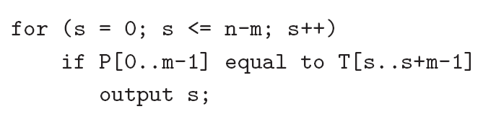
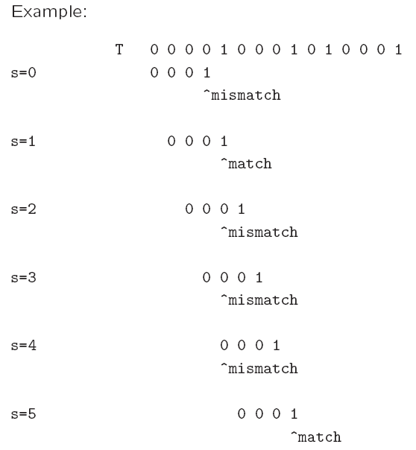
Naïve algorithm
Worst-case running time = O(nm).

Slide 161
Worst Case Running Time
T : a a a a a……..a a f of size say “n”
P : a a a f of size 4

Slide 162
Example ( Step – 1 )
T :
P :
a a a a . . . . . a a f
a a a f
Mismatch found after 4 comparisons

Slide 163
Example ( Step – 2 )
T :
P :
a a a a a , , , , a a f
a a a f
Mismatch found after 4 comparisons

Slide 164
Example
T :
P :
a a a a a . . . .
a a a f
a a a f
Match found after 4 comparisons

Slide 165
Worst Case Running Time
This will continue to happen until (n-4)th alphabet in T is compared with the characters in P and thus the no. of comparisons required is (n-4)4 + 4.

Slide 166
Worst Case Running Time
At every step, after ‘m’ comparisons a mismatch will be found.
These ‘m’ comparisons will be done for (n-m) characters in T.
Thus, the running time obtained is (n-m)m + m.

Slide 167
Brute Force Pseudo-Code
Here’s the pseudo-code
do if (text letter == pattern letter)
compare next letter of pattern to next
letter of text
else move pattern down text by one letter
while (entire pattern found or end of text)

Slide 168
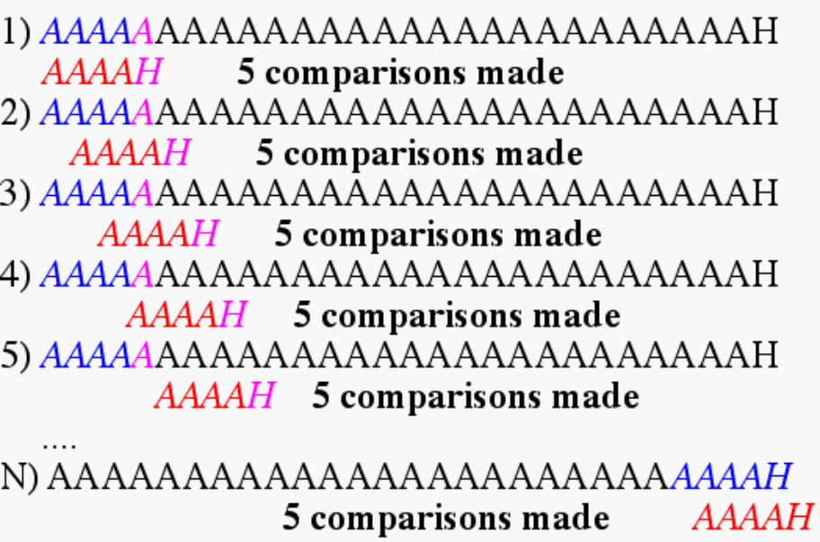
Brute Force-Complexity
Given a pattern M characters in length, and a text N characters in length...
Worst case: compares pattern to each substring of text of length M. For example, M=5.
This kind of case can occur for image data.
Total number of comparisons: M (N-M+1)
Worst case time complexity: O(MN)

Slide 169
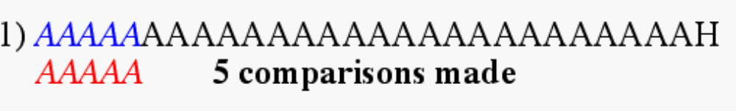
Brute Force-Complexity(cont.)
Given a pattern M characters in length, and a text N characters in length...
Best case if pattern found: Finds pattern in first M positions of text. For example, M=5.
Total number of comparisons: M
Best case time complexity: O(M)

Slide 170
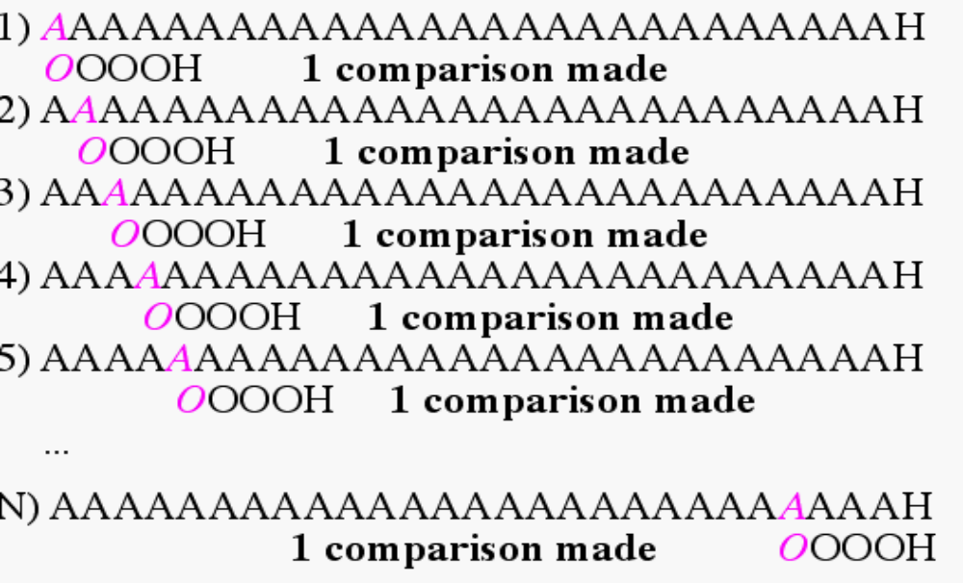
Brute Force-Complexity(cont.)
Given a pattern M characters in length, and a text N characters in length...
Best case if pattern not found: Always mismatch on first character. For example, M=5.
Total number of comparisons: N
Best case time complexity: O(N)

Slide 171
Definition of Rabin-Karp
A string search algorithm which compares a string's hash values, rather than the strings themselves. For efficiency, the hash value of the next position in the text is easily computed from the hash value of the current position.

Slide 172
Steps of Rabin-Karp
The Rabin-Karp string searching algorithm calculates a hash value for the pattern, and for each M-character subsequence of text to be compared.
If the hash values are unequal, the algorithm will calculate the hash value for next M-character sequence.
If the hash values are equal, the algorithm will do a Brute Force comparison between the pattern and the M-character sequence.
In this way, there is only one comparison per text subsequence, and Brute Force is only needed when hash values match.
Perhaps an example will clarify some things...

Slide 173
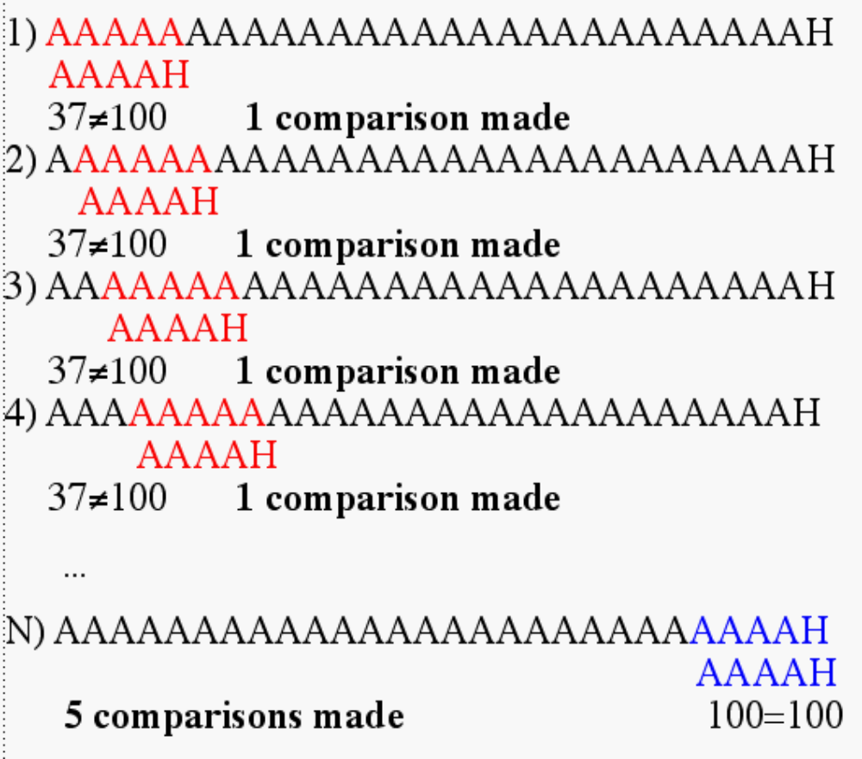
Rabin-Karp Example
Hash value of “AAAAA” is 37
Hash value of “AAAAH” is 100

Slide 174
Rabin-Karp Algorithm
pattern is M characters long
hash_p=hash value of pattern
hash_t=hash value of first M letters in body of text
do
if (hash_p == hash_t)
brute force comparison of pattern
and selected section of text
hash_t= hash value of next section of text, one character over
while (end of text or
brute force comparison == true)

Slide 175
Sorting
Selection Sort
Insertion Sort
Bubble Sort

Slide 176
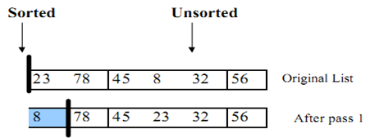
Selection sort
The list is divided into two sublists, sorted and unsorted , which are divided by an imaginary wall.
We find the smallest element from the unsorted sublist and swap it with the element at the beginning of the unsorted data.

Slide 177
Selection sort
After each selection and swapping, the imaginary wall between the two sublists move one element ahead, increasing the number of sorted elements and decreasing the number of unsorted ones.
Each time we move one element from the unsorted sublist to the sorted sublist, we say that we have completed a sort pass.
A list of n elements requires n-1 passes to completely rearrange the data.

Slide 178
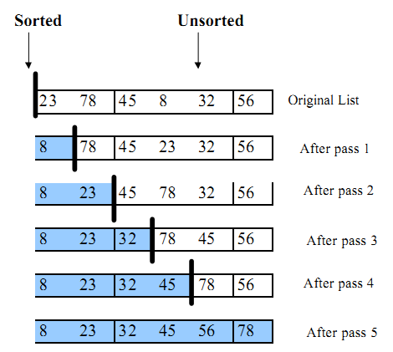

Slide 179
Selection Sort Algorithm
Algorithm SelectionSort(A,n)
Input: A: a sequence of n elements
n: the size of A
Output: A: a sorted sequence in ascending order
for i = 1 to n
min = i
for j = i+1 to n
if A[j] < A[min] then
min = j
Swap(A,min,i)

Slide 180
Selection Sort Algorithm (Cont.)
Algorithm: Swap(A,min,i)
Input: A : a sequence of n elements
min: the position of the minimum value of A while considers at index i of A
i: the considered index of A
Output: exchange A[i] and A[min]
temp = a[min]
a[min] = a[i]
a[i] = temp

Slide 181
Selection sort
Given an array of length n,
  Search elements 0 through n-1 and select the smallest
    Swap it with the element in location 0
  Search elements 1 through n-1 and select the smallest
    Swap it with the element in location 1
  Search elements 2 through n-1 and select the smallest
    Swap it with the element in location 2
  Search elements 3 through n-1 and select the smallest
    Swap it with the element in location 3
  Continue in this fashion until there’s nothing left to search

Slide 182
Analysis of Selection Sort
Suppose the number of items to be sorted is represented by n.
# of swaps = (n-1)
# of comparisons = (n-1) + (n-2) + ... + 1
Total operations:
(n – 1) + (n – 2) + …+ 1 = n(n – 1)/2
It does not depends on the nature of the data in the array.
Number of iteration will be always n-1.
A temporary variable is required for swapping.
Suppose n=6
How many Comparisons?

Slide 183
Worst Case Analysis of Selection Sort
Suppose number of elements n =6
# of comparisons = (n-1) + (n-2) + (n-3) + (n-4) + (n-5)
Now we substitute 6 for n and sum the values.
# of comparisons = (6-1) + (6-2) + (6-3) + (6-4) + (6-5)
# of comparisons = 5 + 4 + 3 + 2 + 1
# of comparisons = 15
Selection Sort will never need more than 15 comparisons regardless of how the six numbers are originally ordered.

Slide 184
Selection Sort
Note that the number of comparisons and exchanges does not depend on the input, that is selection sort is insensitive to the input.
This is why we do not need to consider the worst case, or the best case, or the average case -- the run time efficiency is always the same.

Slide 185
Insertion Sort

Slide 186
Insertion Sort
Most common sorting technique used by card players.
Again, the list is divided into two parts: sorted and unsorted.
In each pass, the first element of the unsorted part is picked up, transferred to the sorted sublist, and inserted at the appropriate place.
A list of n elements will take at most n-1 passes to sort the data.

Slide 187
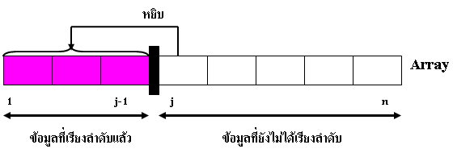
Insertion Sort (Cont.)
Insertion sort uses an incremental approach: having the sorted subarray A[1…j-1], we insert the single element A[ j ] into its proper place and then we will get the sorted subarray A[ 1…j ]
pick up
Sorted order
Unsorted order

Slide 188
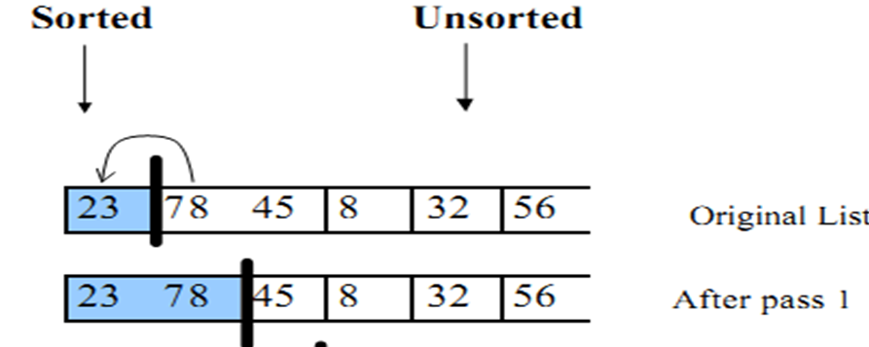
Insertion Sort
Get a hand of unsorted cards
Set a marker for the sorted section after the first card of the hand
Repeat steps 4 through 6 until the unsorted section is empty
Select the first unsorted card
Swap this card to the left until it arrives at the correct sorted position.
Advance the marker to the right one card Stop

Slide 189
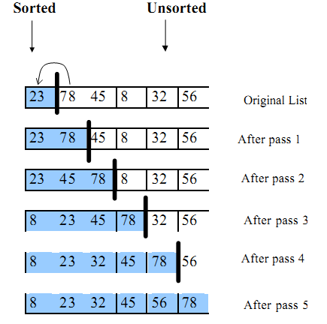

Slide 190
Insertion Sort Algorithm
Algorithm: INSERTION-SORT(A)
Input: A : A sequence of n numbers
Output: A : A sorted sequence in increasing order of array A
for j = 2 to length(A)
key = A[j]
//Insert A[j] into the sorted sequence A[1…j-1]
i = j-1
while i > 0 and A[i] > key
A[i+1] = A[i]
i = i-1
A[i+1] = key

Slide 191
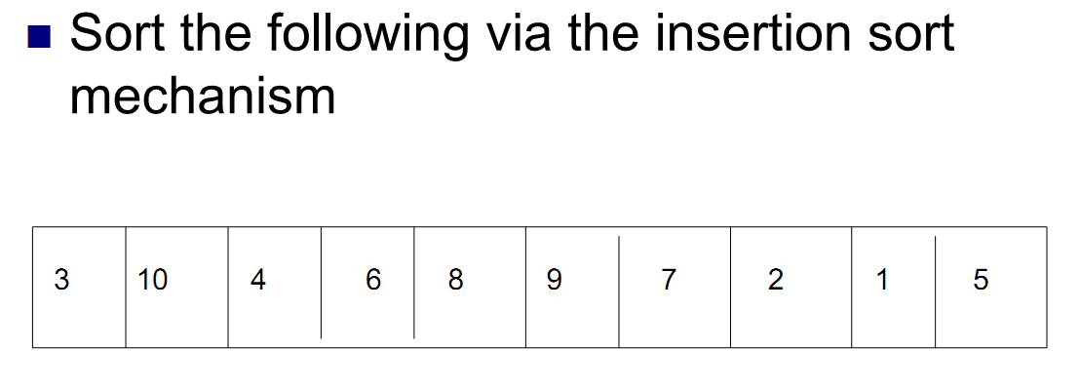

Slide 192
Insertion Sort Analysis
The running – time of INSERTION-SORT depends on the size of input.
Advantages
  Good running time for “almost sorted” arrays Θ(n)
Disadvantages
  Θ(n²) running time in worst and average case
  ≈ n²/2 comparisons and exchanges

Slide 193
Bubble Sort
The list is divided into two sublists: sorted and unsorted.
The smallest element is bubbled from the unsorted list and moved to the sorted sublist.
After that, the wall moves one element ahead, increasing the number of sorted elements and decreasing the number of unsorted ones.
Each time an element moves from the unsorted part to the sorted part one sort pass is completed.

Slide 194
Sorting
Sorting takes an unordered collection and makes it an ordered one.
1 2 3 4 5 6
77
42
35
12
101
5
1 2 3 4 5 6
5
12
35
42
77
101

Slide 195
"Bubbling Up" the Largest Element
Traverse a collection of elements
  Move from the front to the end
  “Bubble” the largest value to the end using pair-wise comparisons and swapping
1 2 3 4 5 6
77
42
35
12
101
5

Slide 196
"Bubbling Up" the Largest Element
Traverse a collection of elements
  Move from the front to the end
  “Bubble” the largest value to the end using pair-wise comparisons and swapping
Swap
1 2 3 4 5 6
42
77
77
42
35
12
101
5

Slide 197
"Bubbling Up" the Largest Element
Traverse a collection of elements
  Move from the front to the end
  “Bubble” the largest value to the end using pair-wise comparisons and swapping
1 2 3 4 5 6
Swap
35
77
42
77
35
12
101
5

Slide 198
"Bubbling Up" the Largest Element
Traverse a collection of elements
  Move from the front to the end
  “Bubble” the largest value to the end using pair-wise comparisons and swapping
1 2 3 4 5 6
Swap
12
77
42
35
77
12
101
5

Slide 199
"Bubbling Up" the Largest Element
Traverse a collection of elements
  Move from the front to the end
  “Bubble” the largest value to the end using pair-wise comparisons and swapping
1 2 3 4 5 6
42
35
12
77
101
5
No need to swap

Slide 200
"Bubbling Up" the Largest Element
Traverse a collection of elements
  Move from the front to the end
  “Bubble” the largest value to the end using pair-wise comparisons and swapping
1 2 3 4 5 6
Swap
5
101
42
35
12
77
101
5

Slide 201
"Bubbling Up" the Largest Element
Traverse a collection of elements
  Move from the front to the end
  “Bubble” the largest value to the end using pair-wise comparisons and swapping
1 2 3 4 5 6
101
42
35
12
77
5
Largest value correctly placed

Slide 202
Items of Interest
Notice that only the largest value is correctly placed
All other values are still out of order
So we need to repeat this process
1 2 3 4 5 6
101
42
35
12
77
5
Largest value correctly placed

Slide 203
Repeat “Bubble Up” How Many Times?
If we have N elements…
And if each time we bubble an element, we place it in its correct location…
Then we repeat the “bubble up” process N – 1 times.
This guarantees we’ll correctly
place all N elements.

Slide 204
“Bubbling” All the Elements
1 2 3 4 5 6
42
35
12
77
5
101
1 2 3 4 5 6
35
12
42
5
77
101
1 2 3 4 5 6
N - 1
12
35
5
42
77
101
1 2 3 4 5 6
12
5
35
42
77
101
1 2 3 4 5 6
5
12
35
42
77
101

Slide 205
Reducing the Number of Comparisons
1 2 3 4 5 6
77
42
35
12
101
5
1 2 3 4 5 6
42
35
12
77
5
101
1 2 3 4 5 6
35
12
42
5
77
101
1 2 3 4 5 6
12
35
5
42
77
101
1 2 3 4 5 6
12
5
35
42
77
101

Slide 206
Sort using Bubble sort.
And calculate no of Comparisons and swap.
8
4
6
9
2
3
1
j

