Slide 1
Digital Logic families
The IC digital logic families are
RTL Resistor –transistor logic
DTL Diode-transistor logic
TTL Transistor-transistor logic
ECL Emitter-coupled logic
MOS Metal-oxide semiconductor
CMOS Complementary metal-oxide semiconductor
The basic circuit in each IC digital logic family is a NAND or NOR gate. This basic circuit is the primary building block from which all other more complex digital components are obtained.

Slide 2
Characteristics of Digital IC:-
The various digital logic families are usually evaluated by comparing the characteristics of the basic gates of each family. The most important governing parameters or properties of various logic families are listed below:-
Propagation delay (speed of operation)
Power dissipation
Fan in
Fan out
Noise immunity
Operating temperature
Power supply requirement
Current and voltage parameters

Slide 3
Propagation Delay:-
It is defined as the time taken for the output of a logic gate to change after the inputs have changed. It is the transition time for the signal to propagate from input to output. This will govern the speed of operation of a logic circuit.
Power Dissipation:-
It is the measure of the power consumed by logic gates when fully driven by all inputs. The average power dissipation is the product of DC supply voltage and the mean current consumed from that supply.
3. Fan in :-
The maximum number of inputs that can be connected to a logic gate without any impairment of its normal operation is referred as Fan in.

Slide 4
4. Fan out :-
Fan out refers to the maximum number of standard loads that the output of the gate can derive without any impairment or degradation of its normal operation.
5. Noise margin or Noise Immunity:-
The noise denotes any unwanted signal, such as transients, glitches, hum etc.. Noise margin or noise immunity is the limit of noise voltage that may appear at the input of logic gate without any impairment of its proper logic operation. The difference between the operating input logic voltage level and the threshold voltage is the noise margin of the circuit.
6. Operating temperature:-
All the IC’s are semiconductor devices and they are temperature sensitive by nature. The operating temperature ranges of an IC vary from 0 ⁰C to+70 ⁰C for commercial and industrial application.

Slide 5
Transistor-Transistor Logic (TTL)
TTL gate come in three different types of output configuration
Open Collector Output
Totem-poll Output
Three state (or tristate) output

Slide 6
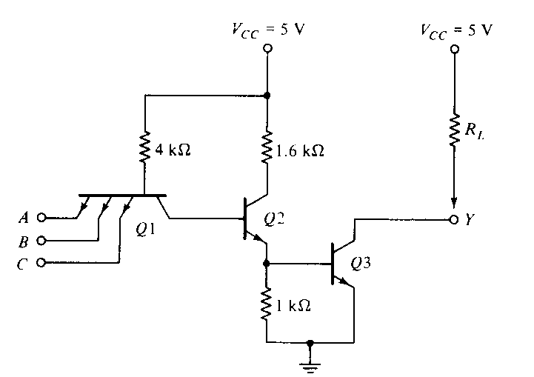
Open Collector Output :-

Slide 7
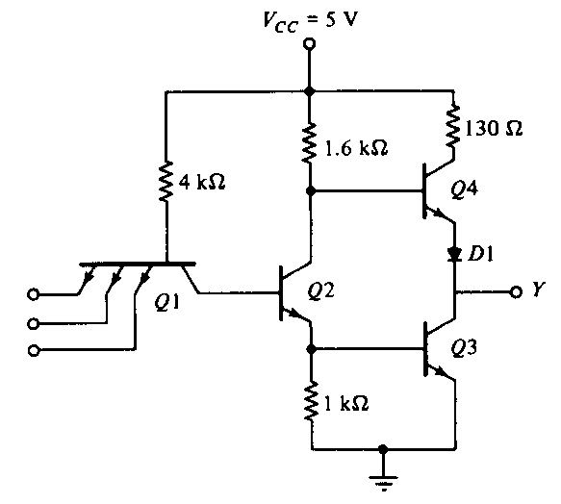
Totem-Pole Output

Slide 8
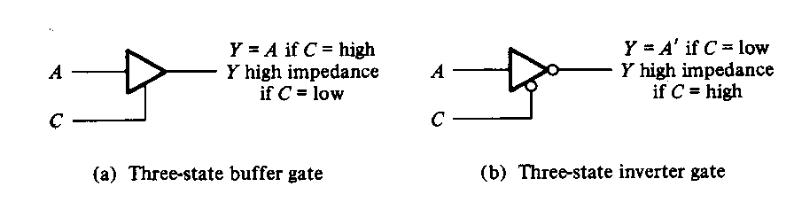
Three State Gate

Slide 9
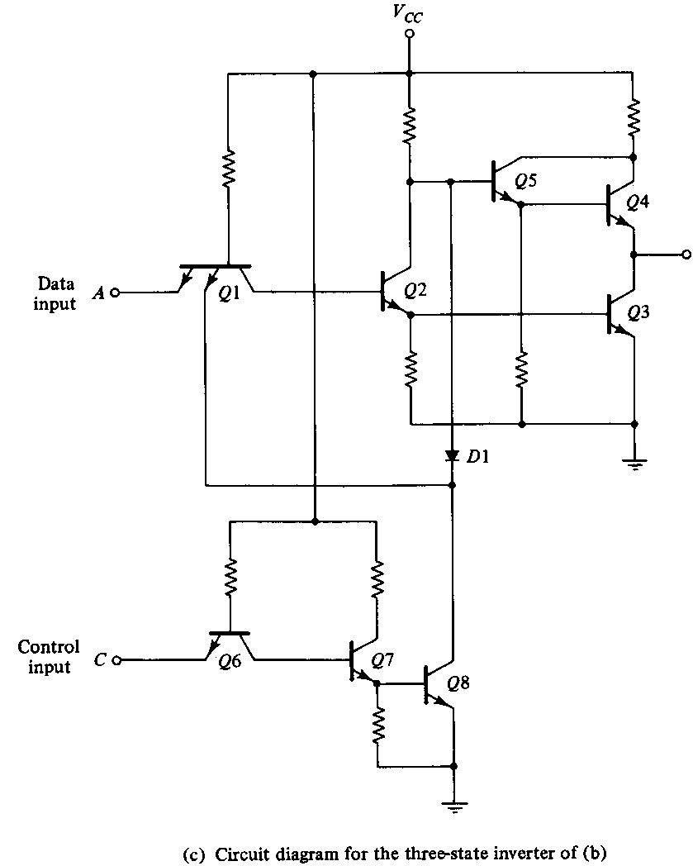

Slide 10
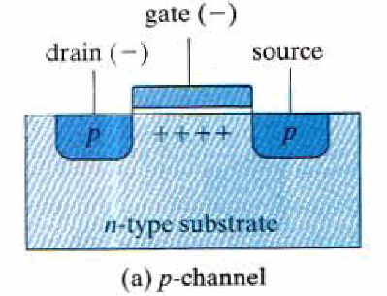
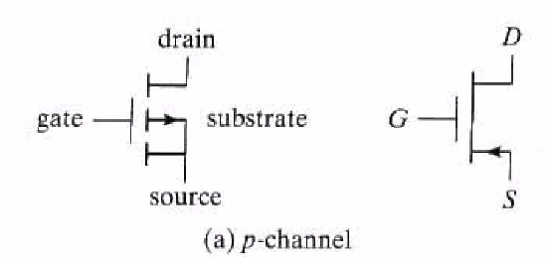
Metal –Oxide Semiconductor :-
The FET is a unipolar transistor, since its operation depends on the flow of only one type of carrier. Two types of FET
JFET - Used in linear circuits.
MOS-FET - Used in Digital circuits.
The Basic structure and Symbols of MOS Transistors:-

Slide 11
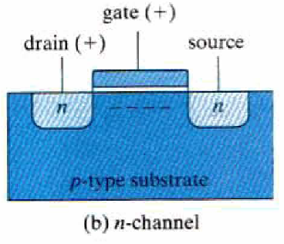
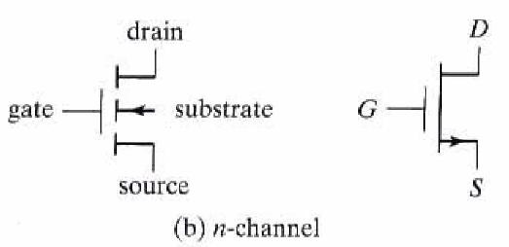
One advantage of the MOS device is that it can be used not only as a transistor but as a resistor as well. A resistor is obtained from the MOS by permanently biasing the gate terminal for conduction. The ratio of the source-drain voltage to the channel current then determines the value of the resistance.

Slide 12
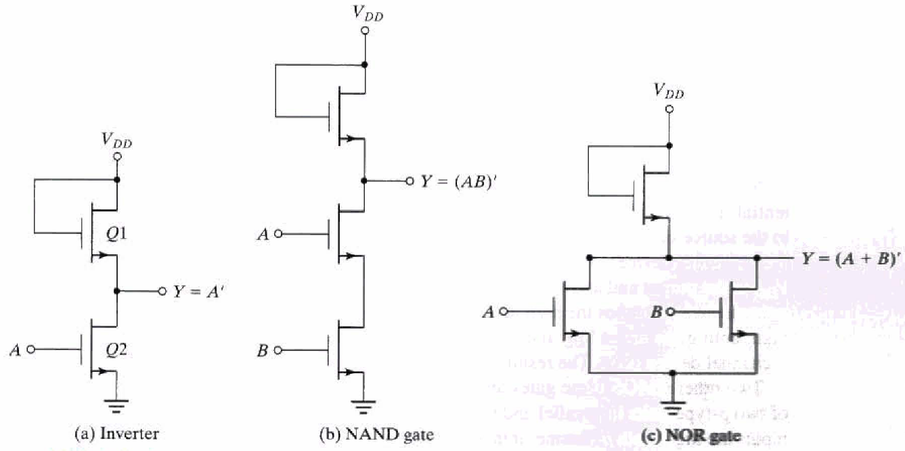
Three logic circuits using MOS devices are shown in figure (as below) :-

Slide 13
The Inverter circuit uses two MOS devices. Q1 acts as the load resistor and Q2 as the active device. The load resistor MOS has its gate connected to V_{DD}, thus maintaining it in the conduction state. When the input voltage is low (below V_{T}), Q2 turns off. Since Q1 is always ON, the output voltage is about V_{DD}. When the input voltage is high (above V_{T}), Q2 turns ON. Current flows from V_{DD} through the load resistor Q1 and into Q2. The geometry of the two MOS devices must be such that the resistance of Q2, when conducting, is much less than the resistance of Q1 to maintain the output Y at a voltage below V_{T}.
The NAND gate shown in figure uses transistors in series. Inputs A and B must both be high for all transistors conduct and causes the input to go low. If either input is low, the corresponding transistor is turned off and the output is high. Again the series resistance formed by the two active MOS devices must be much less than the resistance of the load –resistor MOS.

Slide 14
The NOR gate as shown above uses transistors in parallel. If either input is high, the corresponding transistor conducts and the output is low. If all inputs are low, all active transistors are off and the output is high.
Complementary MOS (CMOS):-
CMOS circuits take advantage of the fact that both n-channel and p-channel devices can be fabricated on the same substrate. CMOS circuits consists of both types of MOS devices, interconnected to form logic functions.
To understand the operation of the inverter the following facts are important :-
The n-MOS conducts when V_{GS} is positive
The p-MOS conducts when V_{GS} is negative
Either type of devices is turned off if its V_{GS} = 0

Slide 15
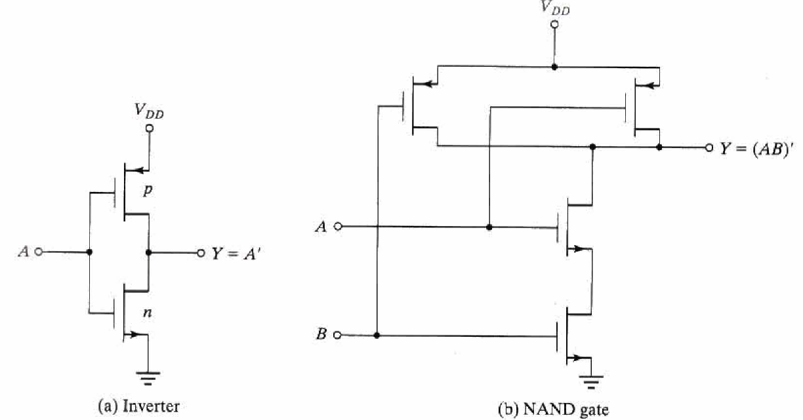

Slide 16
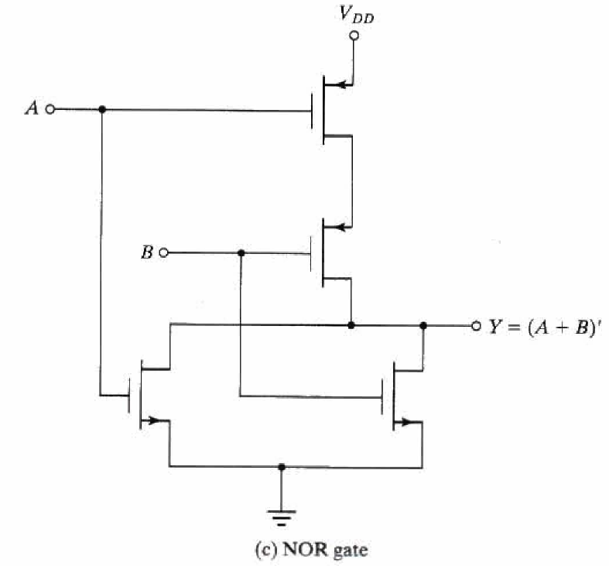

Slide 17
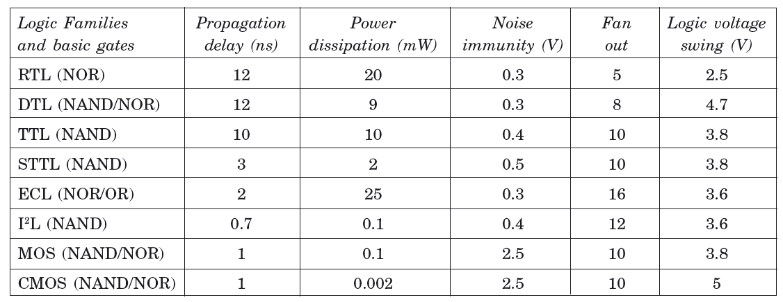
Comparison of Different Logic families :-
A brief comparison of typical performance characteristics of commonly used IC is tabulated as below :-

