Slide 1

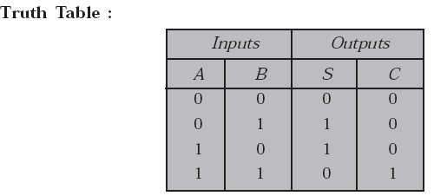
ARITHMATIC CIRCUITS
The logic circuits which are used for performing the digital arithmatic operations such as addition, subtraction, multiplication and division are called ‘arithmatic circuits’.
Half Adder

Slide 2
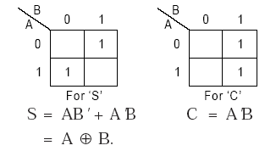
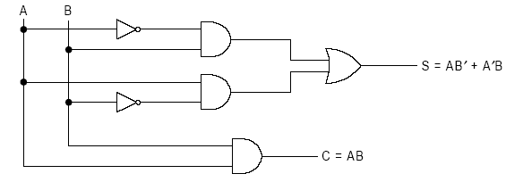
A two variable k-map, separately for both outputs S and C.
Logical Implementation.
(i) Using Basic gates

Slide 3
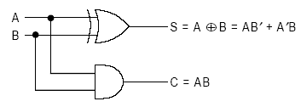

(ii) Using XOR gate
Full Adder

Slide 4
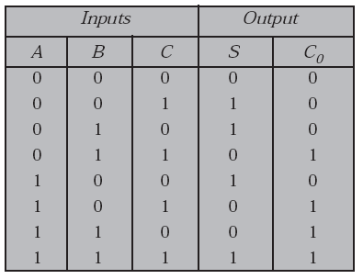
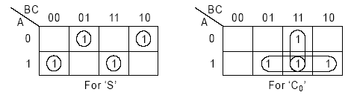
Truth Table
A three variable k-map for both outputs.
S = ABC + AB'C' + A'BC' + A'B'C and Co = AB + AC + BC.

Slide 5
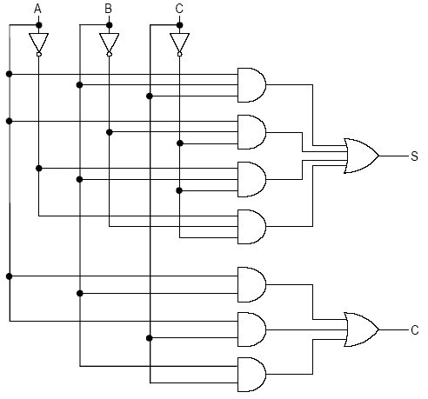
Logical Implementation.
(i) Using basic gates

Slide 6
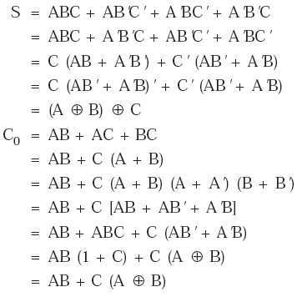
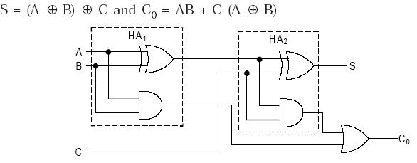
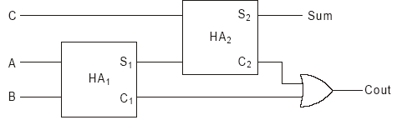
(ii) A ‘Full Adder’ can also be implemented using two half adders and an ‘OR’ Gate
Block Diagram representation of a full adder using two half address

Slide 7

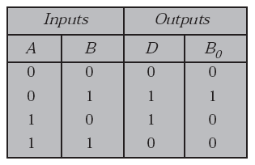
2. Subtractors
(i). Half Subtractor:-
Truth Table

Slide 8
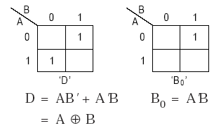
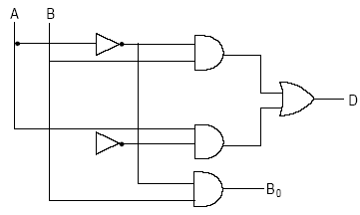
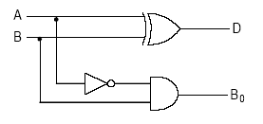
A two variable k-map, for outputs D and B.
Logical Implementation
(a) Using Basic gates:-
(b) using XOR gate

Slide 9

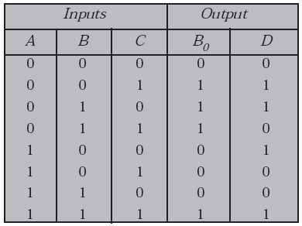
Full subtractor:-
Truth Table

Slide 10
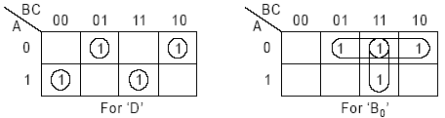
A three variable k-map for both outputs.
D = ABC + AB'C' + A'BC' + A'B'C, B0 = A'B + A'C + BC
Logical implementation—
(i) Using basic gates :- Do your self

Slide 11
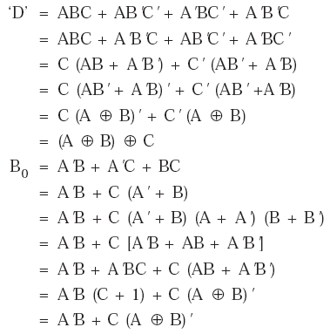
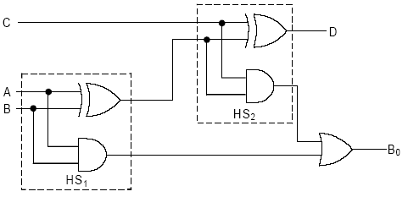
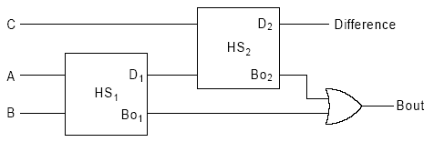
(ii) A ‘full subtractor’ can also be implemented using two ‘half subtractors’ and an ‘OR’ gate

Slide 12
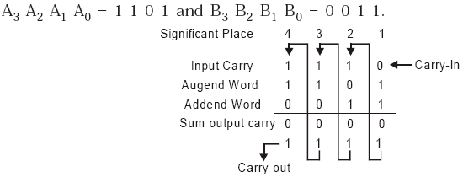
4-bit binary parallel adder
Consider the example that two 4-bit binary numbers to be added
In general, the sum of two n-bit numbers can be generated by using either of the two methods :
(i) The serial addition
and (ii) The parallel addition.

Slide 13
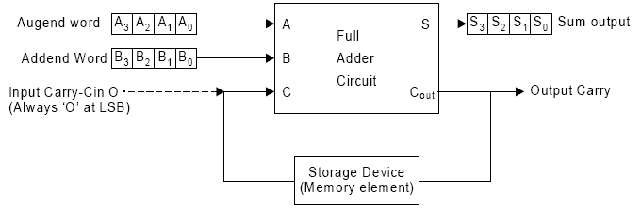
(a). Serial Adder
Operation is carried out bit by bit.
Uses one full adder circuit and some storage device (memory element) to hold generated output carry

Slide 14
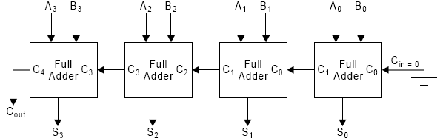
(b). Parallel Adder
To add two n-bit numbers, the parallel method uses n full adder circuits and all bits of addend and augend bits are applied simultaneously.

Slide 15
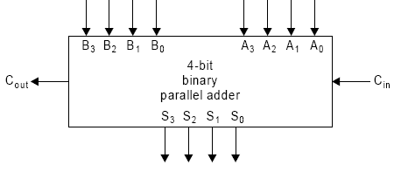
An block diagram of a 4 bit binary parallel adder

Slide 16
Propagation Delay:
The speed of parallel binary adder operation is limited by the carry propagation delay through all stages.
The carry generated by the adder is fed as carry input to (i + 1)^{th} adder. This is called as ‘ripple carry adder’.
The output (C_{out} S₃, S₂, S₁, S₀) is available only after the carry is propagated through each of the adders.
Hence, the addition process can be considered to be complete only after the carry propagation delay through adders, which is proportional to number of stages in it.
One of the methods of speeding up this process is look-ahead carry addition, which eliminates the ripple carry delay.

Slide 17
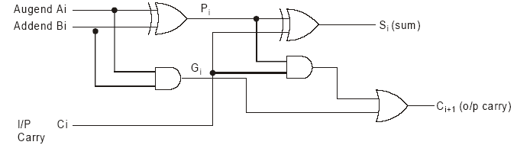
4-bit Look-ahead Carry Generator:-
Based on the principle of looking at the lower order bits
of addend and augend if a higher order carry is generated.
This reduces the carry delay by reducing the number of
gates through which a carry signal must propagate.
To explain its operation let us consider the logic diagram of
a full adder circuit

Slide 18
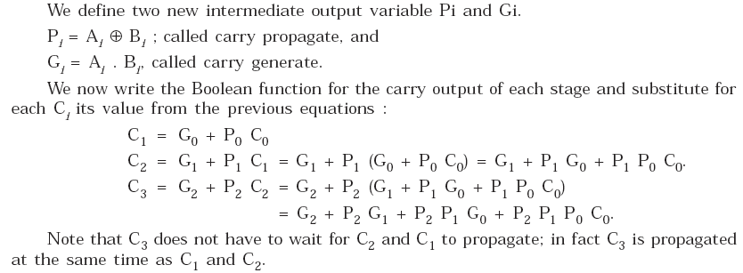

Slide 19
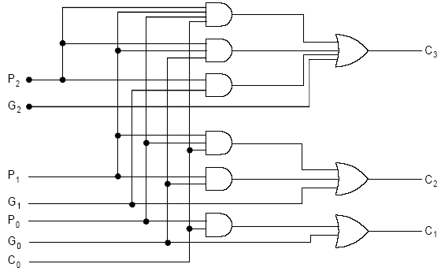
The logic diagram of 4 bit look-ahead carry generator

Slide 20
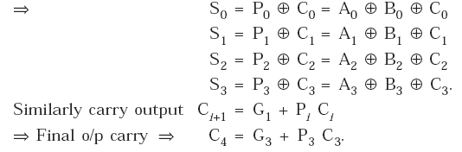
4-bit binary parallel adder with a look-ahead carry generator (FAST ADDER)

Slide 21
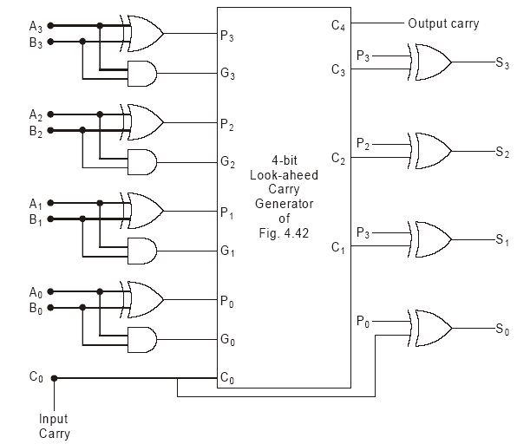

The 4-bit binary parallel adder with a look ahead carry generator can be realized as shown in figure.

Slide 22
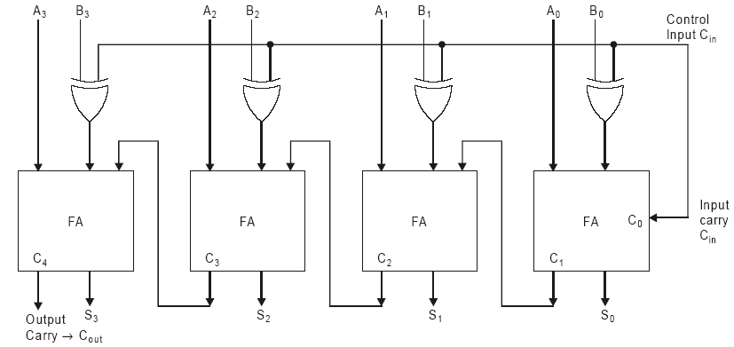
4-bit Parallel Adder/Subtractor
The 4-bit binary parallel adder/subtractor can be realized with the same circuit taking into consideration the 2’s complement method of subtraction and the controlled inversion property of the exclusive or gate.

Slide 23
The control input line C, connected with the input carry of the LSB of the full adder, is used to perform both operations.
To perform subtraction, the control input ‘C’ is kept high. The controlled inverter produces the 1's complement of the addend (B₃' B₂' B₁' B₀'). Since 1 is given to input carry of the LSB of the adder, it is added to the complemented addend producing 2's complement of the addend before addition. Hence, the circuit functions as 4-bit subtractor resulting in difference S₃ S₂ S₁ S₀ and borrow output C_{out}.
To perform addition, the control input ‘C’ is kept low, the controlled inverter allows the addend (B₃ B₂ B₁ B₀) without any change to the input of full adder, and the input carry C_{in} of LSB of full adder, becomes zero, Now the augend (A₃ A₂ A₁ A₀) and addend (B₃ B₂ B₁ B₀) are added with C_{in} = 0. Hence, the circuit functions as 4-bit adder resulting in sum S₃ S₂ S₁ S₀ and carry output C_{out}

Slide 24
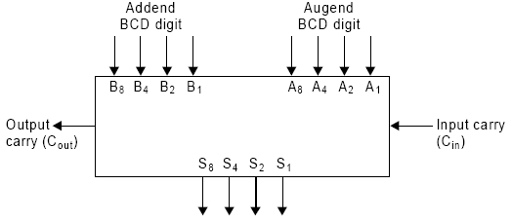
Decimal Adder
A BCD adder is a combinational circuit that adds two BCD digits in parallel and produces a sum digit which is also in BCD. The block diagram for the BCD adder is shown in Figure-

Slide 25
If we consider the arithmetic addition of two decimal digits in BCD, the sum output can not be greater than 9 + 9 + 1 = 19. (Since each input digit does not exceed 9 and 1 being the
possible carry from previous stage).
Suppose we apply two BCD digits to a 4-bit binary parallel adder. The adder will form the sum in binary and produce a sum that will range from 0 to 19. But if we wish to design a BCD adder, it must be able to do the following.
1. Add two 4-bit BCD numbers using straight binary addition.
2. If the four bit sum is equal to or less than 9, the sum is in proper BCD form.
3. If the four bit sum is greater than 9 or if a carry is generated from the sum, the sum is not in BCD form. In this case a correction is required that is obtained by adding the digit 6 (0110) to the sum produced by binary adder.

Slide 26
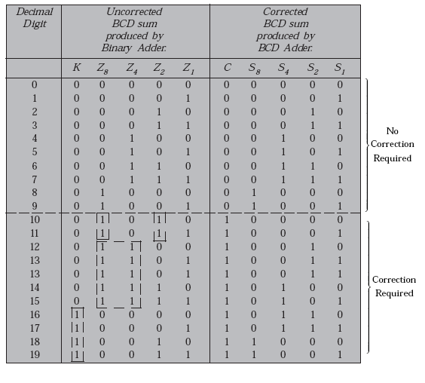
The table shows the results of BCD addition with needed correction.

Slide 27
The correction is required
when k = 1 or Z₈ Z₄ = 1 or Z₈ Z₂ = 1.
or when k = 1 or Z₈ (Z₄ + Z₂) = 1.
K = 1, means the result is 16 or above,
Z₈ Z₄ = 1 means the result is 12 or above
Z₈ Z₂ = 1, and means the result is 10 or above
Therefore, the condition for correction can be written as :
C = K + Z₈ (Z₄ + Z₂)
i.e., whenever C = 1, we need correction i.e. Add binary 0110 (decimal 6) to the sum produced by 4 bit binary adder. It also produce an output carry for the next stage.

Slide 28
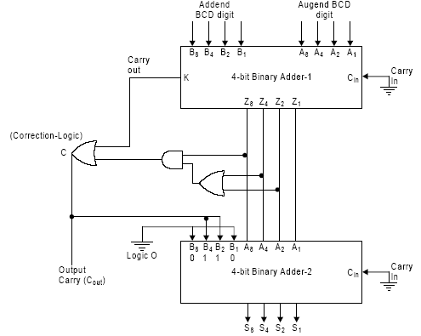
The BCD adder can be implemented using two 4-bit binary parallel adders as shown in figure.

Slide 29
Decimal Subtractor or BCD Subtractor
For BCD subtraction, 9’s compliment of the subtrahend is added to the minuend and we conclude that -
If the sum of minuend and the 9’s compliment of subtrahend is an invalid BCD code or if a carry is produced from MSB, add 6 (binary 0110) and end around carry (EAC) to this sum. The result is positive number.
If the sum of minuend and the 9’s compliment of subtrahend is an valid BCD code, the result is negative number and is in the 9’s compliment form.
9’s compliment of a number can be determined by adding 1010 to the 1’s compliment of the number.

Slide 30
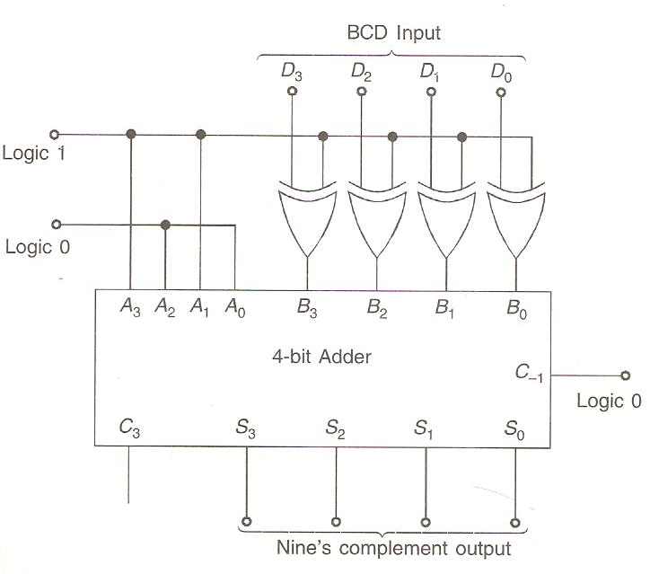
9’s compliment circuit using a 4-bit adder and Ex-OR gates.

Slide 31
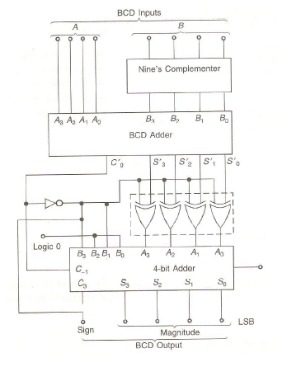
A one digit Decimal or BCD Subtractor , using the 9’s complimentary circuit is shown as below:-

Slide 32

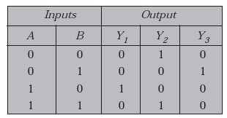
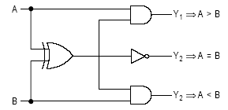
Magnitude Comparator
The block diagram of a single bit magnitude comparator
To implement the single bit magnitude comparator the properties of Ex-NOR gate and AND gate is used.
Truth table

Slide 33
4-bit Magnitude Comparator
Consider two numbers A and B, with four digits each.
A = A₃ A₂ A₁ A₀, B = B₃ B₂ B₁ B₀.
(a) The two numbers are equal if all pairs of significant digits are equal i.e. if A₃ = B₃, A₂ = B₂, A₁ = B₁ and A₀ = B₀. We have seen that equality relation is generated by EX-NOR gate. Thus
x_{i} = A_{i} B_{i} + A_{i}' B_{i}', i = 0, 1, 2, 3.
Where x_{i} represents the equality of two numbers
x_{i} = 1, if A = B.
x_{i} = 0, otherwise.
If follows an AND operation of all variables.
i.e. (A = B) = x₃ x₂ x₁ x₀ = 1 only if all pairs are equal.
(b) To determine if A > B or A < B, we check the relative magnitude of pairs of significant digits starting from MSB. The comparison follows until a pair of unequal digits are reached.
(A > B) = A₃ B₃' + x₃ A₂ B₂' + x₃ x₂ A₁ B₁' + x₃ x₂ x₁ A₀ B₀'
(A < B) = A₃' B₃ + x₃ A₂' B₂ + x₃ x₂ A₁' B₁ + x₃ x₂ x₁ A_{o}' B_{o}.

Slide 34
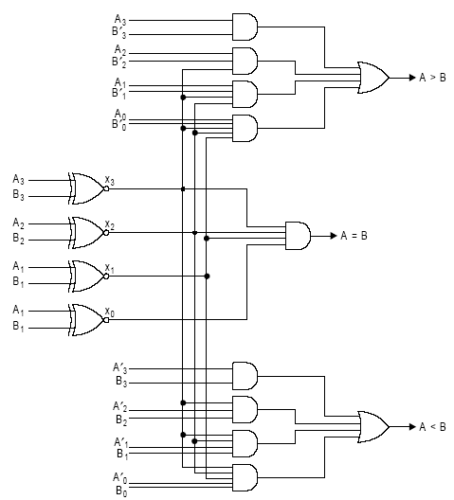
The logical implementation of 4-bit comparator

Slide 35

Code Converters
‘A code converter is a combinational logic circuit that changes data presented in one type of binary code to another type of binary code.’ A general block diagram of a code converter

Slide 36
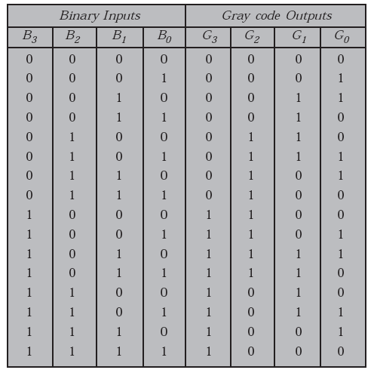
4-bit Binary to Gray code converter
Truth table for binary to gray code converters.

Slide 37

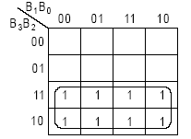
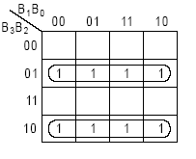


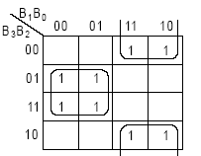
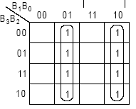
The truth table can be simplified using K-map
Map for G₃: From the octet, we get
Map for G₂:From the two quads, we get
G₃ = B₃
Map for G₁: From the two quads, we get
Map for G₀: From the two quads, we get

Slide 38
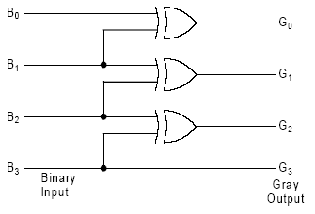
Implementation of binary to gray code converter circuit.

Slide 39
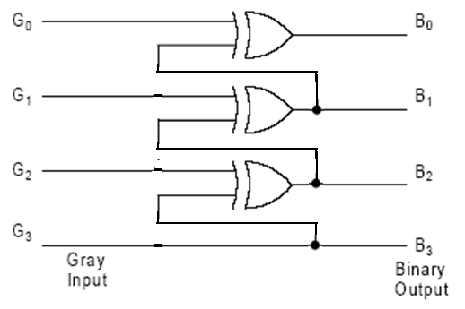
Gray-to-binary Converter
B₃ = G₃
B₂ = G₃′G₂ + G₃ G₂’ = G₃ ⊕ G₂ or, B₂ = B₃⊕ G₂
B₁ = G₃ ⊕ G₂ ⊕ G₁ or, B₁ = B₂⊕ G₁
B₀ = G₃ ⊕ G₂ ⊕ G₁ ⊕ G₀ or, B₀ = B₁ ⊕ G₀ .
The circuit diagram of a gray-to-binary code converter

Slide 40
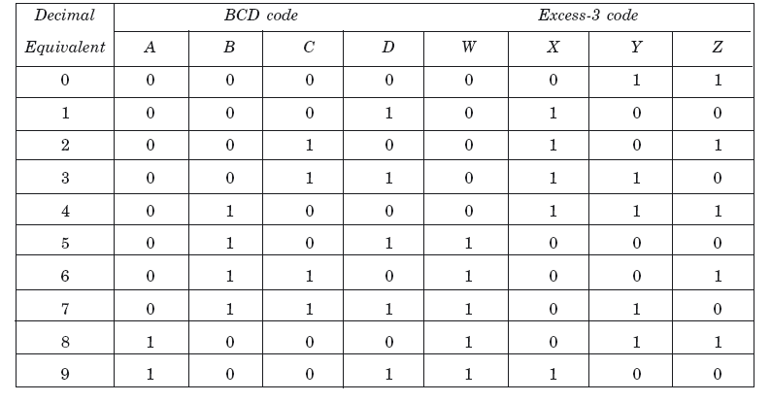
BCD-to-excess-3 Code Converter

Slide 41
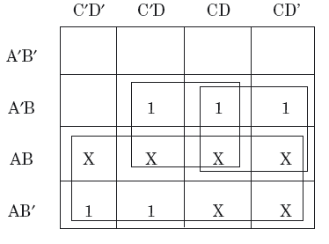
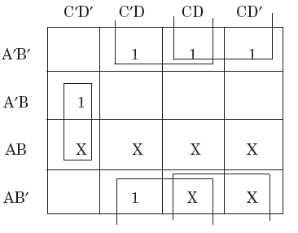
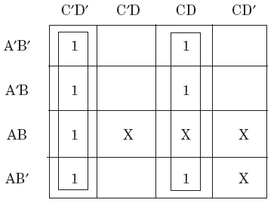
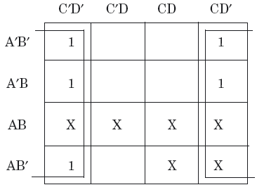
The simplified Boolean expressions of W, X, Y, and Z are given below.
Figure (a) Karnaugh map for W.
Figure (b) Karnaugh map for X.
Figure (c) Karnaugh map for Y.
Figure (d) Karnaugh map for Z.

Slide 42
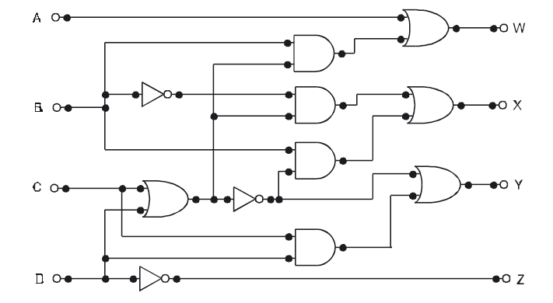
W = A + BC + BD = A+B(C+D)
X = B′C + B′D + BC′D′ = B’(C+D) +B(C+D)’
Y = CD + C′D′ = CD+(C+D)’
Z = D′

Slide 43

Excess-3-to-BCD Code Converter
A = WX + WYZ = W(X + YZ)
B = X′Y′ + X′Z′ + XYZ = X′(Y′ + Z′) + XYZ = X′(YZ)′ + XYZ
C = Y′Z + YZ′
D = Z′

Slide 44

Design a BCD-to-Excess-3 code converter Using
4-bit parallel binary adder IC

Slide 45


BCD-to-seven-segment decoder

Slide 46



Slide 47


(a) Karnaugh map for a.
(b) Karnaugh map for b.
(c) Karnaugh map for c.
(d) Karnaugh map for d.

Slide 48


(e) Karnaugh map for e.
(f) Karnaugh map for f.
(g) Karnaugh map for g.

Slide 49

The Boolean expressions for a to g are given as:-
a = A + CD + BD + B′D′
b = B′ + C′D′ + CD
c = B + C′ + D
d = B′D′ + CD′ + B′C + BC′D
e = B′D′ + CD′
f = A + C′D′ + BC′ + BD′
g = A + BC′ + CD′ + B′C.

Slide 50
PARITY GENERATOR AND CHECKER
Parity is a very useful tool in information processing in digital computers to indicate any presence of error in bit information.
To indicate any occurrence of error, an extra bit is included with the message according to the total number of 1s in a set of data, which is called parity.
The extra bit is considered 0 if the total number of 1s is even and 1 for odd quantities of 1s in a set of data, then it is called even parity.
If the extra bit is 1 for even quantities of 1s and 0 for an odd number of 1s, then it is called odd parity.

Slide 51

Parity Generator
A parity generator is a combination logic system to generate the parity bit at the transmitting side.

Slide 52


Even parity (P_{e}) and Odd parity (P_{o}) are related with four bit massage D₃, D₂, D₁, and D₀ by the following relations:-
P_{e} = D₃⊕D₂⊕D₁⊕D₀ and
P_{o} = (D₃⊕D₂⊕D₁⊕D₀)′.
(a)
(b)

Slide 53
Parity Checker
The circuit that checks the parity at the receiver side is called the parity checker.
The parity checker circuit produces a check bit and is very similar to the parity generator circuit.
If the check bit is 1, then it is assumed that the received data is incorrect .
If the check bit is 0, then it is assumed that the received data is correct.

Slide 54


(a) Even parity Checker

Slide 55


(b) Odd parity Checker

