Slide 1
Data Structures and Algorithms (IDST -232)

Slide 2
Stack
Introduction
Characteristics of stack
Operations on Stack
Array Representation of Stack
List Representation of Stack
Applications of Stack

Slide 3
What is Stack

Slide 4
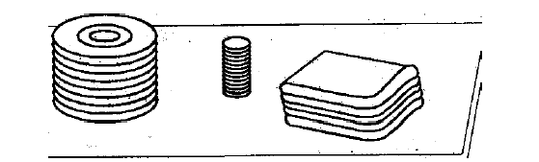
Stack
A stack is a linear structure in which items may be added or removed only at one end.
Example
A stack of dishes
a stack of pennies
a stack of folded towels.

Slide 5
Characteristics of Stack

Slide 6
Characteristics of Stack
Stacks are also called last-in first-out (LIFO) lists. Other names used for stacks are "piles" and "push-down lists.

Slide 7
Last In First Out
A stack is a list of elements in which an element may be inserted or deleted only at one end, called the top of the stack.
This means, that elements which are inserted last will be removed first.
B
A
C
B
A
D
C
B
A
E
D
C
B
A
top
D
C
B
A
top
top
top
A
top

Slide 8
Similarities and Differences between Stack and Queue

Slide 9
Stacks and Queue
Stacks and Queues are two data structures that allow insertions and deletions operations only at the beginning or the end of the list, not in the middle.

Slide 10
How an Stack can be implemented

Slide 11
Stack
Can be implemented with an array and an integer that indicates the top element of the stack (tos).
Empty stack : tos = -1.
Basic Operations : PUSH and POP.

Slide 12
Abstract Data Type: STACK
The operations on stacks are:
CreateStack()
DestroyStack()
Pop(element)
Push(element)
IsEmpty()

Slide 13
Abstract Data Type: STACK
The operations on stacks are:
CreateStack()
Pre-conditions: none
Post-conditions: S is defined and empty
Inputs: no inputs required
Outputs: S - a stack has been created
Algorithm: stack is initialised.

Slide 14
Abstract Data Type: STACK
DestroyStack()
Pre-conditions: none
Post-conditions: S is undefined. All resources (eg memory) allocated to S have been released. No stack operation can be performed on S.
Inputs: the stack
Outputs: an empty stack
Algorithm: stack is re-initialised

Slide 15
Abstract Data Type: STACK
Pop(element)
Pre-conditions: stack is not empty
Post-conditions: the top element has been removed from the stack
Inputs: the stack
Outputs: the changed stack, ie top element, has been removed
Algorithm: remove the top element of the stack; give a copy of the element back to the user

Slide 16
Abstract Data Type: STACK
Push(element)
Pre-conditions: the stack exists, element is of appropriate type
Post-conditions: Element is put onto the top of the stack.
Inputs: a stack and an element
Outputs: a changed stack
Algorithm: insert the element into the stack

Slide 17
Abstract Data Type: STACK
IsEmpty()
Pre-conditions: a stack exists
Post-conditions: returns true if empty false otherwise.
Inputs: a stack
Outputs: boolean value
Algorithm: check initial status of the stack and report whether empty or not.

Slide 18
Operations on Stack

Slide 19
Stack ADT
S = init();
Initialize S to an empty stack.
isEmpty(S);
Returns "true" if and only if the stack S is empty, i.e., contains no elements.
isFull(S);
Returns "true" if and only if the stack S has a bounded size and holds the maximum number of elements it can.

Slide 20
STACK ADT
top(S);
Return the element at the top of the stack S, or error if the stack is empty.
S = push(S,ch);
Push the character ch at the top of the stack S.
S = pop(S);
Pop an element from the top of the stack S.
print(S);
Print the elements of the stack S from top to bottom.

Slide 21
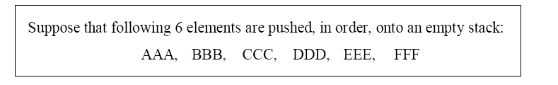
How the stack will look like.

Slide 22
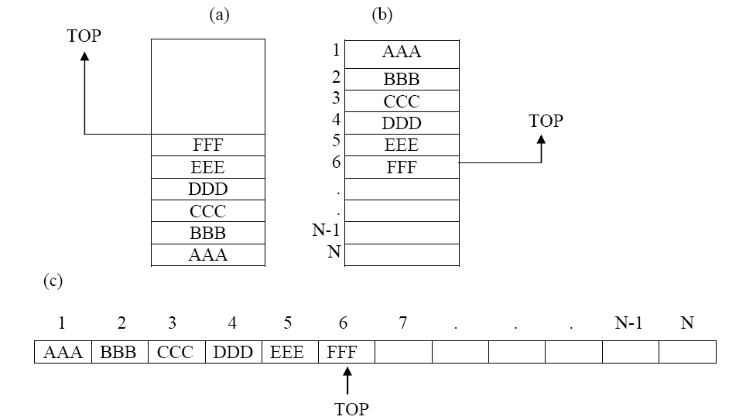

Slide 23
How stack works
Empty stack
push(a)
push(b)
pop(b)
a
b
a
a
tos=1
tos=0
tos=0
tos= -1

Slide 24
Array implementation of stacks

Slide 25
Array implementation of stacks
To implement a stack, items are inserted and removed at the same end (called the top)
To use an array to implement a stack, you need both the array itself and an integer
The integer tells you either:
Which location is currently the top of the stack, or
How many elements are in the stack

Slide 26
Array implementation of stacks
0 1 2 3 4 5 6 7 8 9
stk:
17
23
97
44

Slide 27
Array implementation of stacks
0 1 2 3 4 5 6 7 8 9
stk:
17
23
97
44
top = 3
or count = 4
If the stack is empty
then top = -1 or count = 0

Slide 28
Array implementation of stacks
0 1 2 3 4 5 6 7 8 9
stk:
17
23
97
44
top = 3
or count = 4
To add (push) an element, either:
Increment top and store the element in stk[top], or
Store the element in stk[count] and increment count

Slide 29
Array implementation of stacks
0 1 2 3 4 5 6 7 8 9
stk:
17
23
97
44
top = 3
or count = 4
To remove (pop) an element, either:
Get the element from stk[top] and decrement top, or
Decrement count and get the element in stk[count]

Slide 30
Difference between push and pop

Slide 31
Difference between push and pop
We note that the value of TOP is changed before the insertion in PUSH but the value of TOP is changed after the deletion in POP.

Slide 32
Sharing space
Of course, the bottom of the stack could be at the other end
0 1 2 3 4 5 6 7 8 9
stk:
44
97
23
17
top = 6
or count = 4
Sometimes this is done to allow two stacks to share the same storage area
0 1 2 3 4 5 6 7 8 9
stks:
49
57
3
44
97
23
17
topStk1 = 2
topStk2 = 6

Slide 33
Error checking
There are two stack errors that can occur:
Underflow: trying to pop (or peek at) an empty stack
Overflow: trying to push onto an already full stack

Slide 34
How we can implement Stack

Slide 35
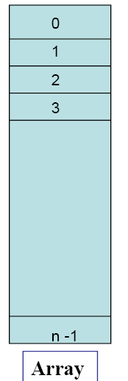
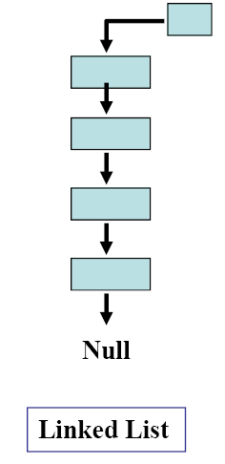
Representation of Stack ADT
Stack ADT can be represented as
Array
Linked List

Slide 36
Comparison of stack representations
When to implement Stack using Array?
When to implement Stack using Linked List?

Slide 37
Comparison of stack representations
Array Based Implementation
An array based implementation suffers from the drawback that all the storage space must be reserved in advance.
maximum depth of the stack is limited to this array’s size.

Slide 38
Comparison of stack representation
Linked List based Implementation
For applications in which the maximum stack size is known in advance, an array is suitable.
If stack size is not known earlier can use the maximum earlier, we use a linked list.

Slide 39
Write down an Algorithm for Push and Pop operations on Stack

Slide 40
objects: a finite ordered list with zero or more elements. methods: Stack createS(max_stack_size) ::= create an empty stack whose maximum size is max_stack_size Boolean isFull(stack, max_stack_size) ::= if (number of elements in stack == max_stack_size) return TRUE else return FALSE Stack push(stack, item) ::= if (IsFull(stack)) stack_full else insert item into top of stack and return
Stack

Slide 41
Boolean isEmpty(stack) ::= if(stack == CreateS(max_stack_size)) return TRUE else return FALSE Element pop(stack) ::= if(IsEmpty(stack)) return else remove and return the item on the top of the stack.
Stack (cont’d)

Slide 42
What are the Difference Between Push and Pop.

Slide 43
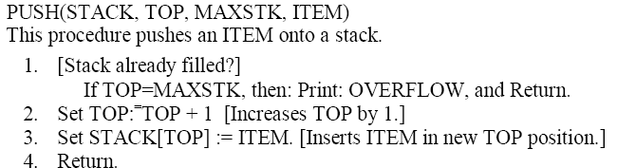
Push Operation on stack
Check Overflow and insert

Slide 44
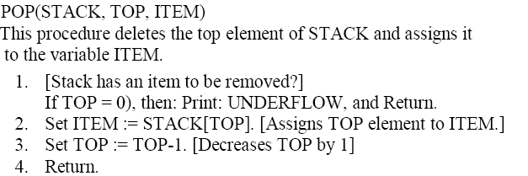
Pop Operation on a stack
Check Underflow and Remove

Slide 45
More about push and pop
Frequently, TOP and MAXSTK are global variables; hence the procedures may be called using only
PUSH(STACK, ITEM) and
POP(STACK, ITEM) respectively.
We note that the value of TOP is changed before the insertion in PUSH but the value of TOP is changed after the deletion in POP.

Slide 46
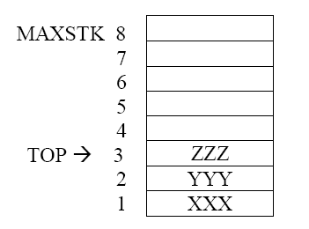
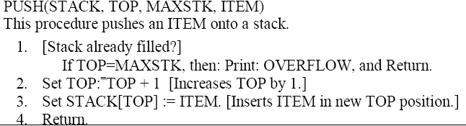
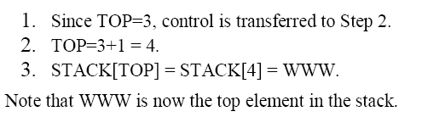
We perform the operation PUSH(STACK, WWW)

Slide 47
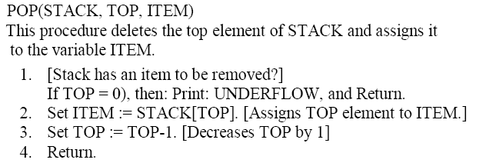
We perform the operation POP(STACK, ZZZ)
1. Since TOP=3, control is transferred to Step 2.
2. ITEM = ZZZ
3. TOP = 3 - 1 = 2.
4. Return.
Observe that STACK[TOP] = STACK[2] = YYY is now the top element in the stack

Slide 48
Stack Applications - I
Evaluating an Expression
Parenthesis matching
Reversing
Backtracking
Tower of Hanoi
Arrangements of printer paper.
Undo and Redo operations

Slide 49
What is the difference
A plus B
Add A and B
A and B are added

Slide 50
How Stack is used in Parenthesis Matching

Slide 51
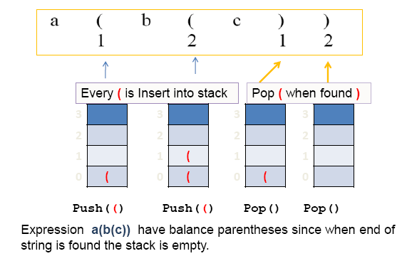
Parenthesis Matching

Slide 52
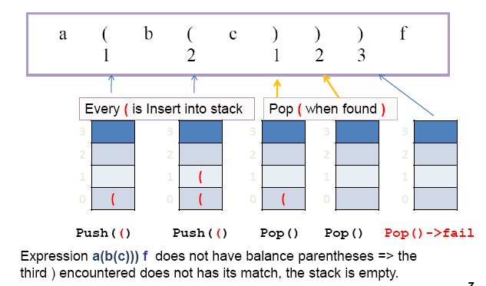
Parenthesis Matching

Slide 53
Exercises: Stack
Write an Algorithm for
How Stack is used in reversing any data.
How Stack is used for finding palindromes.

Slide 54
Stack Applications
Reversing Data: We can use stacks to reverse data.
(example: files, strings)
Very useful for finding palindromes. (RADAR)
Consider the following pseudocode:
1) read (data)
2) loop (data not EOF and stack not full)
1) push (data)
2) read (data)
3) Loop (while stack notEmpty)
1) pop (data)
2) print (data)

Slide 55
Finding Palindromes
Palindrome: a string that reads identically in either direction, letter by letter (ignoring case)
kayak
"I saw I was I"
“Able was I ere I saw Elba”
"Level madam level"
Problem: Write a program that reads a string and determines whether it is a palindrome

Slide 56
APPLICATIONS OF STACKS Evaluation of an expression
What are the different levels of precedence.

Slide 57
APPLICATIONS OF STACKS Evaluation of an expression
Different levels of precedence.
Highest : Exponentiation ( ↑ )
Next highest : Multiplication ( * ) and division ( / )
Lowest : Addition ( + ) and subtraction ( - )

Slide 58
APPLICATIONS OF STACKS Evaluation of an expression
Different levels of precedence.
Highest : Exponentiation ( ↑ )
Next highest : Multiplication ( * ) and division ( / )
Lowest : Addition ( + ) and subtraction ( - )

Slide 59


Example
Let we evaluate the following parenthesis-free arithmetic expression:
Answer=26
Highest : Exponentiation ( ↑ )
Next highest : Multiplication ( * ) and division ( / )
Lowest : Addition ( + ) and subtraction ( - )

Slide 60
APPLICATIONS OF STACKS Evaluation of an expression
Different levels of precedence.
Highest : Exponentiation ( ↑ )
Next highest : Multiplication ( * ) and division ( / )
Lowest : Addition ( + ) and subtraction ( - )

Slide 61
Prefix, Postfix, Infix Notation
What are these notations.
How to convert a notation from one form to another
Which is the commonly used notation

Slide 62
Infix Notation
To add A, B, we write
A+B
To multiply A, B, we write
A*B
The operators ('+' and '*') go in between the operands ('A' and 'B')
This is "Infix" notation.

Slide 63
Prefix Notation
Instead of saying "A plus B", we could say "add A,B " and write
+ A B
"Multiply A,B" would be written
* A B
This is Prefix notation.

Slide 64
Postfix Notation
Another alternative is to put the operators after the operands as in
A B +
and
A B *
This is Postfix notation.
"A,B are multiplied"
"A,B are added"
Notes:
"A,B are multiplied"
"A,B are added"

Slide 65
Why Infix
Because Infix is so common in mathematics, it is much easier to read, and so is used in most computer languages.

Slide 66
Why Infix
Pros: This is the standard way that people learn mathematical notation.
For example, in which notation is it easiest to see that the two 'a' variables cancel?
a + b + c - a + d
+ - + + a b c a d
a b + c + a - d +
Cons: One needs grouping operators (like parentheses) and/or Operator Precedence to disambiguate complex expressions.
Infix notation cannot be interpreted directly by a computer. It must first be parsed into a tree using operator and operand stacks.

Slide 67
Why infix
Infix notation requires precedence and associatively rules to disambiguate it, or addition of extra parentheses.
As long as the number of arguments to each operator are known in advance, both prefix and postfix notation are entirely unambiguous:
"* + 5 6 3" is (5+6)*3, and cannot be interpreted as 5+(6*3), whereas parenthesis is required to achieve with infix.

Slide 68
Why prefix
Known as Polish Notations.
However, Prefix is often used for operators that take a single operand (e.g. negation) and function calls.
Strongly Supports function calling notations.
pow(2,10)

Slide 69
Why postfix
Postfix also known as Reverse Polish Notation (or RPN).
It is easy to program.
No parentheses required.
For example, look at this postfix expression:
1 2 + 3 * 6 + 2 3 + /

Slide 70
Why postfix
For example, look at this postfix expression:
1 2 + 3 * 6 + 2 3 + /
This means "take 1 and 2, add them, take 3 and multiply, take 6 and add, take 2 and 3, add them, and divide".

Slide 71
Converting between notations
INFIX to PREFIX : (A+B) – (C*D)
Do the first brace: (A+B), the PREFIX is +AB
Do the second brace: (C*D), the PREFIX is *CD
The end is operator -: +AB - *CD,
The PREFIX is -+AB*CD

Slide 72
Converting between notations
INFIX to POSTFIX : (A+B) – (C*D)
Do the first brace: (A+B), the POSTFIX is AB+
Do the second brace: (C*D), the POSTFIX is CD*
The end is operator -: AB+ - CD*,
The PREFIX is AB+CD*-

Slide 73
Converting between notations
PREFIX to INFIX : +/*A B C D
Find the first operator: *, take 2 operands before the operator (A and B), the INFIX is (A*B)
Find the second operator: /, take 2 operands before the operator (A*B and C), the INFIX is ((A*B)/C)
Find the third operator: +, take 2 operands before the operator (((A*B)/C) and D), the INFIX is ((A*B)/C)+D

Slide 74
Converting between notations
PREFIX to POSTFIX : +/*A B C D
Find the first operator: *, take 2 operands before the operator (A and B), the POSTFIX is AB*
Find the second operator: /, take 2 operands before the operator (AB* and C), the POSTFIX is AB*C/
Find the third operator: +, take 2 operands before the operator (AB*C/ and D), the POSTFIX is AB*C/D+

Slide 75
Converting between notations
POSTFIX to INFIX : ABCD*/-
Find the first operator: *, take 2 operands before the operator (C and D), the INFIX is (C*D)
Find the second operator: /, take 2 operands before the operator ((C*D) and B), the INFIX is (B/(C*D)
Find the third operator: -, take 2 operands before the operator ((B/(C*D) and A), the INFIX is A – (B/(C*D)

Slide 76
Converting between notations
POSTFIX to PREFIX : ABCD*/-
Find the first operator: *, take 2 operands before the operator (C and D), the PREFIX is *CD
Find the second operator: /, take 2 operands before the operator (*CD and B), the PREFIX is /B*CD
Find the third operator: -, take 2 operands before the operator (/B*CD and A), the PREFIX is -A /B*CD

Slide 77
Exercise: Converting
Convert these INFIX to PREFIX and POSTFIX :
A / B – C / D
(A + B) ^ 3 – C * D
A ^ (B + C)
Convert these PREFIX to INFIX and POSTFIX :
+ – / A B C ^ D E
– + D E / X Y
^ + 2 3 – C D
Convert these POSTFIX to INFIX and PREFIX :
A B C + –
G H + I J / *
A B ^ C D + –

Slide 78
Stack Applications
Evaluating arithmetic expressions.
Prefix: + a b
Infix: a + b
Postfix: a b +
In high level languages, infix notation cannot be used to evaluate expressions.
A common technique is to convert a infix notation into postfix notation, then evaluating it.

Slide 79
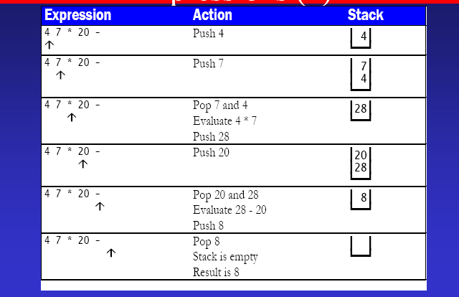
Evaluating Postfix Expressions

Slide 80
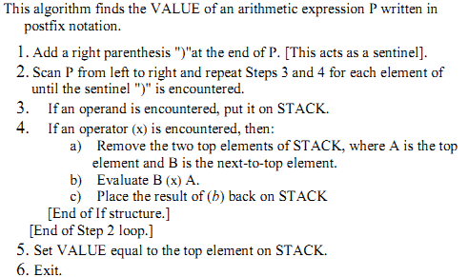
Evaluating a postfix notation

Slide 81
Postfix
Consider the following arithmetic expression P written in postfix notation:
(Commas are used to separate the elements of P so that 5, 6, 2 is not interpreted as the number 562.) The equivalent infix expression Q follows:

Slide 82
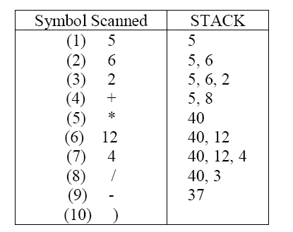

Slide 83
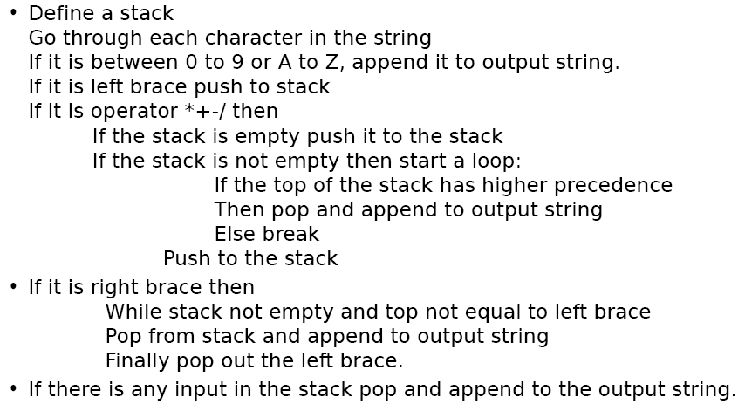
Algorithm for Infix to Postfix

Slide 84
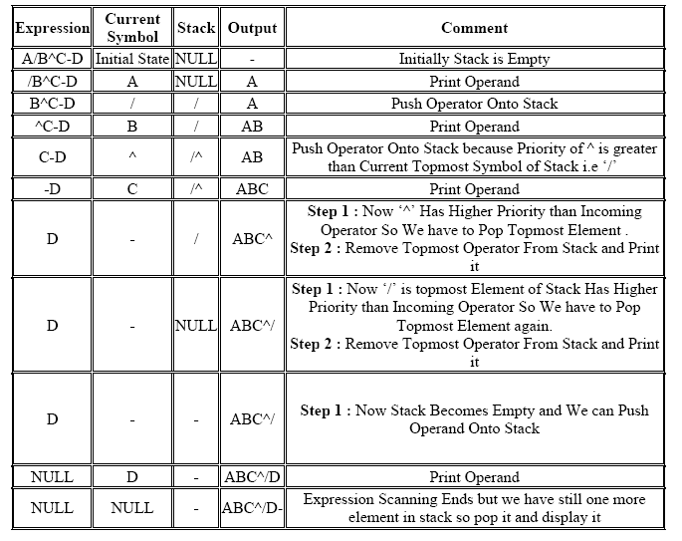

Slide 85

The Towers of Hanoi A Stack-based Application
GIVEN: three poles
a set of discs on the first pole, discs of different sizes, the smallest discs at the top
GOAL: move all the discs from the left pole to the right one.
CONDITIONS: only one disc may be moved at a time.
A disc can be placed either on an empty pole or on top of a larger disc.

Slide 86
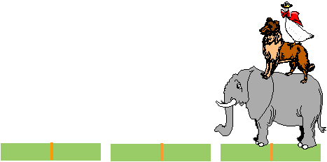
Towers of Hanoi

Slide 87
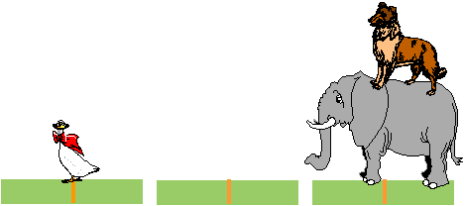
Towers of Hanoi

Slide 88

Towers of Hanoi

Slide 89

Towers of Hanoi

Slide 90

Towers of Hanoi

Slide 91

Towers of Hanoi

Slide 92
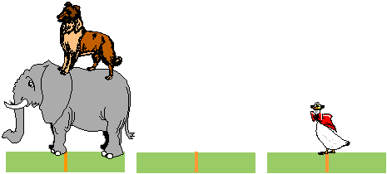
Towers of Hanoi

Slide 93
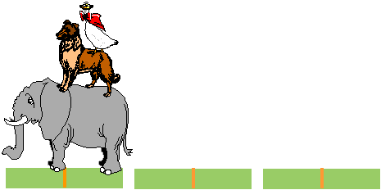
Towers of Hanoi

