Slide 1
SPOTIFY
Listener Statistics
Exploratory Data Analysis & Business Insights
500 records • 12 variables • Countries • Artists • Genres • Platforms
Python • Pandas • NumPy • Matplotlib • Seaborn
By Alok Agarwal
Portfolio-ready data science presentation

Slide 2
Executive summary
The headline answers from the cleaned Spotify listener dataset.
TOP ARTIST
TOP COUNTRY
TOP GENRE
RECENT LEADER
BEST ENGAGEMENT
SKIP CORR.
BTS
Sweden
Classical
Dua Lipa
France
−0.022
124,299M streams
93,450M streams
197,277M streams
4,422M / 30 days
261.02 ratio
No relationship
BUSINESS TAKEAWAY
STRATEGIC DIRECTION
Popularity ≠ engagement
Defend scale. Invest in momentum.
Use reach, historical volume, recent momentum, engagement, and skip behavior together when making portfolio decisions.
Protect BTS scale, test added Classical promotion, support Dua Lipa’s recent momentum, and use France for retention-focused campaigns.

Slide 3
Business objective & analytical workflow
The project converts listening metrics into market, content, and subscription decisions.
Identify the strongest countries and regions
Rank artists, genres, and albums by performance
Compare Free and Premium listening behavior
Measure engagement and skip-rate patterns
Evaluate recent streaming and release-year trends
Translate findings into business recommendations
Load
Validate
Clean
Explore
Analyze
Answer
Recommend
CORE QUESTION
Where should Spotify focus next?
Use the dataset to distinguish high-reach markets, high-volume artists, high-engagement audiences, and content with current momentum.

Slide 4
Dataset overview & data quality
The cleaned dataset is analysis-ready with no missing or duplicate records.
ROWS
VARIABLES
MISSING VALUES
DUPLICATES
RELEASE YEARS
500
12
0
0
2018–2023
Clean observations
Categorical + numeric
Complete fields
No repeated rows
6 cohorts
Key analytical measures
DATA QUALITY ANSWER
Monthly listeners: audience reach
Total streams: historical popularity
Streaming hours: engagement depth
Last 30 days: current momentum
Skip rate: retention / content fit
Platform type: Free vs Premium behavior
Ready for EDA
No imputation or duplicate removal is required in the final cleaned dataset. Interpret results within this supplied project dataset, not as Spotify proprietary performance.

Slide 5
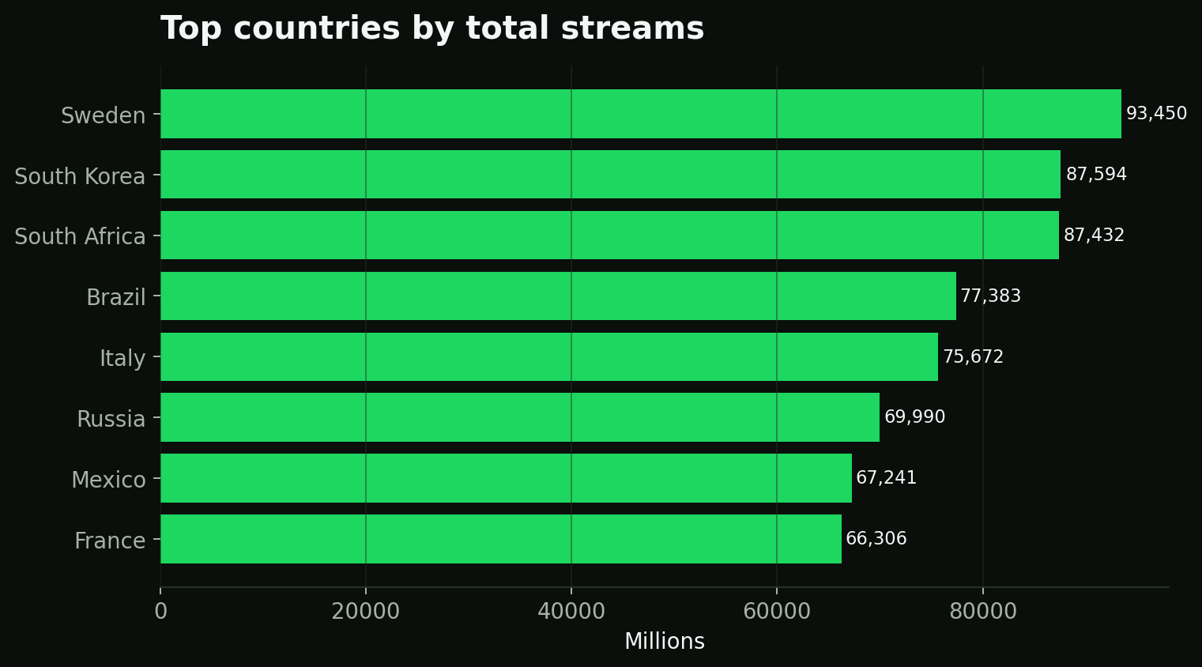
Regional performance
Sweden leads total streams, while Russia leads listener reach.
ANSWER: MOST STREAMS
Sweden
93,449.76M total streams
ANSWER: LARGEST AUDIENCE
Russia
1,603.45M aggregated monthly listeners
Implication: audience size and streaming volume should be managed as separate dimensions.

Slide 6
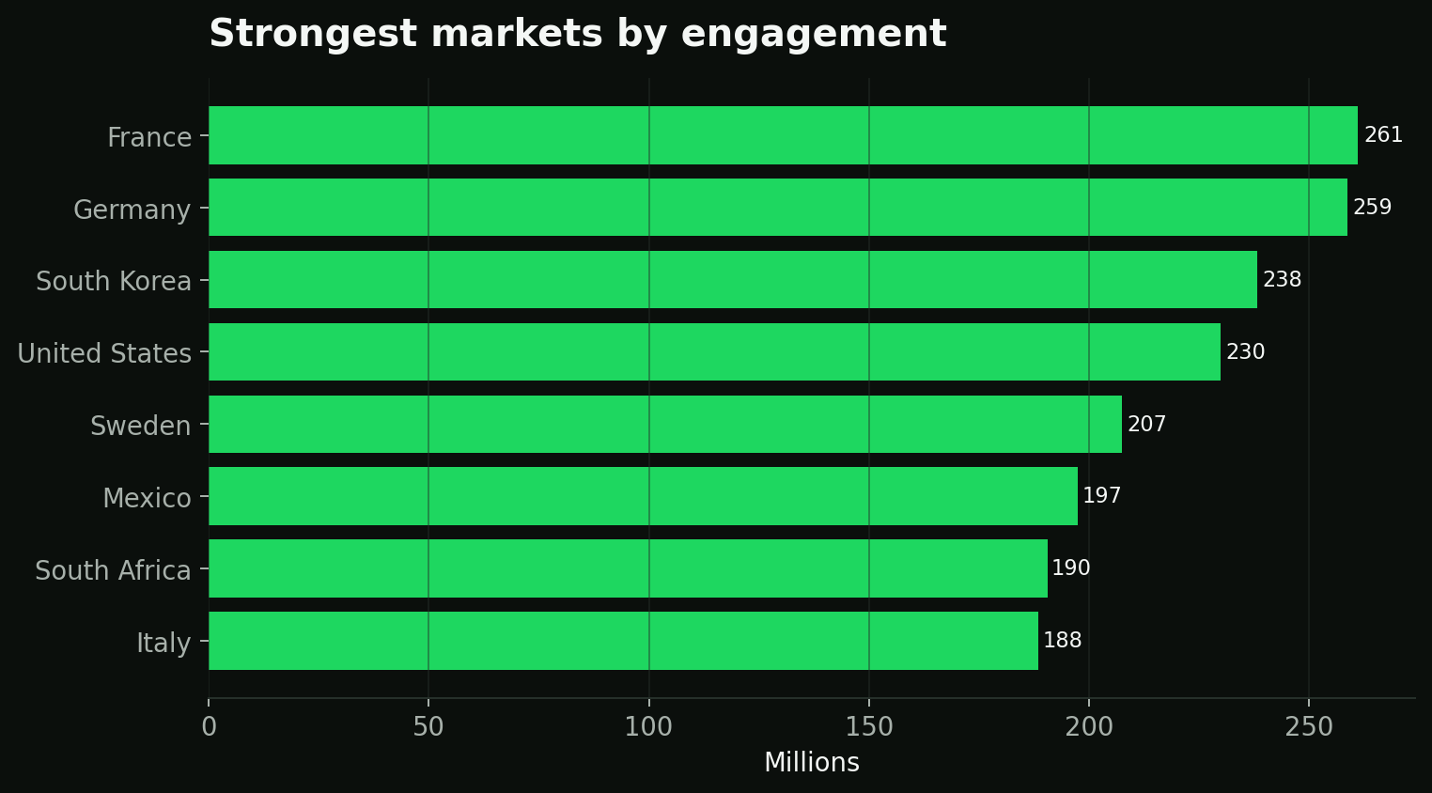
Regional engagement
France produces the deepest listening relative to audience size.
STRONGEST ENGAGEMENT
France
261.02 total-hours / monthly-listener ratio
CURRENT MOMENTUM
Italy
3,227.25M streams in the last 30 days
Engagement score
Priority use cases: retention, Premium conversion, long-session playlists, and localized artist campaigns.

Slide 7
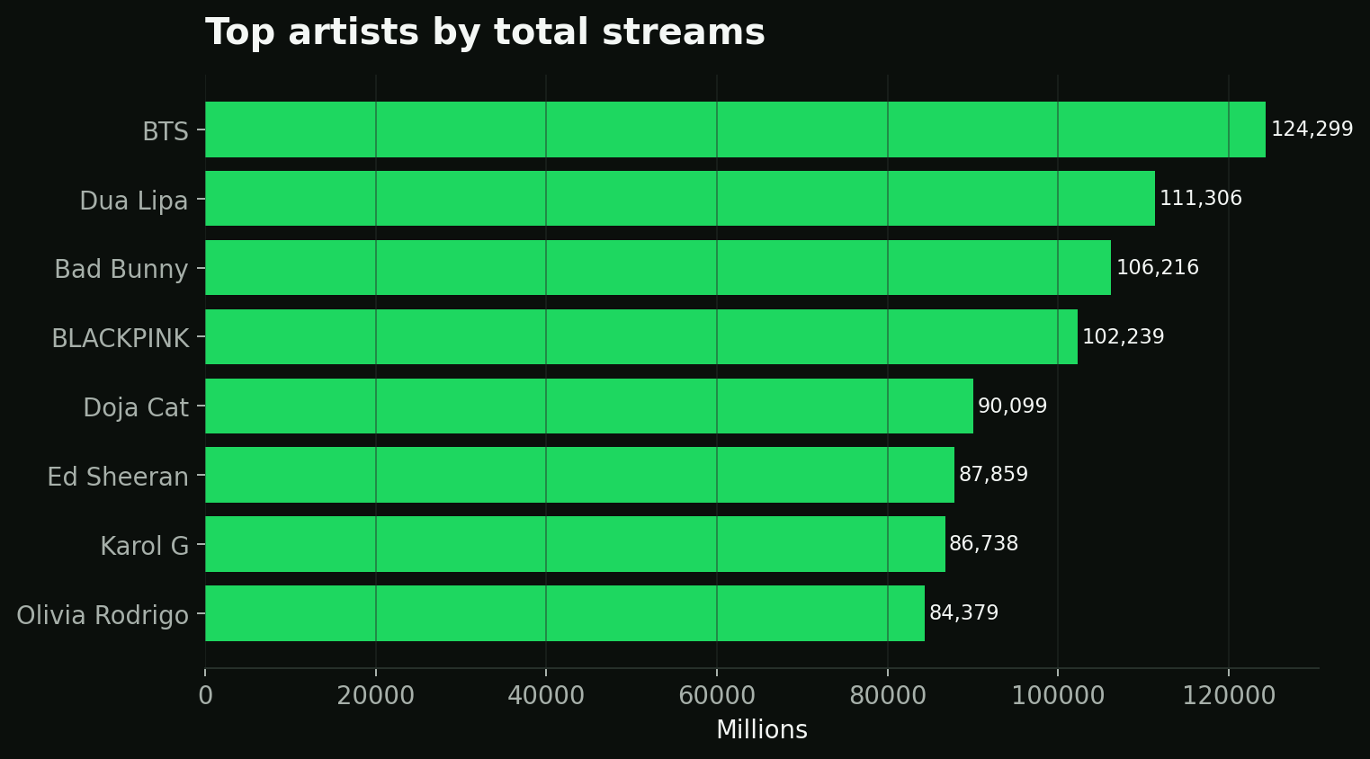
Artist performance
BTS dominates historical scale; Dua Lipa leads current momentum.
ANSWER: HIGHEST VOLUME
BTS
124,299.47M total streams
ANSWER: STRONGEST RECENT
Dua Lipa
4,422.26M streams in the last 30 days
BTS also has the largest aggregated monthly-listener reach at 2,770.65M.

Slide 8
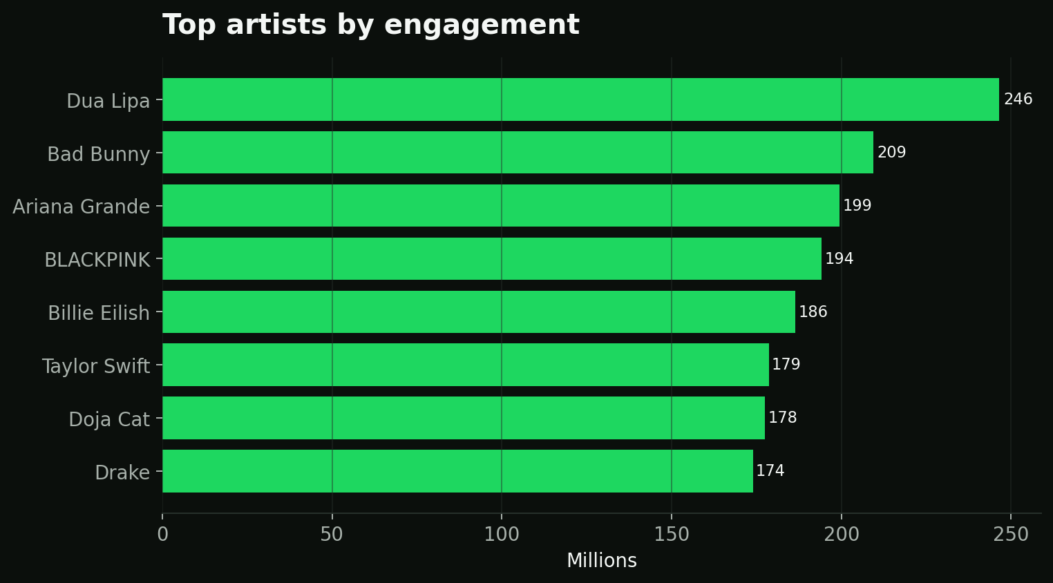
Artist engagement & retention
High-value artists are not always the same as high-volume artists.
STRONGEST ENGAGEMENT
Dua Lipa
246.49 engagement ratio
LOWEST SKIP RATE
BLACKPINK
16.05% average skip rate
Engagement score
Recommendation: use both engagement and skip behavior when selecting artists for discovery and retention playlists.

Slide 9
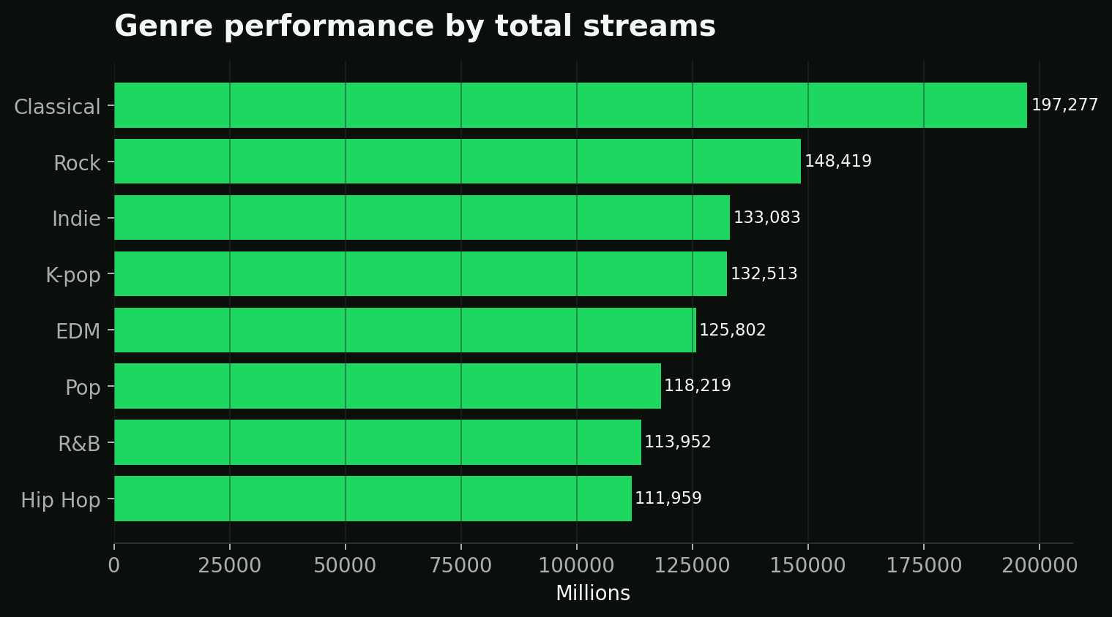
Genre performance & promotion opportunity
Classical leads both scale and the balanced promotion opportunity score.
Scale answer: Classical leads total streams, listeners, and recent streams.
Promotion answer: Classical ranks first on the balanced opportunity score at 94.0.

Slide 10
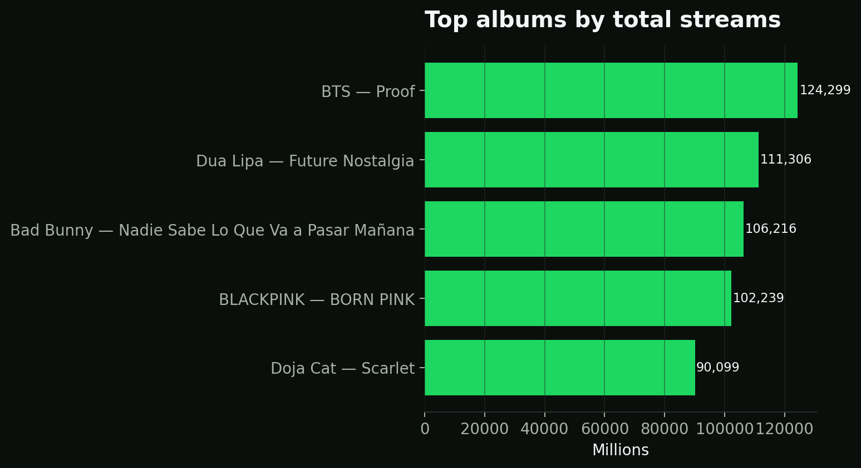
Album performance
The highest-volume albums mirror the strongest artist franchises.
ANSWER: TOP ALBUM
BTS — Proof
124,299.47M total streams
RECENT MOMENTUM
Future Nostalgia
Dua Lipa: 4,422.26M recent streams
Use historical album scale for catalog value and recent streams for campaign timing.

Slide 11
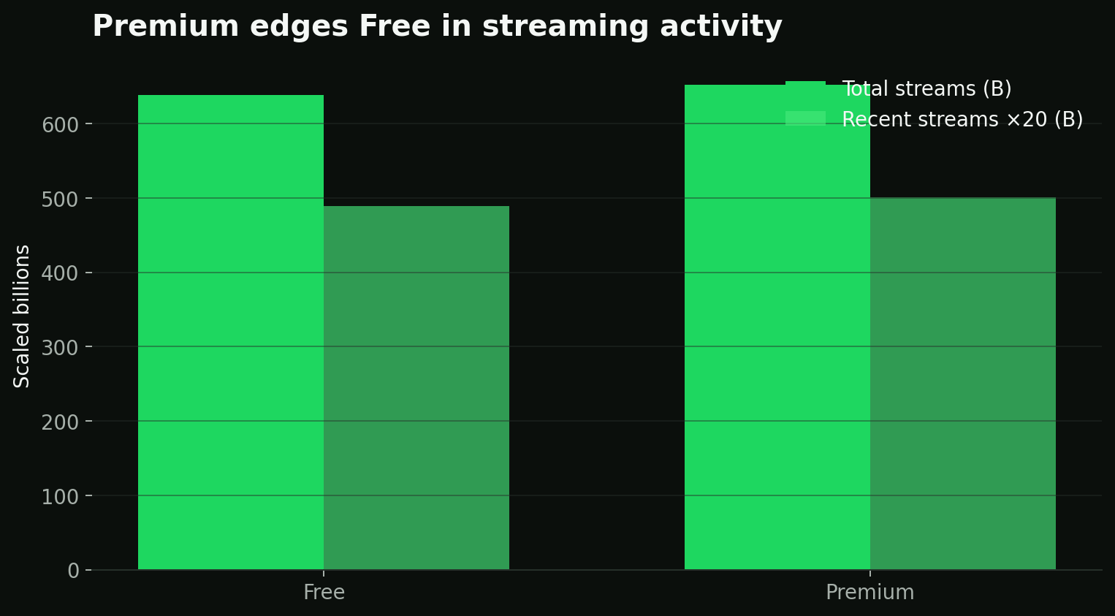
Free vs Premium behavior
Premium records show deeper engagement even with similar average stream duration.
FREE HOURS/LISTENER
PREMIUM HOURS/LISTENER
170.20
180.87
Avg skip 20.47%
Avg skip 20.27%
ANSWER
Premium corresponds to deeper listening
In this dataset, Premium records have more total streams, recent streams, and streaming hours, with about a 6.3% advantage in hours-per-listener engagement.

Slide 12
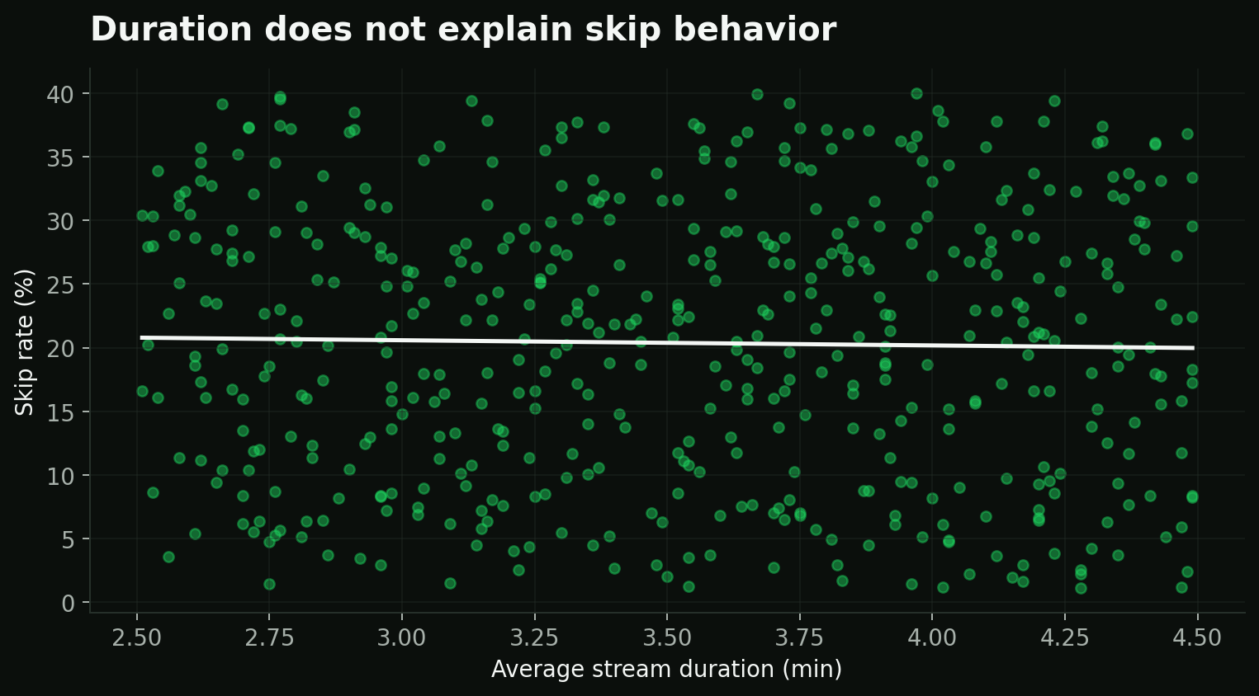
Skip-rate analysis
Longer average stream duration does not meaningfully reduce skipping.
Duration does not explain skip behavior
ANSWER
Correlation = −0.022
This is effectively zero: track duration is not a useful standalone predictor of skip behavior in this dataset.
Future analysis should test playlist context, device, recommendation source, track position, repeat listening, and completion rate.

Slide 13
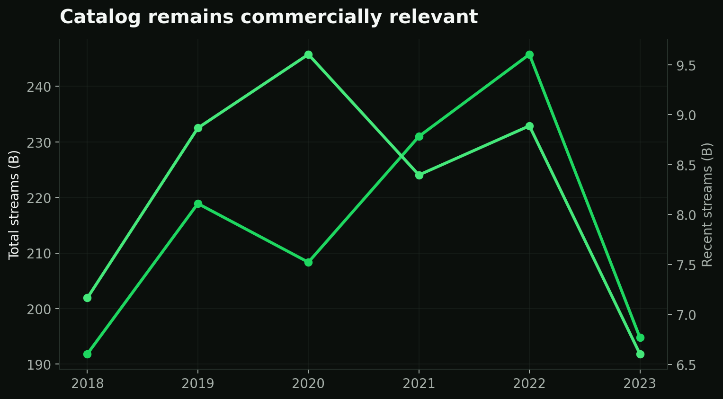
Release-year trends
Older catalog content can remain highly valuable.
HISTORICAL LEADER
2022 releases
245,756.44M total streams
RECENT LEADER
2020 releases
9,603.78M recent streams
2020 also has the lowest release-year skip rate at 17.78%. This supports testing catalog rediscovery campaigns.

Slide 14
Business recommendations
Turn the findings into targeted market, content, and subscription actions.
01
Defend scale
02
Invest in momentum
Protect BTS and Classical with editorial visibility and catalog support.
Prioritize Dua Lipa and recent high-growth content for campaigns.
03
Test genre promotion
04
Set regional goals
Test added Classical promotion while retaining K-pop and R&B as engagement-rich segments.
Use Sweden for streaming volume, Russia for listener reach, and France for engagement and retention.
05
Test membership effects
06
Monitor recent signals
Treat Free versus Premium differences as descriptive and test conversion offers before scaling.
Separate lifetime scale from last-30-day momentum in dashboards and decisions.

Slide 15
Final business answers
A concise answer sheet for the project brief.
Most streams — country
Largest listener base — country
Strongest regional engagement
Sweden
Russia
France
Strongest recent market
Highest streaming artist
Strongest recent artist
Italy
BTS
Dua Lipa
Strongest artist engagement
Lowest artist skip rate
Top genre by scale
Dua Lipa
BLACKPINK
Classical
Promotion candidate
Top album
Premium behavior
Classical
BTS — Proof
Deeper engagement
Duration vs skip rate
Top historical release year
Top recent release year
No meaningful relationship
2022
2020
Decision factors: reach, streaming volume, engagement, and recent momentum

Slide 16
From listening data to business action
Spotify should weigh streaming scale alongside engagement, retention, and recent momentum when prioritizing content and markets.
Thank you
Spotify Listener Statistics — Exploratory Data Analysis
By Alok Agarwal

