Slide 1
Geek God
Team - 6
Bhanuja Nagore
Deva
Shivam

Slide 2

Goals of the Project
The Application is a technology platform for the people interested in Gadgets and Technology
We build the technology to allow anyone to create, share, find and attend new things to do that fuel their passion of New upcoming Technology
The App has following features –
Latest Product info
News about Gadgets
Blogs
Events

Slide 3

Use Cases
User – Information about
Gadgets & Technology
User – Attend Events
User will get
News about latest Gadgets and Tech Events
Blogs from Techies
Latest products information
Events from Tech Industry
User, if willing to proceed further to search for events – Guest User/Register
First Name, Last Name, Mobile, Email, LinkedIn Id, Facebook account
Look for events in any part of the World
Comment about events, Like/dislike
Follow other users

Slide 4
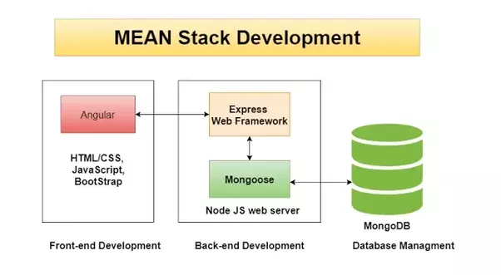

Infrastructure
User Interface – Angular Framework, Bootstrap 4 , JavaScript, HTML
Database – MongoDB
Back end – Node JS, Express JS, Mongoose
Validations – JavaScript
REST API calls to Eventbrite

Slide 5
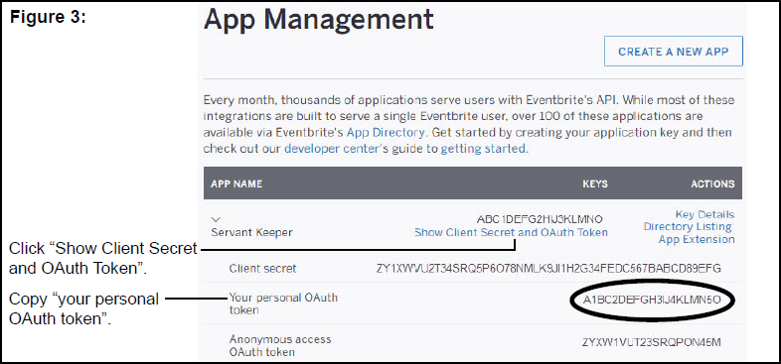

API

Slide 6
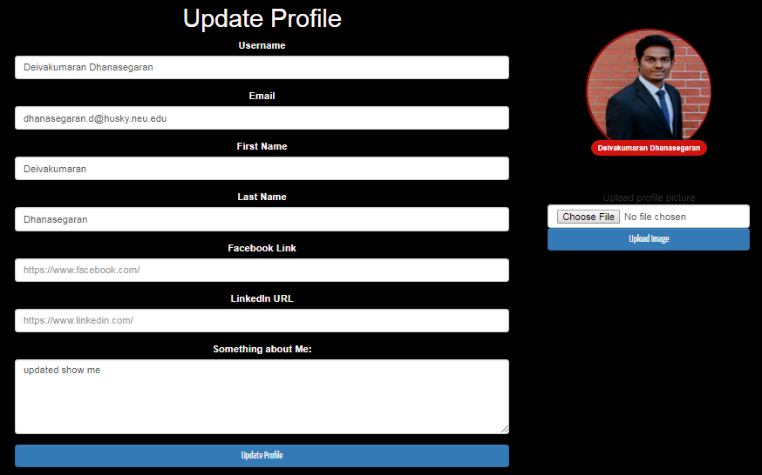
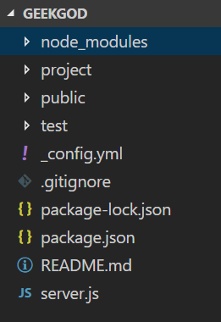
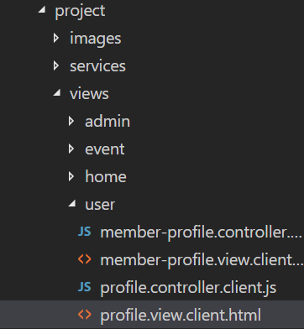
User Interface

Slide 7
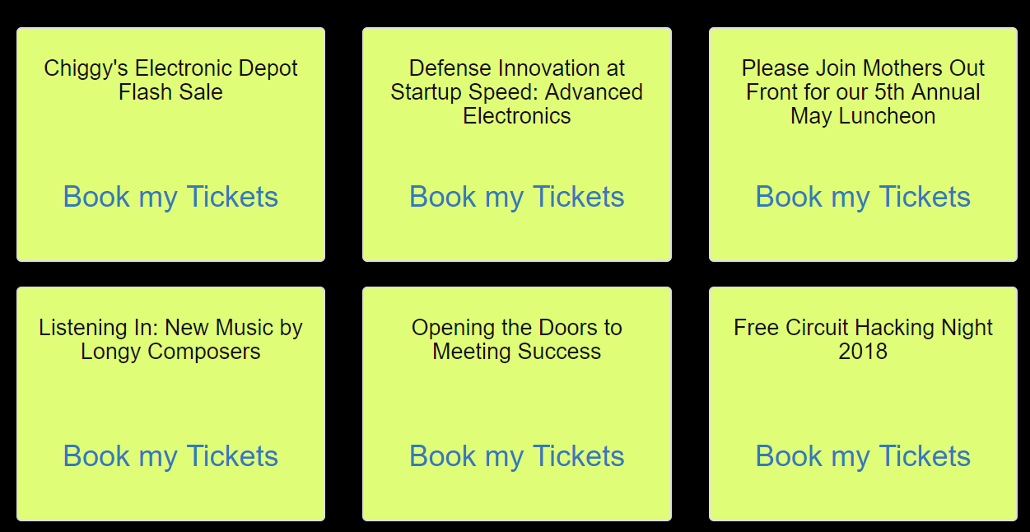
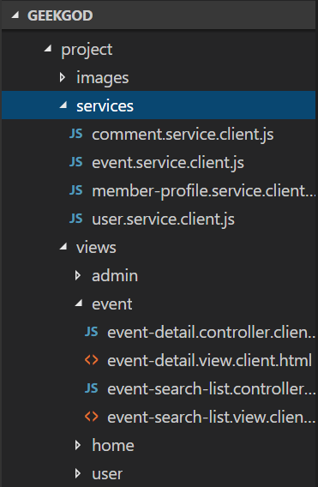
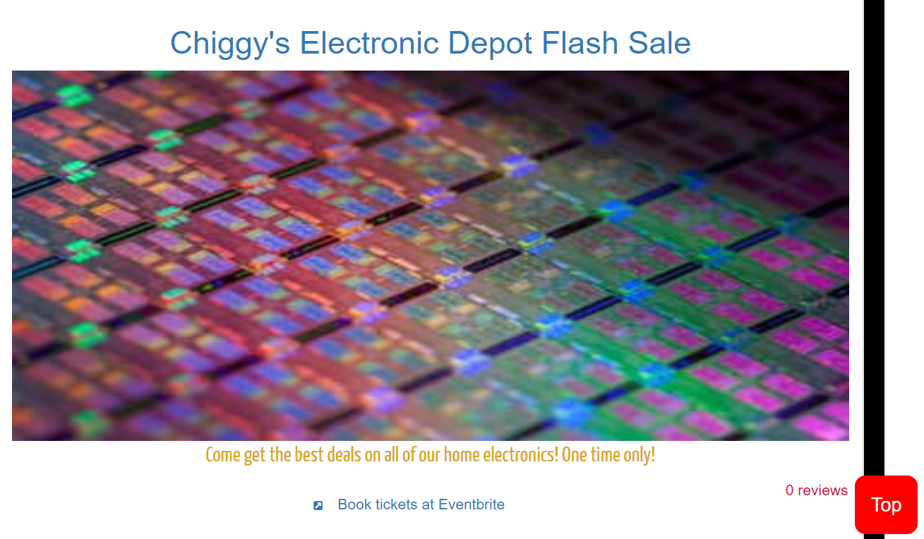
Route to the Events list page to book the events
Select the event interested in and route to the detailed page of the event

Slide 8
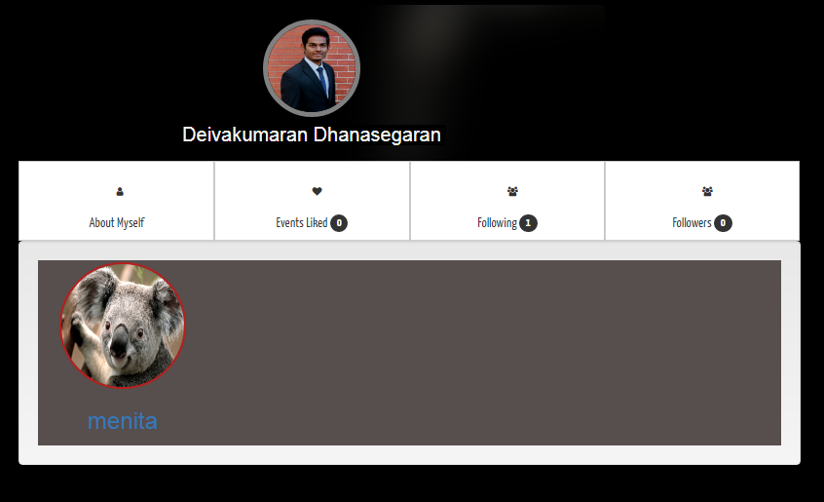

Slide 9
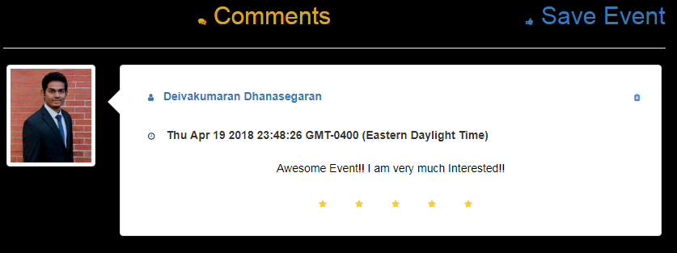

Slide 10
THANK YOU!!!

Slide 11
Thank You!

