Slide 1
Mobile Phone List Android App Getting Started Docment
By Michael C. Li 11/18/2020

Slide 2
Prequisites
Install Android Studio 4.0.1.
Android 4.2 or higher installed on the phone. Debugger mode should be enabled for uploading firmware.
USB cable

Slide 3
Quick Procedures
Easy steps to run the app.
Go to https://github.com/mikelisfbay/Android_App_MobilePhoneList
Download the zip file.
Use the Window File Explorer to extract all on the zip file.
Run Android Studio.
Open the project in the unzipped directory.
Build the project
Enabling USB Debugging on an Android Device
Connect to the Android phone to the USB port.
Click on the Allow button for USB debugging when a popup window appears.
Upload the app to the Android phone in Android Studio.
The app should appear and is ready.

Slide 4
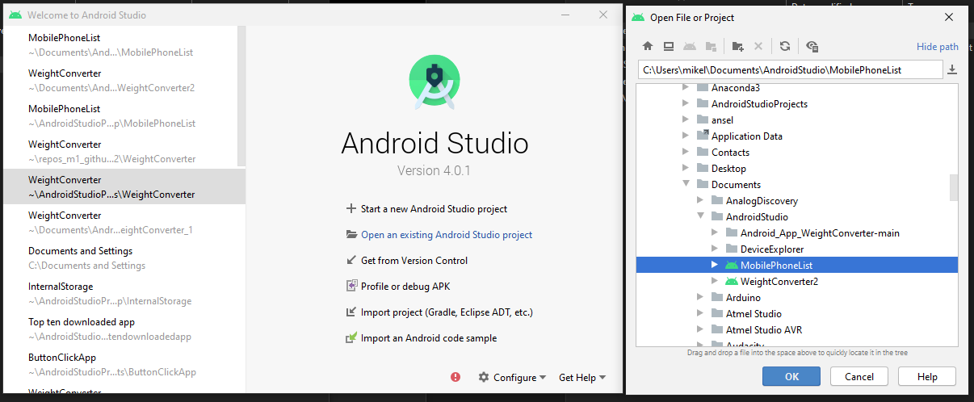
Step 5: Open the project.

Slide 5
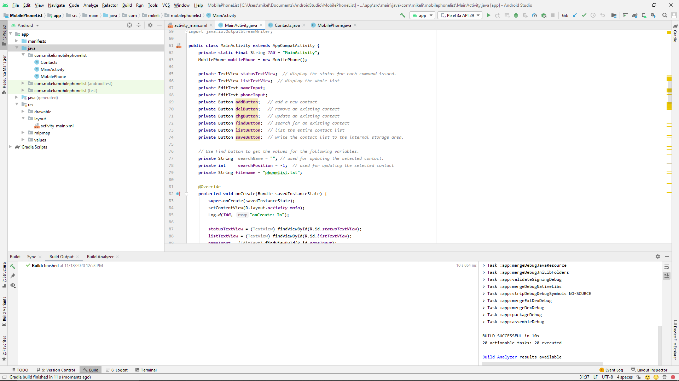
Step 6: Click on the hammer icon to make project (build) Open the Build window for any error.

Slide 6
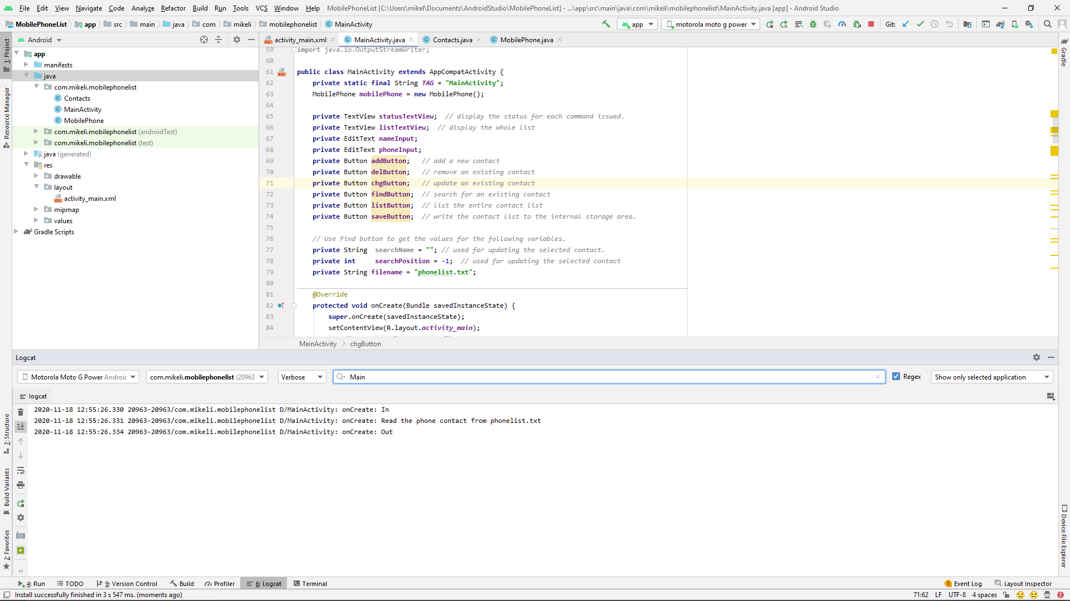
Step 10: upload the app to the Android phone
Press the right arrow icon to upload.
When done, the icon will be changed.
Choose your Android phone ( not the emulator)
Use the logcat to see the status.

Slide 7
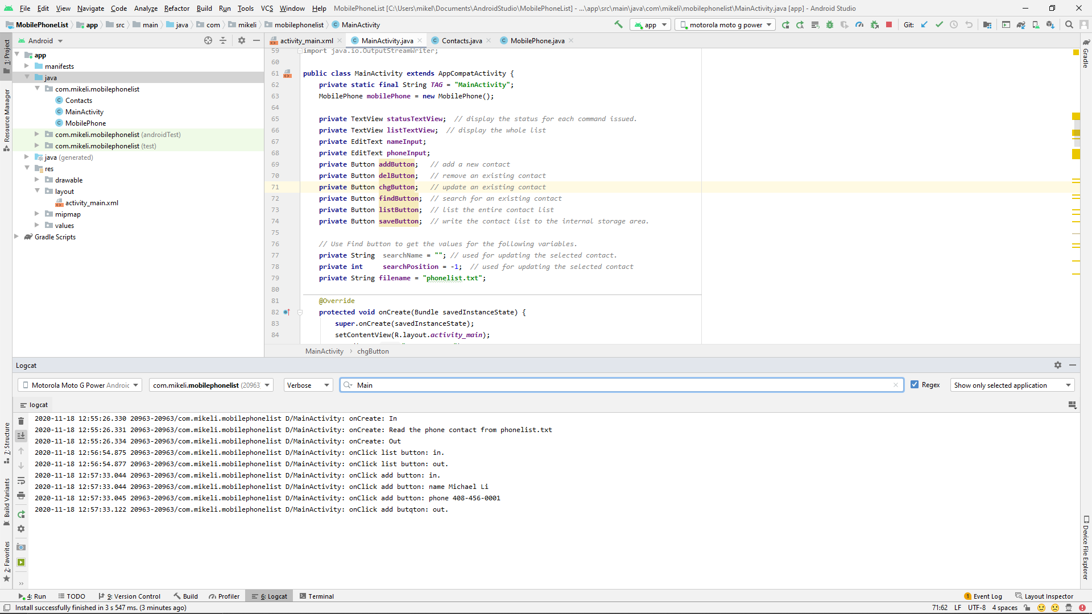
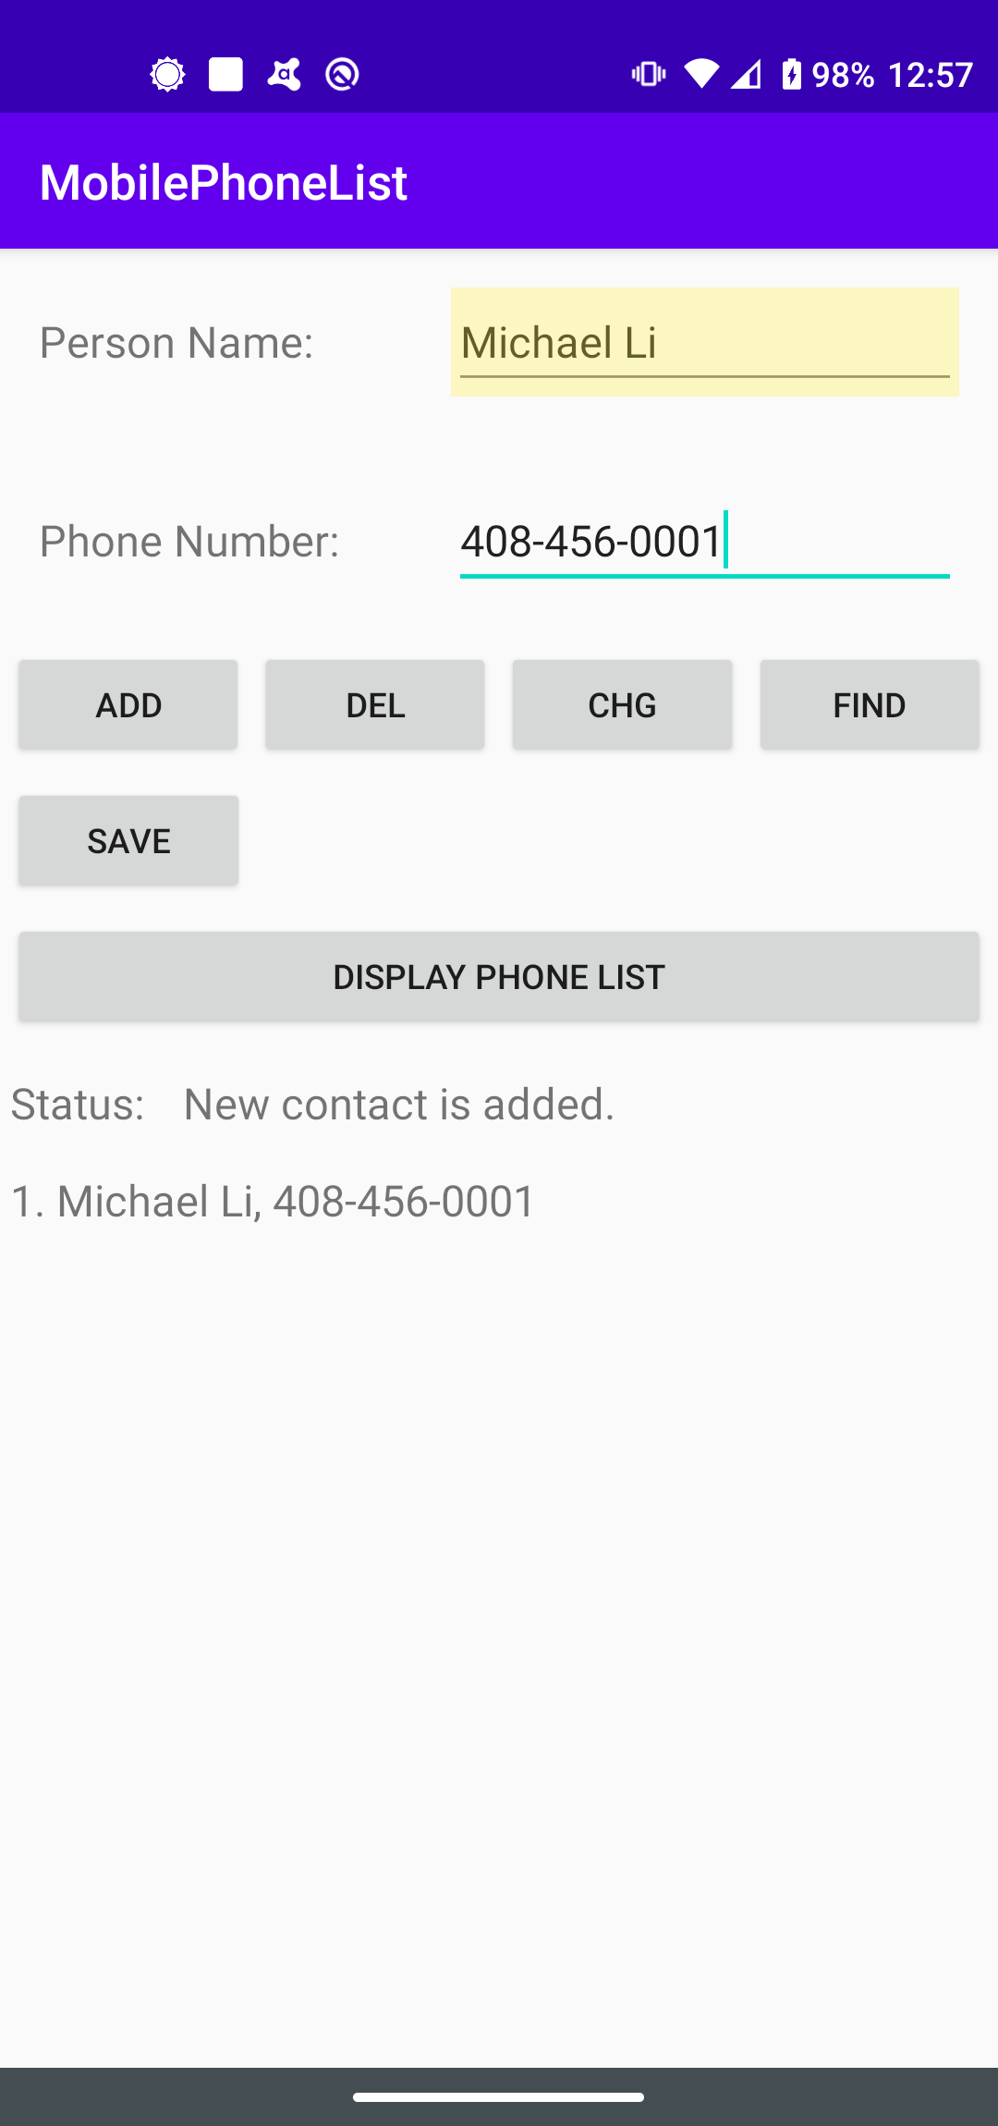
Step 11: Moto G Power (Android 10)
Enter the name
Enter the phone #
Press the ADD button

Slide 8
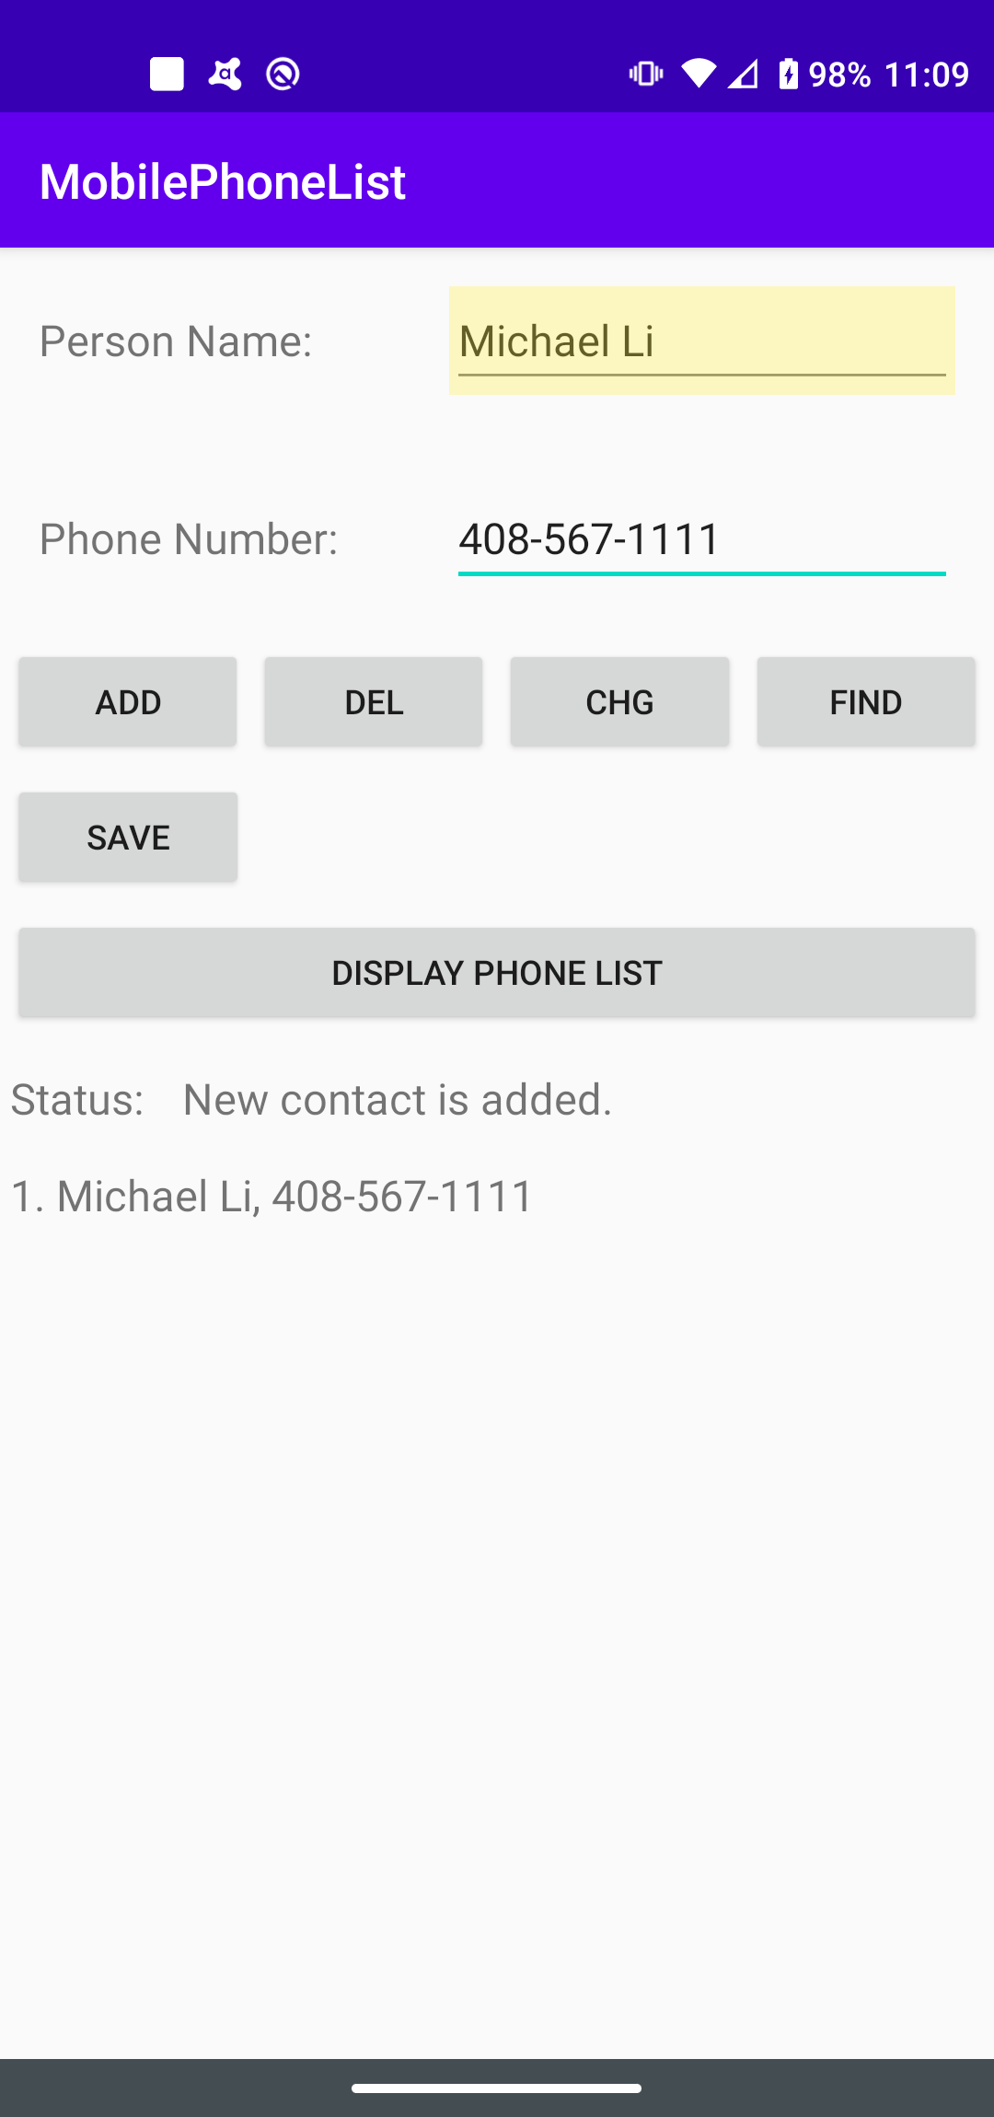
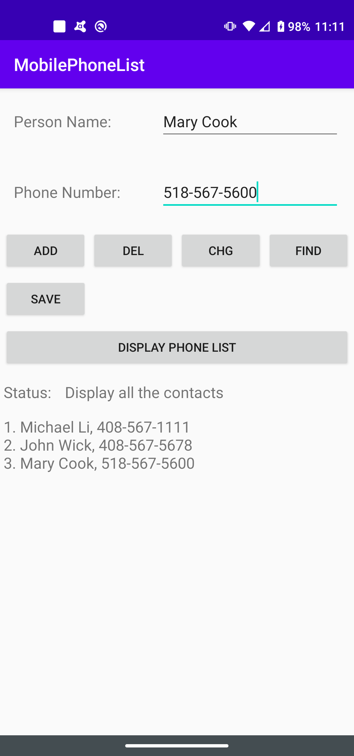
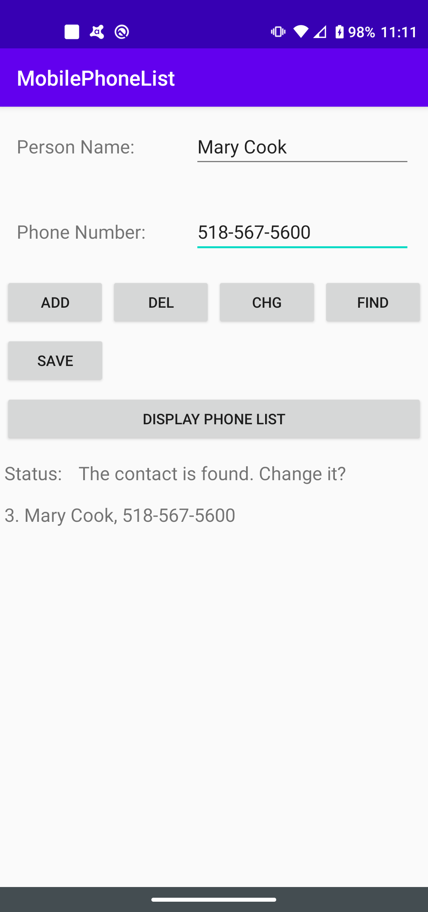
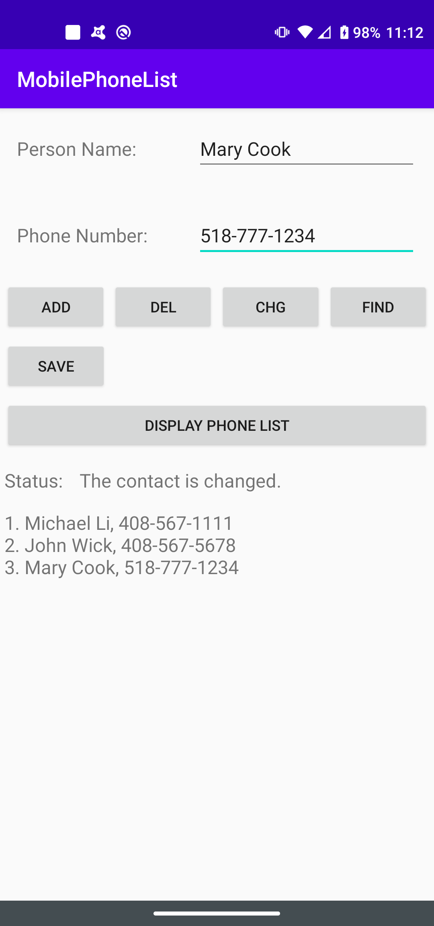
Example : Add → Display Phone List → Find → Change

Slide 9
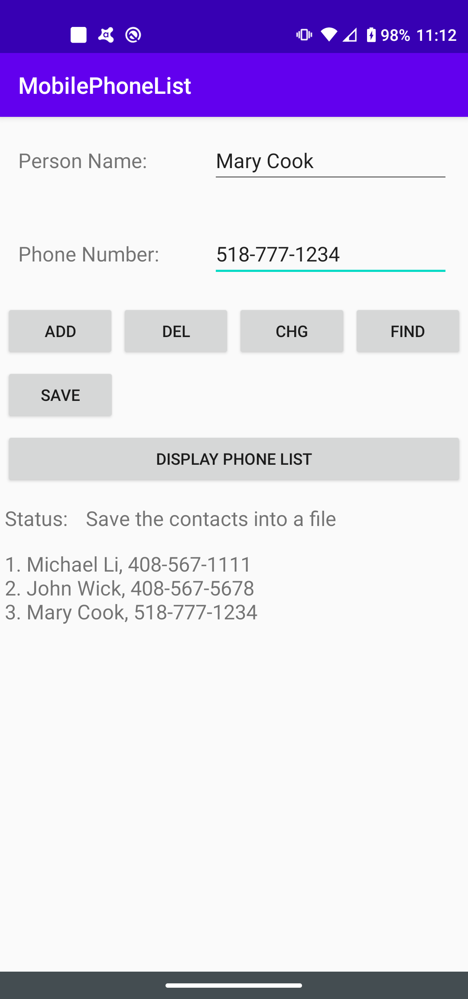
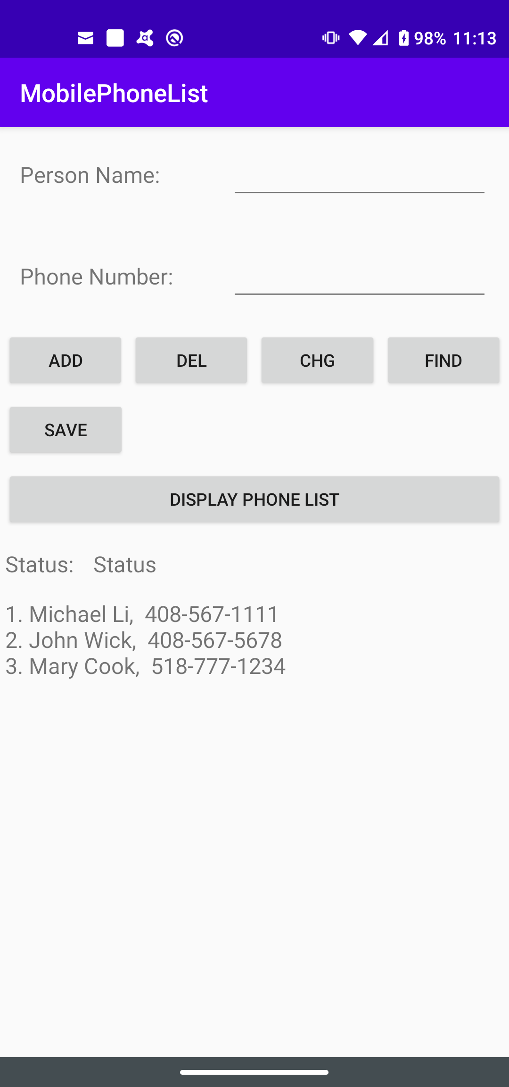
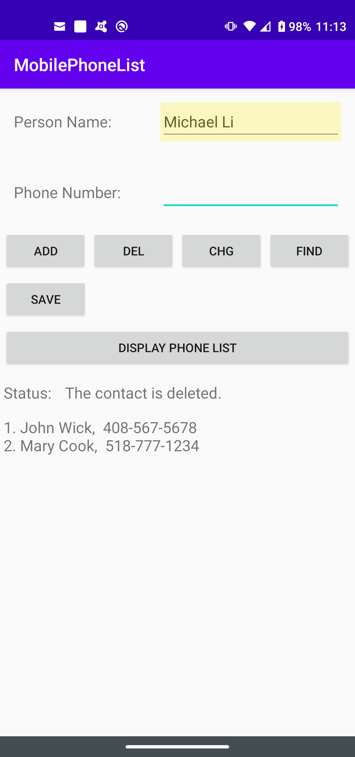
Example: Save → Close/Restart Appp → Delete

Slide 11
Java code (MainActivity.java) Layout design (activity_main.xml)

Slide 12
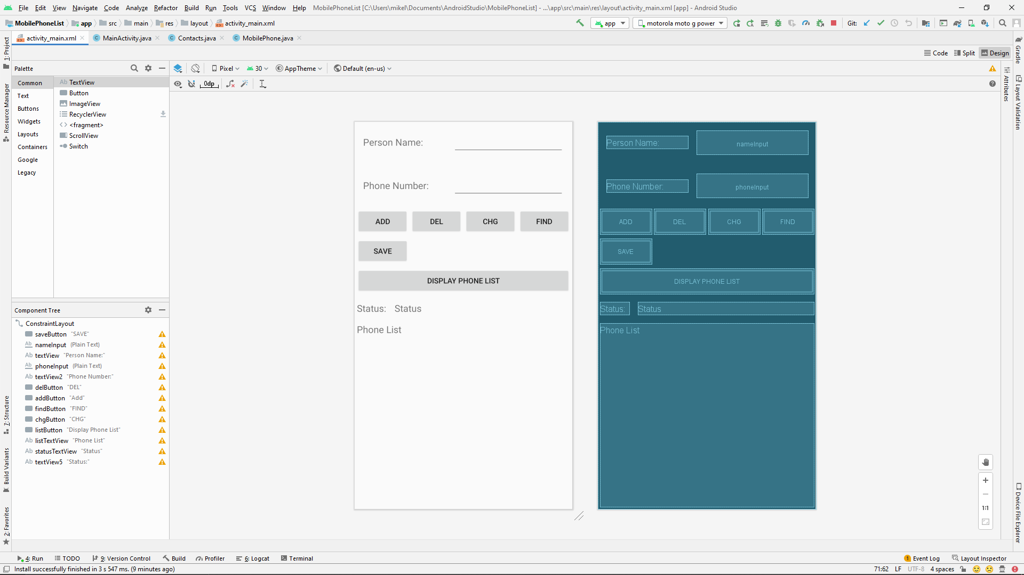
App Interface Layout

Slide 13
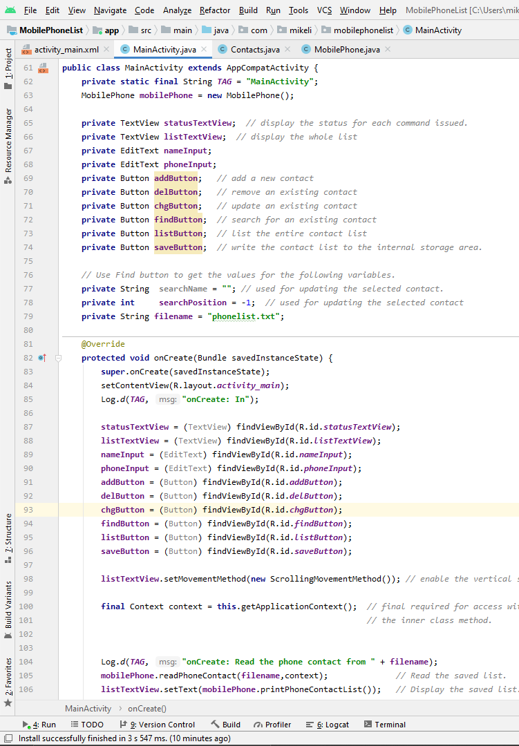
Main Java code
Widget Object Declaration
Widget Object Instantiation

Slide 14
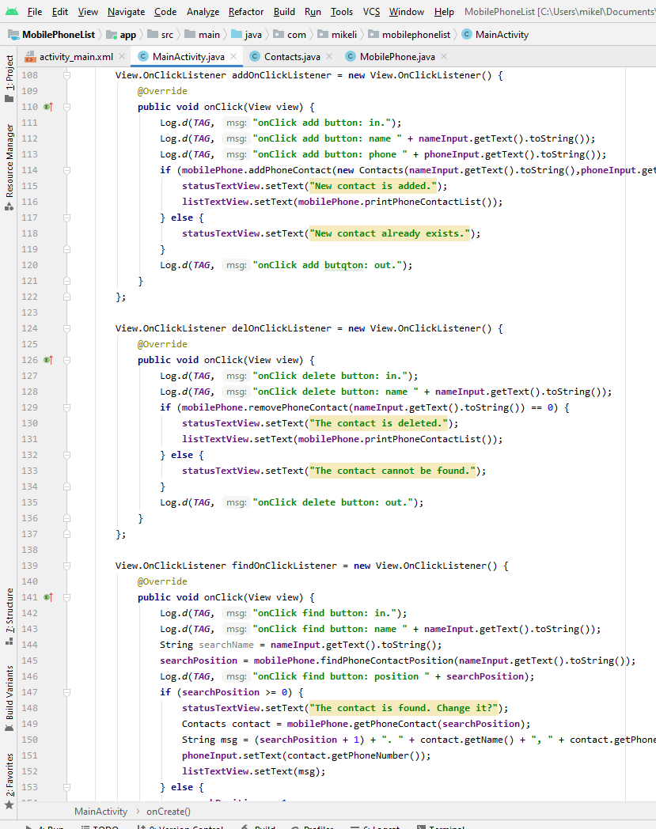
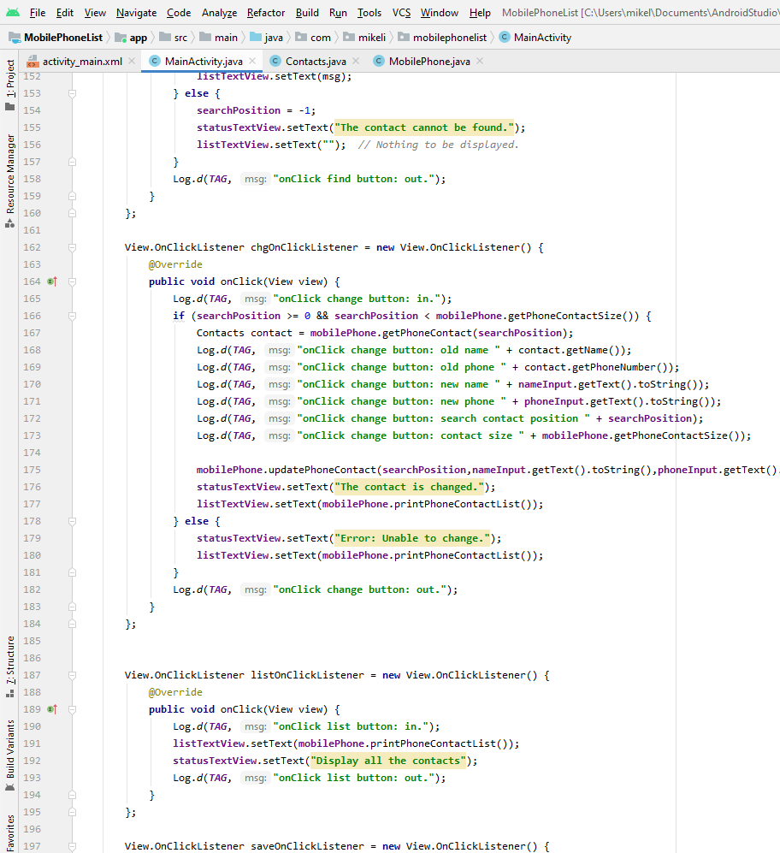
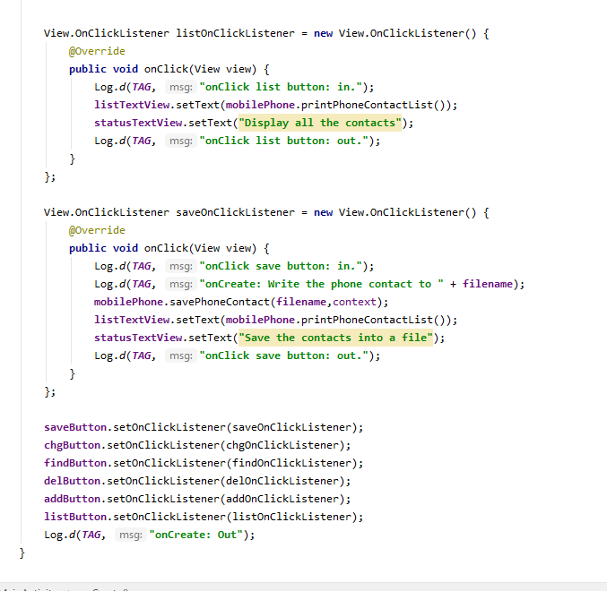
Button Function Subroutines.

Slide 15
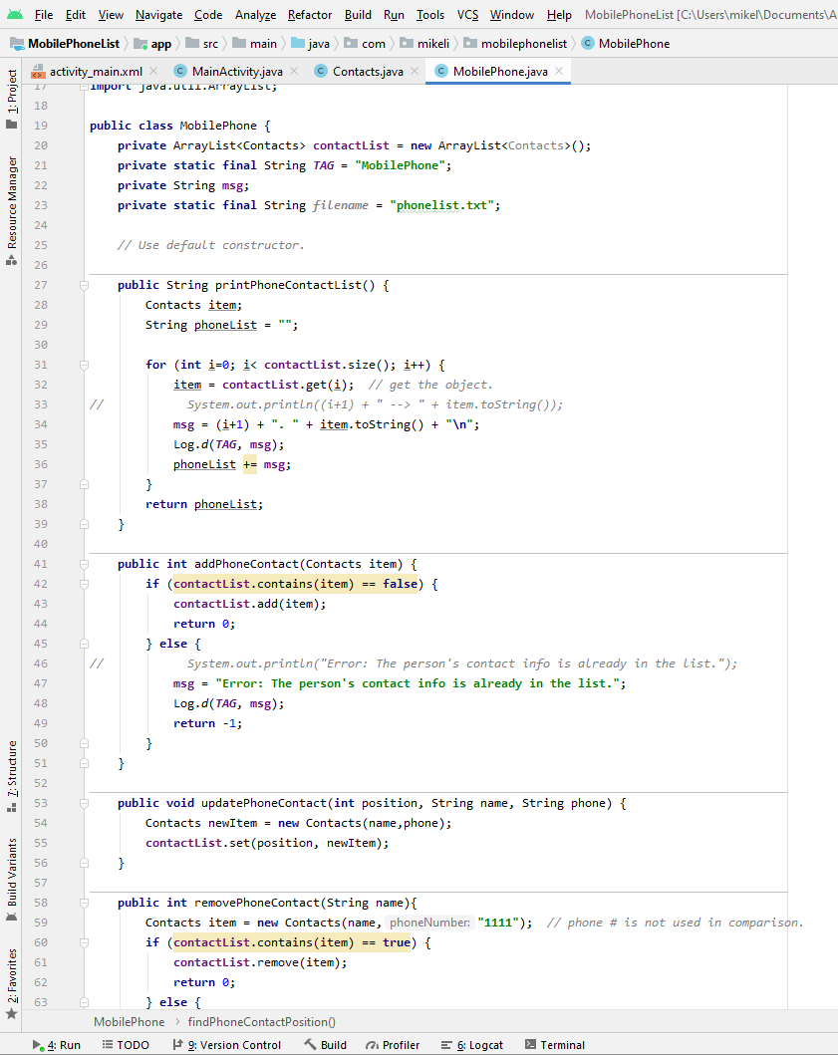
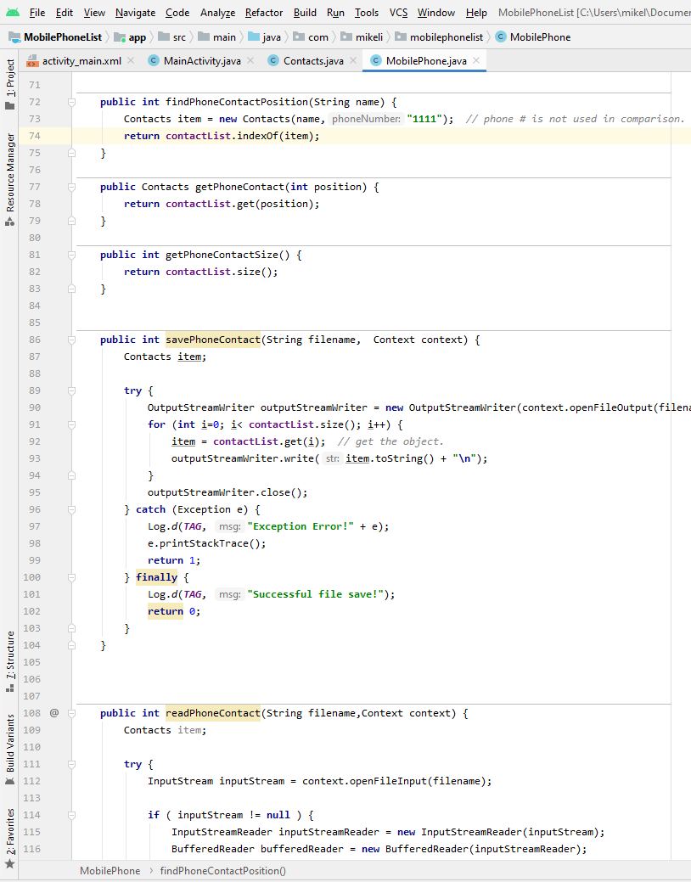
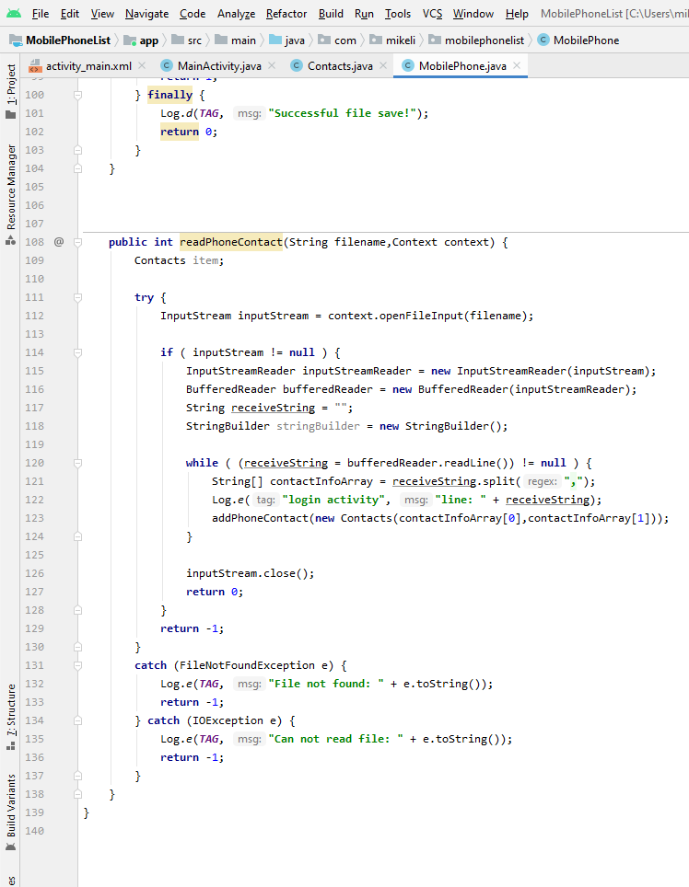
Mobile Phone Class (the contact list and the methods for different list operations)

