Slide 1
PPG based normal and abnormal classification using Random Forest
BY GROUP - 17

Slide 2
TEAM MEMBERS
MOHAN KRISHNA CB.EN.U4AIE22121
SANDEEP KUMAR CB.EN.U4AIE22155
SRI RAM CB.EN.U4AIE22166
PRANAY CB.EN.U4AIE22143

Slide 3
Introduction

Slide 4
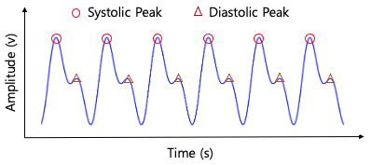
PPG(Photoplethysmogram) signal:
A Photoplethysmogram(PPG) signal: is a non-invasive is a non-invasive physiological waveform that measures the volumetric changes of blood in peripheral circulation, typically in the skin or fingertip. It is widely used in various medical and consumer health monitoring devices to assess cardiovascular health and other related parameters.
The two main components of PPG signal are:
a) Pulsatile (AC) Component: Represents the arterial blood volume changes with each heartbeat.
b) Non-Pulsatile (DC) Component: Represents the baseline blood volume in the tissue.
Types Of Peaks:
a) Systolic peak: The phase of the cardiac cycle during which the
heart muscle contracts, pumping blood
out of the chambers (ventricles) into the arteries.
b) Diastolic peak:The phase when the heart muscle
relaxes after contraction, allowing the chambers
to fill with blood.

Slide 5
Importance of PPG classification
PPG signal classification is vital for detecting cardiovascular abnormalities like myocardial infarction (MI) in a non-invasive, cost-effective, and real-time manner. It supports early diagnosis, improves patient outcomes, and enables personalized healthcare through wearable devices and remote monitoring systems. By leveraging machine learning, PPG classification enhances accuracy and scalability, making it essential for modern healthcare applications.

Slide 6
Block diagram

Slide 7
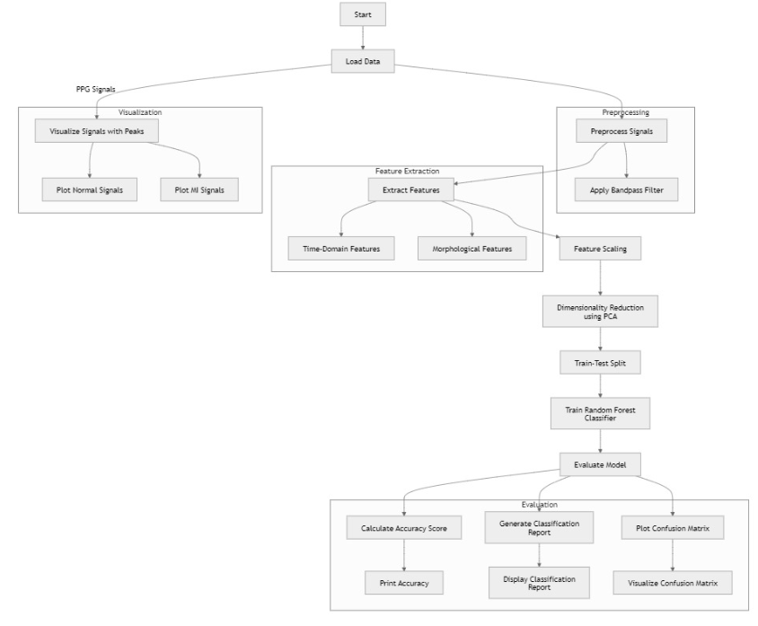

Slide 8
Dataset

Slide 9
Type of data
Normal type data
MI type data
Represent typical blood volume changes in healthy individuals.
Exhibit regular waveforms with consistent peaks and troughs corresponding to the cardiac cycle.
Indicate abnormal blood flow patterns due to a heart attack.
May show irregularities in peak amplitude, waveform shape, or timing due to impaired cardiac output.

Slide 10
Signal pre-processing

Slide 11

BUTTERWORTH BANDPASS FILTER

Slide 12
Feature extraction

Slide 13
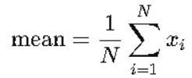
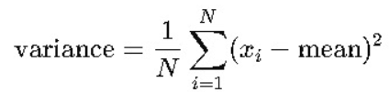


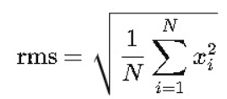
Time based Features
Mean
Varience
Standard deviation
Skewness
RMS

Slide 14

Morphological Features
Number of peaks

Slide 15
Peak detection

Slide 16
Signal filtering
Peak detection
Before peak detection, the raw signal is passed through a bandpass filter. This step removes noise and artifacts outside the desired frequency range for clean data for peak detection.
This function identifies the maxima in the filtered PPG signal, representing significant events like heartbeats.

Slide 17
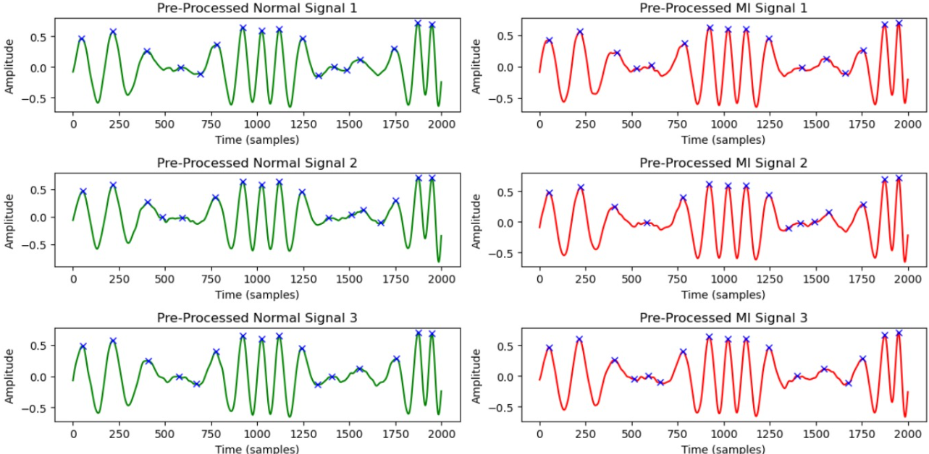
Peak Detection for Normal VS MI

Slide 18
Random Forest

Slide 19
Random Forest Model
Feature-Based Classification:
The Random Forest model is trained on extracted features to classify PPG signals into Normal or MI labels.
Data Splitting:
The dataset is split into testing and training for model to generalize the data it doesn’t see before.
Ensemble Learning:
Random Forest combines predictions from multiple decision trees to improve accuracy and reduce overfitting.
Performance Evaluation:
The model's predictions are evaluated using metrics like accuracy, classification report, and confusion matrix, providing insights into its effectiveness in classifying signals.

Slide 20
Results

Slide 21
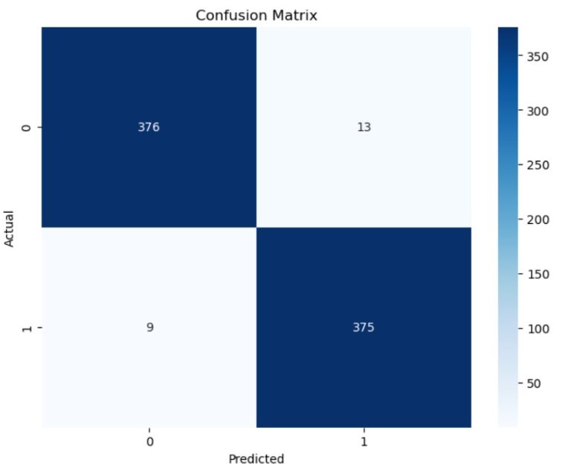
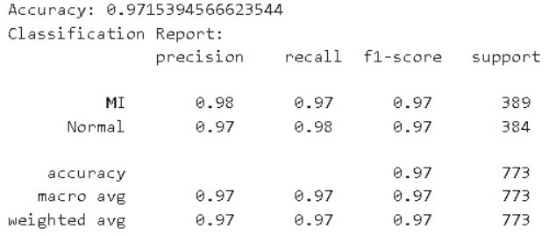
Accuracy Report
Confusion matrix

Slide 22
Conclusion

Slide 23
Further extensions & imrovments
This project can be extended to detect multiple cardiovascular conditions and integrated into wearable devices for real-time monitoring. Using advanced deep learning and combining PPG with other signals like ECG can enhance accuracy. It also supports telemedicine, early warning systems, and large-scale health studies.

Slide 24
THANK YOU

