Slide 1
Nurse Staffing Optimization
19MNG338 Operations Research
BATCH B GROUP 2

Slide 2
01
04
02
03
07
INTRODUCTION
DATASET OVERVIEW
FINAL RESULTS
05
08
PROBLEM STATEMENT
OPTIMIZATION
06
TEAM MEMBERS
OBJECTIVES
METHODOLOGY

Slide 3
INTRODUCTION
Healthcare facilities such as nursing homes and hospitals rely heavily on effective nurse staffing to ensure quality patient care. Proper allocation of Registered Nurses (RNs), Licensed Practical Nurses (LPNs), and Certified Nursing Assistants (CNAs) is critical not only to meet patient care standards but also to control labor costs.
Traditional scheduling methods are often manual, time-consuming, and prone to inefficiencies such as overutilization, underutilization, and excessive overtime. With the availability of large-scale staffing datasets from the Centers for Medicare & Medicaid Services (CMS), optimization techniques can be applied to design cost-effective staffing plans while maintaining compliance with regulatory requirements.

Slide 4
PROBLEM STATEMENT
Nursing homes face the dual challenge of:
Ensuring minimum and maximizing staffing requirements for each category of nurse per resident per day.
Manual scheduling often fails to achieve this balance, resulting in poor care quality or inflated costs. There is a need for an automated optimization approach that can generate optimal staffing schedules based on real data.

Slide 5
OBJECTIVES
To develop an optimization model for nurse staffing that:
Ensures compliance with CMS staffing standards (hours per resident per day).
Balances staff workload to reduce overtime dependency.
Provides actionable scheduling insights for nursing home administrators.
Balance facility staff members with over-time schedule and minimum-time schedule.

Slide 6
DATASET OVERVIEW
Dataset: CMS Payroll-Based Journal (PBJ) Daily Nurse Staffing – 2025 Q1 Key Attributes:
facility_id: Unique nursing home identifier.
date: Day of staffing record.
job_title: Staff role (RN, LPN, CNA).
hours_worked: Total hours worked by that role.
census: Number of residents in the facility.
Derived Metric:
Hours Per Resident Day (HPRD) = hours_worked ÷ census
CMS Guidelines:
RN HPRD ≥ 0.75
LPN HPRD ≥ 0.55
CNA HPRD ≥ 2.25

Slide 7
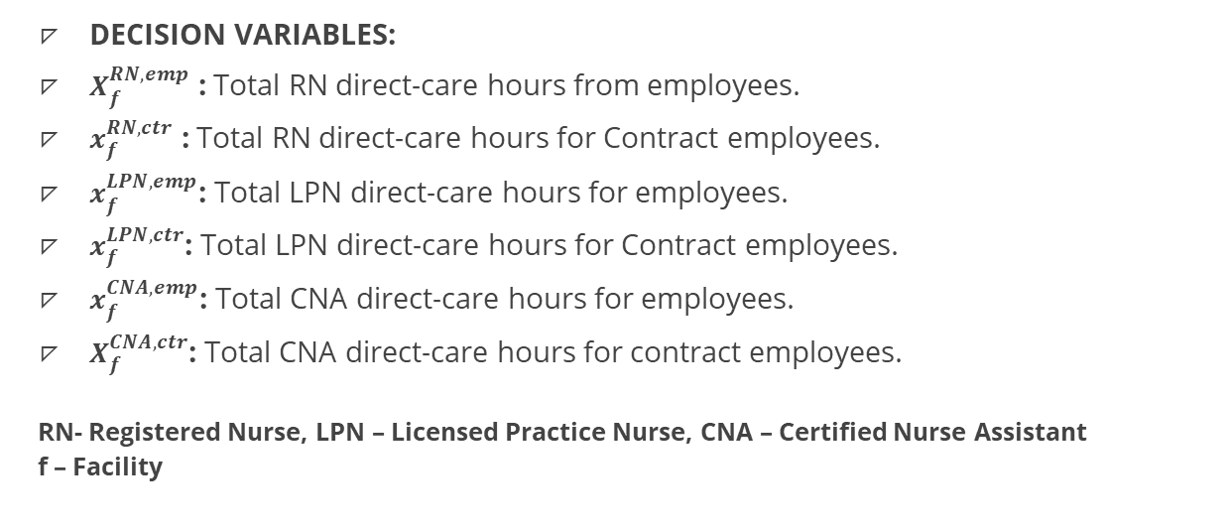
DECISION VARIABLES
DECISION VARIABLES:
$X_{f}^{RN,emp}$ : Total RN direct-care hours from employees.
$x_{f}^{RN,ctr}$ : Total RN direct-care hours for Contract employees.
$x_{f}^{LPN,emp}$: Total LPN direct-care hours for employees.
$x_{f}^{LPN,ctr}$: Total LPN direct-care hours for Contract employees.
$x_{f}^{CNA,emp}$: Total CNA direct-care hours for employees.
$X_{f}^{CNA,ctr}$: Total CNA direct-care hours for contract employees.
RN- Registered Nurse, LPN – Licensed Practice Nurse, CNA – Certified Nurse Assistant
f – Facility

Slide 8
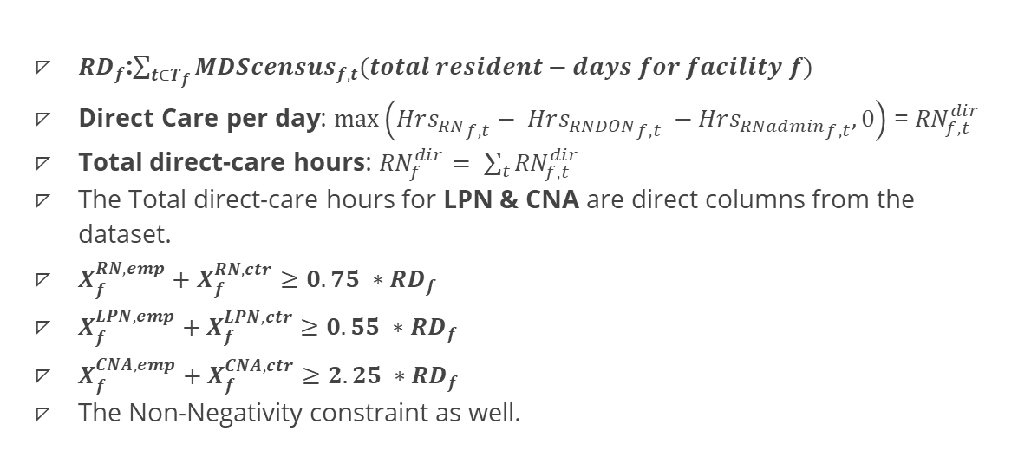
CONSTRAINTS
${RD}_{f}$:$\sum_{t∈T_{f}}{{MDScensus}_{f,t}(total resident−days for facility f)}$
Direct Care per day: $\max\left({Hrs_{RN}}_{f,t}− {Hrs_{RNDON}}_{f,t} −{Hrs_{RNadmin}}_{f,t},0\right)$ = ${RN}_{f,t}^{dir}$
Total direct-care hours: ${RN}_{f}^{dir}= \sum_{t}{{RN}_{f,t}^{dir}}$
The Total direct-care hours for LPN & CNA are direct columns from the dataset.
$X_{f}^{RN,emp}+X_{f}^{RN,ctr}≥0.75 ∗{RD}_{f}$
$X_{f}^{LPN,emp}+X_{f}^{LPN,ctr}≥0.55 ∗{RD}_{f}$
$X_{f}^{CNA,emp}+X_{f}^{CNA,ctr}≥2.25 ∗{RD}_{f}$
The Non-Negativity constraint as well.

Slide 9
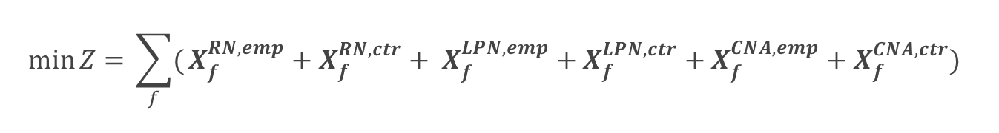
OBJECTIVE FUNCTION
$$\min{Z= }\sum_{f}{(}X_{f}^{RN,emp}+X_{f}^{RN,ctr}+ X_{f}^{LPN,emp}+X_{f}^{LPN,ctr}+X_{f}^{CNA,emp}+X_{f}^{CNA,ctr})$$

Slide 10
OPTIMIZATION
The Goal (Objective): Minimize Total Hours. The model’s main purpose is to find the absolute lowest number of staffing hours needed, which automatically cuts any waste from overstaffed facilities.
The Rules (Constraints): Meet Legal Minimums. The model must follow strict rules that the total hours for RNs, LPNs, and CNAs are always at or above the legal HPRD requirement. This automatically fixes any underutilized and overutilized facilities.
The Decisions (Variables): Find the Best Staff Mix. For each facility, the model’s job is to decide the optimal number of employee and contract hours for each of the three nurse types.
The Final Answer (Solution): Calculate the Optimal Plan. The solver finds the single best staffing plan that perfectly balances the goal (lowest hours) with the rules (legal compliance) and saves this ideal result.

Slide 11
METHODOLOGY
Define the Problem: Identify the core objective as the need to meet the minimum HPRD (Hours Per Resident Day) staffing rules set by CMS.
Prepare the Dataset: Collect the raw CMS staffing data, then clean it to handle errors and aggregate all daily records into a final summary for each facility.
Formulate the Optimization Model: Build a mathematical model for each facility with an objective to minimize total hours and constraints to enforce the HPRD rules.
Solve the Model: Use Python to run the optimization solver and calculate the most efficient staffing plan for every facility.
Evaluate the Solution: Compare the new, optimized results against the original data to measure the impact on compliance and total staffing hours.
Draw Conclusions: Analyze the final evaluation to report on the key findings, such as the scale of underutilization and overutilization along with the effectiveness of the model.

Slide 12
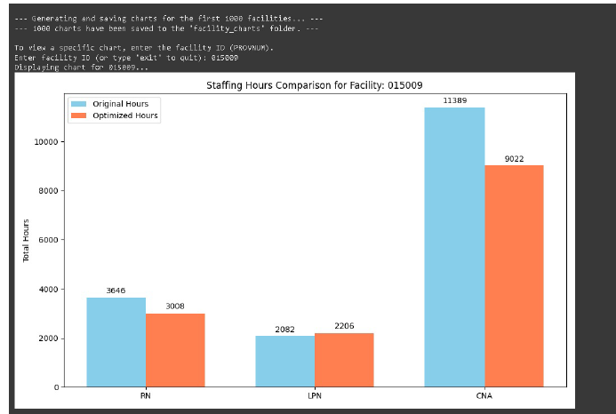
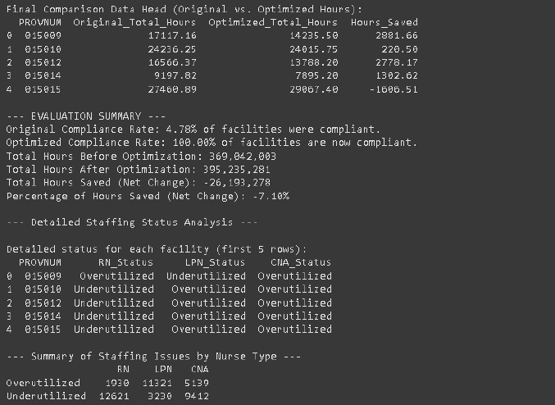
FINAL RESULTS:

Slide 13
TEAM MEMBERS
CB.EN.U4AIE22130- Dhanush MC
CB.EN.U4AIE22155- Sandeep Kumar T.V
CB.EN.U4AIE22121- Mohan Krishna G

Slide 14
THANK YOU

