Slide 1

Bluestock Fintech: Mutual Fund Data Analytics
Empowering Financial Decisions through Data-Driven Insights
Presented by: Ganjikunta Mohan Krishna | June 2026

Slide 2

Problem & Objective
The Challenges
The Objective
Data Fragmentation
Mutual fund data exists in various inconsistent formats, making unified analysis difficult and error-prone.
To build a robust analytics pipeline that transforms raw AMFI data into actionable investment intelligence, enabling data-driven decision making for fintech stakeholders.
Performance Gaps
Investors lack tools for real-time performance comparison across different schemes and categories.
Benchmark Tracking
Absence of automated systems to track fund performance against industry benchmarks.

Slide 3
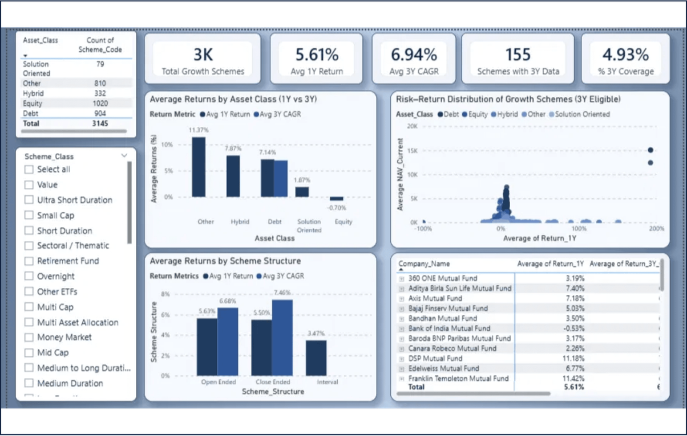
Data Sources & Inventory
87,000+ Rows
Historical Mutual Fund Data
10 Datasets
40 Schemes Covered
PRIMARY DATA SOURCES
AMFI India Public Data mfapi.in Real-time APIs

Slide 4

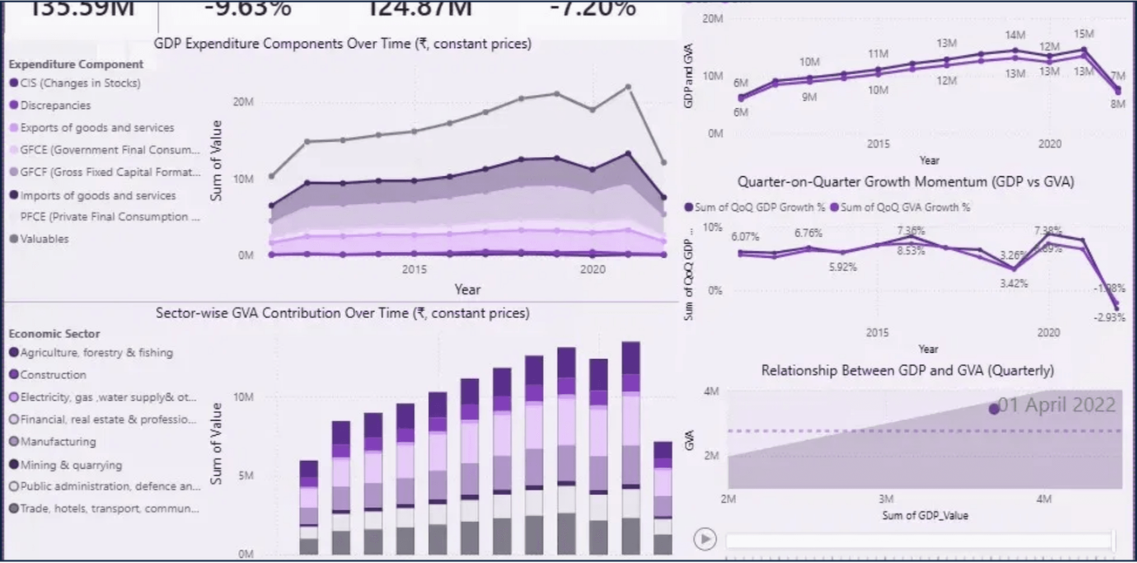
System Architecture
01
02
03
04
05
EXTRACT
TRANSFORM
LOAD
ANALYSE
VISUALISE
Automated ingestion from AMFI and MFAPI sources.
Cleaning, schema mapping, and data standardization.
Structured storage for high-performance querying.
Calculating KPIs, CAGR, and complex risk ratios.
Dynamic dashboards for real-time monitoring.
End-to-End Automation
A seamless 5-layer pipeline designed for scalability and data integrity across 87K+ rows.
Insight Generation
Transforming raw financial data into interactive visual intelligence for strategic decision making.

Slide 5
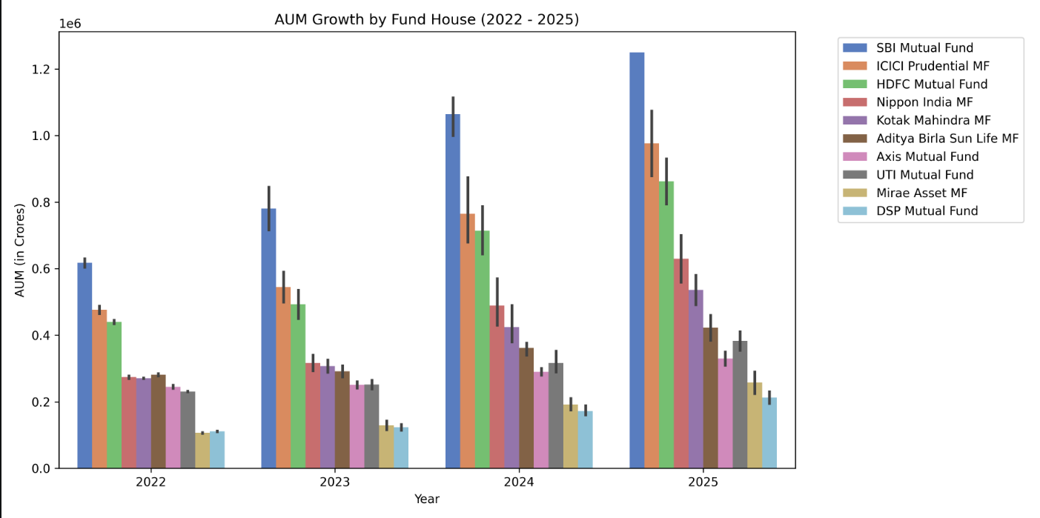
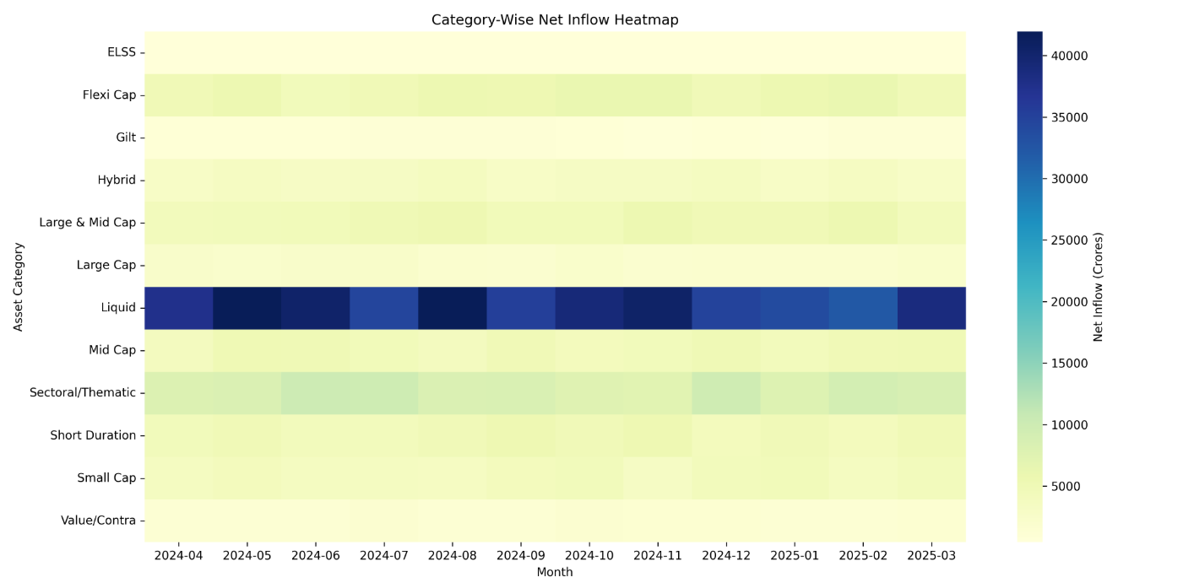
EDA Highlights: Market Trends
INDUSTRY AUM MILESTONE
Rs. 81L Cr
Monumental Growth in Assets
MONTHLY SIP INFLOWS
Rs. 31,002 Cr
Record Retail Participation
The Indian Mutual Fund industry continues its upward trajectory, driven by strong domestic institutional flows and increasing retail confidence through systematic investment plans.

Slide 6

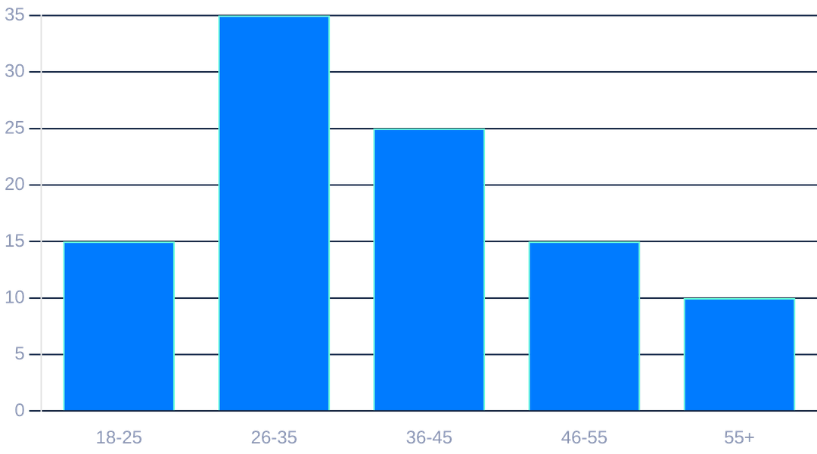
EDA Highlights: Demographics
Geographic Distribution
Investor Age-Group Distribution
T30 vs B30 Cities
While Top 30 (T30) cities contribute the majority of AUM, Beyond 30 (B30) cities are showing a higher growth rate in new investor registrations.
Regional Growth Trends
Increased financial literacy and digital penetration are driving significant inflows from Tier 2 and Tier 3 locations, indicating a shift in market depth.
Data indicates a significant surge in participation from the 18-35 age bracket, reflecting the rise of tech-savvy retail investors.

Slide 7
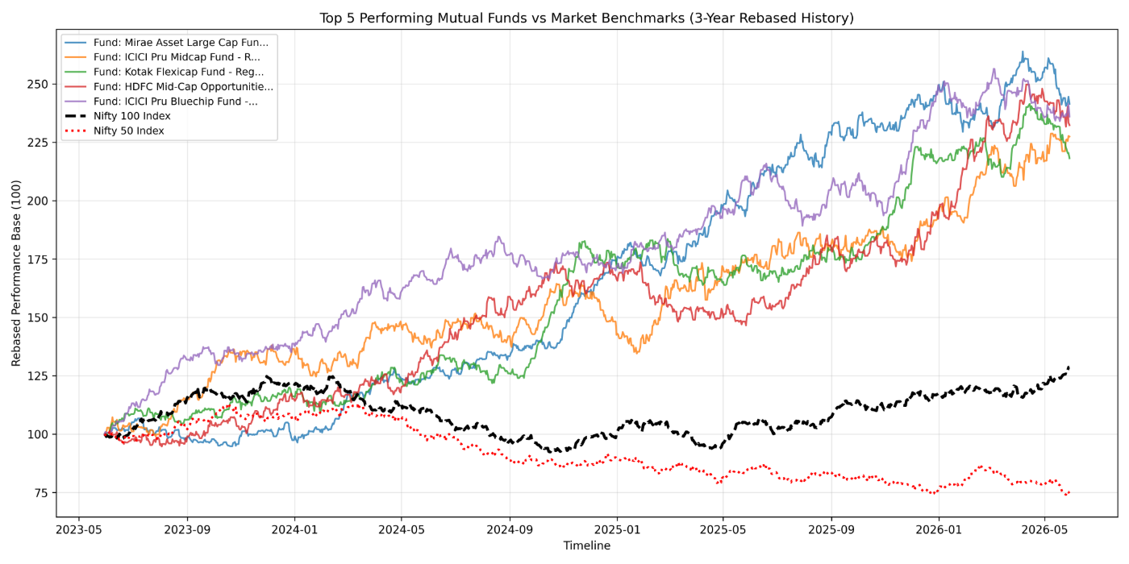
Performance Analytics: Returns
Fund Performance Rankings
Systematic ranking of 40+ schemes based on historical performance and consistency across market cycles.
CAGR Analysis
Detailed tracking of 1-year, 3-year, and 5-year Compounded Annual Growth Rates to identify long-term wealth creators.
Alpha Generation
Identifying funds that consistently deliver returns above their respective benchmarks through active management.

Slide 8

Performance Analytics: Risk
Sharpe Ratio
Evaluating risk-adjusted returns to identify funds with the best performance relative to volatility.
Sortino Ratio
Focusing specifically on downside risk to protect capital during market corrections.
Alpha & Beta
Analyzing market sensitivity (Beta) and the manager's ability to generate excess returns (Alpha).
Maximum Drawdown
Measuring the peak-to-trough decline to assess fund resilience in bear markets.
RISK MANAGEMENT FRAMEWORK
Comprehensive assessment beyond simple returns.

Slide 9
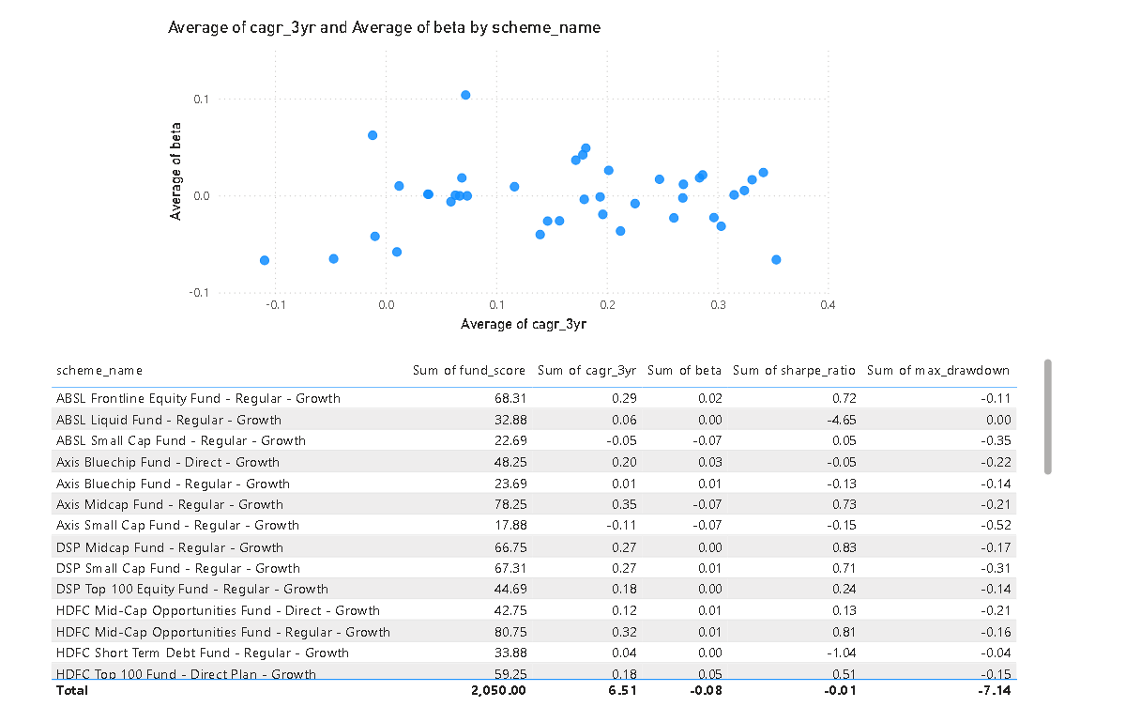
Dashboard: Industry & Performance
Real-Time Monitoring
Unified view of industry-wide AUM trends and category-wise performance metrics updated via MFAPI.
Comparative Analysis
Side-by-side comparison of multiple schemes against selected benchmarks for relative performance tracking.
Interactive Filters
Advanced drill-down capabilities by Asset Management Company (AMC), category, and custom time periods.
Visual Clarity
Intuitive charts and heatmaps designed for rapid identification of market leaders and laggards.

Slide 10
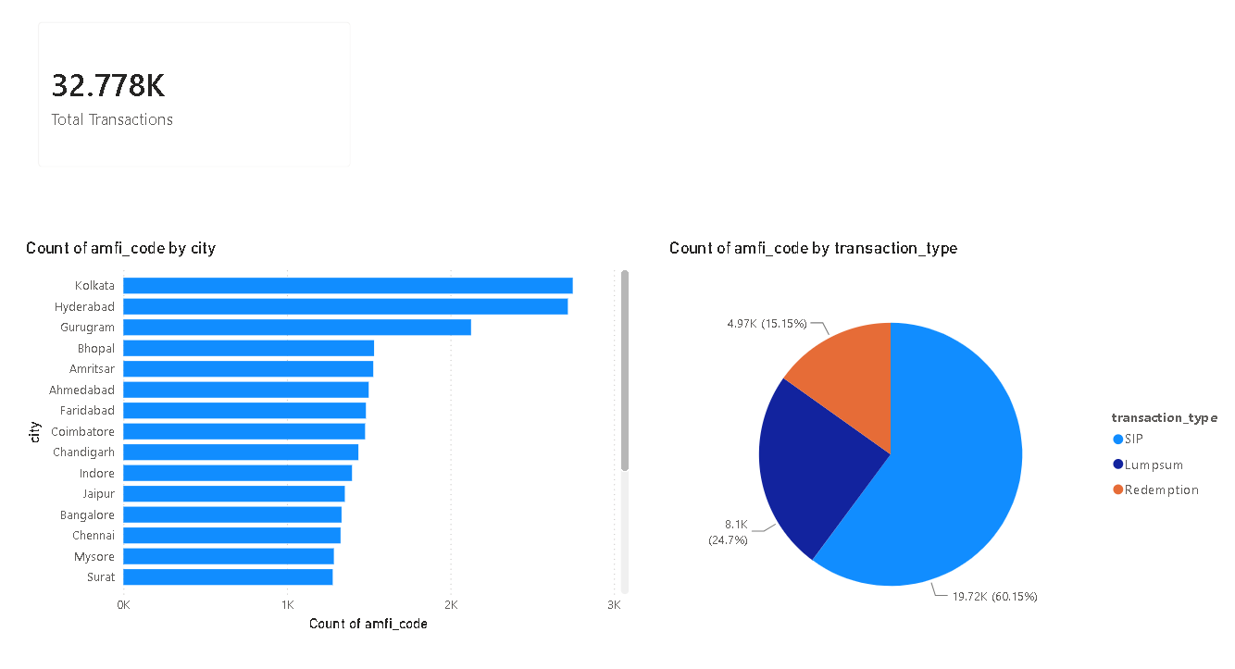
Dashboard: Investor & Market Trends
MARKET INTELLIGENCE
Investor Behavior Tracking
Real-time monitoring of SIP registration trends and redemption patterns across different fund categories.
Demographic Insights
Visualizing geographic heatmaps and investor age-group distributions to identify emerging market segments.
Sentiment Correlation
Correlating fund inflows with broader market indices and macroeconomic factors for a holistic view.

Slide 11
Key Findings & Recommendations
CONSERVATIVE
BALANCED
AGGRESSIVE
LOW RISK
MODERATE RISK
HIGH RISK
Debt & Liquid Funds
Large-Cap & Hybrid
Mid, Small & Sectoral
Focus on high-quality AAA-rated debt instruments and liquid schemes for capital preservation and steady income.
A mix of blue-chip equity funds and corporate bonds to provide growth with a safety cushion.
Growth-oriented portfolio with significant exposure to emerging sectors and high-growth mid-cap companies.
Consistent CAGR
Short-Term Focus
Targeting steady long-term wealth creation with moderate exposure to market fluctuations.
Alpha Generation
Ideal for investors with a 1-3 year horizon seeking lower volatility than equity markets.
Designed for long-term investors (7+ years) aiming to significantly outperform broad market benchmarks.
"Core Insight: Diversification across asset classes remains the most effective strategy for long-term wealth creation and risk mitigation in the Indian Mutual Fund landscape."

Slide 12


Thank You
Questions & Feedback are Welcome
Email
[mohankrishnaganjikunta@gmail.com]
PROJECT REPOSITORY
github.com/mightymistic007/bluestock_mf_capstone

