Slide 1
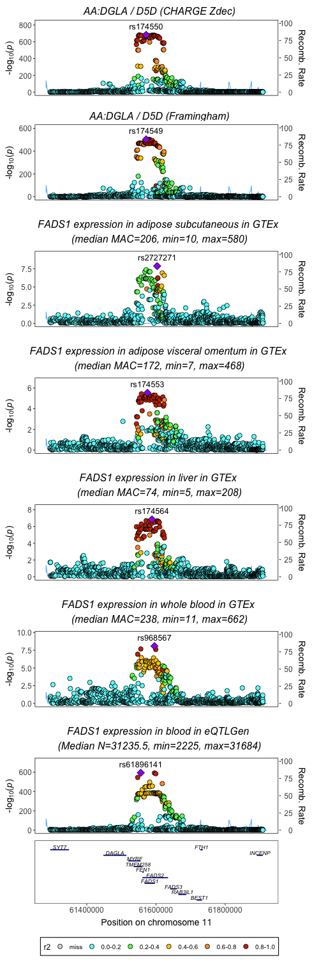
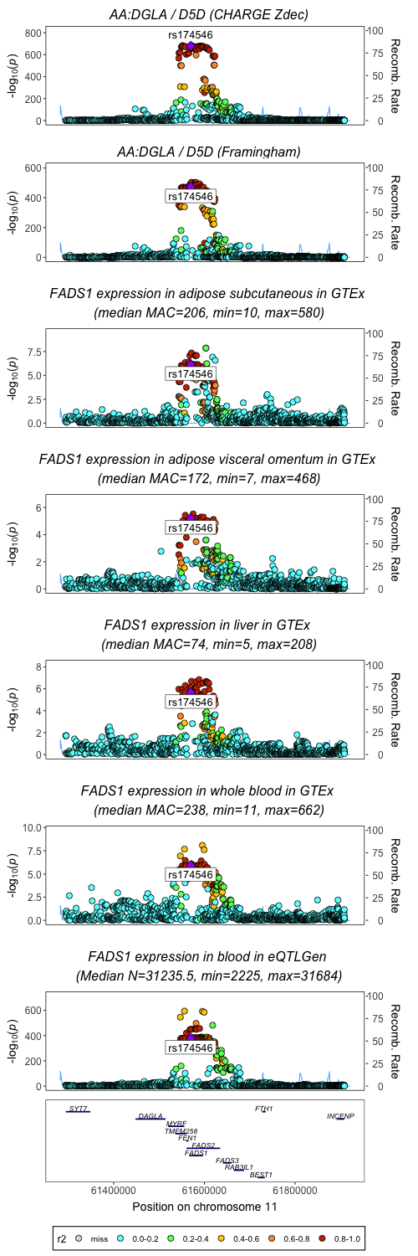
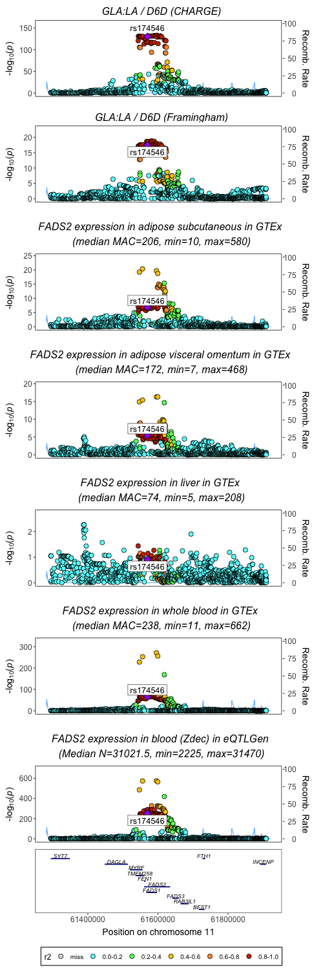
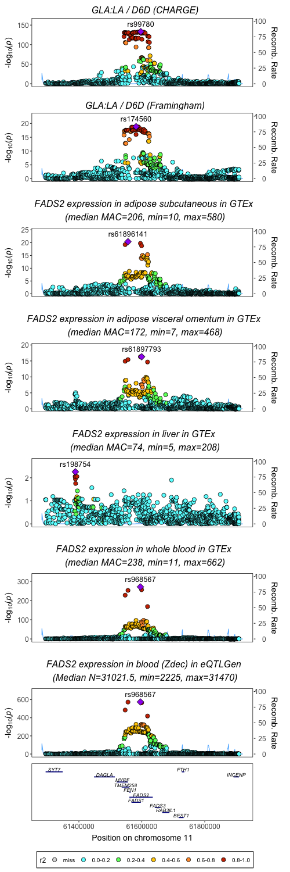
Association of 1296 SNPs with markers of FADS1 and FADS2 at the FADS gene cluster on chromosome 11
FADS1
FADS2
Enzyme activity
rs968567
rs968567
Gene expression
rs968567
rs968567
rs968567
rs968567
Three groups:
1. rs968567/rs61896141 (r2=0.981) – function variant in FADS2 promoter
2. rs174550, rs174549, rs174553, rs174564, rs99780, rs174560 (r2≥0.74) – enhancer residing between FADS1 and FADS2 promoters
3. rs2727271 – unknown mechanism

Slide 2
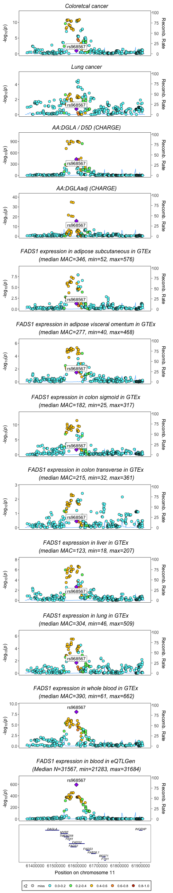
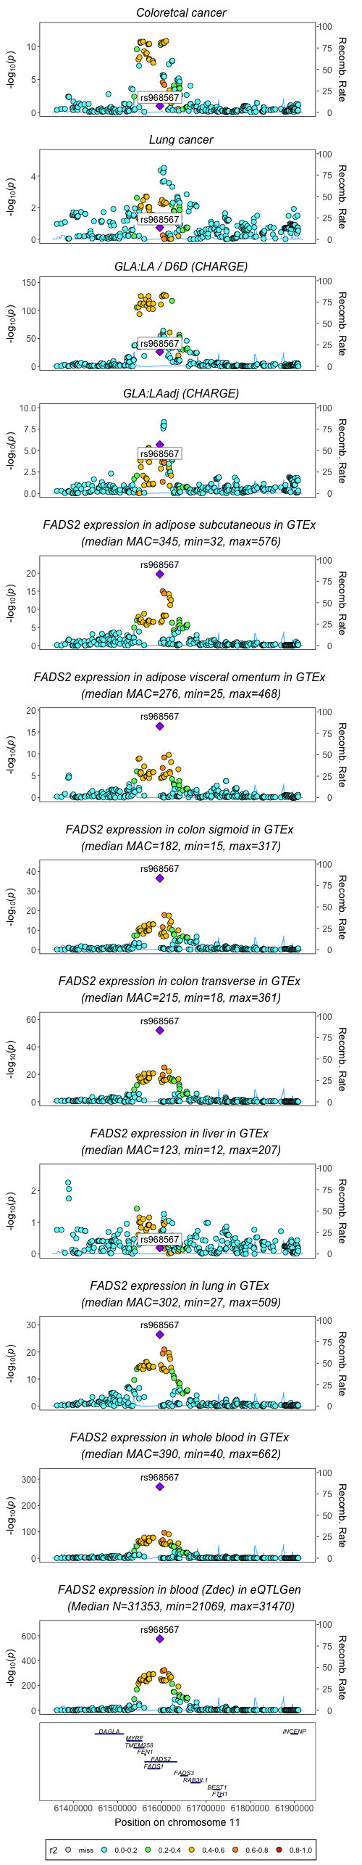

Slide 3
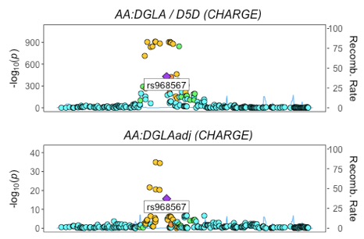
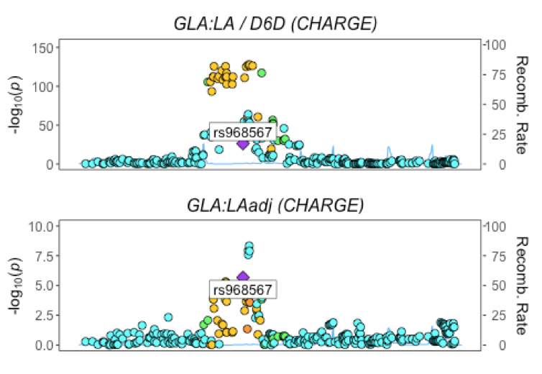
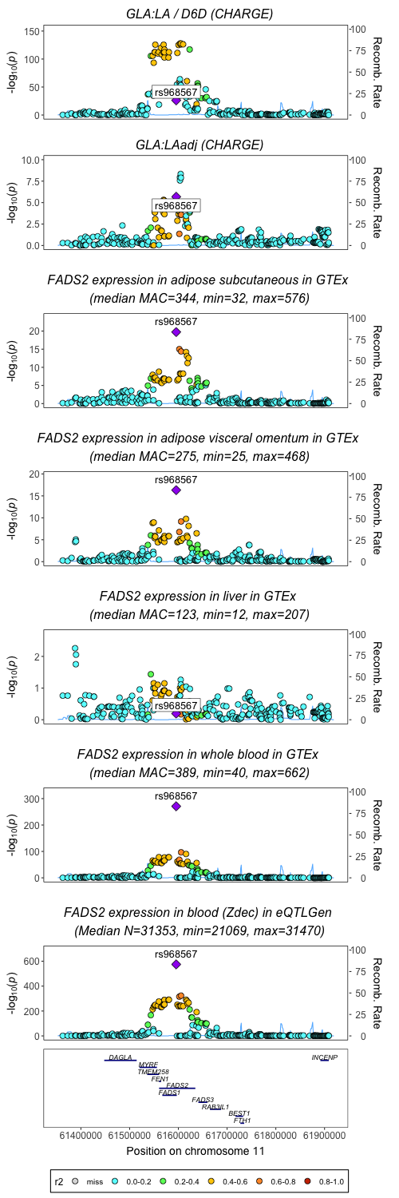
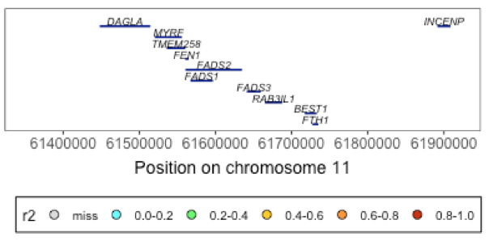
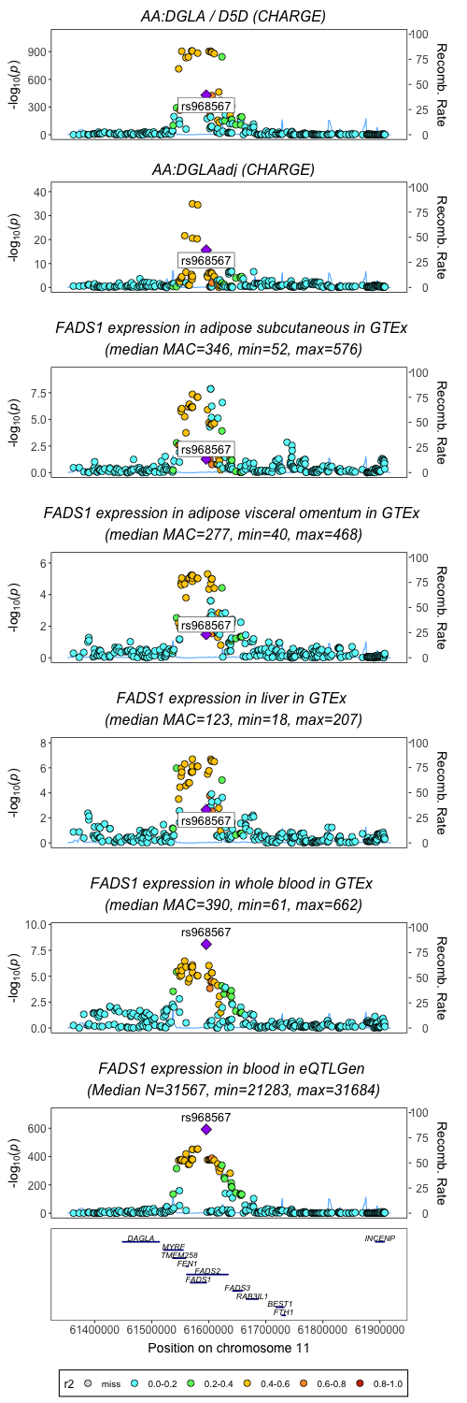
FADS1
FADS2
Unadjusted
Adjusted

Slide 4
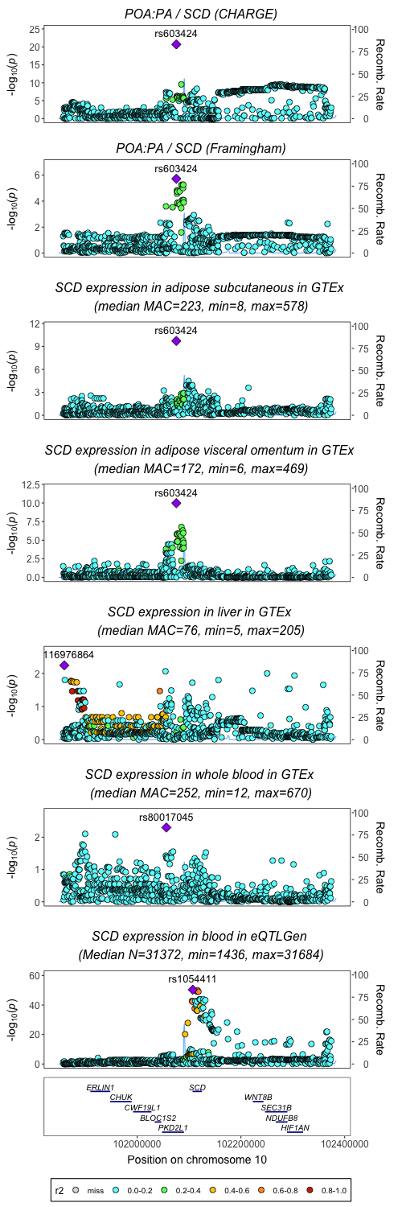
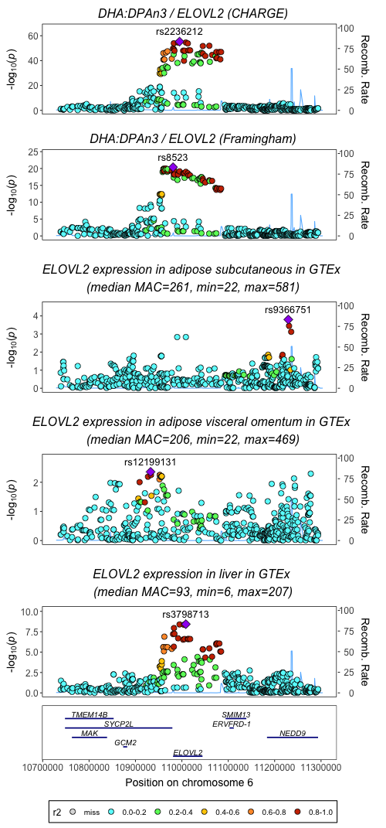
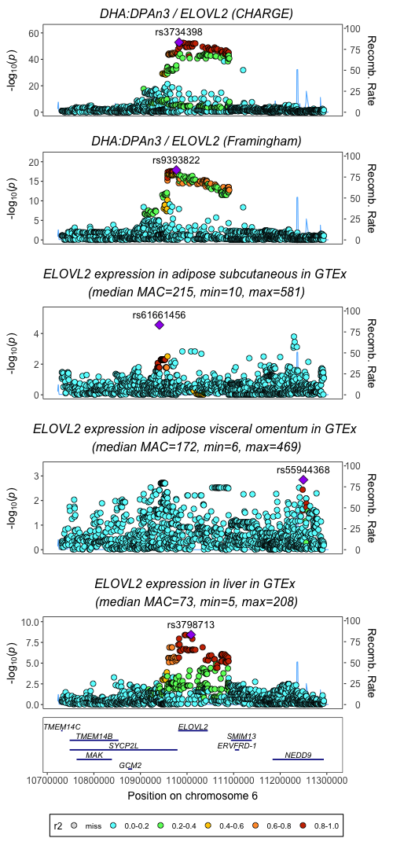
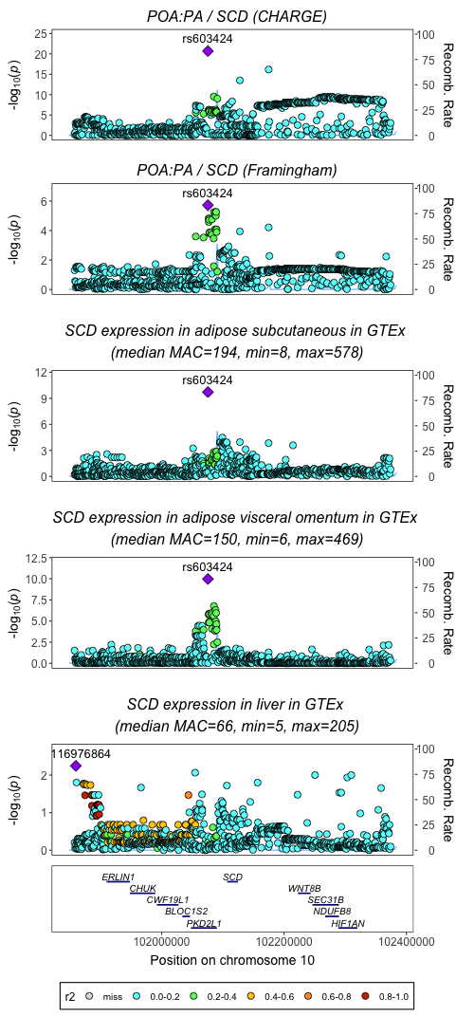
ELOVL2
SCD
Enzyme activity
Gene expression
rs3798713/rs3734398 r2=0.96
RS_number | rs9393822 | rs8523 | rs3734398 | rs2236212 | rs3798713
rs9393822 | 1 | 0.403 | 0.363 | 0.343 | 0.339
rs8523 | 0.403 | 1 | 0.884 | 0.865 | 0.856
rs3734398 | 0.363 | 0.884 | 1 | 0.97 | 0.96
rs2236212 | 0.343 | 0.865 | 0.97 | 1 | 0.99
rs3798713 | 0.339 | 0.856 | 0.96 | 0.99 | 1

