Slide 1

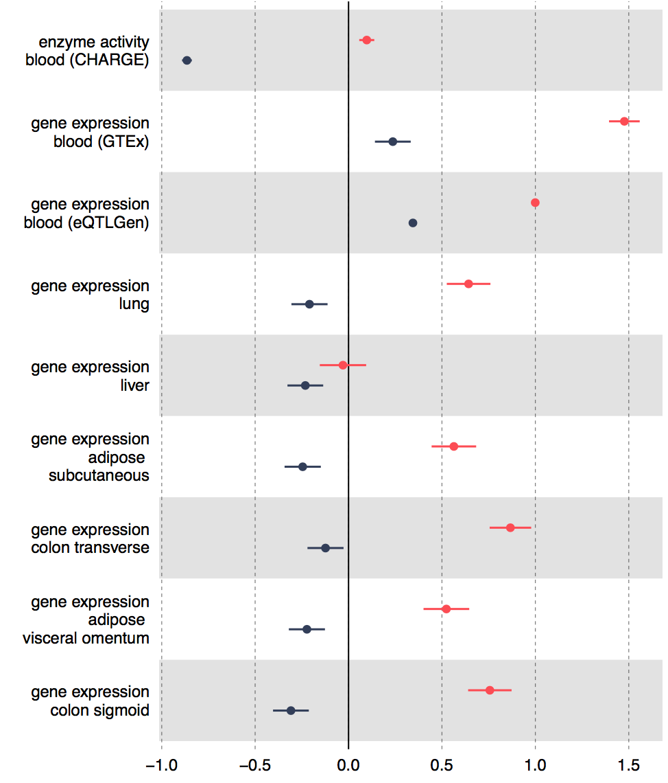
Association of selected SNPs with FADS1 and FADS2
rs968567 – FADS2 association (adjusted for rs174546)
rs174546 – FADS1 association

