Slide 1

Capstone Project
Analysis of ‘Great Outdoors’ Retailers
Migle Kavaliukaite
2022 / Turing College / Data Analytics Course

Slide 2
Content
Overview of the Company
Hypothesis
Methods
Observations & Recommendations

Slide 3
‘Great Outdoors’ is a synthetic dataset, that contains information about daily sales, methods, retailers, and products of a fictitious outdoor equipment retail chain “Great Outdoors”.
Analysed one year long period from July 1, 2017 – to June 30, 2018.
289 active Retailers, located in 21 Countries, divided into 4 Regions (North America, South America, Europe, Asia & Pacific).
Revenue over the last year has grown 25.9% and came to $477.7M.

Slide 4
Hypothesis
1. Retailers from Europe are Top performers.
2. Best Retailer segments contain more Retailers from Europe than from the rest of the World.
3. Retailers from Europe are more reliable and bring more revenue in the long term.

Slide 5
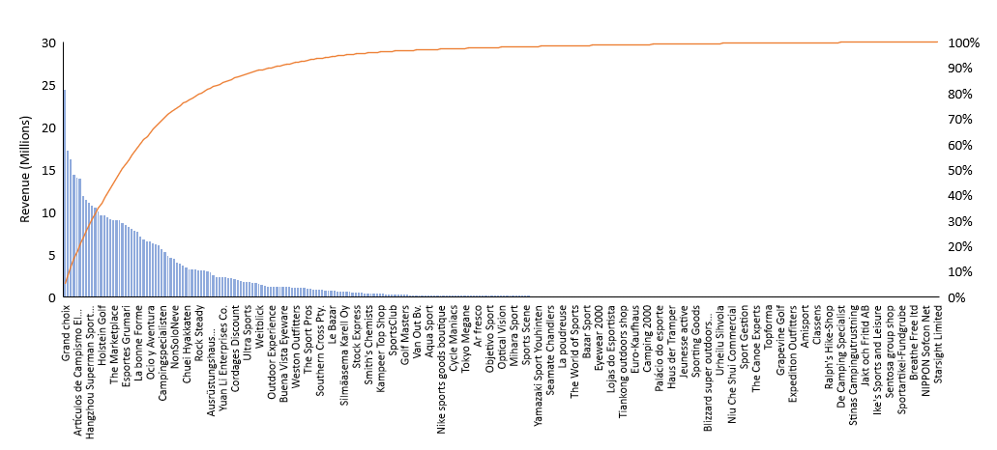
Pareto chart
● Revenue ̶ ̶ % of Total Revenue
80% of Total Revenue
15.9% Retailers (46 of 289) make 80.1% of Total Revenue.

Slide 6
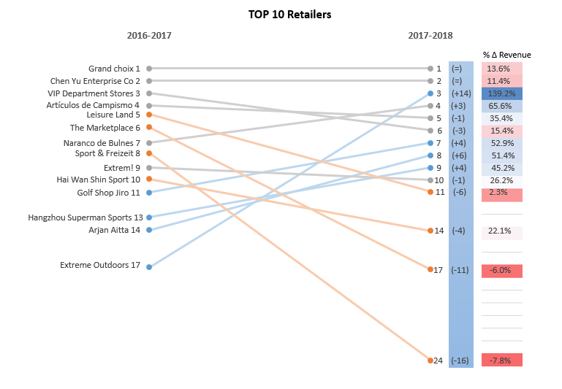
Slope graph
Position change

Slide 7
TOP Performers
H1: Retailers from Europe are Top performers.
 | Europe | North America | South America | Asia & Pacific
Top Performers | 23 (50%) | 13 | 1 | 9
Top 10 | 4 | 3 | - | 3
Top 10 Revenue | 42.1% | 31.5% | - | 26.4%
Analysis confirmed this hypothesis, as among 46 Top Retailers, that make 80% Revenue, there are 50% Retailers from Europe, and 4 European Retailers made it to the Top 10 list.

Slide 8
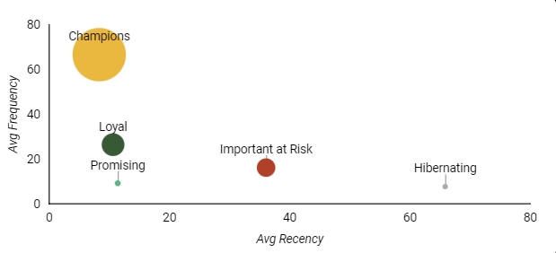
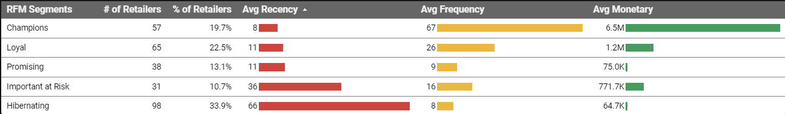
RFM Segmentation

Slide 9
RFM Segmentation
H2: Best Retailer segments contain more Retailers from Europe than from the rest of the World.
 | Europe | Rest of the World
Champions | 26 | 31
Loyal | 32 | 33
Promising | 17 | 21
Important at Risk | 10 | 21
Hibernating | 52 | 46
Hypothesis was rejected, as Europe has a significant number of Hibernating Retailers, and lower number of Retailers in all other segments.

Slide 10
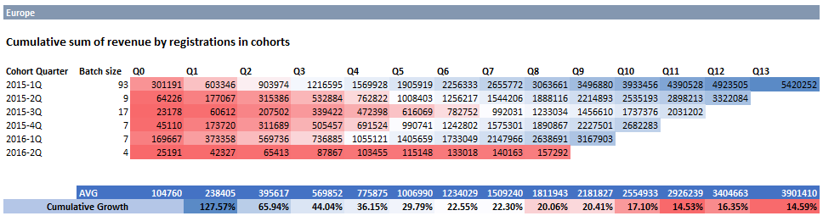

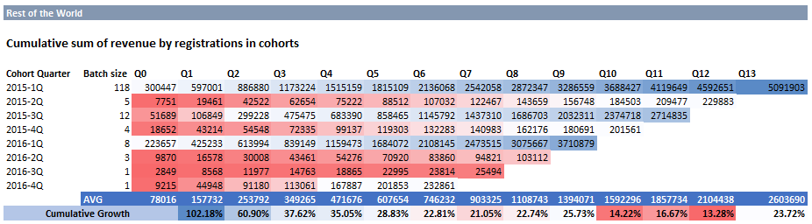

Cohorts and CLV
Prediction
$3.67M All quarterly cohorts average
Prediction
$2.20M All quarterly cohorts average

Slide 11
Cohorts and CLV
H3: Retailers from Europe are more reliable and bring more revenue in the long term.
 | Europe | Rest of the World
Quarterly cohorts average | $3.67M | $2.20M
Retailers | 137 | 152
Estimated Revenue In Q13 | $503.1M | $334.4M
33.5% more
Hypothesis was confirmed by estimating CLV and all quarterly cohort’s avg revenue amount, that is promising over 33% more Revenue from European retailers on Quarter 13 than from Retailers from the rest of the World.

Slide 12
Observations & Recommendations
H1: Retailers from Europe are Top performers.
Analysis confirmed this hypothesis, as among 46 Top Retailers, that make 80% Revenue,
there are 50% Retailers from Europe, and 4 European Retailers made it to the Top 10 list.
H2: Best Retailer segments contain more Retailers from Europe than from the rest of the World.
Hypothesis was rejected, as Europe has a significant number of Hibernating Retailers,
and lower number of Retailers in all other segments.
H3: Retailers from Europe are more reliable and bring more revenue in the long term.
Hypothesis was confirmed by estimating CLV and all quarterly cohort’s avg revenue amount, that is promising over 33% more Revenue from European retailers on Quarter 13 than from Retailers from the rest of the World.

Slide 13
Observations & Recommendations
Prioritize Retailers
Pareto analysis showed, that 15.9% of Retailers (46 of 289) make 80.1% of Total Revenue. This provides company a good reason to take better care of these Retailers, as they are very important to the success of the company. It’s important to track their performance over time and rapidly react to significant changes by providing support and giving extra attention.
Provide personalized engagement
All retailers were divided into 5 segments using RFM segmentation: Champions, Loyal Customers, Promising, Important at Risk and Hibernating. This approach helps company apply personalized forms of engagement with distinct groups to provide a better experience and increase loyalty.

Slide 14
Observations & Recommendations
Plan Revenue and Expenses
Customer Lifetime Value technique helped assess how much a company can expect to earn from an average customer over time. It helps plan expenses for acquisition of new Retailers and gives a glimpse into the future revenue flow.
Acquire new Retailers
Company would benefit from the acquisition of new Retailers, both from Europe and outside Europe. European Retailers seem to be providing steady and reliable growth over time, and every company needs those customers. However, Retailers from the rest of the World, even though, being less predictable can push growth to unexpected hights and boost company’s Revenue even more.

Slide 15
Thank you!

