Slide 1
FPGA implementation of a rad-hard adaptive baseband processor for ground-to-satellite links
Nicola Miglioranza
14.11.2024

Slide 2
Overview
1.
Motivation
2.
Introduction
3.
The Baseband processor
4.
System Architecture
5.
System Design
6.
Fault-Tolerant analysis
7.
Future-work
Notes:
The items on the agenda are generally white with a blue frame. If you want to point out in the presentation where you are, you can highlight this point in blue.

Slide 3
Motivation
Due to insufficient and limited network infrastructures, conventional terrestrial networks (TNs) cannot provide global coverage in remote areas.
TNs can be susceptible to natural disasters, such as earthquakes, floods, or hurricanes, leading to disruptions in communication systems.
TNs cannot satisfy the growing demand for seamless and constant connectivity services that necessitate high bandwidth.

Slide 4
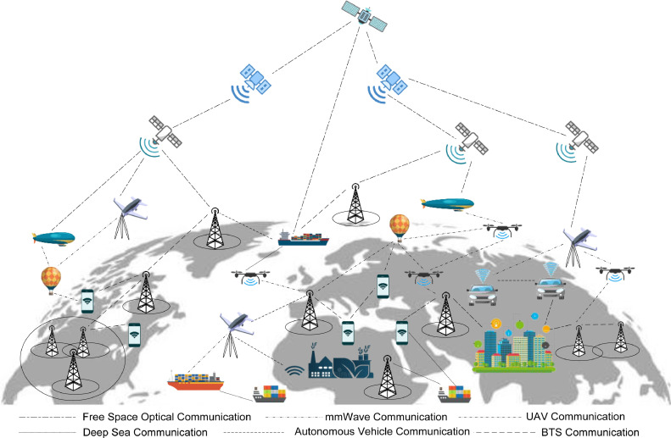
Introduction
A substantial improvement in the reliability and functionality of wireless networks and global coverage can only be accomplished through the integration of TNs with non-terrestrial networks (NTNs).
Generally, a communication system that combines TNs and NTNs is known as a 3D network.

Slide 5
Introduction
In order to realize a network that provides the performance required by the modern wireless communication standards, an ad-hoc hardware component for the PHY layer is needed.
The PHY layer handles the data processing part of the satellite-ground link, and to perform such a task, the hardware component will be integrated into the NTN vehicles.
How to perform such an integration process?
Through the RTL design (VHDL) of the different
functional blocks in the PHY layer .
Implementation and functional verification of the complete
Design (Baseband).
Reliability and fault-tolerance mitigation methodology
analysis .

Slide 6
Deep in the PHY layer: The Baseband processor
Antenna
BB PHY
USB/UART
Control
(SW)
Config.
1 Gb ETH
BB TX
DAC
RF frontend
FIFO
(HW)
1 Gb ETH
BB RX
ADC
RF SoC FPGA
The BB is implemented with a Single-Carrier architecture because of a lower Crest Factor compared to OFDM .
The target platform for the hardware implementation is the Xilinx UltraScale+ RFSoC ZCU111 evaluation board.
Selected frequencies band for the satellite-ground backhaul links :
Uplink → 39.2 – 39.5 GHz
Downlink → 38.0 – 38.3 GHz

Slide 7
Baseband - System Architecture
BB TX
BB RX
Scrambler
Encoder
Interleaver
Mapper
Filter
Filter
Demapper
Deinterleaver
Decoder
Descrambler
Channel
Transmit Control Unit
Receive Control Unit
The two control units (Tx and Rx) are integrated to enable data processing within each block and to facilitate fault data analysis collection.

Slide 8
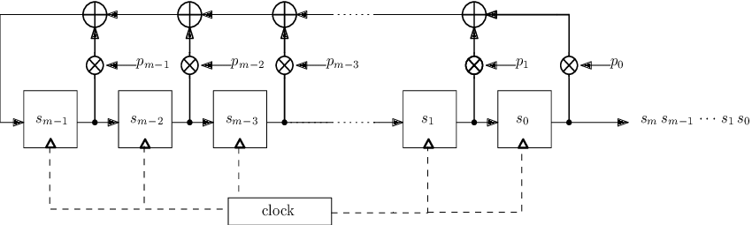
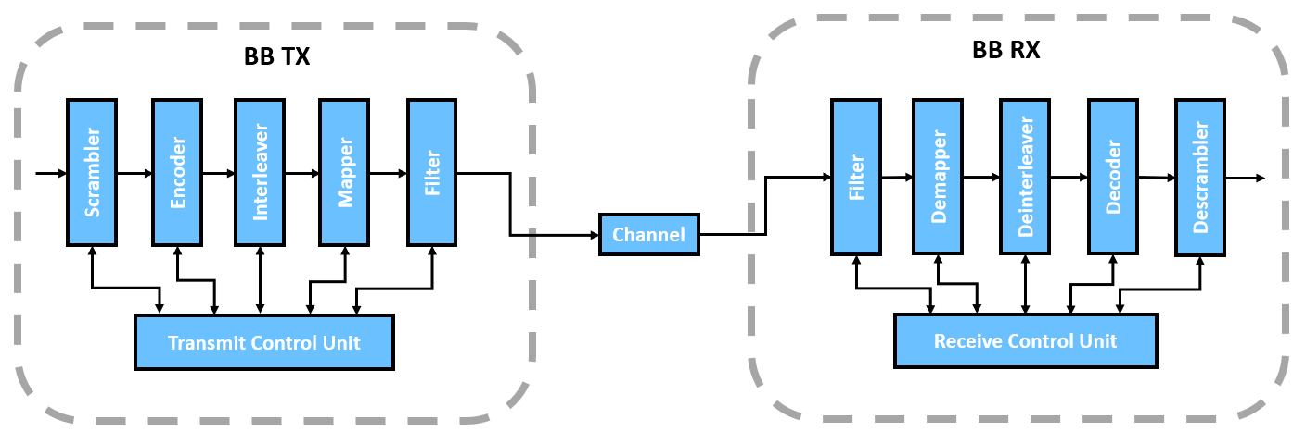
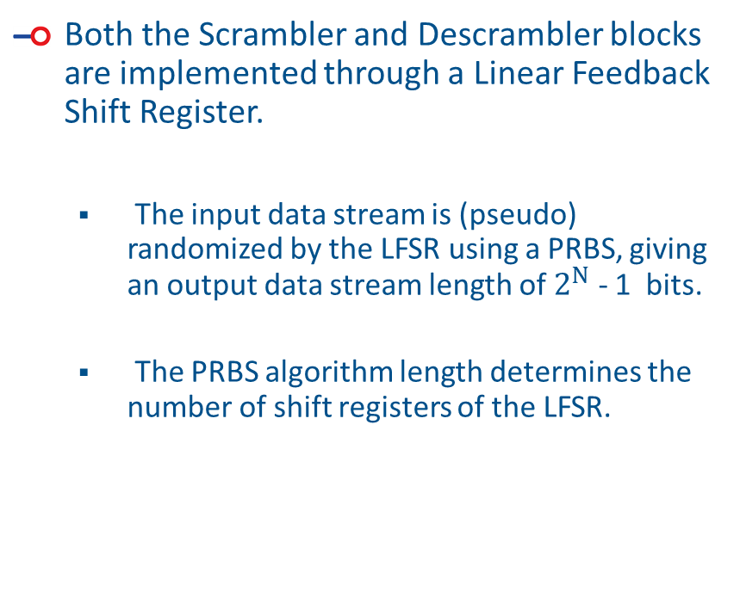
RTL System Design – Scrambler/Descrambler
Both the Scrambler and Descrambler blocks are implemented through a Linear Feedback Shift Register.
The input data stream is (pseudo) randomized by the LFSR using a PRBS, giving an output data stream length of $2^{N}$ - 1 bits.
The PRBS algorithm length determines the number of shift registers of the LFSR.
Legend:
PRBS – Pseudo-Random Binary Sequence.

Slide 9
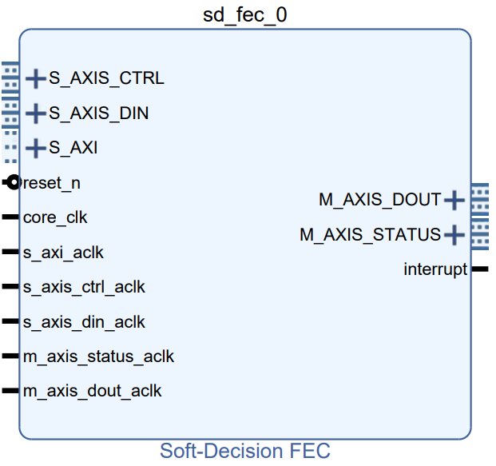
RTL System Design – Encoder/Decoder
The Forward Error Correction (FEC) enhances the reliability of the transmitted data over the channel.
Both the encoder and decoder are integrated with the Soft-Decision FEC IP, which is a hard macro from the IP catalog in Vivado.
The channel conditions can degrade unexpectedly; thus, an adaptive system that adjusts the code rate settings dynamically would be ideal.
One solution could be adjusting the code rate based on application conditions, for example, reducing its value in bad channel conditions (e.g., low SNR).
Data_in
SD-FEC
Core
Data_out

Slide 10

RTL System Design – Encoder/Decoder cont’d.
Every time a core needs a settings change, it must be reset, increasing the latency.
Minimum reset period :
Solution: Instantiating multiple cores, each featuring a different code rate.
Pros: Reduced latency and high reconfigurability.
Cons: Complexity and resource usage.
CLB LUTs (425280) → 6586
CLB Registers (850560) → 7321
Each core implements the LDPC codes for both encoding and decoding.
An FSM is needed to control the workflow of the cores.
SD-FEC
Core 1
Data_out
$3⋅Ts_axi_aclk$ + 3 $⋅$ max(Ts_axis_status, Ts_axis_ctrl)
SD-FEC
Core 2
FSM input control
Data_in
SD-FEC
Core 3
Encoder Utilization
Report
SD-FEC
Core 4

Slide 11

Adaptive Modulation
In addition to the different code rates, the BB mapper/demapper support eight distinct modulation/demodulation schemes to enable data rate adjustments based on application requirements.
E.g. with a symbol rate of 200 MHz and high SNR (good channel conditions), is possible to select a 64 QAM and ¾ code rate → 900 Mb/s .
If the channel worsens, then is possible to reduce to 16-QAM and $2/3$ code rate → 600 Mb/s .
Type of modulation | Modulation schemes | Bits per symbol
Phase Shift Keying (PSK) | BPSK | 1
 | QPSK | 2
Amplitude and Phase Shift Keying (APSK) | 16-APSK | 4
 | 32-APSK | 5
 | 64-APSK | 6
Quadrature Amplitude Modulation (QAM) | 16-QAM | 4
 | 32-QAM | 5
 | 64-QAM | 6

Slide 12
Filter(s) design
Due to non-linearities from the RF frontend, a digital pre-distortion FIR filter has been integrated to counteract the non-linearities.
For mitigating this non-linearities ,the DPD adds an inverse non-linearity to the data stream before the transmission.
Since the RF-DAC operates at a higher sampling frequency than the symbol rate, an up-sampling operation is necessary.
The Up-sampling task is executed by inserting 0s between each symbol
The Up-sampling process has the side effect of creating spectral images of the up-sampled signal; to remove this effect, a low pass filter is implemented.
Pre-distortion FIR filter
Multi-rate FIR filter
Filter(s)
Up-sampled signal
x[n] | 0 | 0 | 0 | x[n-1] | 0 | 0 | 0 | x[n-2]
Original signal
x[n] | x[n-1] | x[n-2]

Slide 13
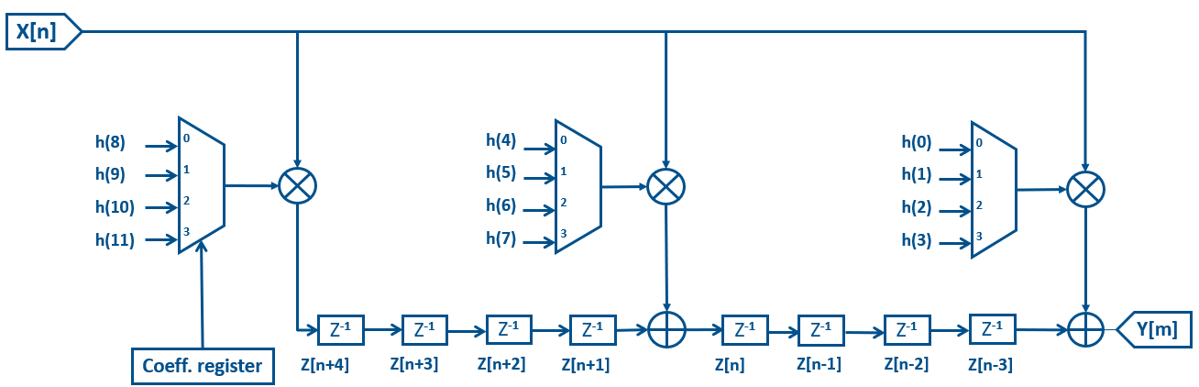
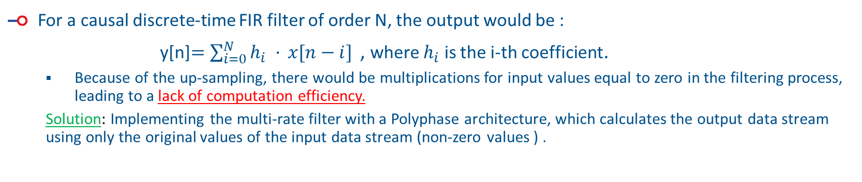
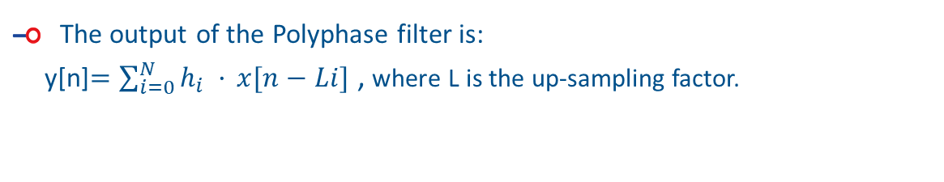
Filter(s) design cont’d.
For a causal discrete-time FIR filter of order N, the output would be :
y[n]$=\sum_{i=0}^{N}{h_{i} ·} x[n−i]$ , where $h_{i}$ is the i-th coefficient.
Because of the up-sampling, there would be multiplications for input values equal to zero in the filtering process, leading to a lack of computation efficiency.
Solution: Implementing the multi-rate filter with a Polyphase architecture, which calculates the output data stream using only the original values of the input data stream (non-zero values ) .
Polyphase FIR filter
L
Low-Pass filter
Up-sampling
n
Multi-rate
FIR filter
The output of the Polyphase filter is:
y[n]$=\sum_{i=0}^{N}{h_{i} ·} x[n−Li]$ , where L is the up-sampling factor.

Slide 14
Ionizing particles – A rad-hard story
Since the baseband processor will be implemented within NTN vehicles, the latter will be subject to ionizing particles in space.
These high-energy particles (alpha particles, heavy ions, neutrons, etc.) are responsible for the most critical radiation-induced effects, like Single Event Upsets (SEUs) and Single Event Transients (SETs).
In order to assess the sensitivity of each functional block to soft errors, a fault-injection analysis is required to evaluate the radiation hardness of the baseband design.
Since the target hardware for the implementation is an FPGA, the fault analisys is carrier out at the RTL level ,using two commercial fault injecting tool :
Cadence Incisive Functional Safety Simulator (IFSS) for the functional blocks.
Xilinx SEM IP tool for the configuration memory of the FPGA.

Slide 15
Simulation results
Comparison of a flawless simulation (top) and a faulty simulation (bottom) performed on the same functional block.
Correct output value
Fault injected and not corrected

Slide 16
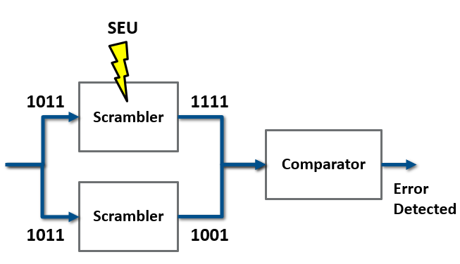
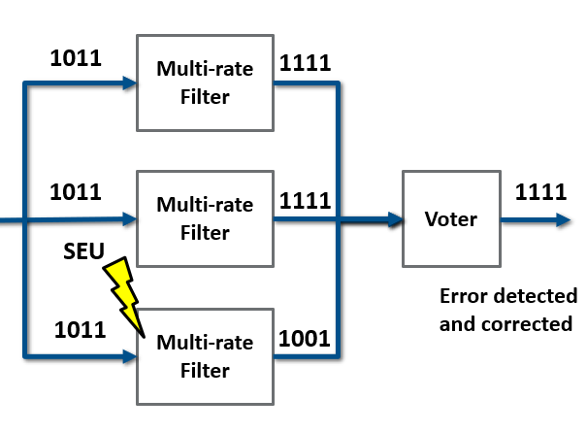
Key Scientific Contribution
At the current state of the art, there are already baseband processor architectures that have a high degree of reconfigurability, capable of adapting their operation dynamically.
However, this architecture will be more self-aware, because each functional block can implement local DMR with comparison, and in the occurrence of an error, only the individual functional block is reset, without the need to repeat the entire computation.
For the functional blocks that are more prone to soft errors also local TMR could be implemented.

Slide 17
Future work
Complete the RTL design of the remaining functional blocks.
Perform fault injection analysis for the completed design.
Perform the fault injection in the FPGA configuration memory.
Possible publications:
Paper on a demonstrator for BB processor.
Paper on the overall architecture of fault-tolerant BB processor.

Slide 18
325
miglioranza@ihp-microelectronics.com

