Slide 1
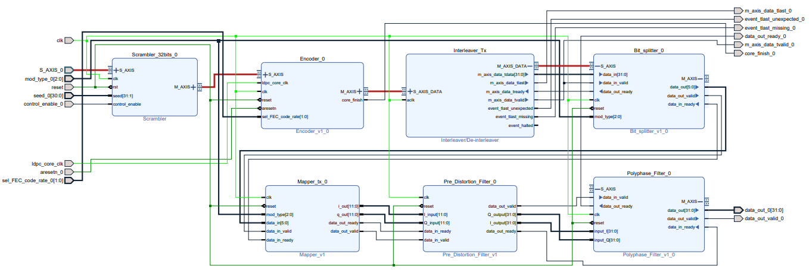
Transmitter Block Design

Slide 2
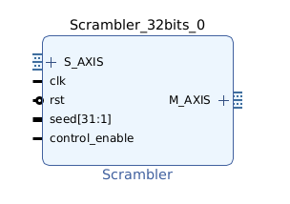
Scrambler
The scrambler is implemented using a Linear Feedback Shift Register (LFSR) that integrates a PRBS-31 (Pseudo-Random Binary Sequence of length 31 ), it is used for randomizing data to ensure that the transmitted data has desirable properties, such as reducing long sequences of zeros which can cause synchronization issues in receivers.
The LFSR uses a specific primitive polynomial to ensure maximum sequence length. For this design, the selected polynomial is: x^31+ x^28 + 1

Slide 3
Encoder
The Encoder block IP, implements the Forward Error Correction (FEC) process which enhances the reliability of the transmitted data over the channel adding redundancy to the transmitted data.
The chosen encoding technique is a type of block code, specifically LDPC (Low-Density Parity-Check) encoding, which is implemented with 802.11 (WiFi) standard.
WiFi standards support multiple code rates for LDPC encoding, with the implemented code rates being 1/2, 2/3, 3/4, and 5/6 .

Slide 4
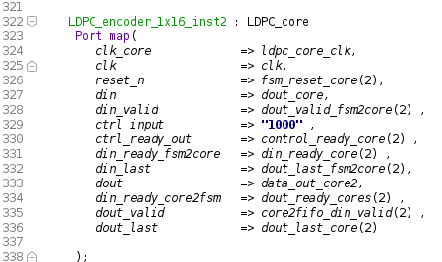
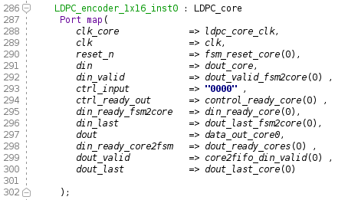
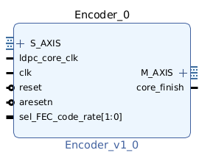
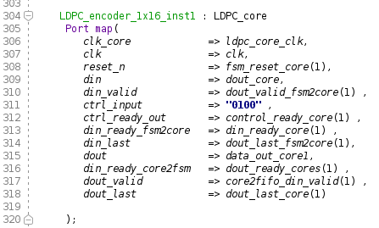
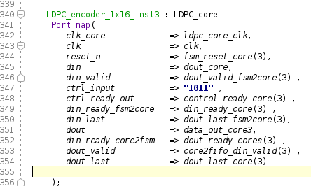
Encoder : VHDL code

Slide 5
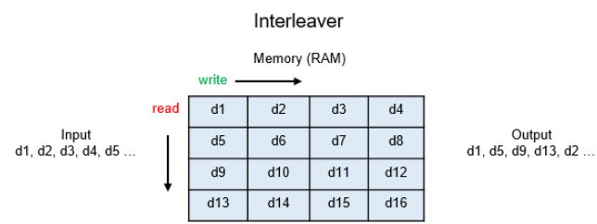
Interleaver
The interleaver is implemented using an IP core from Vivado, specifically employing the rectangular interleaving technique. This technique organizes data into a two-dimensional matrix (rows and columns) and reads the data out in a different order than it was written. Its main purpose is to mitigate the effects of burst errors.

Slide 6
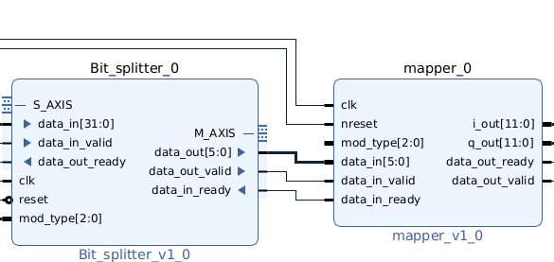
Mapper + Data Splitter
The Mapper block Converts binary data into symbols using a specific modulation scheme.
It generates I (in-phase) and Q (quadrature) components that represent the symbols in the time domain.
The data splitter is implemented for splitting the interleaved data coming from the interleaver from a 32-bit vector to 6 vectors with a bit width of 6-bit each, with the last vector which is padded with 0s depending on the modulation scheme selected.

Slide 7
Digital Pre-Distortion Filter
The DPD filter pre-processes the input signal to counteract the non-linear effects, coming from the RF frontend (Power Amplifier), effectively "linearizing" the PA's behavior.
The non-linear behavior of the PA is characterized using a mathematical model ,in this case a memory polynomial. The model captures both the amplitude-to-amplitude modulation (AM-AM) and amplitude-to-phase modulation (AM-PM) effects of the PA.
The DPD is implemented using an FIR filter which approximate the inverse of the PA's non-linear transfer function for counteracting the non linearities.
The coefficients of the FIR filter are retrieved using Matlab model and then, for the hardware implementation, they are stored in a LUT in the FPGA.

Slide 8
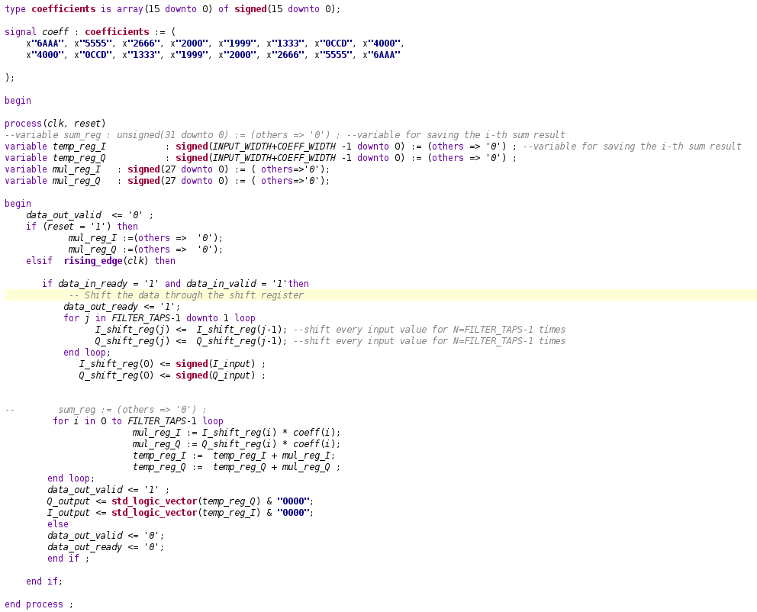
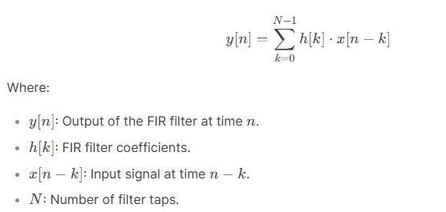
Digital Pre-Distortion Filter : VHDL code
The mathematical equation for the FIR filter can be translated in VHDL as follows →

Slide 9
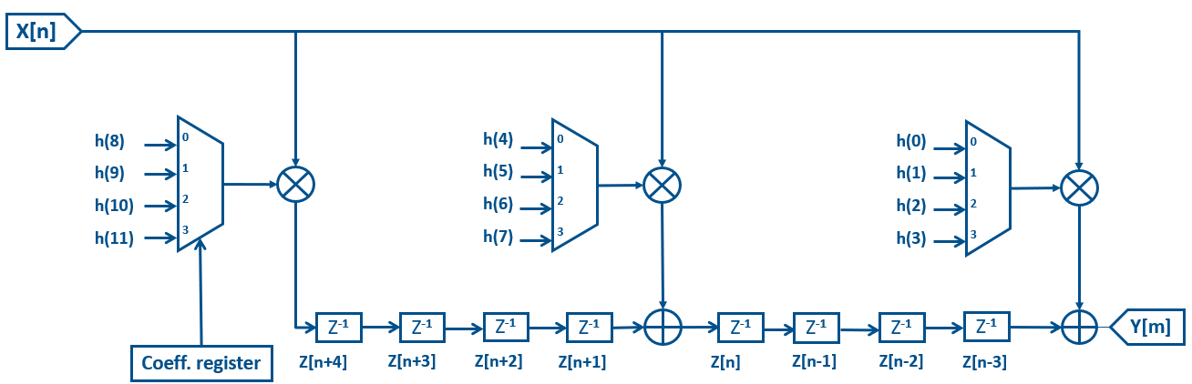
Multi-rate filter
The multi-rate filter is implemented to perform sampling rate conversion, specifically interpolation. It increases the sampling rate of a signal by an integer factor L, which involves inserting zeros between samples and applying a low-pass filter to eliminate imaging effects.
The up-sampling factor is L = 4 and the filter is implemented through a Polyphase FIR filter which decomposes a single filter into multiple sub-filters (called polyphase components) that operate at a lower sampling rate.

Slide 10
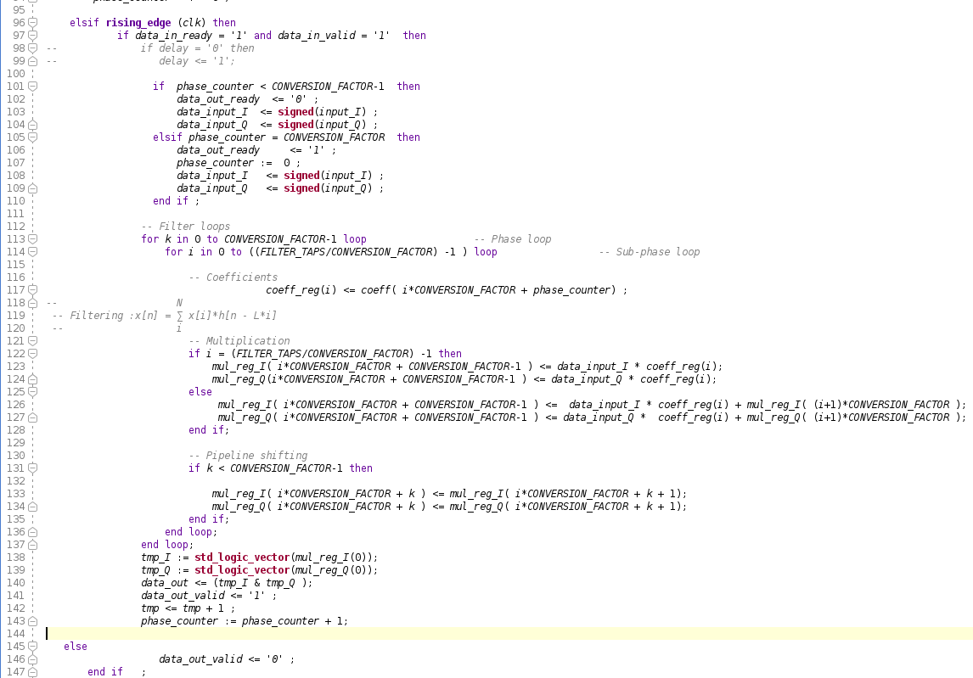
Multi-rate filter : VHDL code

