Slide 1

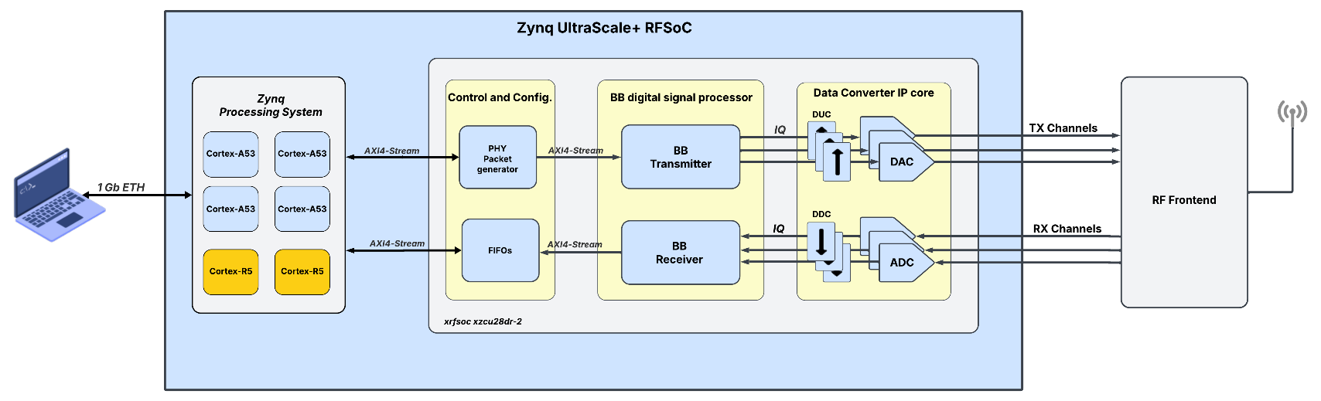
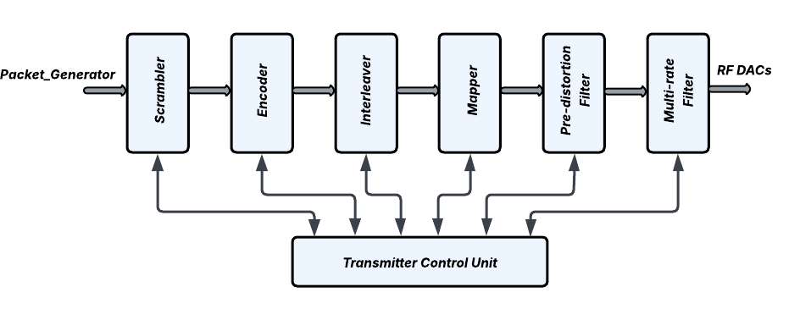
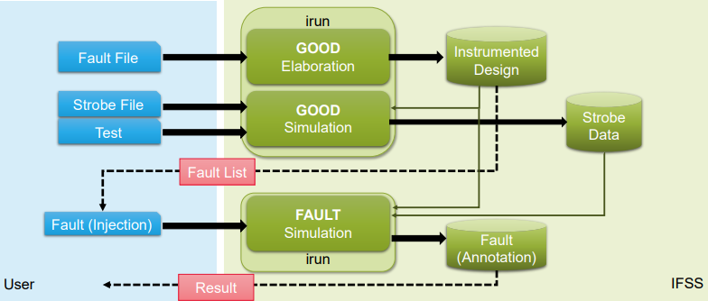

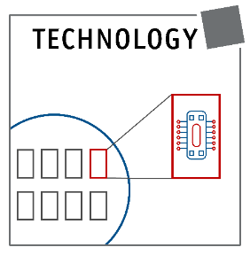
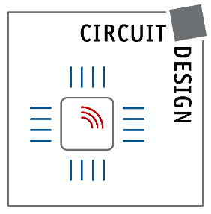



FPGA implementation of a rad-hard adaptive baseband processor for ground-to-satellite links
Nicola Miglioranza, Marko Andjelkovic, Nebojsa Maletic, Milos Krstic
MOTIVATION
GOALS
Due to insufficient and limited network infrastructures, conventional terrestrial networks (TNs) cannot provide global coverage in remote areas.
A substantial improvement can only be accomplished through the integration of TNs with non-terrestrial networks (NTNs).
The union between conventional mobile networks with Aerial Networks (HAPS and LAPS) and space networks (GEO, MEO, LEO) leads to the 3D network architecture that characterizes the 6G paradigm.
Definition of MATLAB model for the baseband processor.
RTL design and verification of the high-level model in Vivado.
FPGA implementation and functional verification of the baseband processor.
Fault analysis of the baseband functional blocks with Cadence Xcelium simulator.
Design validation with lab demonstrator.
FPGA Demonstrator Overview
The FPGA Demonstrator will be integrated on an Xilinx Ultrascale+ RFSoC ZCU111 board.
The Xilinx board is connected to a laptop via a 1 Gb Ethernet interface, which is used to control system parameters.
The FPGA is connected to the processing system through an AXI4-Stream interface. The programmable logic includes:
The Baseband digital signal processor.
The DACs and ADCs, along with their respective Digital Up-converters (DUCs)and Digital Down-converters (DDCs).
A PHY packet generator to simulate packets coming from the MAC layer, and FIFOs for storing performance metrics.
Figure 1: Overall view of the FPGA demonstrator.
Baseband TX Architecture
The Baseband processor architecture implements a Single-Carrier modulation with a symbol rate of 200 – 250 MHz, achieving a data rate up to 1.2 -1.5 Gb/s.
The selected frequency bands are 38 - 38.3 GHz for uplink and 39.2 GHz - 39.5 GHz for downlink.
The encoder implements the LDPC encoding algorithm and is capable of selecting various code rates depending on application requirements.
The symbol mapper supports multiple digital modulation schemes with different constellation sizes, depending on the channel condition.
The digital pre-distortion filter compensates for distortions introduced by the presence of a bandpass filter used for image rejection.
The multi-rate filter works in upsampling mode to meet the different sampling rates of the DACs and implements a low-pass filter to eliminate spectral images.
The control unit manages the different phases of the data transmission, including packet formatting, data padding, and related tasks.
Figure 2: Baseband Transmitter block design.
Type of modulation | Modulation schemes | Bits per symbol
Phase Shift Keying (PSK) | BPSK | 1
 | QPSK | 2
Amplitude and Phase Shift Keying (APSK) | 16-APSK | 4
 | 32-APSK | 5
 | 64-APSK | 6
Quadrature Amplitude Modulation (QAM) | 16-QAM | 4
 | 32-QAM | 5
 | 64-QAM | 6
RTL fault injection analysis
Table 1: Supported modulation schemes.
Since the baseband processor will be implemented within NTN vehicles, it will be exposed to ionizing particles in space, potentially leading to the occurrence of the well-known Single Event Effects (SEEs).
The fault-tolerance of the Baseband design against soft errors will be assessed using the Cadence Incisive Functional Safety Simulator (IFSS).
Fault injection analysis will be conducted at the register transfer level (RTL) for each functional block, simulating the effects of both Single Event Upsets (SEUs) and Single Event Transients (SETs).
The fault analysis will enable the evaluation of the optimal mitigation strategies against soft errors, such as the implementation of DMR with comparison and TMR.
Figure 3: IFSS Fault Injection Campaign Flow Steps.
This work has been done in the framework of the 6G-TakeOff project, funded by the German Federal Ministry for Education and Research (BMBF – Bundesministerium für Bildung und Forschung), under the grant 16KISK060.

