Slide 1
FPGA implementation of a rad-hard adaptive baseband processor for ground-to-satellite links
Nicola Miglioranza, Marko Andjelkovic, Nebojsa Maletic, Milos Krstic
IHP, Frankfurt (Oder), Germany
19.05 – 21.05.2025

Slide 2
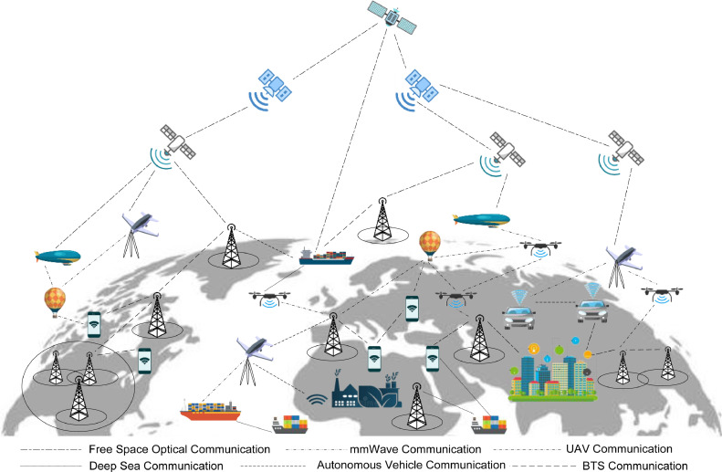
Introduction
Integrating terrestrial (TNs) and non-terrestrial networks (NTNs) into a unified 3D network improves reliability and coverage, overcoming terrestrial limitations and requiring robust technologies for harsh environments typical of the future 6G networks.
The digital baseband processor, the backhaul hardware responsible for data processing in the physical layer, represents a key component in the next wireless communication infrastructure.
The implementation of the baseband in NTNs vehicles, such as satellites and drones, requires a rad-hardening analysis to prevent the soft errors (SEUs and SETs) coming from space radiations.
Figure 1: General architecture of a 3D network

Slide 3
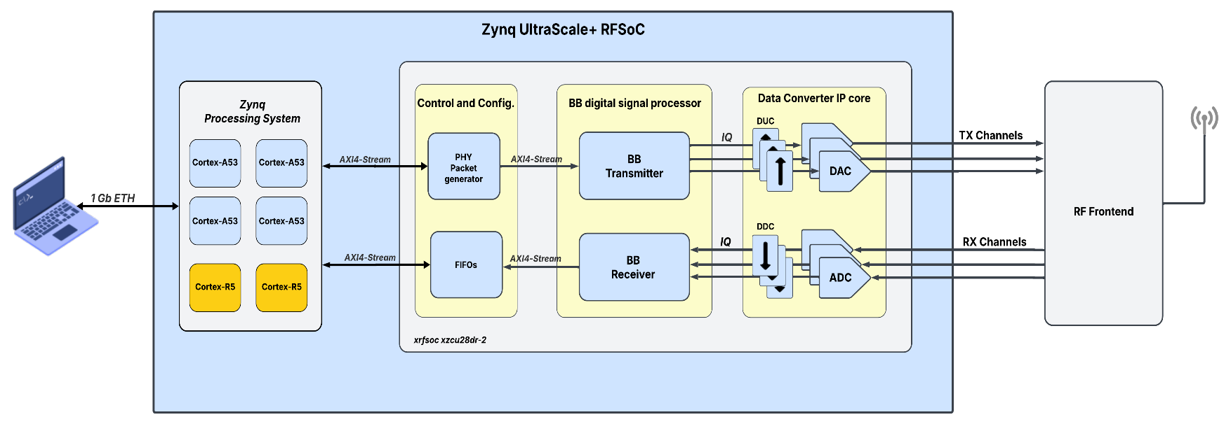
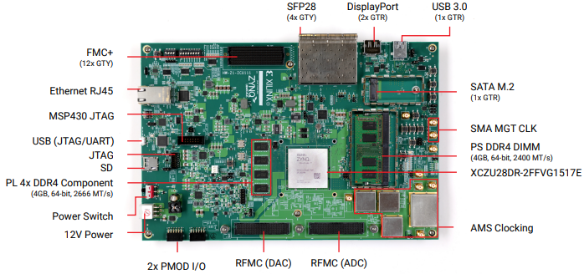
Rad-Hard Baseband Processor for NTNs
The RTL model of the Baseband design was implemented on a commercial Xilinx Ultrascale+ RFSoC FPGA for functional verification and validation.
The fault-tolerance analysis of the baseband design against soft errors will be assessed at the RTL level using the Cadence Incisive Functional Safety Simulator (IFSS).
Figure 2: Overall demonstrator concept
Figure 3: Zynq Ultrascale+ RFSoC ZCU 111

Slide 4
325
miglioranza@ihp-microelectronics.com

